Slide 1
CQRS
Command & Query Responsibility Segregation
“Segregate operations that read data from operations that update data by using separate interfaces. This pattern can maximize performance, scalability, and security; support evolution of the system over time through higher flexibility; and prevent update commands from causing merge conflicts at the domain level.”

Slide 2




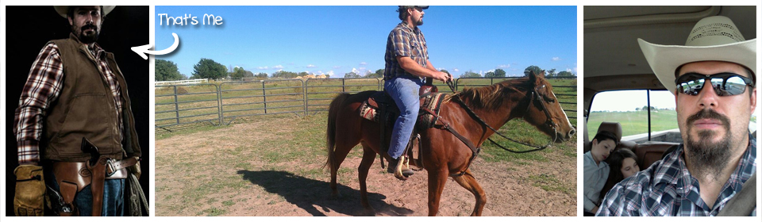


Andrew Siemer
http://about.me/andrewsiemer
Notes:
Andrew Siemer, obstacle races, ranching, shooting

Slide 3
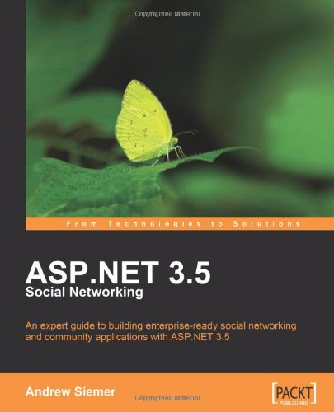
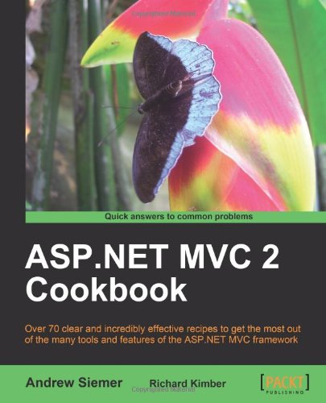
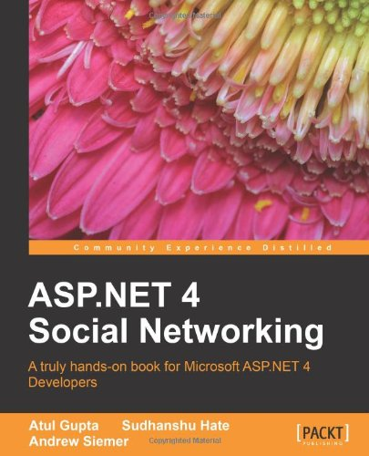

Notes:
Some books I have written or am writing

Slide 4











← We are hiring!!!
Notes:
Some places I have worked and some projects I have worked on

Slide 5
Goals
Introduction
Up to speed on the concepts
Won’t be an expert after this talk
But will be able to identify your next steps
Notes:
Introduction – We will take a look at what CQRS is, what it isn’t, how it came to be, and where it fits. This talk will get you up to speed well enough that you can think about CQRS, but implementing CQRS means something different to everyone. You should be able to pick and choose which ideas that tend to surround CQRS are right for you. But you will likely need more study to implement this idea correctly.

Slide 6
What CQRS is not
Not a framework
Not an architecture
Not a specific tool
Not a BEST PRACTICE
Notes:
Framework – While there are frameworks you can get to make implementing a given notion about CQRS quicker, it is not a framework
Architecture – Think about CQRS being something you can do as a piece of your overall architecture
Tool – And while there are tools to help you implement pieces of CQRS it is not a tool
Best – CQRS if far from the best thing for most projects and we will see why

Slide 7
Not a best practice
I always start the CQRS conversation with “THIS IS LIKELY NOT FOR YOU”
CQRS is great when it is justifiably needed
Due to high complexity, not a buzz word you want “just cause”
Notes:
A best practice is an approach to be used to solve a specific problem. CQRS can cause you more problems that it can solve pretty quickly once you start down this rabbit hole. Be cautious.

Slide 8
What CQRS is
CQRS is a pattern
CQRS ends up being a composition of tools and concepts
No two CQRS implementations are identical
Notes:
Coined by Bertrand Meyer
Command returns nothing
Query has return value
Query does not change state
Command does change state

Slide 9
How we got to the CQRS pattern
DDD made sense and became popular
DDDD: the 4th “D” represents Distributed as apps got bigger
Greg Young first to name it
Others to get behind it
Udi Dahan
Eric Evans
Martin Fowler
Notes:
Domain Driven Design was to some a revelation in how we structure our applications. But once distrusted became a mainstream concept DDDD started to show up. CQS became popular but still semi-dirty with models being mixed for reads and writes. Once it was seen that the responsibility of reads and writes needed to change…we were off.

Slide 10
DDD: Quick Primer

Slide 11
DDD: At a high level
CQRS is based on DDD
DDD is used to address complexity
Aggregate Roots
Bounded Contexts
Domain Events
Notes:
Essential part of DDD
Breaks business concerns into appropriately sized buckets
Principles:
Intention-revealing
Side-effect free functions
Clear encapsulation

Slide 12
DDD: Ubiquitous Language
Domain experts
Technical team
Shared language
Model based on the shared language
Notes:
A single language that all involved parties can use to talk about the business.

Slide 13
DDD: Entities
Have identity
Items like
User
Product
Order
Notes:
Used to describe the important things in your model as it pertains to a given business area.

Slide 14
DDD: Value Objects
Have value, no identity
Items like
User.Address
Product.TechNotes
Order.OrderItem
Notes:
The important, albeit less important, things that dangle from your Entities. The meta data used to describe an entity in full.

Slide 15
DDD: Aggregates and their Root
An aggregate of one or more Entities and Value objects
One Entity is the Root that is used to reference the aggregate
Conceptual boundary by root
Consistency boundary
transactional
Notes:
Used as the primary point of interaction with a set of entities that are closely related.
A consistency boundary
Has identity, rather than value.
Introduction of Entity/Value type just to describe aggregates

Slide 16
DDD: Bounded Context
Two or more distinct (obviously related) models
Interactions between them
Usually delineated by business groups or tasks
Notes:
As you model out a business area you might quickly find that a “Product” to one part of your business is not the “Product” that another business area describes. It is entirely acceptable to have multiple representations of similar items that exist in your business language. They may share an ID across boundaries (a correlation ID)…but their state is likely stored separately.

Slide 17
DDD: Domain Event
Represents something that happened in the past
Immutable
Historical record

Slide 18
CQS was first on the scene

Slide 19
What is CQS?
CQS: Command Query Separation
Command methods change state
Query methods read state
One object in code for state change and querying works
Using the same data store is ok
Supports shared schema with read replica concepts

Slide 20
CQS in code: NOT
public class User
{
public string Address { get; set; }
}
Yuck!
Notes:
Changing the state of the user’s address loses all intent as to why the change was made
Was the address changed due to a typo, did they move, did they get married
No separation between state change and queries – forced coupling of model
Can’t scale any of this independently

Slide 21
CQS in code: BETTER
public class Entity
{
//...
public void Move(string newAddress)
{
//changes state
}
public string GetAddress()
{
//queries state
}
}
Notes:
This is allows you separate how you read and write. Which is better. But you lose the intent. Why did this entity move?

Slide 22
Back to CQRS

Slide 23
What is CQRS?
CQRS: Command & Query Responsibility Segregation “Two objects where there once was one”
Command objects change state
Query objects read state
Two objects represented in code
One for state change
One for querying data
Decoupled model for different concerns

Slide 24
CQRS in code
public class UserWriteService
{
// Commands
public void Move(User user, string newAddress);
//...
}
public class UserReadService
{
// Queries
public User GetUser(int userId);
//...
}

Slide 25
Segregation opens doors
Scale reads from writes independently
Decouple read model from write model
Different data shapes
Flexibility in modeling different concerns
Ability to capture with why the state changed
Not just changing the state
Notes:
The topic of CQRS really is about what possibilities this segregation offers.
Reduces accidental restrictions through the promotion of explicitness and separation of concerns.

Slide 26
CQRS: Command
Message
Handler changes state
Always returns void (nothing)
Works with business intent, not just a record
Not a CRUD style operation
Notes:
What we’ve seen so far are implicit commands.
CQRS uses the well-known Command Message Pattern.
Makes *intent of change* explicit
Not just a ChangeRecordCommand
A “correct address” task—which technically identical—is separate from a “move” task

Slide 27
CQRS: Command in code
public class MoveCustomerCommand : Command
{
public Address NewAddress { get; set; }
}

Slide 28
CQRS: Query
Does not change state
Has return value
Also a type of message
Notes:
The opposite of a Command is query
Gets state, does not change state.

Slide 29
CQS vs. CQRS: Feature matrix
 | CQS | CQRS
Zero coupling between domain logic (state) and reporting (read) concerns |  | X
More robust scalability options |  | X
Decouples domain concerns from display concerns |  | X
Object model specific to its responsibility |  | X
Different data stores/shapes for domain logic and reporting concerns |  | X
Option to performance optimize data storage for write and read layer(s) | X | X
Can be used with a message based architecture | X | X
Easy deployment story | X
Less code complexity | X
Less pieces to manage | X
Coupled read and write model | X

Slide 30
What does CQS look like?
Data shape IS the same
Client creates data through one set of methods
Client reads data through another set of methods
Likely the same object model
The read and write model are likely the same
Or a sub-set thereof
Can support read replicas (at DB)
Doesn’t support multiple different containers of data

Slide 31
What does CQRS look like at a high level?
Store can be the same
Data shape IS different
Data flow is different
Zero model concerns are leaked to view concerns

Slide 32
CQRS: Myth busting
CQRS requires Event Sourcing
Requires an eventual consistent read store
Requires a bus/queues/asynchronous messaging
Commands are fire and forget
Escapes consistency problems and eliminate concurrency violations
CQRS is easy!
Notes:
Event Sourcing has nothing to do with CQRS…but they do play well together
Eventual consistency is not required by CQRS –that is a side effect of a truly distributed non-RPC style application
You can make a synchronous CQRS system where a command is fired and you wait for all work to be completed
A bus, messaging, etc. is not required by CQRS. But CQRS is modeled in such a way that slipping in messaging and a bus fits nicely
Do be aware that anything eventually consistent adds to the complexity of what you need to handle on your side
Anything that will eventually be worked on means that they could fail in an unexpected way. If your user has already moved on, you need to handle success/fail scenarios.
You must plan down to the most minute detail to ensure that all scenarios are handled. Network unplugged? Message delivered more than once? Price updated – data not replicated?
As with any added widgets to track and handle – complexity goes up. Number of widgets to build is greater. Test area grows. Deployment complexity increases.

Slide 33
What does CQRS look like for us?
Store for each
Rich domain
View concerns
Reporting concerns
Data shape IS different
Messaging for distribution
Lots of scalability options
Supports different storage mechanisms

Slide 34
Anything else about CQRS?
UI workflow might be different
Synchronous UI flow: view form > submit > confirmation page
Asynchronous UI flow: view form > submit > processing > email confirmation
Not every avenue through your code has to be CQRS!
Sometimes there business needs that might like a more direct route
Move work out of process only when needed, distributed is harder
This can be done with an in memory bus

Slide 35
Worth reading
Microsoft: CQRS Journey
Jimmy Bogard: Busting some CQRS myths

