Slide 1
Toronto Bar Supplier Coursera Capstone Project

Slide 2
Agenda
01
02
03
Introduction and business problem
Data and methods
Results
04
05
Discussion
Outlook

Slide 3

01
Introduction and business problem

Slide 4
Introduction and business problem
Bar supply
The globally operating bar equipment supplier "Bar10der" is entering the Canadian market and is targeting large Canadian cities to supply local bars with bar equipment (e.g. chairs, beer taps).
Start-up
Bar10der is a young, asset-light business reducing operational cost by delivering bar supply without a truck or car fleet.
Warehousing operations
Bar10der reduces the distance between warehouse and bar by renting a multi-purpose location serving as office space and warehouse in the city center.
In order to determine the optimal warehouse location, Bar10der looks for the city area that contains the highest bar density.

Slide 5

02
Data and methods

Slide 6
Data and methods
Foursquare API
Wikipedia
Location data and information about bars
Data to identify neighborhoods
By identifying those Toronto postal codes that have the highest bar density (determined by the number of bars), the ideal Toronto area (as postal code) will be identified and visualized on a Folium map based on geolocation data.
Geocache
Additional geospatial data
Notes:
sustainablity: chemical industry consumes 7 % of world energy

Slide 7
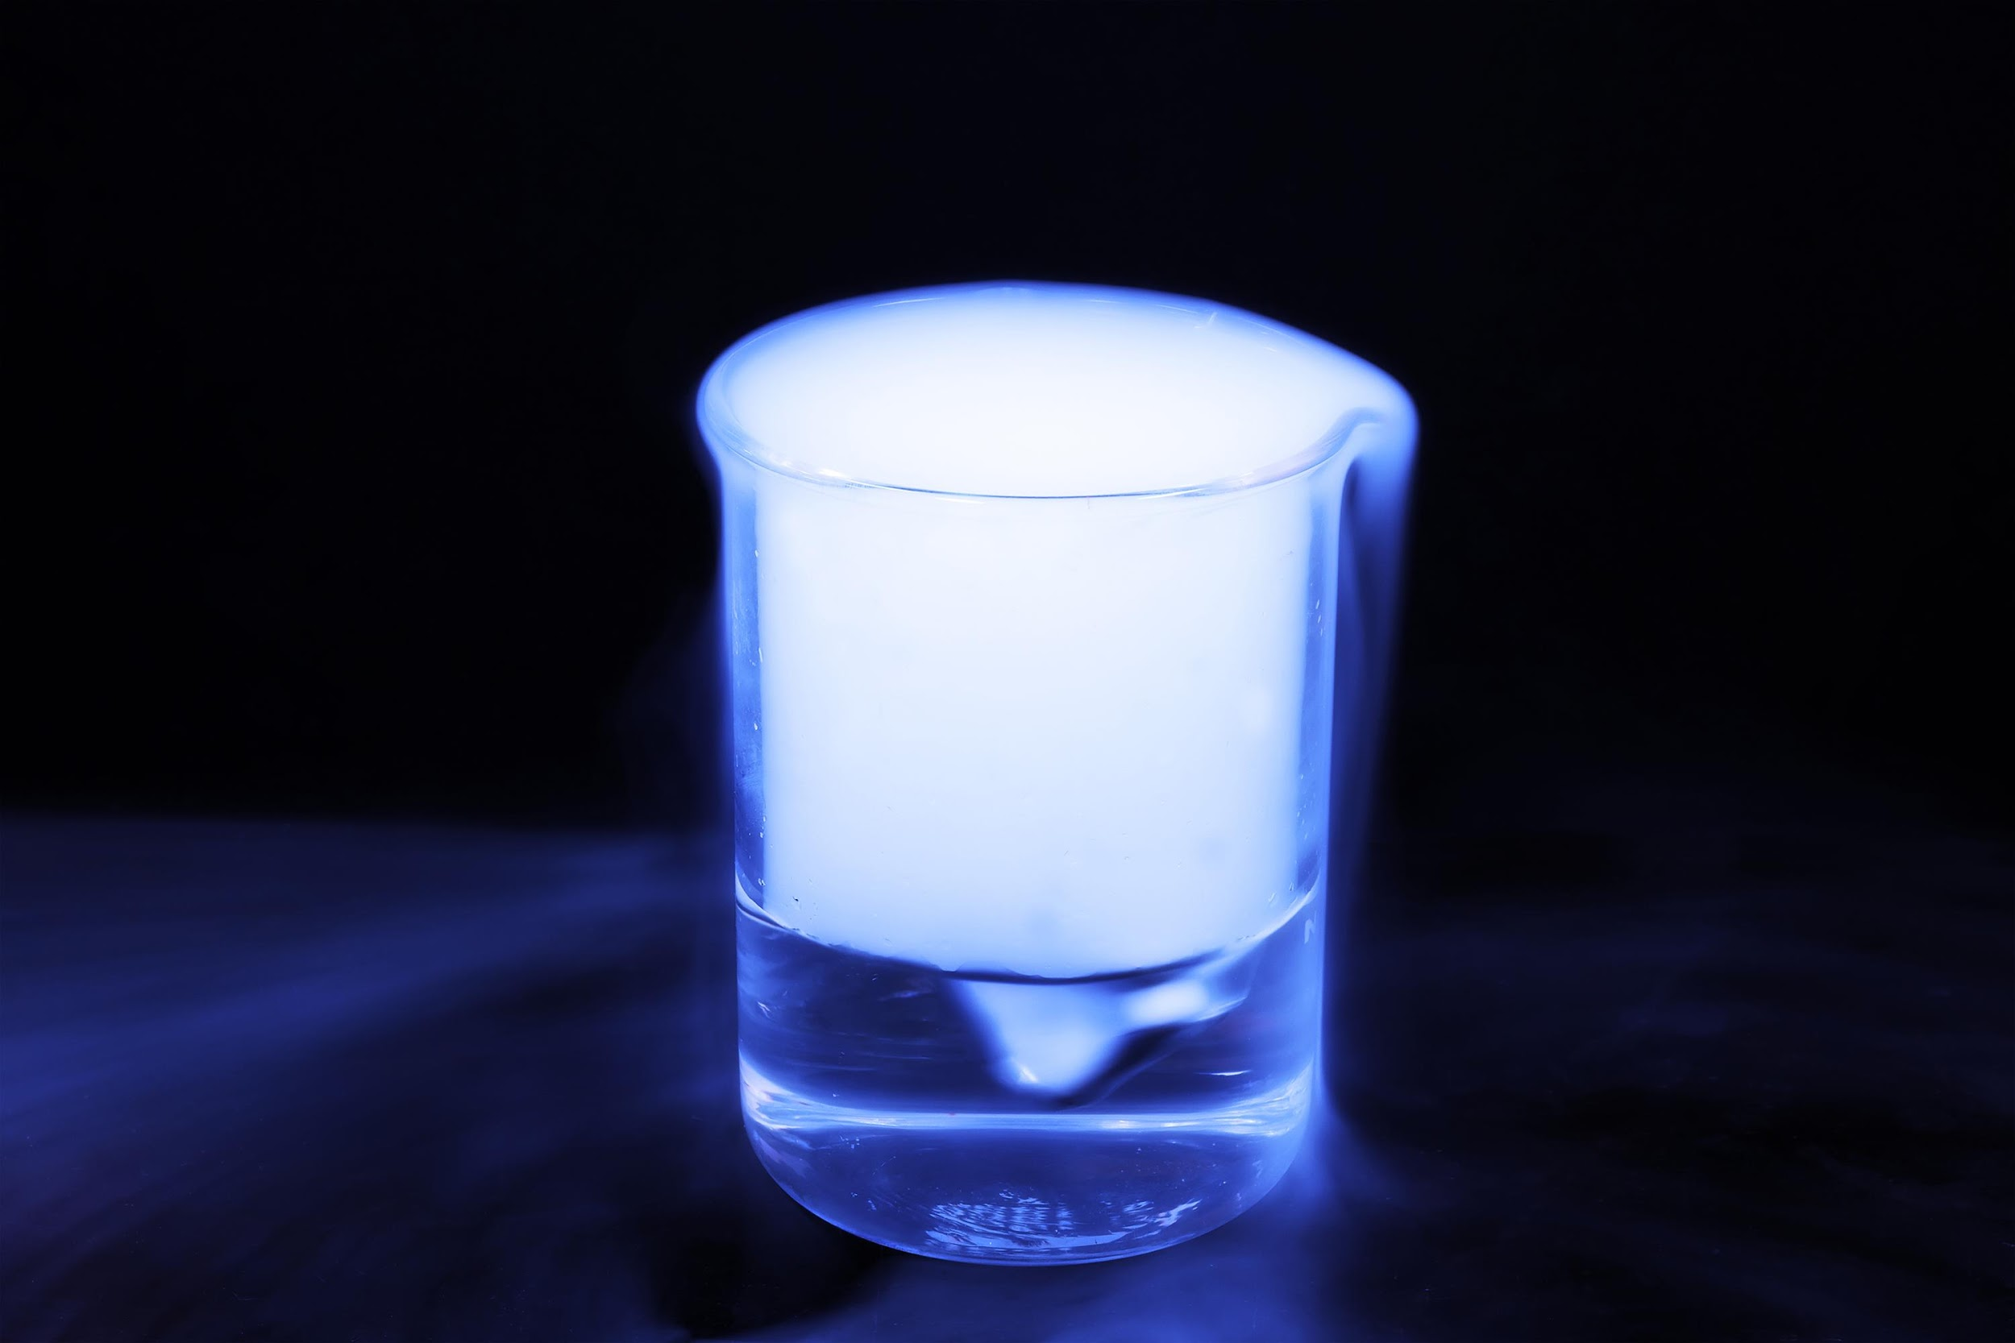
03
Results

Slide 8



Results
Postal Code | Bar density
M5H | 6
M5B | 5
M5V | 4
M5J | 2
The analysis shows that postal code M5H has the highest bar density with 6 bars. In the following, the result is visualized.

Slide 9

04
Discussion

Slide 10
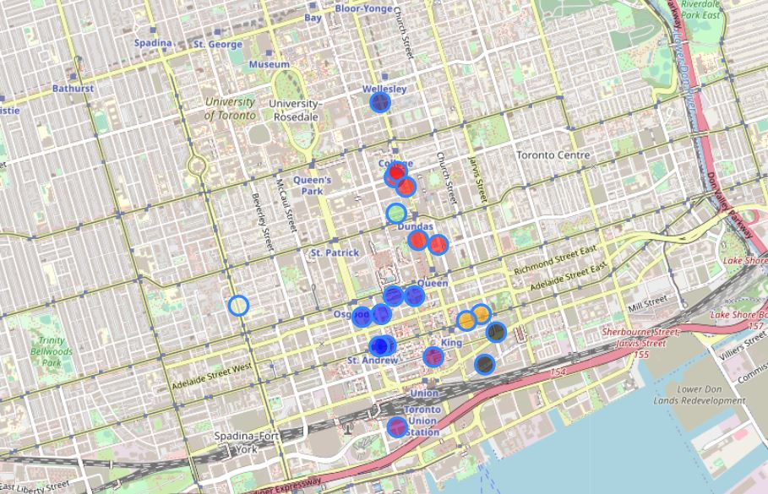
Discussion
Map of Toronto based on Folium, showing highest bar density area “M5H” in blue
Notes:
If we break down the sales by the distinct parts of the value chain we can see that revenues are split quite equally.

Slide 11

05
Outlook

Slide 12
Further analysis could reveal which radius (independent of postal code) has the highest bar density and how Bar10der could best (as in most efficiently) serve those bar locations.

Slide 13
Thank you!

