Slide 1
Spillover Simulation Exploration
Becca and Taran
3-17-25

Slide 2
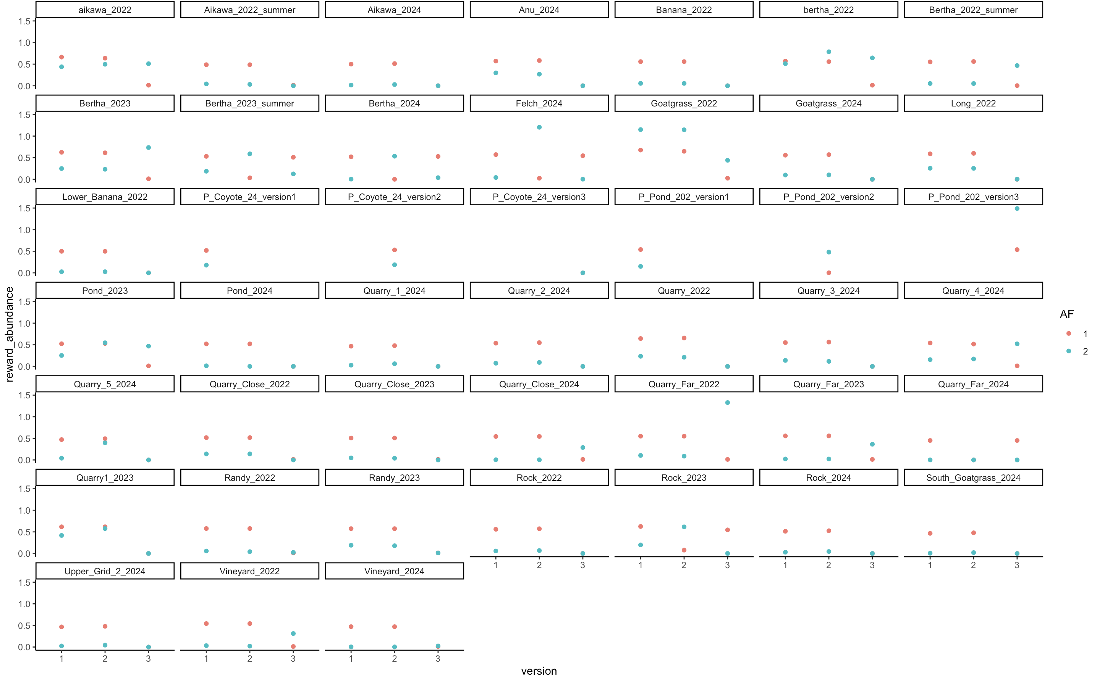

Slide 3
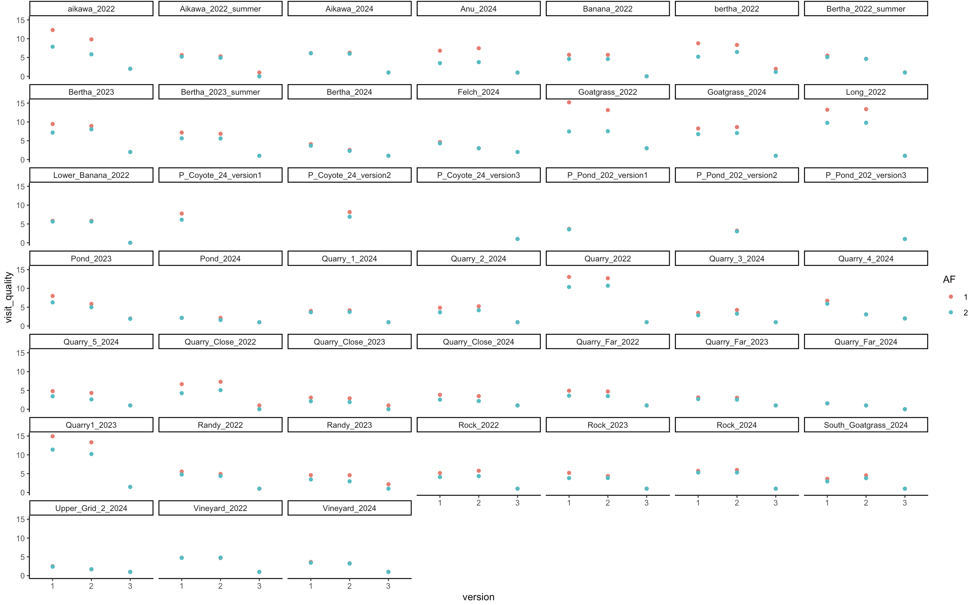

Slide 4
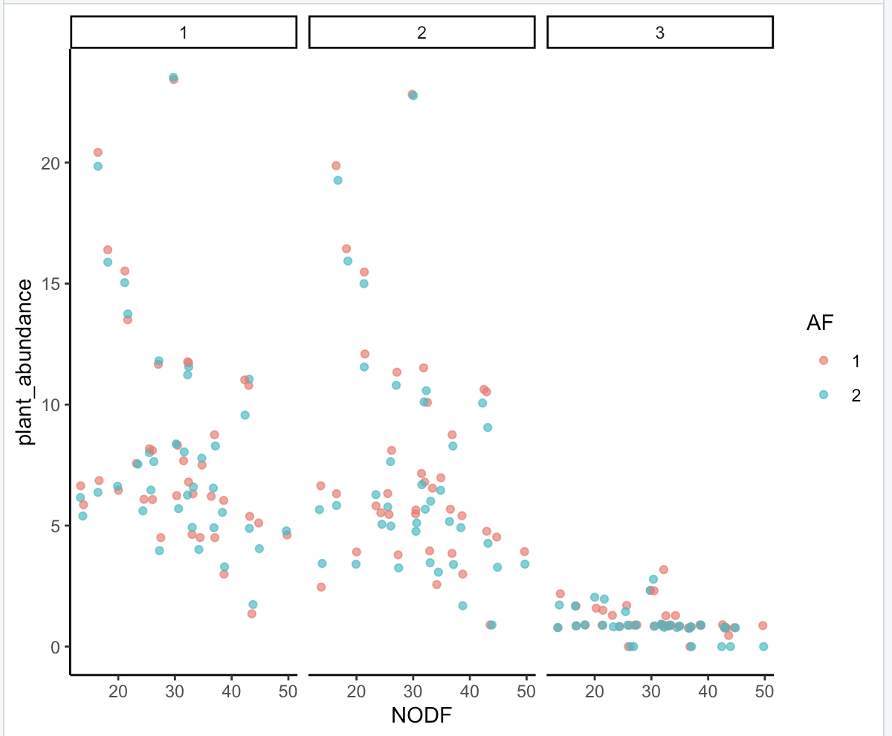
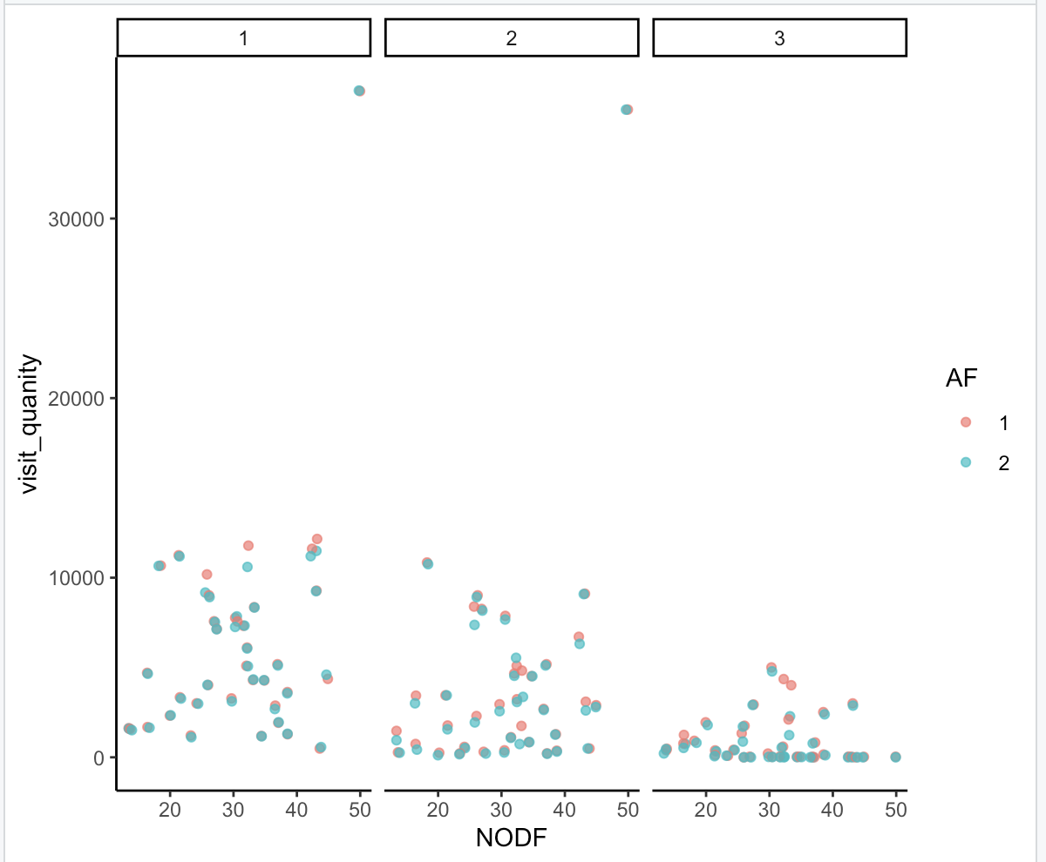
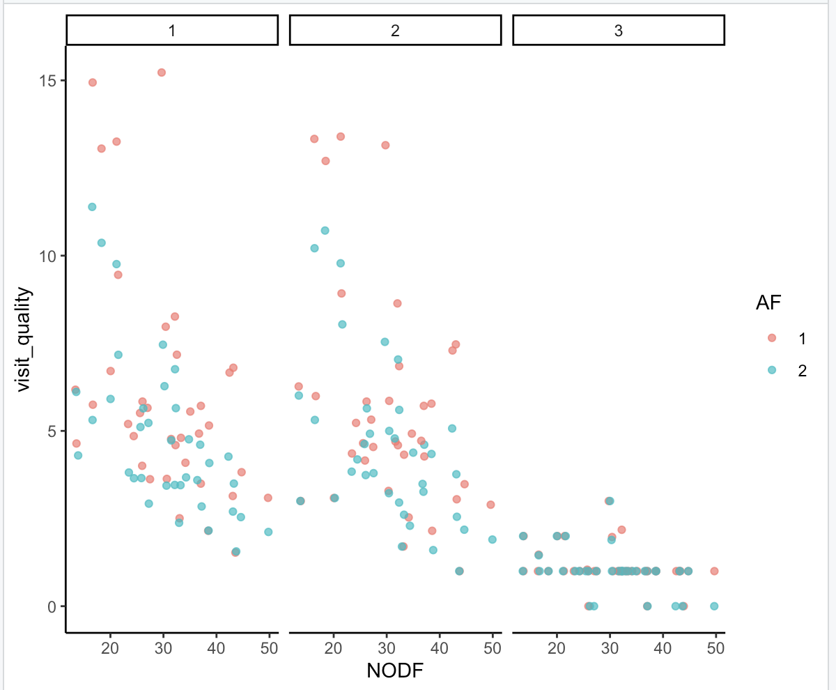

Slide 5
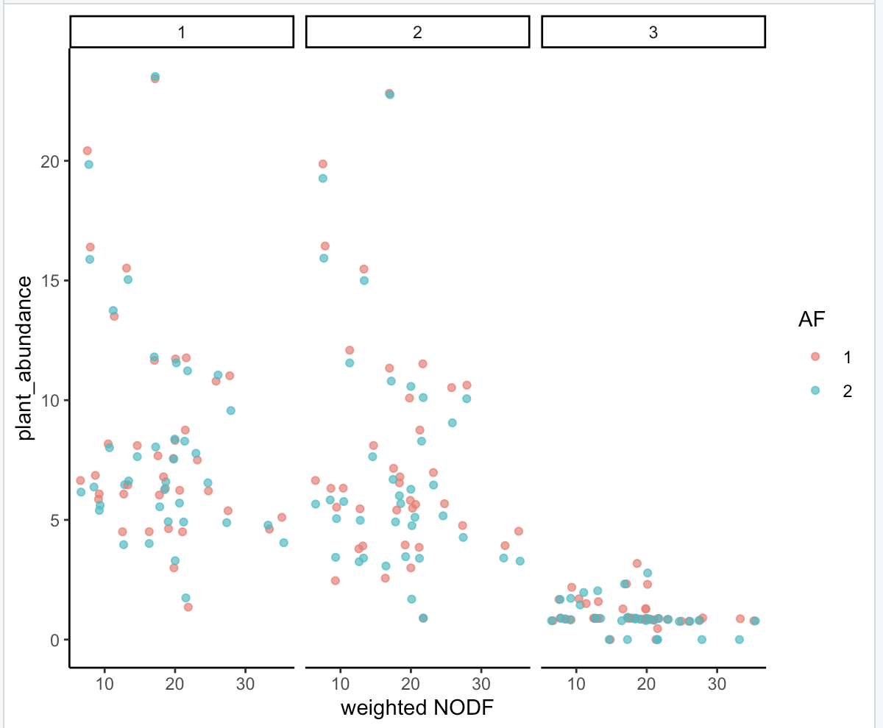
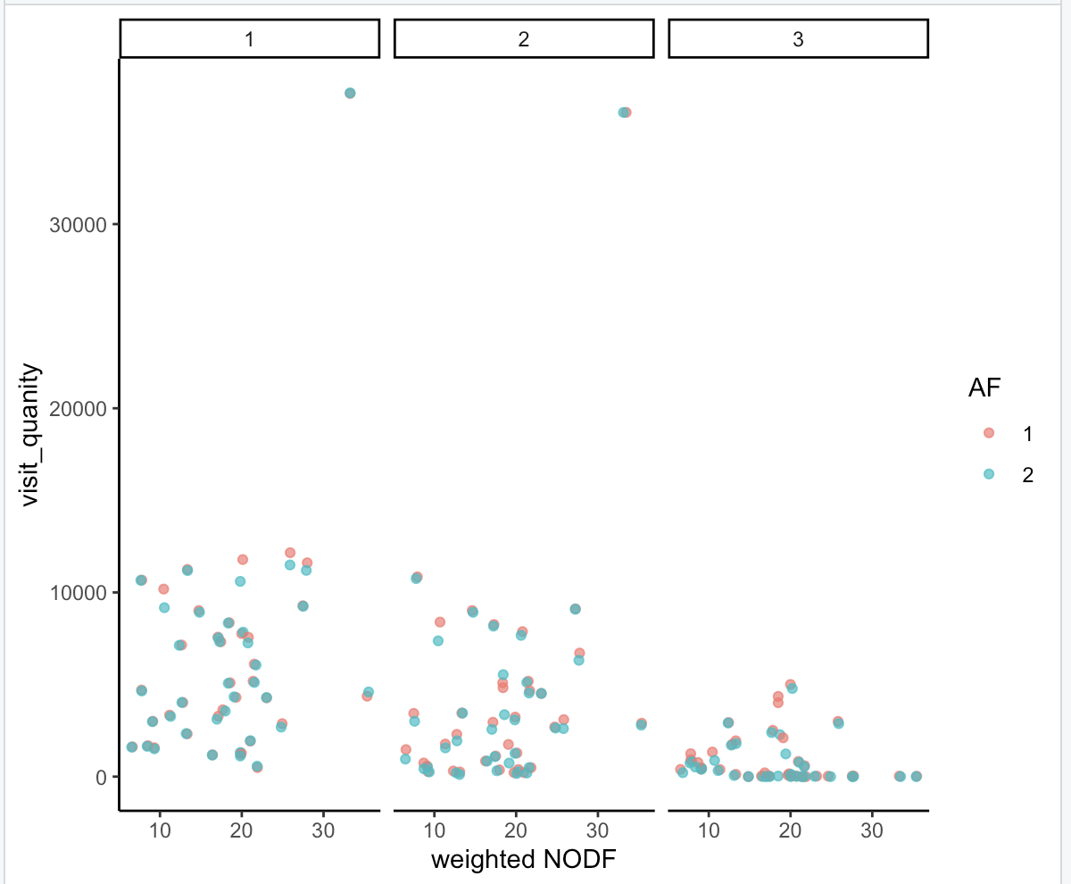
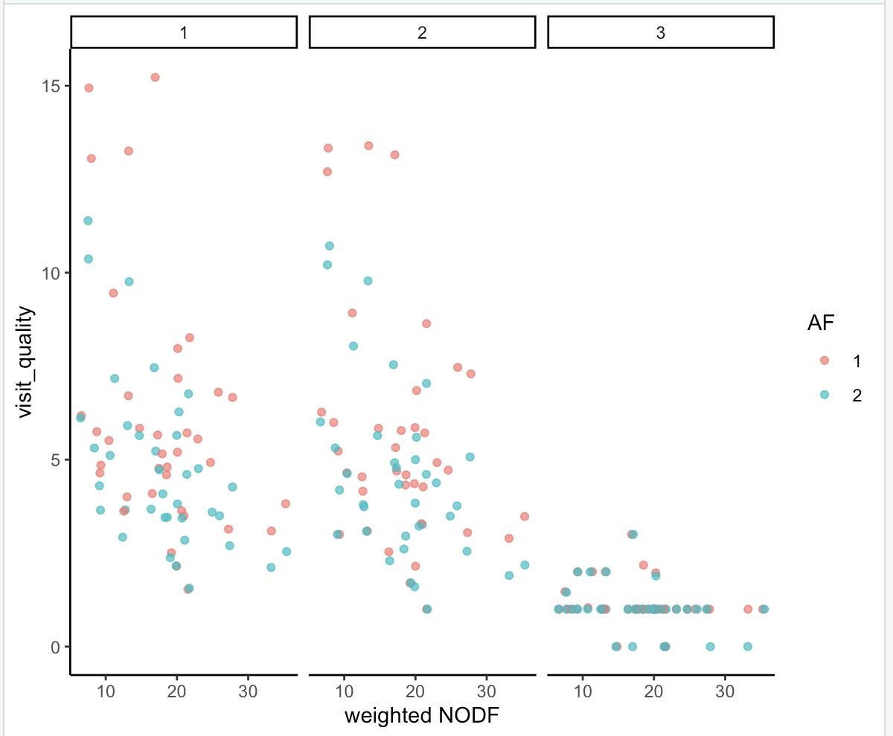

Slide 6
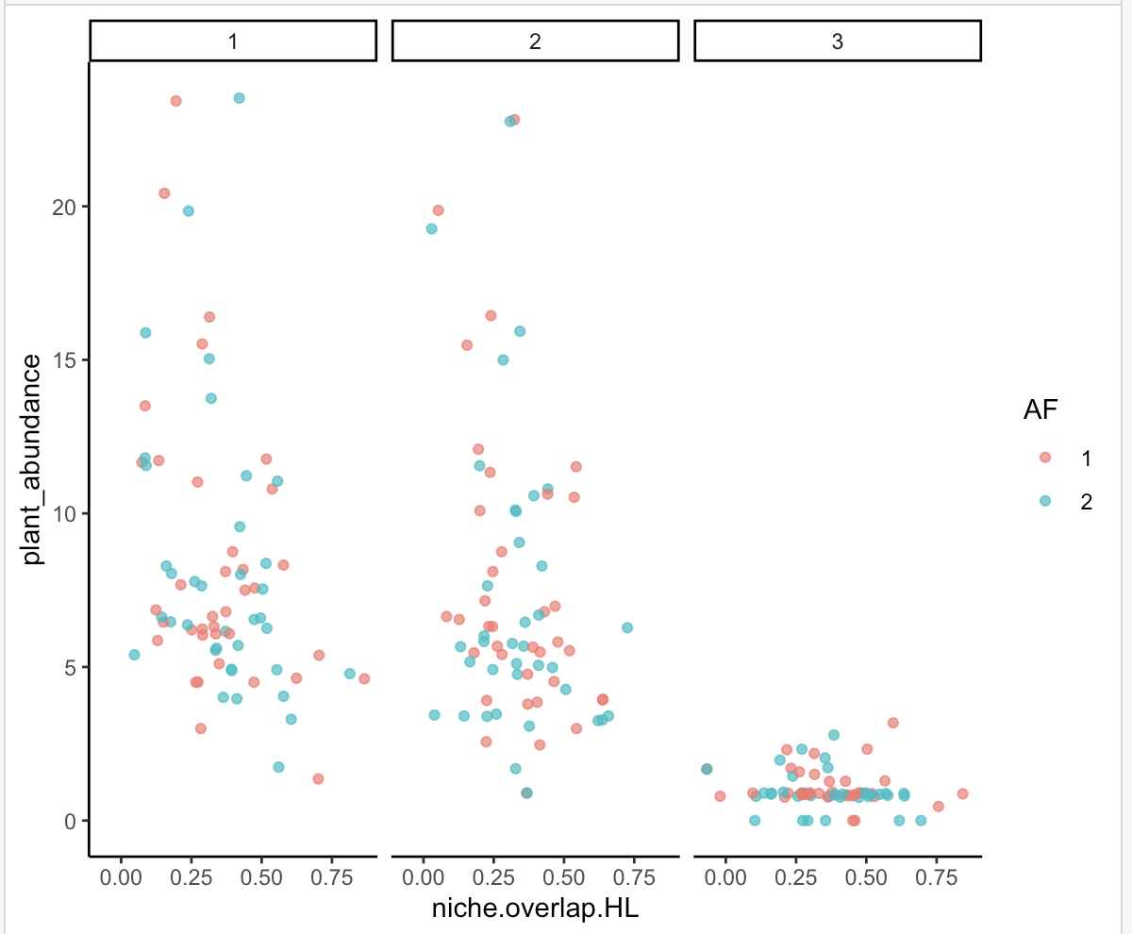
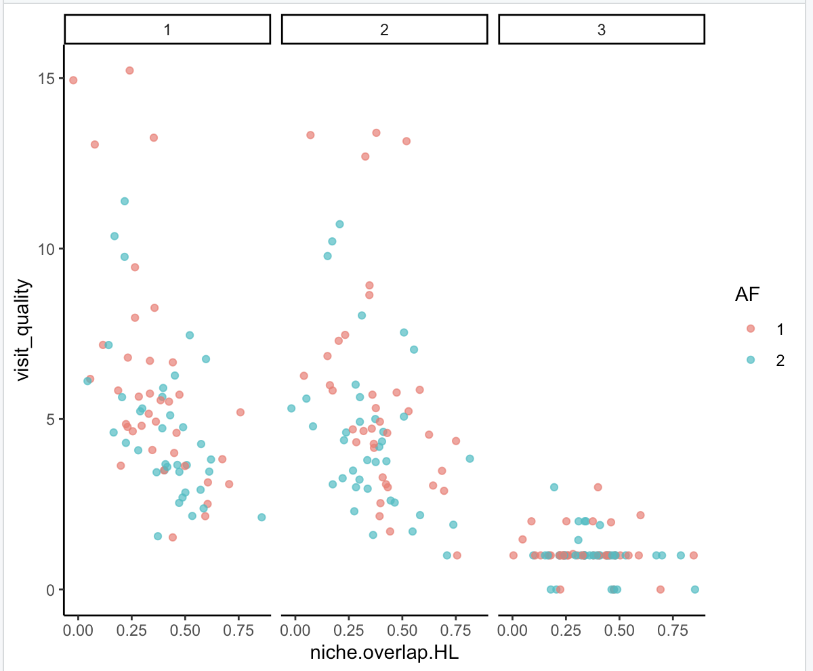
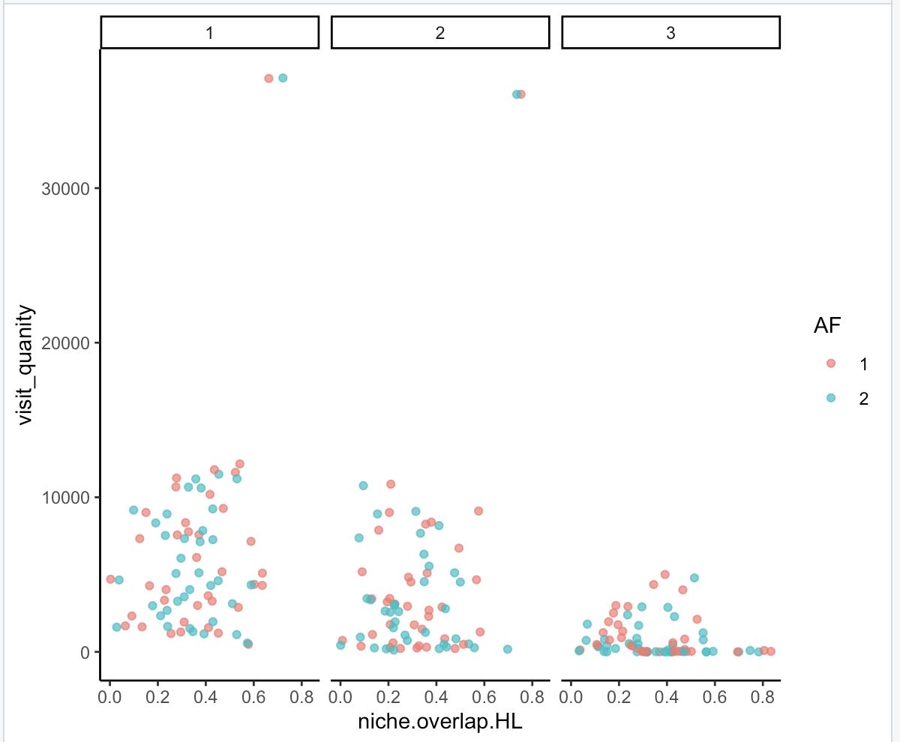

Slide 7
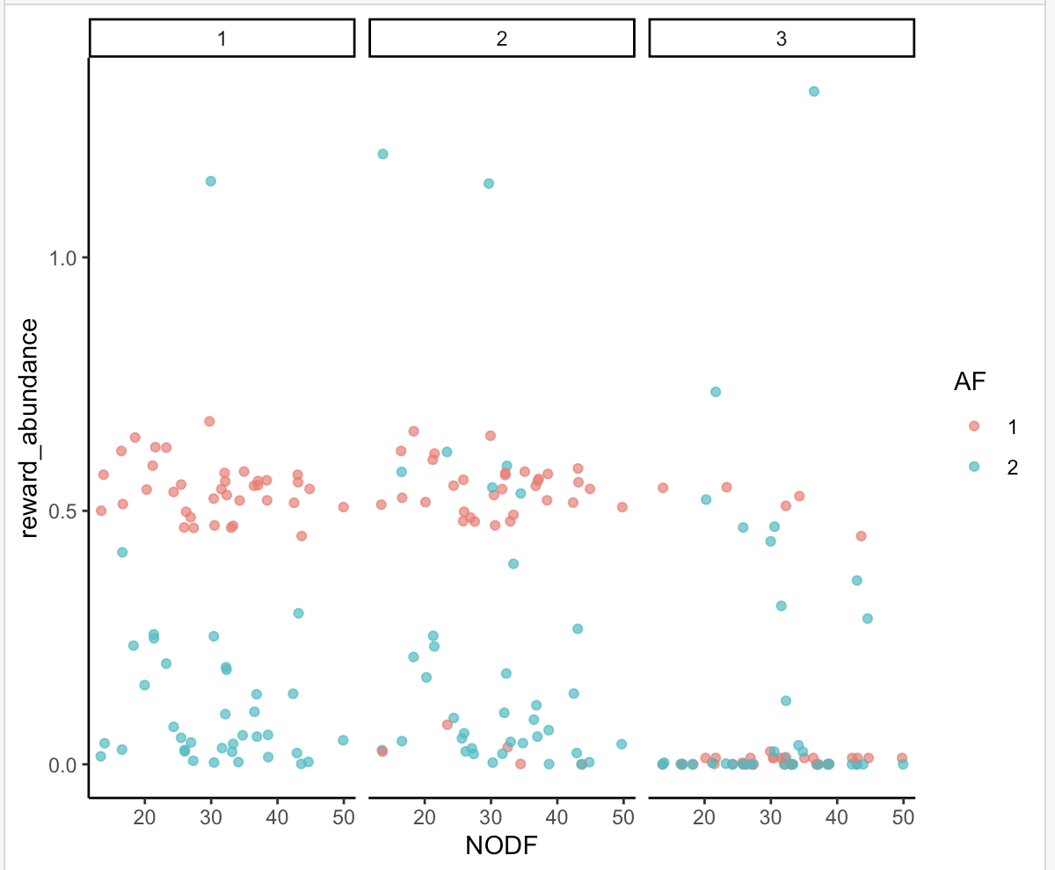

Slide 8
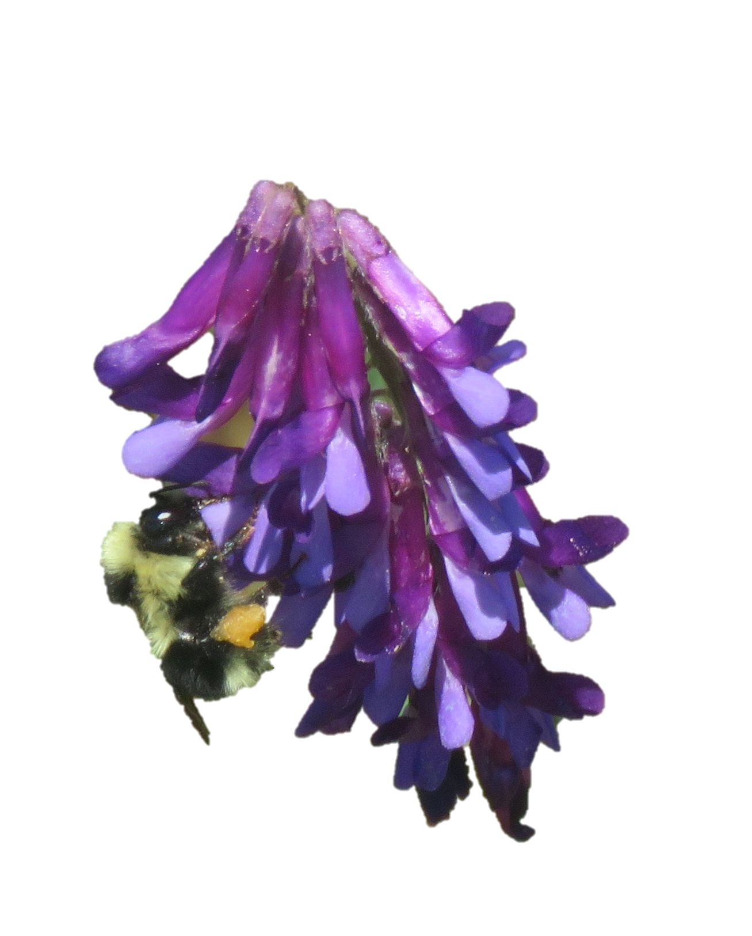
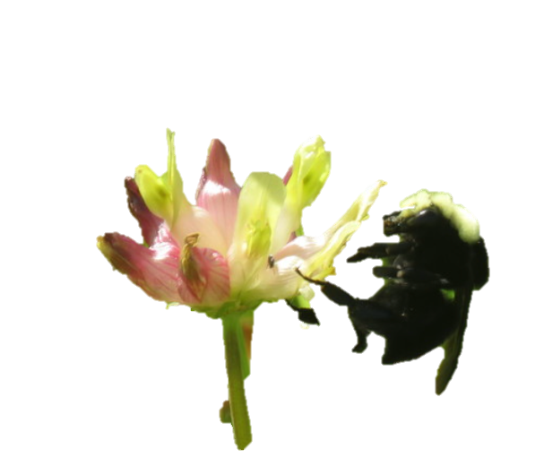
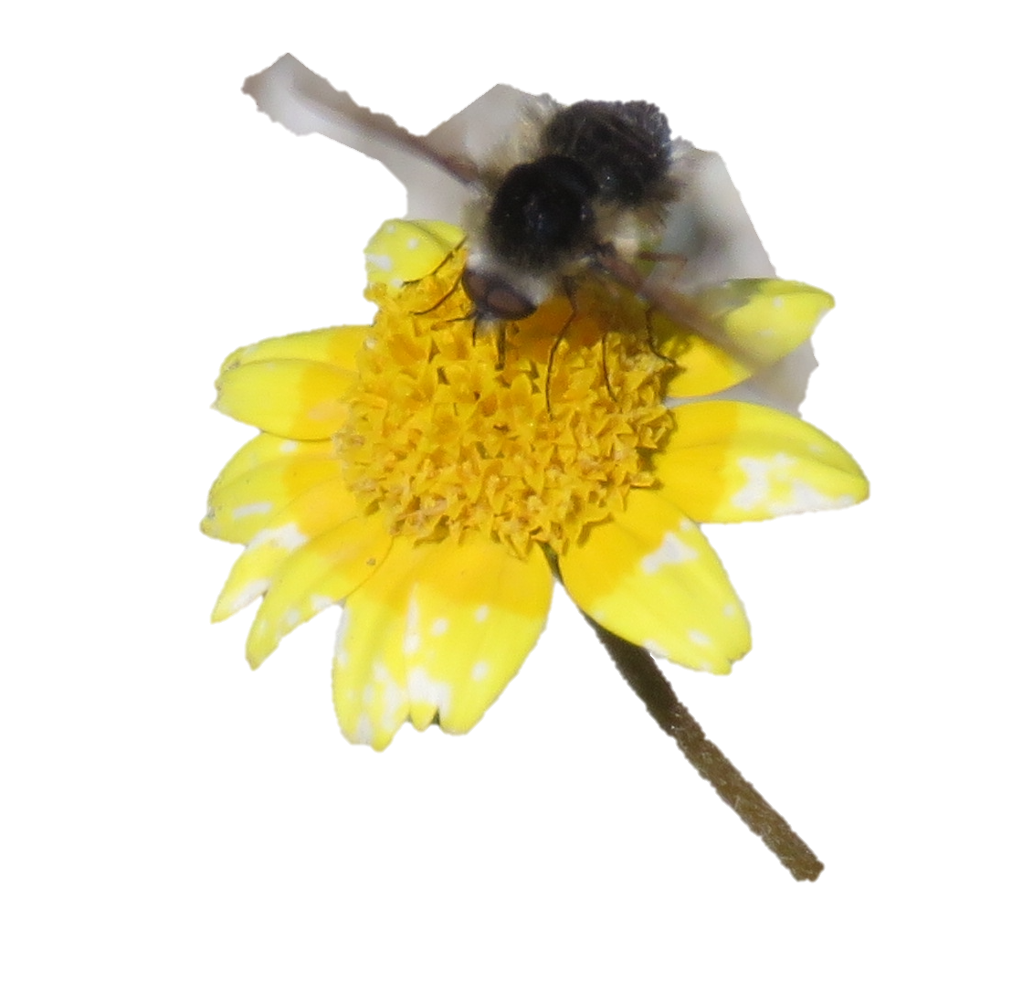
Trifolium fucatum
Lasthenia californica
Vicia villosa

Slide 9
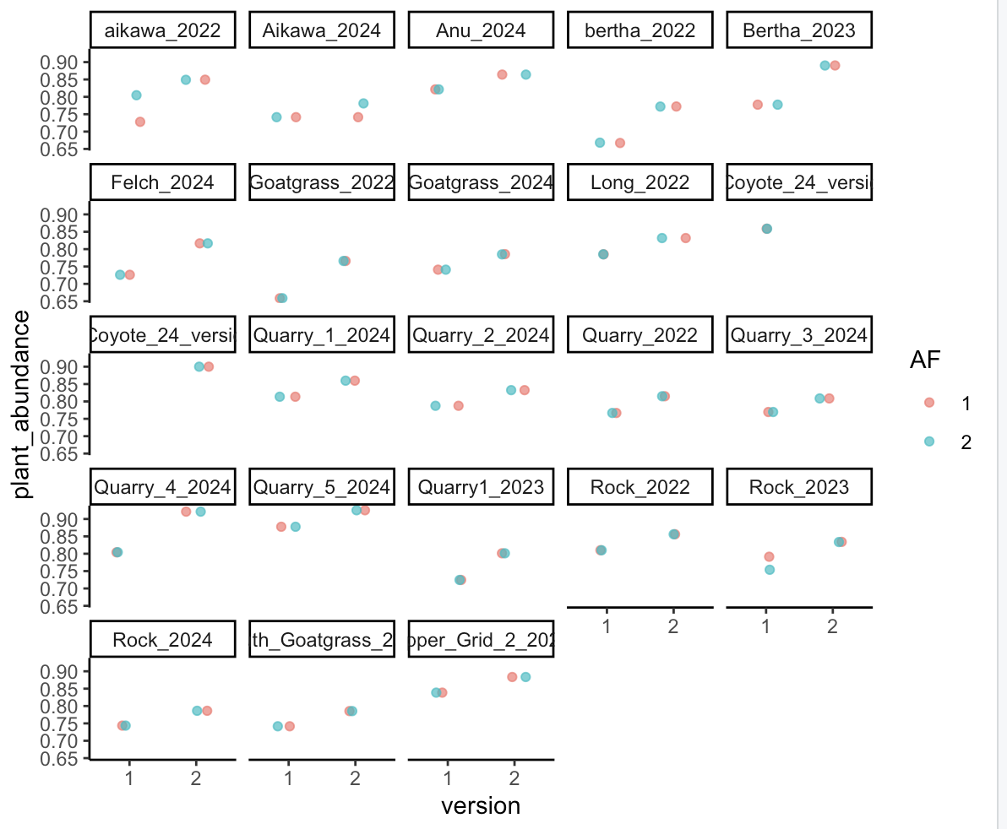
Notes:
TRFU, 1=full, 2=serp

Slide 10
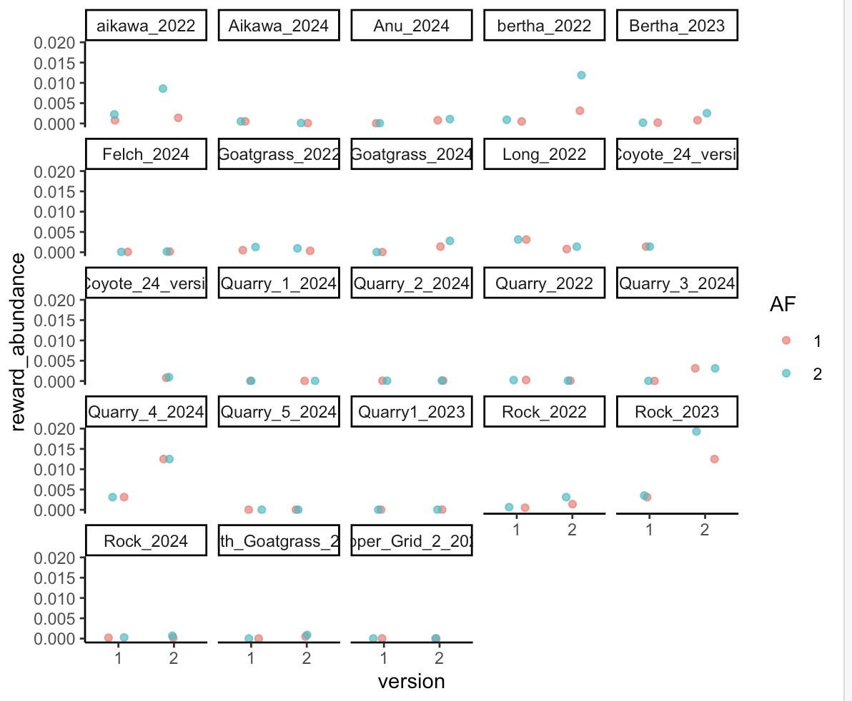
Notes:
TRFU, 1=full, 2=serp

Slide 11
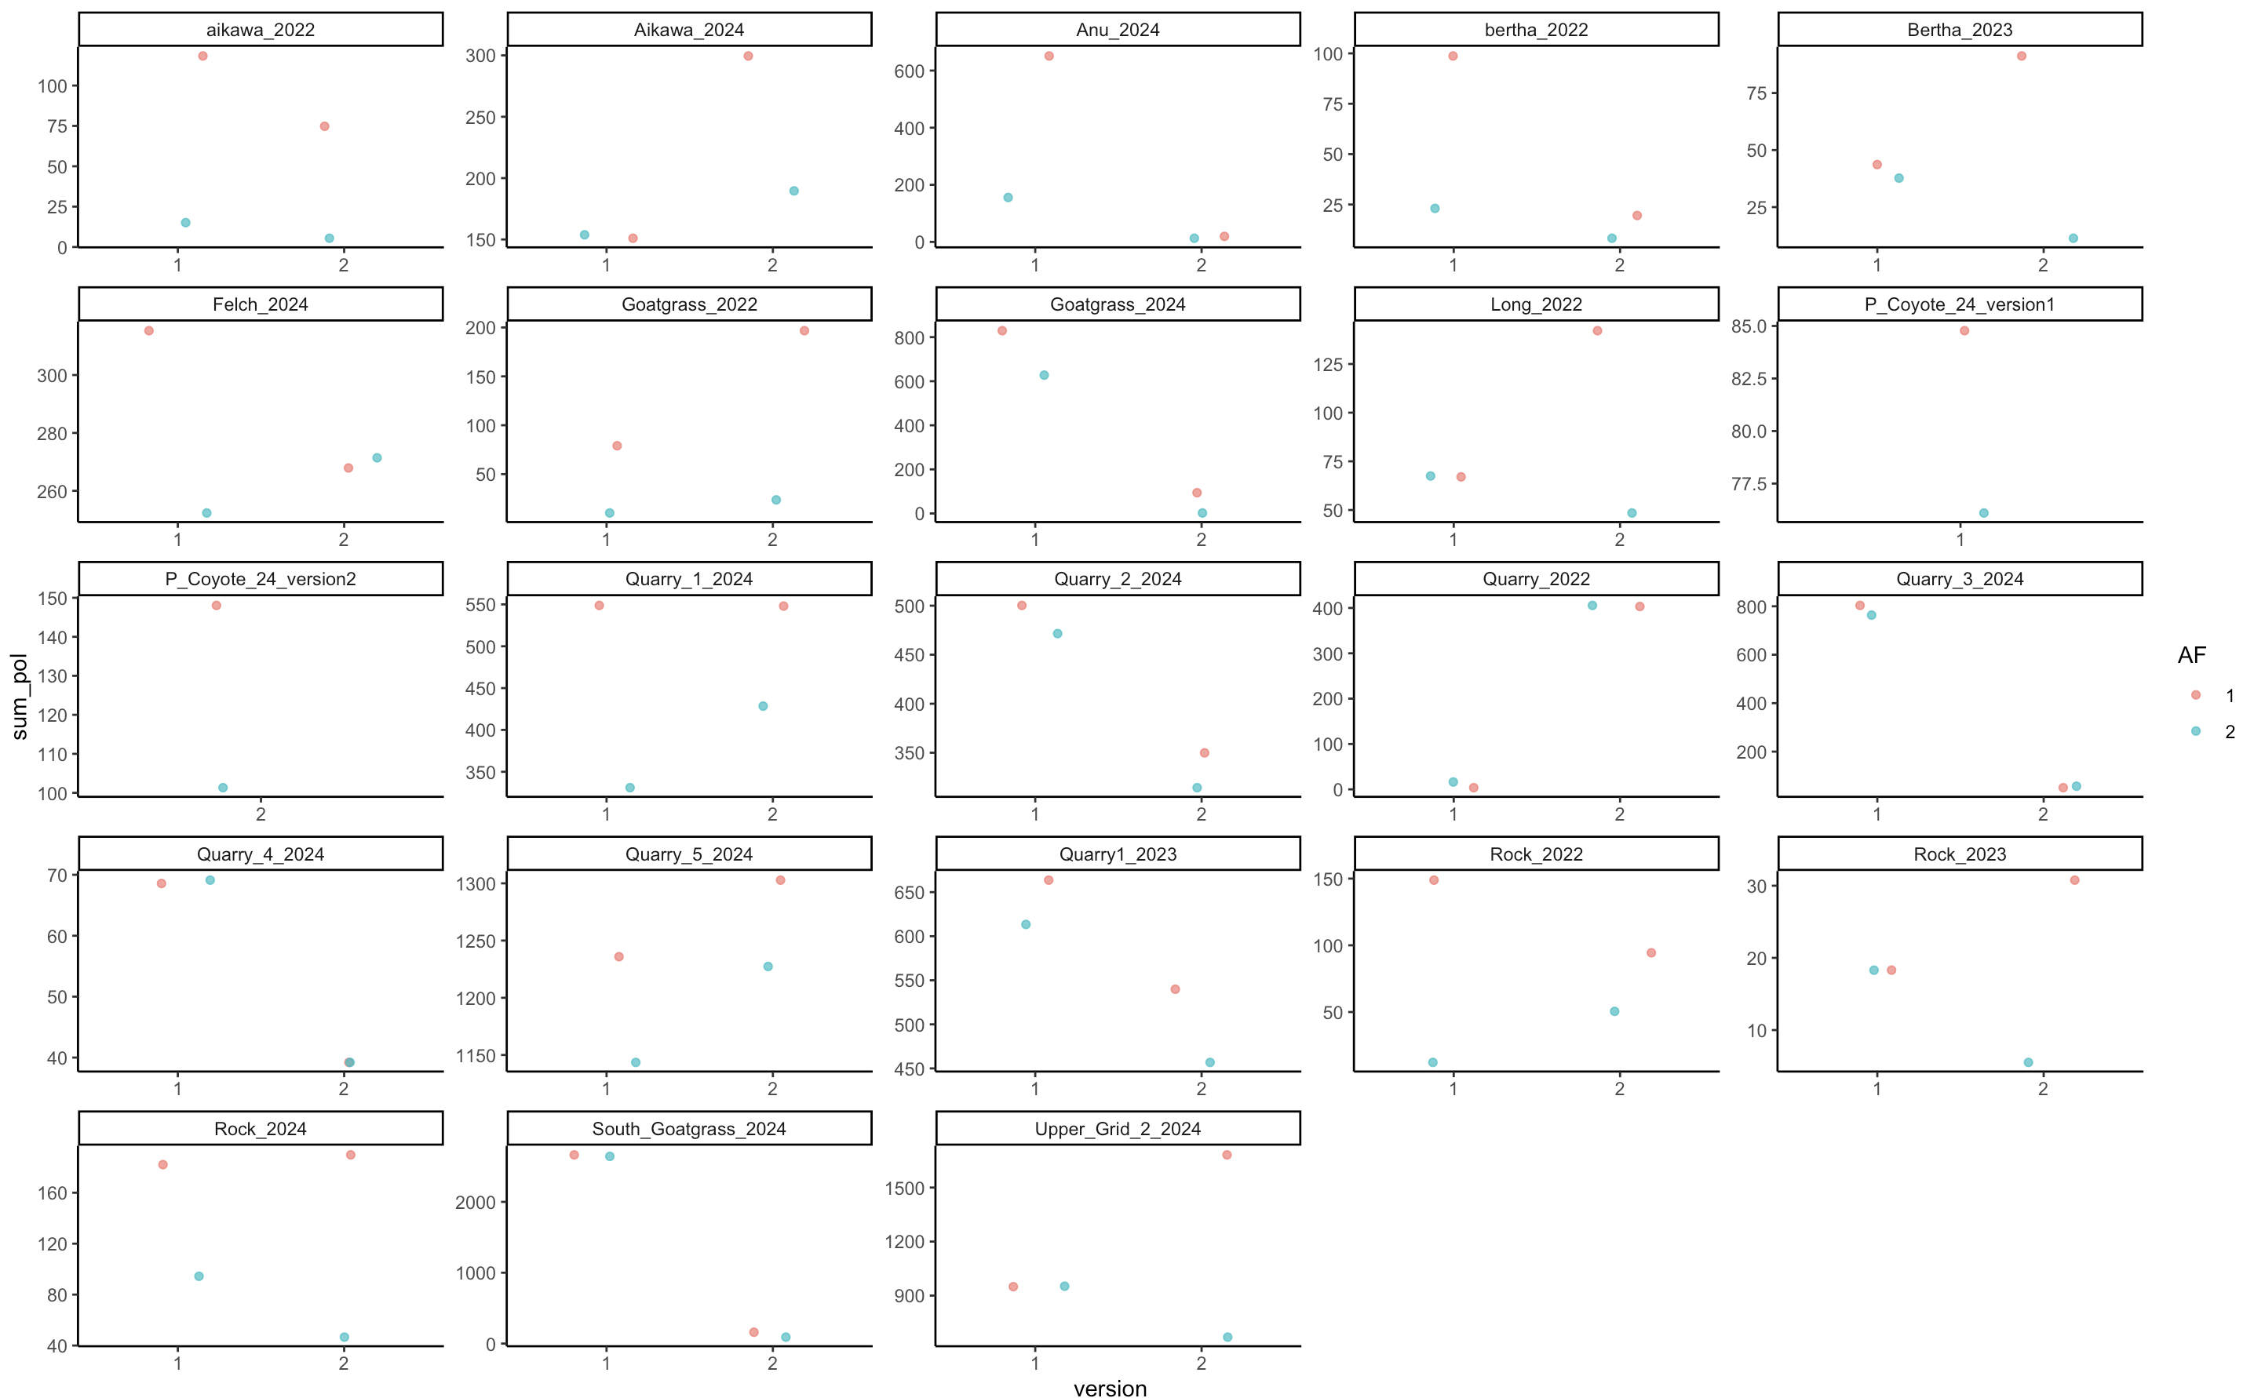
Notes:
TRFU, 1=full, 2=serp

Slide 12
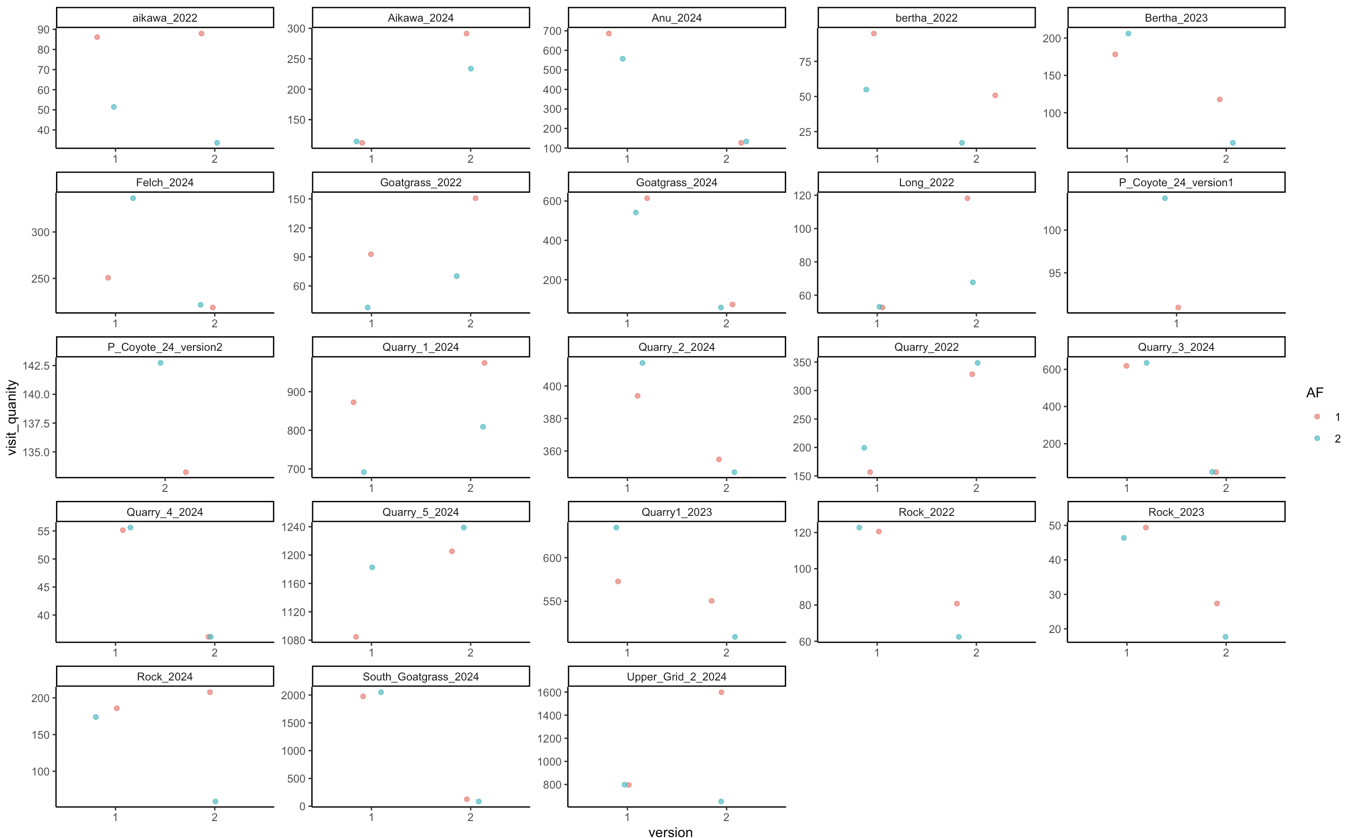
Notes:
TRFU, 1=full, 2=serp

Slide 13
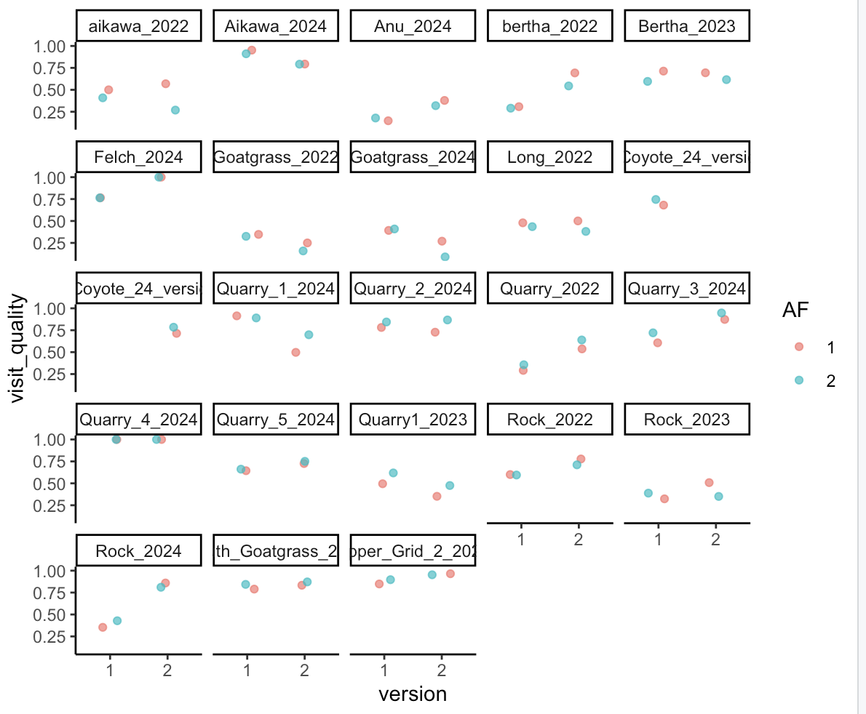
Notes:
TRFU, 1=full, 2=serp

Slide 14
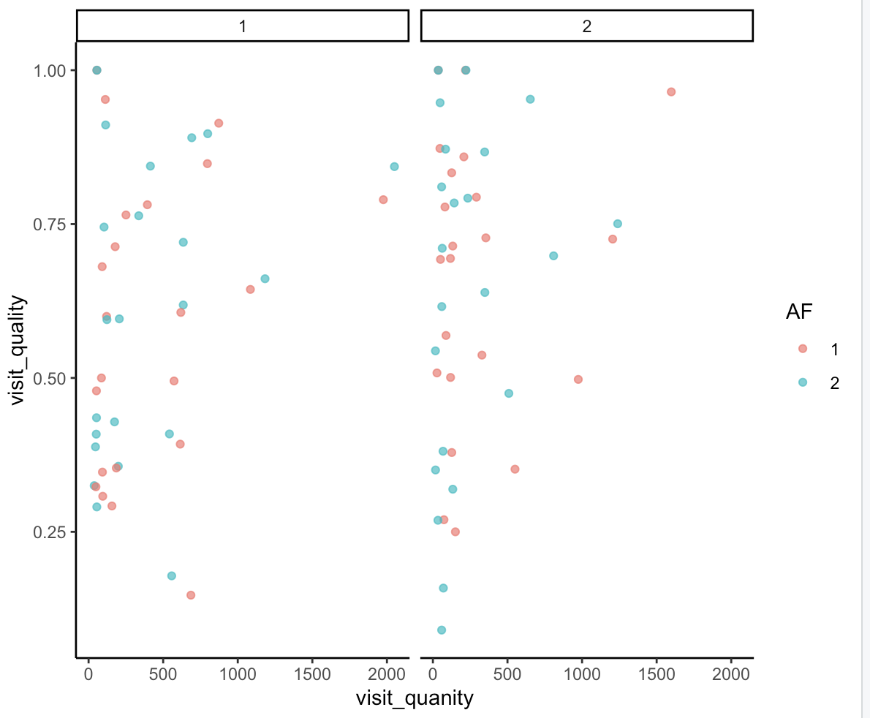
Notes:
TRFU, 1=full, 2=serp

Slide 15
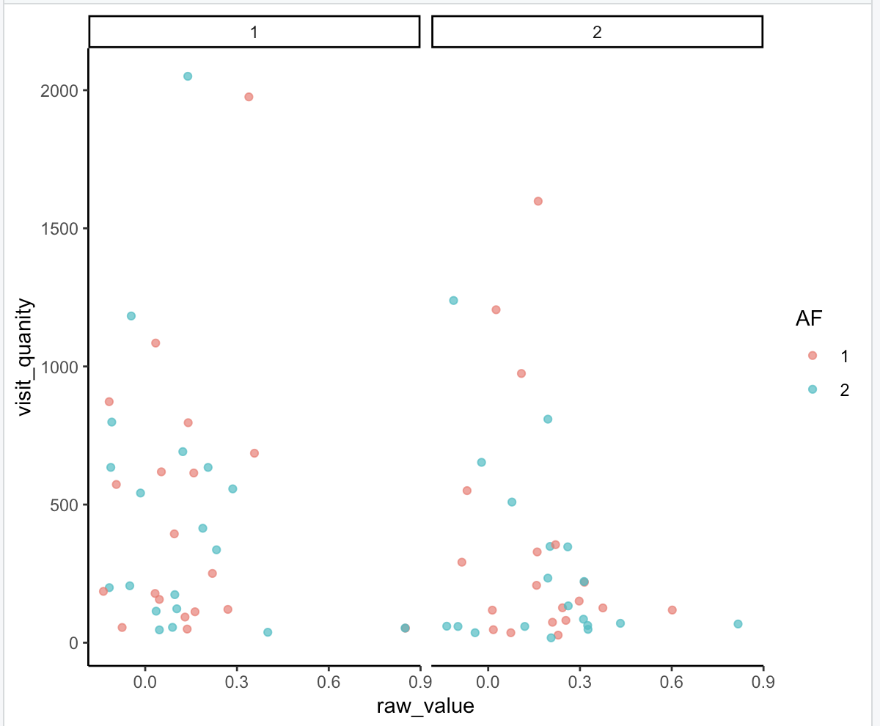
VIVI on TRFU

Slide 16
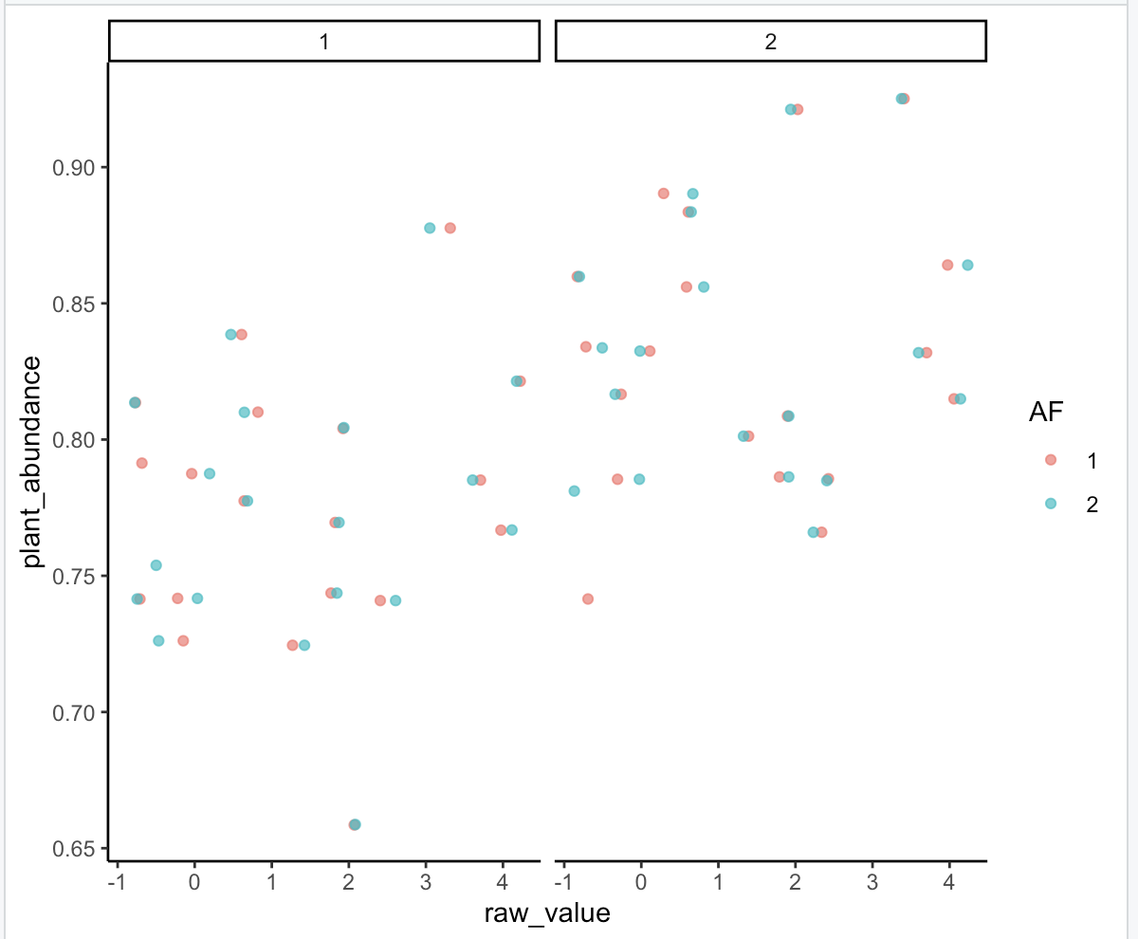
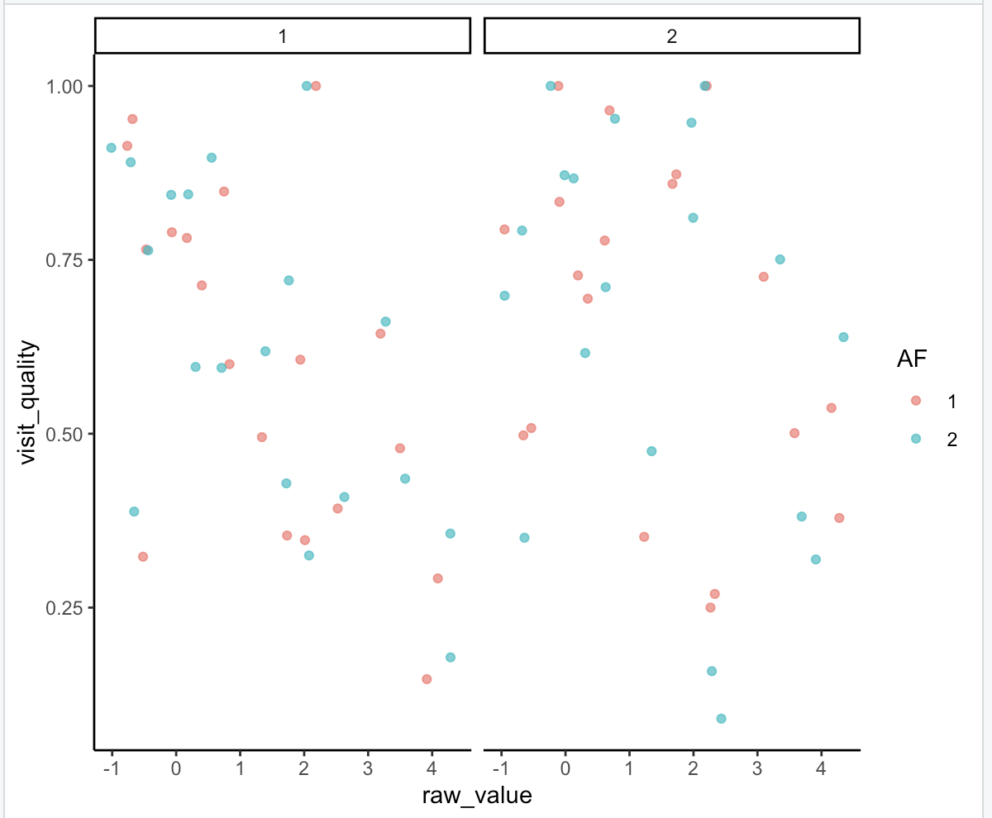
Ind Contribution TRFU
Ind Contribution TRFU

Slide 17
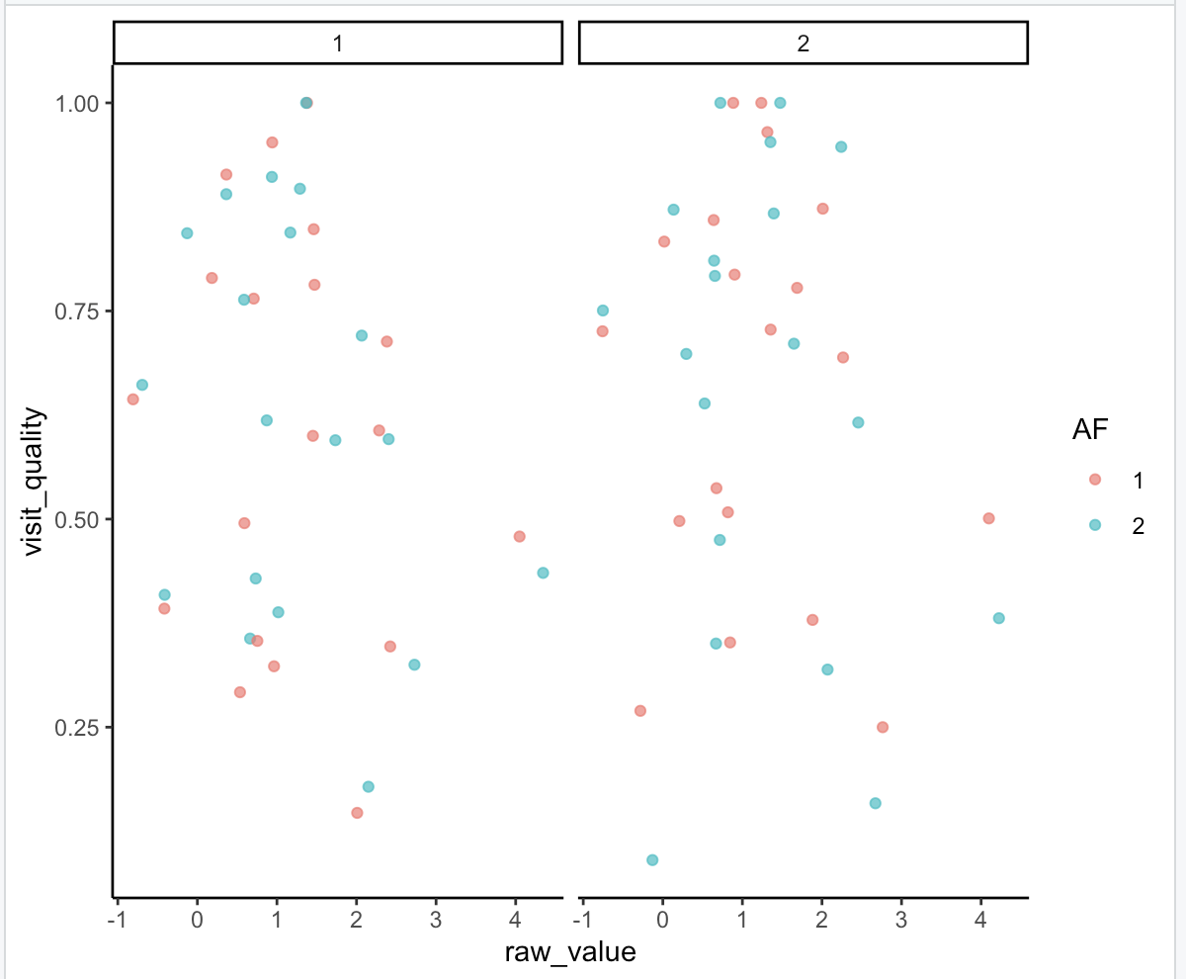
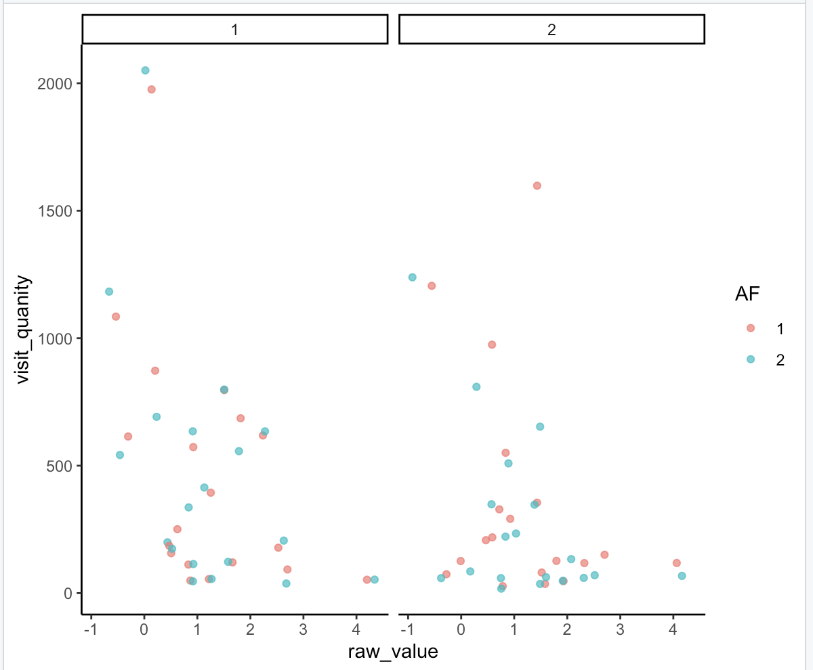
Ind Contribution VIVI
Ind Contribution VIVI

Slide 18
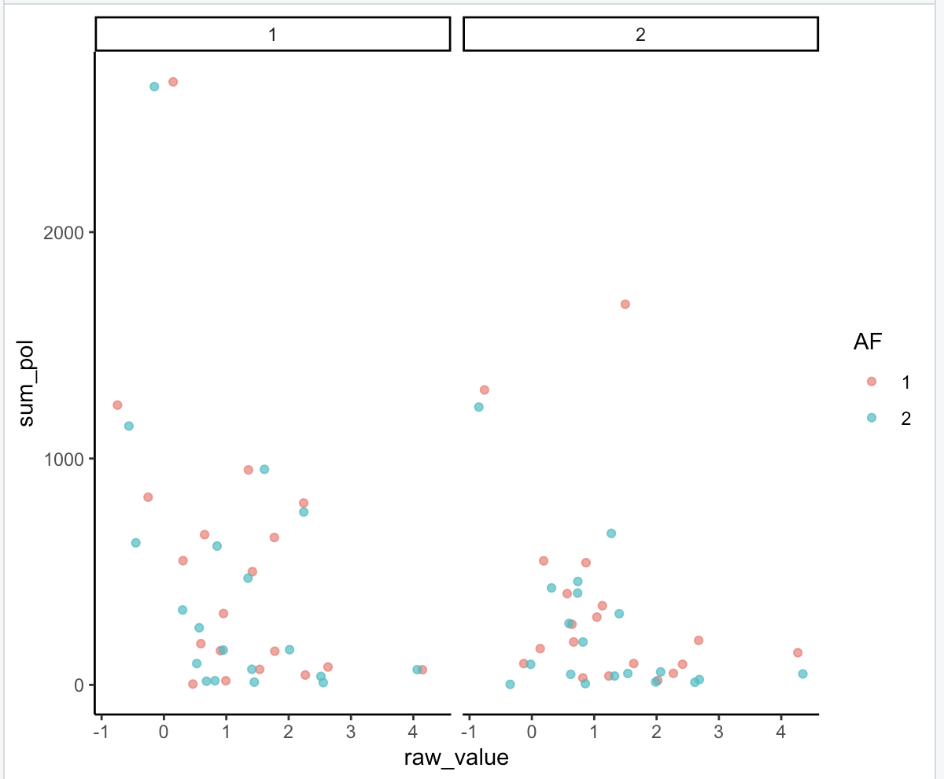
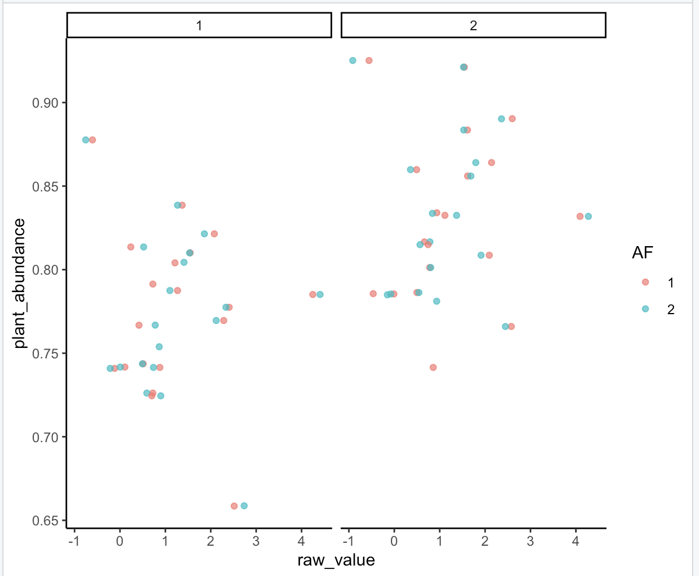
Ind Contribution VIVI
Ind Contribution VIVI

Slide 19
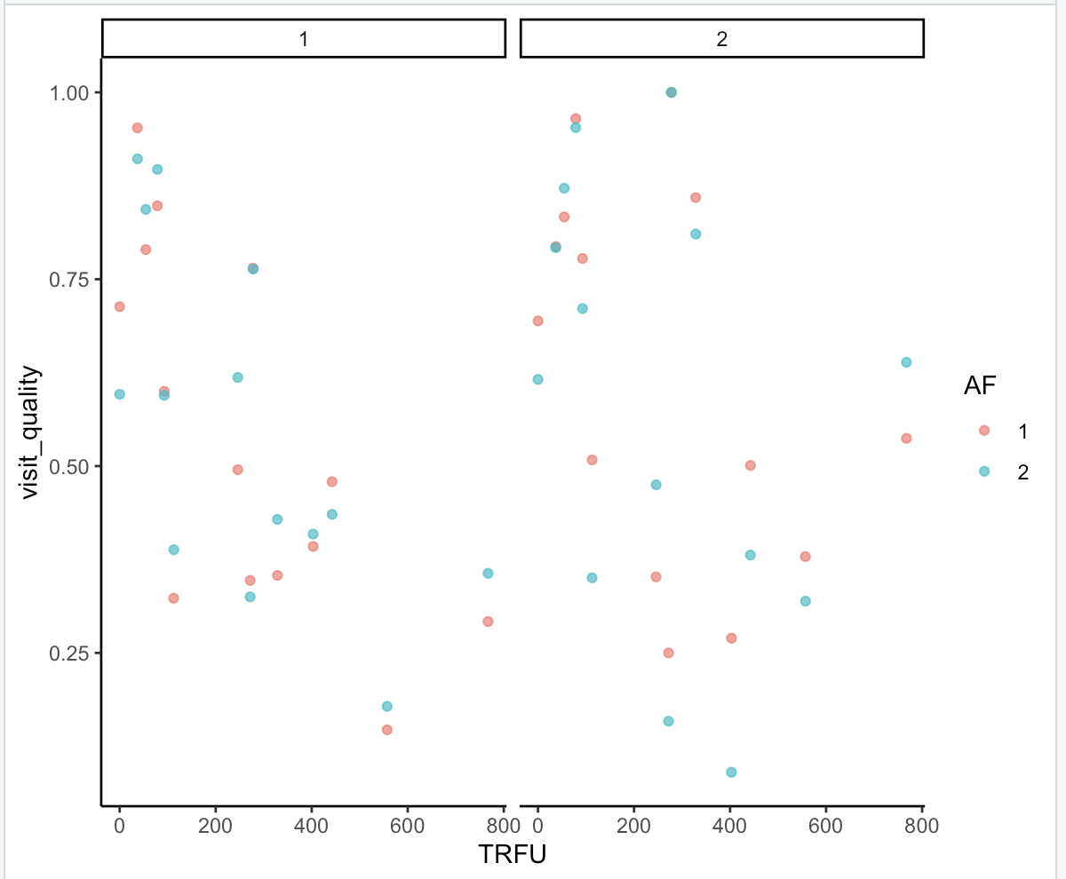
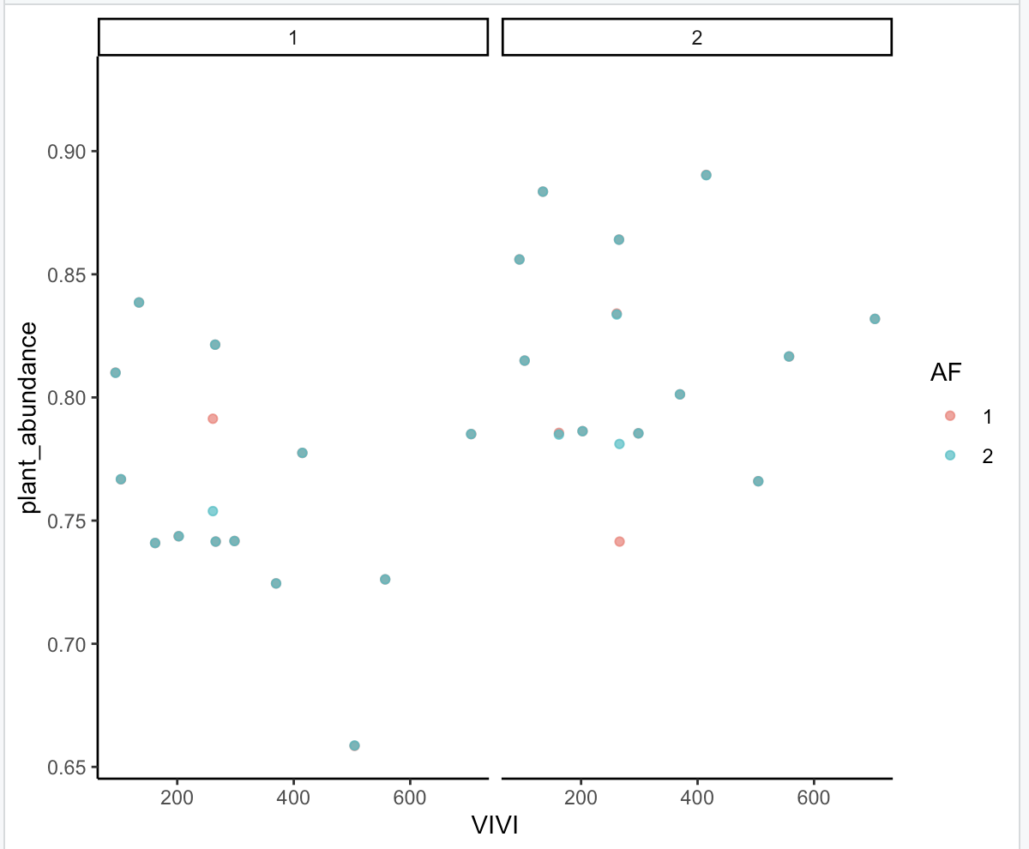
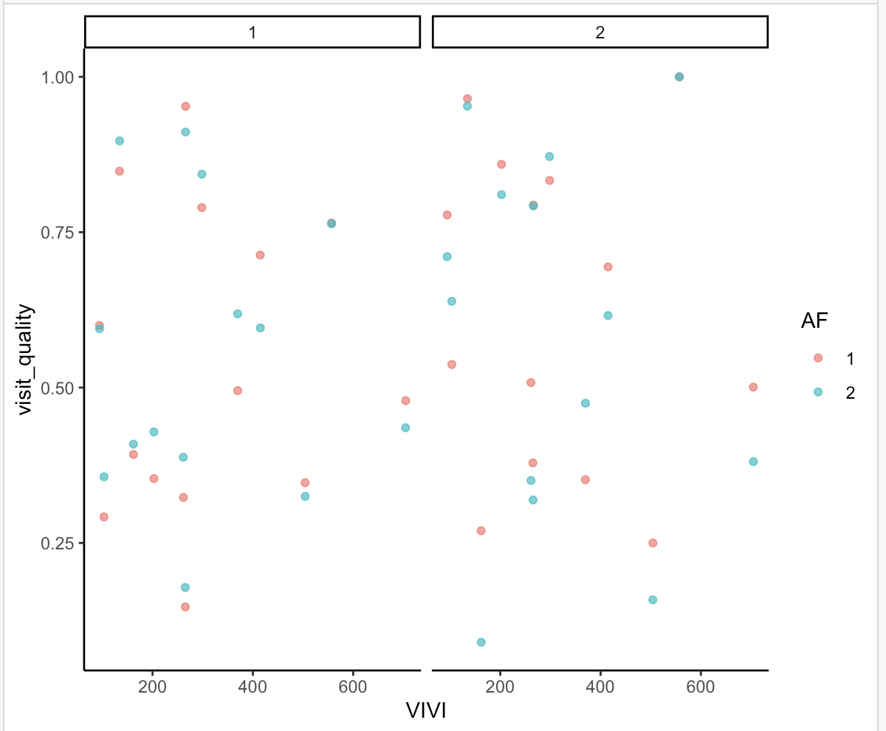
VIVI betweenness centrality
VIVI betweenness centrality
TRFU betweenness centrality

Slide 20
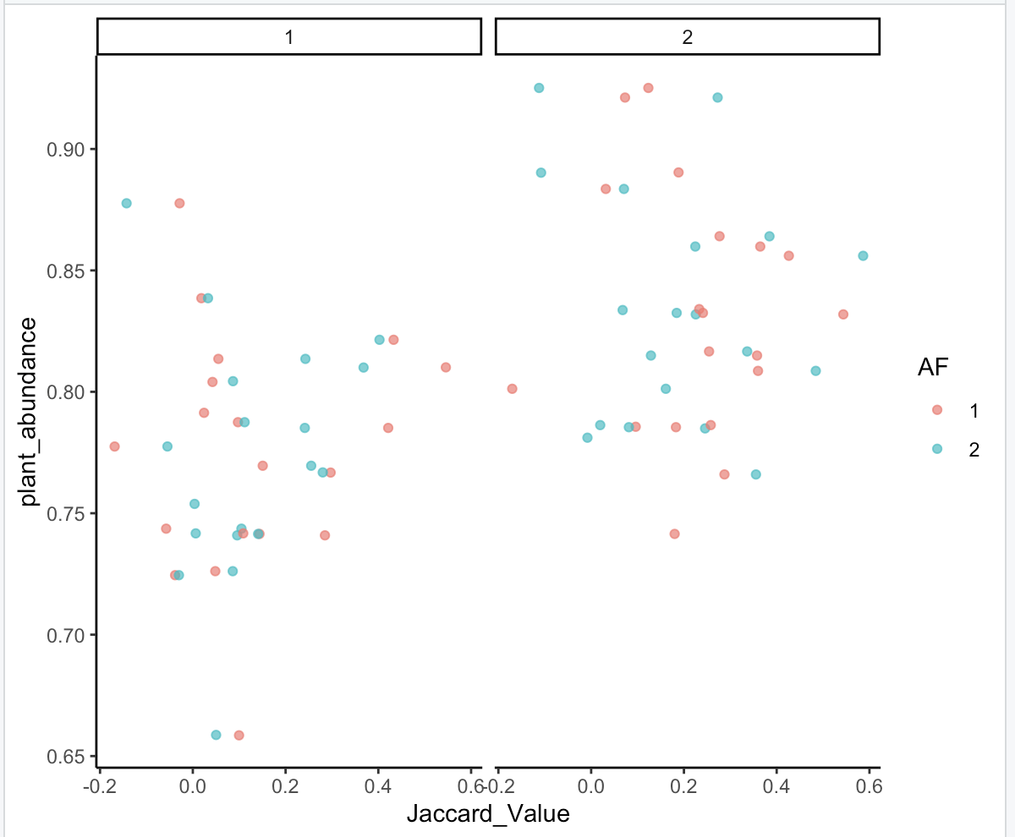
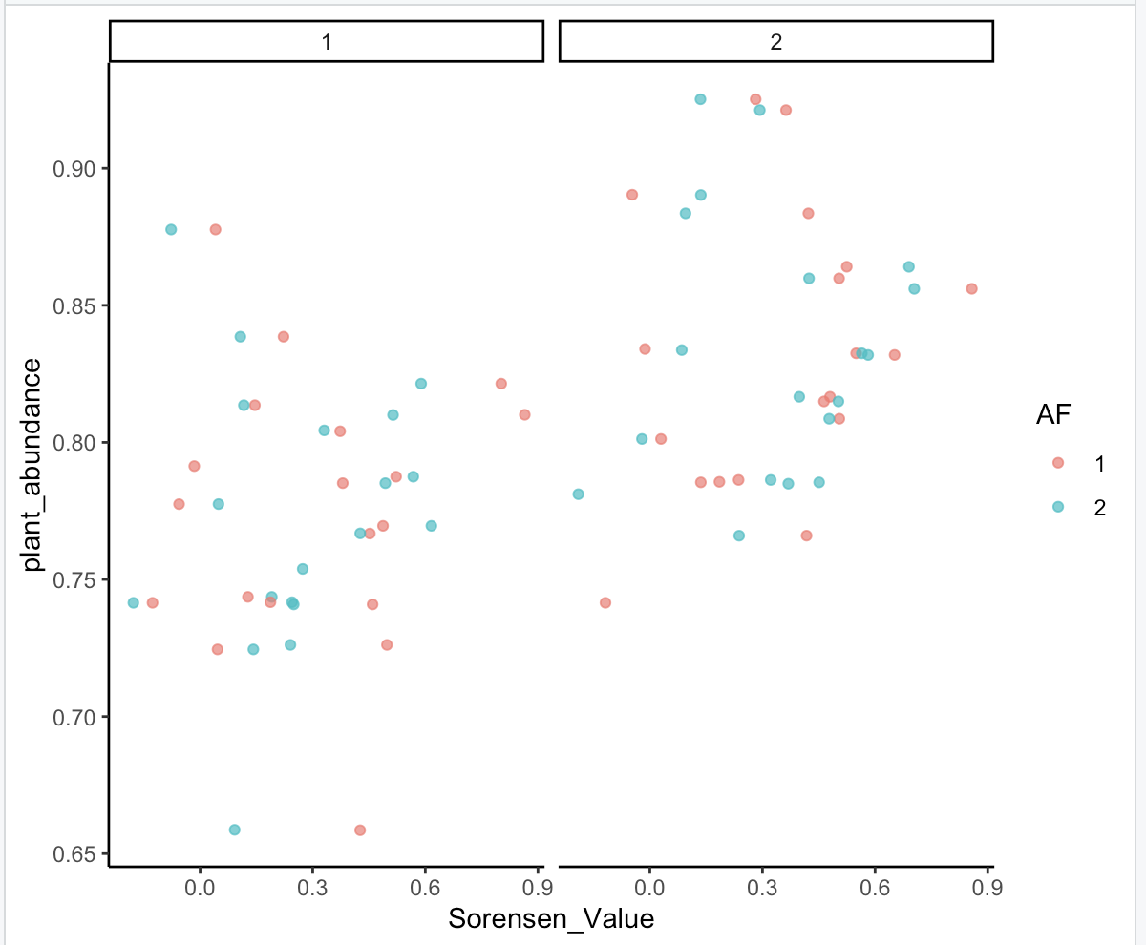

Slide 21
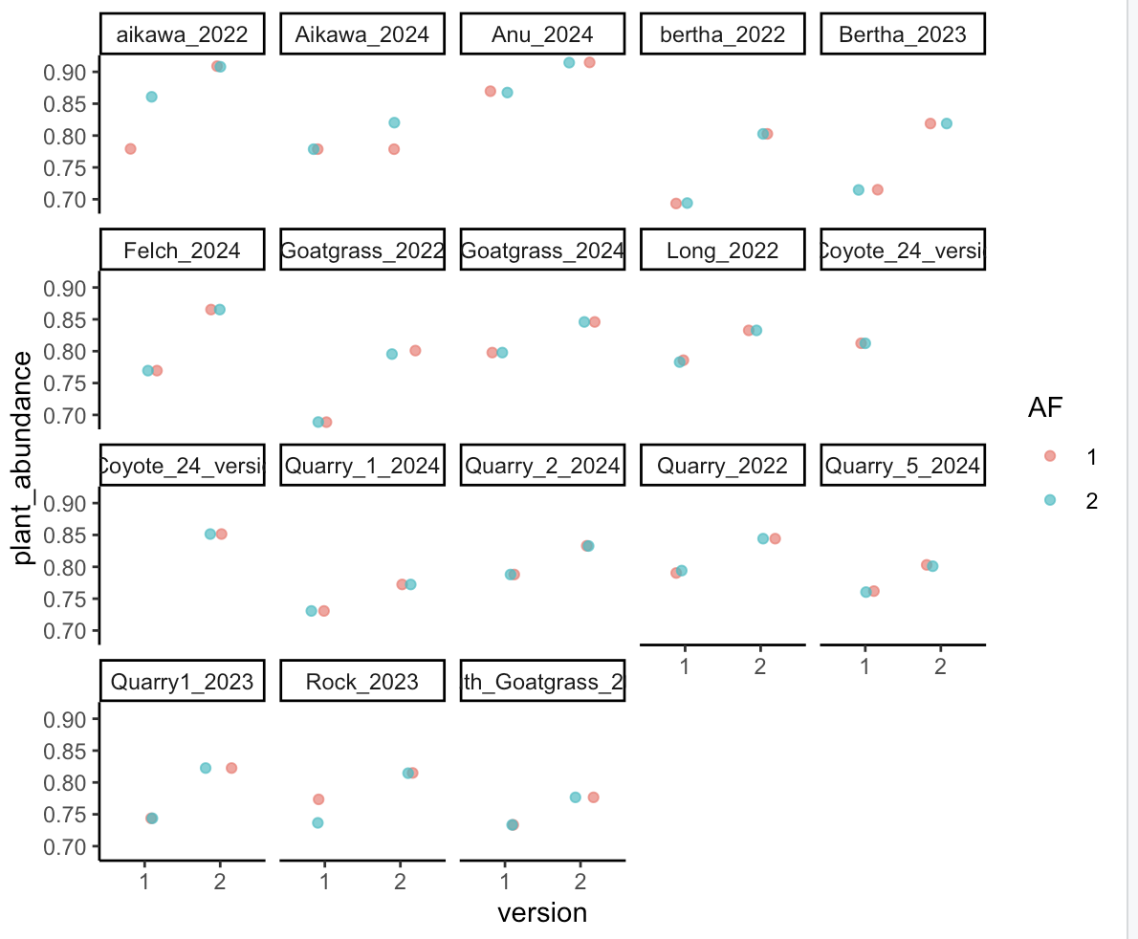
Notes:
TRFU, 1=full, 2=serp

Slide 22
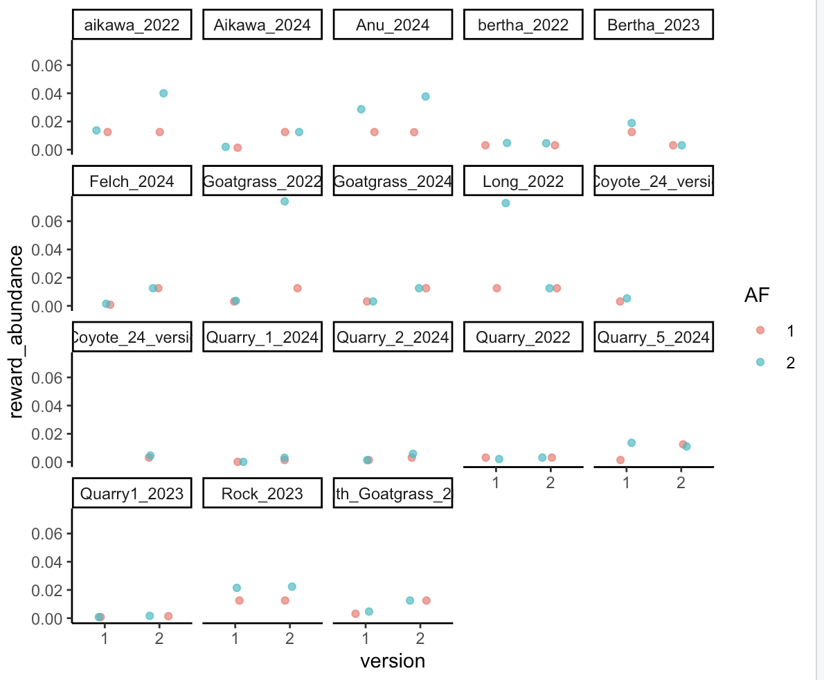

Slide 23
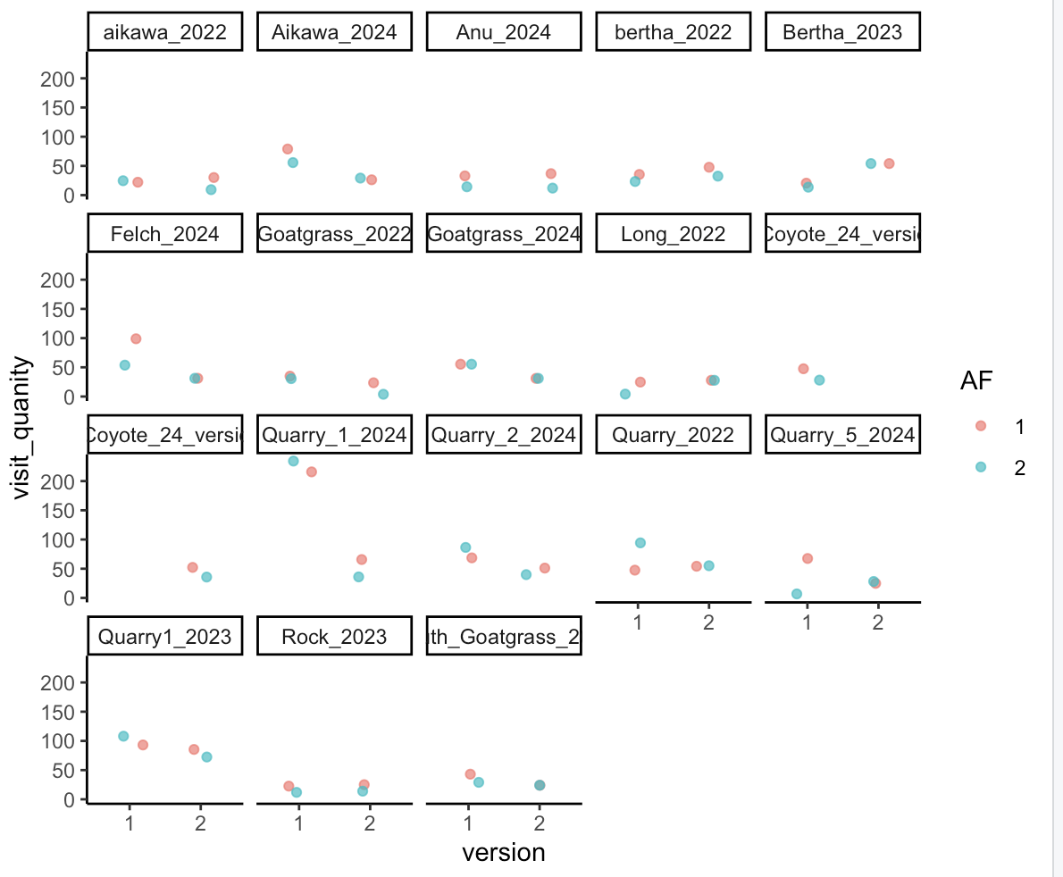

Slide 24
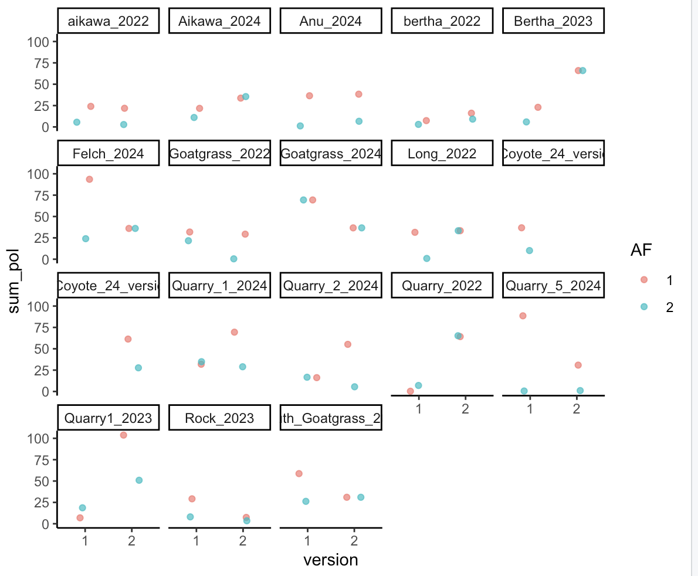

Slide 25
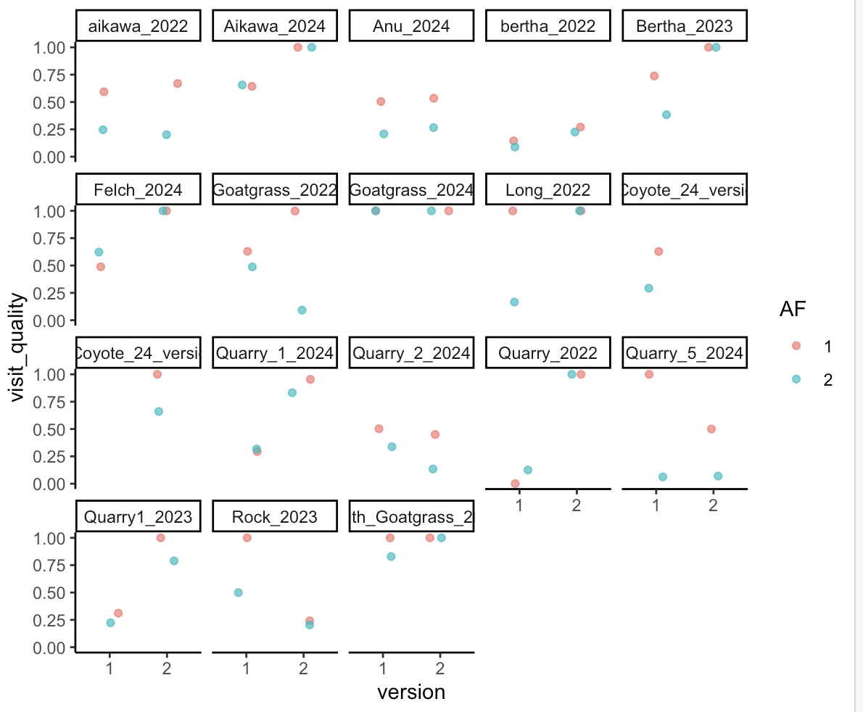

Slide 26
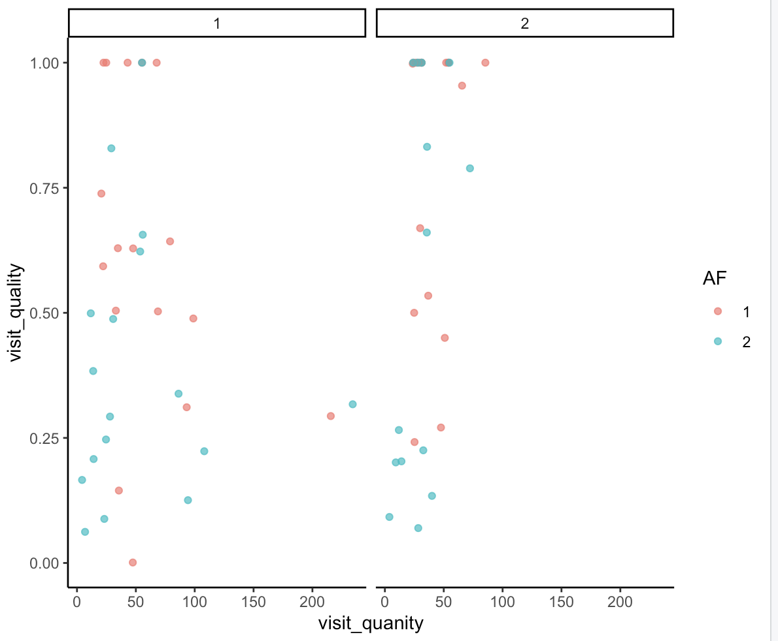

Slide 27
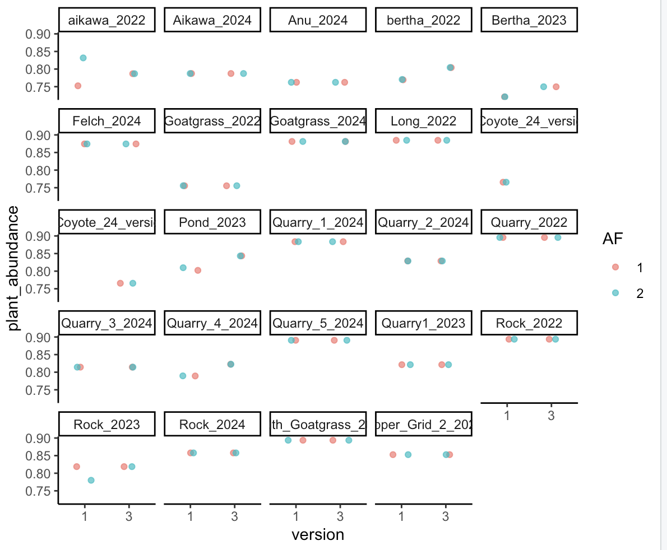

Slide 28
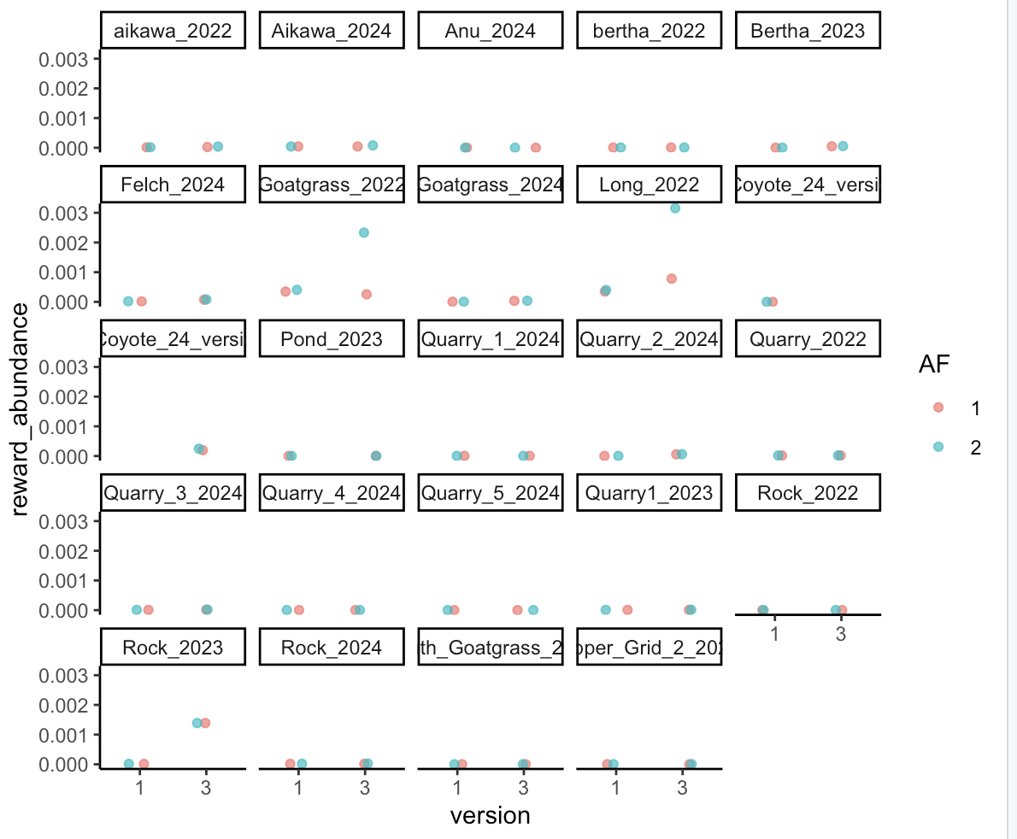

Slide 29
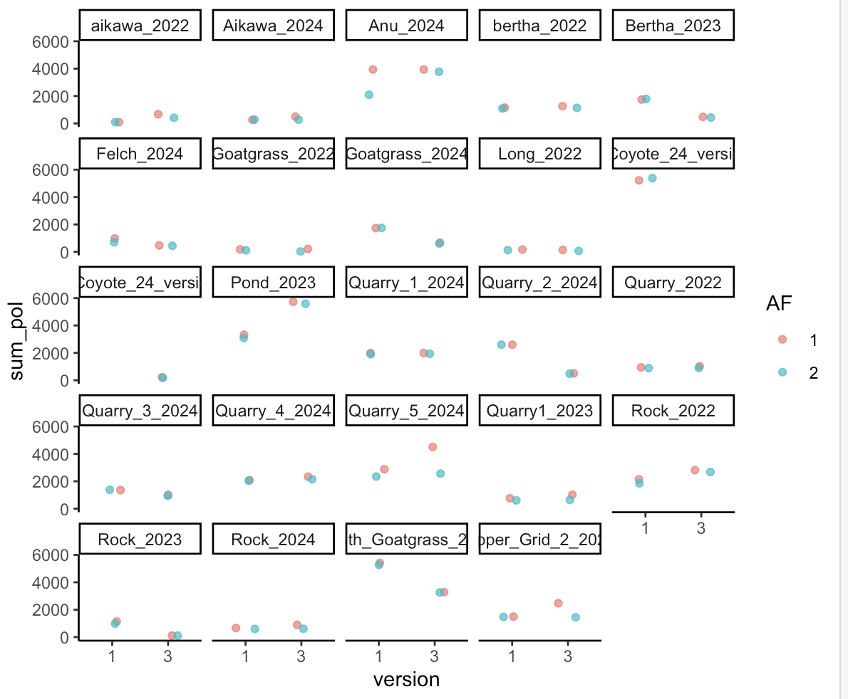

Slide 30
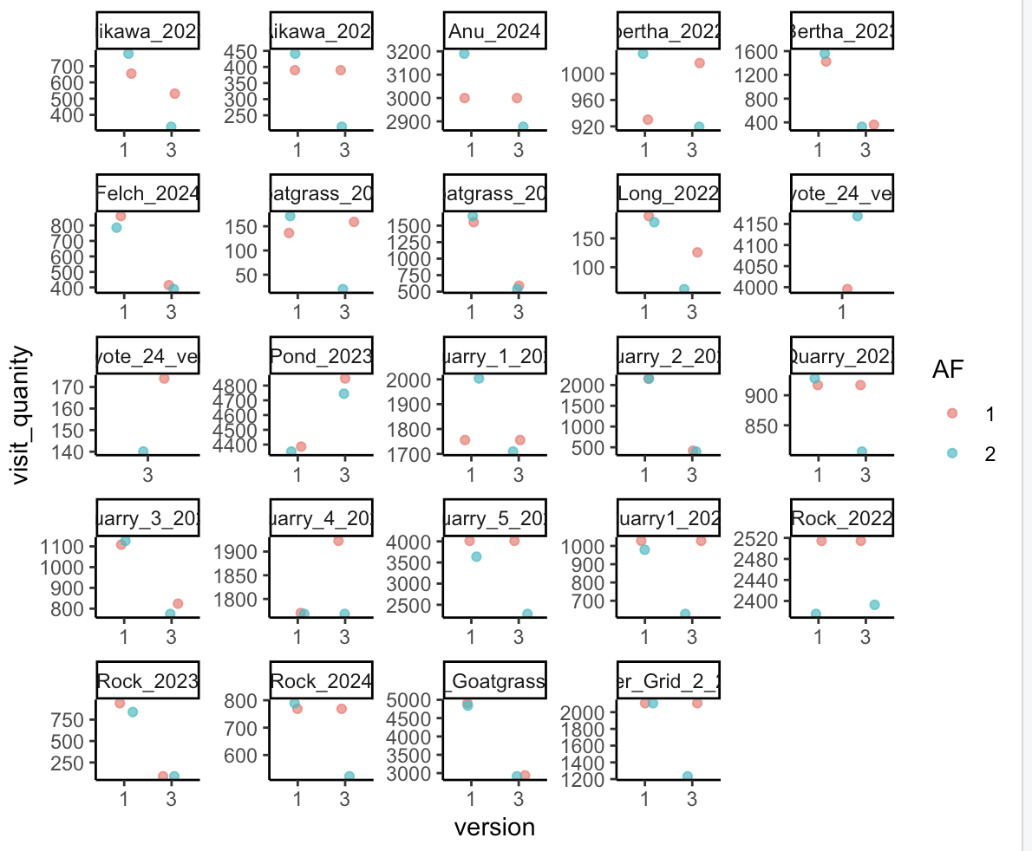

Slide 31
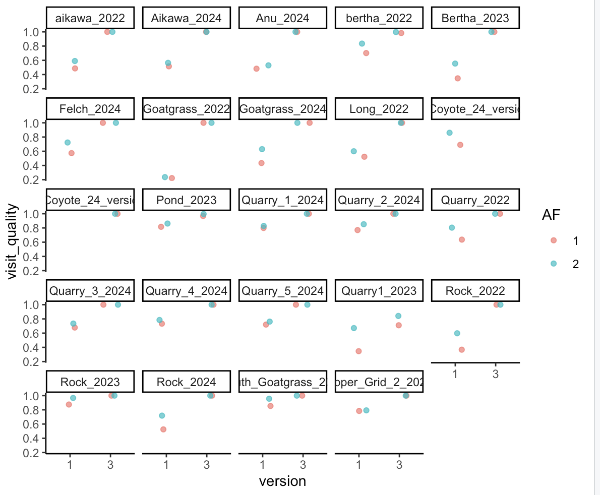

Slide 32
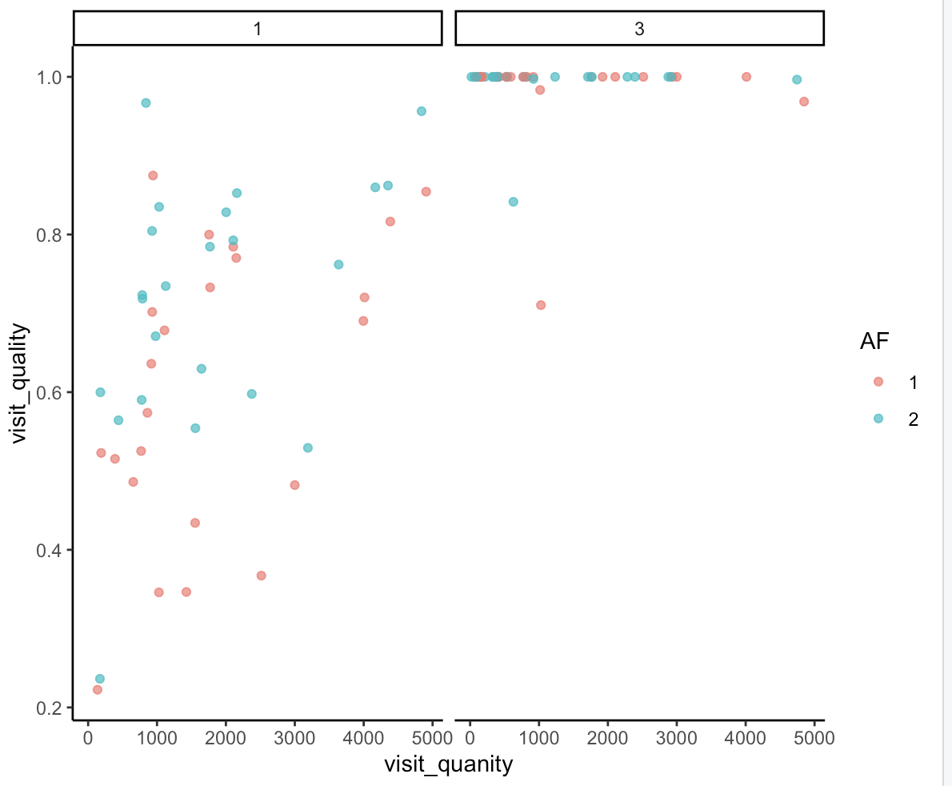

Slide 33
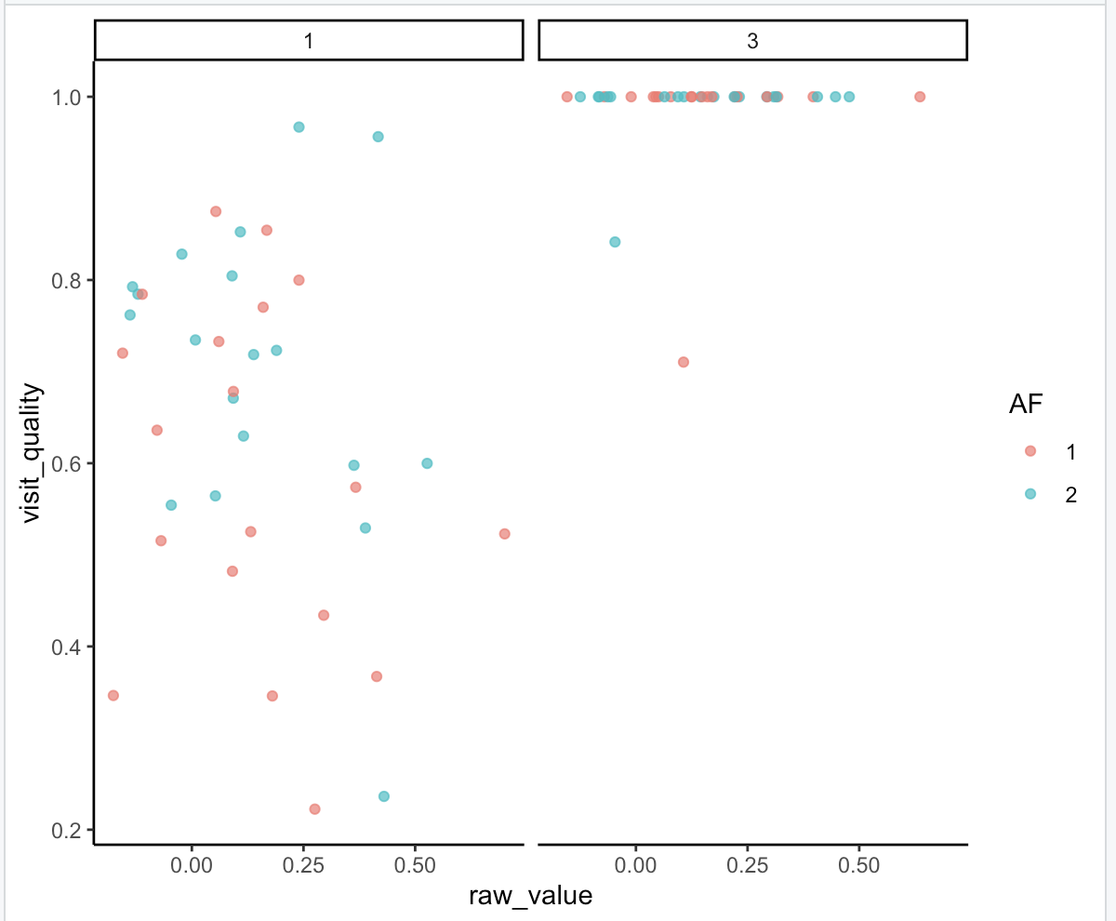
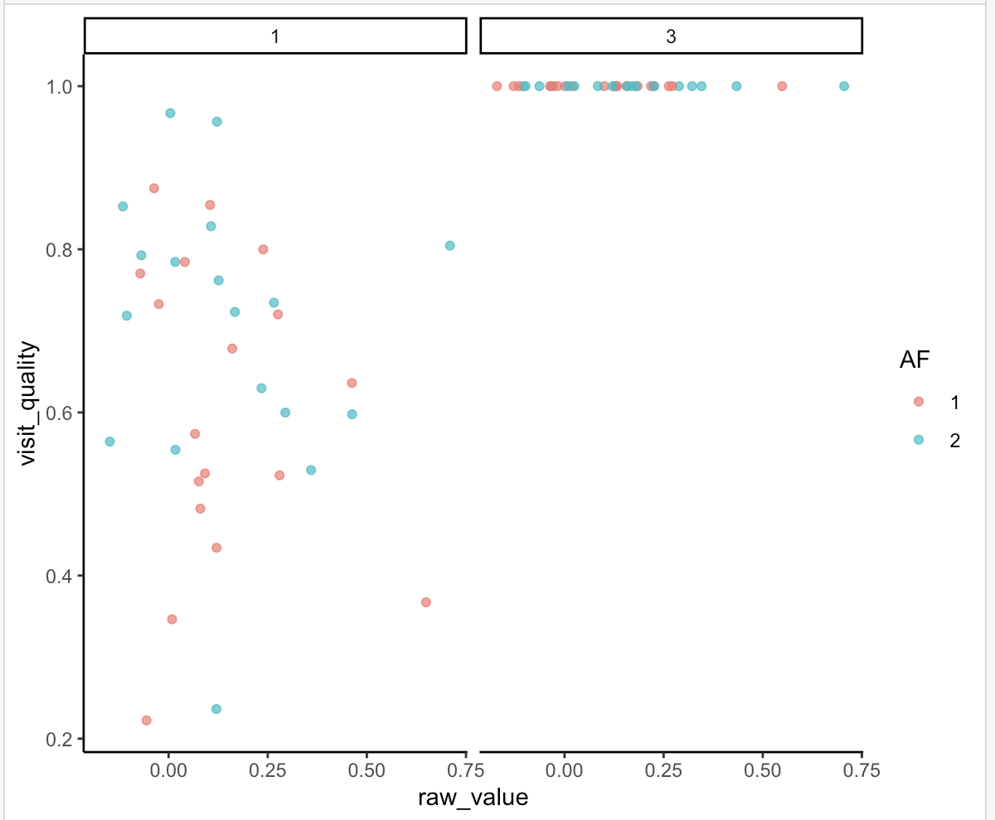
VIVI on TRFU
TRFU on VIVI

Slide 34
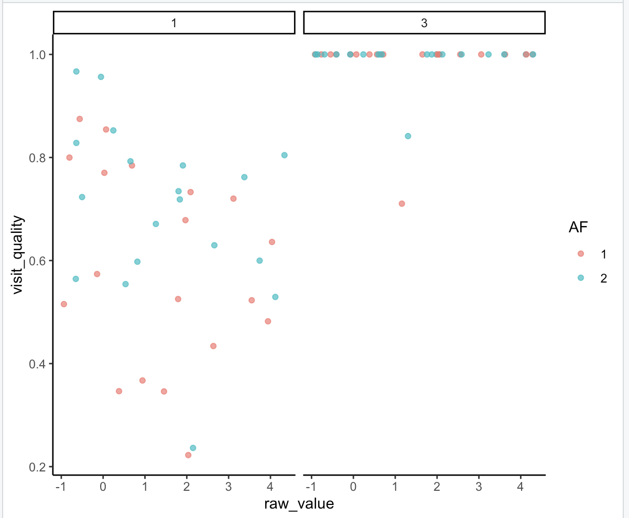
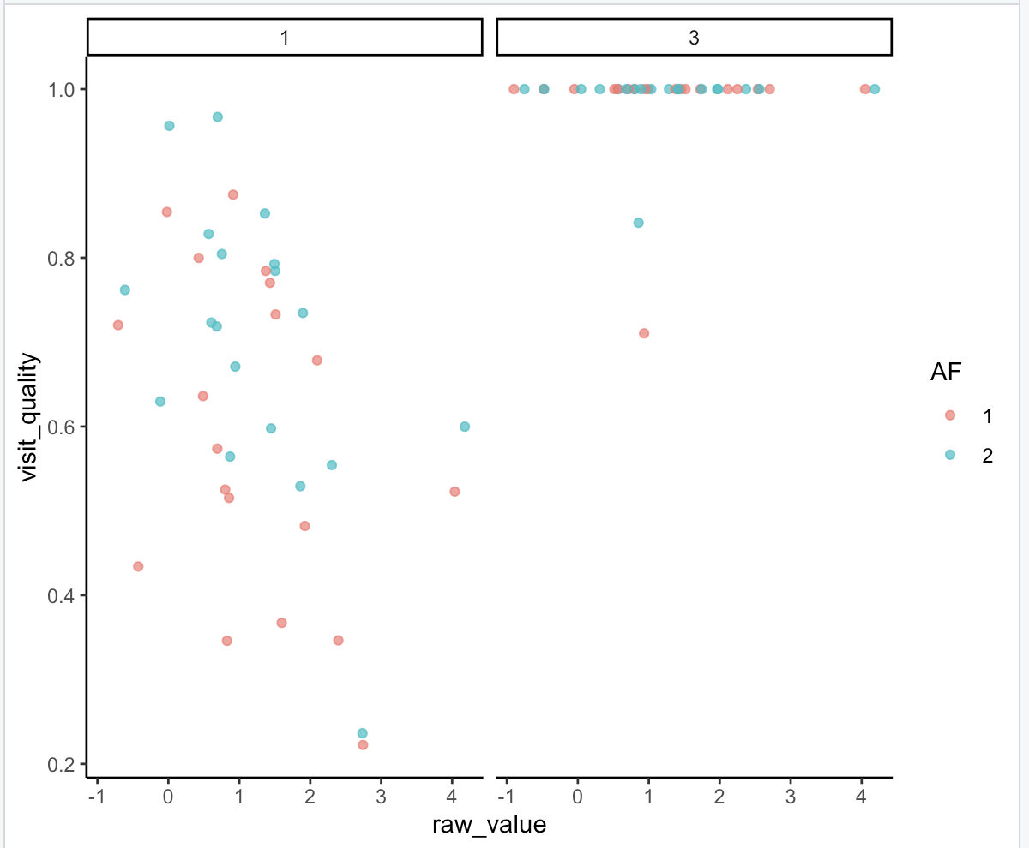
TRFU nested contribution
VIVI nested contribution

Slide 35
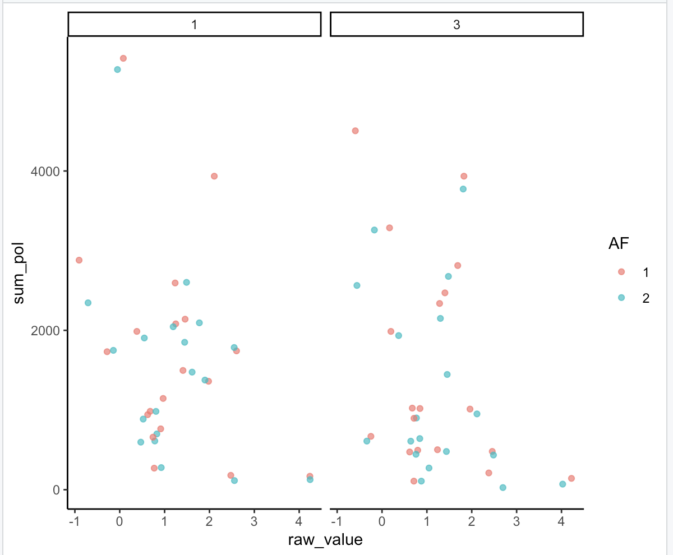

VIVI nested contribution
VIVI nested contribution

Slide 36


Slide 37


Helianthus exilis
Centaurea solstitialis

Slide 38


Slide 39


Slide 40


Slide 41


Slide 42


Slide 43


Slide 44



Ind Contribution CESO

Slide 45


Slide 46


Slide 47


Slide 48


Slide 49


Slide 50


Slide 51



Ind Contribution HEEX
Ind Contribution CESO

Slide 52

Betweenness Centrality

Slide 53


Slide 54


Slide 55

Honeybee Abundance

