Slide 1
Spillover Graphs
Becca and Taran
3-19-25

Slide 2
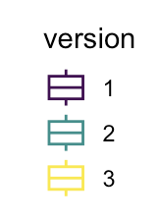
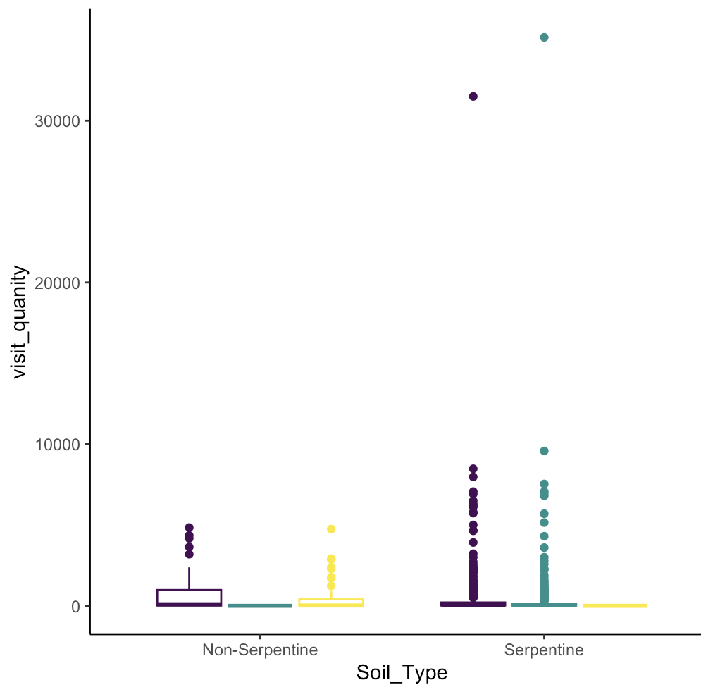
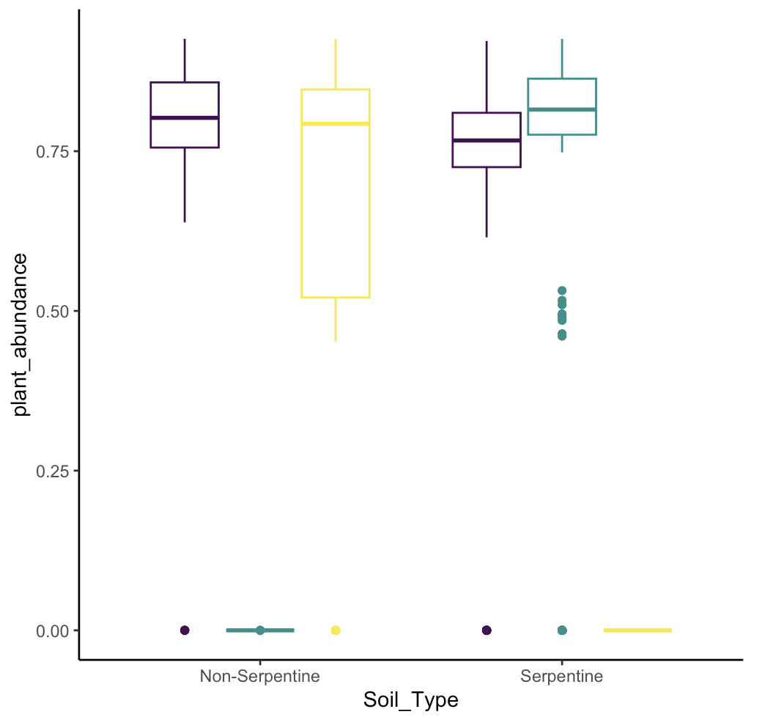
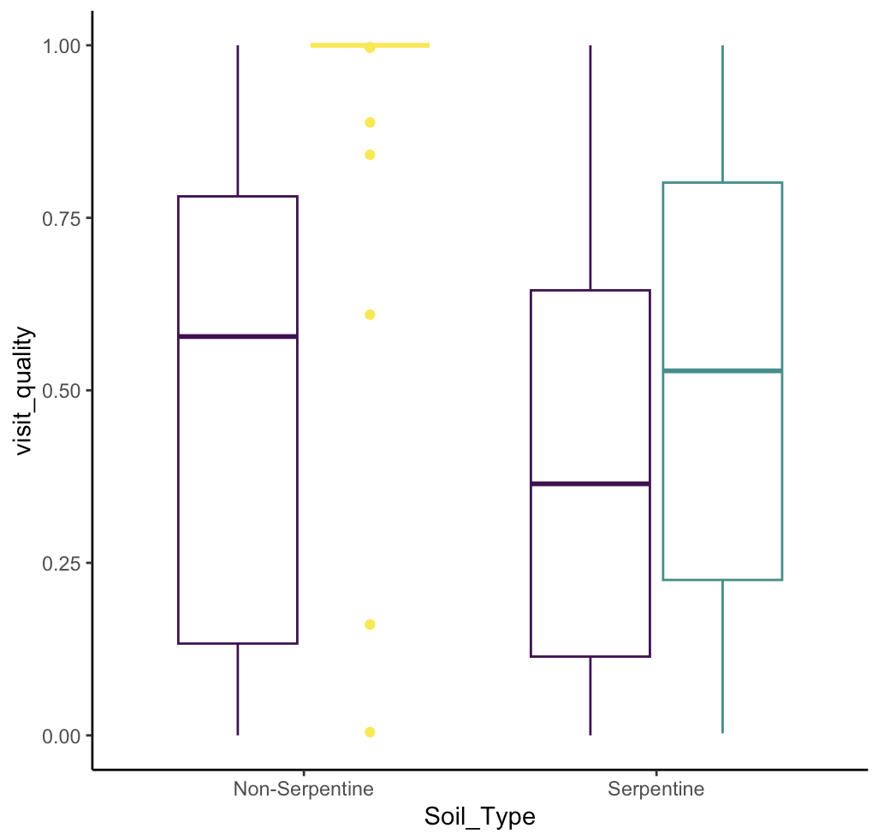
A
B
C
Notes:
Shows only AF = 2

Slide 3
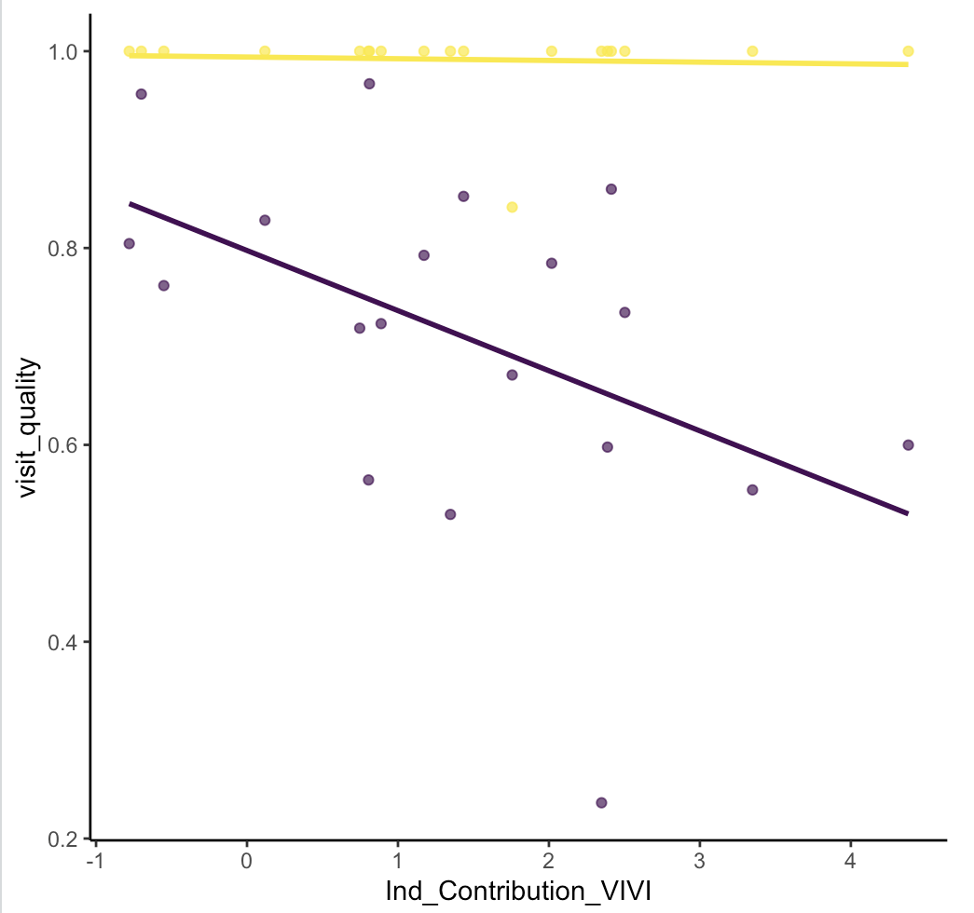
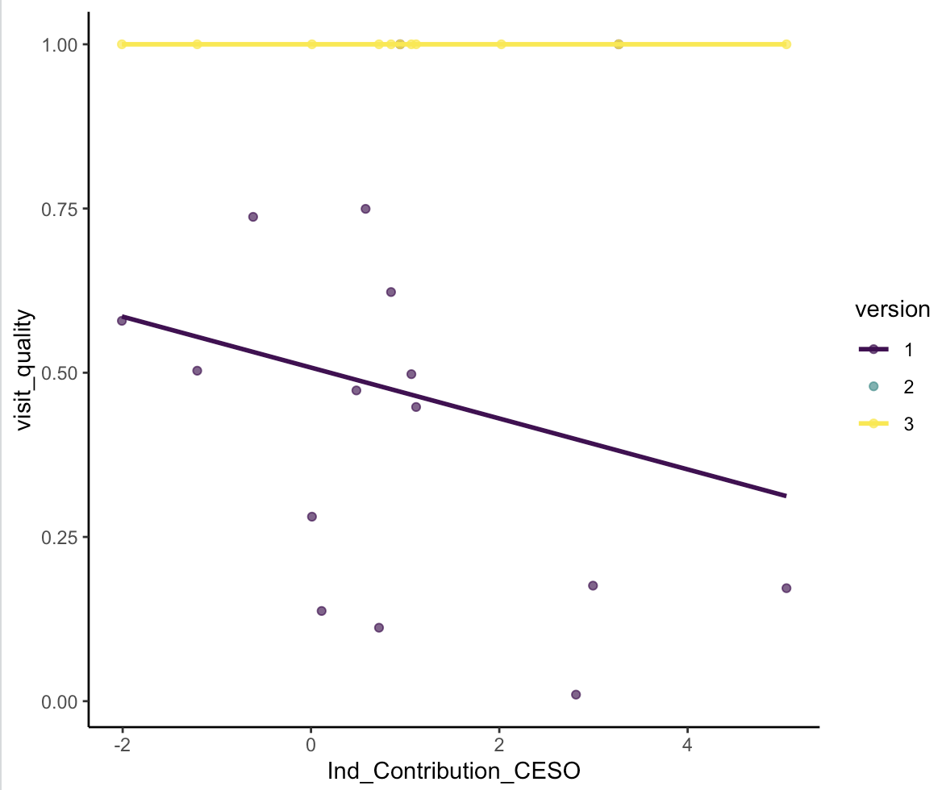
A
B
Notes:
AF = 2

Slide 5
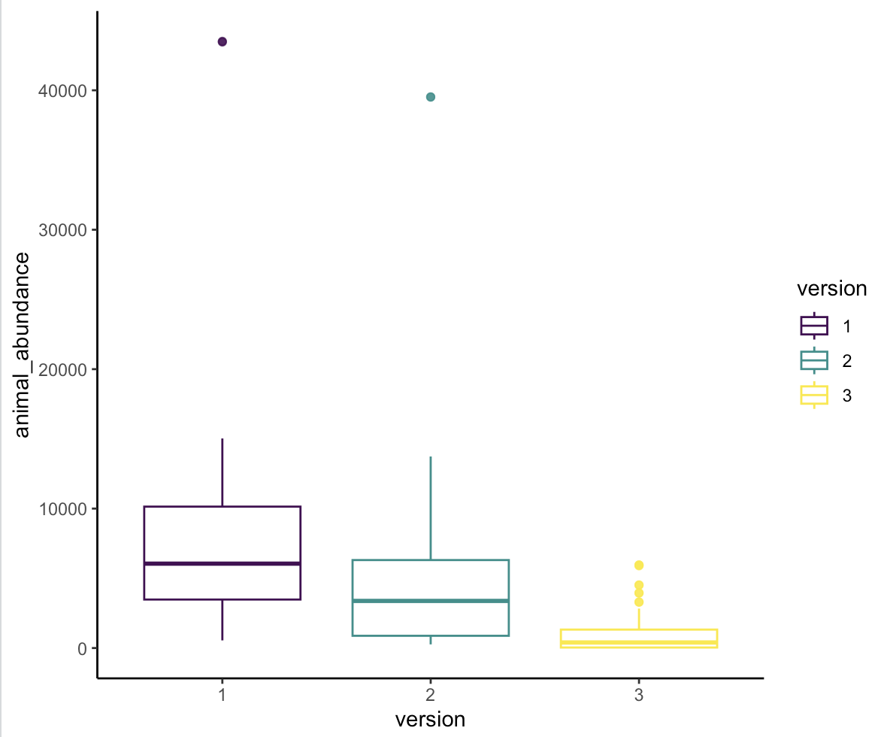
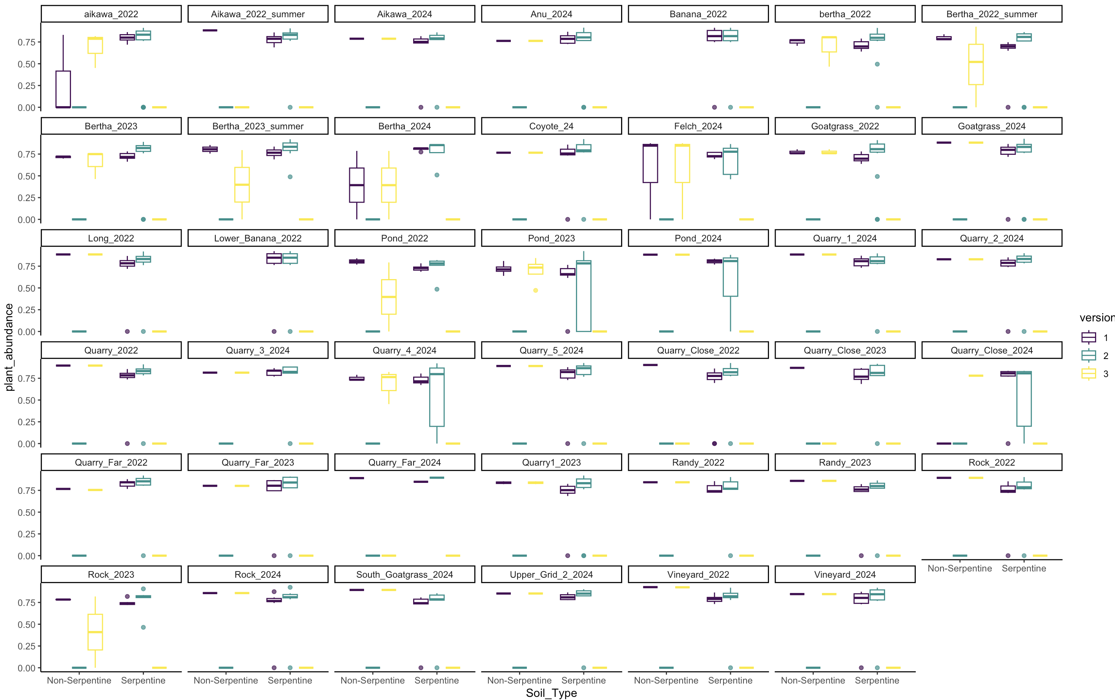
Notes:
For AF types

Slide 6
NS > both for NS plant abundance
Notes:
AF=2, a lot of site variation

Slide 7
NS < both for NS plant abundance
Notes:
AF=2, a lot of site variation

Slide 8
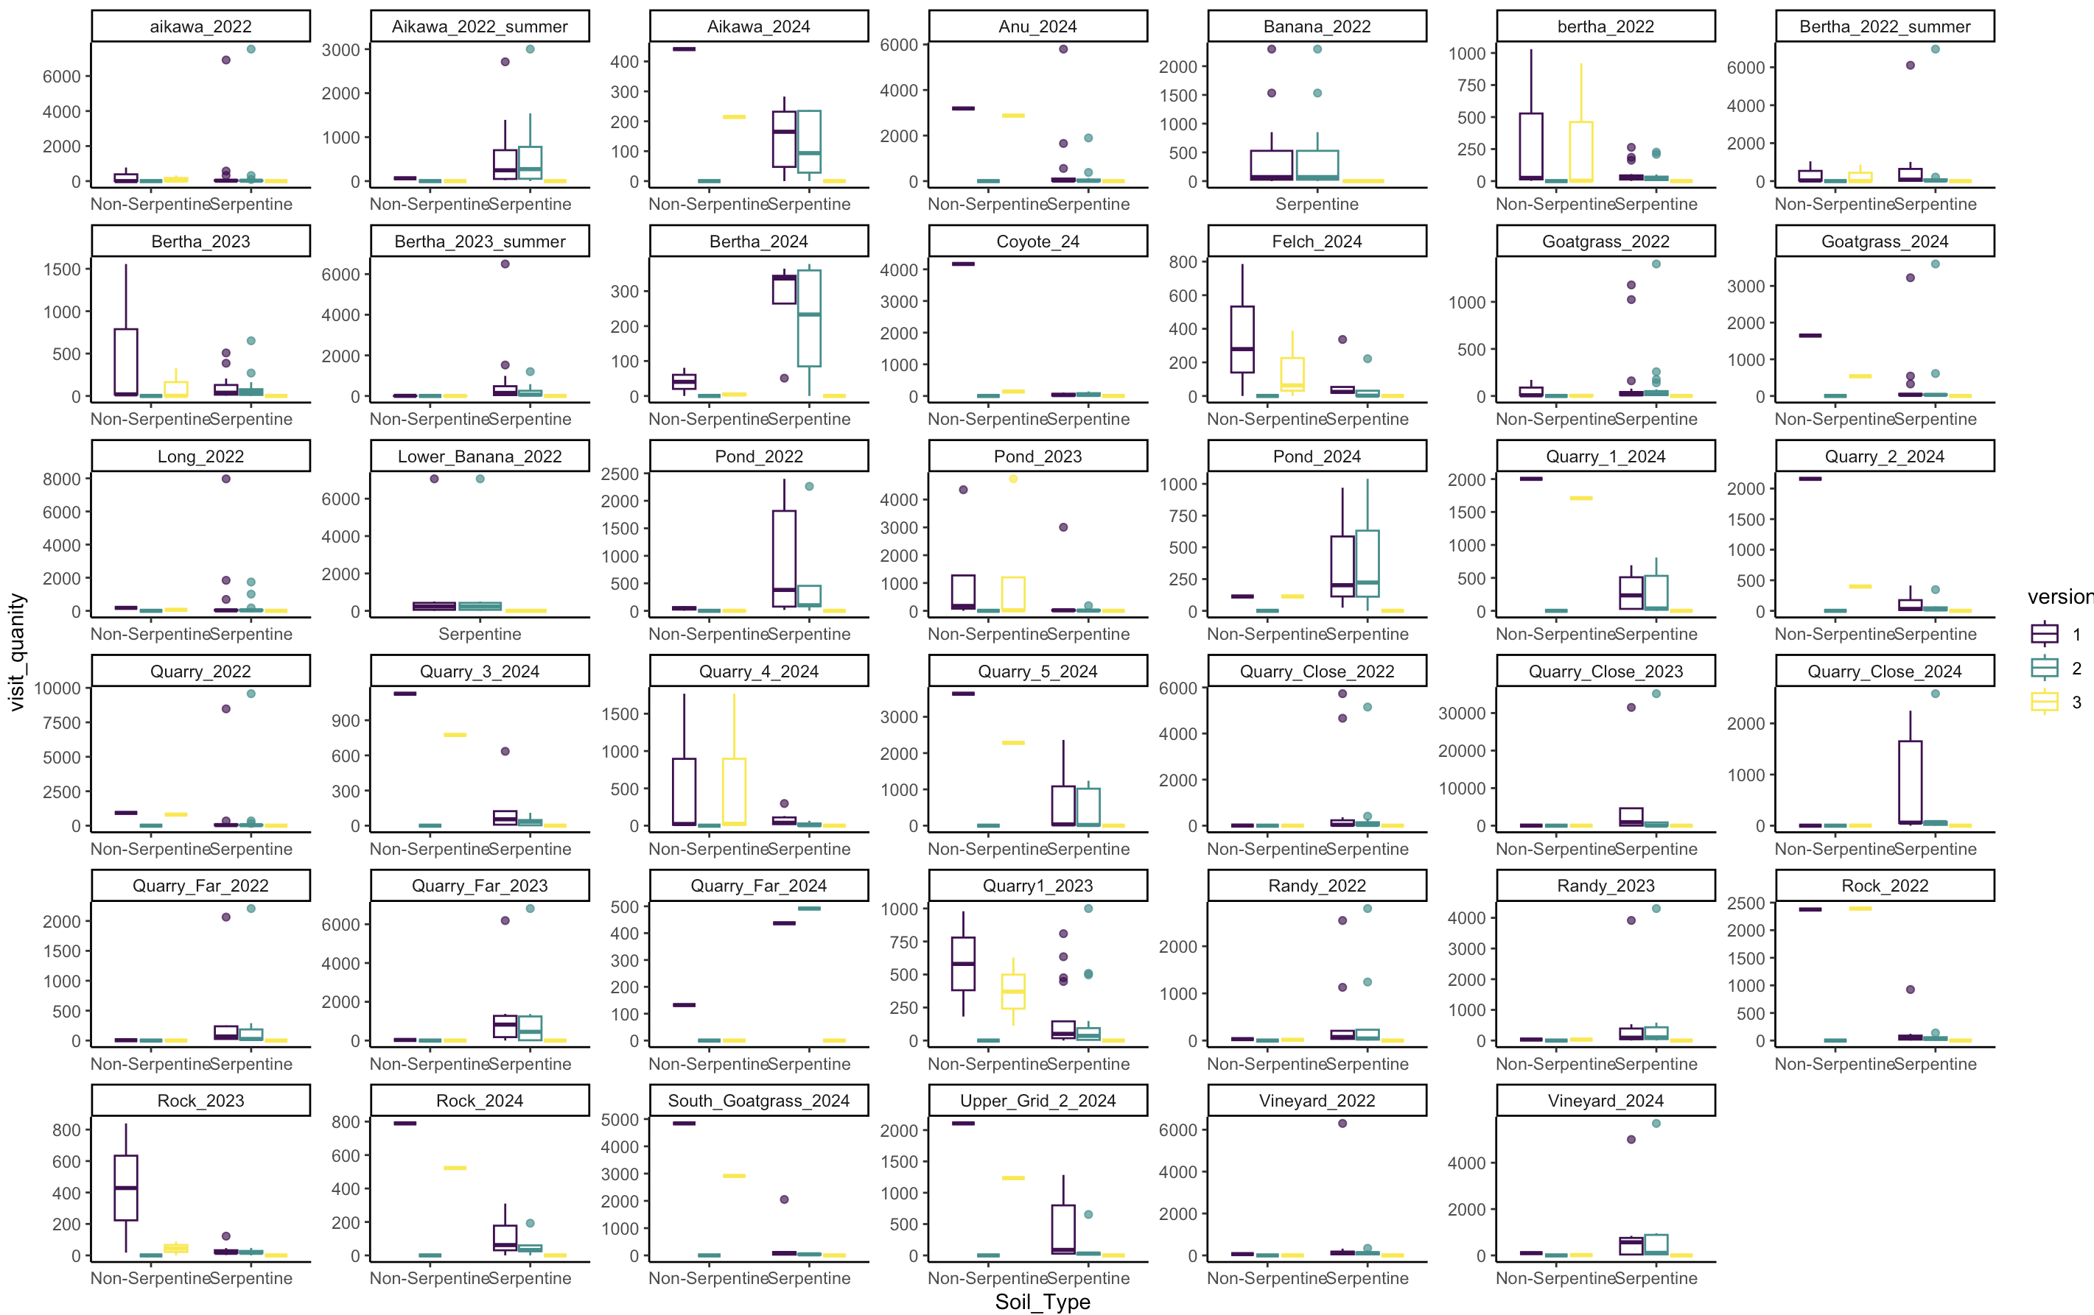
NS < both for NS quality
Notes:
AF=2, a lot of site variation

Slide 9
