Slide 1
Sexism Detection in German Online News Fora
Approach: LLMs (GPT 3.5)

Slide 2
Overview
Detection of sexism/ misogyny in German
Data from comment section of an Austrian online newspaper
Large potion annotated with at least 4 annotators (max 10 Annotators)
Important dates:
Competition Phase: 07.06.2024 - 25.06.2024
Paper Submission: 01.07.2024
Camera ready paper: 20.07.2024
Konvens: 10.09.2024

Slide 3
Open and Closed Track
Closed Track
use only the annotated data provided within this task to develop their model.
no additional labelled data
use of pretrained/ embeddings of labelled sexism data is not allowed
LLMs where trainings data or fine-tuned steps are not public are not allowed
No models which specific information about sexism is not allowed
Bert allowed, but no specific (pre-) trained models on sexism
Only fully open-source solutions accepted in publication
Open Track
If possible: open source and reproducible
Additional data: must be publicly available

Slide 4
Subtask I
the goal is to predict labels for each text in a dataset where the labels are derived from the original labels assigned by several human annotators.
Tasks:
bin_maj: predict 1 if a majority of annotators assigned a label other than 0-Kein, predict 0 if a majority of annotators assigned a label 0-Kein. If there was no majority, then both the label 1 and 0 will count as correct in the evaluation.
bin_one: predict 1 if at least one annotator assigned a label other than 0-Kein, 0 otherwise
bin_all: predict 1 if all annotators assigned labels other than 0-Kein, 0 otherwise
multi_maj: predict the majority label if there is one, if there is no majority label, any of the labels assigned is counted as a correct prediction for evaluation
disagree_bin: predict 1 if there is disagreement between annotators on 0-Kein versus all other labels and 0 otherwise

Slide 5
Subtask II
the binary distribution (‘dist_bin’): two values are predicted, which add up to 1.
dist_bin_0: refers to the portion of annotators labeling the text as ‘not-sexist’ (0-Kein)
dist_bin_1: refers to the portion of annotators labeling the text as ‘sexist’ (1-Gering, 2-Vorhanden, 3-Stark, or 4-Extrem).
the multi score distribution (‘dist_multi’): five values are predicted, which add up to 1.
dist_multi_0: predict the portion of annotators labeling the text as 0-Kein.
dist_multi_1: predict the portion of annotators labeling the text as 1-Gering.
dist_multi_2: predict the portion of annotators labeling the text as 2-Vorhanden.
dist_multi_3: predict the portion of annotators labeling the text as 3-Stark.
dist_multi_4: predict the portion of annotators labeling the text as 4-Extrem.

Slide 6
Metrics and Submission
Submission
.tsv file and compressed as .zip file
Metrics Subtask I
F1 macro score
Final score: unweighted average over all 5 scores
Metrics Subtask II
Jensen-Shannon distance
unweighted average of the two JS-distances

Slide 7
Dataset
Name | Entries
Test Trial | 500
Train Trial | 1000
Test Dev | 1512
Train Dev | 4486
Train Split Dev | 450
Test Comp | 1986
Train Comp | 5998

Slide 8
Dataset Structure
{"id": "4689b9ccb5d79f222ba110f389cf1fb6",
"text": "Trump hat 2 Dinge \u00fcbersehen:\nevery vote counts\n\nund\n\nevery cunt votes\n\n\n... selbst schuld, Donald!",
"annotations": [
{"user": "A001", "label": "0-Kein"},
{"user": "A002", "label": "3-Stark"},
{"user": "A005", "label": "3-Stark"},
{"user": "A008", "label": "1-Gering"},
{"user": "A007", "label": "3-Stark"},
{"user": "A004", "label": "3-Stark"},
{"user": "A009", "label": "2-Vorhanden"},
{"user": "A003", "label": "3-Stark"},
{"user": "A010", "label": "0-Kein"},
{"user": "A012", "label": "3-Stark"}]}
Notes:
Format jsonl
Test files, with annotator names but without label

Slide 9
Data analysis
Annotator | Min. Score | Max. Score | Average Score | Total
A001 | 0 | 4 | 0.88 | 970
A002 | 0 | 4 | 0.515 | 5998
A003 | 0 | 4 | 1.11 | 1242
A004 | 0 | 4 | 0.91 | 1394
A005 | 0 | 4 | 0.82 | 1552
A007 | 0 | 4 | 0.88 | 1246
A008 | 0 | 4 | 0.64 | 1849
A009 | 0 | 4 | 0.59 | 2923
A010 | 0 | 4 | 0.88 | 678
Com Trainset
Text:
Max. length: 999 chars
Min. length: 3 chars
Average: 217 chars
Median: 147 chars
Annotators:
Max. annotators: 8
Min. annotators: 2
Average: 2.98

Slide 10
Data analysis
Annotator | 0-Kein | 1-Gering | 2-Vorhanden | 3-Stark | 4-Extrem
A001 | 609 | 49 | 159 | 130 | 23
A002 | 4366 | 513 | 816 | 268 | 35
A003 | 662 | 123 | 160 | 248 | 49
A004 | 923 | 58 | 138 | 172 | 103
A005 | 958 | 94 | 331 | 152 | 17
A007 | 781 | 60 | 212 | 157 | 36
A008 | 1379 | 51 | 194 | 156 | 69
A009 | 1989 | 421 | 299 | 152 | 62
A010 | 382 | 66 | 161 | 63 | 6

Slide 11
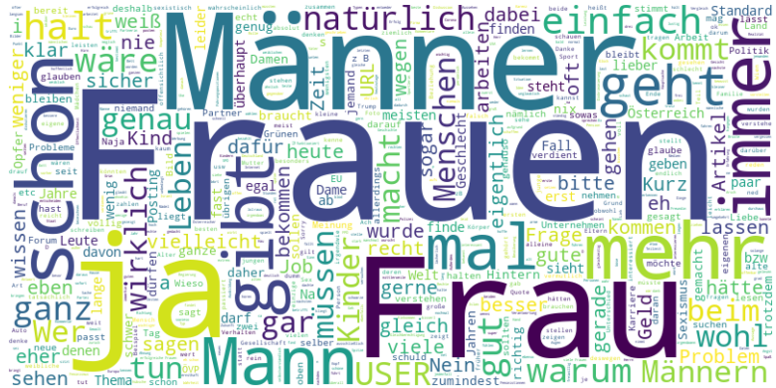
Wordcloud

Slide 12
Baseline Subtask I
Request with GPT 3.5
Prompt + amount and name of annotators
Only a subset with 450 entries
Score:
F1 bin_maj: 0.4715
F1 bin_one: 0.5711
F1 bin_all: 0.4378
F1 multi_maj: 0.2331
F1 disagree_bin: 0.4406
Final score: 0.4308

Slide 13
Source
https://ofai.github.io/GermEval2024-GerMS/
https://platform.openai.com/docs/models/gpt-3-5-turbo
https://www.codabench.org/competitions/2745/#/results-tab

