Slide 1



Value Investing Calculator
cardano developer class final project

Slide 2
“The price of a stock does not always reflect its value”
- PRICE VS VALUE

Slide 3
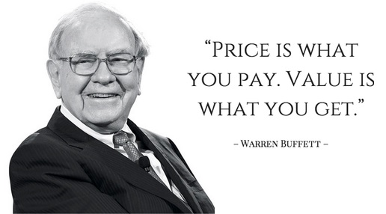

Slide 4
“How to know ‘Intrinsic Value’ of stock is cheap or expensive ? Is it worth it for longterm investment ?”
- The reason that I made value investing calculator

Slide 5
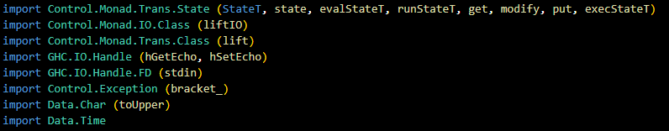
LIBRARY

Slide 6
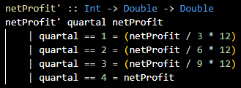
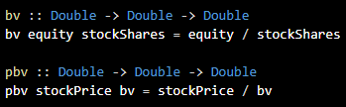

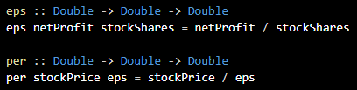

FORMULA
Annualized Net Profit
Book Value & Price Book Value
Return of Equity
Earning Per Share & Price Earning Ratio
Debt of Equity

Slide 7
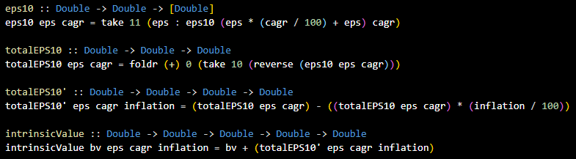

FORMULA
Intrinsic Value
Margin of Safety
1 Digit Rounding After Comma

Slide 8

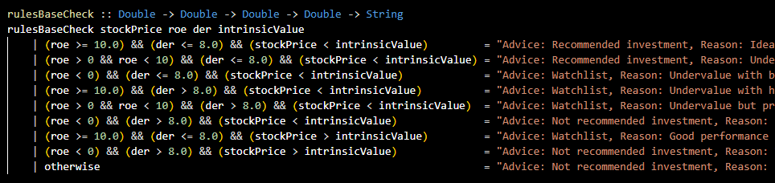
RULEBASE
RuleBase Decision
RuleBase Check For Finance Sektor

Slide 9
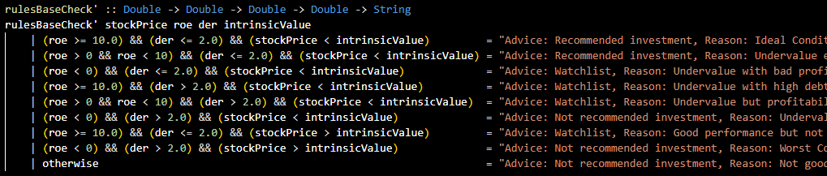
RULEBASE
RuleBase Check For Non - Finance Sektor

Slide 10
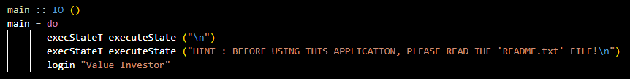

MAIN FUNCTION
main function
Monad StateT

Slide 11
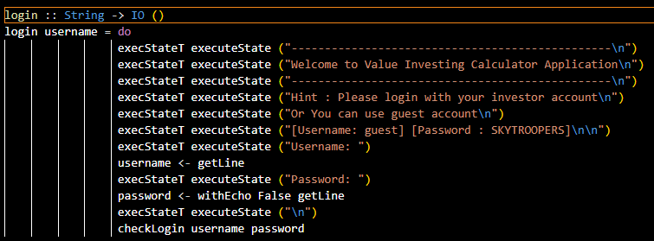

LOGIN FUNCTION
Login
Invicible Password Ala Linux

Slide 12
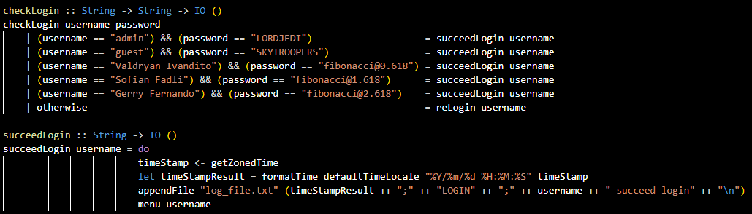
LOGIN FUNCTION

Slide 13
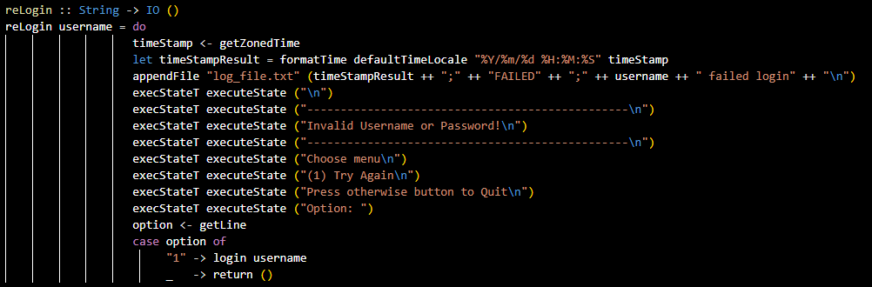
LOGIN FUNCTION

Slide 14
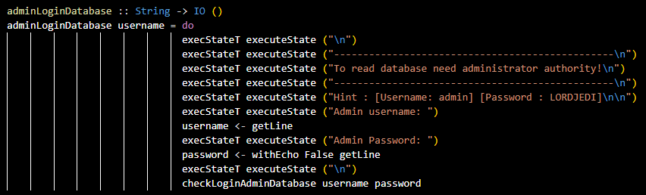
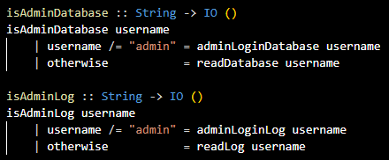
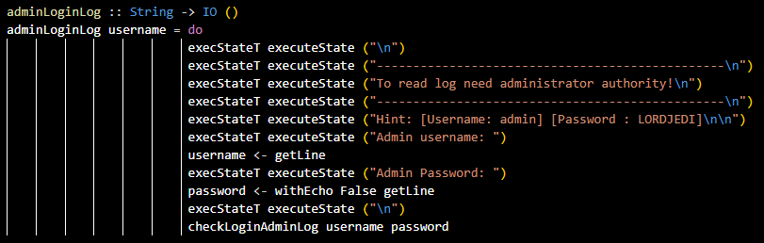
LOGIN FUNCTION

Slide 15
LOGIN FUNCTION

Slide 16
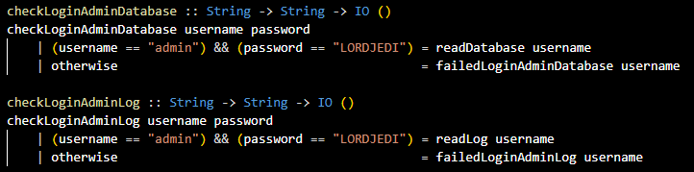
LOGIN FUNCTION

Slide 17
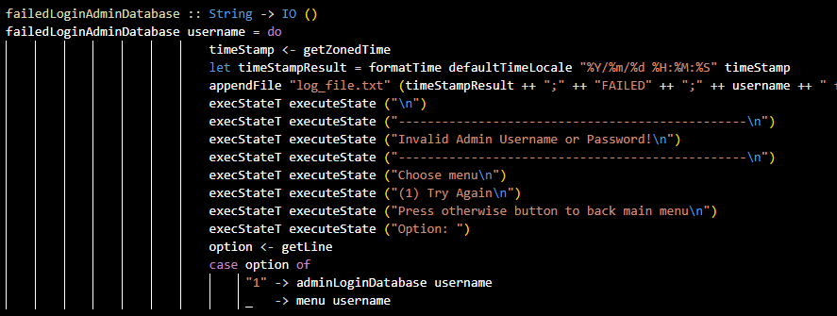
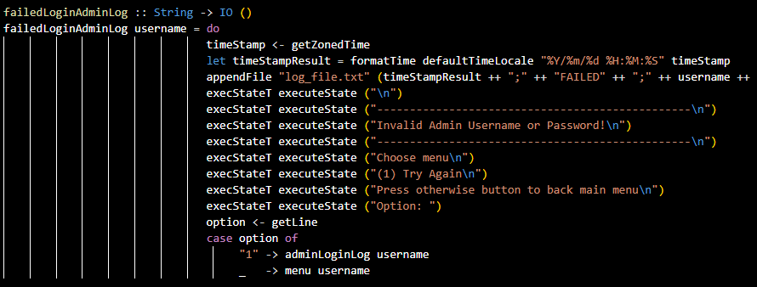
LOGIN FUNCTION

Slide 18

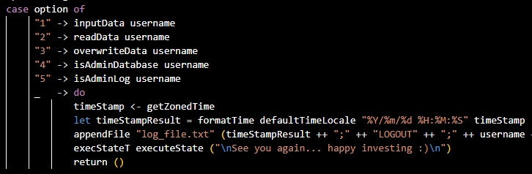
MENU FUNCTION

Slide 19





MENU FUNCTION

Slide 20
MENU FUNCTION
Input Data -> To input data about stocks to be analyzed and then it will generate data in the form of financial ratio parameters with recommendation and reason that will be used by investors.
Read Data -> To load the data from the stock analysis data input that the previous user created.
Overwrite Data -> To overwrite the data that the previous user created and then user can create new data from beginning.
Read Database -> To read database_file.txt that contains all the data inputted by each user.
Read Log -> To read all activities in the application

Slide 21

DEMO

Slide 22

ESPECIALY TO
EMURGO Academy
Mr. Arie (Trainer)

