Slide 1


45 TGV

Slide 2
France’s Tren à Grande Vitesse
This Train was the one that rallied most of Europe around a rail system that was faster, more affordable and more energy-efficient than any other type of travel.
Also, it was safe, too: Since TGV’s debut in 1981, there’s only been one fatal accident, during a test run.

Slide 3
A Steep Climb
France’s national rail company, which was inspired by the ability of roller coasters to reach high speeds, began looking for ways to speed up trains.

Slide 4
The Process
The SNCF (acronym) touted the possibility of designing a faster train compatible with existing tracks, but the French government scoffed the project. SNCF proceeded with the project anyway.
They added
Gas turbines Redesigned Railcar
To pump up the propulsion power More aerodynamic silhouette
The silhouette became bullet-shaped

Slide 5
The First Prototype
The early project became immediately obsolete, before it could be reality: The gas turbine engine was hurled during the global oil crisis of the 1970s in favor of a fully electric model powered by overhead lines
A final production model arrived in April 1980, and TGV service was rolled out the following year.

Slide 6

Percentages

Slide 7
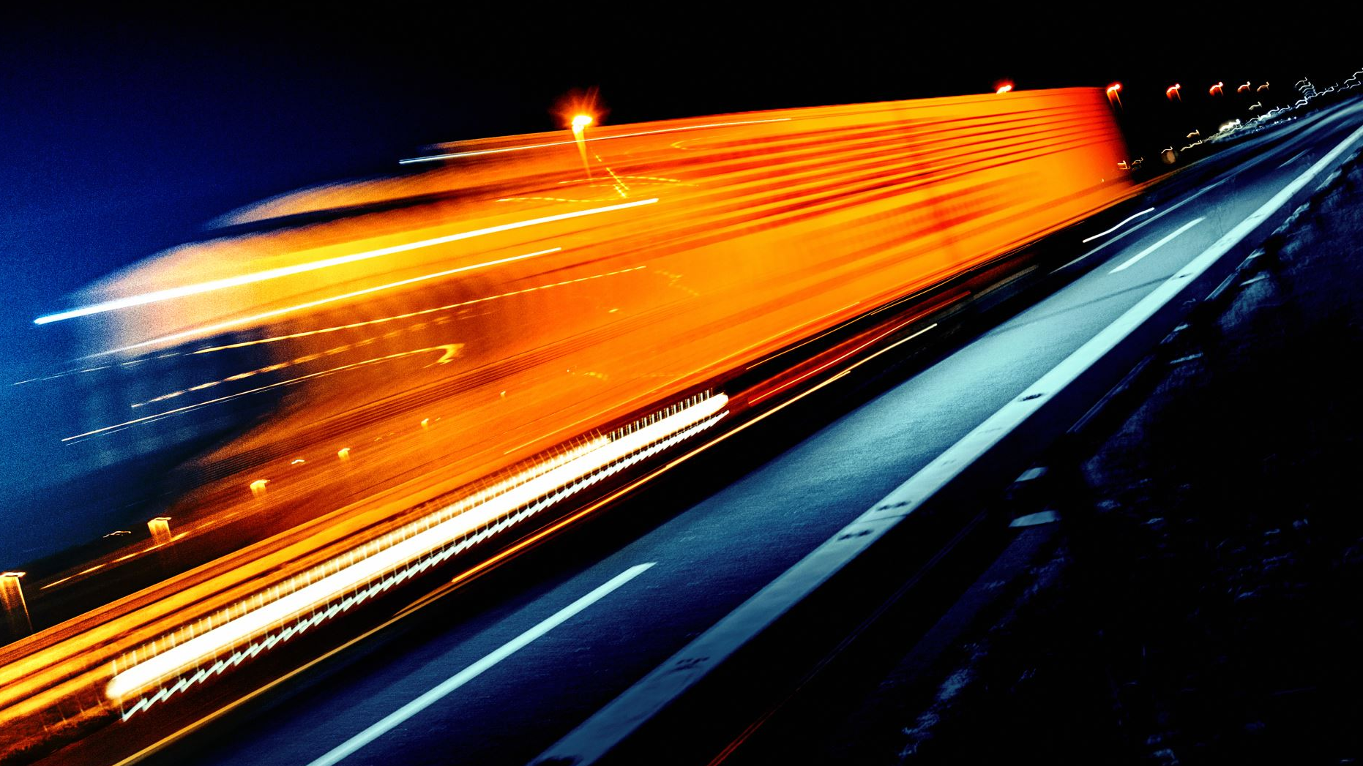
Within one year of its debut, TGV trains running the Paris-to-Lyon route had whisked 14 million passengers. Within three years, the share of air traffic along the route dropped from 31 percent to 7 percent, while the share of high-speed rail traffic surged from 40 percent to 72 percent.

Slide 8

Today, TGV has reached 100 million riders annually, running across France and into multiple countries. Extensive redesigns in the past several years have increased passenger space, reduced the trains’ carbon footprint and energy use, simplified maintenance and cut production costs-all part of SNCF’s plan to attract 15 million new high-speed train passengers by 2020.

Slide 9
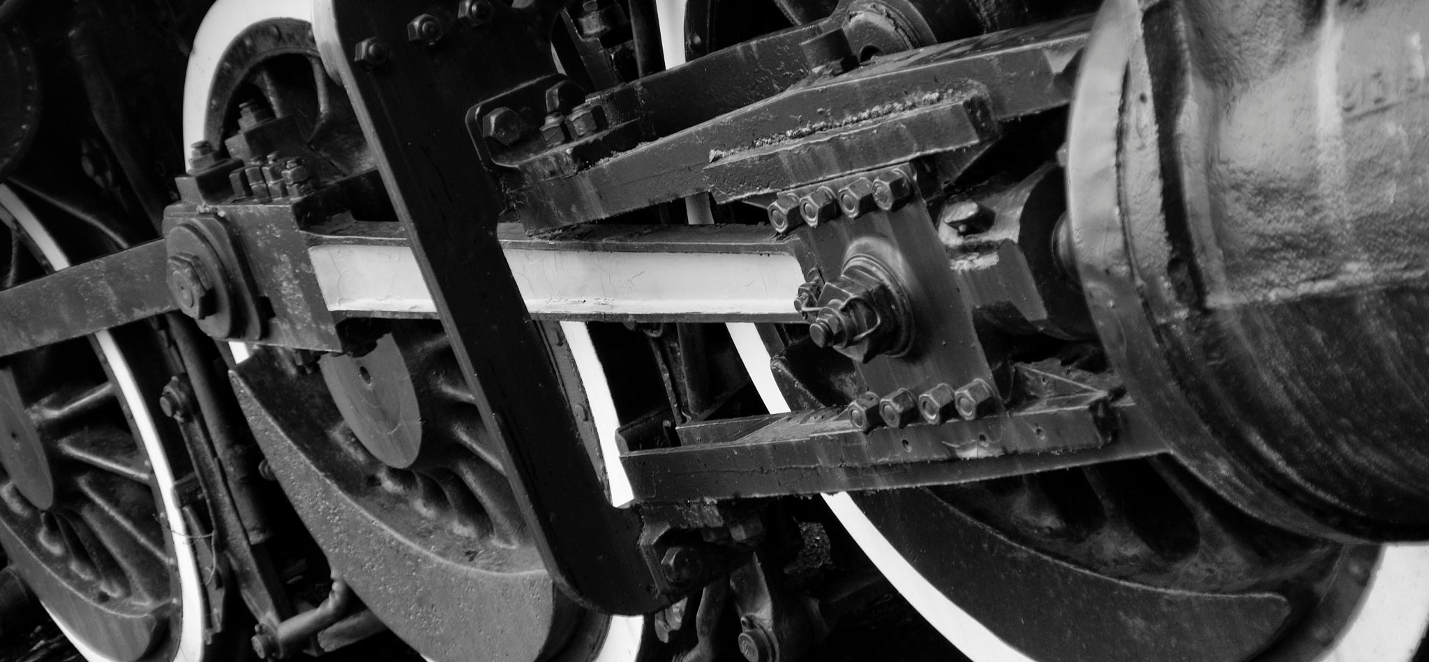
TGV
By Valentin Ichim

