Slide 1
How does sport affect art sentiment?
Yuval Saadaty
Valerie Melul

Slide 2
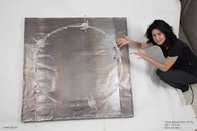

Slide 3
Data set
We want to answer through internet data
From Reddit
Subreddits in English
Although not natural, it is not under our control but the selection is done by the users themselves without our intervention

Slide 4
Art
Sport

Slide 5
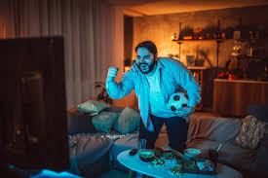
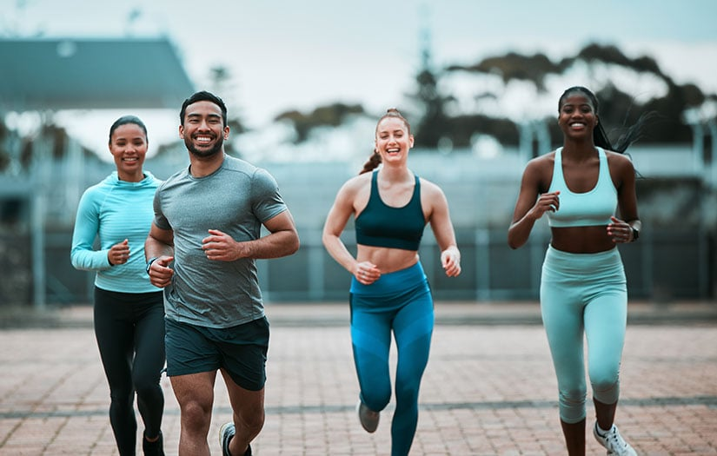
Issues
Find interesting natural experiment
Stuck at registration stage
Translate our interest into concrete subreddits and parsing texts
vs
https://www.istockphoto.com/photo/overweight-man-watching-a-soccer-match-gm1084453658-290977139
https://blog.nasm.org/fitness-trends

