Slide 1
Image Processing with Jetson Nano

Slide 2
Overview
Image Processing
VPI
GPUs with Torch
Cameras

Slide 3
Image Processing

Slide 4
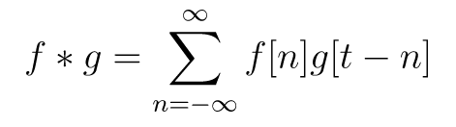
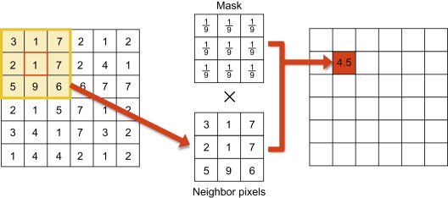
Convolution
Mathematically, dragging one time-reversed function across another
  How correlated is f to a time-reversed g?
More practically, apply a certain effect on an image
  Blurring
  Sharpening
  Finding edges

Slide 5
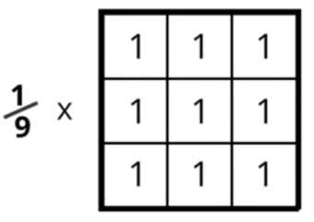
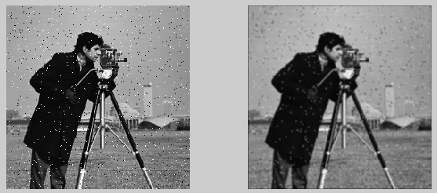
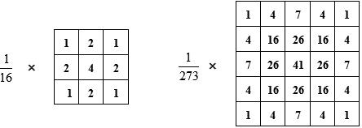
LP and Gaussian Filters
Low Pass and Gaussian filters are used to blur photos
LP Box filters are essentially averaging neighboring pixels
Box filters do not completely attenuate high frequencies; Gaussian fixes this

Slide 6
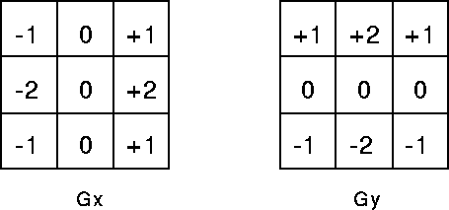
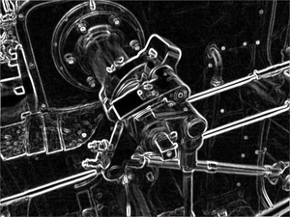
Edge Detection
Edges are just fast changes in intensity/color between pixels
  Can measure this change with derivatives/gradients
Use Sobel operator to find gradients
For an easy alternative, subtract a blurred image from the original
  This leaves only high frequencies

Slide 7
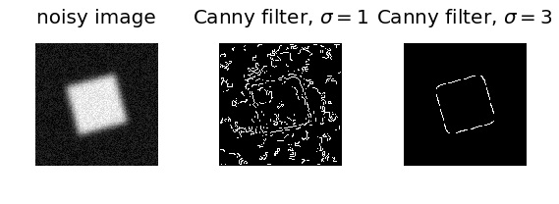
Canny Edge Detector
Algorithm for better edge detection
Steps in Edge Detector
  Smoothing – run a LP filter over image
  Gradient Calculation – use sobel operator kernels to find gradient intensities at each pixel
  Non-Maximal Suppression – suppress lower intensity pixels
  Double Threshold – mark extremely intense pixels as strong pixels and less intense as weak pixels
  Hysteresis – for each weak pixel, only keep it as an edge if it is next to a strong pixel

Slide 8
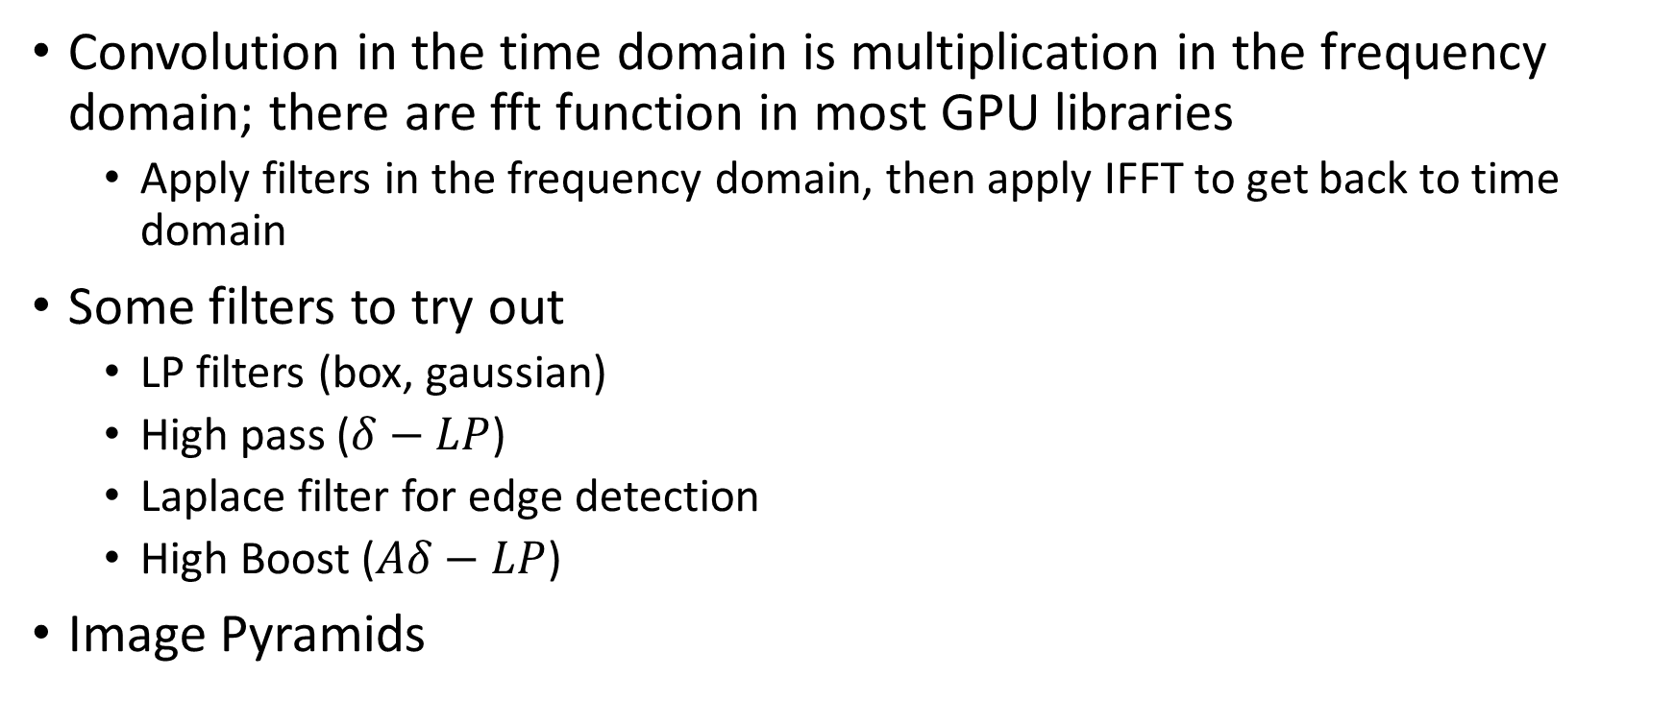
Further Work/Ideas
Convolution in the time domain is multiplication in the frequency domain; there are fft function in most GPU libraries
  Apply filters in the frequency domain, then apply IFFT to get back to time domain
Some filters to try out
  LP filters (box, gaussian)
  High pass ($δ−LP$)
  Laplace filter for edge detection
  High Boost ($Aδ−LP$)
Image Pyramids

Slide 9
Jetson Nano and VPI

Slide 10
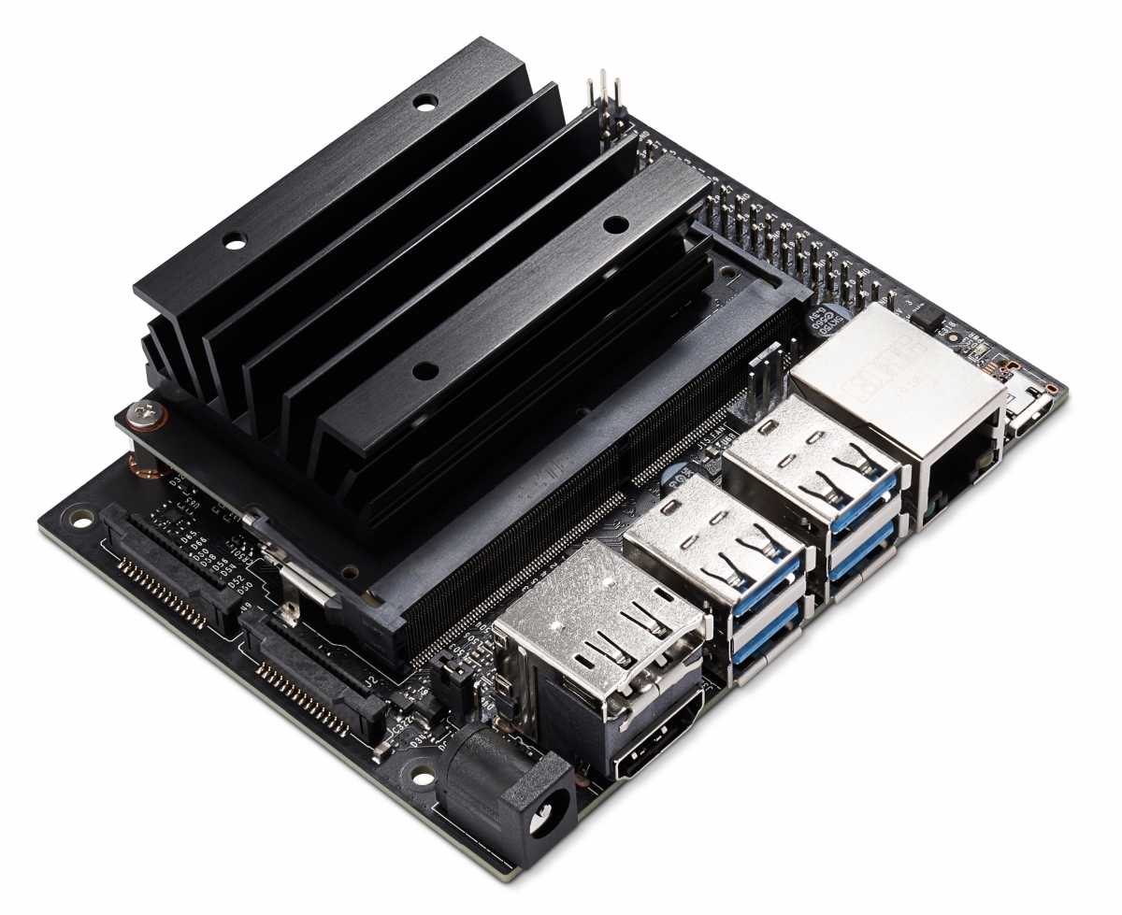
Jetson Nano
Quad core ARM A57 CPU
128 core Nvidia Maxwell GPU
1x MIPI CSI Camera lane

Slide 11
VPI
Vision Processing Interface is a computer vision library provided by Nvidia
Easy to use, easy interface to various hardware accelerators
Has several useful CV algorithms

Slide 12
VPI Backends
Backends are accelerators VPI can work with, which include
  CPU – your CPU. Boring, dependable, but slow
  CUDA – your CUDA-enabled GPU. Good for computationally heavy, parallel work
  PVA – Programmable Vision Accelerator. Don’t have one of these ☹
  VIC – Video Image Compositor. Accelerator for certain small image functions
Can use a combination of backends to get work done in parallel

Slide 13
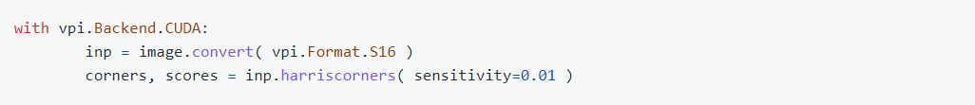
VPI Backends

Slide 14
Functions from VPI
Harris Corners
KLT Bounding Box Tracker
Background Subtractor
Convolution
FFT/IFFT

Slide 15
Torch & CUDA & GPUs

Slide 16
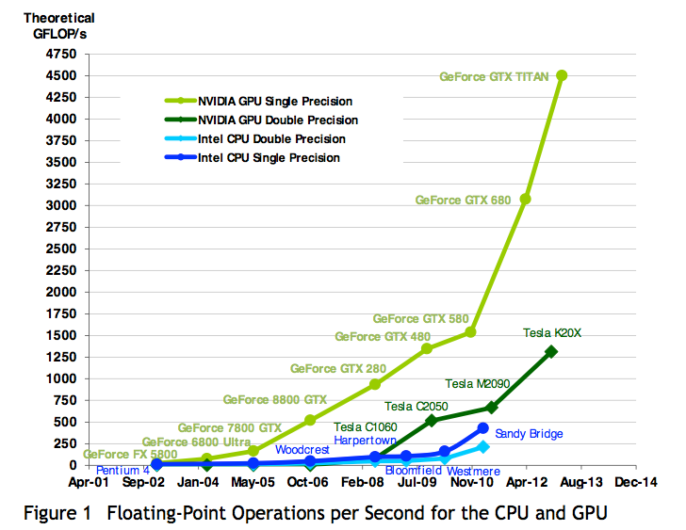
Working with GPUs
Writing in CUDA is hard and sucks
VPI only has a limited set of algorithms
But GPUs are fast and video lag is bad…

Slide 17
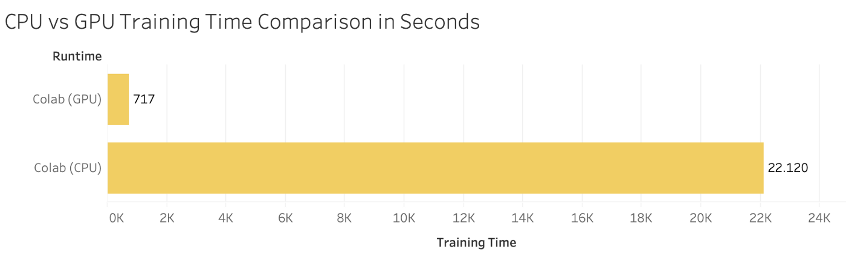
PyTorch
Neural Networks and machine learning have recently made a big push to run on GPUs
PyTorch (and Tensorflow) offer CUDA support
Write on Python, torch will emit CUDA instructions for the GPU for you
  Easy interface + GPU speedup = ☺

Slide 18
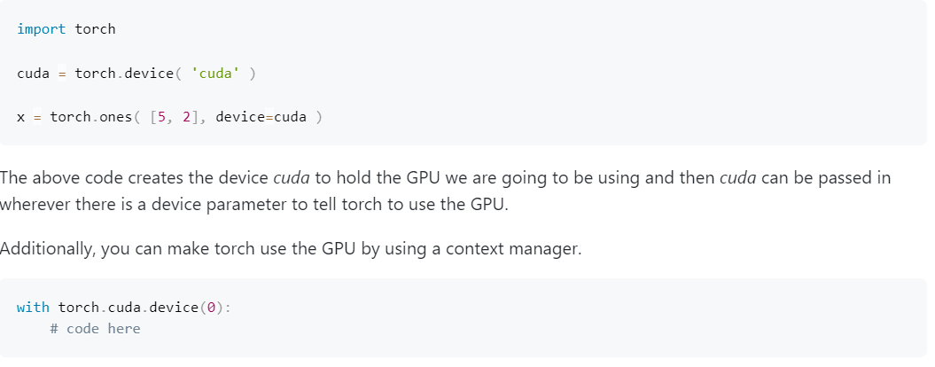
The Code
Create a torch device to hold GPU, pass into all tensors, layers, models, etc.
Alternatively, context manager

Slide 19
Some Coding Considerations
Moving from the CPU to the GPU or the VIC means copying memory
  Copying is very expensive time-wise, space-wise
You can do convolution in either torch or VPI, but it is easier to stay in one library
OpenCV is downloaded on the Jetson without GPU support
  For more complicated functions check those out
All the models in the Jetson Hello AI tutorials are also downloaded
You can pip install anything else you need

Slide 20
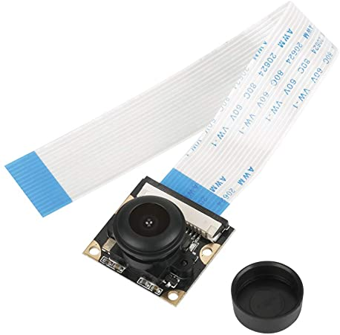
Cameras

Slide 21
Taking Pictures
Run command ‘nvgstcapture-1.0’ to capture individual pictures
  Press j-ENTER to capture a picture
  Press q-ENTER to exit
Image will be saved in current directory

Slide 22
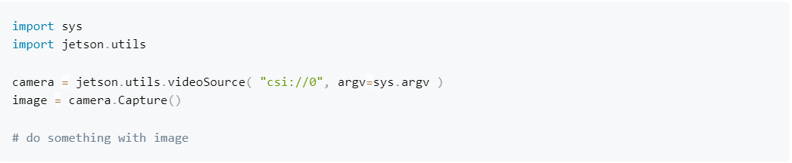
MIPI CSI Camera

Slide 23

Flask
Flask is a python framework for web apps
For this workshop we’ll be using to stream video from the cameras

Slide 24
Flask
Create an app
  app = Flask( __name__ )
Define a function to run when at root of website
  Use decorator @app.route(“/”)
Function should return a Response wrapped around a generator that returns frames of video
  Use ‘yield’ instead of ‘return’

Slide 25
Flask Website
Jetson
Your laptop
Camera

Slide 26
Resources
https://github.com/dusty-nv/jetson-inference
https://towardsdatascience.com/how-to-display-video-streaming-from-a-webcam-using-flask-7a15e26fbab8
https://www.dspguide.com/ch6.htm
https://docs.nvidia.com/vpi/tutorial.html
https://en.wikipedia.org/wiki/Canny_edge_detector

