Slide 1
Linux Command Line Workshop
10/12/2021

Slide 2
Overview + Repository
Repo: https://github.com/ValenYamamoto/IEEE_Linux_Workshop
git clone https://github.com/ValenYamamoto/IEEE_Linux_Workshop
Find linux command line to follow along
ICS servers – uci_net_id@openlab.ics.uci.edu
Sign in with ICS username/password
EECS servers uci_net_net_id@[bondi,crystalcove,laguna,zuma].eecs.uci.edu
Sign in UCI Net username/password (what gets you into Canvas)
Windows – download WSL/Ubuntu Shell
https://docs.microsoft.com/en-us/windows/wsl/install
https://www.microsoft.com/en-us/p/ubuntu/9nblggh4msv6?activetab=pivot:overviewtab
MacOS – terminal is unix-based

Slide 3

What is Linux?
Open source OS based on Unix
Lots of different distros
Ubuntu
RedHat
Debian

Slide 4
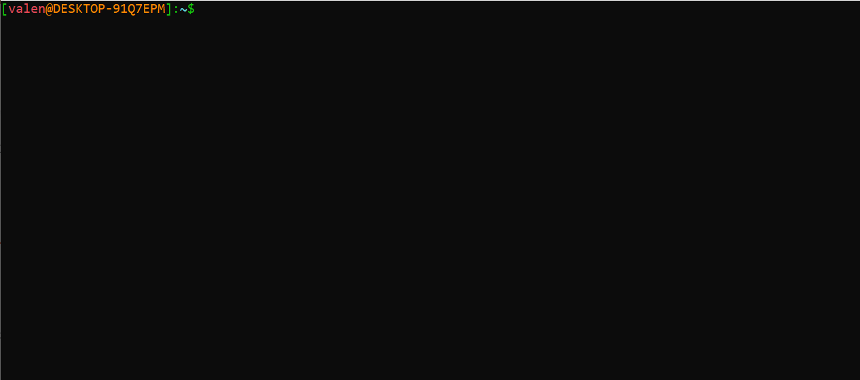
Welcome to the Command Line

Slide 5
Gathering Information
whoami – get username
pwd – print working directory
echo – print on the screen

Slide 6
Linux Filesystem
Everything in Linux is a file (including directories, external devices, etc.)
Information is organized in directories (folders)
Filenames that start with a dot (.) are often configuration files and are often hidden

Slide 7
ls
ls (list) – list files in directory
Options
-a – list all files, including hidden files
-l – long list, which prints permissions, last access time
-t – sort by last access time
-S – sort by file size
Can have multiple options at once
ls –al – long list all files

Slide 8
cd
cd – change directory, move between different directories
Usage: cd <directory_name>
Special directories
. – the current directory (cd .)
.. – the parent directory (cd ..)
~ – your home directory (cd ~)
- – the last directory you were in (cd -)

Slide 9
Viewing Files
cat – concatenate files and print to terminal
Usage: cat <filename1> <filename2> …
less – view longer files
Usage: less <filename1> <filename2> …
head – view the beginning of a file
Usage: head <filename1> <filename2> …
tail – view the end of the file
Usage: tail <filename1> <filename2> …

Slide 10
Interacting with Files
file – get type of file
Usage: file <filename>
ls –l <filename>
Get information on permissions, file size, last access time

Slide 11
Permissions
3 groups of permissions
User – what permission you have
Group – what permissions the group has
Global - what permissions everyone has
Represented as bit string (rwx-rwx-rwx)
r = 4
w = 2
x = 1
Change with chmod
Usage: chmod 644 <filename>

Slide 12
Next Steps
For Vim practice and information
Vim golf - https://www.vimgolf.com/
Vim adventure - https://vim-adventures.com/
Vim tips wiki - https://vim.fandom.com/wiki/Vim_Tips_Wiki
Vim cheat sheet - https://vim.rtorr.com/
Tmux Cheat Sheet - https://tmuxcheatsheet.com/
Check out Spring 2021 Workshop on dotfiles - https://github.com/ieee-uci/IEEE-Linux_Dotfiles
Bash scripting - https://linuxconfig.org/bash-scripting-tutorial-for-beginners
Come to our next workshop!!!!!

