Slide 1


Multithreaded Programming with MPI
IEEE Technical Workshop 11/12/2020

Slide 2
Outline
Background
Introduction to MPI and MPI Terms
Examples
Next Steps

Slide 3
GitHUB Repo
Github repo will contain lecture notes and this PowerPoint
At this link here: https://github.com/ValenYamamoto/IEEE_MPI_Workshop
Resources
Lecture Notes: mpi_lecture_notes.md
This PowerPoint: MPI_Workshop.pptx
Code/Final Code: Links in README.md

Slide 4

Google Colab
Examples and final code are in a Google Colab notbook
Link Python: https://colab.research.google.com/drive/1DmPziA4KuqG6Z9EwsM07X5OYod_Wq2SF?usp=sharing
Link C: https://colab.research.google.com/drive/12-AmHyu3AvMKvNoYE4xiOlxOnt_k7CcQ?usp=sharing
Google Colab allows anyone to write and execute arbitrary python code through the browswer
In this case, we’ll need to write out our files in order to run them on multiple cores, which is why we can also use C

Slide 5
Background
Why Multithreaded Programming?

Slide 6

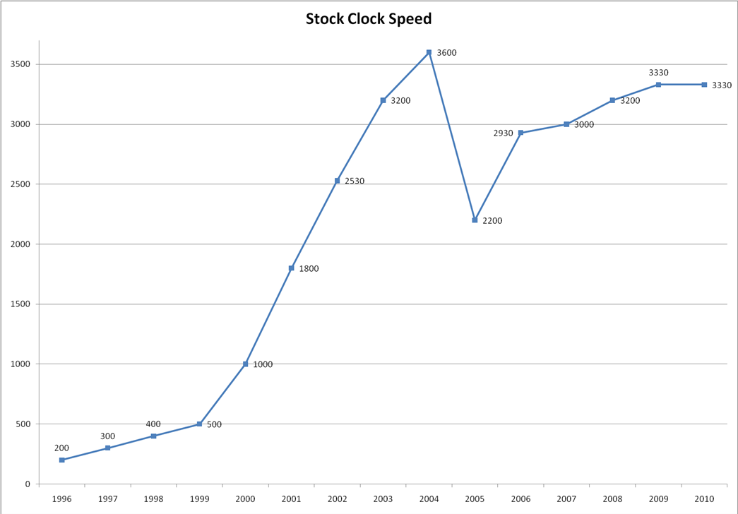
Multi-Core Processors
Originally CPU designers tried to improve performance by increasing clock frequency
Generates too much heat and consumes too much power
Switched to having multiple processors on one chip
Each processor is called a “core”
Need to change how programs are written to make use of new multi-core architecture

Slide 7


Amdahl’s Law
Gives the theoretical speedup in latency of the execution of the task at a fixed workload that can be expected of a system whose resources are improved
In practice, just a reminder that adding more threads does not speed up the serial portion of the code

Slide 8
Introduction to MPI

Slide 9
What is MPI?
MPI stands for Message Passing Interface and is a message passing library standard
First standardized, vector independent message passing library
Some different MPI library implementations
Open MPI – thread safe, open source MPI (C, Fortran)
Mpi4py – MPI for Python
Used for many different scientific computing and research projects

Slide 10
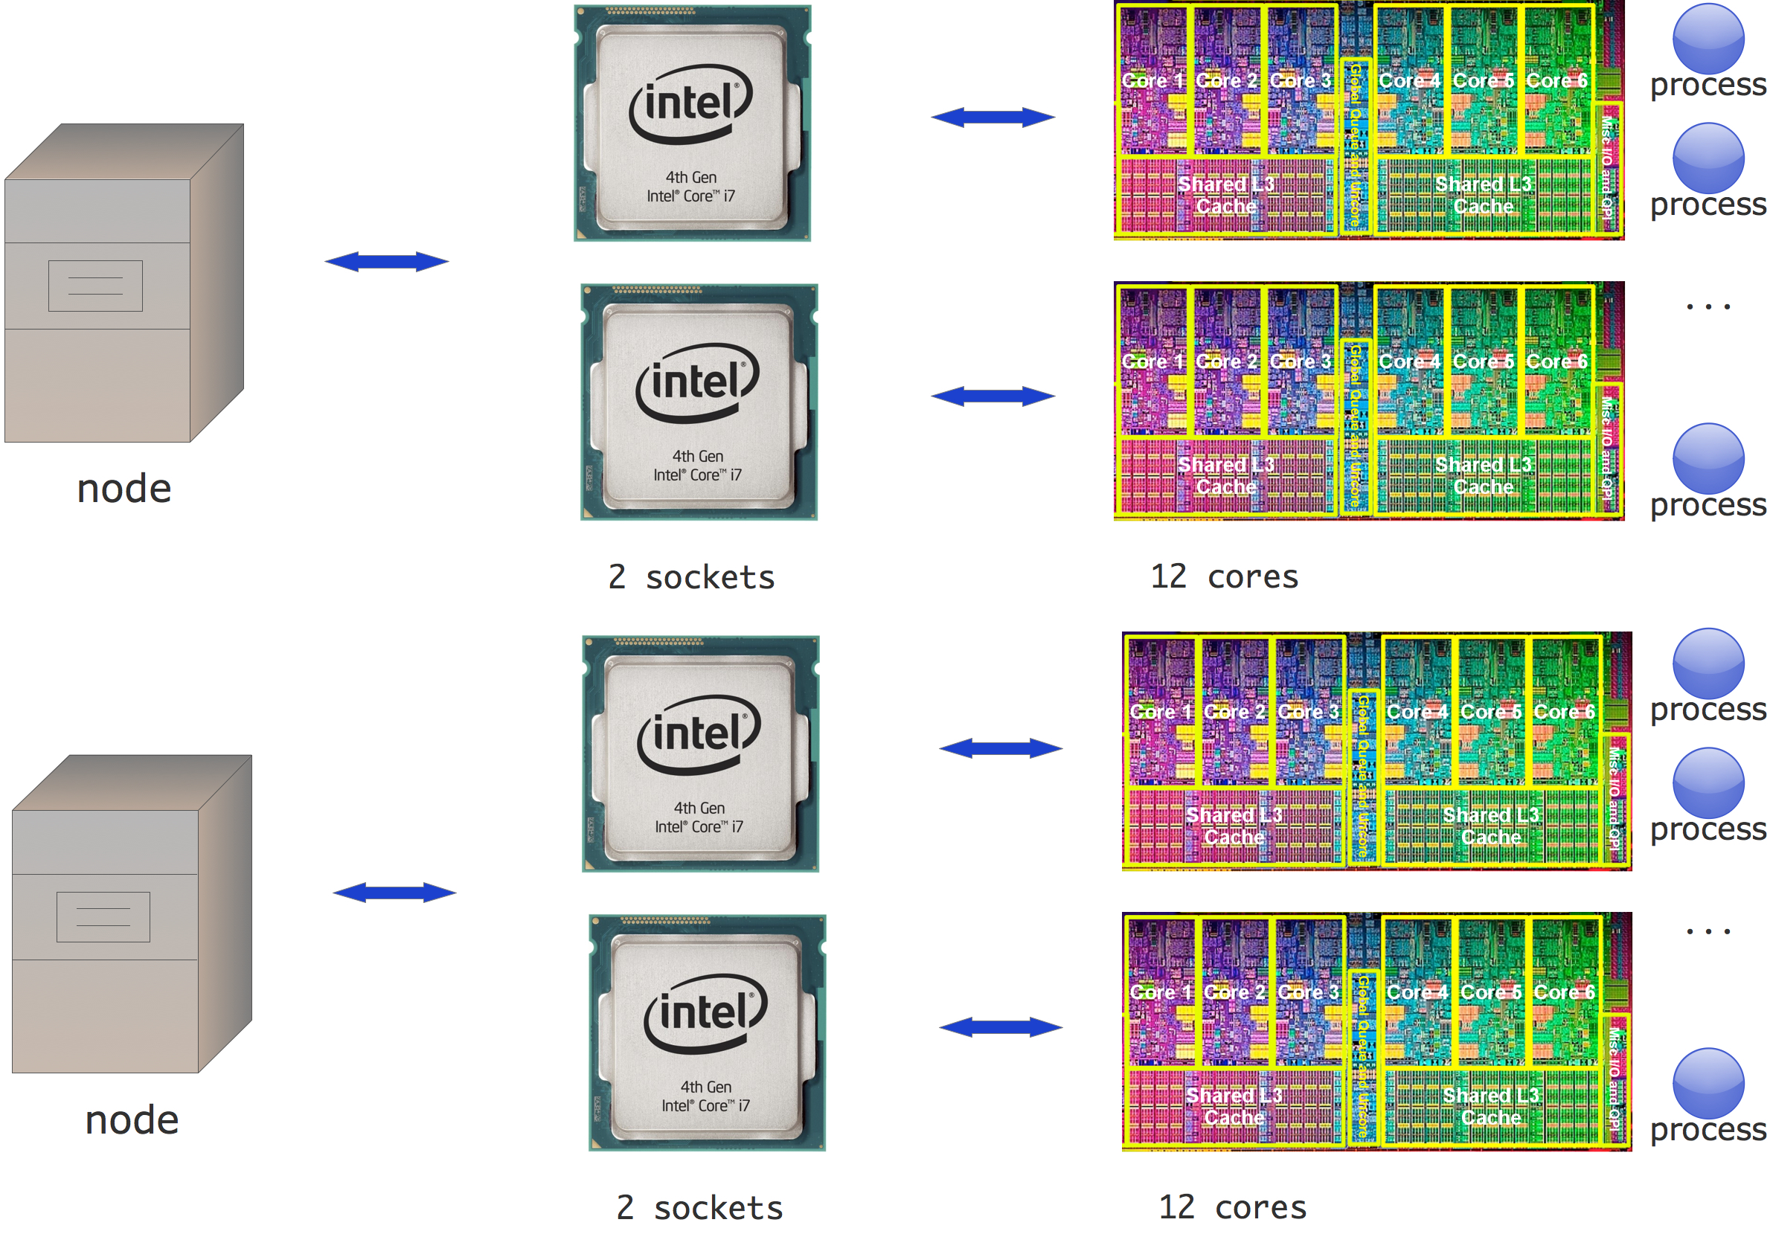
MPI Overview
MPI spawns what it calls processes or tasks
Ideally, one task per core/thread
Can spawn over many different machines
General MPI Program Structure
MPI environment initialization
Parallel work
MPI environment teardown (in C/Fortran)

Slide 11
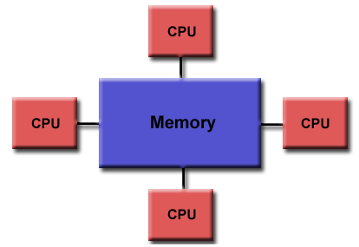
Communicators and task ids
MPI uses communications (comms) and groups to define which collection of processes may communicate with each other
Most of the time, comm will be MPI_COMM_WORLD (MPI.COMM_WORLD), which is like the global communicator
Within each comm, each process is assigned a unique integer identifier called a rank or task ID
In each comm, ranks start at 0 and proceed contiguously

Slide 12
Sending and Receiving data
MPI point-to-point operations typically involve message passing between two and only two MPI tasks
One process sends data; data is received by task with matching receive
Many different type of send/receive routines
Synchronous send
Blocking send/receive
Non-blocking send/receive
Buffered send
Combined send/receive
Ready send

Slide 13
Buffers
A system buffer is reserved to hold data in transit
Buffer is managed entirely by MPI Library and is oblique to the programmer
MPI guarantees that messages will no overtake each other
If message 1 is sent before message 2, message 1 will always be received before message 2
If receive 1 is posted before receive 2, receive 1 will always be receive its value before receive 2

Slide 14
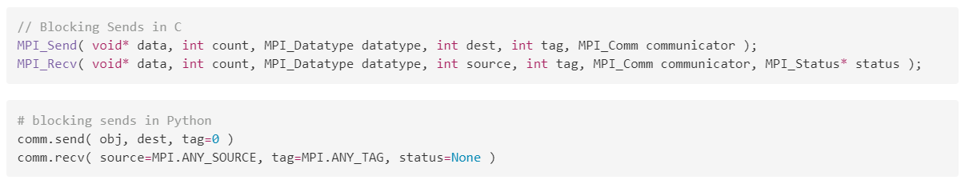
Blocking Send/Receive
Blocking send only returns when it is safe to modify send data for reuse
Doesn’t mean data is received, can still be in buffer
Blocking receive only returns when the data is received and ready to be used

Slide 15
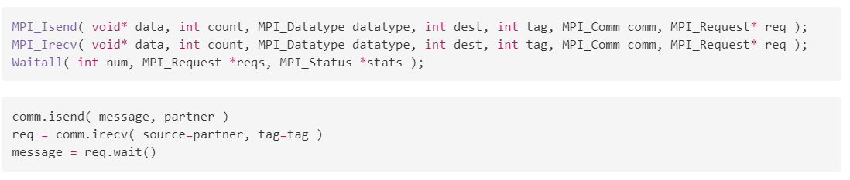
Non-Blocking Send/Receive
Non-Blocking send/receive return almost immediately and don’t wait for communication to complete
Used to overlap computation with communication for performance gain
Need a wait routine (or test routine) to make sure data is ready to be modified

Slide 16
Examples
Google Colab Links:

Slide 17
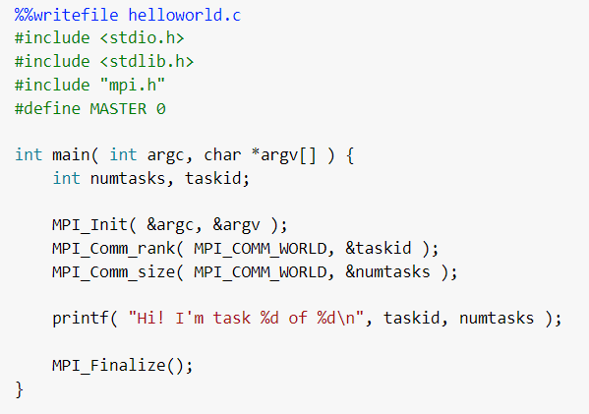
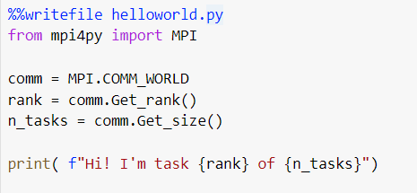
Hello World
Every task says hello

Slide 18
Hello Master task
0
1
2
3
4
5
6
7

Slide 19
Non-blocking ping
0
1
2
3
7
6
5
4

Slide 20
Round robin
0
1
7
2
6
3
5
4

Slide 21
Monte Carlo
Calculate Pi!

Slide 22
Expensive Computation
One task is constantly on; the other does computation (in this case, sleeps) and then send the result of the computation to the main task

Slide 23
Next Steps
What to do now?

Slide 24
Parallelize existing code/algorithms
A good way to learn MPI to write code
Interesting algorithms to look into
Matrix multiplication
Sorting algorithms
Sleep sort

Slide 25
Do a project
Most computers are multicore
Some multicore single-board computers
Raspberry Pi 3/4 have quad-core processors
ARM Cortex-M4 and Cortex-M0
Some project ideas
One thread deals with inputs/immediate actions, one thread does computation
Robot that has one thread doing path planning and another dealing with sensors and moving
Splitting large calculations on multiple threads
Neural nets, matrix multiplications

Slide 26
Resources
MPI Tutorial - https://computing.llnl.gov/tutorials/mpi/ (in C and Fortran)
mpi4py docs - https://mpi4py.readthedocs.io/en/stable/
Some more on Non-Blocking https://www.codingame.com/playgrounds/349/introduction-to-mpi/non-blocking-communications---exercise
Cannon's Algorithm - https://en.wikipedia.org/wiki/Cannon%27s_algorithm

