Slide 1
InventoryFlow: Smarter Inventory Management
Valencia Walker

Slide 2
Project overview
The product: InventoryFlow is a responsive inventory-management app and website for local business owners and staff. It helps users monitor stock, add products, track sales, identify low-stock items, and quickly understand inventory health.

Slide 3
Project duration: May 2026 to August 2026
The problem: Small businesses often rely on spreadsheets, handwritten notes, or disconnected systems to track inventory. These workflows can make it difficult to know what is in stock, what needs reordering, and how sales affect inventory.
The goal: Create a simple, responsive experience that makes inventory information easy to understand and routine stock tasks fast to complete.
Project overview

Slide 4
My role: UX designer and UX researcher
Responsibilities:
• User research and synthesis
• Personas and problem statements
• User journey mapping
• Information architecture and sitemap planning
• Paper and digital wireframing
• Low- and high-fidelity prototyping
• Usability testing and iteration
• Responsive web design
• Accessibility review
Project overview

Slide 5
User research: I conducted moderated usability conversations and task-based testing with small-business owners and employees who regularly manage products and sales. I began with the assumption that users primarily wanted more features, but research showed that speed, clarity, and confidence were more important than feature volume.
Understanding the user

Slide 6
1. Scattered information — Users had to check multiple places to understand current stock. The design should surface inventory status in one clear dashboard.
2. Manual updates — Users found repeated data entry frustrating. The design should make adding and updating products efficient.
3. Low-stock uncertainty — Users wanted an obvious signal when action was needed. The design should use clear status indicators and filtering.
4. Mobile constraints — Staff may update inventory while moving around a store. Controls must remain readable, tappable, and focused on essential actions.
User research: pain points

Slide 7
Persona: Jordan
Jordan, 38, owns a neighborhood retail business and manages inventory with a small team.
Problem statement: Jordan is a time-conscious small-business owner who needs a fast way to monitor and update inventory because manual tracking makes it difficult to identify low-stock products before they affect sales.

Slide 8
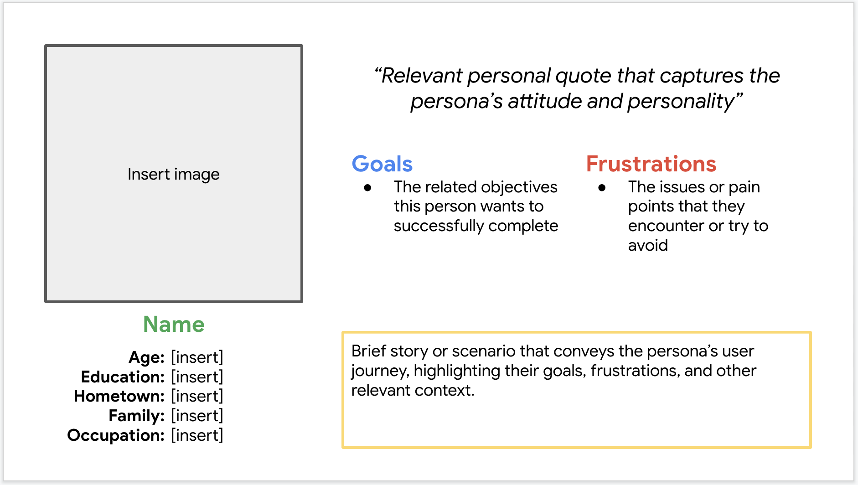
User journey map
Journey: Open dashboard → Review stock health → Search/filter products → Open product → Update quantity → Confirm change → Return to dashboard.
Design goal: Reduce uncertainty at each step by keeping status, quantity, and primary actions visible and consistent.

Slide 9
Paper wireframes: I explored multiple dashboard layouts before selecting a structure that prioritized inventory status, search, and the most common actions. I intentionally kept secondary information visually quieter so users could scan the page quickly.
Starting the design

Slide 10
Digital wireframes
Dashboard design: A summary area gives users an immediate view of total items, low-stock products, and recent inventory activity. Search and filters sit close to the inventory list so users can move from overview to action without unnecessary navigation.

Slide 11
Digital wireframes
Product detail design: The product screen emphasizes the current quantity, stock status, sales activity, and an easy-to-find update action. This supports the core task of checking an item and changing its inventory level.

Slide 12
Low-fidelity prototype
User flow: Dashboard → Inventory list → Product detail → Edit quantity → Save → Updated inventory status.
The prototype was designed to test whether users could complete a common inventory update without assistance.

Slide 13
Usability study: findings
Round 1 findings:
1. Users wanted low-stock items to stand out immediately.
2. Several users looked for search before browsing categories.
Round 2 findings:
1. Users completed updates more confidently when the quantity field was paired with a clear save action.
2. Users preferred plain-language stock labels over ambiguous icons.
3. Responsive layouts needed stronger spacing and hierarchy on smaller screens.

Slide 14
Refining the design
Before and after: The dashboard was revised to make low-stock products more prominent and to reduce competing visual elements. The revised layout gives users a clearer starting point and makes urgent inventory issues easier to scan.

Slide 15
Refining the design
Before and after: The product-detail screen was simplified so the current quantity and primary update action are visually dominant. Supporting information remains available without competing with the main task.

Slide 16
High-fidelity responsive designs include desktop, tablet, and mobile layouts. The visual system uses consistent cards, status labels, form controls, spacing, and navigation patterns so users can transfer knowledge across screen sizes.
Mockups

Slide 17
High-fidelity prototype
Prototype flow: Dashboard → Inventory → Search/filter → Product details → Edit quantity → Save → Confirmation.
Prototype link: Add the published Figma prototype URL here before submission.

Slide 18
Accessibility considerations
1. Color and contrast — Status information is not communicated by color alone; labels and icons reinforce meaning, and text maintains readable contrast.
2. Touch and keyboard usability — Interactive controls are sized and spaced for comfortable use, with a logical interaction order.
3. Clear language and hierarchy — Labels, headings, form instructions, and confirmation messages use plain language and consistent structure to reduce cognitive load.

Slide 19
Takeaways
Impact: The final concept creates a more focused workflow for monitoring stock and completing routine inventory updates. In usability testing, participants were able to understand the primary dashboard and product-update flow with less hesitation after the design revisions.
What I learned: Strong UX is often about removing friction rather than adding features. Research changed my assumptions about what users valued most and helped me prioritize clarity, task efficiency, and responsive behavior.

Slide 20
Next steps
1. Conduct a larger usability study with business owners across different retail categories.
2. Test the responsive experience with real devices and accessibility technologies.
3. Explore future features such as purchase-order tracking, role-based permissions, sales analytics, and inventory alerts.

Slide 21
Let’s connect!
Thank you for reviewing my case study.
I’m a UX-focused designer who enjoys combining research, interaction design, technology, and problem solving to create useful digital experiences.
Contact: Valencia Walker
Portfolio: Add your portfolio URL
LinkedIn: Add your LinkedIn URL
Email: Add your professional email address

Slide 22
InventoryFlow — UX case study
Valencia Walker
Thank you!

