Slide 1
Comparative genomics of Histoplasma capsulatum
Whole-genome sequencing of 183 isolates: lineage, population structure, virulence, and links to geography and disease
Dhairya Katala
Notes:
Six objectives. The rest of the deck follows them in order.

Slide 2
Six objectives
Sequencing
Isolate genomic DNA and sequence H. capsulatum from clinical isolates
Quality control
Pre-process reads and check their quality
1
2
Variant calling
Align reads to a reference and call variants
Assembly and annotation
Assemble genomes and annotate their genes
3
4
Phylogenomics, population genetics, function
Infer the tree, ancestry and virulence and resistance genes
Comparative analysis
Integrate genomic results with geography and clinical phenotype
5
6

Slide 3
Workflow: raw reads to answers
1
2
3
4
5
6
DNA and sequencing
Quality control
Variant calling
Assembly and annotation
Trees, ancestry, genes
Integration
Done In progress Next
Two analysis tracks run on the same cleaned reads: variants against a reference, and de novo assemblies. Each covers the other's blind spot.

Slide 4
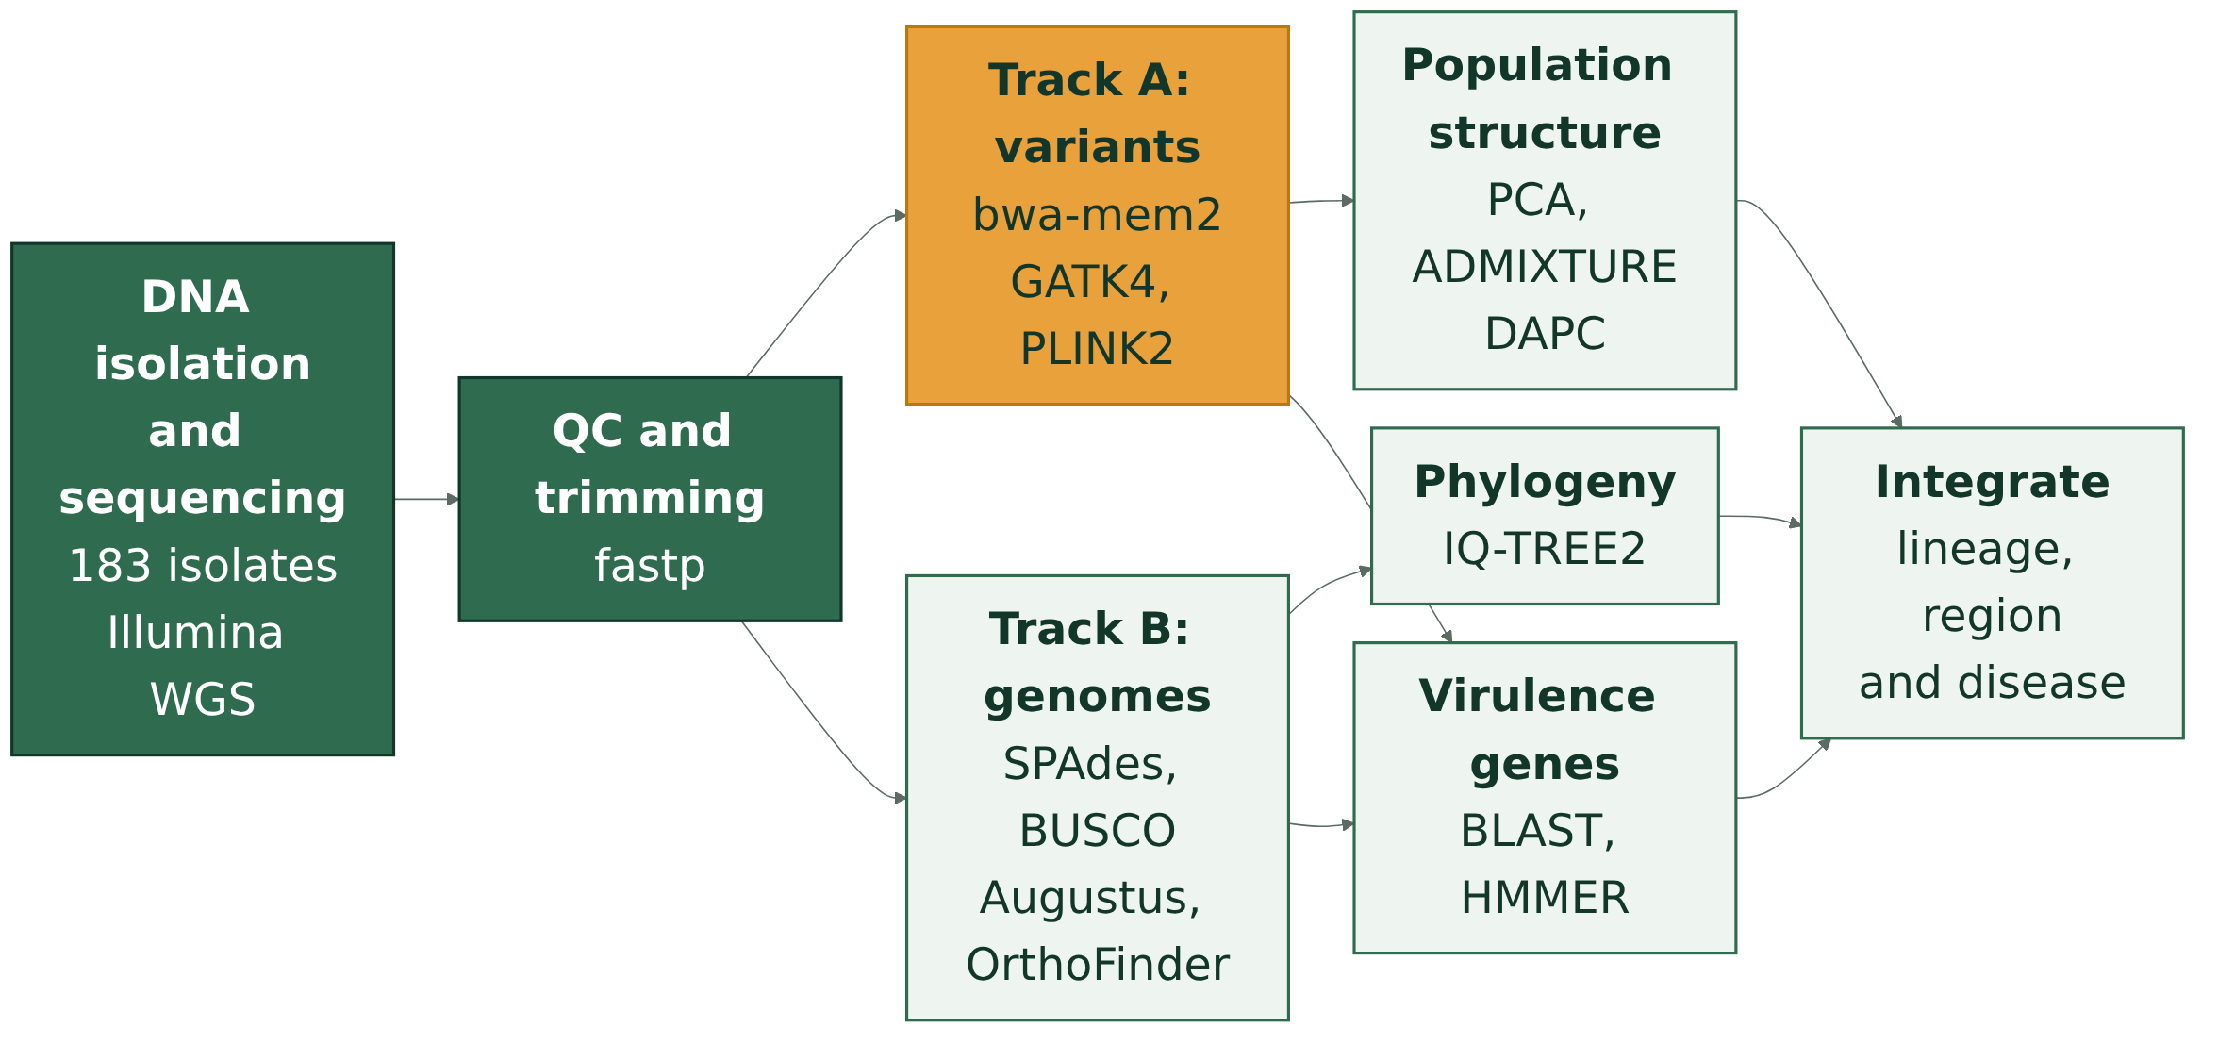
Pipeline: two tracks, one answer

Slide 5
Objectives 1 to 3: from sample to variants
1 Sequencing
DNA isolation from clinical isolates; Illumina paired-end WGS
Status: 183 of 183 sequenced (public data)
2 Quality control
fastp: adapter and quality trimming, per-sample report
Status: done for 183 of 183
3 Variant calling
bwa-mem2 alignment to WU24; GATK4 haploid calls; joint SNP matrix; PLINK2
Status: 7 of 183 called; slow step, in progress

Slide 6
Objectives 4 and 5: genomes, trees and genes
4 Assembly and annotation
SPAdes de novo assembly
BUSCO completeness check
Augustus gene prediction
Functional annotation
5 Phylogenomics
OrthoFinder orthologous genes
IQ-TREE 2 maximum-likelihood tree
Population genetics
DAPC and ADMIXTURE
5 Functional characteristics
Virulence genes (BLAST, HMMER)
Antifungal resistance variants
Mating-type idiomorphs

Slide 7
Objective 6: comparative analysis
Genome-level comparison
Genome size and gene count per lineage
Gene family gains and losses between lineages
Integration with biology
Lineage against geography
Lineage against clinical phenotype
Test whether genetic groups match place and disease
Question: does genetic lineage explain where isolates come from and how severe the disease is?

Slide 8
Data: 183 isolates from 16 countries
North America
USA 114
Africa
South Africa 18, Cameroon 4, Cote d'Ivoire 3, and 6 more
Central and South America
Brazil 18, Panama 2, Venezuela 1
Asia and Europe
India 2, China 1, Belgium 1
Source: NCBI BioSample metadata. 11 isolates have no location.

Slide 9
Data: clades as reported by each study
Read with care
110 isolates come from studies that report NAm1 and NAm2 together, not per isolate.
H88 is labelled NAm1 in the metadata, but Sepulveda 2017 places it in the African lineage.
Our own tree will replace these labels.
Source: clade as reported by each study, grouped.

Slide 10
Where we are and what comes next
Done
Sequence data and quality control for all 183 isolates
In progress
Variant calling, 7 of 183 isolates, to build the shared SNP matrix
Next
Assemblies and annotation, the phylogeny, population structure, virulence profiling, and the integration

