Slide 1
Comparative genomics of Histoplasma capsulatum
183
isolates sequenced (Illumina, paired-end)
16
countries on 5 continents
Whole-genome sequencing of 183 public isolates to test whether genetic lineage tracks geography and clinical disease
133
from human patients (73%)
Dhairya Katala
Notes:
183 public Illumina paired-end runs from NCBI SRA. Metadata comes from NCBI BioSample records. 133 isolates are from Homo sapiens hosts, the rest from cats, dogs, other or unspecified hosts.

Slide 2
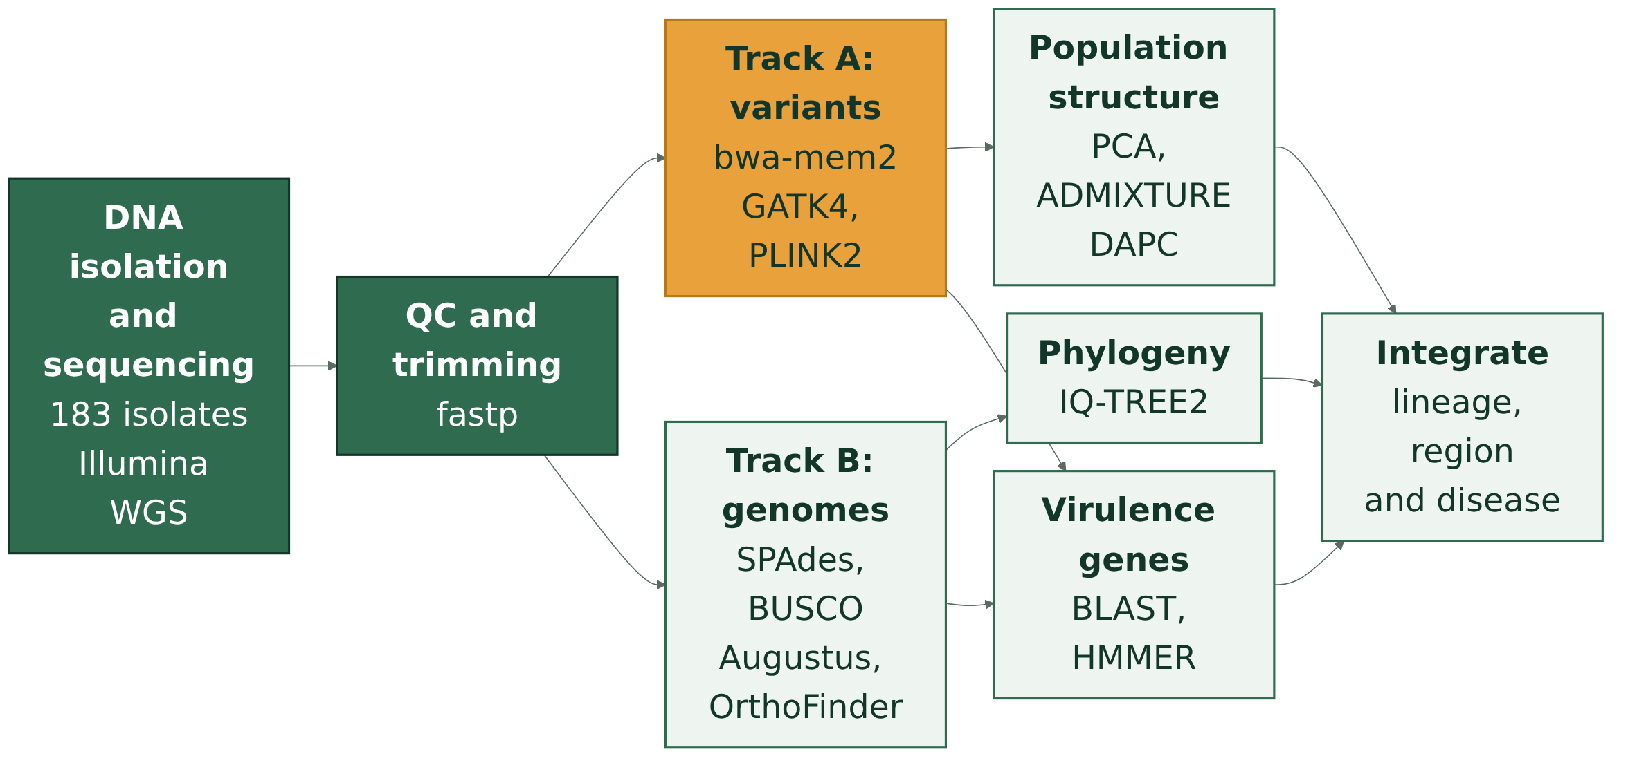
Our pipeline: two tracks, one answer
Done
In progress: 7 of 183 isolates
Next
Notes:
Two parallel tracks from the same cleaned reads. Track A aligns every isolate to the WU24 reference to get a shared SNP matrix for population genetics, but it is biased toward lineages close to the reference. Track B assembles each genome without a reference, so it sees genes the reference lacks and gives the gene content for the tree. Each track covers the other's blind spot. Done: sequencing data and QC (183 of 183). In progress: variant calling, 7 of 183, slow because GATK time grows with how far an isolate is from the reference. Next: assemblies, tree, population structure, virulence profiling, integration.

Slide 3
183 isolates from 16 countries, by region
North America
USA 114
Africa
South Africa 18, Cameroon 4, Cote d'Ivoire 3, and 6 more countries
Central and South America
Brazil 18, Panama 2, Venezuela 1
Asia and Europe
India 2, China 1, Belgium 1
Source: NCBI BioSample metadata. 11 isolates have no location.
Notes:
Counts come from the Geographic_Origin column of histoplasma_183_wgs_comprehensive_phenotypic_metadata.csv. 114 of 183 isolates are from the USA, so the sample leans heavily to North America. Africa has 33 isolates across 9 countries. 11 isolates have no usable location (7 unspecified, 4 not collected).

Slide 4
Isolates by clade, per source study
Read with care
110 isolates come from studies that report NAm1 and NAm2 together, not per isolate.
H88 is labelled NAm1 in the metadata, but Sepulveda 2017 places it in the African lineage.
Our own tree will replace these labels.
Source: clade as reported by each study, grouped.
Notes:
Clade labels are what each source study reported, not our result. Groups: 110 North American (62 from a three-species study plus 48 from a US clinical study, NAm1 and NAm2 not split per isolate); 33 African; 19 Latin American A (18 from a Brazilian study plus strain 7090); 12 reference strains and mixed panels (WU24, H88, three CBS 136.72 entries, Indian and Thai isolates, a BSL-3 reference, a 4-isolate cryptic speciation panel); 7 on the G217B lab background (6 G217B plus the SG1 mutant); 2 Panama strains G184AR and G186AR. Our own tree will assign clades per isolate.

