Slide 1
Comparing figures between a point count analysis that uses all WOTH vs. one that uses only singing males
Note, manuscript figures 1 and 5 are identical between the two analyses and are not presented

Slide 2
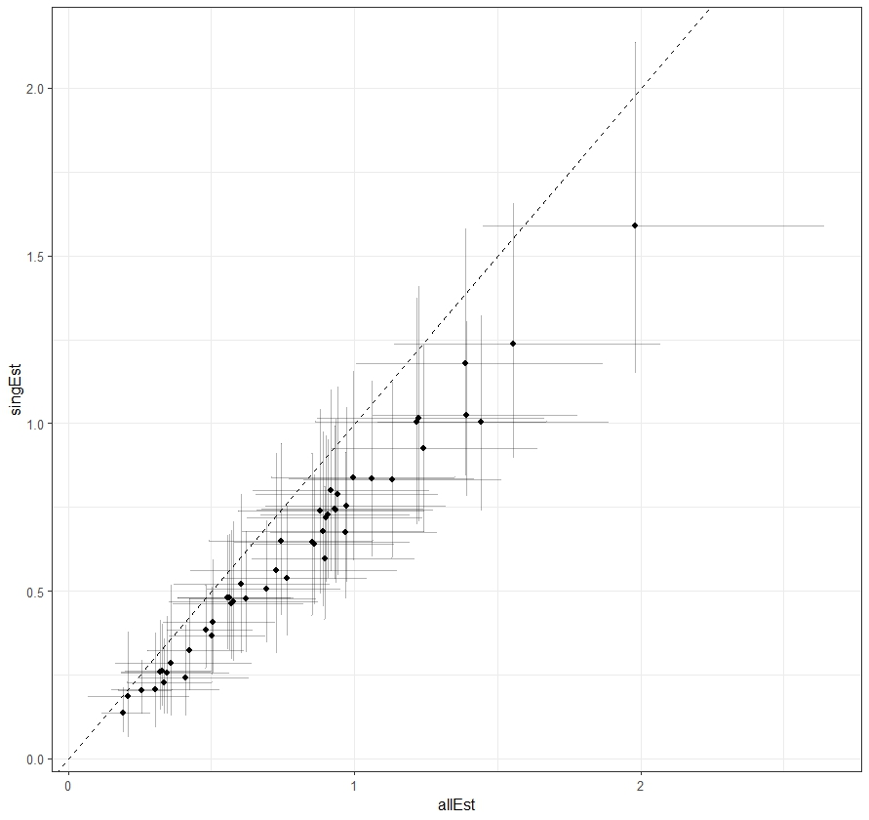
Quick comparison
When we use only the singing males to estimate WOTH densities from the point counts, we get slightly lower density estimates compared to when we use all WOTH. This is expected.

Slide 3
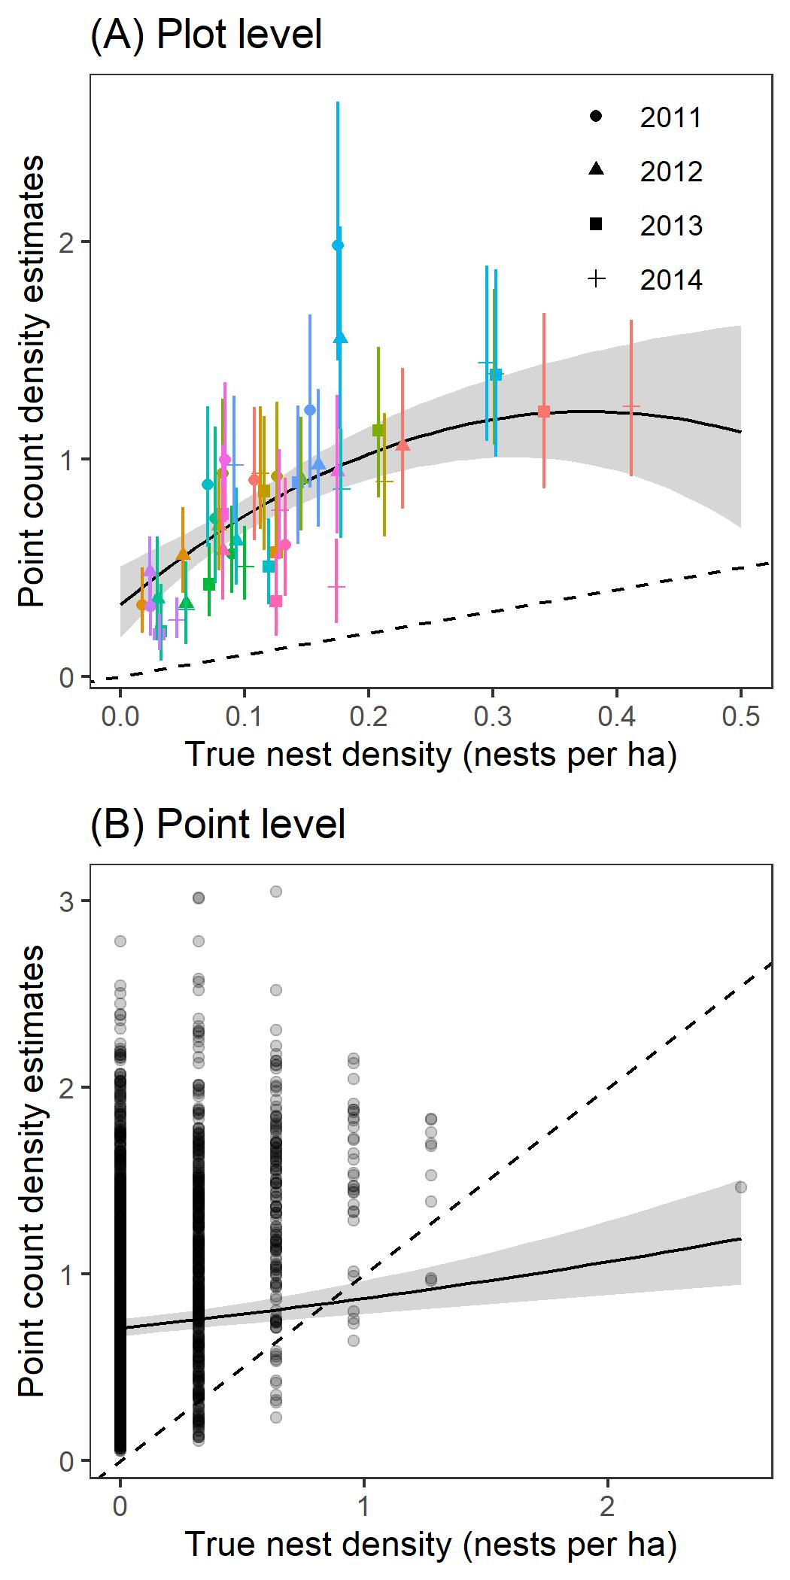
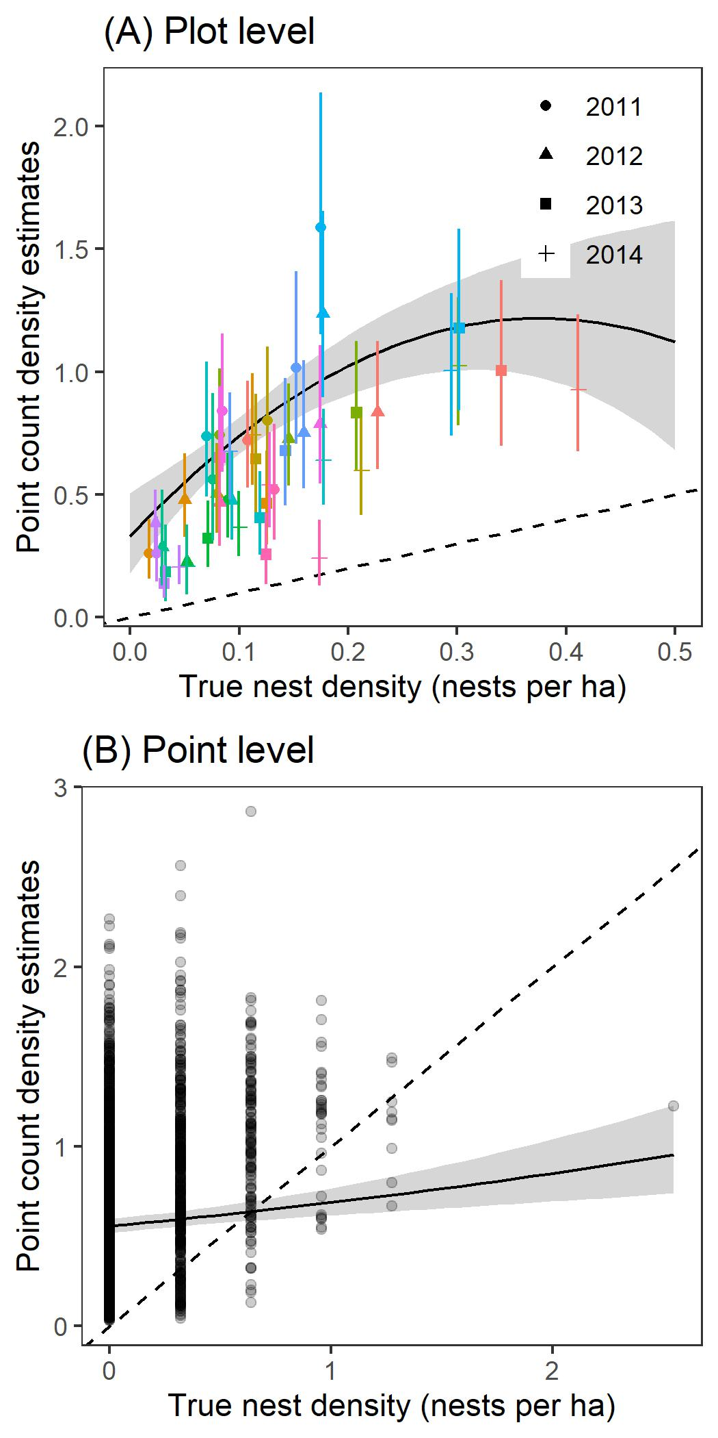
Figure 2
However, this really doesn’t change our story at all when we look at the figures reported in the manuscript
All WOTH
Singing males

Slide 4
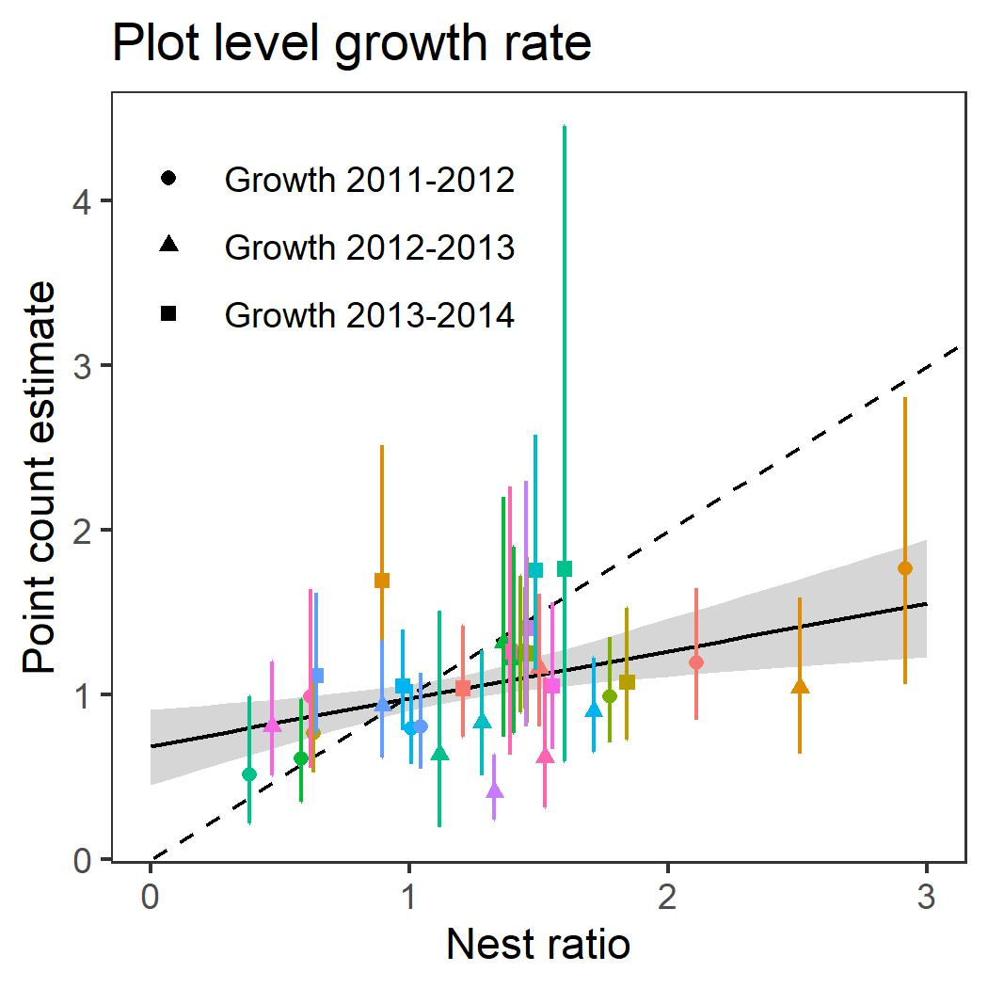
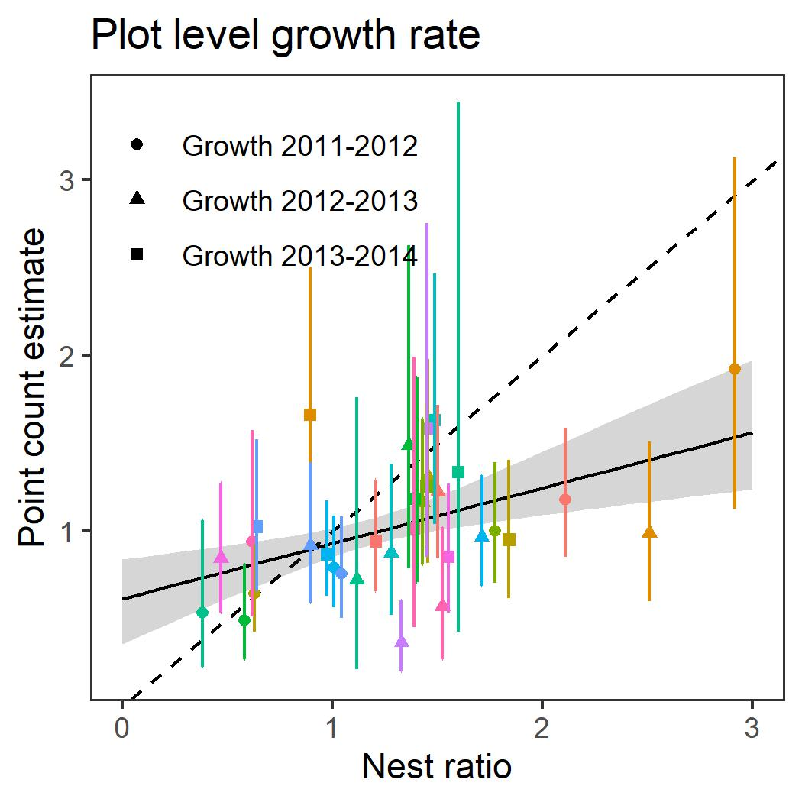
Figure 3
All WOTH
Singing males

Slide 5
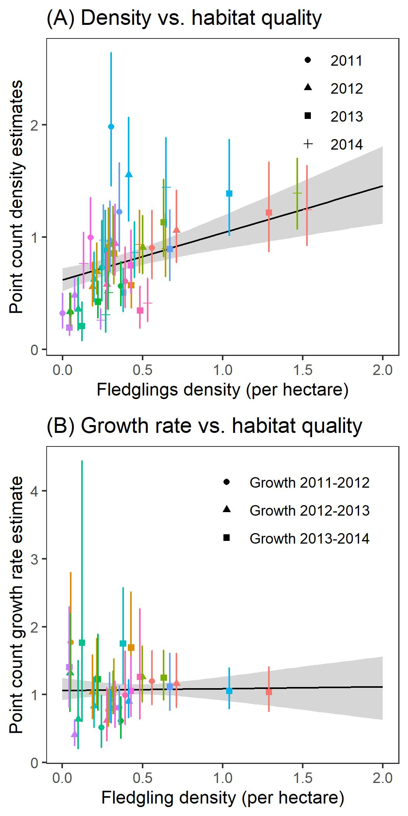
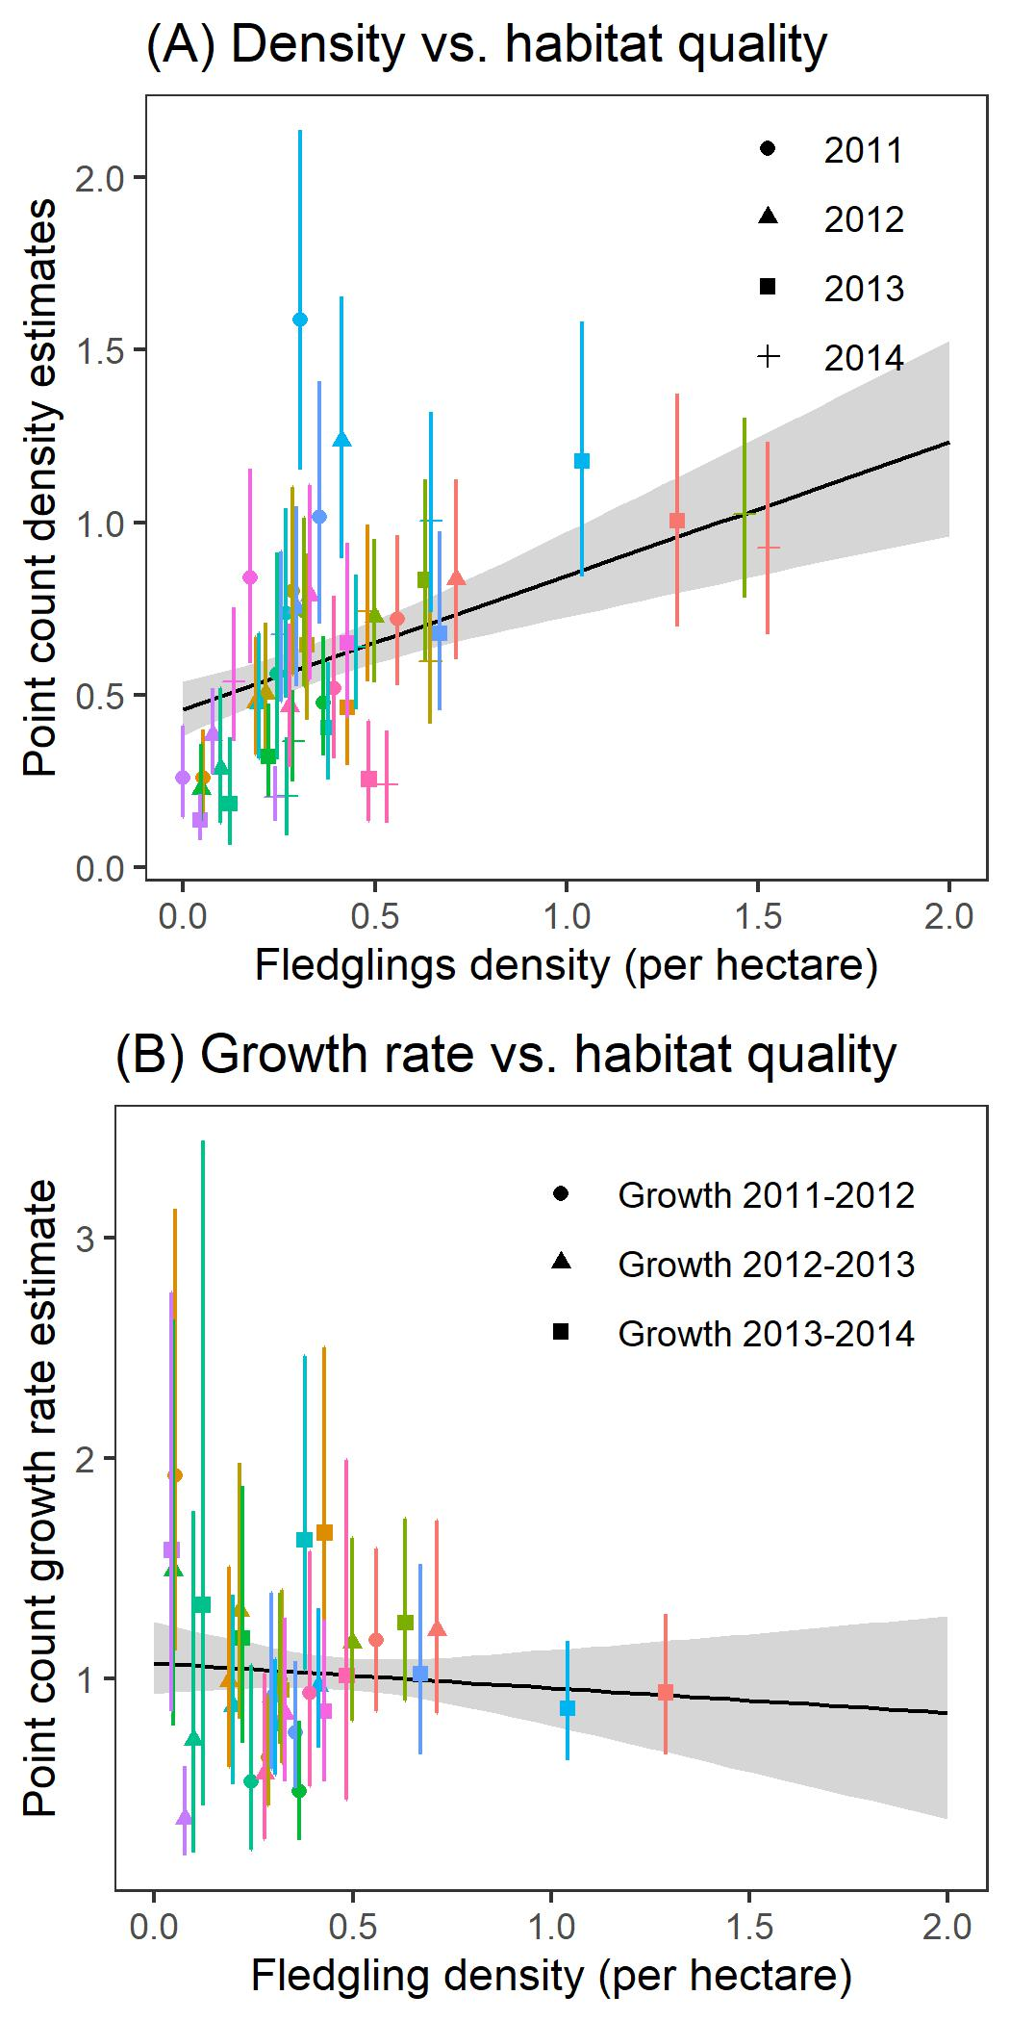
Figure 4
All WOTH
Singing males

Slide 6
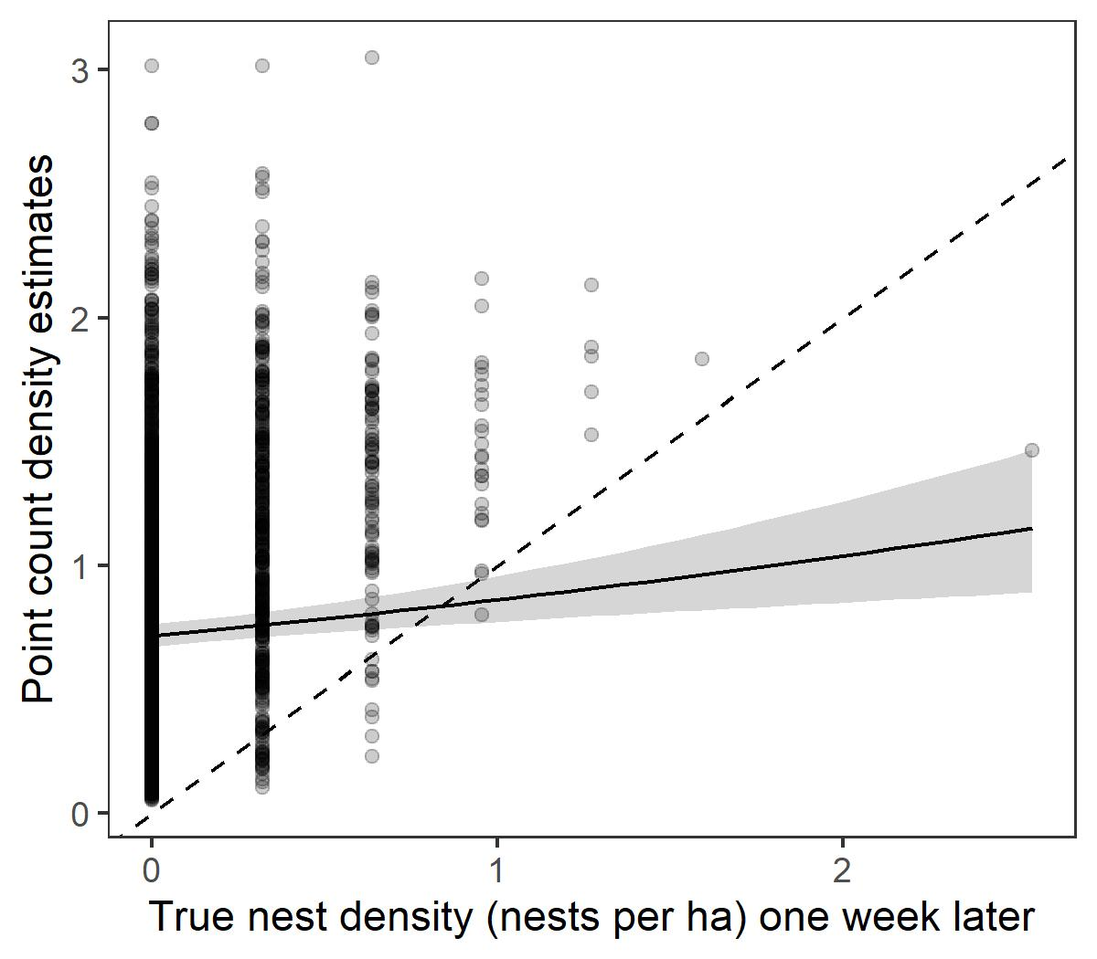
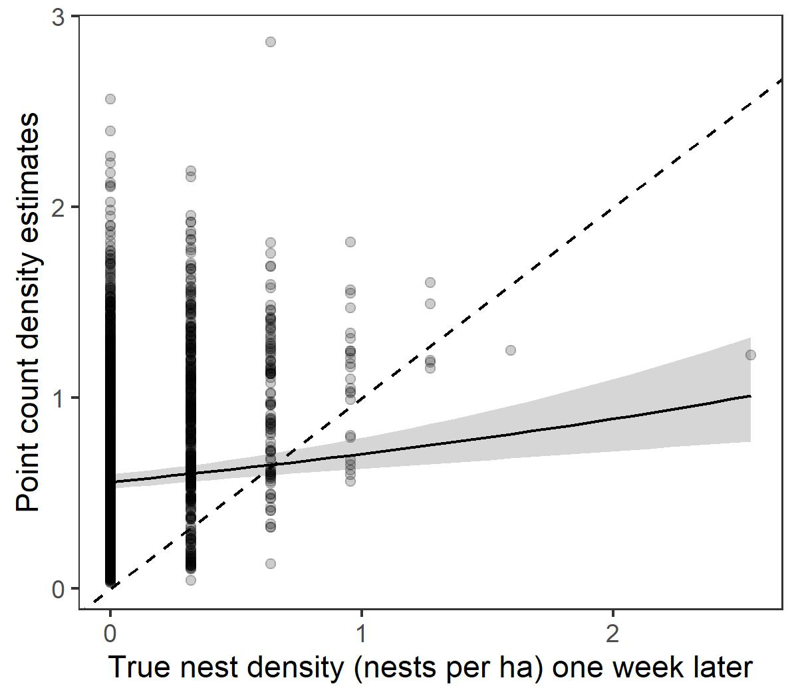
Figure S1
All WOTH
Singing males

Slide 7
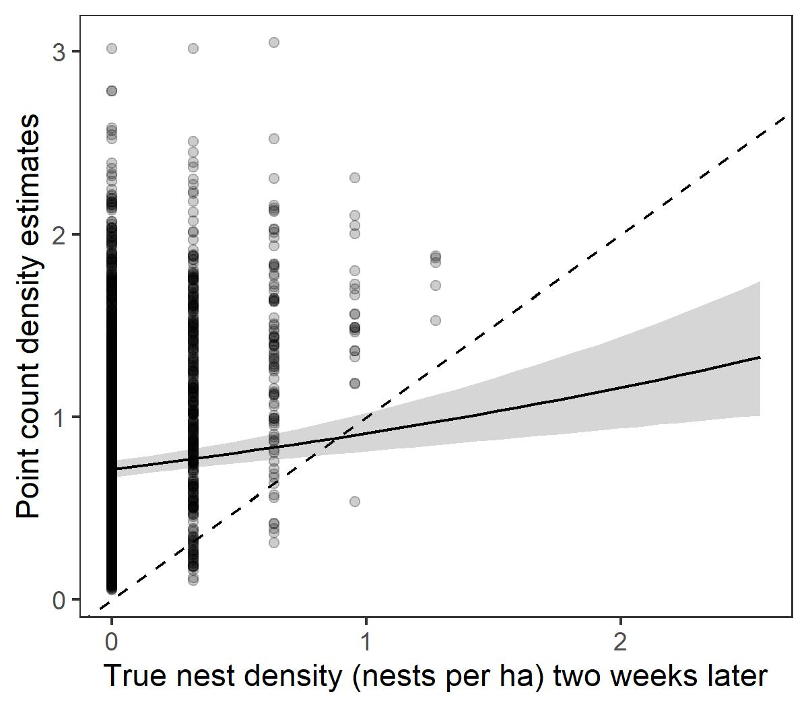
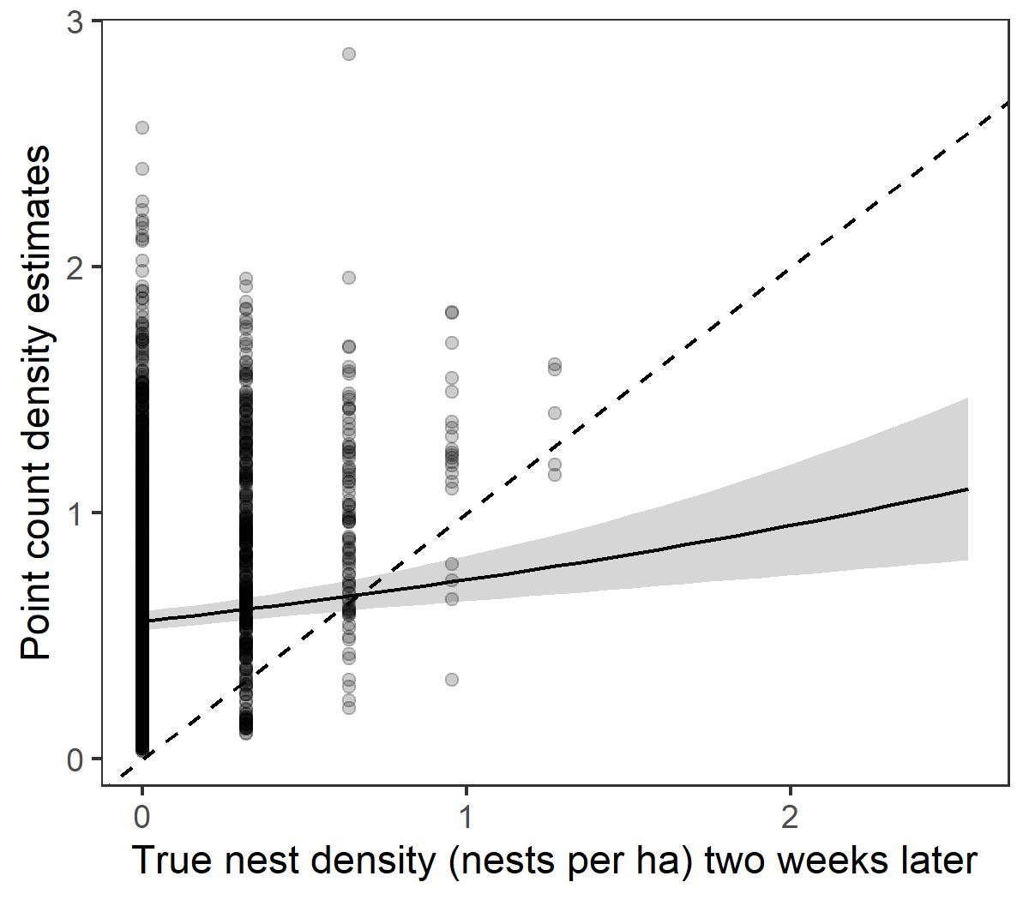
Figure S2
All WOTH
Singing males

Slide 8
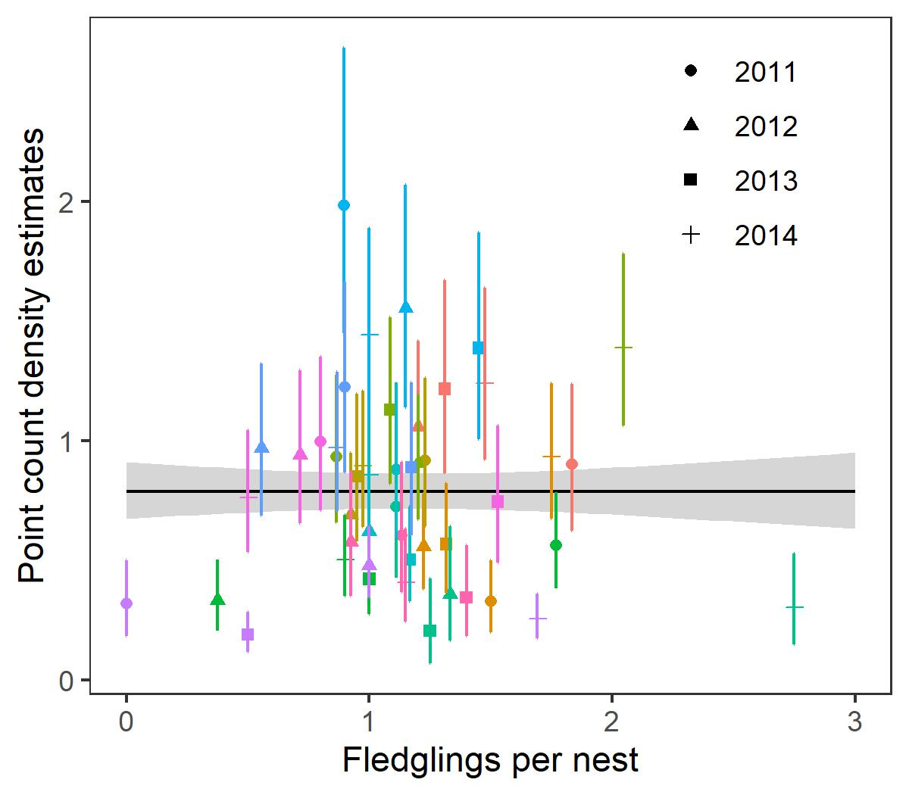
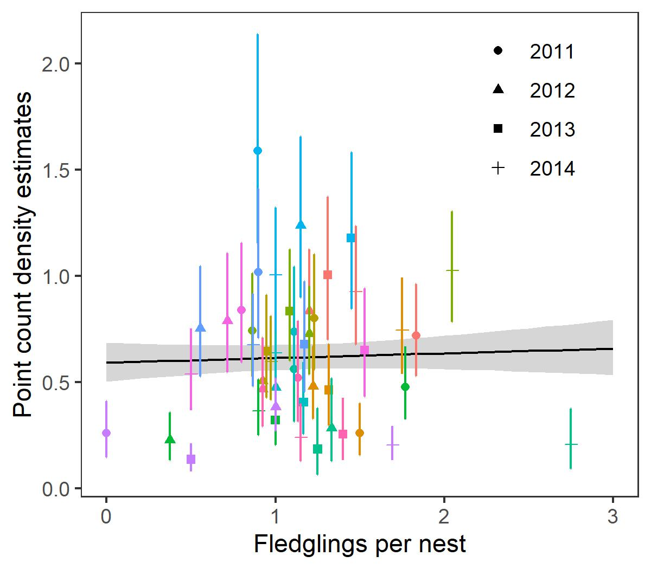
Figure S3
All WOTH
Singing males

Slide 9
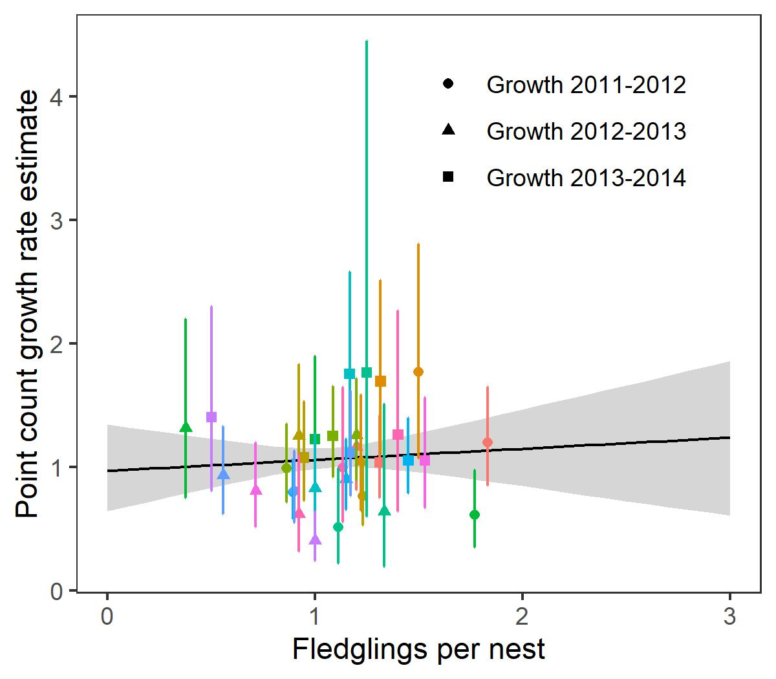
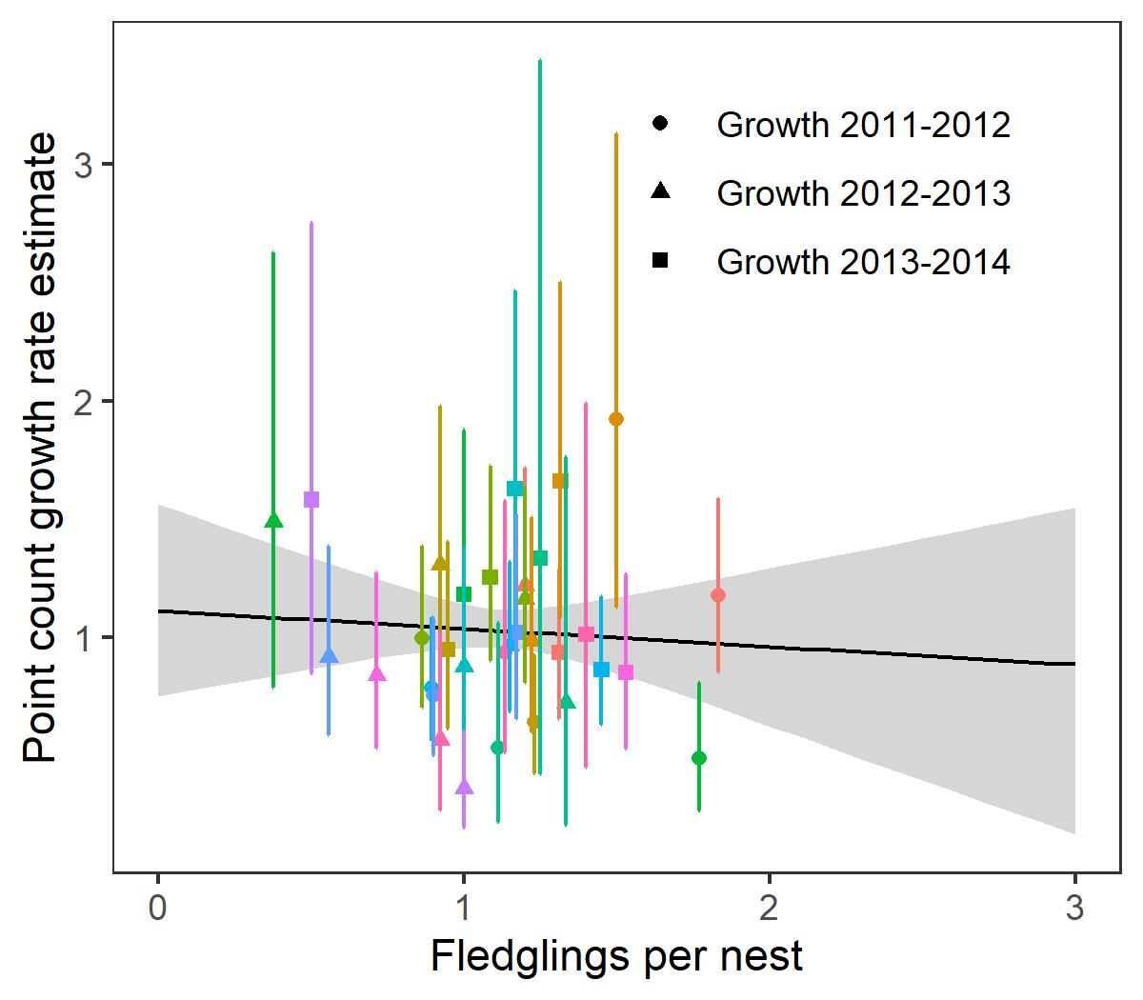
Figure S4
All WOTH
Singing males

