Slide 1
Introduction to Explainable AI
Valentin Mueller, SAP
July 30, 2023

Slide 2
Agenda
LIME
Explaining models by utilizing explainable surrogate models
SHAP
Combining LIME with game theoretical approaches
Sensitivity Analysis
Powerful, statistical technique for models making numerical predictions
XRL
Brief showcase of different techniques for explainable reinforcement learning

Slide 3
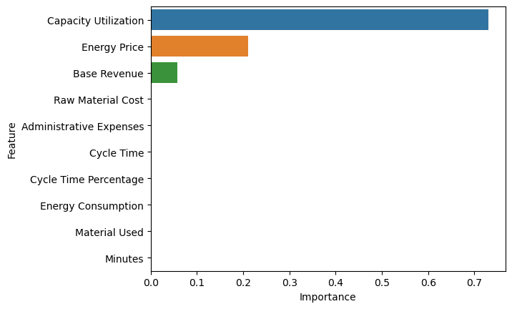
Local Interpretable Model-agnostic Explanations (LIME)
Some models (i.e. linear regression, decision trees, knn, …) are explainable models by default → model-specific
Non-explainable models can be approximated by an explainable one, and the explanations of the explainable one can be used
Makes explainable models applicable to any model → model-agnostic

Slide 4
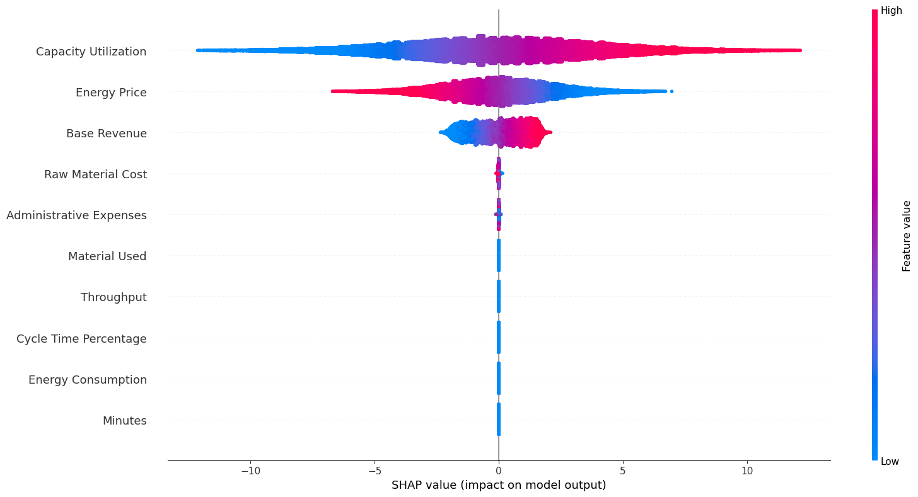
Shapley Additive Explanations (SHAP)
Shapley values stem from game theory and indicate contribution of a player (feature) to the payout (prediction)
SHAP-values: Shapley values of conditional expectation function of original model, explain feature importance as additive attribution
Average prediction + sum of SHAP-values = specific prediction

Slide 5
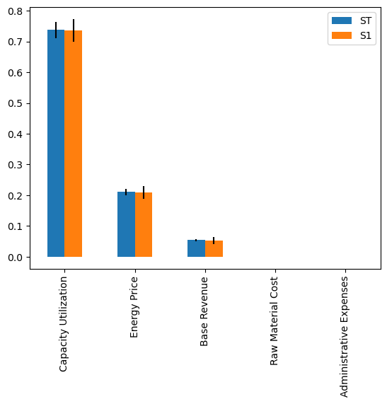
Sensitivity Analysis
Collection of (statistical) methods to examine how input of a model influences its output
Multiple approaches exist, but the ones based on variance are especially common
Sensitivity indices Si measure the contribution of an input variable Xi to the total variance of the output Y

Slide 6
Explainable Reinforcement Learning (XRL)
Feature Importance (FI)
Builds on FI from supervised learning
Learn an intrinsically interpretable policy
Convert a non-interpretable policy to a interpretable one
Directly generate explanations manually or automatically
Learning Process and MDP (LPM)
MDP = Markov decision process
Reveal interactions of MDP with agent during learning → commonly transition dynamic
Approaches:
Model Domain Information
Decompose Reward Function
Identify Training Points
Policy-Level (PL)
Describe agent’s long-term behavior
Summarize Using Transitions: context of experiences during training
Convert RNN to Interpretable Format
Extract Clusters or Abstract States: Behavior with similar states

Slide 7
Sources
Borgonovo, Emanuele (2017): Sensitivity Analysis: An Introduction for the Management Scientist. Cham: Springer International Publishing (International Series in Operations Research et Management Science, 251).
Guyon, I.; Luxburg, U. von; Bengio, S.; Wallach, H.; Fergus, R.; Vishwanathan, S.; Garnett, R. (Eds.) (2017): Advances in Neural Information Processing Systems: Curran Associates, Inc.
Lundberg, Scott M.; Lee, Su-In (2017): A Unified Approach to Interpreting Model Predictions. In I. Guyon, U. von Luxburg, S. Bengio, H. Wallach, R. Fergus, S. Vishwanathan, R. Garnett (Eds.): Advances in Neural Information Processing Systems, vol. 30: Curran Associates, Inc. Available online at https://proceedings.neurips.cc/paper/2017/file/8a20a8621978632d76c43dfd28b67767-Paper.pdf.
Milani, Stephanie; Topin, Nicholay; Veloso, Manuela; Fang, Fei (2022): A Survey of Explainable Reinforcement Learning.
Molnar, Christoph (2022): Interpretable Machine Learning: A Guide for Making Black Box Models Explainable. 2nd ed. Available online at https://christophm.github.io/interpretable-ml-book.
Owen, Guillermo (2013): Game theory: Emerald Group Publishing.
Shapley, Lloyd S. (1953): A value for n-person games.
Sobol’, Ilya M. (2001): Global sensitivity indices for nonlinear mathematical models and their Monte Carlo estimates. In Mathematics and Computers in Simulation 55 (1-3), pp. 271–280.

Slide 8
Thank you.
Valentin Mueller
valentin.mueller@sap.com

