Slide 1
Active Learning
Introduction
How active learning works
Active Learning Strategies
Application
Challenges and Considerations

Slide 2
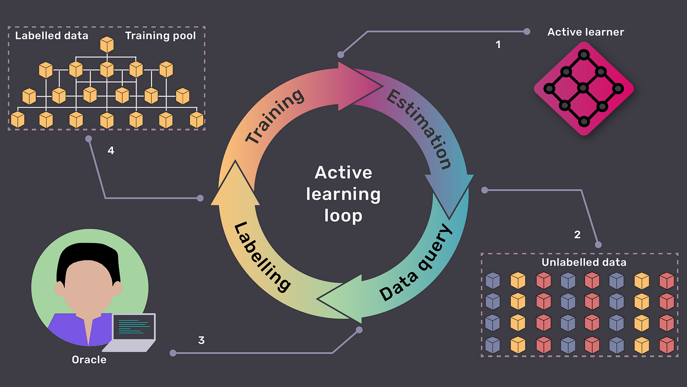
1/ Introduction
Definition:
- Active Learning is a type of machine learning where the algorithm selects the most informative data points to be labeled by an oracle
Efficiency: Reduces the amount of labeled data required.
Cost-Effective: Minimizes labeling costs by focusing on the most informative samples.
Performance: Can achieve higher accuracy with less data.

Slide 3
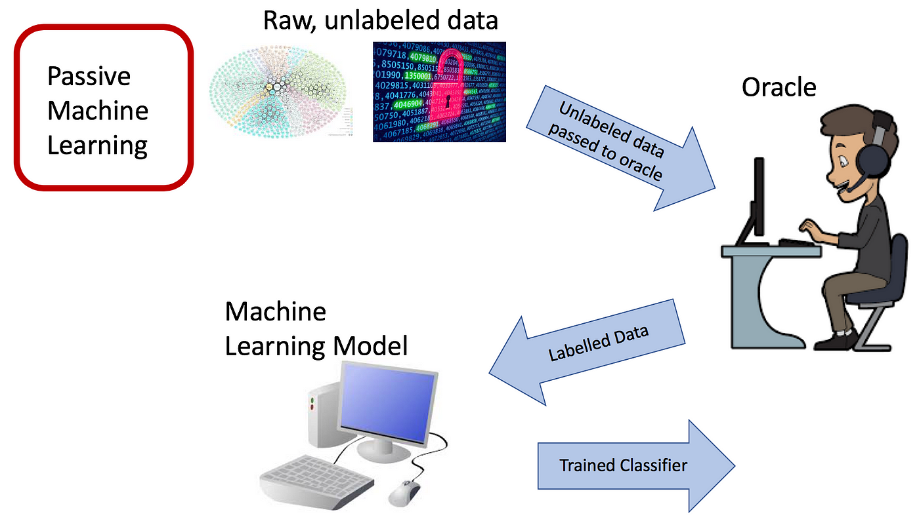
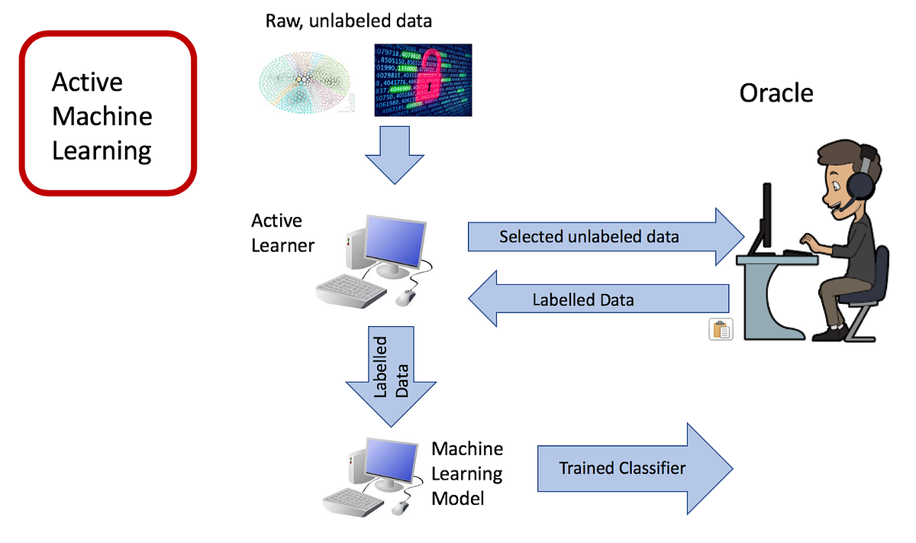
2/ How active learning works

Slide 4
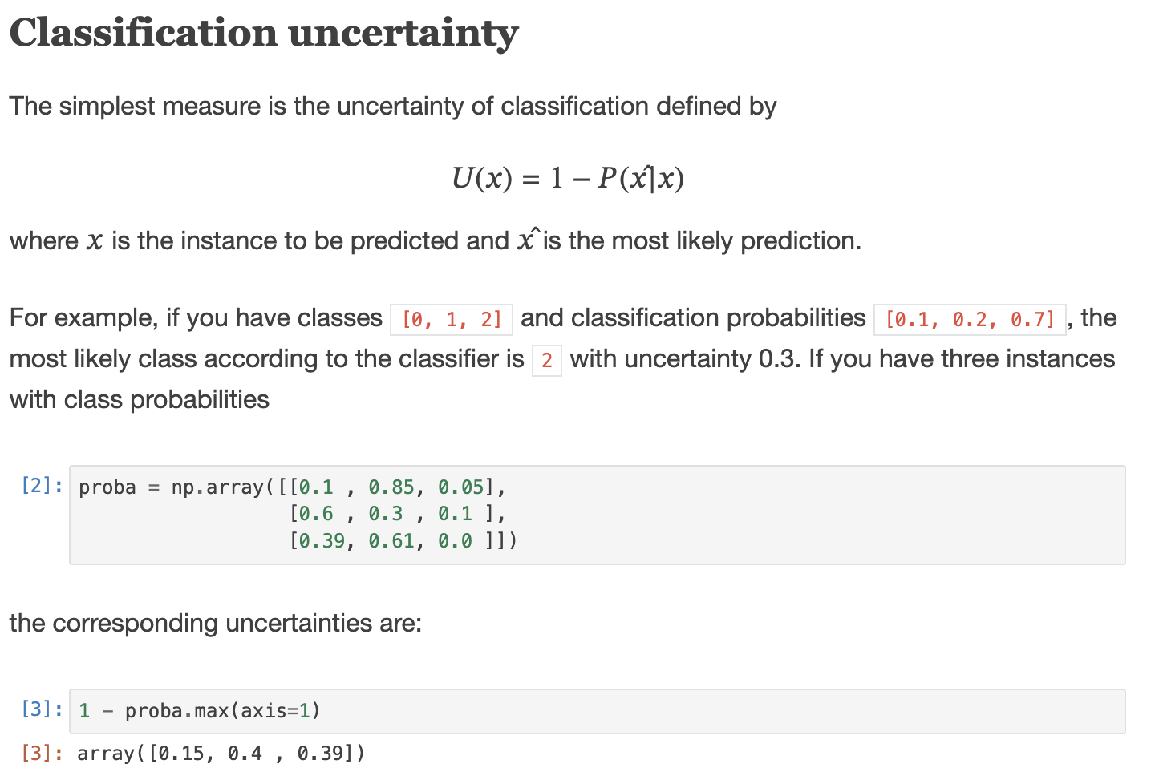
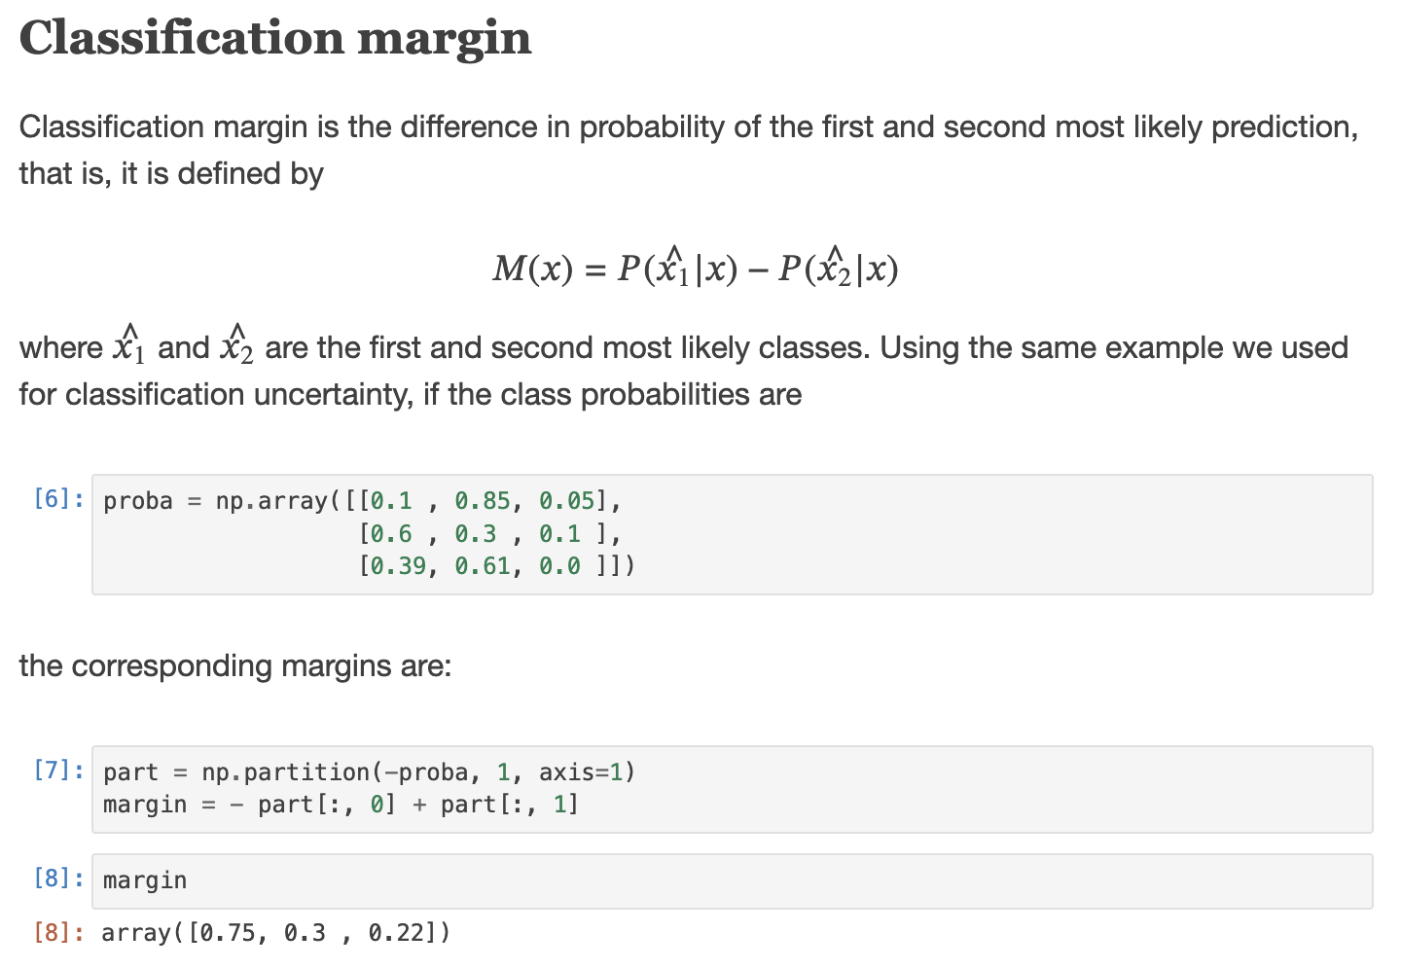
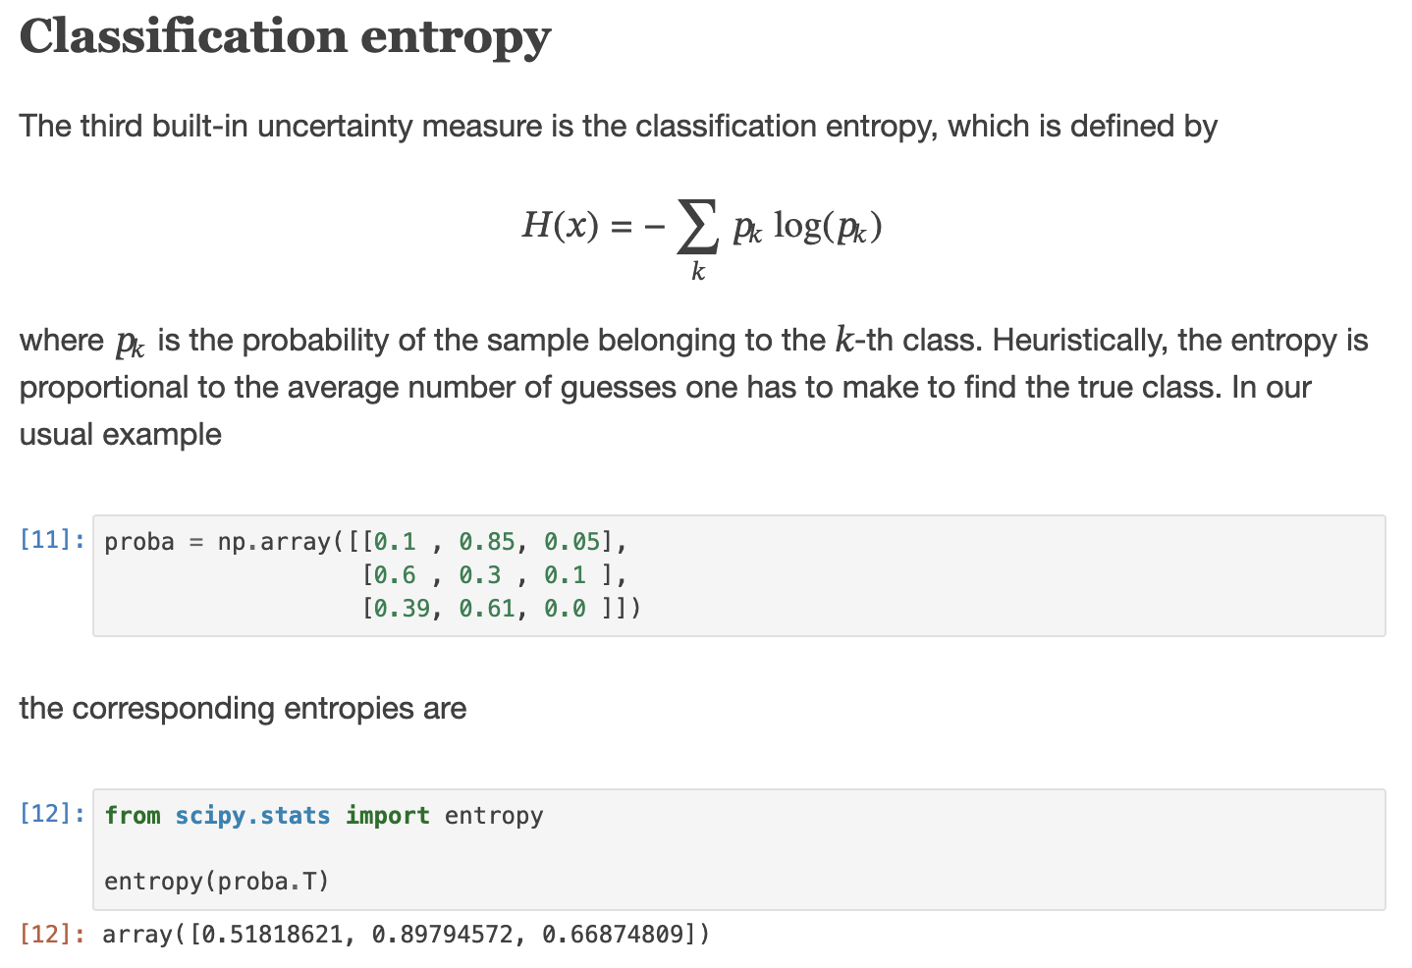
3/ Active learning strategies
Uncertainty Sampling: Selects data points where the model is least certain
Query by Committee: Uses multiple models to vote on the most uncertain data

Slide 5
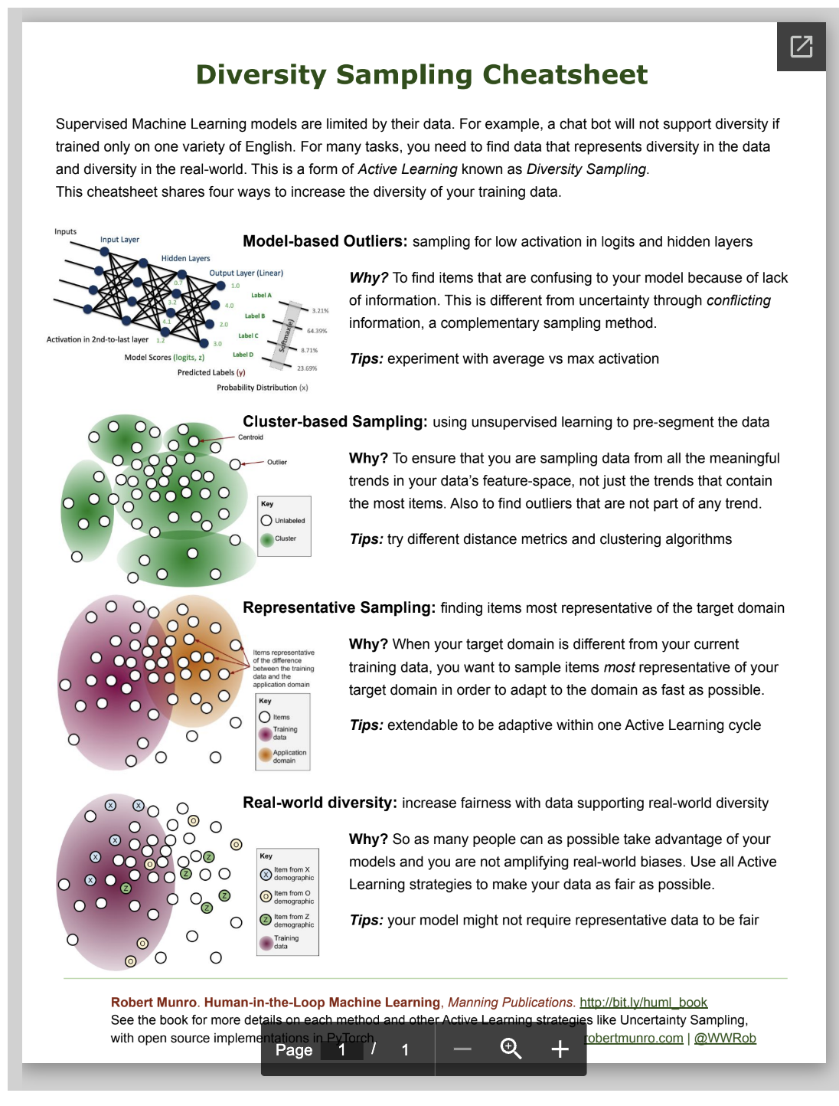
3/ Active learning strategies
Diversity Sampling: Chooses a diverse set of data points to maximize information gain.
Expected Model Change: Selects points that would most change the current model.

Slide 6
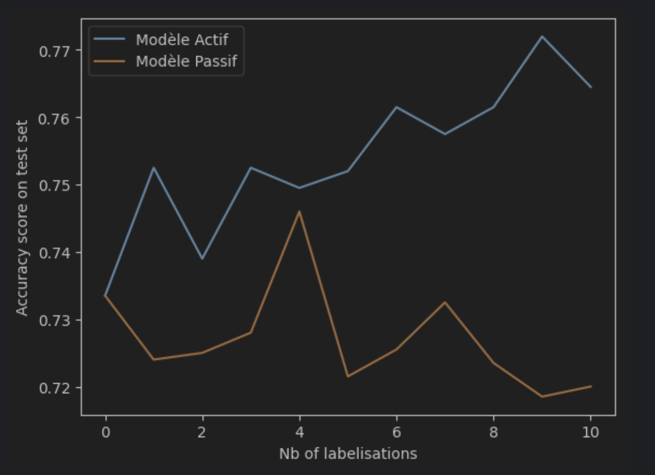
4/ Application

Slide 7
5/ Challenges and Considerations
Labeling Quality: Ensuring high-quality labels from the oracle.
Model Bias: Avoiding biases introduced during the selection process.
Computational Cost: Managing the computational resources required for retraining models.
Stopping Criteria: Deciding when to stop the active learning process.
Strategies Optimisation: More Simple More Fun

