Slide 1
Impact of Anti-Smoking Policies and Support Programs on Smoking Rates in European Countries
Valentin SIRLONGE

Slide 2
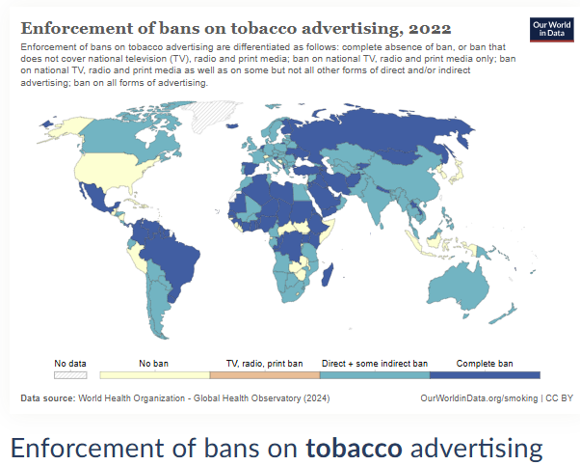
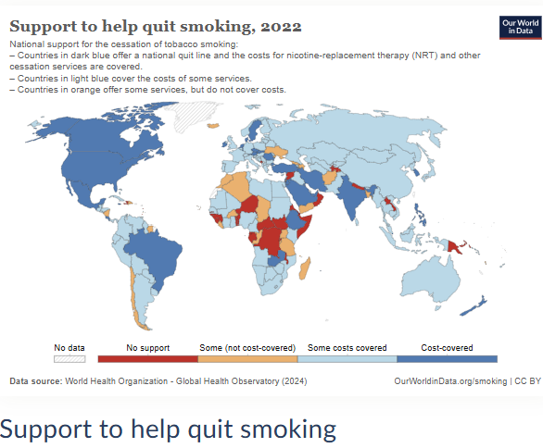
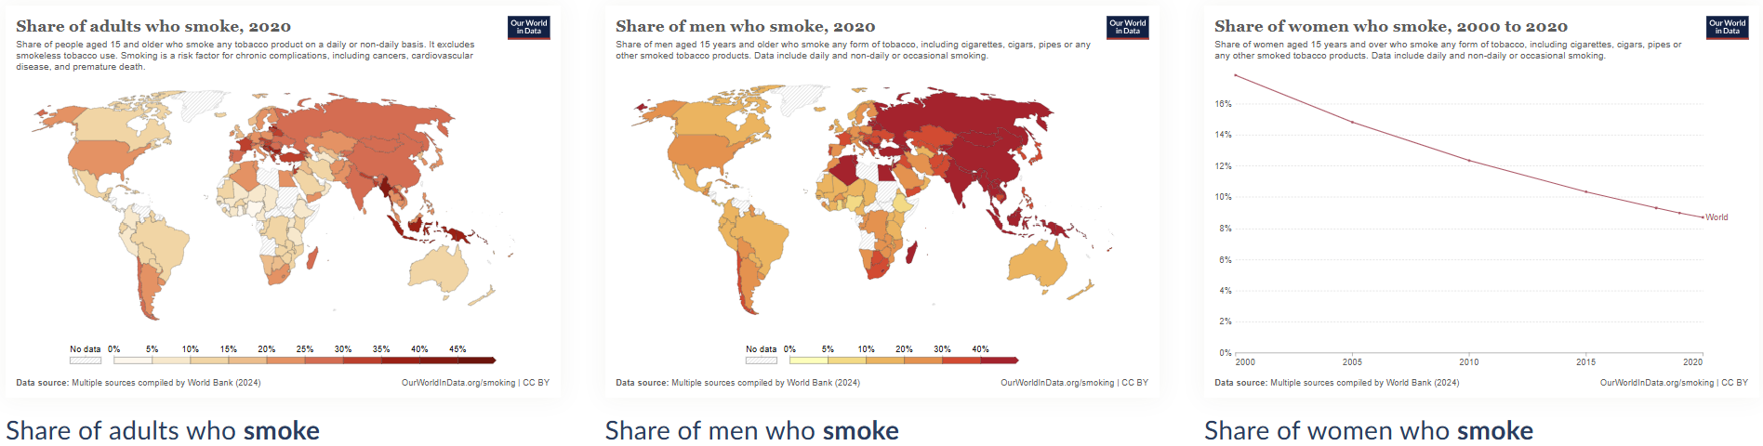
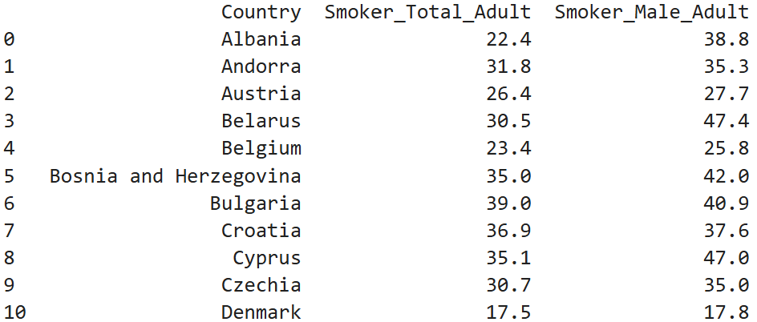
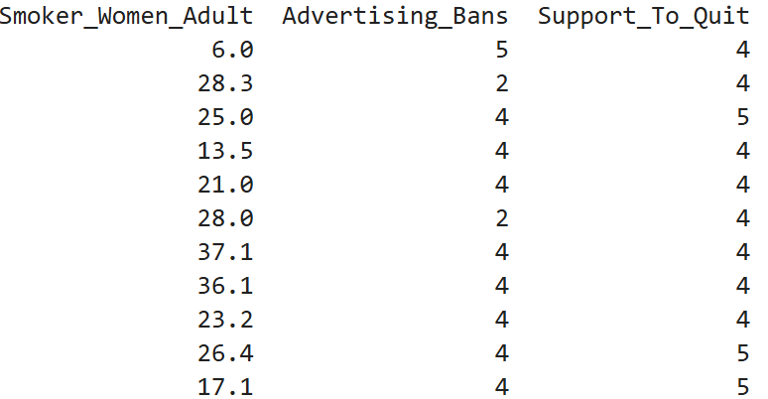
Hypothesis and Data Sources
Hypothesis : Men smoke more than women, even in European countries actively combating tobacco consumption.
Datasets: I used 5 datasets that I merged together. I renamed some columns and filtered to keep only European countries and the year 2020. I kept only these columns :

Slide 3
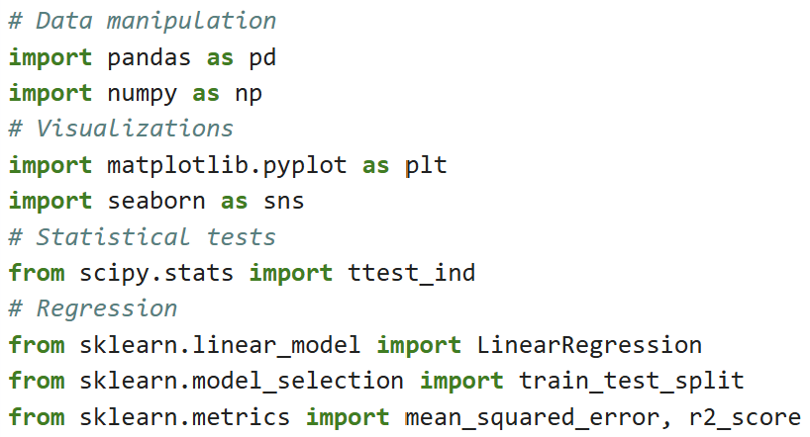

Analysis
Libraries Used : pandas, numpy, seaborn, matplotlib, scipy.stats, sklearn.metrics,
sklearn.linear_model, sklearn.model_selection.
Steps Taken:
Data Cleaning: Filtering European countries and 2020 data.
Exploratory Data Analysis: Generated descriptive statistics and visualizations.
Hypothesis Testing: Performed a t-test to compare male vs. female smoking rates.
Regression Analysis: Examined the relationship between policies and smoking rates.
Linear Regression: Used to predict total smoking rates based on gender specific rates.

Slide 4
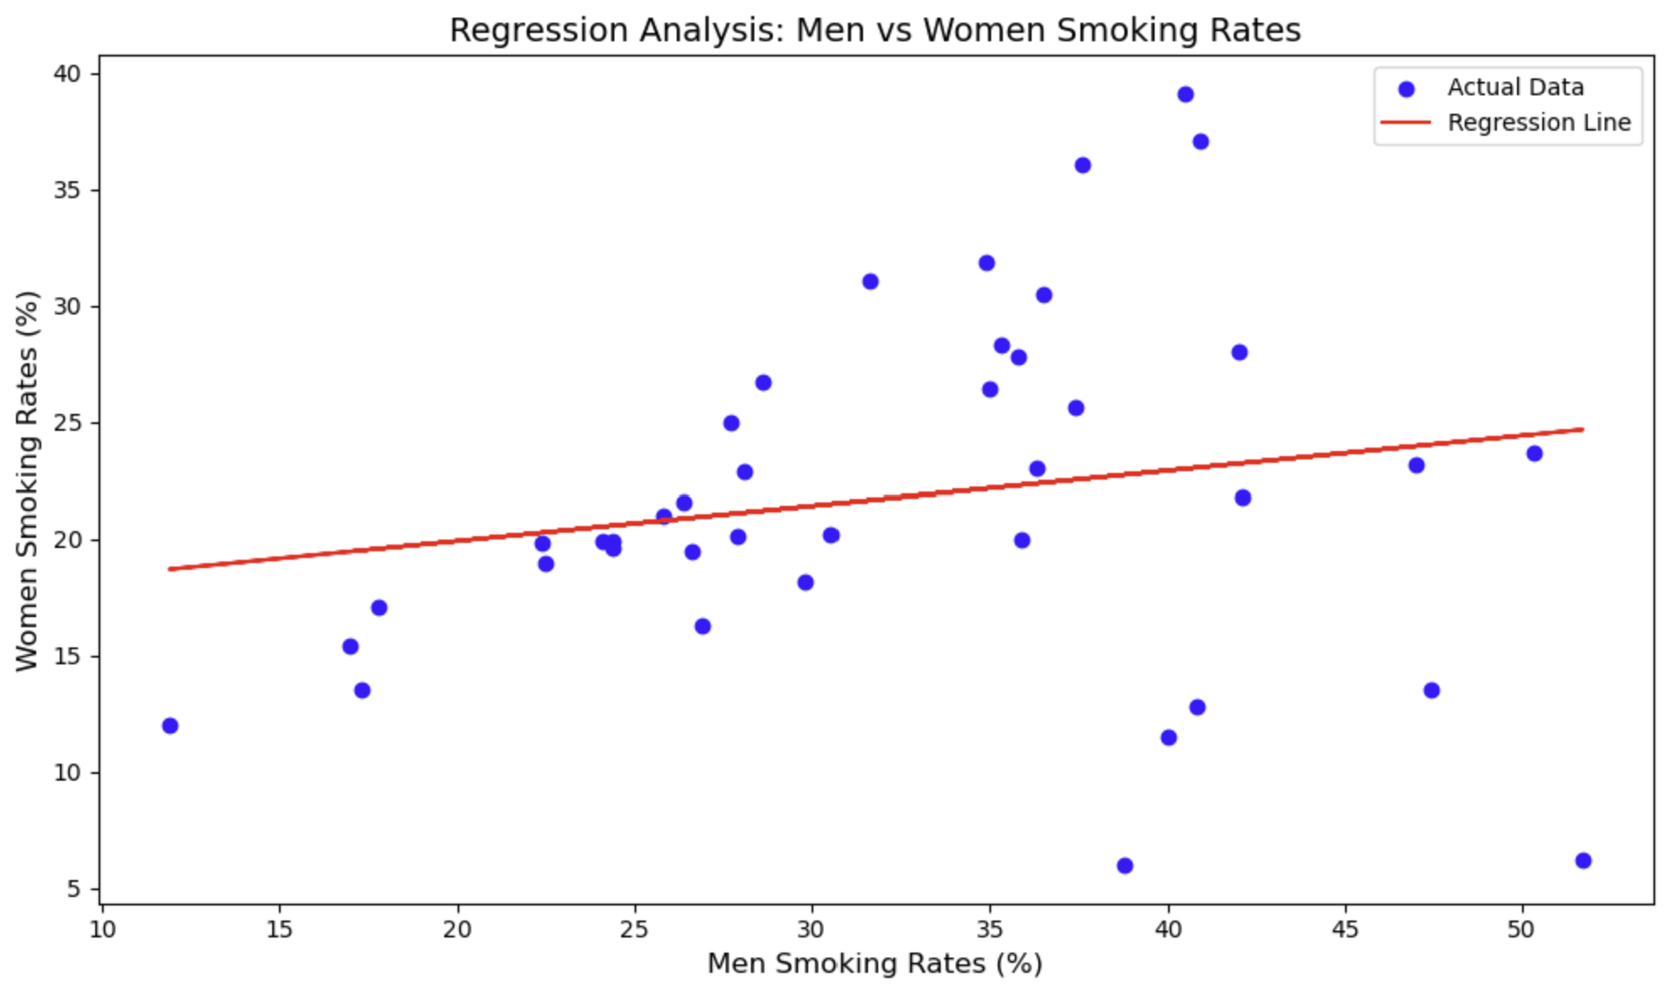
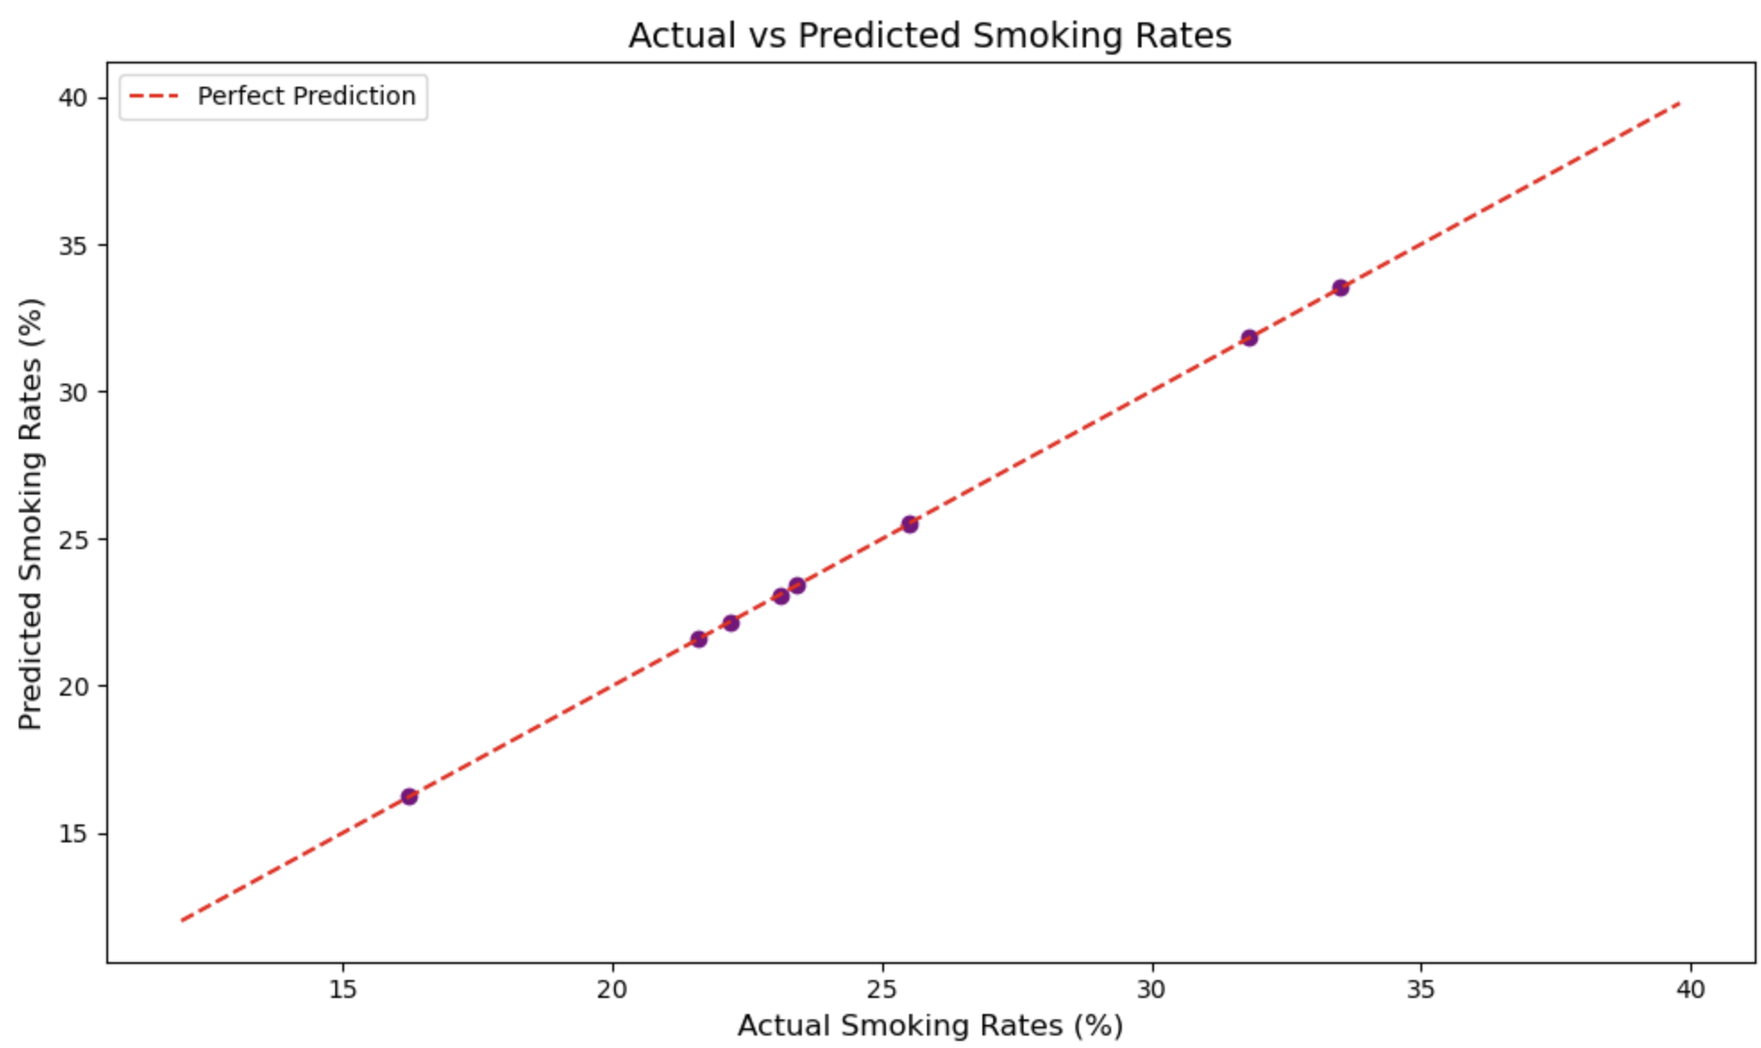
Results
T-Test
P-value: 0.0000001305 (highly significant, far below 0.05).
There is a significant difference in smoking rates between men and women.
Regression Analysis
Regression coefficient: 0.10 (positive correlation).
A 1% increase in male smoking rates corresponds to a 0.10% increase in female smoking rates, suggesting additional external factors influence smoking behaviors.
Linear Regression
Mean Squared Error : 0.00060
A lower MSE indicates the model is better at predicting total smoking rates from men and women data.

Slide 5

Conclusion
The analysis supports the hypothesis: Men smoke more than women, even in European countries actively combating tobacco consumption.
Key Findings:
Only countries with very strict advertising bans report lower smoking rates.
Eastern Europe has the highest concentration of smokers.
Support programs to quit smoking are high in European countries.
Men smoke more than women across Europe, with 32.97% of men smoking compared to 22.03% of women.

