Slide 1

Hypermedia As the Engine of Application State (HATEOAS)
SoftUni Team
Technical Trainers
Software University
https://softuni.bg

Slide 2
Table of Contents
What is HATEOAS
HATEOS Examples
Implement HATEOAS in Spring
Benefits & Negatives
HAL Explorer

Slide 3
Have a Question?
sli.do #java-web

Slide 4

What is HATEOAS

Slide 5
Hypermedia As the Engine of Application State
HATEOAS is a constraint of the REST application architecture
Keeps the RESTful style architecture unique from most other network application architectures
Uses hypermedia to describe what future actions are available to the client
Allowable actions are derived in the API based on the current application state and returned to the client as a collection of links

Slide 6
Hypermedia As the Engine of Application State (2)
Client uses these links to drive further interactions with the API
Tells the client what options are available at a given point in time.
Doesn't tell them how each link should be used or exactly what information should be sent
It is conceptually the same as a web user browsing through web pages by clicking the relevant hyperlinks to achieve a final goal

Slide 7

HATEOAS Example

Slide 8
HATEOAS Example (1)
Simple response without using HATEOAS
We have a simple REST controller that returns entity in JSON format to the client
{ "id" :2, "name": "Pesho", "age":12 }

Slide 9
HATEOAS Example (2)
Using HATEOAS
{ "id":2,"name":"Pesho","age":12," _links":{ "self":{"href":"http://localhost:8080/students/2"},
"delete":{"href":"http://localhost:8080/students/delete/2"},
"update":{"href":"http://localhost:8080/students/update/2"},
"orders":{"href":"http://localhost:8080/orders/allByStudentId/2"}
} }

Slide 10
Rel & Href
rel - describes the relationship between the Student resource and the URL
In example above – self, update, delete …
describes the action that's performed with the link
It's important that this value is intuitive as it describes the purpose of the link
href - the URL used to perform the action described in rel

Slide 11

Implement HATEOAS in Spring

Slide 12
Using HATEOAS in Spring Framework
Adding hypermedia links to RESTful responses is something you could implement on your own, but …
Spring HATEOAS makes it very easy
<dependency>
<groupId>org.springframework.hateoas</groupId>
<artifactId>spring-hateoas</artifactId>
<version>1.1.0.RELEASE</version>
</dependency>

Slide 13
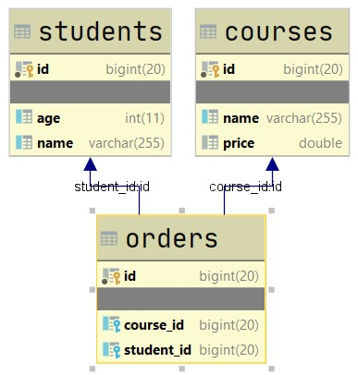
Example App DB
Our example app have small base with some relations between entities
We have Students, Orders and Courses

Slide 14
Prepare Controllers to Work
If we implementing RepresentationModel <T> we can added links directly to our entity
We need two methods from WebMvcLinkBuilder, that’s why we must import them
import static org.springframework.hateoas.server.mvc.WebMvcLinkBuilder.linkTo;
import static org.springframework.hateoas.server.mvc.WebMvcLinkBuilder.methodOn;

Slide 15
Main Work in Controller (1)
... // Without implementing RepresentationModel<T>
Optional<Student> studentOpt = this.studentRepository.findById(id);
return studentOpt .map(s -> ResponseEntity.ok( EntityModel.of(s, getStudentLinks(s)))) .orElse(ResponseEntity.notFound().build());
//continue to next slide
...

Slide 16
Main Work in Controller (2)
... // Without implementing RepresentationModel<T>
private Link[] getStudentLinks(Student student) {
Link self = linkTo(methodOn(StudentsController.class)
.getStudent(student.getId()))
.withSelfRel();
Link orders = linkTo(methodOn(StudentsController.class)
.getAllOrdersByStudentId(student.getId()))
.withRel("orders");
return List.of(self, orders).toArray(new Link[0]);
}

Slide 17
Main Work in Controller (3)
... // Implementing RepresentationModel<T>
Student student = this.studentService.findById(id);
student.add(linkTo(methodOn(StudentsController.class)
.getStudent(student.getId())) .withSelfRel());
student.add(linkTo(methodOn(StudentsController.class)
.deleteStudent(student.getId())) .withRel("delete"));
//continue to next slide
...

Slide 18
Main Work in Controller (4)
... // Implementing RepresentationModel<T>
student.add(linkTo(methodOn(StudentsController.class)
.updateStudent(student.getId(), student)) .withRel("update"));
student.add(linkTo(methodOn(OrdersController.class)
.findAllOrdersByUserId(student.getId()))
.withRel("orders"));
return ResponseEntity.ok(student);
...

Slide 19
Benefits of Using HATEOAS
URL structure of the API can be changed without affecting clients
If the URL structure is changed in the service, clients will automatically pick up the new URL structure via hypermedia
Hypermedia APIs are explorable
Guiding clients toward the next step in the workflow by providing only the links that are relevant based on the current application state

Slide 20
Negatives of Using HATEOAS
Adds extra complexity to the API, which affects to:
developer needs to handle the extra work of adding links to each response
more complex to build and test than a vanilla CRUD REST API
clients also have to deal with the extra complexity of hypermedia

Slide 21

HAL Explorer

Slide 22
HAL Explorer
To use HAL Explorer we need to add dependency
<dependency>
<groupId>org.springframework.data</groupId>
<artifactId>spring-data-rest-hal-explorer</artifactId>
</dependency>

Slide 23
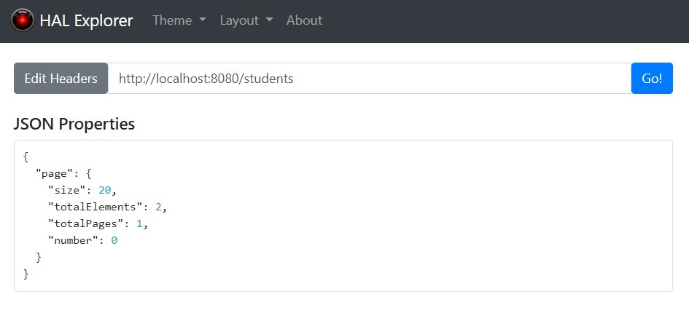
HAL Explorer Example (1)

Slide 24
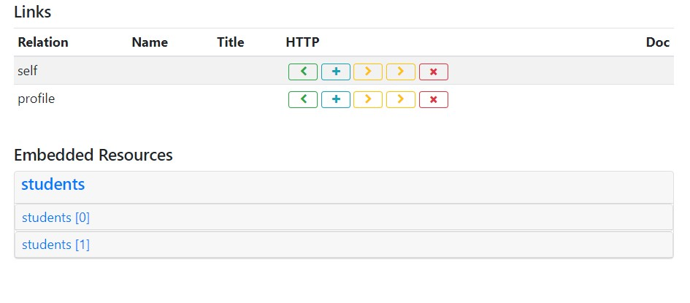
HAL Explorer Example (2)
GET
DELETE
POST
PATCH
PUT

Slide 25
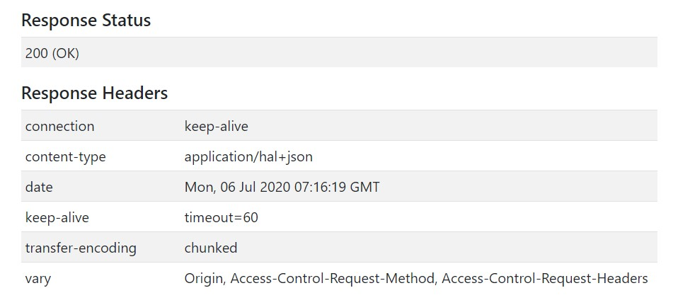
HAL Explorer Example (3)

Slide 26
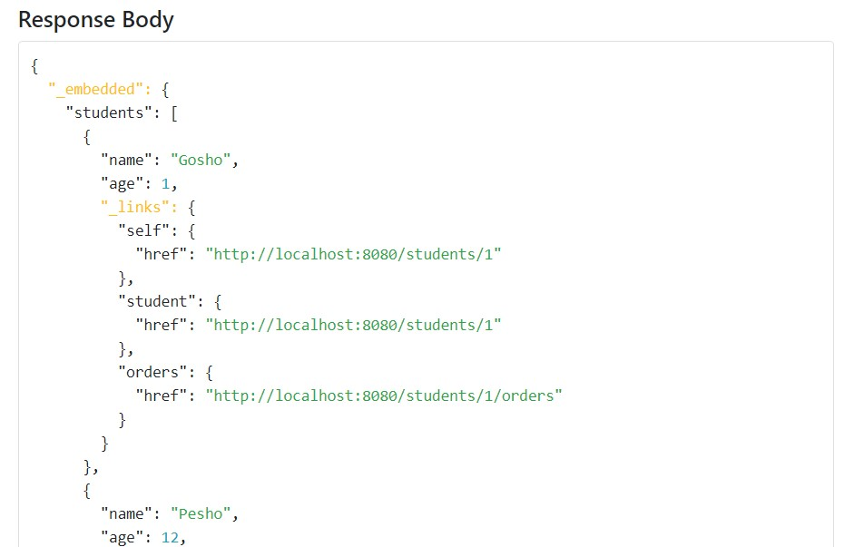
HAL Explorer Example (4)

Slide 27

Summary
HATEOAS
What is HATEOAS
HATEOAS Examples
Implementing it in Spring
HAL Explorer
Working with HAL Explorer

Slide 28
Questions?
Notes:
28

Slide 29












SoftUni Diamond Partners

Slide 30


Educational Partners

Slide 31
Trainings @ Software University (SoftUni)
Software University – High-Quality Education, Profession and Job for Software Developers
softuni.bg, about.softuni.bg
Software University Foundation
softuni.foundation
Software University @ Facebook
facebook.com/SoftwareUniversity
Software University Forums
forum.softuni.bg
Notes:
31

Slide 32

License
This course (slides, examples, demos, exercises, homework, documents, videos and other assets) is copyrighted content
Unauthorized copy, reproduction or use is illegal
© SoftUni – https://about.softuni.bg/
© Software University – https://softuni.bg
Notes:
32

