Slide 1
Generating new music with deep probabilistic models
Valentin Vignal
Notes:
Hello,
French student
- French Double Degree Program
- This is my dissertation
I’m going to talk about my Dissertation and the work I have done.
Deep neural network handle one task
Generate
harmonize
Musician can do several task:
Create song
Arrange
Harmonize
Improvize
Play with others
Objective : create a model which can perfom several tasks
Generate
Create musical part(s) from other musical part(s)
Play with people ?
I wanted to give some knowledge to the model:
3 loss functions
I’m a musician -> Did all the decision by following my musical instinct

Slide 2
List of contents
Background knowledge
Related works
Contribution
Results
Band Player
Questions

Slide 3
Background knowledge
MIDI format
Music theory
Physical properties

Slide 4
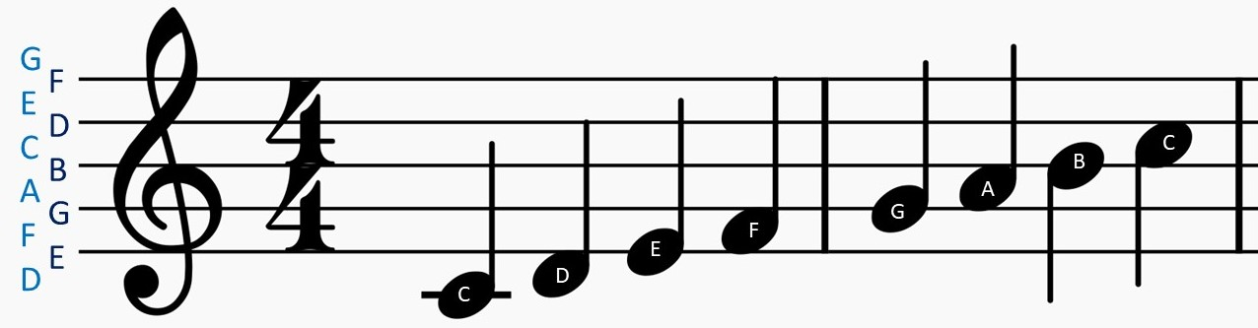
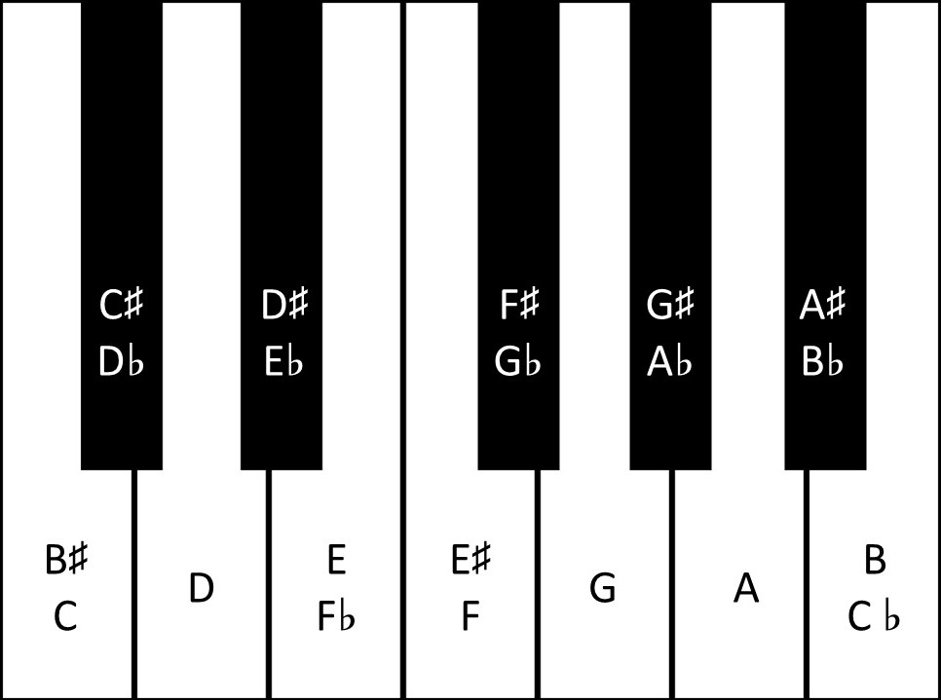
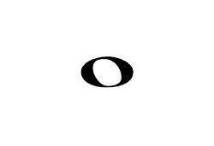




Musical Stave
Pitch
Time
Note shape | Name | Note length
 | Whole note | 4 beats
 | Half note | 2 beats
 | Quarter note | 1 beat
 | Eighth note | ½ beat
 | Sixteenth note | ¼ beat
Notes:
Musical stave:
2 axis:
Time
Pitch
Note correspond to the white key: C major or A minor
Shape of the note: its length
12 different notes

Slide 5
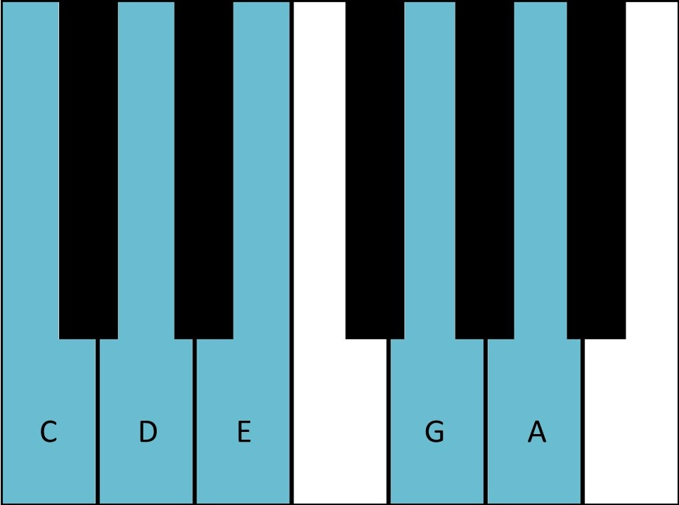
Musical Scale
A scale is a set of notes.
The white keys of a piano form the C major scale
C major pentatonic
Notes:
A scale is a set of notes
Several scales:
Major
Minor
Natural
Harmonic
Melodic
Pentatonic
Major
Minor
The human ear is used to those sets of notes so it sounds nice.

Slide 6

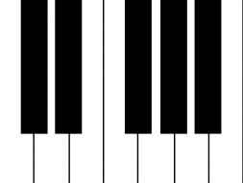



MIDI Format
It is a protocol to carry musical events between musical devices or software
VST
MIDI signal
Musical waveform
“Note on” event:
$$<NoteOn, channel, pitch, velocity>$$
“Note off” event:
$$<NoteOff, channel, pitch, velocity>$$
$channel∈[0, 15]$
$pitch∈[0, 127]$
$velocity∈[$0, 127]
Notes:
VST: Virtual Studio Technology
Events:
NoteOn to activate a note
NoteOff to deactivate it

Slide 7
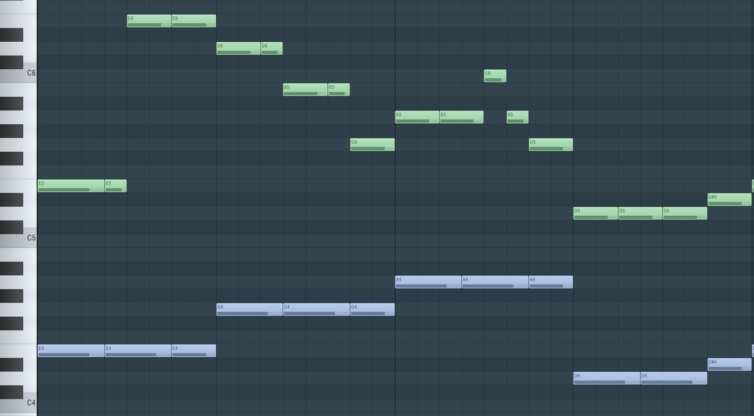
MIDI format
Pianoroll
E5, _ , _ , E5, E6, _ , E6, _ , D6, _ , D6, B5, _ , B5, G5, _ , …
E4, _ , _ , E4, _ , _ , E4, _ , G4, _ , _ , G4, _ , _ , G4, _ , …
Text
Notes:
Several format can be derived from the MIDI one
Pianoroll:
Most of the electronic composition software use that (FL Studio, Ableton…)
Text:
Just write the notes
Then go through word2vec model
Most of the works use these 2 translations -> I use this one
Waveform
48 kHw -> Too much data -> poor results

Slide 8

Harmonics
A musical sound is composed of harmonics
$$s\left(t\right)= \sum_{n=1}^{∞}{α_{n} sin⁡(nft+φ_{n})}$$
Harmonic number | Frequency (Hz) | Note Name | Musical Interval
1 | 440 | A4 | Unison
2 | 880 | A5 | Octave
3 | 1320 | E5 | Fifth
4 | 1760 | A6 | Octave
5 | 2200 | C#6 | Major Third
6 | 2640 | E6 | Fifth
Notes:
I don’t consider inharmonicity of stringed instruments (common assumption)
Sound has several harmonics
Multiple of its fundamental frequency
All harmonics of A5 or E5 or … are contained in the harmonics of A4
-> A5 or E5 or … is IN A4

Slide 9
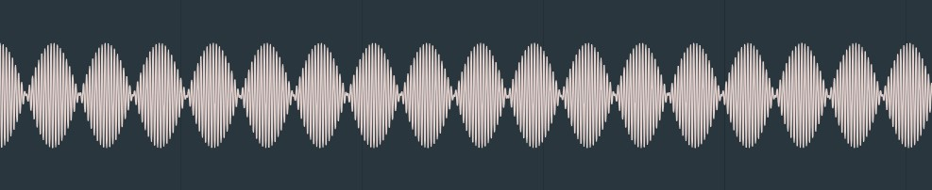
Resonance phenomena
Two sounds with a close frequency will generate a resonance phenomena
Resonance phenomena from a B4 and a C5
$\cos\left(f\right)+\cos\left(f+δf\right)=2\cos\left(\frac{2f+δf}{2}\right)\cos\left(\frac{δf}{2}\right)$
Notes:
B4: 494Hz
C5: 523Hz
Trigonometric identity

Slide 10
Intervals
“Acceptable” intervals
“Not acceptable” intervals
Interval | Reason | Example with A4
Octave | Contained in tonic’s Harmonics | A5
Minor Third | Share harmonics (A and C share E in their harmonics) | C6
Major Third | Contained in tonic’s harmonics | C#6
Fifth | Contained in tonic’s harmonics | E6
Interval | Reason | Example with A4
Semitone | Resonance phenomena between fundamental frequencies | A#5
Tone | Resonance phenomena between fundamental frequencies | B5
Tritone | Resonance phenomena between fundamental frequency and third harmonic (D and D#) | D#6
Notes:
From the harmonics and the resonance phenomena
Some notes sound good together
Some other don’t
Major chord sounds really nice because all notes in tonic.
Not acceptable intervals generate resonance phenomena
Tritone called Diabolus in musica"("Devil in the music") and was forbidden by the church at medieval time

Slide 11
Related works
Objective
Generate musical parts
Harmonize
Data Representation
MIDI format translated to text
Songs transposed in C major
Architectures Users
NADE
AutoEncoder (most common)
VAE
GAN
Transformers
Notes:
### Objectives
Generate
Bach Both
Create an accompaniment
DeepBach
### Data representation
Most of the works use MIDI dataset translated in text
They consider only Sixteenth notes
The dataset is usually transposed into C major or A minor
Some metadata can be passed
Beat number
Tempo
Fermata symbol
### Architecture used
NADE (Bach Doodle)
AutoEncoder (most popular) (DeepBach, BachBot)
VAE (waveform mostly) , not for generation, more for interpolation
GAN (for style transfert mostly: CycleGan)
Transformers: State of the art longest generated sequences (Google Magenta)

Slide 12
Contribution
Objectives
Data representation
RMVAE
Global architecture
RPoE
Encoder/Decoder Architecture
Activation function
Custom loss functions
Scale
Rhythm
Harmony

Slide 13
Objectives
Generate a music with several musical parts
Create an accompaniment from a melody
Create a melody from an accompaniment
Create musical parts from other musical parts
Notes:
Generate song
Recreate musical part(s) from other musical part(s)

Slide 14



Data representation
I consider binary rhythm only (1 beat is divided in 2 equal beats)
The smallest notes I consider are the Sixteenth notes
A “step” is a measure
There are 16 Sixteenth notes division in a measure
From a fixed number of measures, the model will predict the next one
128 different pitches
A tensor representing a measure: (16, 128, channels)
$$m_{1}$$
model
…
$$m_{n+1}$$
$$m_{n}$$
Notes:
MIDI format
Binary Rhythm
Sixteenth notes
Measure is a step
Rhythm
Scale
Tensor shape (16, 128, channels)

Slide 15
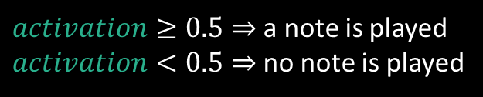
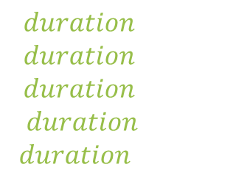
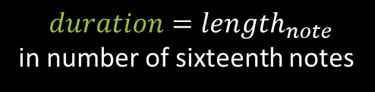
Data Representation – Polyphonic Music
(16, 128, channels=2)
Activation channel:
Sigmoid activation function
Binary cross-entropy loss
Duration channel:
ReLU activation function
Mean squared error loss
$activation≥0.5⇒$a note is played
$activation<0.5⇒$no note is played
duration
activation
Pitch
$$duration=length_{note}$$
in number of sixteenth notes
$$duration=1⇒$$
$$duration=2⇒$$
$$duration=4⇒$$
$$duration=8⇒$$
$$duration=16⇒$$
Channel
Time

Slide 16


Data Representation –Monophonic Music
(16, 128 + 1, channels=1)
Activation channel:
Softmax activation function
Categorical cross-entropy loss
Extra $note_{continue}⇒$continue the previous note
activation
Pitch
Argmax of $activation$ is played
Time
Notes:
Simpler
Reduce model size

Slide 17
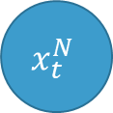
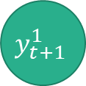

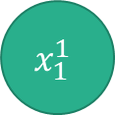

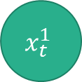
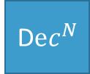



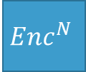

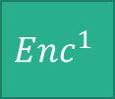



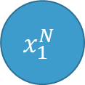
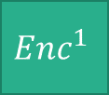
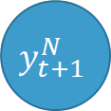

Recurrent Multimodal Variational AutoEncoder
$$x_{1}^{1}$$
$$x_{1}^{N}$$
$$x_{t}^{1}$$
$$x_{t}^{N}$$
…
…
$$Enc^{1}$$
$$Enc^{N}$$
$$Enc^{1}$$
$$Enc^{N}$$
$$μ_{1}^{1}, σ_{1}^{1}$$
$$μ_{1}^{N}, σ_{1}^{N}$$
$$μ_{t}^{1}, σ_{t}^{1}$$
$$μ_{t}^{N}, σ_{t}^{N}$$
PoE
…
PoE
$$μ_{1}, σ_{1}$$
$$μ_{t}, σ_{t}$$
Sampling
Sampling
$$z_{1}$$
$$z_{t}$$
LSTM
…
LSTM
D$ec^{1}$
D$ec^{N}$
$$y_{t+1}^{1}$$
$$y_{t+1}^{N}$$
…
Notes:
Last step: MVAE
Encoder: return the parameters of the latent distribution
PoE : From MVAE of Mike Wu: compute parameters from joint posterior distribution
Sampling: (from VAE) to get a point from the latent space
LSTM layers to encode the time dependencies of this latent space
Decoders: take point from latent space and generate the new measures

Slide 18














Recurrent Product of Experts
$$μ_{prior}, σ_{prior}$$
$$μ_{1}^{1}, σ_{1}^{1}$$
$$…$$
$$μ_{1}^{N}, σ_{1}^{N}$$
$$μ_{2}^{1}, σ_{2}^{1}$$
$$…$$
$$μ_{2}^{N}, σ_{2}^{N}$$
$$μ_{T}^{1}, σ_{T}^{1}$$
$$…$$
$$μ_{T}^{N}, σ_{T}^{N}$$
PoE
PoE
PoE
$$…$$
$$μ_{1}, σ_{1}$$
$$μ_{2}, σ_{2}$$
$$μ_{T}, σ_{T}$$

Slide 19
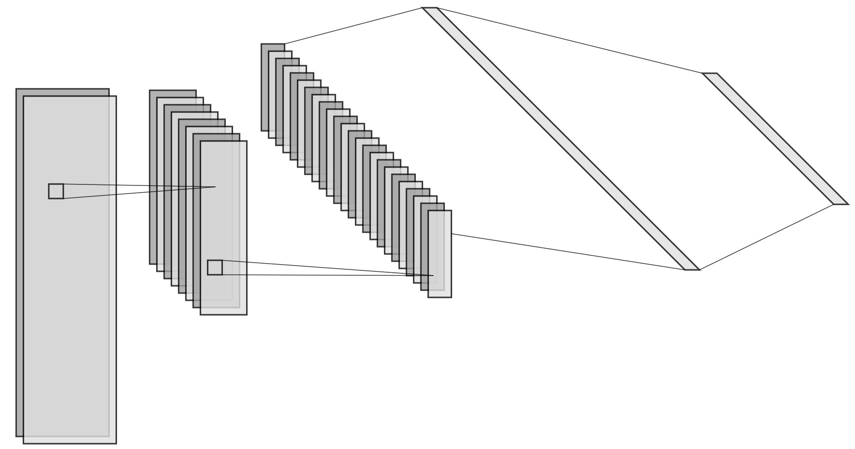
Convolutional Encoder/Decoder
Input tensor : (16, 128, channels)
Encoder
Convolutional layers
Fully Connected layers
Decoder
Fully Connected layers
Transposed Convolutional layers
1 Fully Connected layer
Convolutional filter : (5, 5)
Notes:
Same dimensions for Encoder and Decoder
1 fully connected at the end
Big
But helps a lot
Filter size (5, 5) -> Receptive field of first layer is a beat and a Major Third

Slide 20


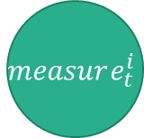











Recurrent Encoder/Decoder
$$measure_{t}^{i}$$
$$latent_{t}^{i}$$
Split
$$FC_{measure}^{dec, i}$$
Input tensor : (16, 128)
$$frame_{0}$$
$$frame_{15}$$
…
LSTM
LSTM
Encoder
Splits the measure into several frames
Encodes the frames with fully connected layers
Extracts the latent space with bidirectional LSTMs
Encodes the latent space with fully connected layers
Decoder
Decodes the latent space with fully connected layers
Generates the encoded frames with bidirectional LSTMs
Decodes the frames with fully connected layers
Concatenates the frames to create the measure
…
$$FC_{frame}^{enc, i}$$
$$FC_{frame}^{enc, i}$$
$$FC_{frame}^{dec, i}$$
$$FC_{frame}^{dec, i}$$
LSTM
…
LSTM
$$frame_{0}$$
$$frame_{15}$$
…
$$FC_{measure}^{enc, i}$$
Concat
$$latent_{t}^{i}$$
$$measure_{t}^{i}$$
Notes:
Only for monophonic music
Succesion of frame (Sixteenth note)

Slide 21
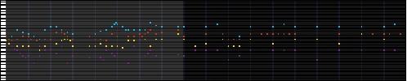

Activation and Loss function
Softmax activation
Categorical crossentropy loss
Notes:
For monophonic music
Poor results: no notes
TIP TO FOLLOW:
Follow the first or last voice

Slide 22
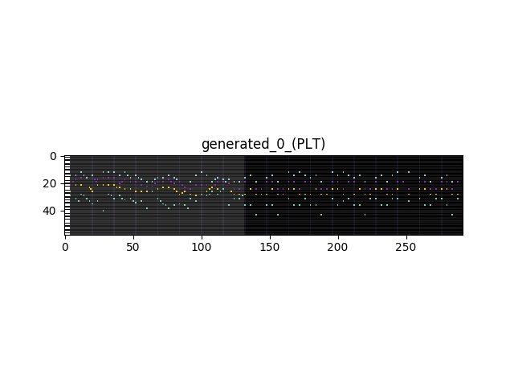


Activation and Loss function
softmax
$note_{continue}$
Sigmoid activation
Binary crossentropy
“real” notes
Softmax activation
Categorical crossentropy
“real” notes
Sigmoid
$$note_{continue}$$
Notes:
For monophonic music
Huge number of considered notes (128 + 1)
Average: silence and note not played
Note continue axis: rhythm axis
More notes are generated

Slide 23

Prior knowledge with loss function
Helps the model to do “acceptable mistakes”
Gives a reward (decrease the loss)
Prevents the model to do “unacceptable mistakes”
Gives a penalty (increase the loss)
var loss;
var reward > 0;
var penalty > 0;
if (soundsGood($note_{predicted}$)) {
loss -= reward;
} else {
loss += penalty;
}
Notes:
I wanted the network to generate more notes
Not much
Always the same
Difficulties
soundsGood function
It has to be differentiable

Slide 24

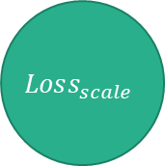
Scale loss
truth
predict
Reconstructs the local scale with the notes present in the truth tensor
Incites the model to generate note present in the truth tensor
(inst, 16, 128)
Reduce sum
Reduce sum
(128,)
Segment sum
Segment sum
A1
B1
C1
D1
A2
B2
C2
D2
A3
B3
C3
D3
1
0
0
1
0
0
1
1
0
0
1
1
(12,)
$$1−2×clip_{01}$$
(12,)
Scalar product
+
+
+
+
(1,)
Segment sum
1
0
2
3
$$Loss_{scale}$$
A
B
C
D
Notes:
Generate the local loss from the truth tensor
Reduce sum + segment sum -> project the note in the 12 notes space
Clip part to normalize it
Positive value for generated notes not in local scale
Negative value for generated notes in local scale
It is differentiable

Slide 25
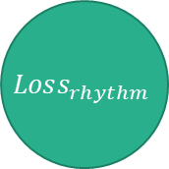
Rhythm loss
truth
predict
Reconstructs the local rhythm with the notes present in the truth tensor
Incites the model to generate notes when a note is played in the truth tensor
(inst, 16, 128)
Reduce sum
Reduce sum
(16,)
$$1−2×clip_{01}$$
(16,)
Scalar product
(1,)
$$Loss_{rhythm}$$
Notes:
Same as scale
Positive value for predicted note not at the same time as a truth note
Negative value for predicted note at the same time as a truth note
It is differenciable

Slide 26






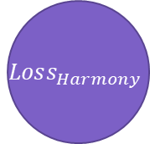
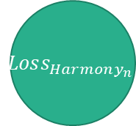

Harmony loss
predict
predict
(inst, 16, 128)
(inst, 16, 128)
3 intervals are dissonant on their own:
Semitone
Tone
Tritone
Harmony prevents the model to play these intervals
$$Harmony_{1}$$
$$Harmony_{2}$$
$$Harmony_{6}$$
Reduce sum
(1,)
(128,)
sum
Segment sum
(1,)
$$Loss_{Harmony}$$
$$Roll_{n}$$
(12,)
Scalar product
$$Harmony$$
(1,)
$$Loss_{Harmony_{n}}$$
0
1
2
3
4
5
6
7
8
9
10
11
$$Harmony_{n}$$
$$Roll_{2}$$
2
3
4
5
6
7
8
9
10
11
0
1
Notes:
Prevents unacceptable intervals
Only takes predicted tensor: cost function
Use a sub function Harmony_n to prevent a n-th interval (counted in semitones)
As scale loss: projection in the 12 notes space
Positive value (from softmax activation)
If unwanted interval in predicted tensor -> High value

Slide 27
Results
Implemented tasks
Experiments
Transposed data
Model size
Scale and Rhythm losses
Harmony loss
RPoE layer
Notes:
Implemented tasks
Conducted experiments

Slide 28
Generate
The generate task takes several measures and generate the next one
var seed; // list of measures
var n; // number of measures to generate
function generate(seed, n) {
var seedLength = seed.length;
var generated = seed;
for (k=1; k<=n; k++) {
var input = genetared[-seedLength:];
var output = model.predict(input); generated.push(output);
}
return generated;
}
Notes:
Generate new measure from the seed
Over and over
Can specify what instruments to consider with mask input

Slide 29
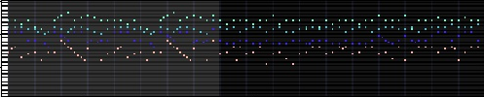
Generate – Convolutional and Recurrent encoder/decoder
Convolutional
Recurrent

Slide 30
Fill
Re-generates a voice of a song
var song; // list of measures
var instrument; // Instrument to replace
function fill(song, instrument) {
song.deleteInstrument(instrument);
var filled = song;
for (k=0; k < song.length – seedLength; k++) {
var input = genetared[k:k + seedLength];
var output = model.predict(input);
filled[k + seedLength, instrument] = output[instrument];
}
return filled;
}
Notes:
Create a musical voice from the others
Delete the instrument to recreate
Do generated task with corresponding mask

Slide 31
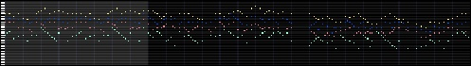
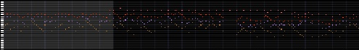
Fill
Original
Replace first voice
Notes:
Fill first voice (yellow and pink/red) at the top
See the complexity is low
End actually follow the music

Slide 32
Redo
Recreates a song by replacing one by one every voices
var song; // list of measures
function redo(song) {
var redone = song;
for (k=0; k < nbInstruments; k++) {
redone = fill(redone, k);
}
return redone;
}
Notes:
Recreate a song by replacing one by one every voices
It will do the fill task on every voices

Slide 33
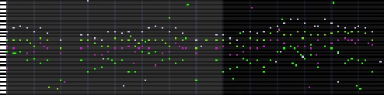
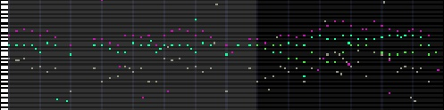
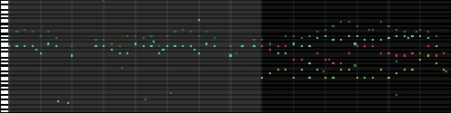
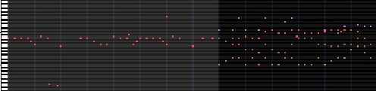
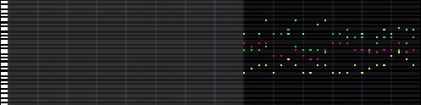
Redo
Original
Step 1
Replace instrument 3
Step 2
Replace instrument 4
Step 3
Replace instrument 1
Step 4
Replace instrument 2

Slide 34
Experiments
Notes:
Conducted some experiences to know if the loss functions or layers were actually helping the model
And I conducted some surveys:
Result : it doesn’t help

Slide 35
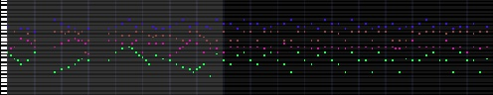
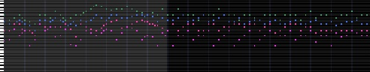
Transposed data
Without transposed data
With transposed data

Slide 36
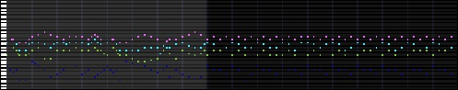
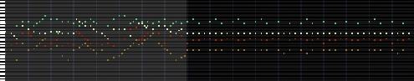
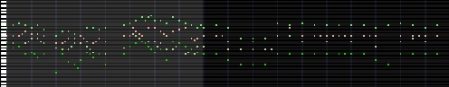
Model size
Small
Medium
Large

Slide 37
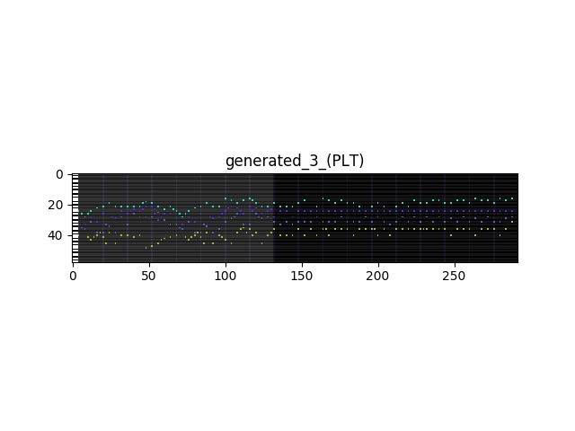
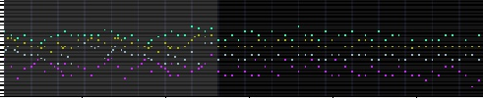
Scale and Rhythm losses
Without scale and rhythm losses
With scale and rhythm losses

Slide 38
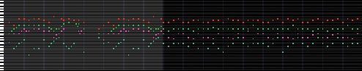
Harmony
Without harmony loss
With harmony loss

Slide 39
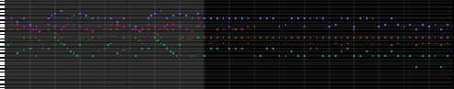
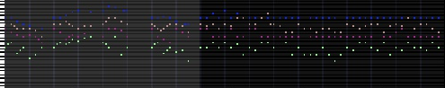
RPoE
Without RPoE
With RPoE

Slide 40
Band Player
Take a trained model and play with the user
The model had to be trained to predict the second next measure (for real time purpose)
Demonstration
Notes:
Script implementation to play in real time with the model
Works (But models are not good)
Can be real time because it calls the model only once every measure
For real time purpose: trained model should generate not the next measure but the one after
Can choose what voice to play and what voices to play with
Also some jupyter notebooks
Band player:
python controller.py -l r0sr00h0b1p1BP-MRRMVAEMono,1,8-100-0
python controller.py -l r1sr11h1b1p1BP-MRRMVAEMono,1,8-100-0
python controller.py -l name-MRRMVAEMono,pc,2-10-0 --nb-steps-shown 8
Jupiter Notebook:
- Jupyter notebook
Other:
Train: python train.py -m MRRMVAEMono,pc,2 --mono --pc -d Scale --use-binary

Slide 41
Conclusion
The RMVAE is an architecture able to handle several tasks
The results are poor in complexity and variations
The different loss functions and the RPoE layer don’t help the training.
Future works:
An exploration on most of the hyper parameter could help the model to perform better
The scale loss can be improved by including some scale templates
Notes:
Successfully handle several tasks with consistency
Easy to create a script for other tasks from the ones I already implemented
Poor results…
Loss functions and layers doesn’t help the model
BIG ISSUE: time
Train a model for 50 epochs : 2 days
Trained only on the quarter of all the songs I had
Because of the sub-sample training paradigm of the MVAE
Tensorflow Keras => Leak memory on CPU
Couldn’t do long training
Had to not load all the data in memory -> some tricks but it is longer (read a file)
Had to launch all the run manually
Hard for finding HP
No grid search
No Bayesian Search
Scale can be improved: templates (harmonics order or Third Major cycle order) (harmonics or chord theory)

Slide 42
References
C. Doersch, “Tutorial on Variational Autoencoders,” arXiv:1606.05908 [cs, stat], Jun. 2016. [Online]. Available: http://arxiv.org/abs/1606.05908
M. Wu and N. Goodman, “Multimodal Generative Models for Scalable Weakly-Supervised Learning,” in Advances in Neural Information Processing Systems 31, S. Bengio, H. Wallach, H. Larochelle, K. Grauman, N. Cesa-Bianchi, and R. Garnett, Eds. Curran Associates, Inc., 2018, pp. 5575–5585. [Online]. Available: http://papers.nips.cc/paper/ 7801-multimodal-generative-models-for-scalable-weakly-supervised-learning. Pdf
G. Hadjeres, F. Pachet, and F. Nielsen, “DeepBach: a Steerable Model for Bach Chorales Generation,” arXiv:1612.01010 [cs], Dec. 2016. [Online]. Available: http://arxiv.org/abs/1612.01010
F. T. Liang, M. Gotham, M. Johnson, and J. Shotton, “Automatic Stylistic Composition of Bach Chorales with Deep LSTM,” in ISMIR, 2017.
C.-Z. A. Huang, C. Hawthorne, A. Roberts, M. Dinculescu, J. Wexler, L. Hong, and J. Howcroft, “The Bach Doodle: Approachable music composition with machine learning at scale,” arXiv:1907.06637 [cs, eess, stat], Jul. 2019, arXiv: 1907.06637. [Online]. Available: http://arxiv.org/abs/1907.06637

Slide 43
Questions
Thank you for your attention.

Slide 44

AutoEncoder
Encoder
Takes the input
Encodes it in the latent space
Decoder
Takes a point from the latent space
Reconstructs the output
The AutoEncoder tries to reconstruct the input
$$\left|space_{latent}\right|≪\left|space_{input}\right|$$
Input
Output
Latent space
Notes:
Compress the input
Force high level features extraction and comprehension

Slide 45



Variational AutoEncoder
$$z$$
Tries to maximize the marginal likelihood
$$argmax_{θ}[\log\left(p_{θ}\left(x\right))\right], x∈data$$
$$\log\left(p_{θ}\left(x\right)\right)=\log\left(\int_{z}{p_{θ}\left(x | z\right)p\left(z\right)dz}\right)$$
Maximizes the ELBO
$$ELBO\left(x\right)=𝔼_{q_{φ}\left(z | x\right)}\left(\log\left(p_{θ}\left(x | z\right)\right)\right)−𝔻_{KL}\left(q_{φ}\left(z | x\right), p\left(z\right)\right)$$
$$p\left(z\right)∼𝒩\left(0, 1\right)$$
$$x$$
Notes:
ELBO: Evidence Lower Bound
KLD: Killback Leibler Divergence
Marginal likelihood intractable
Graphical model:
observed space x
Latent space z

Slide 46
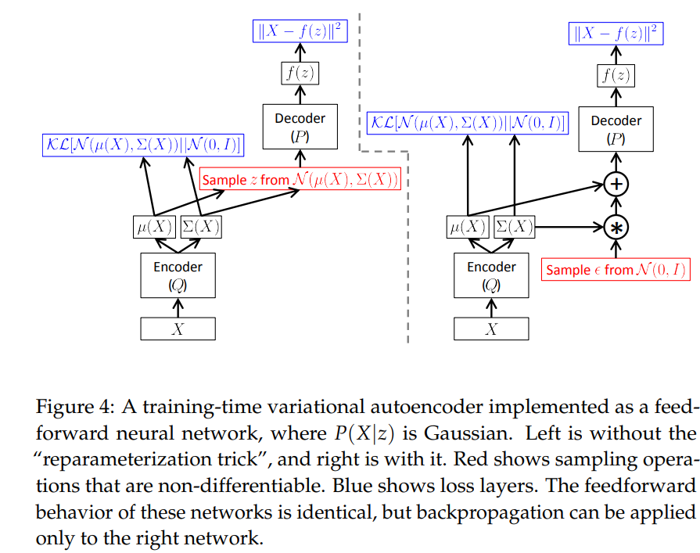
Reparameterization trick
Reparameterization trick from C. Doersch “Tutorial on Variational Autoencoders”
Notes:
ELBO: Evidence Lower Bound
KLD: Killback Leibler Divergence

Slide 47




Multimodal Variational AutoEncoder
Introduced by Mike Wu to solve the multi-model inference problem
Miximizes the ELBO
$$ELBO\left(x\right)=𝔼_{q_{φ}\left(z | x\right)}\left(\sum_{x_{i}∈X}{λ_{i}\log\left(p_{θ}\left(x | z\right)\right)}\right) −β 𝔻_{KL}\left(q_{φ}\left(z | x\right), p\left(x\right)\right)$$
$$z$$
$$x_{1}$$
$$x_{1}$$
Notes:
Graphical model:
observed space x
Latent space z
Several modalities

Slide 48



Product of Experts
Approximates the joint posterior
$$p\left(z\right|x_{1},…, x_{N}) ∝p(z) \prod_{i=1}^{N}{q\left(z | x_{i}\right)}$$
With $q\left(z | x_{i}\right)$ an estimator of $\frac{p\left(z | x_{i}\right)}{p\left(z\right)}$
Source: Mike Wu’s paper

Slide 49

Product of Experts details
$$p\left(z | x_{1}, …, x_{N}\right)=\frac{p\left(x_{1},…, x_{N} | z\right)p\left(z\right)}{p\left(x_{1},…, x_{N}\right)}=\frac{p\left(z\right)}{p\left(x_{1},…, x_{N}\right)}\prod_{i=1}^{N}{p\left(x_{i} | z\right)}$$
$$=\frac{p\left(z\right)}{p\left(x_{1},…, x_{N}\right)}\prod_{i=1}^{N}{\frac{p\left(z | x_{i}\right)p\left(x_{i}\right)}{p\left(z\right)}}=\frac{\left(\prod_{i=1}^{N}{p\left(z | x_{i}\right)}\right)}{\prod_{i=1}^{N−1}{p\left(z\right)}}\frac{\left(\prod_{i=1}^{N}{p\left(x_{i}\right)}\right)}{p\left(x_{1}, …, x_{N}\right)}$$
$$∝\frac{\prod_{i=1}^{N}{p\left(z | x_{i}\right)}}{\prod_{i−1}^{N−1}{p\left(z\right)}}=p\left(z\right)\prod_{i=1}^{N}{q\left(z | x_{i}\right)}$$
With $q\left(z | x_{i}\right)$ an estimator of $\frac{p\left(z | x_{i}\right)}{p\left(z\right)}$

Slide 50

ELBO
$$ℒ\left(q_{φ}\left(z | x\right)\right)+𝔻_{KL}\left(q_{φ}\left(z | x\right), p\left(z\right)\right)=\int_{z}{q_{φ}\left(z | x\right)\log\left(p_{θ}\left(x | z\right)\right) −\int_{z}{q_{φ}\left(z | x\right)\log\left(\frac{p\left(z\right)}{q_{φ}\left(z | x\right)}\right)}}=\int_{z}{q_{φ}\left(z | x\right)\log\left(\frac{p_{θ}\left(x, z\right)}{q_{φ}\left(z\right)}\right) −\int_{z}{q_{φ}\left(z | x\right)\log\left(\frac{p\left(z\right)}{q_{φ}\left(z | x\right)}\right)}}=\int_{z}{q_{φ}\left(z\right)\left(\log\left(p_{θ}\left(x,z\right)\right)−\log\left(q_{φ}\left(z\right)\right) −\log\left(p\left(z | x\right)\right)+\log\left(q_{φ}\left(z\right)\right)\right)=\int_{z}{q_{φ}\left(z\right)\log\left(p_{θ}\left(x\right)\right)}=\log\left(p_{θ}\left(x\right)\right)=ELBO(x)}$$
Notes:
ELBO: Evidence Lower Bound

