Slide 1
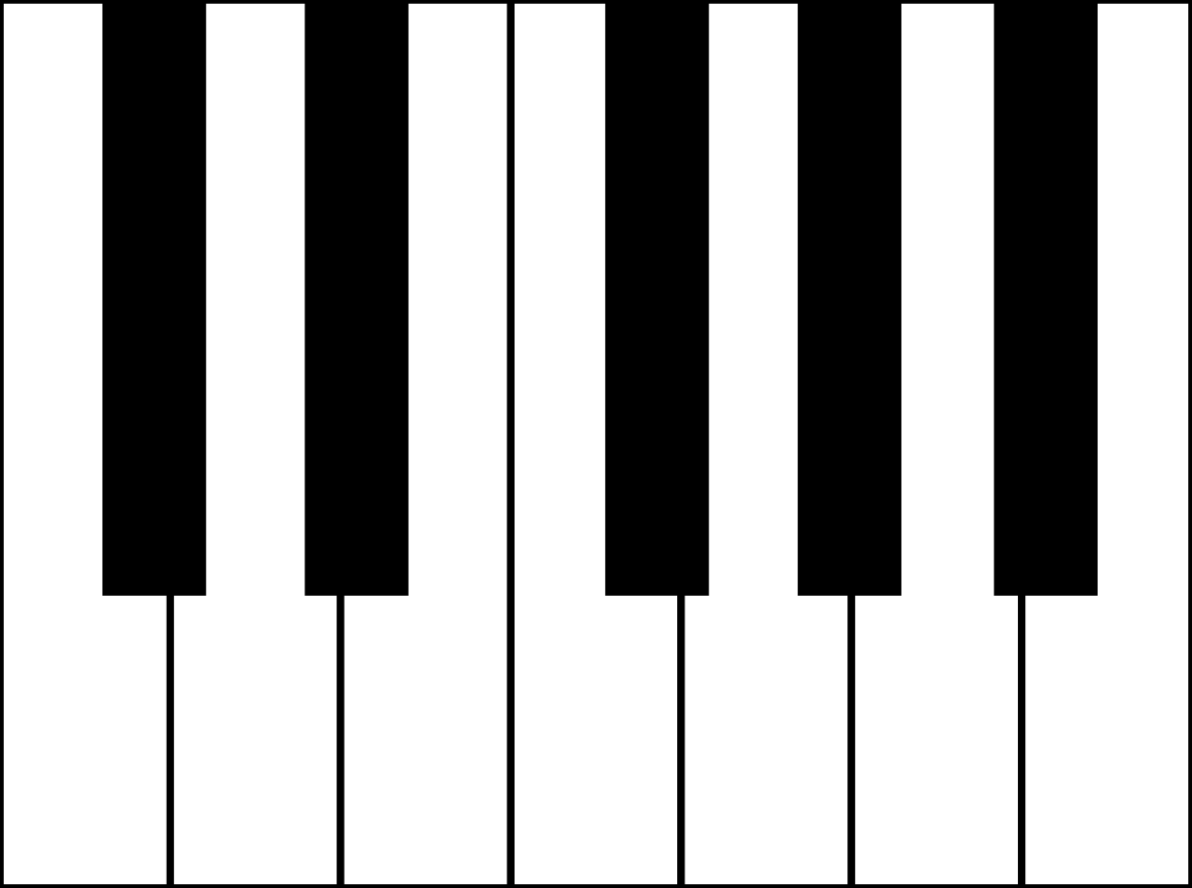
C♯
D♭
D♯
E♭
F♯
G♭
G♯
A♭
A♯
B♭
B♯
C
E
F♭
E♯
F
B
C ♭
D
G
A

Slide 2
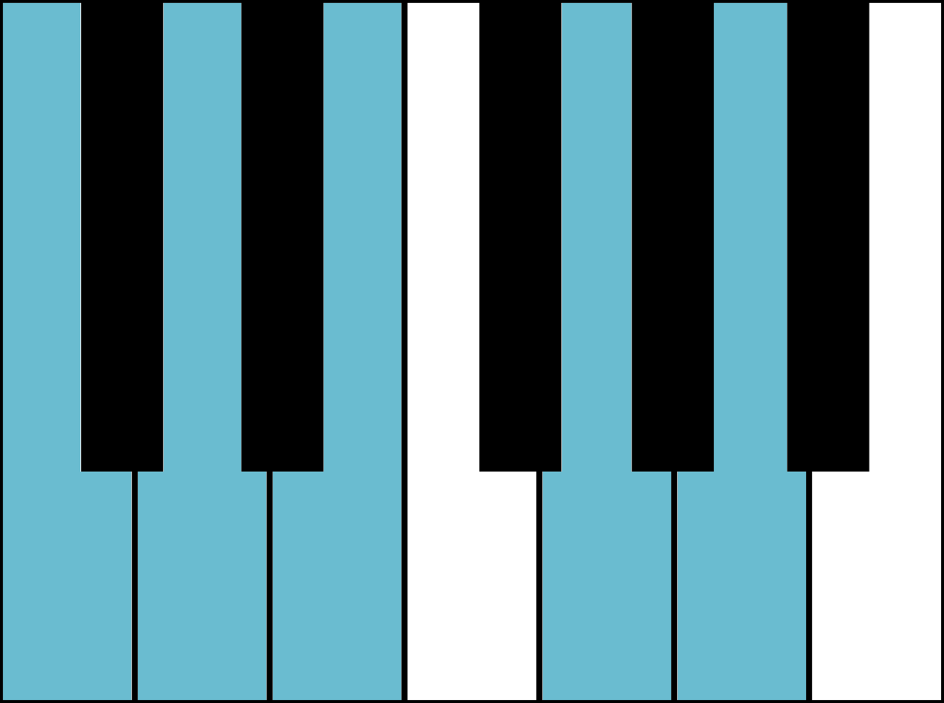
C
D
E
G
A

Slide 3
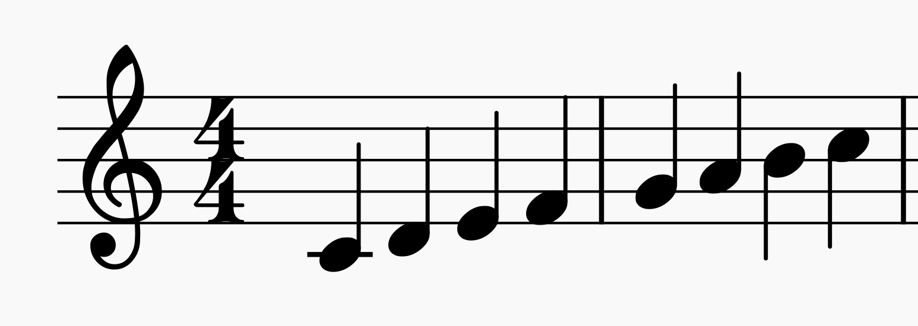
G
E
C
A
F
D
F
D
B
G
E
C
B
A
G
F
E
D
C

Slide 4


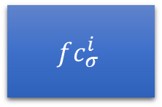
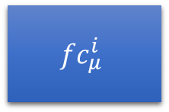

$$μ_{t}^{i}$$
$$fc_{μ}^{i}$$
$$Enc^{i}$$
$$σ_{t}^{i}$$
$$fc_{σ}^{i}$$

Slide 5














$$μ_{prior}, σ_{prior}$$
$$μ_{1}^{1}, σ_{1}^{1}$$
$$…$$
$$μ_{1}^{N}, σ_{1}^{N}$$
$$μ_{2}^{1}, σ_{2}^{1}$$
$$…$$
$$μ_{2}^{N}, σ_{2}^{N}$$
$$μ_{T}^{1}, σ_{T}^{1}$$
$$…$$
$$μ_{T}^{N}, σ_{T}^{N}$$
PoE
PoE
PoE
$$…$$
$$μ_{1}, σ_{1}$$
$$μ_{2}, σ_{2}$$
$$μ_{T}, σ_{T}$$

Slide 6
A1
B1
C1
D1
A2
B2
C2
D2
A3
B3
C3
D3
1
0
0
1
0
0
1
1
0
0
1
1
+
+
+
+
1
0
2
3
A
B
C
D

Slide 7
A
Semitone
G#
A#
Semitone
Tone
G
B
Tone
Minor Third
F#
C
Minor Third
Major Third
F
D#
Major Third
Fourth/Fifth
E
D
Fourth/Fifth
D#
Tritone

Slide 8
0
1
2
3
4
5
6
7
8
9
10
11
2
3
4
5
6
7
8
9
10
11
0
1

Slide 9
1
0
2
3
4
6
6
8
6
8
3
1
1
0
3
4
1
2
2
4

Slide 10
Input
Latent space
Output
Encoder
Decoder

