Slide 1
Generating new music with deep probabilistic models
Valentin Vignal
Notes:
Hello,
I’m going to talk about my Dissertation and the work I have done.
Deep neural network handle one task
Generate
harmonize
Musician can do several task:
Create song
Arrange
Harmonize
Improvize
Play with others
Objective : create a model which can perfom several tasks
Generate
Create musical part(s) from other musical part(s)
Play with people ?
I wanted to give some knowledge to the model:
- 3 loss functions

Slide 2
List of contents
Background knowledge
Related works
Contribution
Results
Band Player
Questions

Slide 3
Background knowledge
Musical Background
MIDI format
Music theory
Physical properties
Deep learning background
AutoEncoder
Variational AutoEncoder
Multimodal Variational AutoEncoder

Slide 4
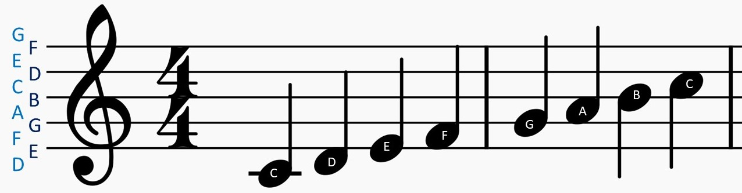
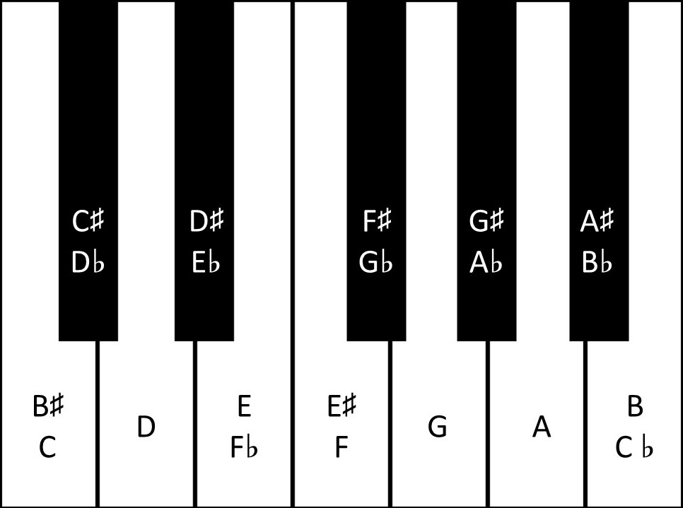
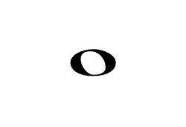




Musical Stave
Pitch
Time
Note shape | Name | Note length
 | Whole note | 4 beats
 | Half note | 2 beats
 | Quarter note | 1 beat
 | Eighth note | ½ beat
 | Sixteenth note | ¼ beat
Notes:
Musical stave:
2 axis:
Time
Pitch
Note correspond to the white key: C major or A minor
Shape of the note: its length

Slide 5
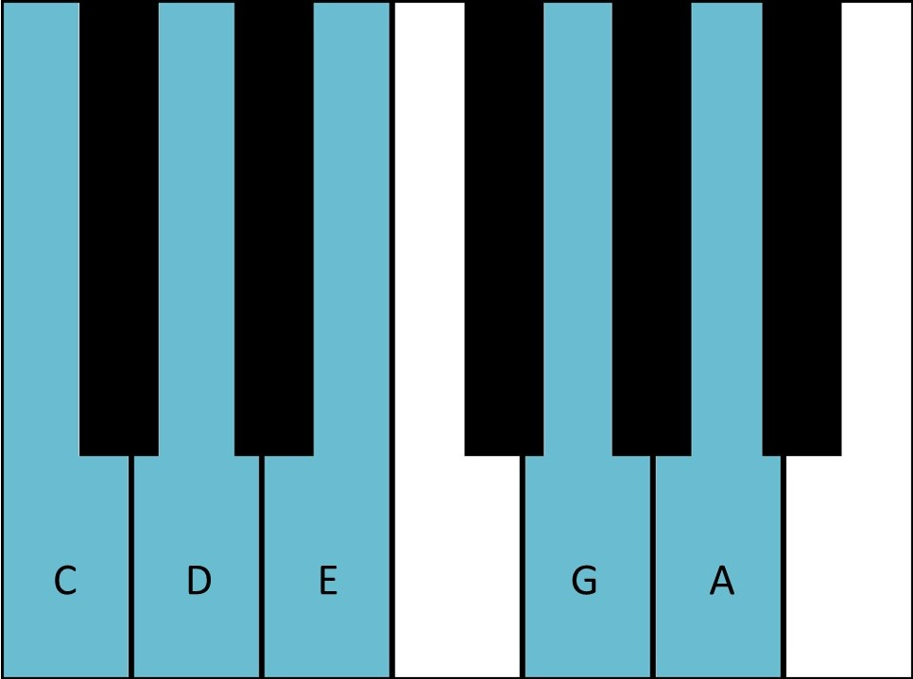
Musical Scale
A scale is a set of notes.
The white keys of a piano form the C major scale
C major pentatonic
Notes:
A scale is a set of notes
Several scales:
Major
Minor
Natural
Harmonic
Melodic
Pentatonic
Major
Minor
The human ear is used to those sets of notes so it sounds nice.

Slide 6

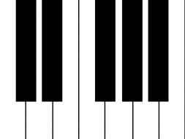



MIDI Format
It is a protocol to carry musical events between musical devices or software
VST
MIDI signal
Musical waveform
“Note on” event:
$$<NoteOn, channel, pitch, velocity>$$
“Note off” event:
$$<NoteOff, channel, pitch, velocity>$$
$channel∈[0, 15]$
$pitch∈[0, 127]$
$velocity∈[$0, 127]
Notes:
VST: Virtual Studio Technology
Events:
NoteOn to activate a note
NoteOff to deactivate it

Slide 7
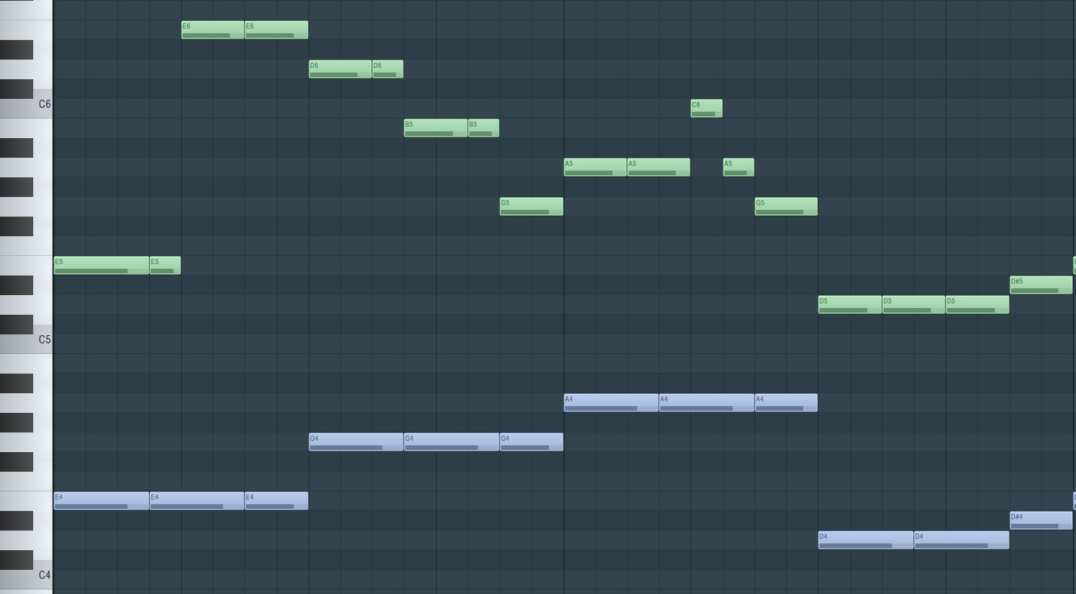
MIDI format
Pianoroll
E5, _ , _ , E5, E6, _ , E6, _ , D6, _ , D6, B5, _ , B5, G5, _ , …
E4, _ , _ , E4, _ , _ , E4, _ , G4, _ , _ , G4, _ , _ , G4, _ , …
Text
Notes:
Several format can be derived from the MIDI one
Pianoroll:
Most of the electronic composition software use that (FL Studio, Ableton…)
Text:
Just write the notes
Then go through word2vec model
Most of the works use these 2 translations -> I use this one
Waveform
48 kHw -> Too much data -> poor results

Slide 8

Harmonics
A musical sound is composed of harmonics
$$s\left(t\right)= \sum_{n=1}^{∞}{α_{n} sin⁡(nft+φ_{n})}$$
Harmonic number | Frequency (Hz) | Note Name | Musical Interval
1 | 440 | A4 | Unison
2 | 880 | A5 | Octave
3 | 1320 | E5 | Fifth
4 | 1760 | A6 | Octave
5 | 2200 | C#6 | Major Third
6 | 2640 | E6 | Fifth
Notes:
I don’t consider inharmonicity of stringed instruments (common assumption)
Sound has several harmonics
Multiple of its fundamental frequency
All harmonics of A5 or E5 or … are contained in the harmonics of A4
-> A5 or E5 or … is IN A4

Slide 9
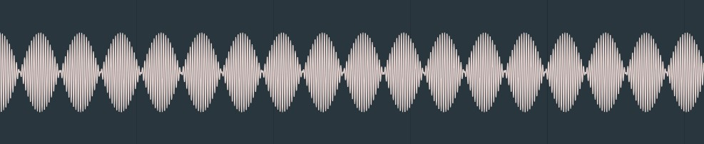
Resonance phenomena
Two sounds with a close frequency will generate a resonance phenomena
Resonance phenomena from a B4 and a C5
$\cos\left(f\right)+\cos\left(f+δf\right)=2\cos\left(\frac{2f+δf}{2}\right)\cos\left(\frac{δf}{2}\right)$
Notes:
B4: 494Hz
C5: 523Hz

Slide 10
Intervals
“Acceptable” intervals
“Not acceptable” intervals
Interval | Reason | Example with A4
Octave | Contained in tonic’s Harmonics | A5
Minor Third | Share harmonics (A and C share E in their harmonics) | C6
Major Third | Contained in tonic’s harmonics | C#6
Fifth | Contained in tonic’s harmonics | E6
Interval | Reason | Example with A4
Semitone | Resonance phenomena between fundamental frequencies | A#5
Tone | Resonance phenomena between fundamental frequencies | B5
Tritone | Resonance phenomena between fundamental frequency and third harmonic (D and D#) | D#6
Notes:
From the harmonics and the resonance phenomena
Some notes sound good together
Some other don’t
Major chord sounds really nice because all notes in tonic.
Tritone called Diabolus in musica"("Devil in the music") and was forbidden by the church at medieval time

Slide 11
AutoEncoder

Slide 12
Variational AutoEncoder

Slide 13
Multimodal Variational AutoEncoder

Slide 14
Related works
Deep Bach
Bach Bot
Bach Doodle
Music Transformer

Slide 15
Contribution
Objectives
Data representation
RMVAE
Global architecture
RPoE
Encoder/Decoder Architecture
Activation function
Custom loss functions
Scale
Rhythm
Harmony

Slide 16
Objectives
Generate a music with several musical parts
Create an accompaniment from a melody
Create a melody from an accompaniment
Create musical parts from other musical parts

Slide 17



Data representation
I consider binary rhythm only (1 beat is divided in 2 equal beats)
The smallest notes I consider are the Sixteenth notes
A “step” is a measure
There are 16 Sixteenth notes division in a measure
From a fixed number of measures, the model will predict the next one
128 different pitches
A tensor representing a measure: (16, 128, channels)
$$m_{1}$$
model
…
$$m_{n+1}$$
$$m_{n}$$

Slide 18
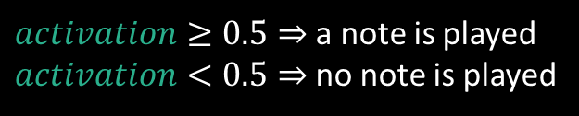
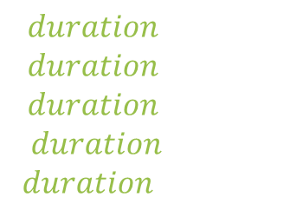
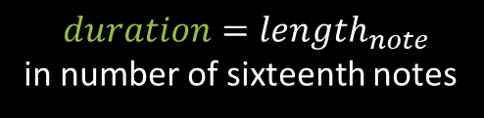
Data Representation – Polyphonic Music
(16, 128, channels=2)
Activation channel:
Sigmoid activation function
Binary cross-entropy loss
Duration channel:
ReLU activation function
Mean squared error loss
$activation≥0.5⇒$a note is played
$activation<0.5⇒$no note is played
duration
activation
Pitch
$$duration=length_{note}$$
in number of sixteenth notes
$$duration=1⇒$$
$$duration=2⇒$$
$$duration=4⇒$$
$$duration=8⇒$$
$$duration=16⇒$$
Channel
Time

Slide 19
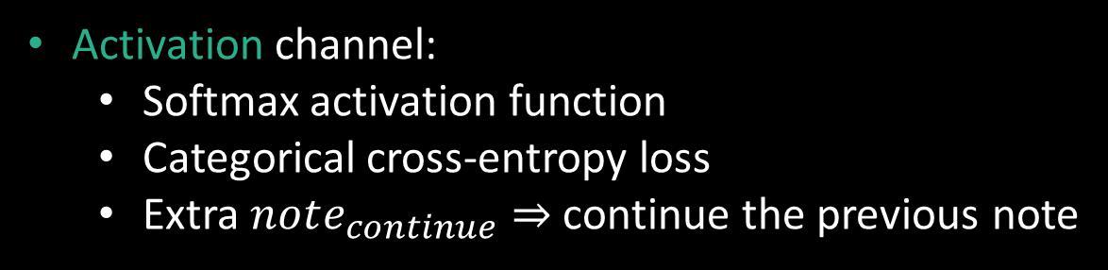

Data Representation –Monophonic Music
(16, 128 + 1, channels=1)
Activation channel:
Softmax activation function
Categorical cross-entropy loss
Extra $note_{continue}⇒$continue the previous note
activation
Pitch
Argmax of $activation$ is played
Time

Slide 20
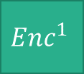
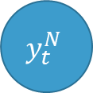

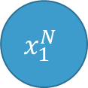

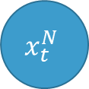
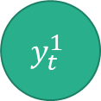

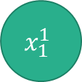


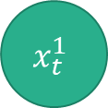
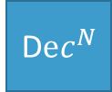
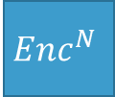



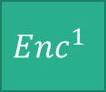


Recurrent Multimodal Variational AutoEncoder
$$x_{1}^{1}$$
$$x_{1}^{N}$$
$$x_{t}^{1}$$
$$x_{t}^{N}$$
…
…
$$Enc^{1}$$
$$Enc^{N}$$
$$Enc^{1}$$
$$Enc^{N}$$
$$μ_{1}^{1}, σ_{1}^{1}$$
$$μ_{1}^{N}, σ_{1}^{N}$$
$$μ_{t}^{1}, σ_{t}^{1}$$
$$μ_{t}^{N}, σ_{t}^{N}$$
PoE
…
PoE
$$μ_{1}, σ_{1}$$
$$μ_{t}, σ_{t}$$
Sampling
Sampling
$$z_{1}$$
$$z_{t}$$
LSTM
…
LSTM
D$ec^{1}$
D$ec^{N}$
$$y_{t}^{1}$$
$$y_{t}^{N}$$
…

Slide 21














Recurrent Product of Experts
$$μ_{prior}, σ_{prior}$$
$$μ_{1}^{1}, σ_{1}^{1}$$
$$…$$
$$μ_{1}^{N}, σ_{1}^{N}$$
$$μ_{2}^{1}, σ_{2}^{1}$$
$$…$$
$$μ_{2}^{N}, σ_{2}^{N}$$
$$μ_{T}^{1}, σ_{T}^{1}$$
$$…$$
$$μ_{T}^{N}, σ_{T}^{N}$$
PoE
PoE
PoE
$$…$$
$$μ_{1}, σ_{1}$$
$$μ_{2}, σ_{2}$$
$$μ_{T}, σ_{T}$$

Slide 22
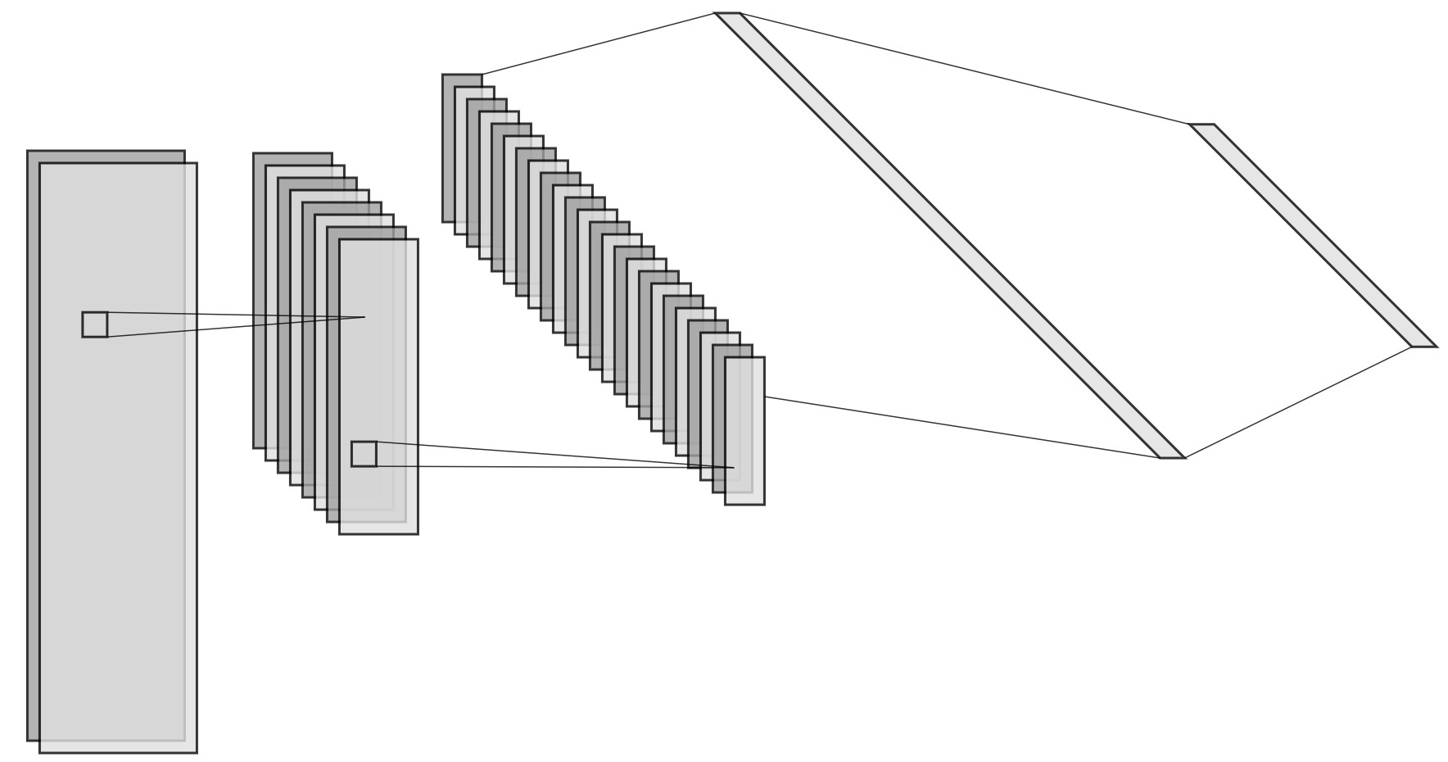
Convolutional Encoder/Decoder
Input tensor : (16, 128, channels)
Encoder
Convolutional layers
Fully Connected layers
Decoder
Fully Connected layers
Transposed Convolutional layers
1 Fully Connected layer
Convolutional filter : (5, 5)

Slide 23


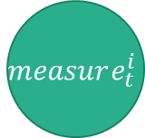


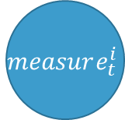


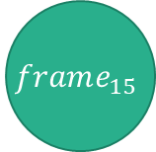


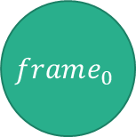


Recurrent Encoder/Decoder
$$measure_{t}^{i}$$
$$latent_{t}^{i}$$
Split
$$FC_{measure}^{dec, i}$$
Input tensor : (16, 128)
$$frame_{0}$$
$$frame_{15}$$
…
LSTM
LSTM
Encoder
Split the measure into several frames
Encode the frames with fully connected layers
Extract the latent space with bidirectional LSTM
Encode the latent space with fully connected layers
Decoder
Decode the latent space with fully connected layers
Generate the encoded frames with bidirectional LSTM
Decode the frames with fully connected layers
Concatenate the frames to create the measure
…
$$FC_{frame}^{enc, i}$$
$$FC_{frame}^{enc, i}$$
$$FC_{frame}^{dec, i}$$
$$FC_{frame}^{dec, i}$$
LSTM
…
LSTM
$$frame_{0}$$
$$frame_{0}$$
…
$$FC_{measure}^{enc, i}$$
Concat
$$latent_{t}^{i}$$
$$measure_{t}^{i}$$
Notes:
Only for monophonic music

Slide 24
Activation and Loss function

Slide 25
Scale loss

Slide 26
Rhythm loss

Slide 27
Harmony loss

Slide 28
Results
Implemented tasks
Experiments
Transposed data
Model size
Scale and Rhythm losses
Harmony loss
RPoE layer

Slide 29
Band Player
Demonstration

Slide 30
Questions

Slide 31
References

