Slide 1
AIR POLLUTION

Slide 2






Causes
Industrial Pollution
Transportation
Fossil Fuels
Forest Fires
Air pollution is caused activities such as industrial pollution, fossil fuels, forest fires, transportation, cigarette smoke and chemicals from mining.
Cigarette smoke
Chemicals from mining

Slide 3
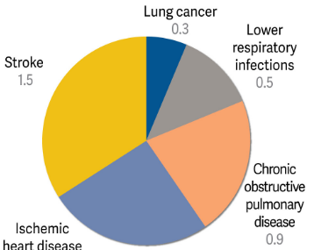
Effects
Air pollution cause life threatening conditions such as lung cancer, lower respiratory infections, chronic obstructive pulmonary diseases, stroke and ischemic heart diseases. Therefore, it is necessary to reduce air pollution as much as possible.

Slide 4




Remedy
The following are solutions that can help solve air pollution:
1) Stop using fossil fuels such as coal, oil and natural gas.
2) Use energy-efficient light bulbs and appliances.
3) Plant trees near highways, factories and other sources of pollution in order to absorb some of the emissions.
4) Drive less by carpooling or taking public transport, use bike or walking instead of car when possible and switch from petrol powered cars to electric cars or hybrid cars.
5) Do not buy products that use a lot of packaging materials or that use too much energy to make.
Reduce forest fires
Turning of the lights when not in use
Use of public transport
Ride bicycle or walk

Slide 5
References

