Slide 1


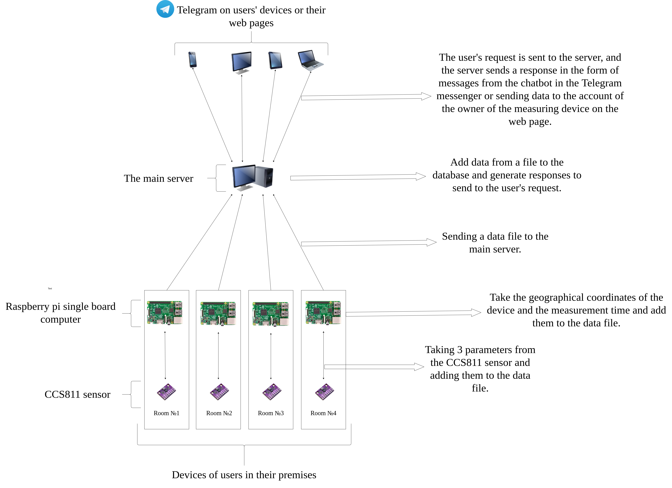
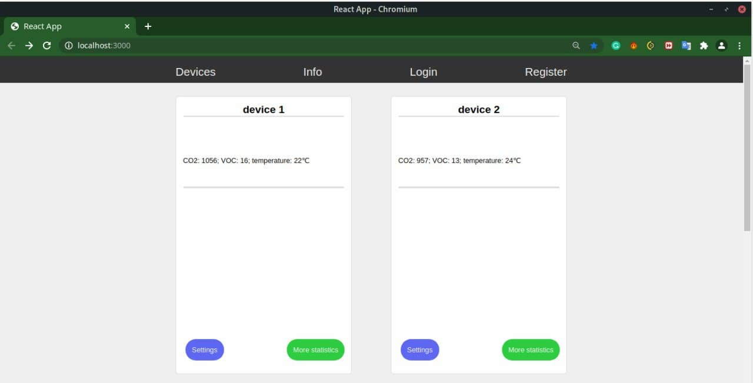
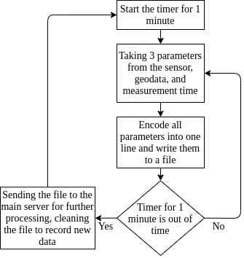
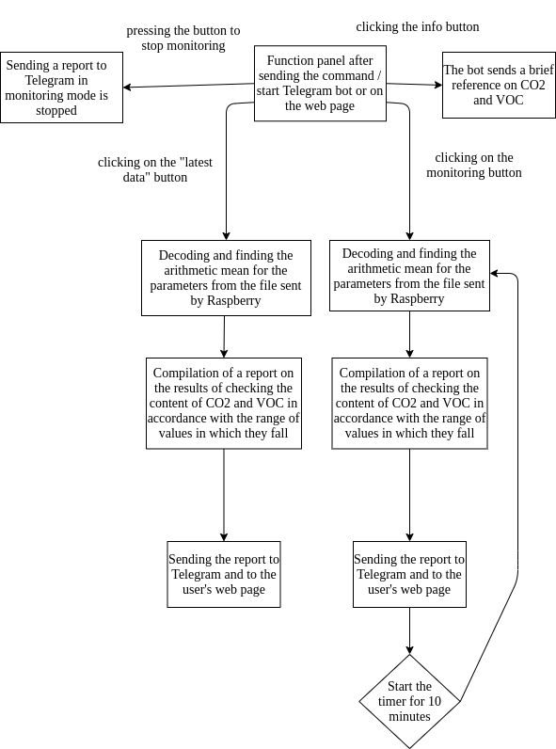
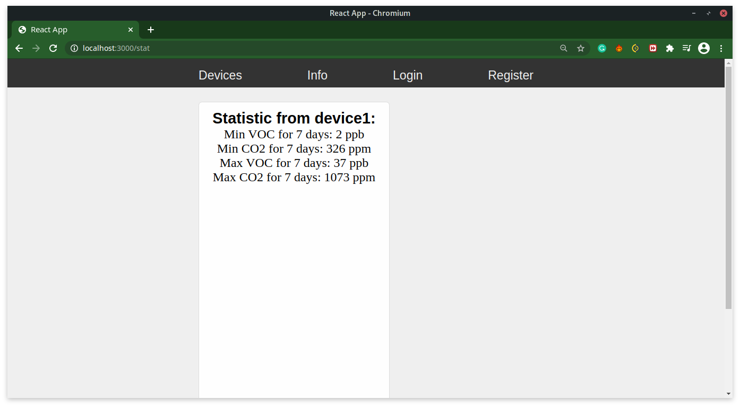
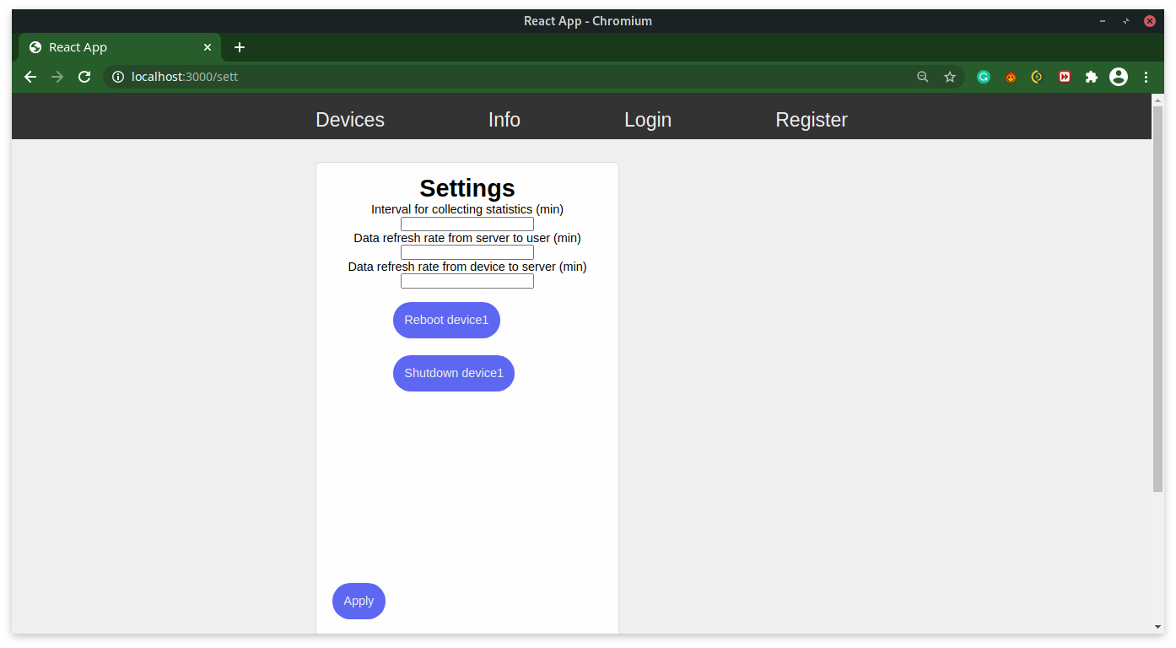
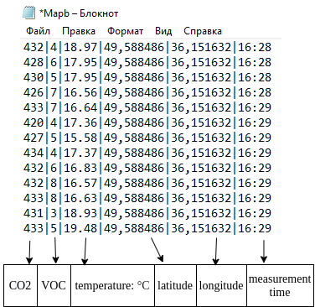
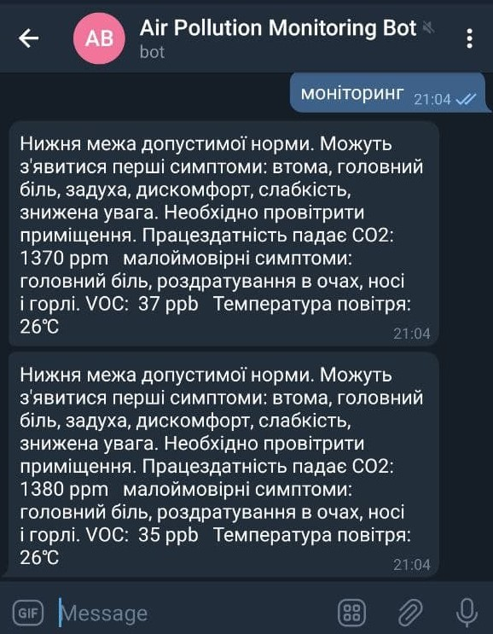
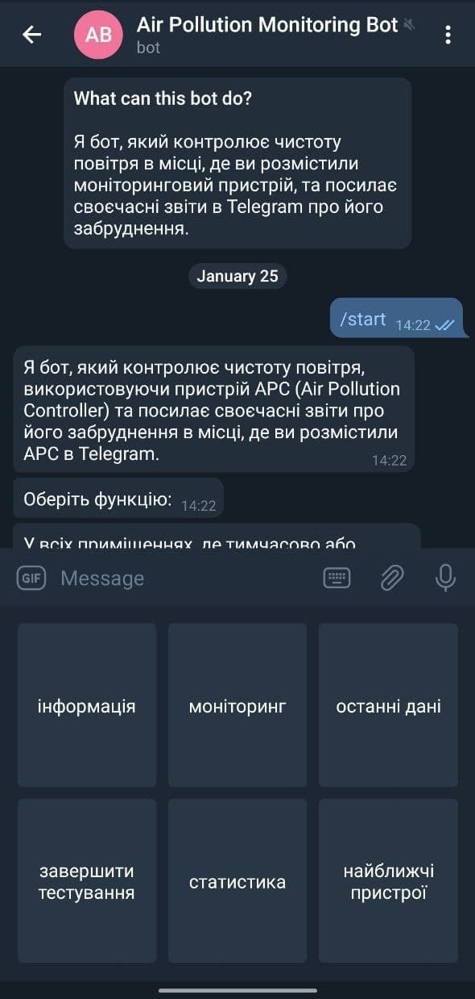
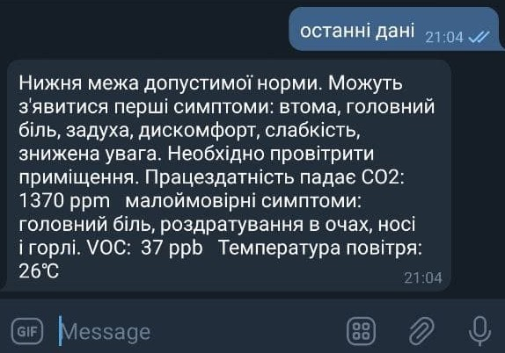
ATMOSPHERIC AIR QUALITY MONITORING SYSTEM IN PREMISES
Valentyn Mitin National center «Junior Academy of Sciences of Ukraine‎» under the auspices of UNESCO
SUPERVISOR: Kiril Rukkas Supervisor`s Professor of Theoretical and Applied Informatics. Associate Professor, Doctor of Technical Sciences
UKRAINE
TEAM
Introduction
Monitoring
system
The goal of the work:
Ensuring the collection of data on indoor air quality.
Objectives of the study:
1. Selection of optimal sensor and board;
2. Development of the program of reading of indications from the sensor and their transfer to the main server;
3. Development of a program for data analysis on the server and transmission of the final result to the user.
Object of study:
Indoor air quality data collection and display processes.
Subject of study:
Algorithms for collecting and displaying indoor air quality data.
Research methods:
Collection and display of indoor air quality data by
using developed programs.
Fig. 1. Scheme of operation of the monitoring system
Fig. 5. Screenshot of the main page of the WEB-site
Fig. 2. Block diagram of the Raspberry Pi program
Fig. 6. Screenshot of the “More statistic” page
Fig. 4. Example file with recorded parameters
Fig. 3. Block diagram of the Telegram bot program
Fig. 7. Screenshot of the “Settings” page
Results
As a result of this work, a software and hardware complex was developed that allows to obtain and process air quality data at any point of geolocation, with subsequent transmission of the result to the end user using a bot in the Telegram messenger or to its web page.
Conclusions
1. Currently, the development of air quality measuring devices, which would allow users to receive information at any time convenient for them, is becoming increasingly important.
2. A detailed review of existing projects and individual air quality monitoring systems revealed that they have not yet become widespread in Ukraine and that the need for information on air quality, especially indoors, is not satisfactory.
3. To develop an air quality monitoring system, the optimal CCS811 sensor, which supports intelligent algorithms for processing CO2 and VOC measurements, as well as the Raspberry pi board, was analyzed and selected.
4. The software was written in the Python programming language.
Fig. 10. Screenshot of the chatbot's response to the "latest data" command
Fig. 9. Screenshot of the chatbot's response to the "monitoring" command
Fig. 8. View of the main control panel

