Slide 1
ATMOSPHERIC AIR QUALITY MONITORING SYSTEM IN PREMISES
Reporter:
Mitin Valentin Vitalievich,
11th grade student of Kharkiv
Educational complex
№45 "Academic Gymnasium"
Supervisor:
Rukkas Kirilo Markovic

Slide 2
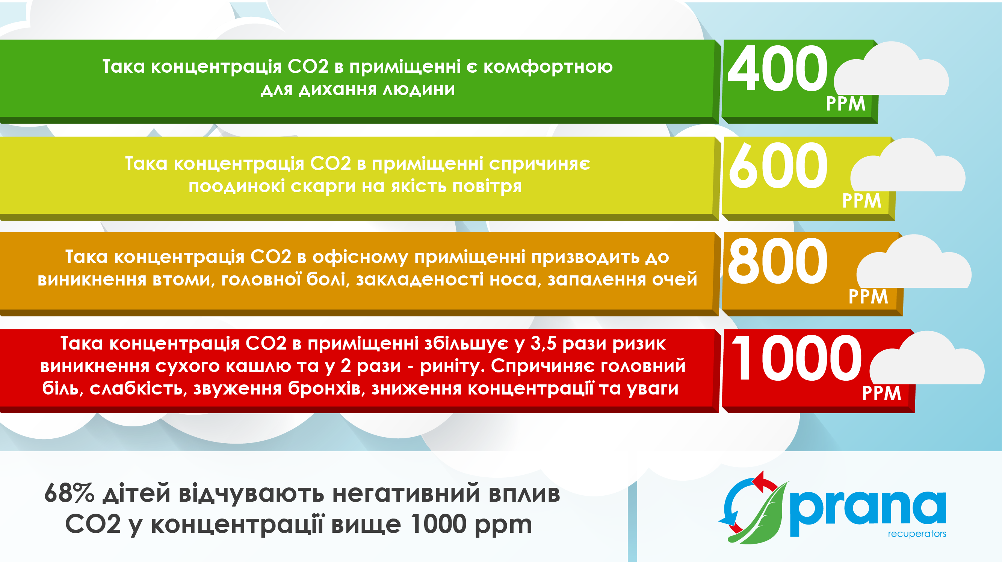
<number>
Topicality:

Slide 3
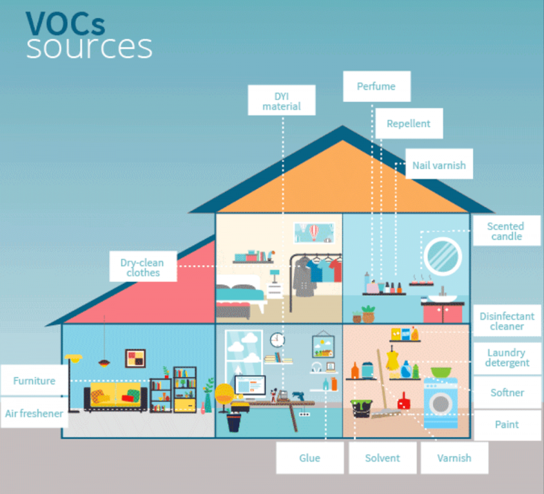
<number>
Topicality:

Slide 4
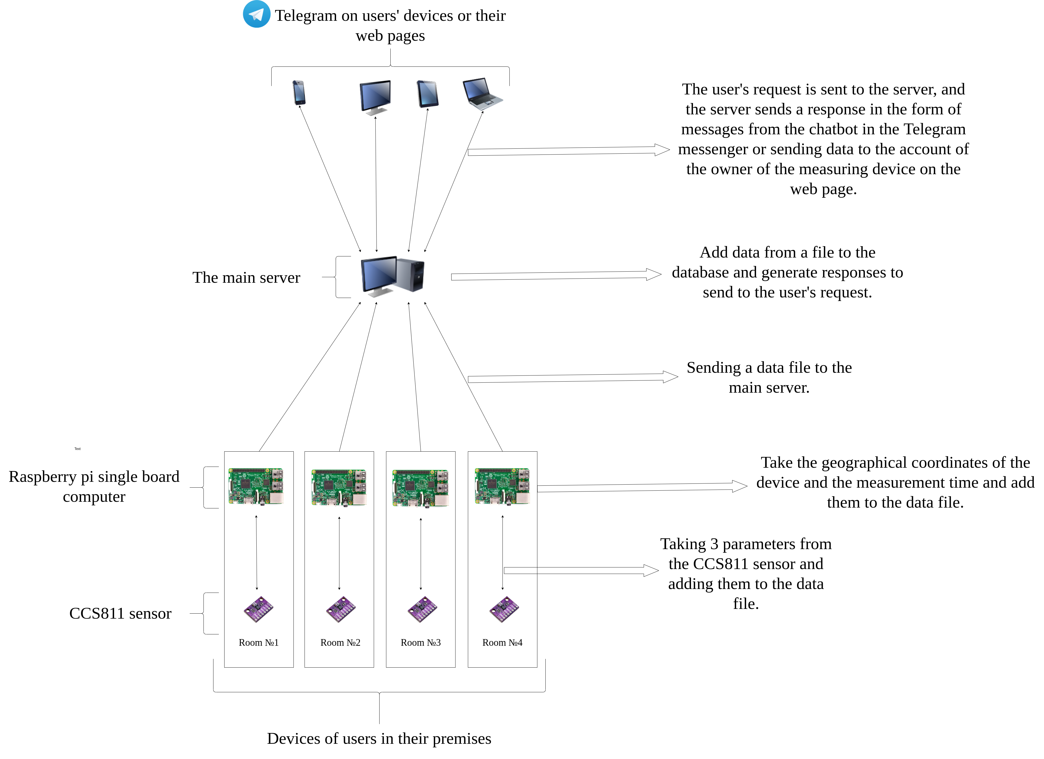
WITHheme monitoring system:
<number>

Slide 5
<number>
Formulation of the problem:
To achieve this goal the following tasks were solved:
Sensor and board selection;
Development of a program for reading indicators from the sensor and transmitting them to the main server;
Development of a program for data analysis on the server and transmission of the final result to the user.

Slide 6
Comparison of MQ and CCS811 series sensors:
<number>
Sensor | The gas to which it reacts | Substrate material
MQ-2 | Liquefied hydrocarbons gases | SnO2
MQ-3 | Alcohol | SnO2
MQ-4 | CH4 | SnO2
MQ-5 | Liquefied hydrocarbon gases, natural gas | SnO2
MQ-6 | Liquefied hydrocarbon gases, propane | SnO2
MQ-7 | CO | SnO2
MQ-9 | CH4, Liquefied hydrocarbon gases | SnO2
MQ-131 | O3 | SnO2
MQ-135, MQ-136, MQ-137, MQ-138 | Multipurpose | SnO2
MQ-303A | Alcohol | -
MQ-306 | Liquefied natural gas | -
CCS811 | CO2, VOC | MOX

Slide 7
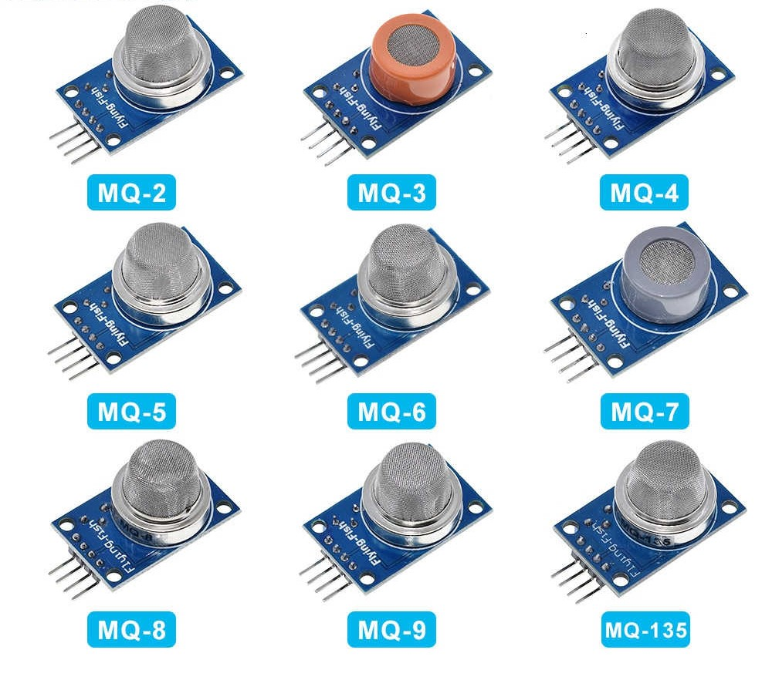
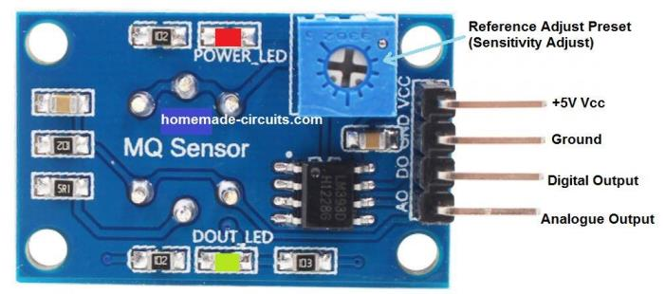
<number>
Example of MQ series sensors:

Slide 8
<number>
Comparison of Arduino microcontroller and Raspberry pi single board computer:
 | Microcontroller | Single board computer
Productivity | 1 core, tens to hundreds of MHz, dozens of KB of RAM, tens to hundreds of KB of permanent memory. | 1 or more cores, hundreds of thousands of MHz, hundreds of MB of RAM, gigabytes of non-volatile memory.
Multitasking | No. | So. Managed by Raspbian OS.
Ease of working with the Internet | Additional modules and in-depth knowledge of protocols are usually required. | Easily connected from the box, the network module is usually already installed on the board.
Battery life | Consumes units - tens of mA. Possible weeks of battery life. | Consumes hundreds of thousands of mA. The charge of a large battery will last for ten hours.
Response rate in time-critical projects | 100% control over the time and duration of signals. | Because of multitasking, a critical process can fall asleep in time.
Choice of programming languages | Limited. Most often C / C ++. | Python, JavaScript, Bash and dozens of others: any available in the OS.

Slide 9
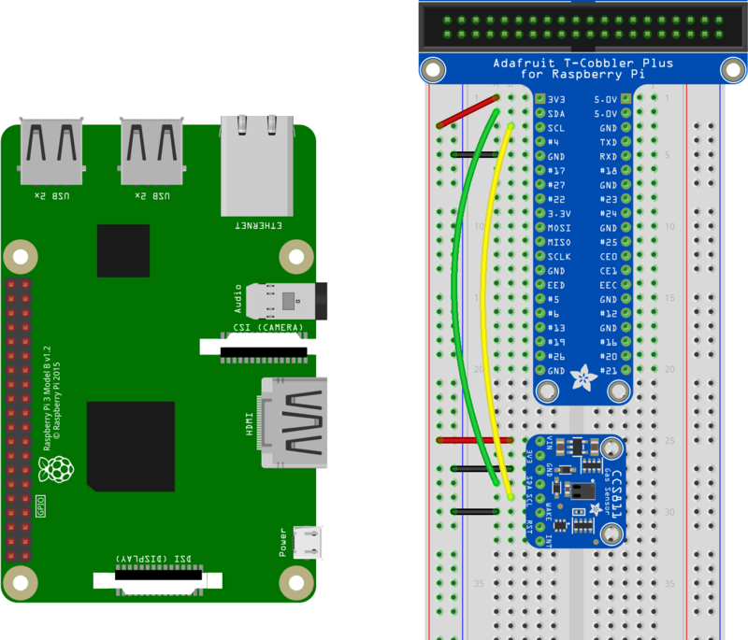
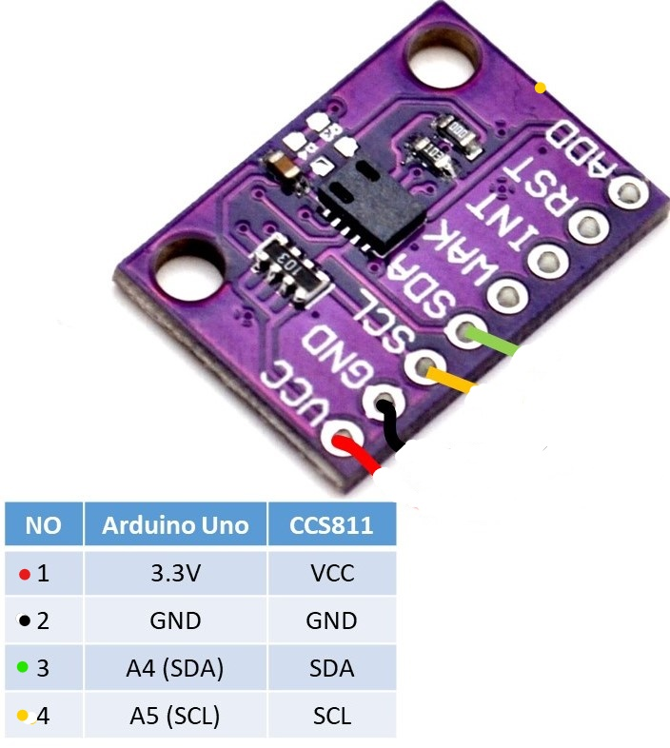
Scheme of connection of the sensor to Raspberry Pi:
<number>

Slide 10
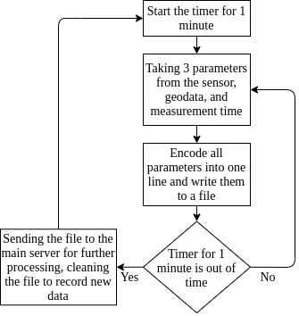
<number>
Control algorithm CCS811 sensor on Raspberry Pi:

Slide 11
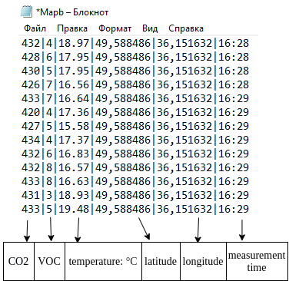
<number>
Example data file:
This format of writing data to a file through characters simplifies their decryption on the main server.

Slide 12
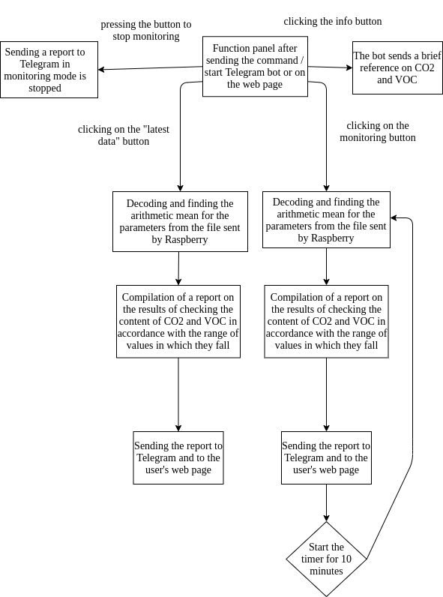
Algorithm of chatbot operation on the main server:
<number>

Slide 13
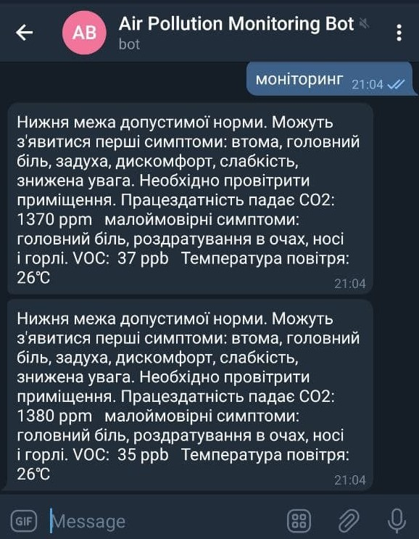
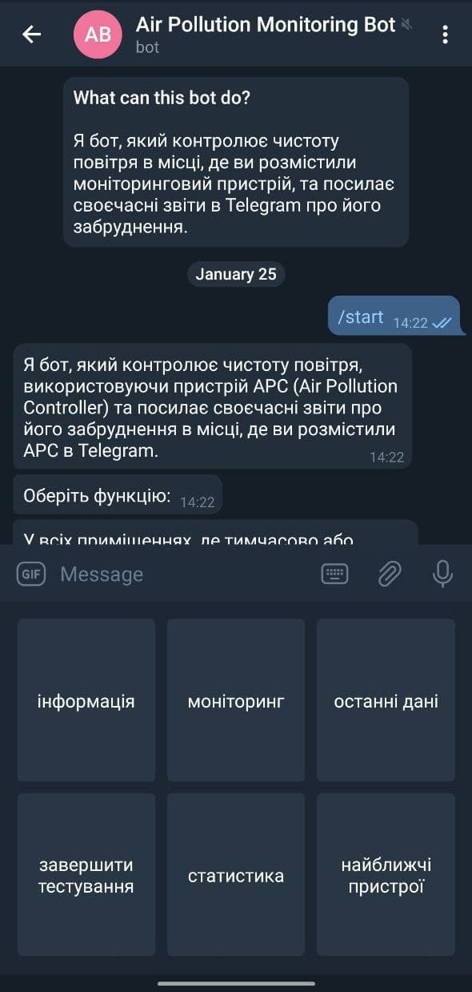
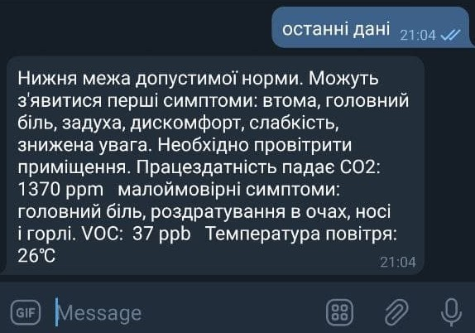
Example of communication with a bot:
<number>
Fig. 1 Screenshot of the chatbot's response to the command "monitoring"
Fig. 2 Screenshot of the chatbot's response to the command "Latest data"
Fig. 3 Screenshot of the menu of commands offered by the chatbot after the start of communication

Slide 14
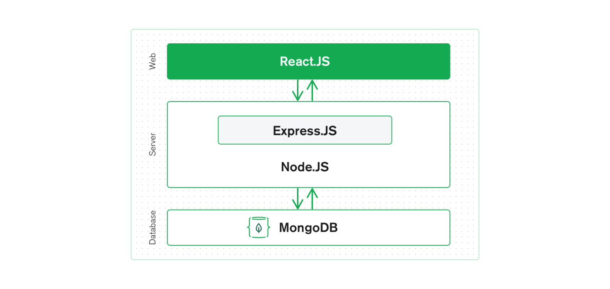
WEB-site development
<number>
A stack is a combination of technologies used to create a web application. Any web application will be created using several technologies (frameworks, libraries, databases, etc.).
The MERN stack is a JavaScript stack designed to simplify the development process. MERN includes four open source components: MongoDB, Express, React and Node.js. These components provide a comprehensive environment for developers to work.
Fig. 4 Scheme of interaction of MERN stack components

Slide 15
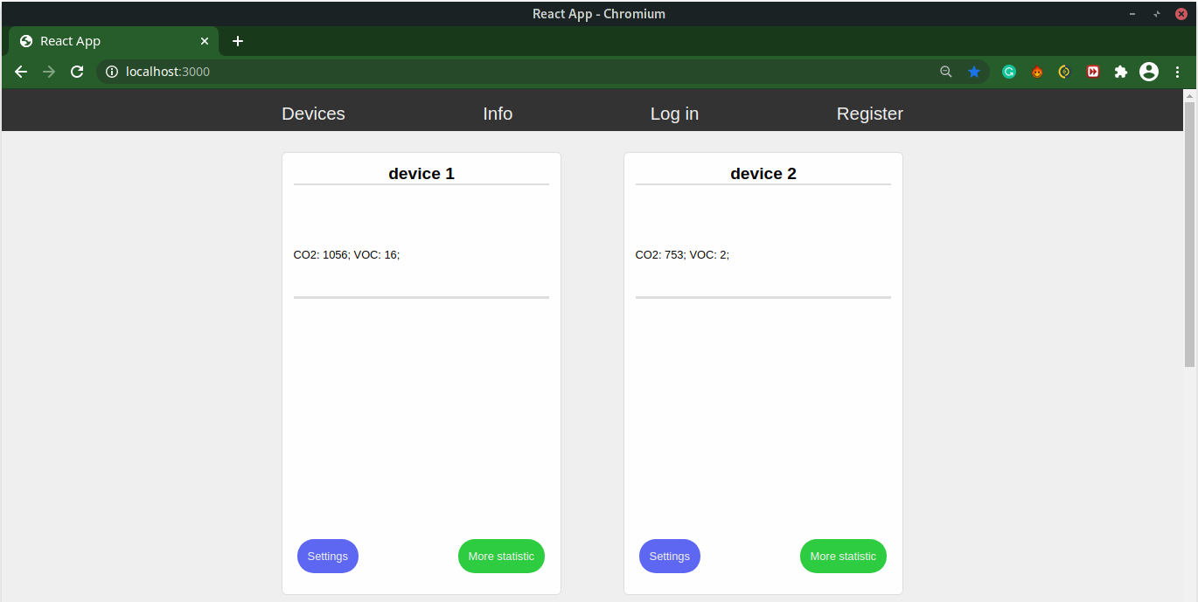
Screenshot of the main page of the website:
<number>
Fig. 4 Screenshot of data card devices

Slide 16
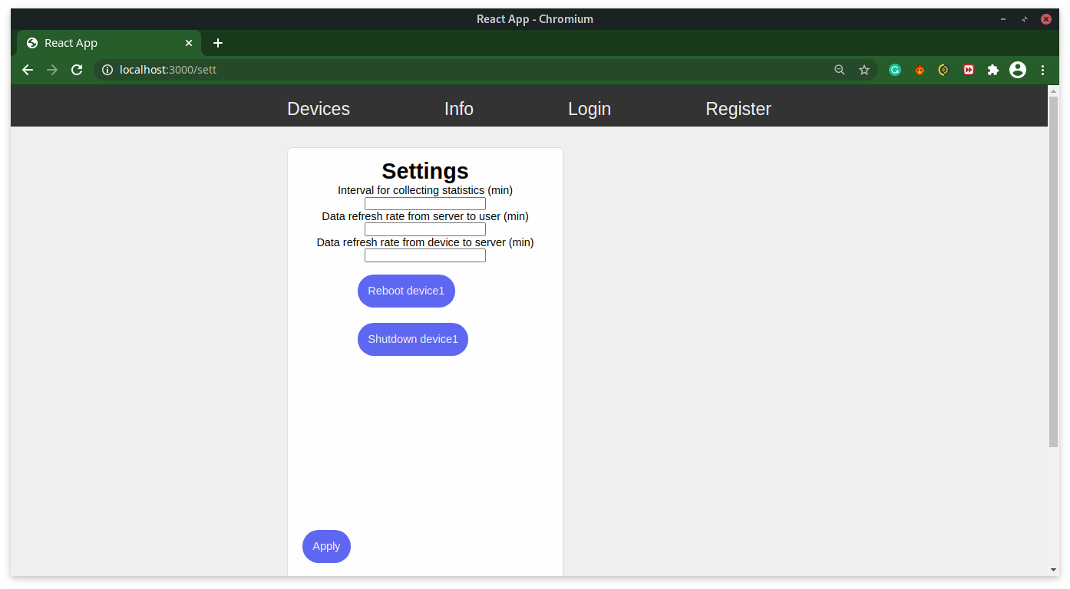
Appearance pages for setting up the device "Settings"
<number>
Fig. 5 Screenshot of the data setup and device management card

Slide 17
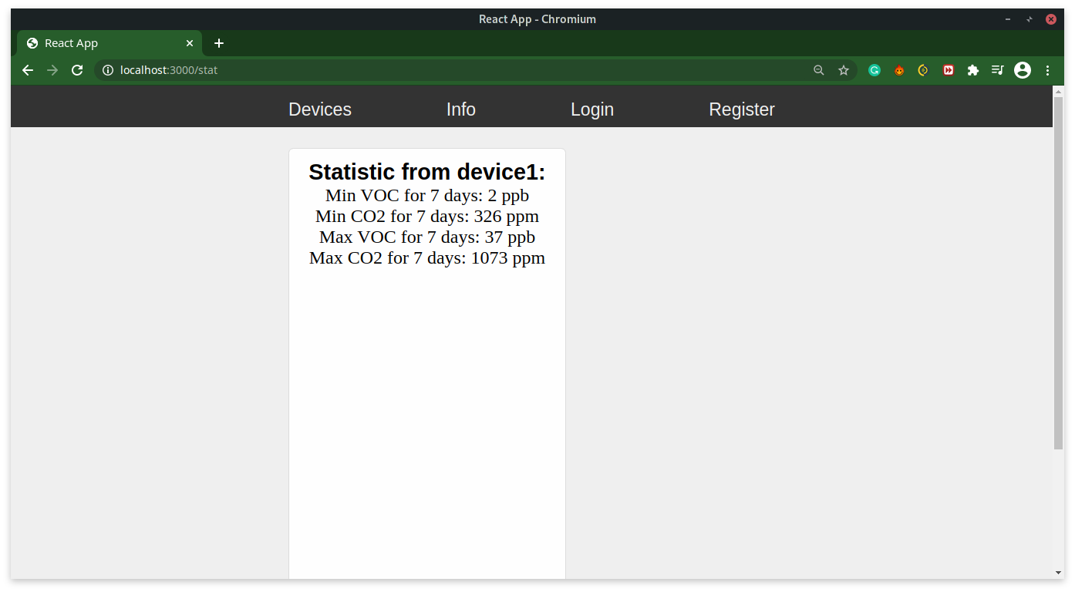
Page view “More statistic”
<number>
Fig. 6 Screenshot of the statistics card

Slide 18
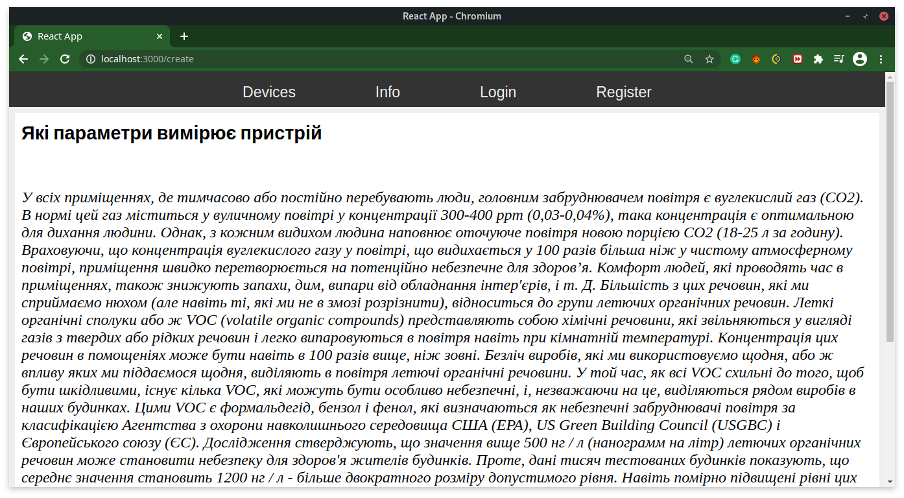
View of the page with information about the project "Info"
<number>
Fig. 7 Screenshot of the page with information about the project and the impact of measuring substances on human health

Slide 19
Other air quality monitoring systems:
<number>
Systems | Interaction with the system: | Measurement parameters:
My system | Telegram bot and web page | VOC, CO2 and air temperature
Atmotube | Application for smartphones in the online stores App store and Play market | VOC, fine dust
Xiaomi PM 2.5 Air Detector | Application for smartphones online stores App store and Play market | Fine dust

Slide 20
<number>
Conclusions:
1. Currently, the development of air quality measuring devices, which would allow users to receive information at any time convenient for them, is becoming increasingly important.
2. A detailed review of existing projects and individual air quality monitoring systems revealed that they have not yet become widespread in Ukraine, and the need to obtain
information on air quality, especially indoors, is not satisfied.
3. To develop an air quality monitoring system, the optimal CCS811 sensor, which supports intelligent algorithms for processing CO2 and VOC measurements, as well as the Raspberry Pi board, was analyzed and selected.
4. The software was written in the Python programming language.
5. As a result of the carried out work the software and hardware complex allowing to receive and process data on air quality in any point of geolocation, with the subsequent transfer of result to final was developed.
to the user by means of a bot in the messenger - Telegram or on the user's web page.

Slide 21
Thank you very much for your attention

