Slide 1
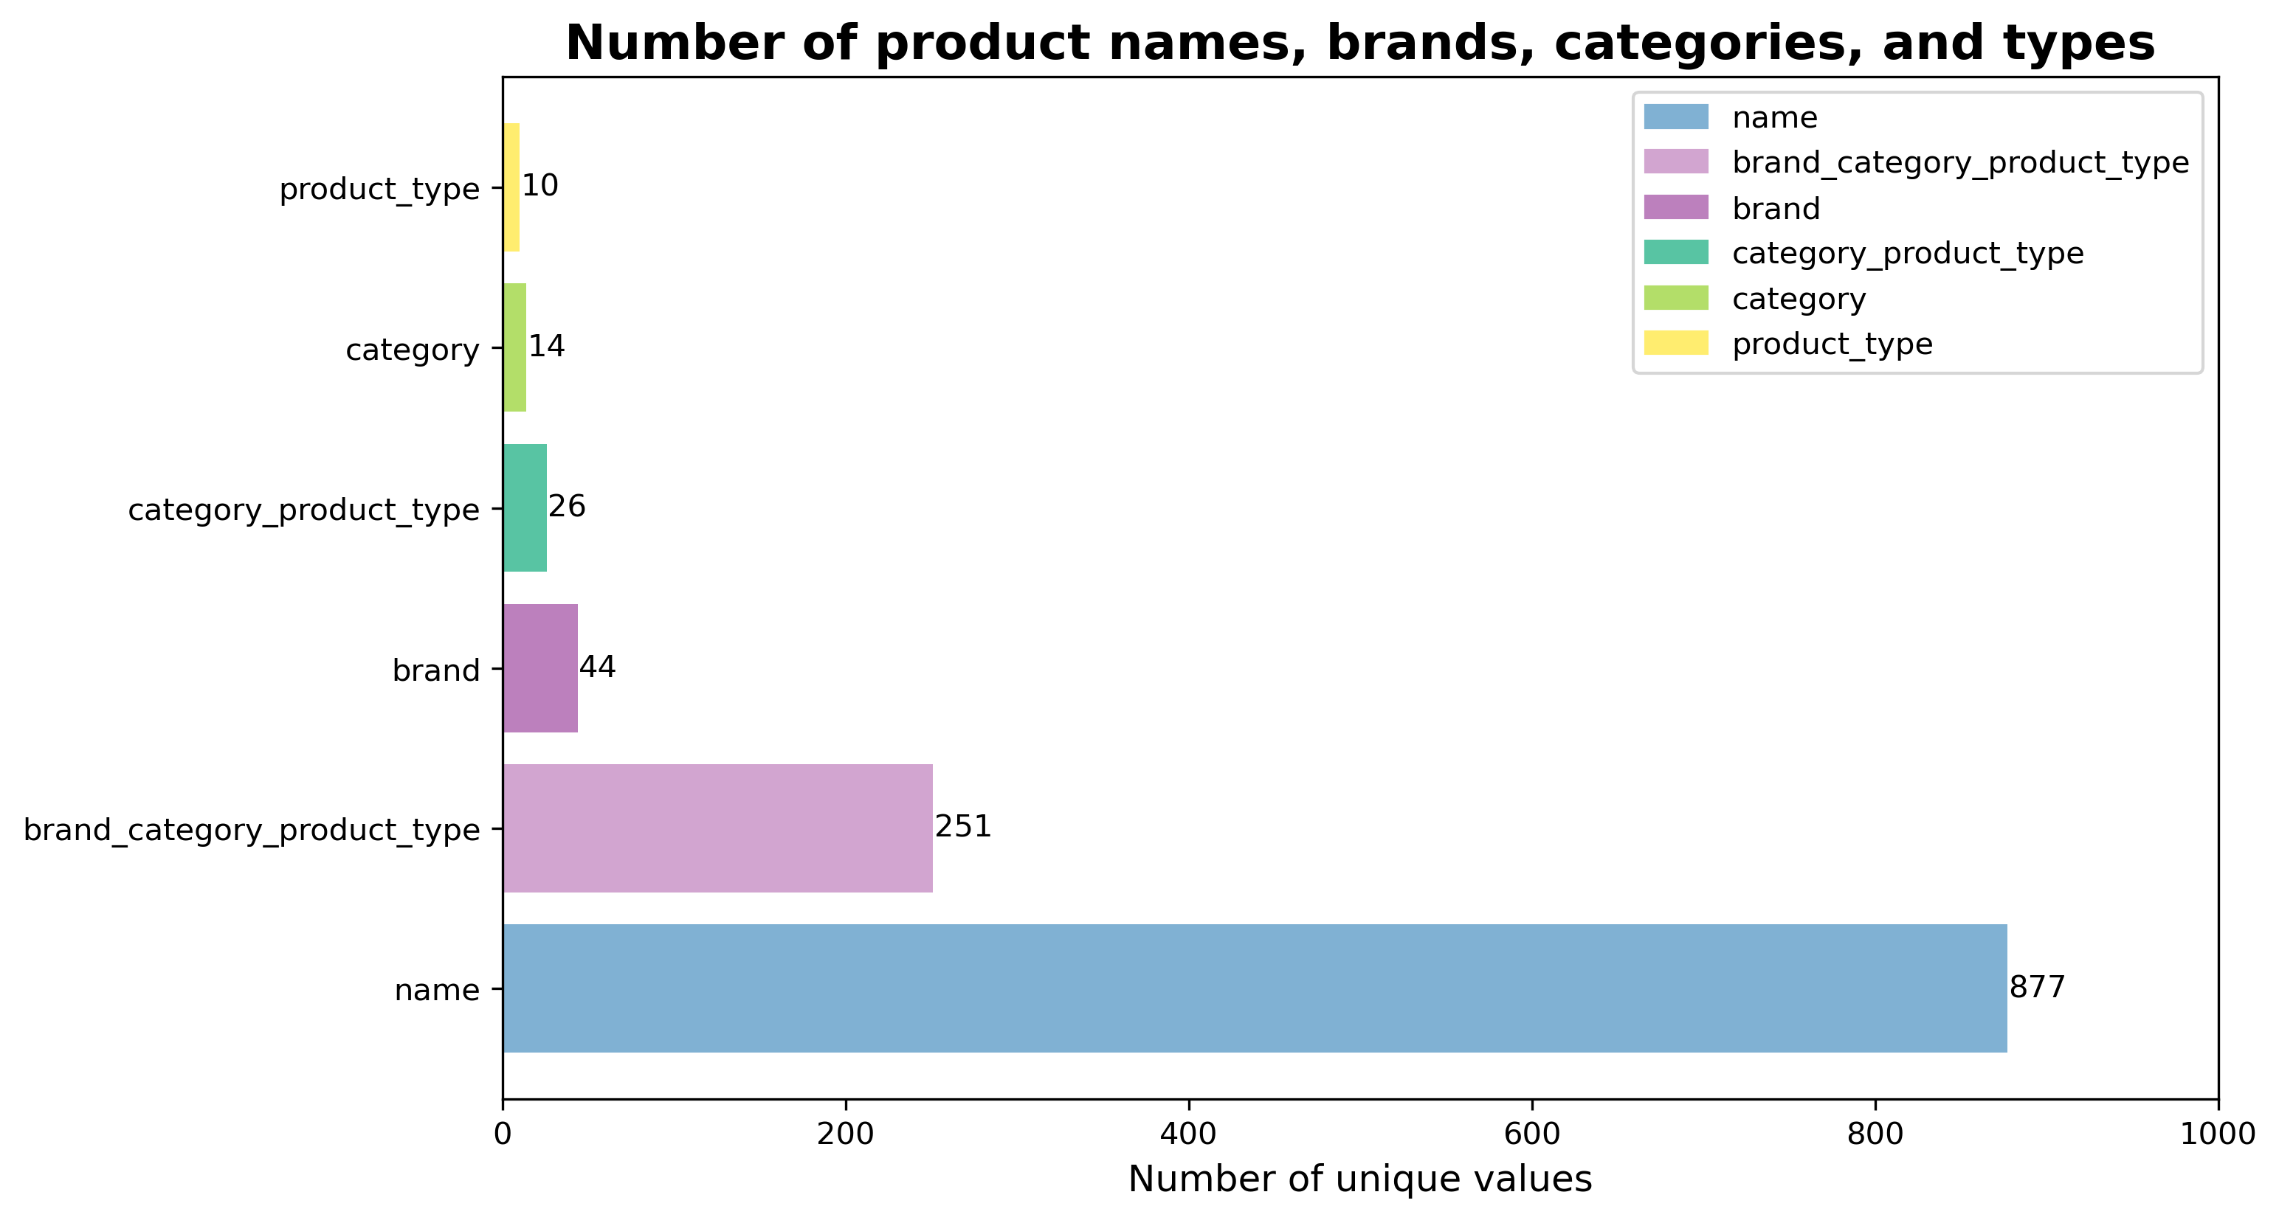
Number of Unique Products, Brands, Categories, and Types
• Chart type: barh (horizontal bar chart).
• Displayed: Number of unique values for each data category.

Slide 2
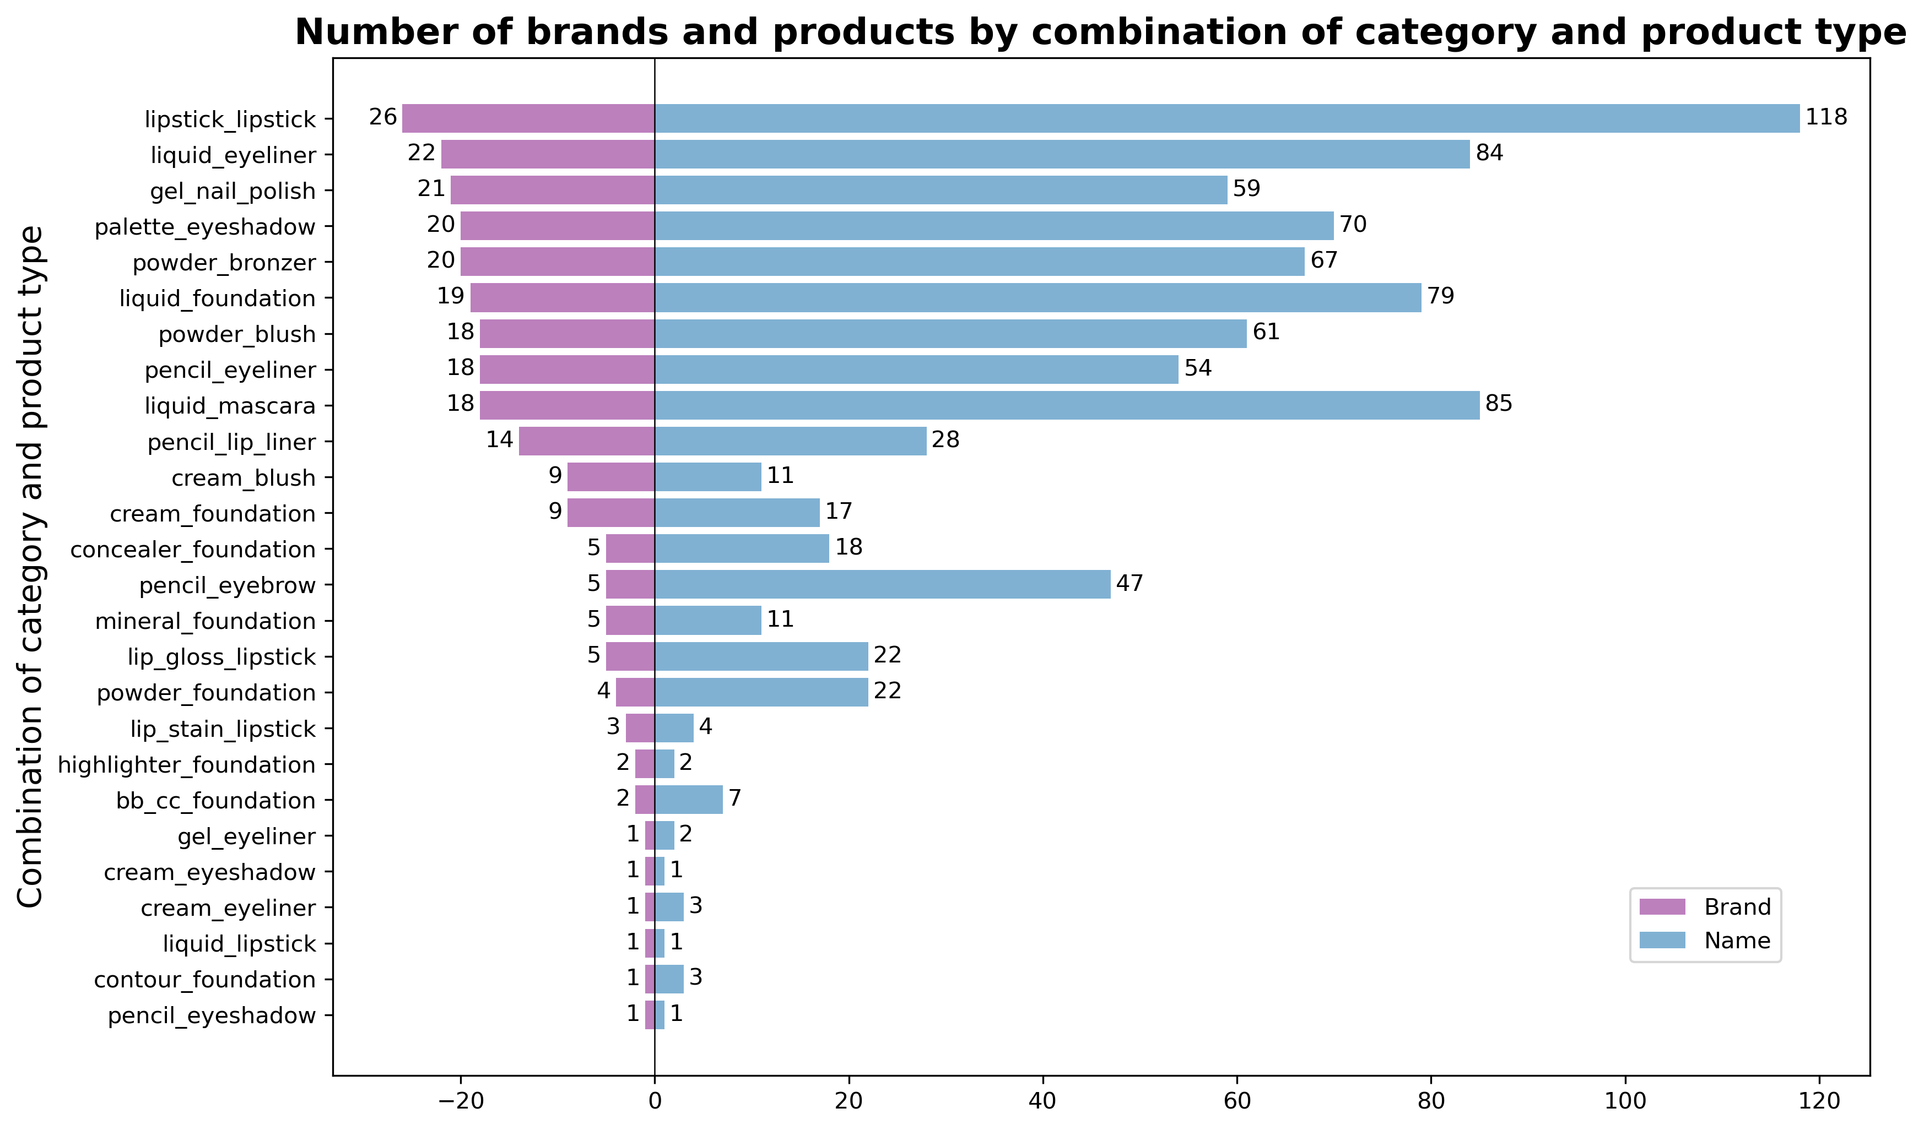
Number of Brands and Products by Categories
• Chart type: barh (horizontal bars).
• Displayed:
– Brand — Number of unique brands (on the left).
– Name — Number of unique products (on the right) for each combination of category and product type.

Slide 3
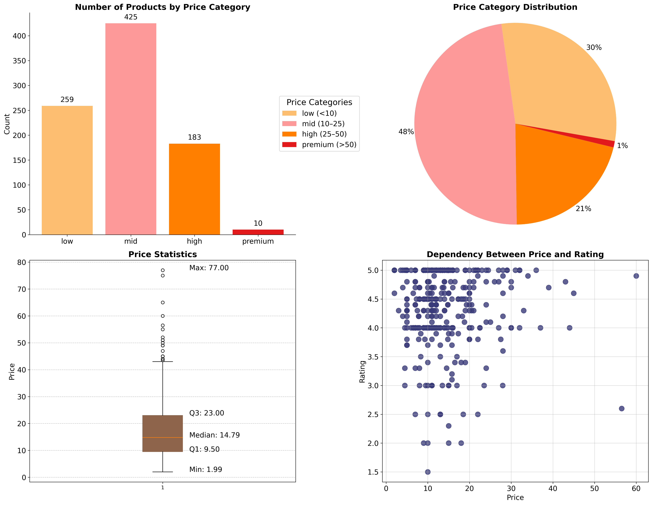
Price Analysis
• Chart types: bar, pie, boxplot, scatter.
• Displayed:
– Bar chart: Number of items by price categories.
– Pie chart: Percentage share of each price category.
– Boxplot: Minimum, maximum, median price, quartiles.
– Scatter plot: Dependency between price and rating.

Slide 4
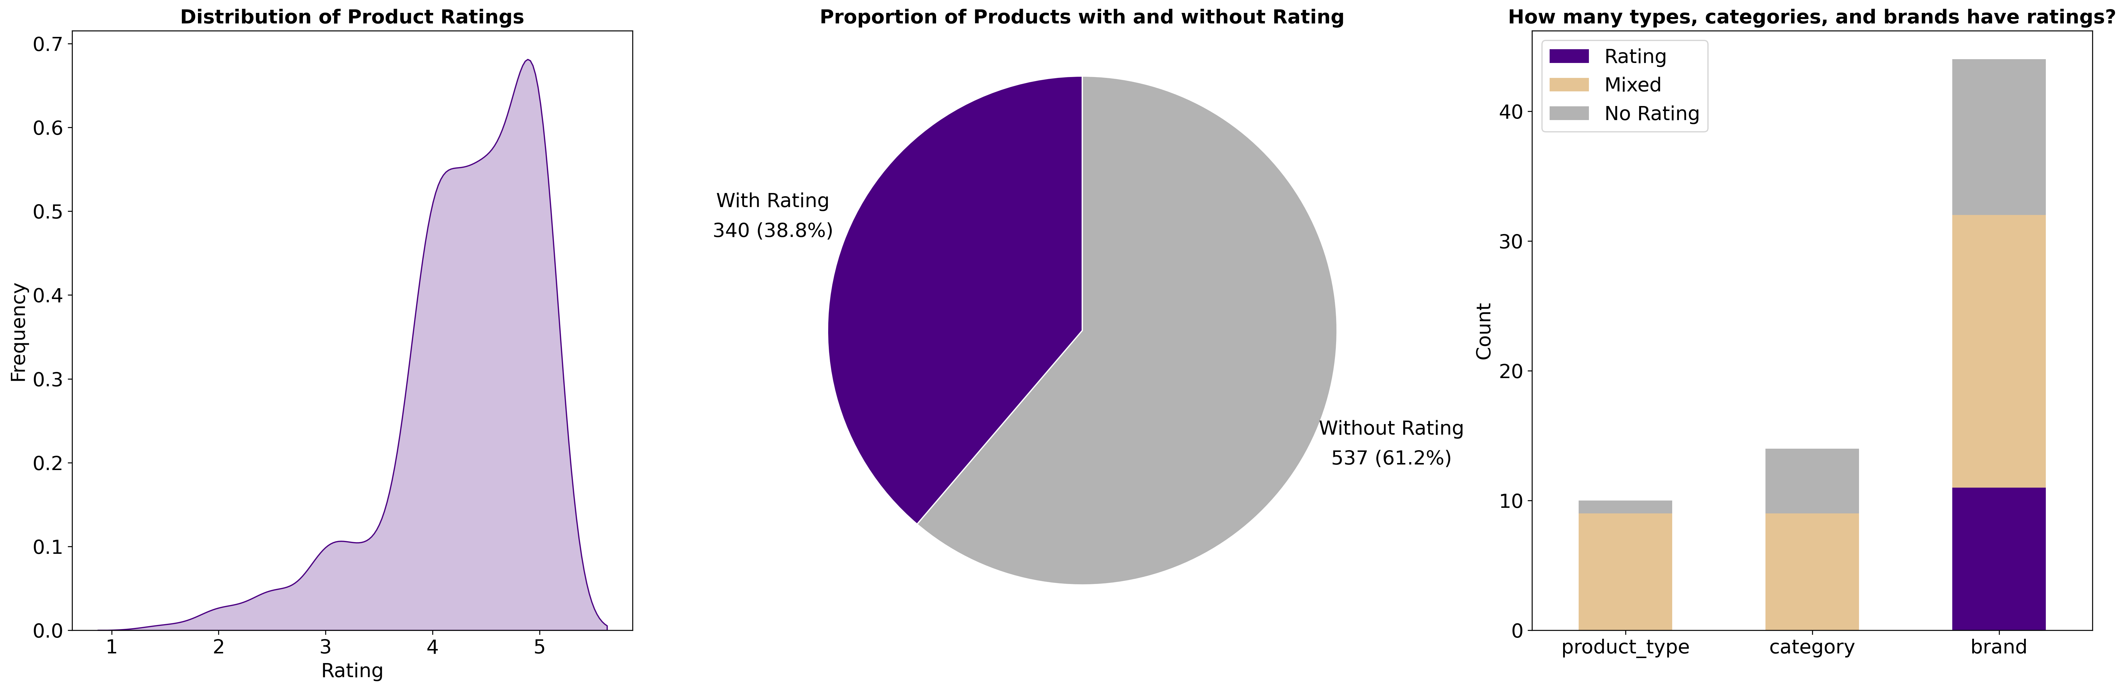
Product Ratings
• Chart types: kdeplot (density estimation), pie, bar.
• Displayed:
– Distribution of rating values.
– Share of items with and without ratings.
– Count of types, categories, and brands with ratings.

Slide 5
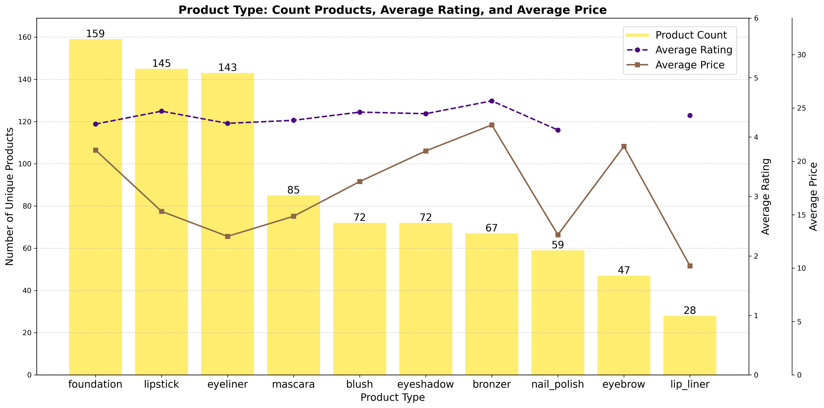
Product Type Analysis
• Chart types: bar (bars), line (lines).
• Displayed:
– Number of products for each type.
– Average rating and price by product types.

Slide 6
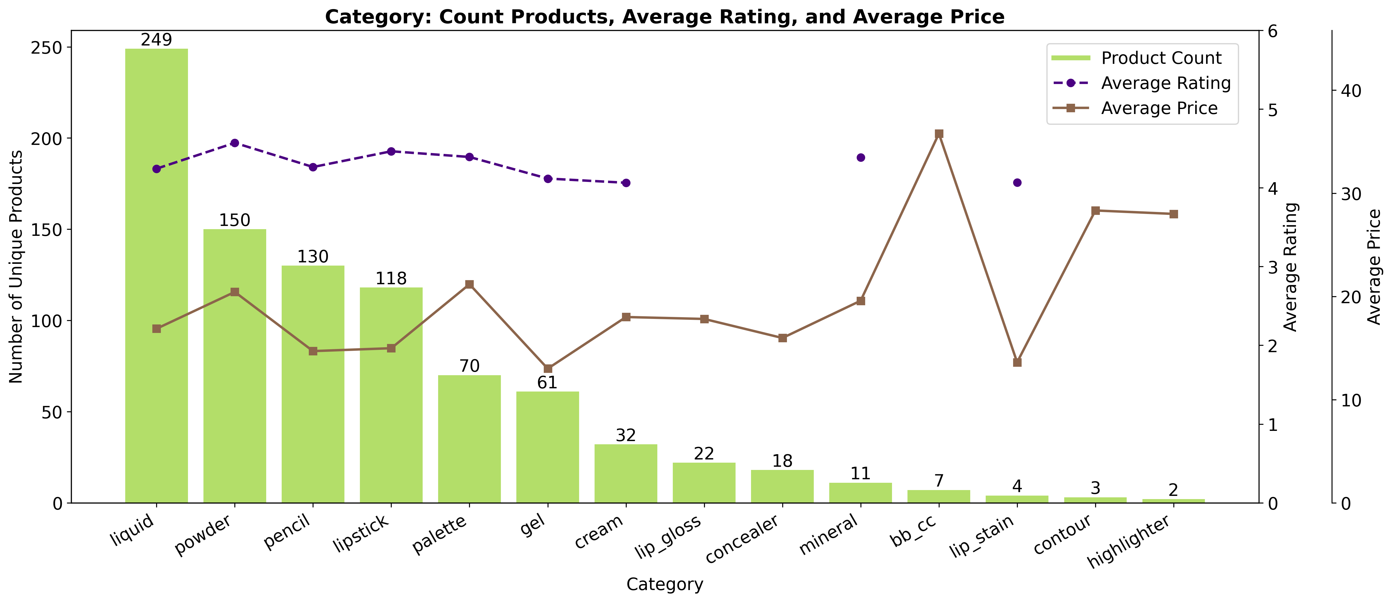
Product Categories
• Chart types: bar (bars), line (lines).
• Displayed:
– Number of products.
– Average rating and price by categories.

Slide 7
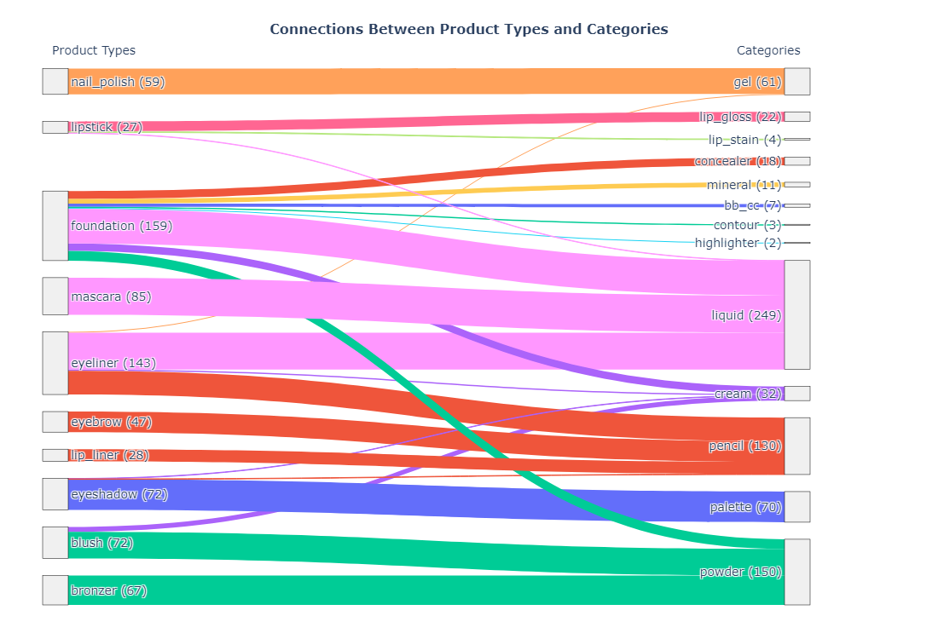
Connections Between Product Types and Categories
• Chart type: Sankey Diagram.
• Displayed:
– Relationships between product types and categories.
– Distribution of products between types and categories represented by line widths.

Slide 8
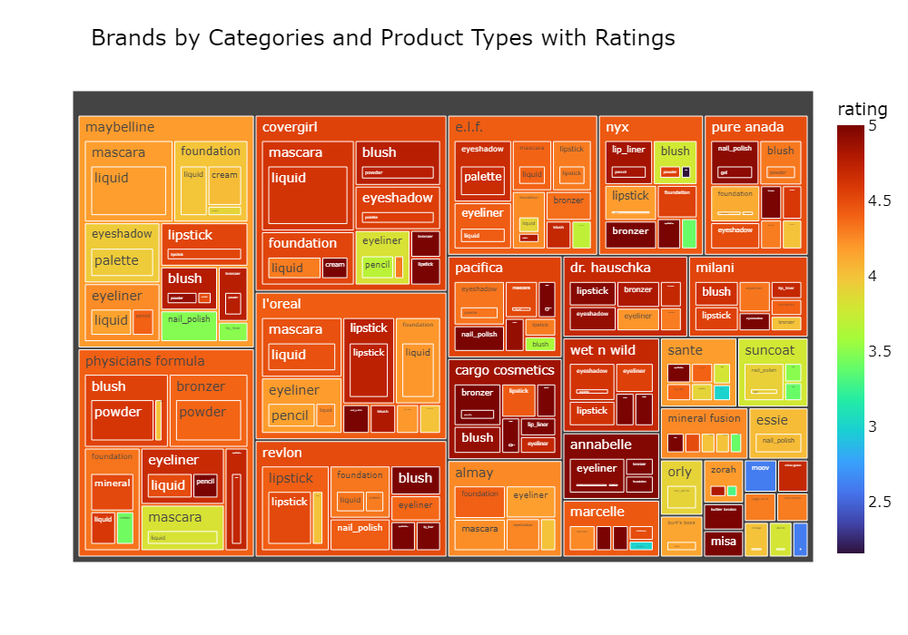
Brands by Categories and Product Types
• Chart type: Treemap.
• Displayed:
– Hierarchical structure of brands in categories.
– Rating indicated by a color scale.

Slide 9
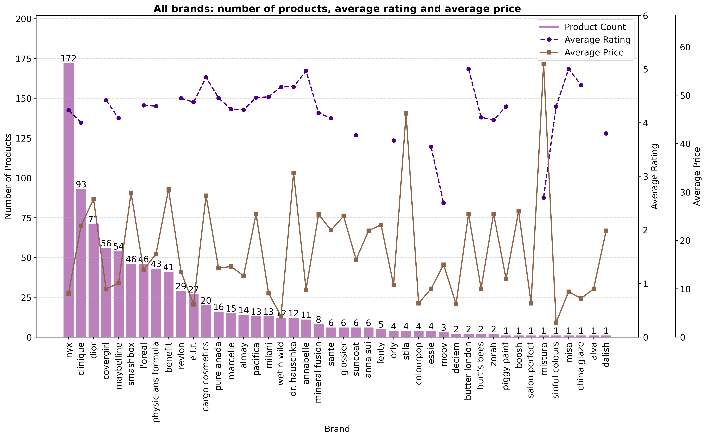
Overview of All Brands
• Chart types: bar, line.
• Displayed:
– Number of products for each brand.
– Average rating and price.

Slide 10
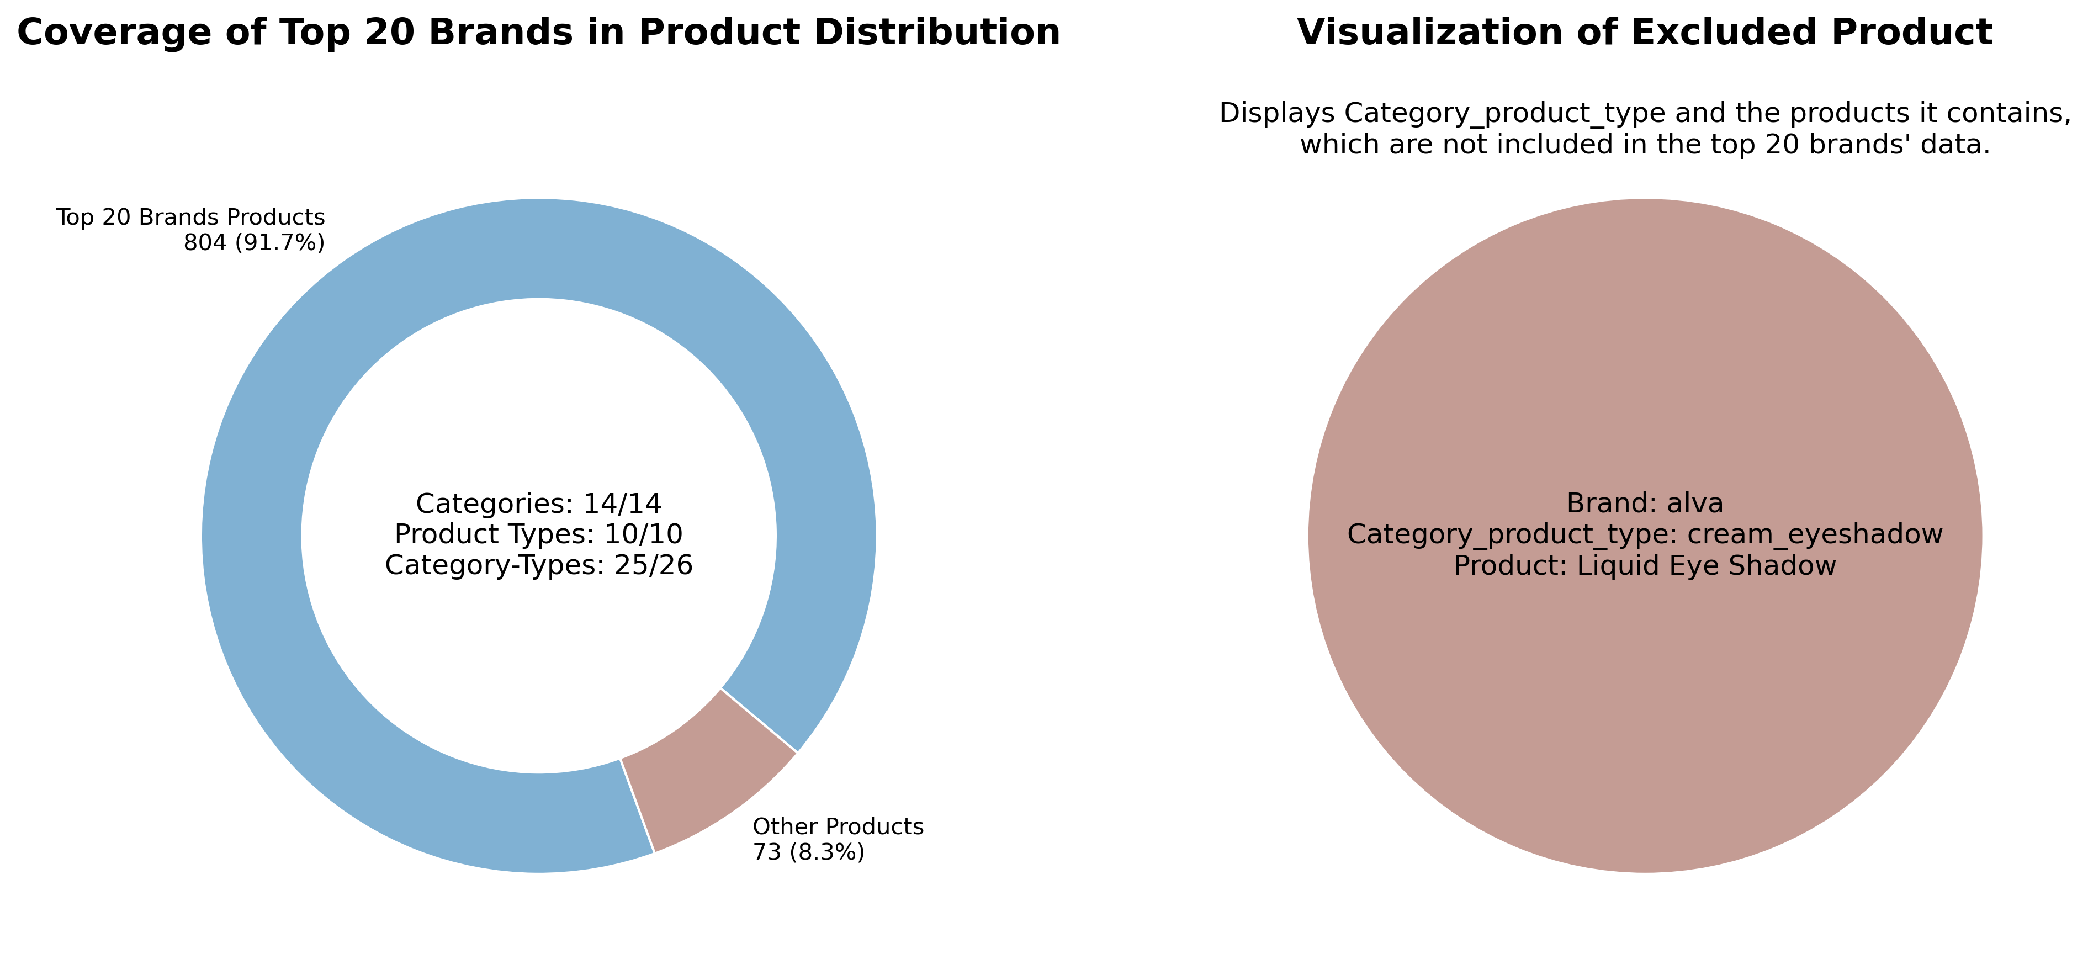
Top 20 Brands
• Chart types: donut chart, pie chart.
• Displayed:
– Share of products offered by the top 20 brands.
– Count of categories, product types, and their coverage.

Slide 11
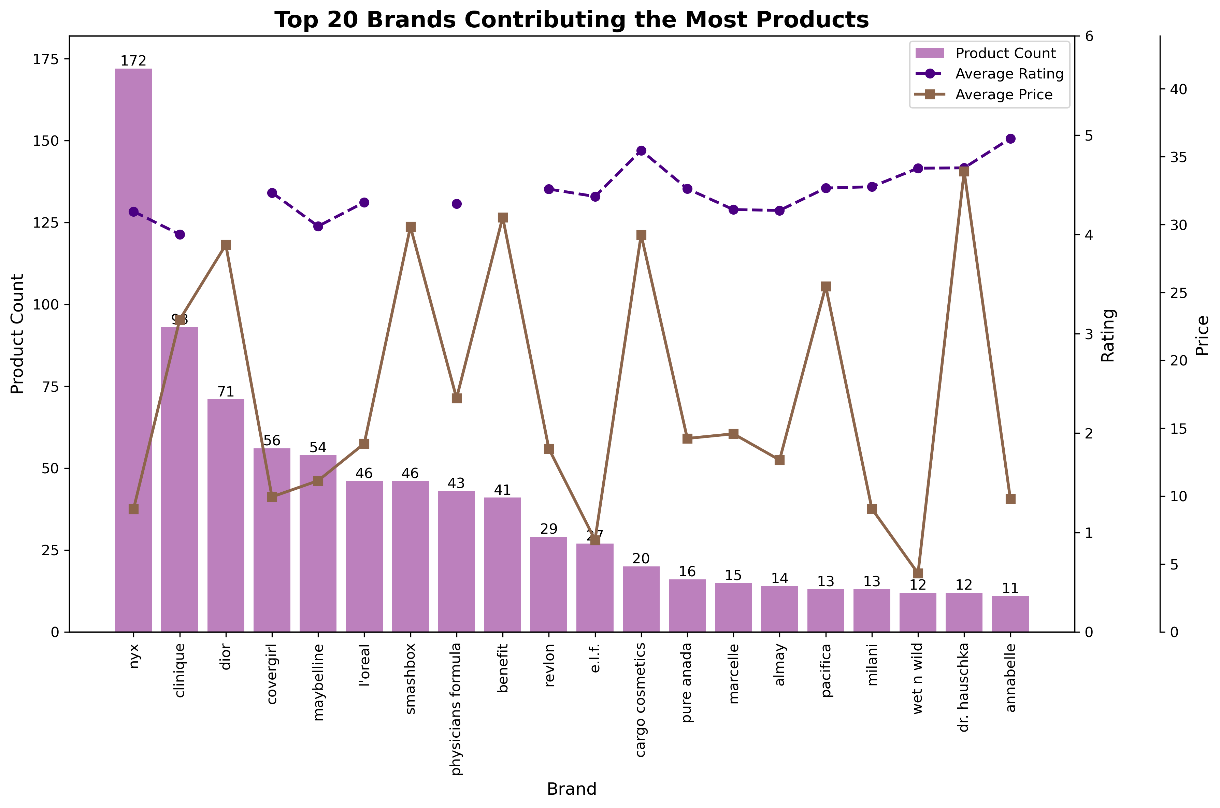
Analysis of Top 20 Brands
• Chart types: bar, line.
• Displayed:
– Number of products, ratings, and average price per brand.

Slide 12
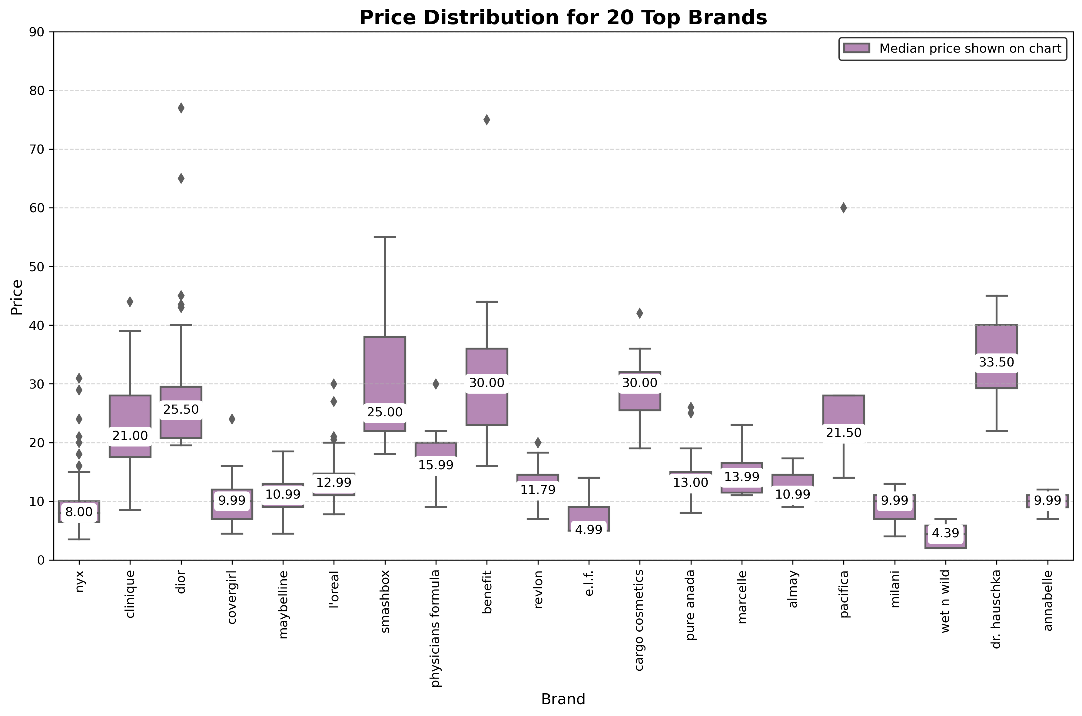
Top Brands Prices
• Chart type: boxplot.
• Displayed:
– Price distribution for each brand, including minimum, maximum, median.

Slide 13
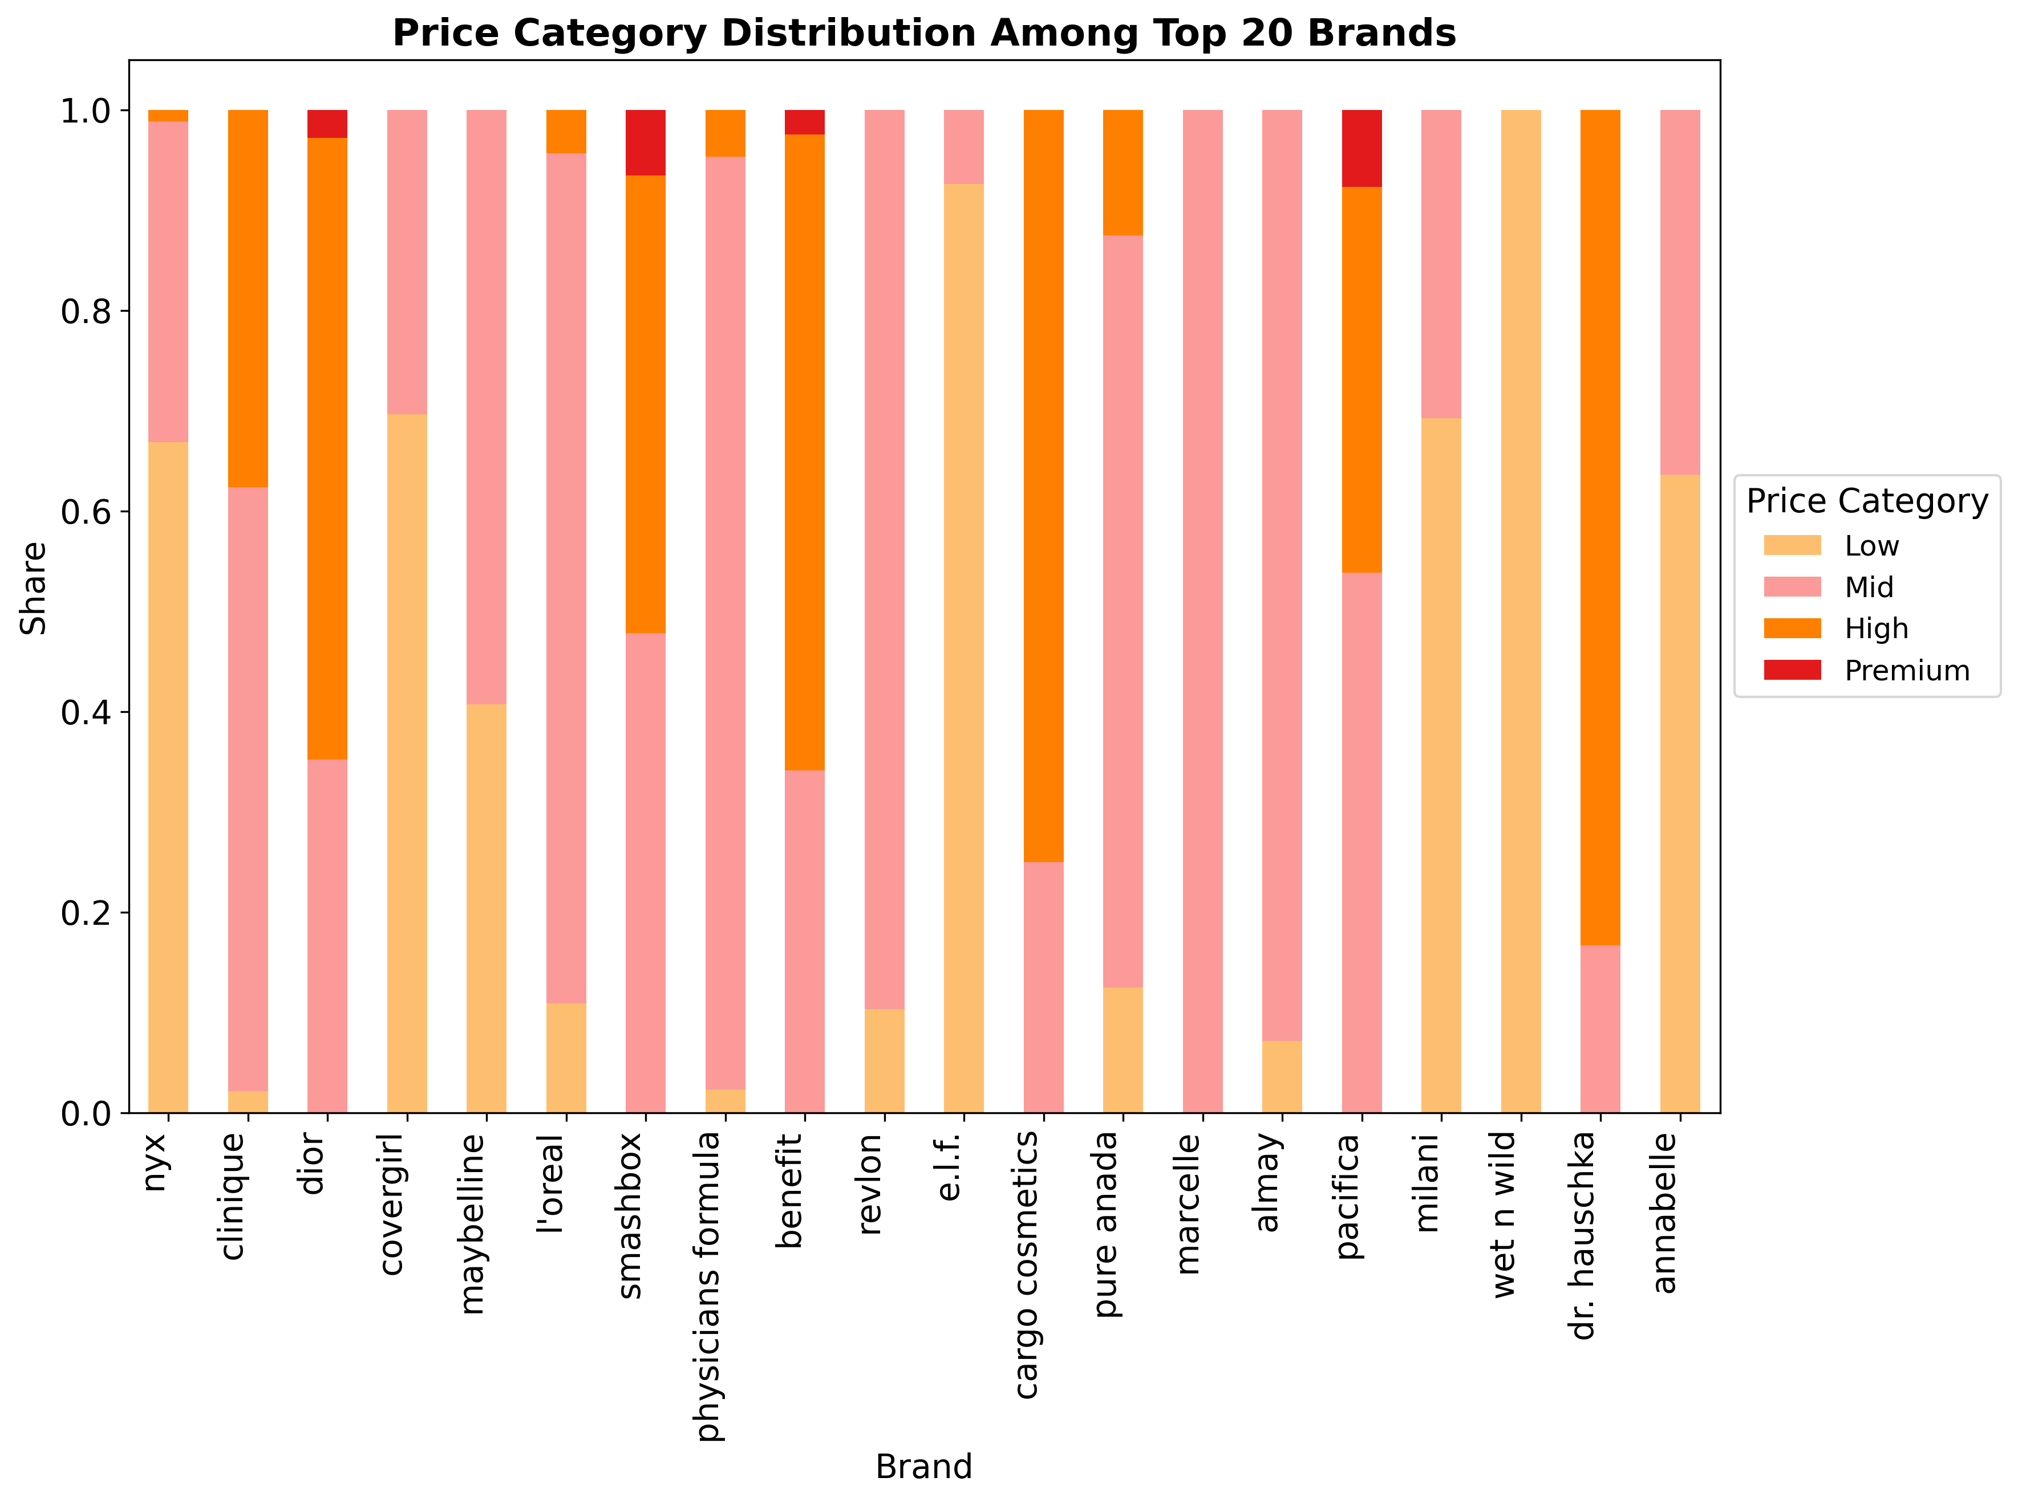
Price Distribution Among Products
• Chart type: stacked bar.
• Displayed:
– Representation of brands across different price categories.

Slide 14
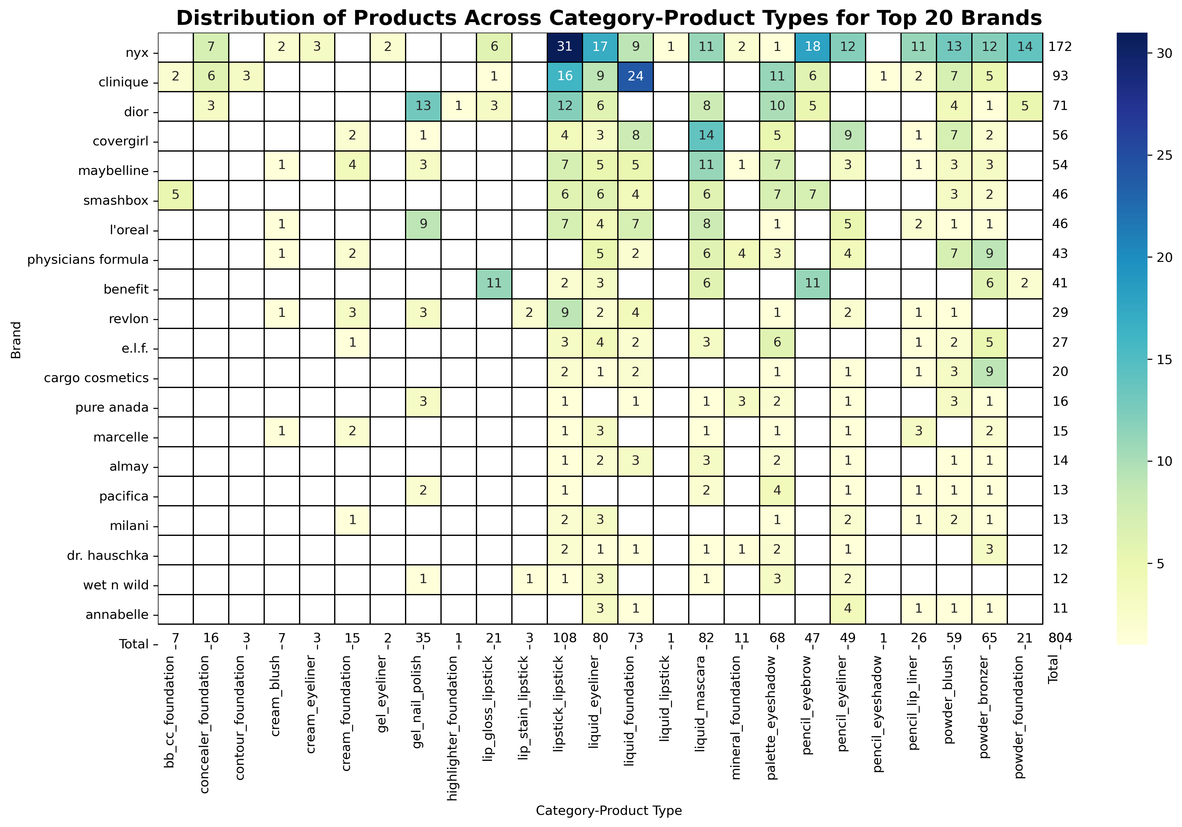
Product Distribution Across Categories and Types Among Top 20 Brands
• Chart type: heatmap.
• Displayed:
– Count distribution of category-product types among top 20 brands.
– The chart highlights which brands actively operate across different category-product types and their relationships.

