Slide 1

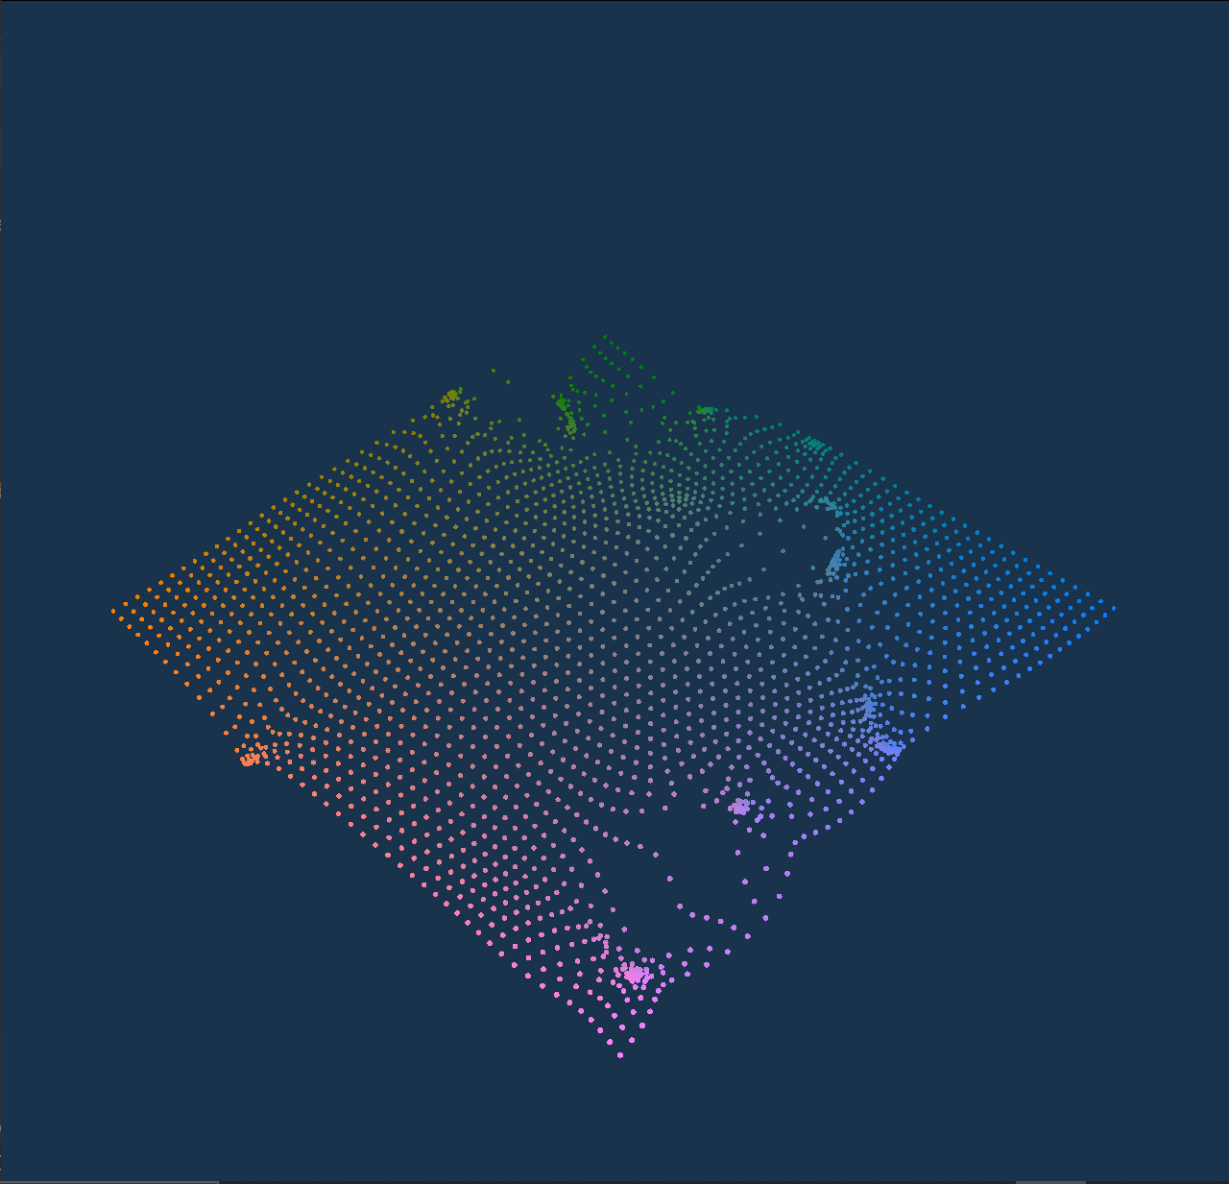
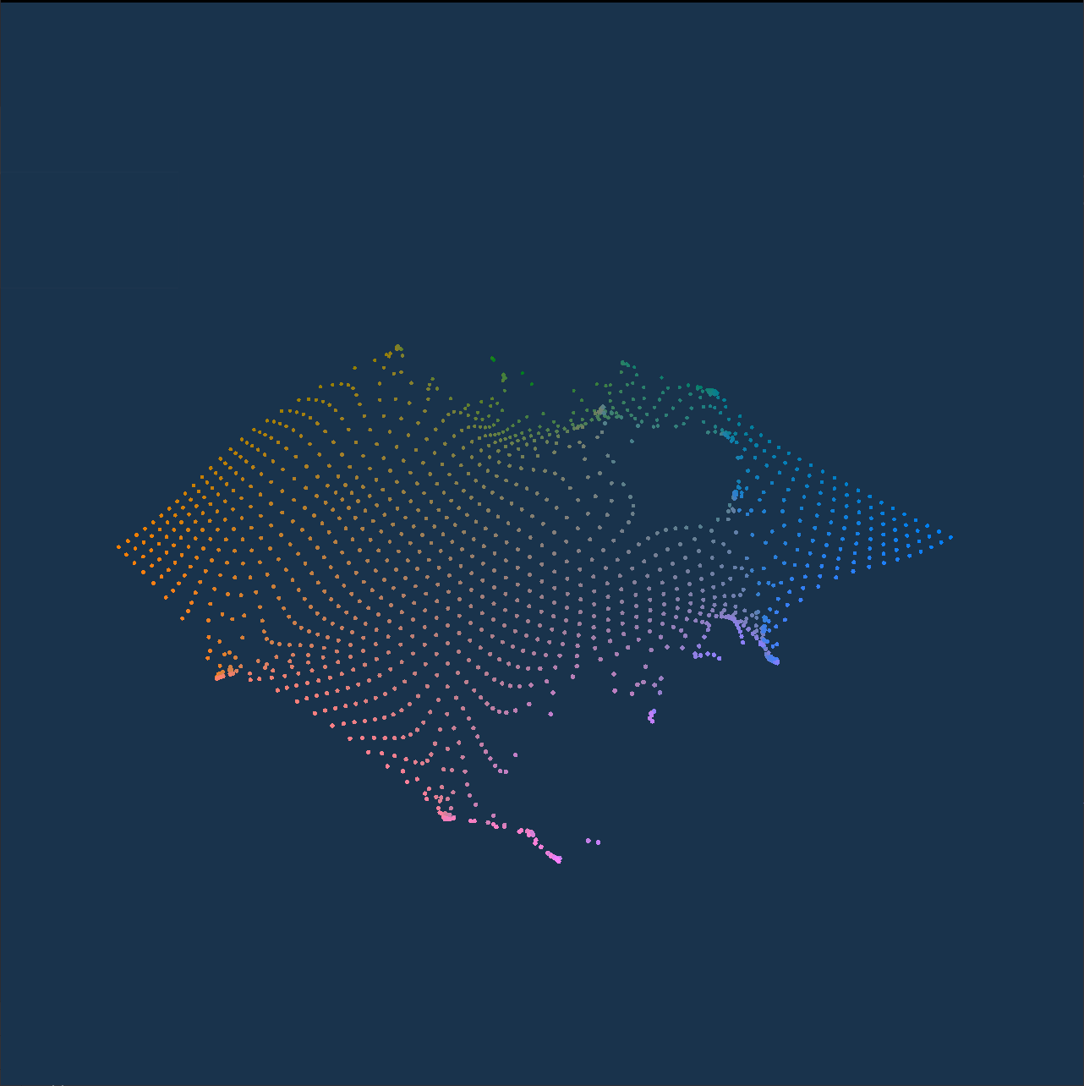
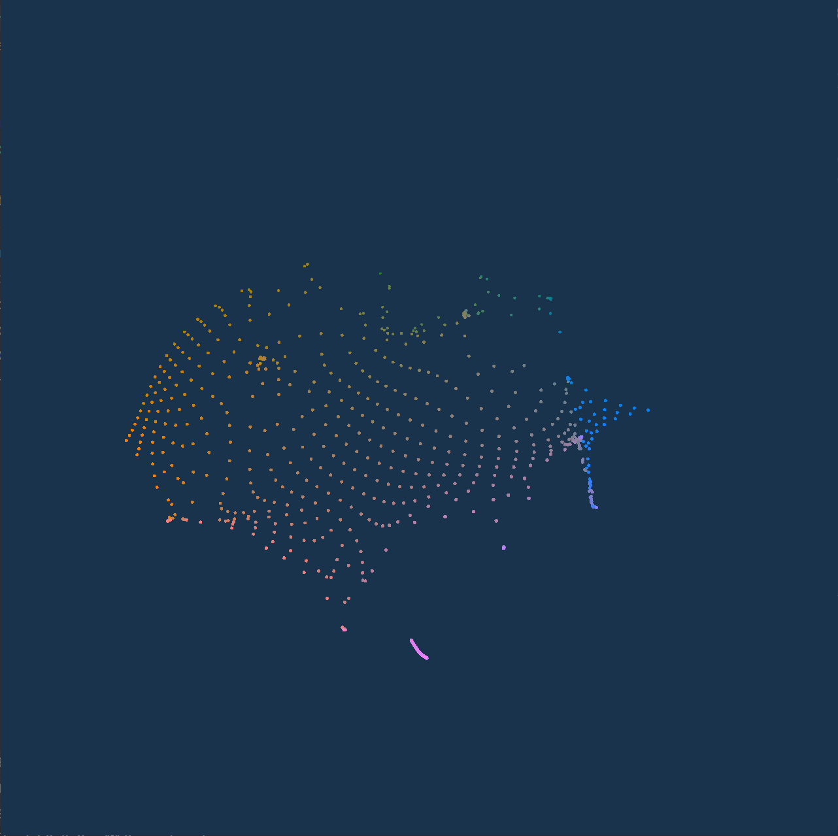
Viability of a Web Based Data Visualization System
Does the new WebGPU standard enable web applications to utilize the GPU in a general purpose and performant manner? Furthermore, does the use of this new standard allow a real-time data visualization software to be run entirely on the web?
Valerie Dagley, Professor Hank Childs, University of Oregon

Slide 2
Introduction
Does the new WebGPU standard enable web applications to utilize the GPU in a general purpose and performant manner? Furthermore, does the use of this new standard allow a real-time data visualization software to be run entirely on the web?
Web Applications are becoming increasingly central to the modern software ecosystem.
Web Applications are typically slower than desktop applications, oftentimes 5-10x slower.
WebGPU, a new web standard released officially in April of 2023, allows web applications to make use of modern hardware improvements for high performance applications
3D data visualization makes use of difficult calculations that are optimized through use of this modern hardware.

Slide 3
Background
Does the new WebGPU standard enable web applications to utilize the GPU in a general purpose and performant manner? Furthermore, does the use of this new standard allow a real-time data visualization software to be run entirely on the web?
Modern computers contain 2 main processors: the CPU and the GPU. The CPU is fast but runs sequentially, whereas the GPU does many simpler operations in parallel.
Web applications are limited by the CPU, preventing them from being useful in scenarios which require high performance.
The GPU is useful for applications that require large amounts of simple operations.
Historically this has been used for 3D graphics, however in the past 10 years it has been used for applications like AI, simulations, data visualization, and cryptocurrency.

Slide 4
Method
Does the new WebGPU standard enable web applications to utilize the GPU in a general purpose and performant manner? Furthermore, does the use of this new standard allow a real-time data visualization software to be run entirely on the web?
To answer our guiding question, we chose to implement a common data visualization method utilizing the GPU.
We chose to use Rust and Web Assembly, which allows us to create a single program that can run on both the web and the desktop with minimal differences.
Our program runs a data visualization method called mass particle advection, which is very well suited for the GPU.
We then measured the amount of time it takes to compute and render each frame under increasing stress loads. Each test was run over 10 seconds, taking the average result.

Slide 5
Demo
Does the new WebGPU standard enable web applications to utilize the GPU in a general purpose and performant manner? Furthermore, does the use of this new standard allow a real-time data visualization software to be run entirely on the web?

Slide 6
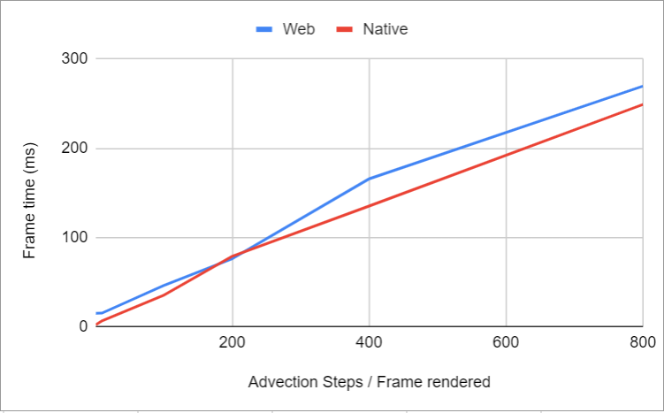
Results
Does the new WebGPU standard enable web applications to utilize the GPU in a general purpose and performant manner? Furthermore, does the use of this new standard allow a real-time data visualization software to be run entirely on the web?
Using our test data, we observed that the application served on the web scaled at an equal rate as the application served natively on the desktop.
Slowdowns existed due to the overhead of running on the web, but are minor under large GPU loads.
This shows extreme promise for the future of general-purpose GPU computing on the web.

Slide 7


Acknowledgements
This research was funded by the Center for Undergraduate Research and Engagement (CURE) through their First Year Research Experience (FYRE) fund.
I would like to acknowledge the assistance of:
Professor Hank Childs, who led me through this research and encouraged me throughout.
Ph.D students Manish Mathai and Meghanto Majumder for their interest and collaboration with this project.
Peter Nelson for his parallel work in this area.

Slide 8
Research Experience
This research was funded by the Center for Undergraduate Research and Engagement (CURE) through their First Year Research Experience (FYRE) fund.
It was a great experience to be able to live near campus over the summer and work with my faculty mentor learning how to research.
As part of this experience I will be participating in the University of Oregon Undergraduate Research Symposium on May 23, 2024.

Slide 9
