Slide 1
How to avoid data disaster
Valeria Bo
Sergio Martinez

Slide 2
Data Files
Format: .txt, .csv, .xls, …
Data?
Tables, lists, …
Numbers, names, dates, …
Graphs, images, ...

Slide 3
Always, always RAW data
NOT
Processed
Filtered
Manipulated
either electronically or manually

Slide 4
Why? Because…
Maintain consistency
Data format, codes (M,F)
Separator: , ; tab
Reduce human errors
Copy / Paste / Cut
Delete
Addition unwanted characters

Slide 5
Why? Because…
Reduce machine errors
Cell formats
Save file with a different extension

Slide 6
Example 1
Patient ID | Sex | Date of birth
1 | M | 01-01-2013
2 | f | 04-18-1998
3 | Male | 1st April 2004
4 | Female | NA
5 | F | 2010/03/12
6 | F
7 | M | 10012012

Slide 7
Example 1
Consistency: F, female, f, fem, 2, …
Single common format for all dates
YYYY-MM-DD or YYYYMMDD
Consistency about missing values
NA(not available), NULL, , ...

Slide 8
Example 1 - modified
Patient ID | Sex | Date of birth
1 | M | 2013-01-01
2 | F | 1998-04-18
3 | M | 2004-04-01
4 | F | NA
5 | F | 2010-03-12
6 | F | NA
7 | M | 2012-01-10

Slide 9
A bit more about consistency
Realistic and easy to understand Variable names
File names
Unique and consistent variable names
Multiple tables

Slide 10
Blank spaces
Be careful about extra spaces within cells
Blank cell is different then a cell that contains a single space
“male” is different from “ male ”
These can be a headache later on!

Slide 11
Example 2
Patient ID | date | value
1 | 2015-06-14 | 123
2 |  | 76.5
3 | 2015-06-18 | 32
4 |  | 120.3
5 |  | 109
6 | 2015-06-20 | 105
7 |  | 143

Slide 12
Example 2
Fill in all cells
Problems when sorting
Empty cell
Missing value?
Value meant to be repeated multiple times?
Missing value -> NA

Slide 13
Example 2
Make sure it’s clear that the data is missing and
not
unintentionally
left blank

Slide 14
Example 2
Patient ID | date | value
1 | 2015-06-14 | 123
2 | 2015-06-14 | 76.5
3 | 2015-06-18 | 32
4 | 2015-06-18 | 120.3
5 | 2015-06-18 | 109
6 | 2015-06-20 | 105
7 | 2015-06-20 | 143

Slide 15
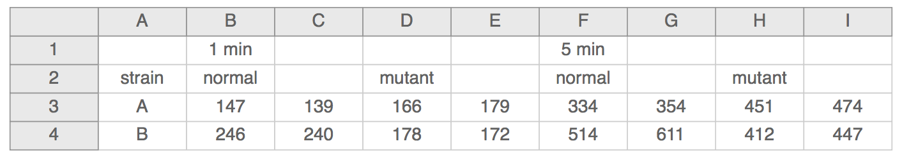
Example 3

Slide 16
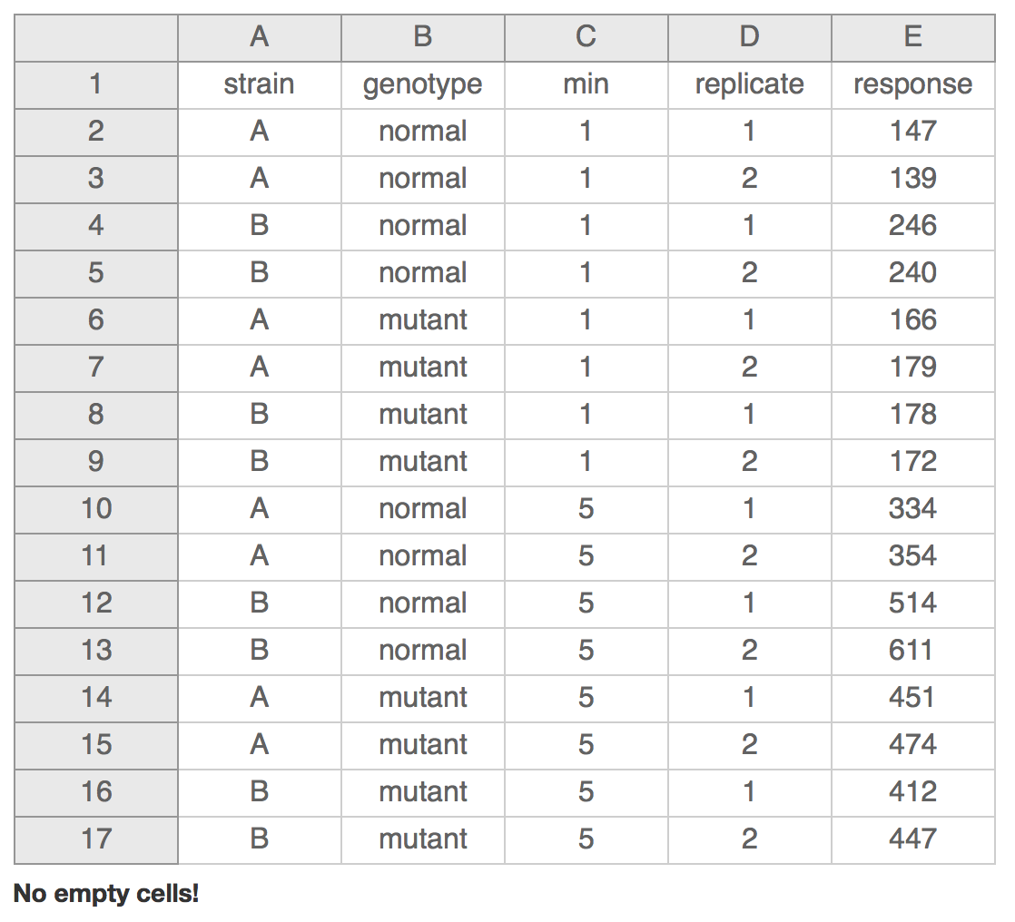
Example 3

Slide 17
More…
Don’t put too much information in 1 cell
1 cell = 1 information
Don’t include units such as “30 g”.
“g” in the column name
“0 (below threshold)”
write notes in a separate column

Slide 18
More…
Make it rectangle
Create a data dictionary – separate file
Avoid using “,” or “;” or tab
Do not manually modify values – copies

Slide 19
More..
No calculations
No font colour or highlighting
computer doesn’t recognize it

Slide 20
Good vs Bad Name
Good Name | Good alternative | Bad name
MaxTemp | max_temp | Maximum Temperature (C)
Quantity | Quantity_mg | Quamg
Sex |  | M/F
Weight | Weight_kg | w

Slide 21
Write-protect
Mac:
Right-click on the file in Finder
Select “Get Info”
Sharing and permission
Priviledge
Read only

Slide 22
Write-protect
Windows:
Right-click on the file in windows explorer
Properties
General tab
Attributes
Select the box for “read only” and click ok

Slide 23
Data validation
Excel data validation feature
Select a column
In the menu bar, choose Data
Validation
Integer or decimal number - range
List of possible values
Limited length text

Slide 24
Save
Always keep a copy of your data files in a plain text format
Tab delimited
, or ; separated
Such as .csv

Slide 25
Be careful
When identifiers are long integers
1000000 -> 1e06
Do not fill blank cells with 0s
0s are data!

Slide 26
Practise 1

Slide 27
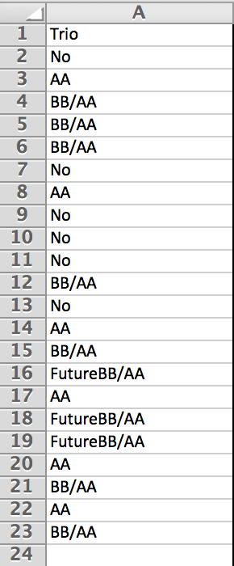
IDs

Slide 28
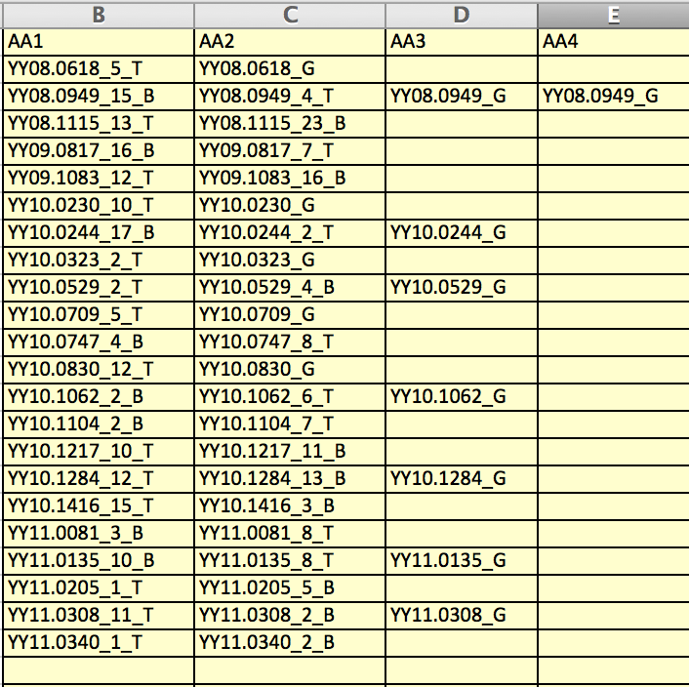
Column titles
Missing values

Slide 29
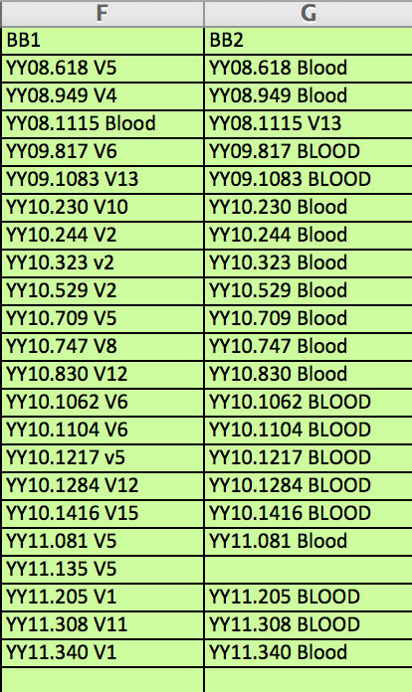
Name consistency

Slide 30
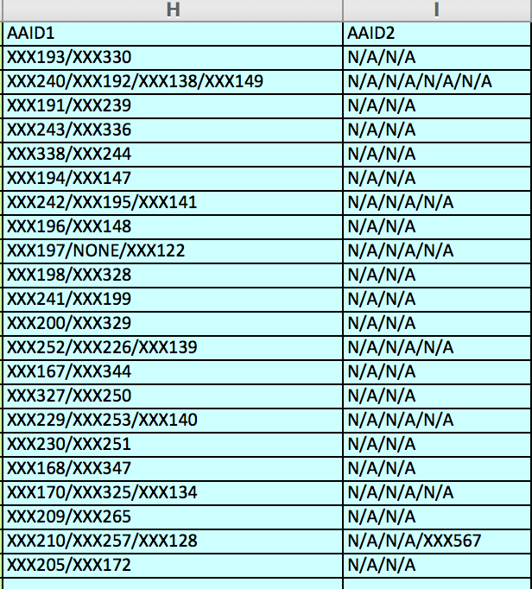
ID1/ID2
Separate columns
N/A/N/A
NA/NA
Separate columns

Slide 31
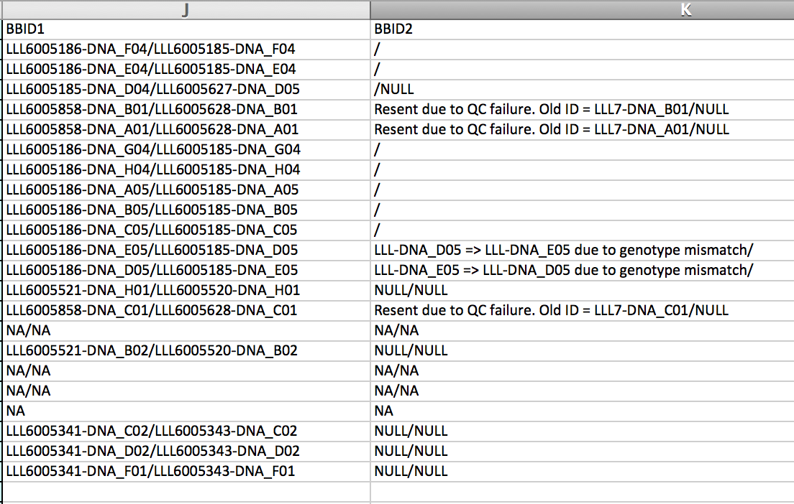
“/” or “N/A” or “NULL”?

Slide 32
Practise 2

