Slide 1
How to avoid data disaster
Valeria Bo

Slide 2
Introduction
.txt, .csv, .xls, …
Tables, lists, …
Numbers, names, dates, …
Graphs, figures, images

Slide 3
Always, always RAW data
NOT
Processed
Filtered
Manipulated
either electronically or manually

Slide 4
Why? Because…
Maintain consistency
Reduce human errors
Copy
Delete
Addition unwanted characters
Reduce machine errors
Cell formats
Save file with a different extension

Slide 5
Example 1
Patient ID | Sex | Date of birth
1 | M | 01-01-2013
2 | f | 04-18-1998
3 | Male | 1st April 2004
4 | Female | NA
5 | F | 2010/03/12
6 | F
7 | M | 10012012

Slide 6
Example 1
Consistency: F, female, f, fem, 2, …
Fixed code for missing values
Single common format for all dates
YYYY-MM-DD
Consistency about missing values

Slide 7
Example 1 - modified
Patient ID | Sex | Date of birth
1 | M | 2013-01-01
2 | F | 1998-04-18
3 | M | 2004-04-01
4 | F | NA
5 | F | 2010-03-12
6 | F | NA
7 | M | 2012-01-10

Slide 8
A bit more about consistency
Unique and consistent variable names
Multiple tables
Variable names
File names

Slide 9
Extra spaces
Be careful about extra spaces within cells
Blank cell is different then a cell that contains a single space
“male” is different from “ male ” (that is, with spaces at the beginning and end)
These can be a headache later on.

Slide 10
Example 2
Patient ID | date | value
1 | 2015-06-14 | 123
2 |  | 76.5
3 | 2015-06-18 | 32
4 |  | 120.3
5 |  | 109
6 | 2015-06-20 | 105
7 |  | 143

Slide 11
Example 2
Fill in all cells
Problems when sorting
empty cell
Missing value?
Value meant to be repeated multiple times?
Missing value -> NA
Make sure it’s clear that the data is missing and not unintentionally left blank

Slide 12
Example 2
Patient ID | date | value
1 | 2015-06-14 | 123
2 | 2015-06-14 | 76.5
3 | 2015-06-18 | 32
4 | 2015-06-18 | 120.3
5 | 2015-06-18 | 109
6 | 2015-06-20 | 105
7 | 2015-06-20 | 143

Slide 13
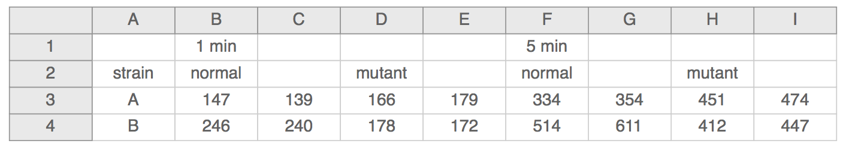
Example 3

Slide 14
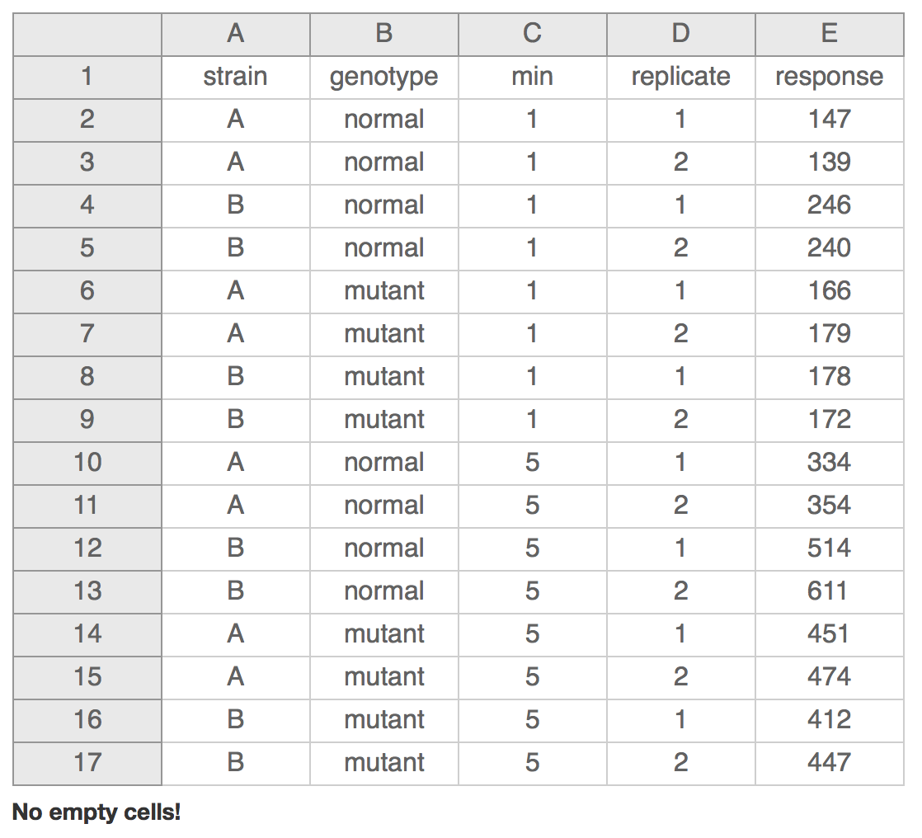
Example 3

Slide 15
More…
Don’t put too much information in 1 cell
1 cell = 1 thing
Don’t include units such as “30 g”.
“g” in the column name
“0 (below threshold)”
write notes in a separate column

Slide 16
More…
Make it rectangle
Create a data dictionary – separate file
Avoid using “,” or “;” or tab
Do no manually modify values – copies

Slide 17
More..
No calculations
No font colour or highlighting
computer doesn’t recognize it

Slide 18
Good vs Bad Name
Good Name | Good alternative | Bad name
MaxTemp | max_temp | Maximum Temperature (C)
Quantity | Quantity_mg | Quamg
Sex | Sex | M/F
Weight | Weight_kg | w

Slide 19
Write-protect
Mac:
Right-click on the file in Finder
Select “Get Info”
Sharing and permission
Priviledge
Read only

Slide 20
Write-protect
Windows:
Right-click on the file in windows explorer
Properties
General tab
Attributes
Select the box for “read only” and click ok

Slide 21
Data validation
Excel data validation feature
Selct a column
In the menu bar, choose Data and then Validation
Whole or decimal number on some range
List of possible values
Limited length text

Slide 22
Save
Always keep a copy of your data files in a plain text format
Tab delimited
, or ; separated
Such as .csv

Slide 23
Be careful
When identifiers are long integers
1000000 -> 1e06
Do not fill blank cells with 0s
0s are data!

Slide 24
Practise 1

Slide 25
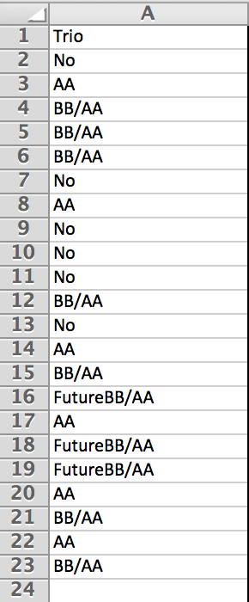
IDs

Slide 26
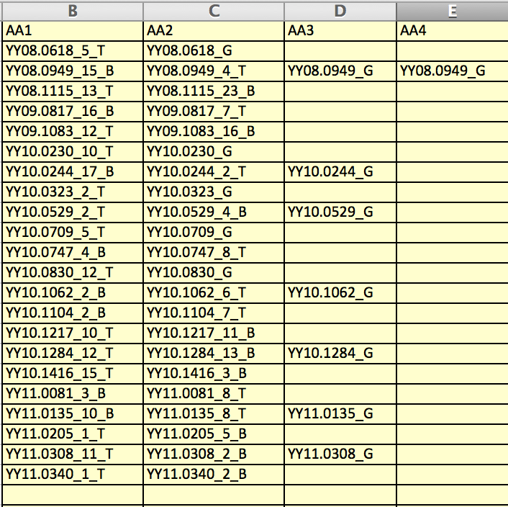
Column titles
Missing values

Slide 27
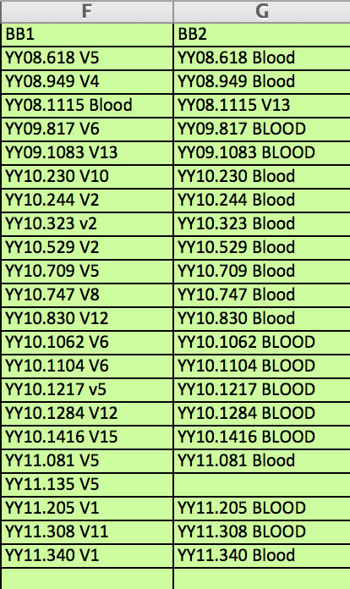
Name consistency

Slide 28
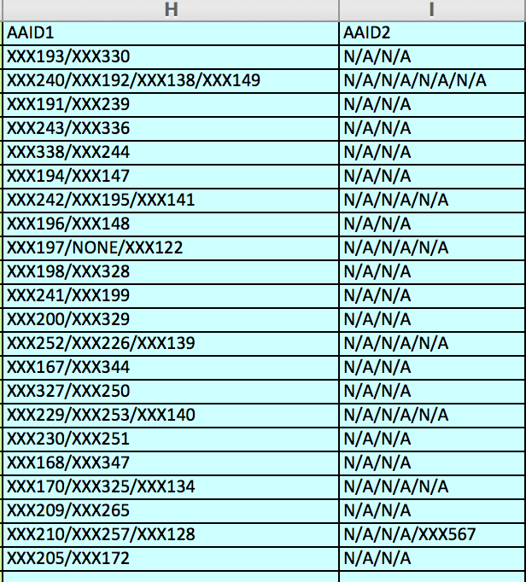
ID1/ID2
Separate columns
N/A/N/A
NA/NA
Separate columns

Slide 29
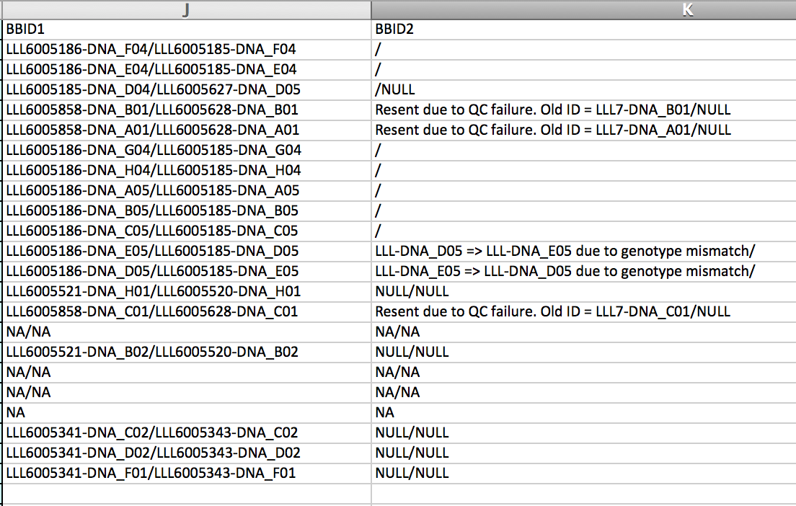
“/” or “N/A” or “NULL”?

Slide 30
Practise 2

