Slide 1
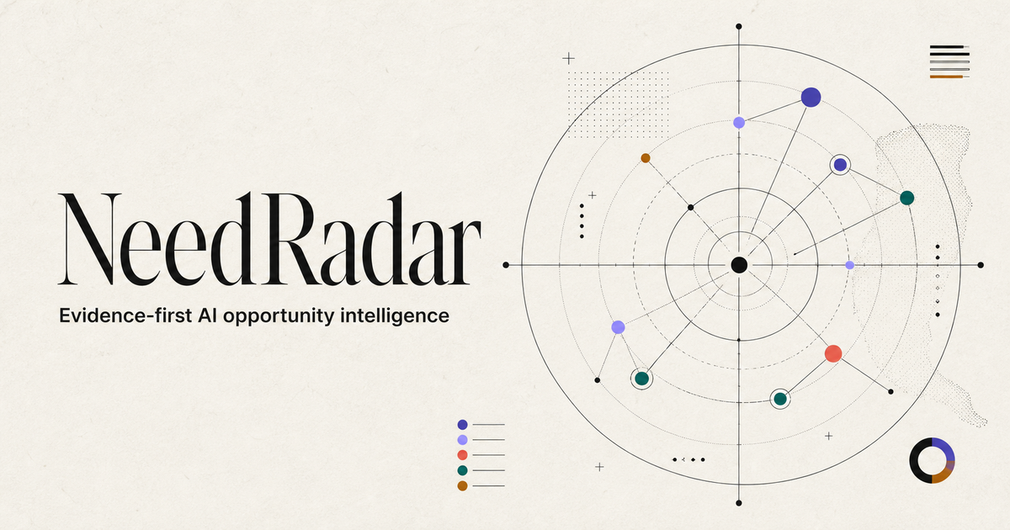
AI STRATEGY / TRANSFORMATION CASE
Sihan Xu · Product strategy, governance, and implementation
Notes:
The artwork is the production NeedRadar social identity generated for this revision.
[Sources]
- https://needradar-ai.xusihan615.chatgpt.site
- https://github.com/ValerianXXX/needradar
[/Sources]

Slide 2
NEEDRADAR / AI STRATEGY CASE
EXECUTIVE ANSWER
THE DECISION PROBLEM
NEEDRADAR MAKES THREE THINGS EXPLICIT
The problem is not
a shortage of AI ideas.
01
Provenance
What was said, where, and under which source policy.
It is the absence of a repeatable way to decide which workflow deserves evidence, a pilot, and organizational attention.
02
Distinct demand
Whether the task is genuinely new or repeats an existing brief.
03
Proof boundary
What is a public signal, and what still requires real behavior.
RECOMMENDATION
Automate evidence preparation. Keep investment and adoption decisions accountable.
02
Notes:
Executive recommendation from docs/AI_STRATEGY_CASE_STUDY.md.
[Sources]
- https://needradar-ai.xusihan615.chatgpt.site
- https://github.com/ValerianXXX/needradar
[/Sources]

Slide 3
NEEDRADAR / AI STRATEGY CASE
EVIDENCE MODEL
Four evidence layers stop a plausible story
from becoming an unsupported claim.
01
02
03
04
Observation
Need cluster
AI opportunity
Validated demand
A public expression with source, date, language, and minimal excerpt.
Compatible tasks repeated across independent authors or source policies.
An editorial model of mechanism, dependencies, risk, and human gates.
Confirmation, completed action, real tasks, repeat use, and sustained outcomes.
SOMEONE EXPRESSED THIS.
THE WORKFLOW RECURS.
AI MAY FIT.
ONLY THE ATTAINED STAGE.
A stronger narrative never substitutes for a stronger evidence layer.
03
Notes:
Evidence model from docs/DATA_AND_VALIDATION.md and docs/PUBLIC_DATA_BOUNDARY.md.
[Sources]
- https://needradar-ai.xusihan615.chatgpt.site
- https://github.com/ValerianXXX/needradar
[/Sources]

Slide 4
NEEDRADAR / AI STRATEGY CASE
IMPLEMENTED OPERATING MODEL
The pipeline turns raw signal into a decision object —
without hiding who owns the judgment.
01
02
03
04
05
06
Govern
Screen
Structure
Cluster
Draft
Publish
Approved source
or consented link
Noise, PII,
accessibility
User, job,
workaround, AI fit
Independent signals
and membership
Counterevidence
and unknowns
Completeness +
similarity gates
SYSTEM / AI
ACCOUNTABLE HUMAN
Normalize · classify · cluster · draft · compare · log reasons
Source rights · strategic priority · real-task interpretation
04
Notes:
Architecture and governance boundary from docs/ARCHITECTURE.md and docs/SOURCE_POLICY.md.
[Sources]
- https://needradar-ai.xusihan615.chatgpt.site
- https://github.com/ValerianXXX/needradar
[/Sources]

Slide 5
NEEDRADAR / AI STRATEGY CASE
PRODUCTION EVIDENCE
PUBLIC PRODUCTION SNAPSHOT / 26 AUG 2026
PUBLIC LAYER
117
421
public observations
stored observations
PUBLISHED LAYER
10
A working evidence pipeline with source, privacy, classification, clustering, and publication controls.
deduplicated opportunity briefs
SYSTEM OUTPUT, NOT MARKET VALIDATION
20 source policies · 12 active · 5 submission-only
Boundary: no customer count, adoption, revenue, savings, ROI, or PMF is claimed.
05
Notes:
Production snapshot retrieved 2026-08-26.
[Sources]
- https://needradar-ai.xusihan615.chatgpt.site/api/v1/meta
- docs/PORTFOLIO_CLAIMS.md
[/Sources]

Slide 6
NEEDRADAR / AI STRATEGY CASE
USE-CASE DECISION
ILLUSTRATIVE PILOT / SPECIALIST OCR
Preserve the source image
when OCR is uncertain.
SOURCE OBSERVATION
“
I would rather see the original pixels than a perfectly rendered but mathematically incorrect digital word.
A bounded input, visible uncertainty, and a review handoff make this a strong discovery candidate — not a scale decision.
4 observations · 4 author groups · V2 repeated signal
PILOT HYPOTHESIS
Route only low-confidence regions to a person while preserving pixels, coordinates, and correction history.
DECISION
Proceed to 30-day discovery — not scale.
06
Notes:
The roadmap and pilot recommendation are proposed, not executed.
[Sources]
- https://needradar-ai.xusihan615.chatgpt.site/opportunities/specialized-ocr-confidence-workflow
- https://softwarerecs.stackexchange.com/questions/95367/ocr-software-for-math-texts-with-selective-font-replacement-based-on-confidence
- docs/AI_STRATEGY_CASE_STUDY.md
[/Sources]

Slide 7
NEEDRADAR / AI STRATEGY CASE
TARGET OPERATING MODEL
Scale repeatable preparation.
Retain accountable judgment.
SYSTEM / AI
ACCOUNTABLE HUMAN
AI
01
Normalize source records
HUMAN
01
Approve source rights and exceptions
02
Detect PII, noise, and likely duplicates
02
Choose strategic priority and acceptable failure
03
Classify, cluster, and draft
03
Observe real work and adoption behavior
04
Flag uncertainty and retain reasons
04
Own scale, redesign, or stop decisions
The boundary follows decision risk — not a generic “human in the loop” label.
07
Notes:
Operating model from docs/AI_STRATEGY_CASE_STUDY.md and docs/PRIVACY_SECURITY.md.
[Sources]
- https://needradar-ai.xusihan615.chatgpt.site
- https://github.com/ValerianXXX/needradar
[/Sources]

Slide 8
NEEDRADAR / AI STRATEGY CASE
PROPOSED 90-DAY PATH
PROPOSED / NOT YET EXECUTED
Move a V2 signal toward a scale, redesign, or stop decision.
DAYS 0–30
DAYS 31–60
DAYS 61–90
Align & baseline
Prototype & trial
Adoption & value
01
Name one workflow owner
01
Build the smallest end-to-end flow
01
Run a bounded production-like pilot
02
Observe 5–8 target operators
02
Test held-out inputs and failures
02
Compare outcomes with baseline
03
Measure time, error, and rework
03
Run facilitated real-task sessions
03
Decide scale, redesign, or stop
DECISION OUTPUT
Named owner · measured baseline · observed adoption · documented risk · explicit next investment
08
Notes:
This is a proposed client-style validation roadmap; it has not been executed.
[Sources]
- docs/AI_STRATEGY_CASE_STUDY.md
[/Sources]

Slide 9
NEEDRADAR / AI STRATEGY CASE
CLOSE
THE TAKEAWAY
PROVEN
Build the decision system
before scaling the AI.
A working
decision system
Production pipeline · traceable evidence · governance controls · engineering checks
NeedRadar demonstrates strategy-to-production judgment: framing the opportunity, governing evidence, defining human/AI ownership, implementing the product, and stating what remains unproven.
NOT YET PROVEN
Customer adoption · measured workflow improvement · commercial value · ROI · product-market fit
LIVE PRODUCT
needradar-ai.xusihan615.chatgpt.site
GITHUB
github.com/ValerianXXX/needradar
09
Notes:
Claim boundary from docs/PORTFOLIO_CLAIMS.md.
[Sources]
- https://needradar-ai.xusihan615.chatgpt.site
- https://github.com/ValerianXXX/needradar
[/Sources]

