Slide 1
Proteomics
Plant signal transduction
Thema 5(b), Periode 1, 2018

Slide 2
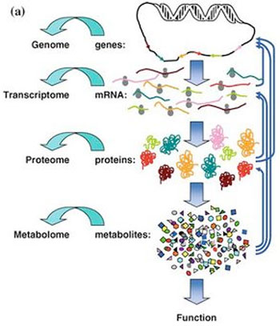
There’s more besides DNA
www.systemsbiology.nl
http://cisncancer.org/research/what_we_know/omics/metabolomics.html

Slide 3
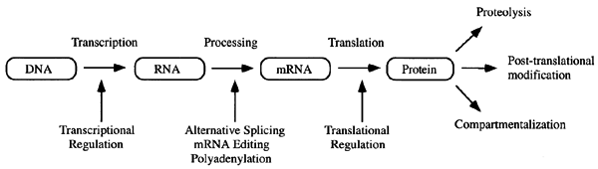
~Omics ???
www.systemsbiology.nl
~Omics - suffix to denote the study of the entire set of something
Genomics: Study of all genes
Transcriptomics: Study of all mRNA transcripts
Proteomics: Study of all proteins
I. Paffen

Slide 4
Proteomics
What can you measure on omics level?
Why bio-informatics?

Slide 5
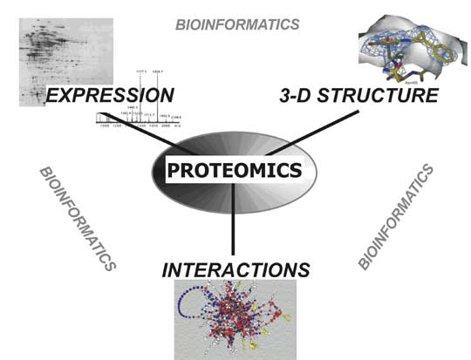
http://biol.lf1.cuni.cz/ucebnice/en/proteomics.htm

Slide 6
What is proteomics ?
Proteomics:
(Large scale) identification and characterization of proteins and all their properties
welke eiwitten zijn aanwezig (tijd/plaats)?
post-transcriptionele modificaties?
interacties?
3D structure?
functie?
Notes:
What now is proteomics exactly? When you do proteomics you would like to study a complete set of proteins. You would want to know which proteins are present at a certain location in the cell at a specific moment. Are those proteins post-translationally modified? With which other proteins do they interact. What is their 3D structure and of course what is their function. Of course it is not possible, at least not at the moment, to look at all proteins at the same time and answer all these questions. Therefore we rephrased the term proteomics into large-scale identification and characterization of proteins.

Slide 7
Proteomics techniques
Protein function
Biochemical assays
Protein micro-arrays
Post-translational modifications
MS or MS/MS
Protein separation
2D gels
Liquid chromatography
Protein identification
MS or MS/MS
Protein micro-arrays
3D structure determination
X-ray
NMR
Homology modelling
Protein-protein interactions
Yeast two-hybrid
Affinity chromatography + MS
In silico techniques
Protein micro-arrays
Notes:
Besides doing biochemcial assays, determining the 3D structure of a protein, further insight into the function of a protein can be obtained by finding out to which proteins each protein can bind.

Slide 8
Course overzicht
 |  | Beroepstaak 4
 |  | Uitvoeren van natuurwetenschappelijk onderzoek
Bio-informatica |  | Chemie |  | Life Science
Proteomics tools Massa Spectrometrie Signaaltransductie |  | Aminozuren en eiwitten Koolhydraten Lipiden DNA |  | Aminozuren pH en pI Eiwitten Eiwitstructuren Scheidingstechnieken Signaal transductie
 |  | Beroepsproducten |  | Practicum
 |  | Onderzoeksplan (groep) Onderzoeksverslag (groep) |  | Eiwitisolatie biologische activiteit

Slide 9
Toetsing
Deeltentamens | Feedback vorm | Wie beoordeelt
Onderzoeksplan (Op) | Groepscijfer | Expert
Onderzoeksverslag (V) | Groepscijfer | Expert
Praktijkbeoordeling (P) | Voldaan/niet voldaan | Praktijkdocent
Kennistoets Life science/Chemie (K) | Cijfer | Vakdocenten
Thematoets (T) | Cijfer | Expert
Paraaf m.b.t. inzet op scorekaart (IPV) | V/NV | Tutor

Slide 10
Toetsing
Praktijk, IPV = Voldoende
Eindcijfer = (2K + 2T + Op + V)/6

Slide 11
Course opbouw
Week 1-2:
Weektaken
Week 3-7
Project

Slide 12
Afspraken
Vakantie is voorbij
Meedoen met lessen
Project is onderzoek
Groepsindeling
Copyright @ I. Paffen, HAN
Alle afbeeldingen in deze presentatie zijn geraadpleegd op 8-11-12

