Slide 1
TableauProject-FAA
File created on: 2024-01-08 9:28:27 AM

Slide 2
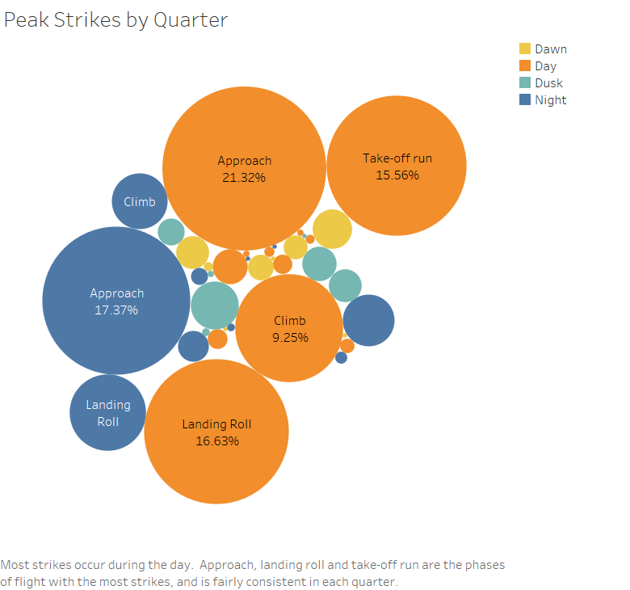

Slide 3
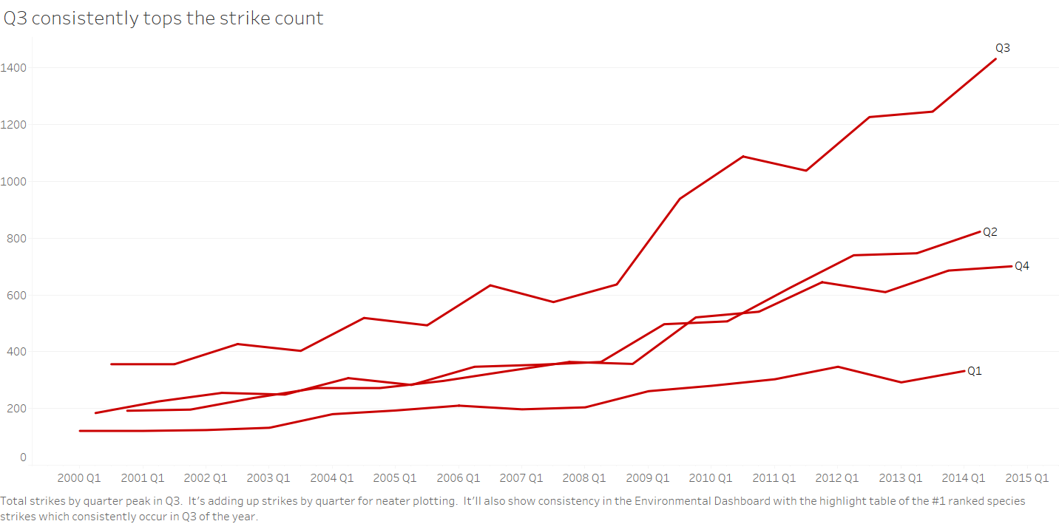

Slide 4
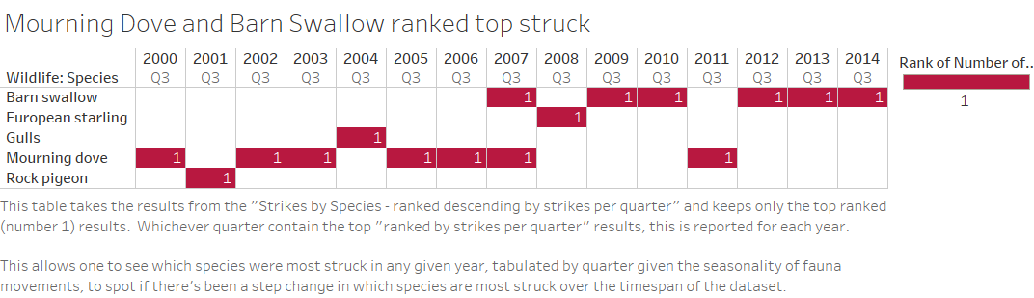

Slide 5
