Slide 1
Классификация текстов по экологии
ДПО «Компьютерная лингвистика»
2023-2024
(На материале английского языка)
Кошелева Валерия Олеговна

Slide 2
Цель
Обучить классификатор новостных текстов по экологии.
Этапы:
Парсинг новостных статей по экологии,
Предобработка материала,
Обучение и сравнение моделей машинного обучения,
Визуализация данных.

Slide 3
Материал
Новостные статьи на английском языке с сайта www.theguardian.com из раздела «Environment» по темам:
Endangered Species
Greenhouse Gas Emissions
Waste
Fossil Fuels
Farming
Renewable Energy

Slide 4
Предобработка данных
Удаление выражения «Sign up for guardian Australia’s free morning and afternoon email newsletters for your daily news roundup»
Приведение к нижнему регистру
Лемматизация
Удаление пунктуации

Slide 5
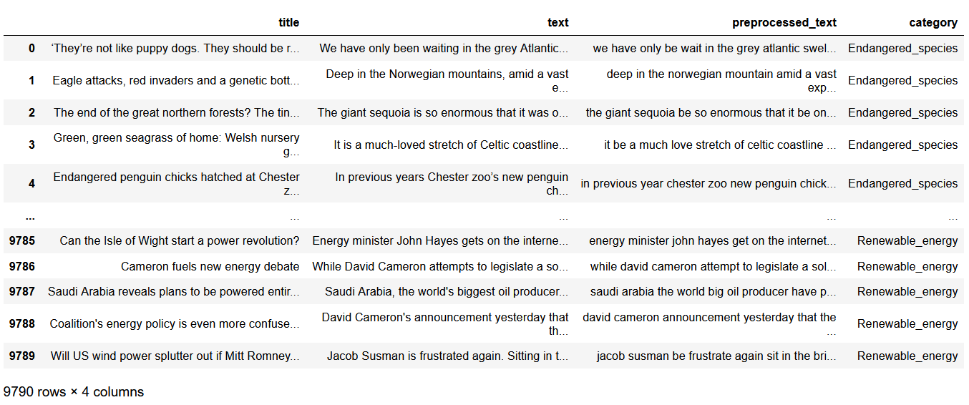
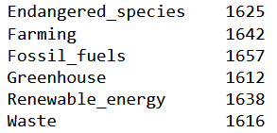
Корпус

Slide 6
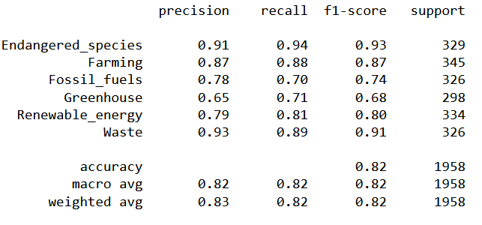
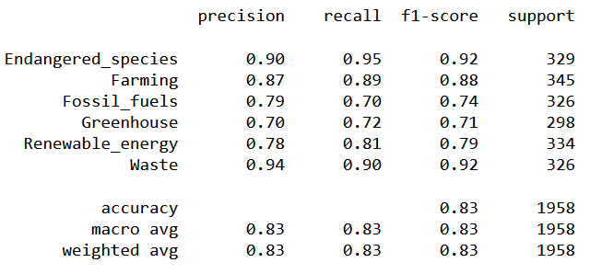
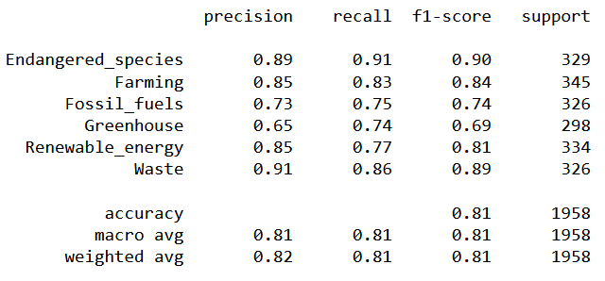
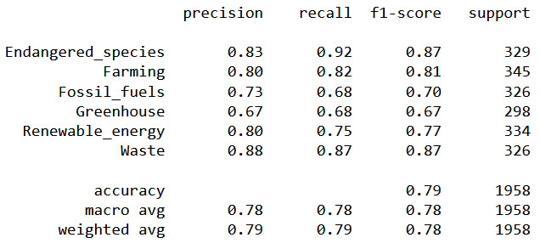
Обучение моделей
Multinomial NB
Random Forest Classifier
KNeighbors Classifier
Bagging Classifier

Slide 7
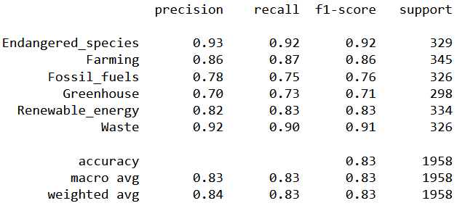
Обучение моделей
Gradient Boosting Classifier

Slide 8
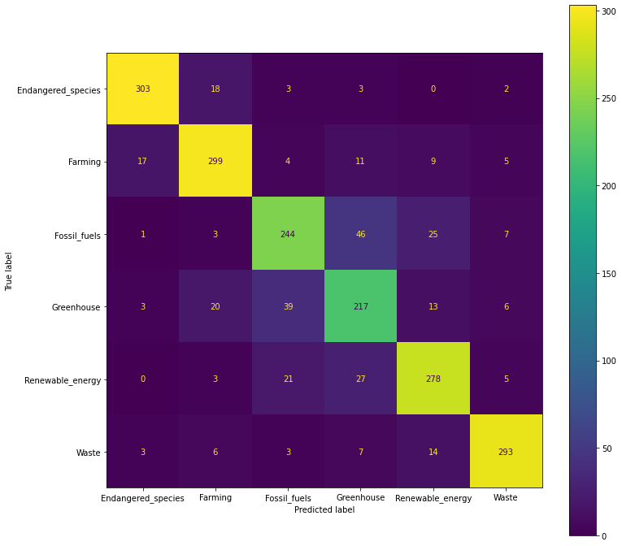
Ошибки Классификации

Slide 9
Ошибки Классификации
Real Category: Greenhouse
Predicted Category: Renewable_energy
The world’s renewable energy industry grew at its fastest pace since 1999 last year, despite the disruption caused by the Covid-19 pandemic, and may have established a standard for growth in the future, according to the International Energy Agency (IEA). The global energy watchdog revealed that the delivery of renewable energy projects, including windfarms and solar power projects, grew by 45% last year in a step change for the global industry. Wind power capacity doubled over the last year, while solar power grew by almost 50% more than its growth before the pandemic, due to the growing appetite for clean energy from governments and corporations. The clean energy boom has prompted the IEA to revise its renewable energy forecasts for the coming years up by about 25% from its previous growth estimates due to the faster than expected expansion of renewables in China, Europe and the US. Fatih Birol, the executive director of the IEA, said governments need to “build on this promising momentum”. “A massive expansion of clean electricity is essential to giving the world a chance of achieving its net zero goals,” Birol added. However, China is the world’s largest emitter of greenhouse gases because of its use of coal-fired power plants to meet the country’s rising energy demand. The country’s president, Xi Jinping, has pledged that China will become carbon neutral by 2060, but experts have warned that it will need to develop enough renewable energy to shut down nearly 600 of its coal-fired power plants in the next 10 years to meet this target. The passing of a key industry deadline for state subsidies in China is expected to cause the country’s renewable energy growth to slow in the years ahead. But the IEA believes booming demand for clean energy across Europe and the US will keep the global industry’s annual growth close to last year’s level. Heymi Bahar, the IEA’s lead author of the report, described last year’s renewables boom as “unprecedented” because although it matched the rate last seen in 1999 the industry has become far larger in the last two decades. “The momentum is there from business and government,” he said. The IEA’s latest forecasts do not take into account the new US president, Joe Biden, whose administration is expected to spur an even faster rate of renewables growth. Biden has pledged to cut US emissions by half in the next 10 years.

Slide 10
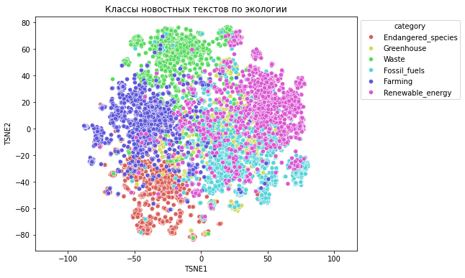
T-SNE Визуализация

