Slide 1

Do Ambiguous Patients Form a Distinct Cluster? A Comparative Clustering Analysis

Slide 2
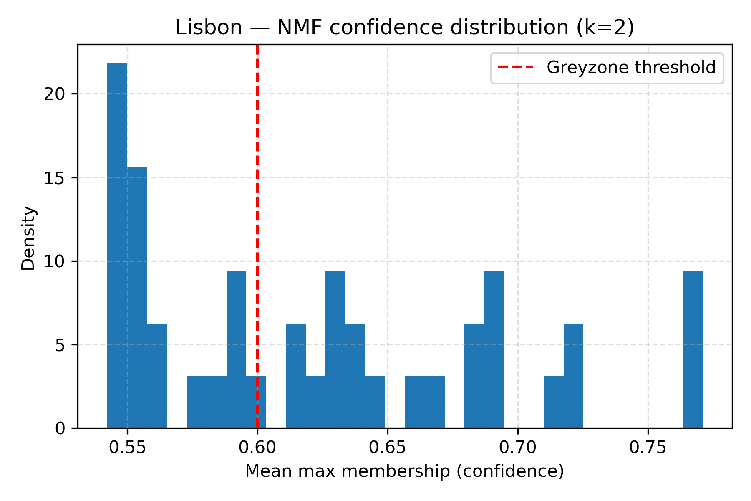
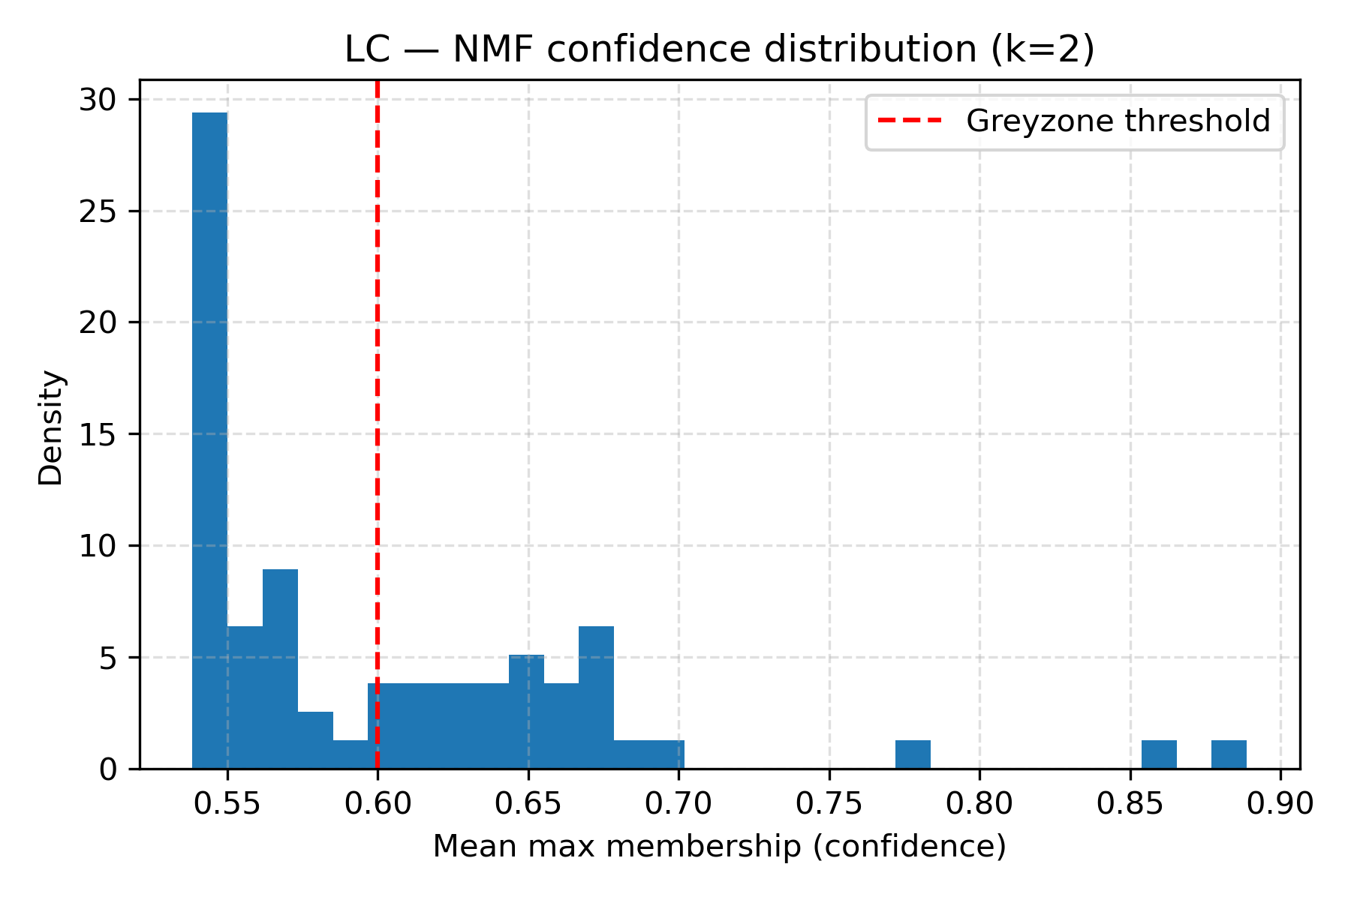
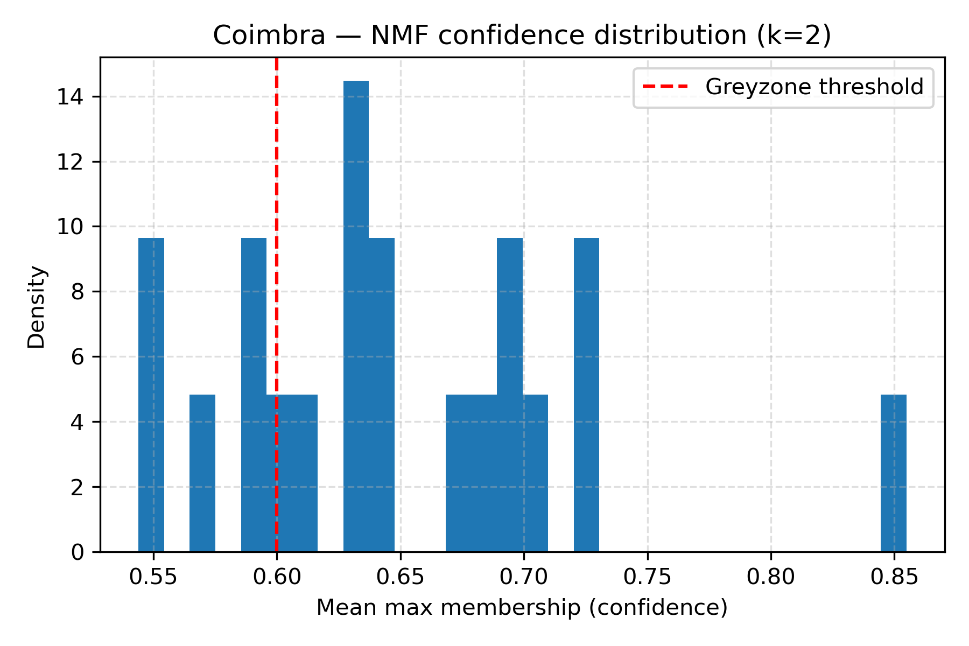
Distribution of Patient Assignment Confidence (NMF, k=2)

Slide 3
Distribution of Patient Assignment Confidence (NMF, k=2)
 | GREY ZONE | BORDERLINE | CLEAR
COIMBRA | 5 | 11 | 4
LISBON | 19 | 17 | 6
LC | 38 | 26 | 3
NMF assignment confidence shows a substantial fraction of uncertain patients across datasets.
Grey zone: low confidence assignments 0.5-0.6
Borderline: moderate confidence 0.6-0.7
Clear: strong cluster assignment >0.7
Including borderline patients would capture a large portion of the cohort
We therefore focus on the most ambiguous group (grey zone)
LC → 11 Coimbra --- 27 Lisbon

Slide 4
Key Questions
Where do grey zone patients go across models?
How are clusters composed in terms of grey zone vs non-grey zone patients?
Are clusters driven by dataset origin (Coimbra and Lisbon) or by underlying biological structure?
Do ambiguous patients with K = 2 form a distinct third cluster?

Slide 5
K-means Assignment of Grey Zone Patients (K = 2)
 | % grey patients within each cluster |  | Distribution of grey patients
 | CLUSTER 1 | CLUSTER 2 | CLUSTER 1 | CLUSTER 2
COIMBRA | 36% ± 3.2% | 11.6% ± 6.1% | 77.2%±13.3% | 22.8%±13.3%
LISBON | 41.4% ± 2% | 48.3% ± 1.6% | 40.9%± 3.5% | 59.1%± 3.5%
LC | 60.0% ± 0% | 50.0% ± 0% | 71.1% ± 0% | 28.9% ± 0%
Number of patients
 | CLUSTER 1 | CLUSTER 2
COIMBRA | 8 | 12
LISBON | 23 | 19
LC | 45 | 22
Cluster composition dataset
CUSTER 1 |  | CLUSTER 2
COIMBRA | LISBON | COIMBRA | LISBON
0% | 100% | 100% | 0%

Slide 6
Ward Assignment of Grey Zone Patients (K = 2)
 | % grey patients within each cluster |  | Distribution of grey patients
 | CLUSTER 1 | CLUSTER 2 | CLUSTER 1 | CLUSTER 2
COIMBRA | 31.2% | 0% | 100% | 0%
LISBON | 57.7% | 25% | 78.9% | 21.1%
LC | 60.9% | 47.6% | 73.7% | 26.3%
Number of patients
 | CLUSTER 1 | CLUSTER 2
COIMBRA | 16 | 4
LISBON | 26 | 16
LC | 46 | 21
Cluster composition dataset
CUSTER 1 |  | CLUSTER 2
COIMBRA | LISBON | COIMBRA | LISBON
2.2% | 97.8% | 100% | 0%

Slide 7
Spectral Assignment of Grey Zone Patients (K = 2)
 | % grey patients within each cluster |  | Distribution of grey patients
 | CLUSTER 1 | CLUSTER 2 | CLUSTER 1 | CLUSTER 2
COIMBRA | 33.3% ± 0% | 18.2% ± 0% | 60%±0% | 40%±0%
LISBON | 47.8% ± 0% | 42.1% ± 1.6% | 57.9%± 0% | 42.1%± 0%
LC | 67.4% ± 0% | 37.5% ± 0% | 76.3% ± 0% | 23.7% ± 0%
Number of patients
 | CLUSTER 1 | CLUSTER 2
COIMBRA | 11 | 9
LISBON | 23 | 19
LC | 26 | 41
Cluster composition dataset
CUSTER 1 |  | CLUSTER 2
COIMBRA | LISBON | COIMBRA | LISBON
75% | 25% | 9.3% | 90.7%

Slide 8
Spectral Co-Clustering Assignment of Grey Zone Patients (K = 2)
 | % grey patients within each cluster |  | Distribution of grey patients
 | CLUSTER 1 | CLUSTER 2 | CLUSTER 1 | CLUSTER 2
COIMBRA | 20% ± 0% | 30% ± 0% | 40% ± 0% | 60% ± 0%
LISBON | 50% ± 0% | 38.9% ± 0% | 63.2%± 0% | 36.8%± 0%
LC | 48.3% ± 0% | 63.2% ± 0% | 36.8%± 8.1% | 63.2%± 0%
Number of patients
 | CLUSTER 1 | CLUSTER 2
COIMBRA | 10 | 10
LISBON | 24 | 18
LC | 38 | 29
Cluster composition dataset
CUSTER 1 |  | CLUSTER 2
COIMBRA | LISBON | COIMBRA | LISBON
55.2% | 44.8% | 15.8% | 84.2%

Slide 9
NMF Assignment of Grey Zone Patients (K = 2)
 | % grey patients within each cluster |  | Distribution of grey patients
 | CLUSTER 1 | CLUSTER 2 | CLUSTER 1 | CLUSTER 2
COIMBRA | 35.7% ± 12.8% | 0% | 100% | 0%
LISBON | 33.3% ± 11.1% | 54.2% ± 10.2% | 31.6%± 10.7% | 68.4%± 10.7%
LC | 54.5% ± 8.7% | 58.8% ± 8.4% | 47.4%± 8.1% | 52.6%± 8.1%
Number of patients
 | CLUSTER 1 | CLUSTER 2
COIMBRA | 14 | 6
LISBON | 18 | 24
LC | 33 | 34
Cluster composition dataset
CUSTER 1 |  | CLUSTER 2
COIMBRA | LISBON | COIMBRA | LISBON
51.5% | 48.5% | 14.7% | 85.3%

Slide 10
OPTICS Assignment of Grey Zone Patients Lisbon
 | % grey patients within each cluster |  |  | Distribution of grey patients
 | CLUSTER 1 | CLUSTER 2 | NOISE | CLUSTER 1 | CLUSTER 2 | NOISE
LISBON | 45% | 25% | 100% | 31.6% | 47.4% | 21.1%
Number of patients
 | CLUSTER 1 | CLUSTER 2 | NOISE
LISBON | 20 | 16 | 6

Slide 11
Grey Zone Behaviour Across Models and Datasets
Coimbra (20 patients)
K-means → collapse
Ward → collapse
NMF → collapse
Spectral clustering → partial split
Spectral co-clustering → partial split
Lisbon (42 patients)
K-means → balanced
Ward → collapse
NMF → partial split
Spectral clustering → balanced
Spectral co-clustering → partial split
LC (67 patients)
K-means → collapse
Ward → collapse
NMF → balanced
Spectral clustering → collapse
Spectral co-clustering → partial split

Slide 12
Strong dataset-driven structure in LC
K-means and Ward almost perfectly separate Lisbon and Coimbra patients
NMF and spectral co-clustering show substantial dataset mixing
Perfect balance is not expected due to LC cohort imbalance

Slide 13
K-means Assignment of Grey Zone Patients (K = 3)
 | % grey patients within each cluster |  |  | Distribution of grey patients
 | CLUSTER 1 | CLUSTER 2 | CLUSTER 3 | CLUSTER 1 | CLUSTER 2 | CLUSTER 3
COIMBRA | 26.5%±6.6% | 4.7%±6.6% | 32.8%±7.9% | 48%±15% | 4%±8% | 48%±13.9%
LISBON | 13.2%±9.7% | 2.6%±5.4% | 92.2%±5.5% | 10.5%±8% | 1.7%±3.7% | 87.8%±9%
LC | 85.6%±0.4% | 41.4%±4% | 30.7%±4.8% | 62.7%±1% | 20.7%±3% | 16.6%±3%
Cluster composition dataset
CLUSTER 1 |  | CLUSTER 2 |  | CLUSTER 3
COI | LIS | COI | LIS | COI | LIS
0% | 100% | 100% | 0% | 15.1%±6.7 | 84.9%±6.7
Number of patients
 | CLUSTER 1 | CLUSTER 2 | CLUSTER 3
COIMBRA | 9 | 4 | 7
LISBON | 14 | 10 | 18
LC | 28 | 19 | 20

Slide 14
Ward Assignment of Grey Zone Patients (K = 3)
 | % grey patients within each cluster |  |  | Distribution of grey patients
 | CLUSTER 1 | CLUSTER 2 | CLUSTER 3 | CLUSTER 1 | CLUSTER 2 | CLUSTER 3
COIMBRA | 12.5% | 0% | 50% | 20% | 0% | 80%
LISBON | 25% | 78.9% | 0% | 21.1% | 78.9% | 0%
LC | 47.6% | 44% | 81% | 26.3% | 28.9% | 44.7%
Cluster composition dataset
CLUSTER 1 |  | CLUSTER 2 |  | CLUSTER 3
COI | LIS | COI | LIS | COI | LIS
100% | 0% | 4% | 96% | 0% | 100%
Number of patients
 | CLUSTER 1 | CLUSTER 2 | CLUSTER 3
COIMBRA | 8 | 4 | 8
LISBON | 16 | 19 | 7
LC | 21 | 25 | 21

Slide 15
Spectral Assignment of Grey Zone Patients (K = 3)
 | % grey patients within each cluster |  |  | Distribution of grey patients
 | CLUSTER 1 | CLUSTER 2 | CLUSTER 3 | CLUSTER 1 | CLUSTER 2 | CLUSTER 3
COIMBRA | 23.7%±6.8% | 5.7%±7.9% | 39.3%±2.5% | 33.2%±9% | 6.8%±9.5% | 60%±0%
LISBON | 35.3%±2.1% | 71%±7.1% | 40%±0% | 31.6%±0% | 36.8%±0% | 31.6%±0%
LC | 85.2%±0% | 29.8%±1.2% | 45.2%±0.8% | 60.5%±0% | 15.6%±0% | 23.8%±0%
Cluster composition dataset
CLUSTER 1 |  | CLUSTER 2 |  | CLUSTER 3
COI | LIS | COI | LIS | COI | LIS
0% | 100% | 9.7% | 90.3% | 100% | 0%
Number of patients
 | CLUSTER 1 | CLUSTER 2 | CLUSTER 3
COIMBRA | 7 | 5 | 8
LISBON | 17 | 10 | 15
LC | 27 | 20 | 20

Slide 16
NMF Assignment of Grey Zone Patients (K = 3)
 | % grey patients within each cluster |  |  | Distribution of grey patients
 | CLUSTER 1 | CLUSTER 2 | CLUSTER 3 | CLUSTER 1 | CLUSTER 2 | CLUSTER 3
COIMBRA | 27.2%±7.1% | 27.2%±8.7% | 20.8%±7.7% | 38.4%±12% | 35.6%±10% | 26%±11.5%
LISBON | 42.9%±24% | 40.4%±9.6% | 47%±20.8% | 31.9%±21% | 28.4%±11% | 39.7%±22%
LC | 48%±22.3% | 47.9%±18% | 62.3%±24% | 25.7%±13% | 36.1%±21% | 38.2%±22%
Cluster composition dataset
CLUSTER 1 |  | CLUSTER 2 |  | CLUSTER 3
COI | LIS | COI | LIS | COI | LIS
88.1%±16 | 11.9%±16 | 13.3%±17 | 86.7±17% | 12.7%±21 | 87.3%±21
Number of patients
 | CLUSTER 1 | CLUSTER 2 | CLUSTER 3
COIMBRA | 7 | 6 | 6
LISBON | 13 | 13 | 15
LC | 19 | 26 | 21

Slide 17
Spectral Co-Clustering Assignment of Grey Zone Patients (K = 3)
 | % grey patients within each cluster |  |  | Distribution of grey patients
 | CLUSTER 1 | CLUSTER 2 | CLUSTER 3 | CLUSTER 1 | CLUSTER 2 | CLUSTER 3
COIMBRA | 40%±0% | 28.6%±0% | 12.5%±0% | 40%±0% | 40%±0% | 20%±0%
LISBON | 41.7%±0% | 42.9%±0% | 50%±0% | 26.3%±0% | 31.6%±0% | 42.1%±0%
LC | 50%±0% | 83.7%±1.3% | 30.4%±6% | 28.9%±0% | 54.5%±5% | 16.5%±5%
Cluster composition dataset
CLUSTER 1 |  | CLUSTER 2 |  | CLUSTER 3
COI | LIS | COI | LIS | COI | LIS
100% | 0% | 0% | 100% | 0% | 100%
Number of patients
 | CLUSTER 1 | CLUSTER 2 | CLUSTER 3
COIMBRA | 5 | 7 | 8
LISBON | 12 | 14 | 16
LC | 22 | 25 | 20

Slide 18
OPTICS Assignment of Grey Zone Patients Coimbra and LC
 | % grey patients within each cluster |  |  |  | Distribution of grey patients
 | CLU. 1 | CLU.2 | CLU.3 | NOISE | CLU.1 | CLU.2 | CLU.3 | NOISE
COIMBRA | 50% | 0% | 0% | 50% | 40% | 0% | 0% | 60%
LC | 63.6% | 21.4% | 12.5% | 100% | 18.4% | 7.9% | 5.3% | 68.4%
Cluster composition dataset
CLUSTER1 |  | CLUSTER2 |  | CLUSTER3 |  | NOISE
COI | LIS | COI | LIS | COI | LIS | COI | LIS
0% | 100% | 100% | 0% | 0% | 100% | 30.8% | 69.2%
Number of patients
 | CLUSTER 1 | CLUSTER 2 | CLUSTER 3 | NOISE
COIMBRA | 4 | 6 | 4 | 6
LC | 11 | 14 | 16 | 26

Slide 19
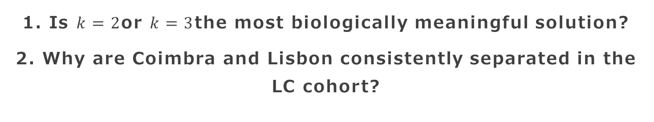
Open Questions
1. Is $k=2$or $k=3$the most biologically meaningful solution?
2. Why are Coimbra and Lisbon consistently separated in the LC cohort?

Slide 20
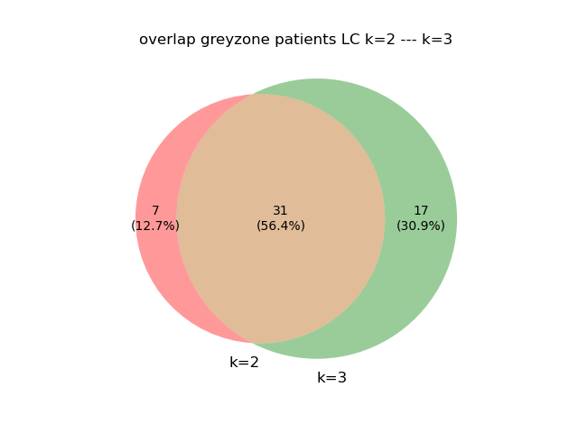
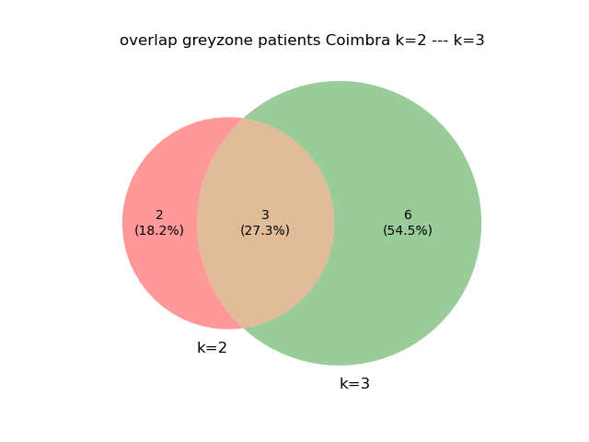
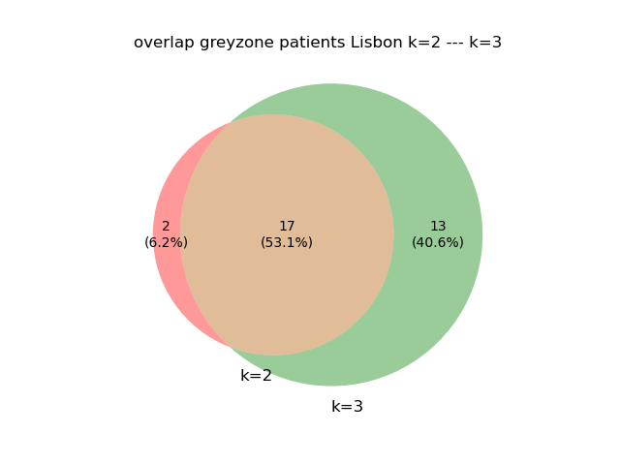
Greyzone Patients Remain Unstable at k = 3

Slide 21
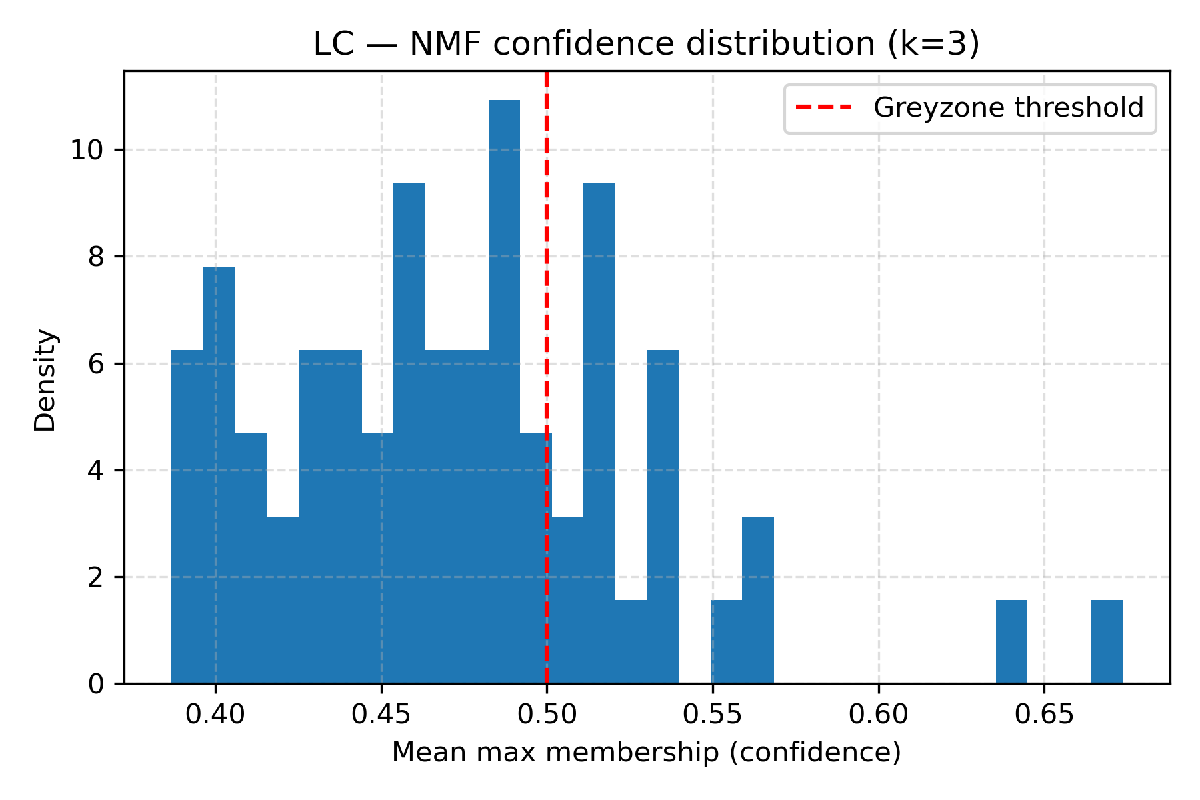
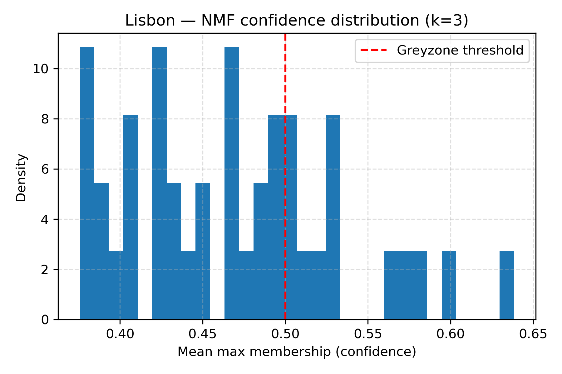
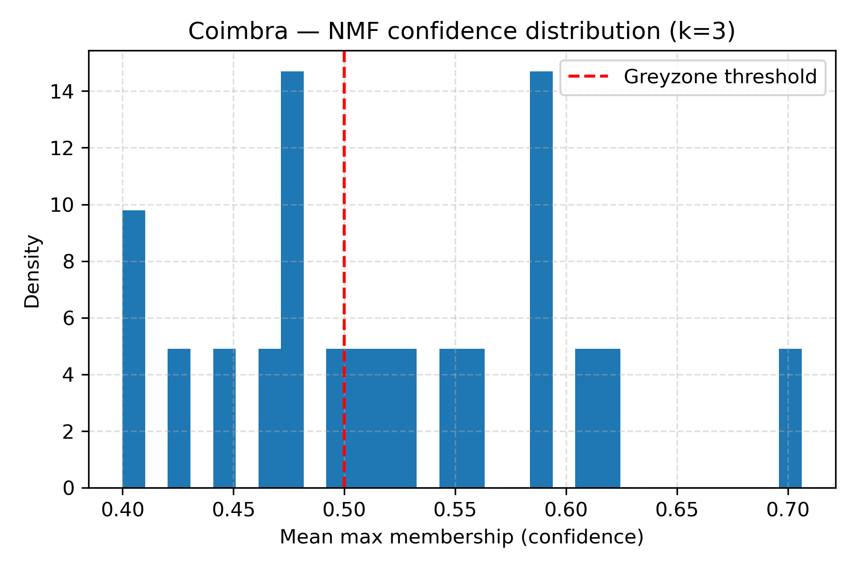
Persistent low-confidence membership at k = 3

Slide 22
Does Increasing k Reveal a Stable Third Cluster?
Main observations
Greyzone patients identified at k=2 largely remain grey at k=3
Increasing cluster resolution does not produce a stable third subgroup
Membership confidence remains low/intermediate across runs
Interpretation
Current results support a bipartite structure (k=2)
Greyzone patients may represent intermediate/transitional profiles rather than a distinct cluster.
Next step
A deeper biological comparison between k=2 and k=3 is required
Pathway enrichment and biological interpretability will determine whether the third cluster reflects meaningful biology or clustering noise

Slide 23
Understanding cohort-specific clustering
Clinical characterization
Compare demographic and clinical variables between Coimbra and Lisbon
Proteomic differential analysis
Identify proteins differentially expressed between cohorts

Slide 24
OBRIGADO!

Slide 25
Grey Zone Behaviour Across Models and Datasets with K=3
Coimbra (20 patients)
K-means → splitted in two clusters
Ward → collapse
NMF → balanced
Spectral clustering → collapse
Spectral co-clustering → collapse
Lisbon (42 patients)
K-means → collapse
Ward → collapse
NMF → balanced
Spectral clustering → balanced
Spectral co-clustering → asymmetric redistribution
LC (67 patients)
K-means → collapse
Ward → asymmetric redistribution
NMF → balanced
Spectral clustering → collapse
Spectral co-clustering → asymmetric redistribution

