Slide 1
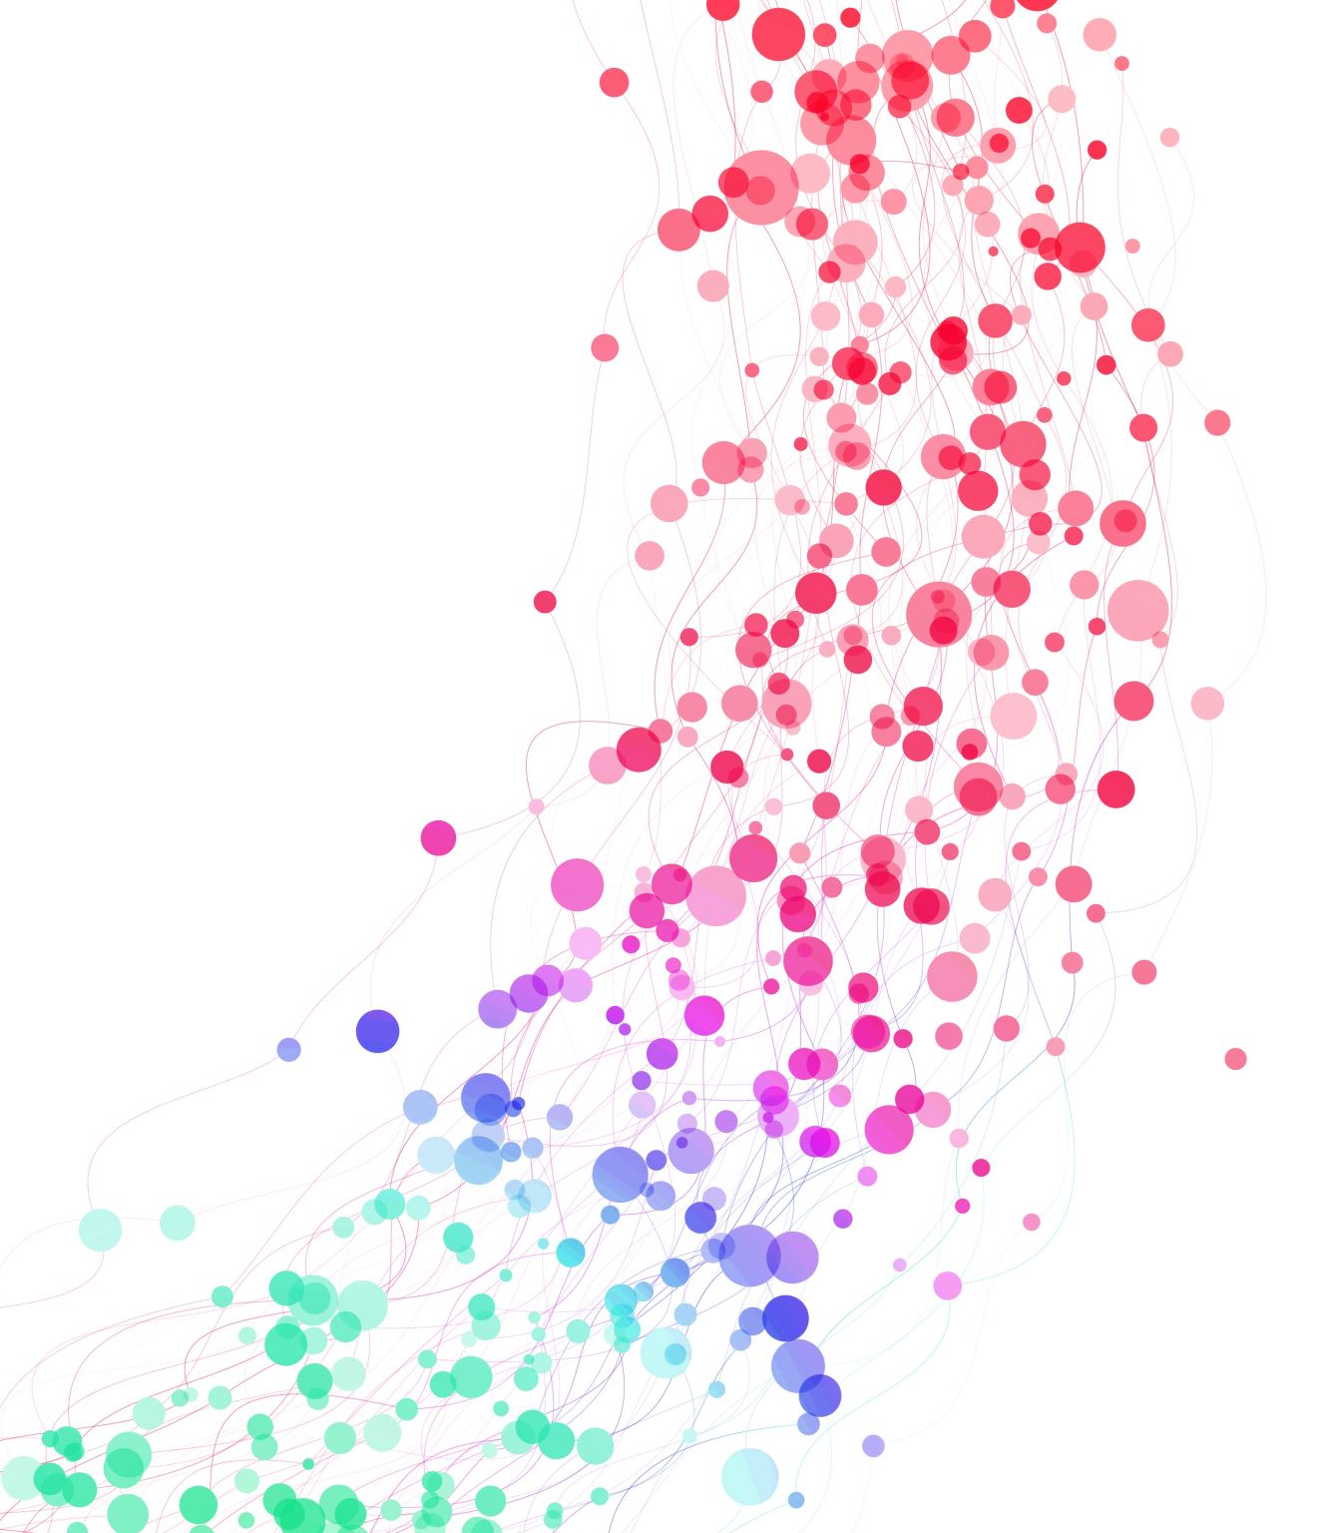
From CSF Proteome to Alzheimer’s Subtypes: Comparative Clustering Pipeline

Slide 2

Cohort design in AD proteomic subtyping
Two-Cohort Structure:
Discovery cohort
Validation cohort
Single integrated cohort:
Integrated cohort
Internal stratification

Slide 3
CSF Proteomics: Quantitative Proteomic Approach
CSF collected via lumbar puncture
Proteins digested into peptides
Tandem Mass Tag (TMT) multiplex labeling
High-resolution LC–MS/MS analysis
FDR-controlled protein identification
Normalized protein abundance matrix

Slide 4
Defining AD+ and AD−: CSF biomarker-based classification
Primary Criterion
Amyloid-β (Aβ42 or Aβ42/Aβ40 ratio) → Determines biological AD positivity (AD+)
Supporting Biomarkers
t-tau and p-tau
→Contribute to defining pathological CSF profile
→Reflect neuronal injury
→Used for refinement and characterization

Slide 5
Identifying AD-associated proteins
Kruskal–Wallis Test:
Non-parametric statistical test
Evaluates each protein independently
Identifies proteins with significant differences between AD+ and AD−
PLS-DA (Partial Least Squares Discriminant Analysis):
Supervised multivariate model
Maximizes separation between AD+ and AD−
Identifies discriminative proteins via VIP scores

Slide 6
Subtype discovery using non-negative matrix factorization (NMF)
What is NMF?
Unsupervised clustering method
Decomposes proteomic data: protein profiles, patient subtype memberships
Captures multivariate and potentially non-linear patterns
Ensures non-negative components (biologically interpretable)

Slide 7
How is it applied?
Run NMF multiple times test different k values
Assess clustering stability Cophenetic coefficient
Evaluate cluster separation Silhouette score
Compare model fit Improvement over lower or random solutions

Slide 8
Structural stability: Louvain algorithm
What is it?
A network-based community detection method
Identifies groups of highly interconnected nodes
Maximizes network modularity
Why use it after NMF?
Provides an independent clustering approach
Based on network connectivity rather than matrix factorization
Tests whether subtype structure emerges with a different methodology

Slide 9
Role of Random Forest in Subtype Analysis
Train model using NMF-derived subtype labels
Apply to independent cohorts
Assess generalizability and reproducibility
Identify most discriminative proteins
Derive reduced protein signatures
Assess subtype separability
Subtype prediction (External Validation)
Feature importance (Within-Cohort Refinement)

Slide 10



Biological Characterization of Subtypes
Gene Ontology (GO) analysis
Identification of enriched biological pathways
Inflammatory, synaptic, metabolic processes
Functional Enrichment
Classical AD Biomarkers
CSF Aβ
t-tau
p-tau
Other established markers
Cognitive performance
Disease progression
MRI-based measures (e.g., cortical thickness)
Vascular damage indicators
Clinical & Imaging Features

Slide 11
Methodological Considerations
Protein Pre-selection Strategy
Kruskal–Wallis (univariate) vs PLS-DA (supervised multivariate)
NMF-Specific Considerations
NMF is stochastic → different runs may yield different solutions
Requires pre-specification or testing of cluster number (k)
Cluster selection relies on heuristic criteria (cophenetic, silhouette)
Subtype structure can depend on selected proteins

Slide 12
Methodological Refinement
Standard NMF
Standard NMF treats all proteins equally
Not all features contribute equally to subtype separation.
Proposed Improvement
Introduce feature-weighted or constrained NMF
Modify the reconstruction error with an adaptive weighting matrix
Increase contribution of subtype-discriminative proteins
Potential Benefits
Improved internal subtype separation
Reduced influence of global disease effects
Greater biological specificity
Some proteins primarily differentiate AD vs controls, while others discriminate within AD subtypes

Slide 13
Cross-Stage validation
Proposed Approach
Apply the same clustering model
On follow-up samples from the same individuals
At a later disease stage
Expected Outcome
If subtype structure remains consistent → Evidence of biological robustness
If subtype structure changes → Subtypes may reflect dynamic disease states

Slide 14
Implications for Our Study
Data Availability
Do we have longitudinal data? (cognitive decline, imaging, biomarker trajectories)
Are genetic data available? (e.g., APOE status, PRS)
Technical Harmonization
Were samples processed using the same proteomic platform?
Were laboratory protocols consistent across cohorts?

Slide 15
Cluster Number: Biology or Resolution Effect?
Observed Across Studies
Key Question
Important Consideration
However, cluster granularity may depend on
2 subtypes → small MCI cohort
3 subtypes → ~200 individuals
5 subtypes → ~400+ individuals
Does the number of clusters reflect true biological diversity or increased statistical resolution with larger sample size?
Larger N may reveal finer substructure
Sample heterogeneity
Statistical power
Noise structure
Model sensitivity

Slide 16
Bibliography
Humpel C, Hochstrasser T. Cerebrospinal fluid and blood biomarkers in Alzheimer's disease. World J Psychiatry. 2011 Dec 31;1(1):8-18. doi: 10.5498/wjp.v1.i1.8. PMID: 24175162; PMCID: PMC3782169.Imaging data analysis using non-negative matrix factorization
Guo, Y.-T., Li, Q.-Q., & Liang, C.-S. (2024). The rise of nonnegative matrix factorization: Algorithms and applications. Information Systems, 123, 102379, https://doi.org/10.1016/j.is.2024.102379
Chen M, Gong M, Li X. Feature Weighted Non-Negative Matrix Factorization. IEEE Trans Cybern. 2023 Feb;53(2):1093-1105. doi: 10.1109/TCYB.2021.3100067. Epub 2023 Jan 13. PMID: 34437084.
Tijms BM, Gobom J, Reus L, Jansen I, Hong S, Dobricic V, Kilpert F, Ten Kate M, Barkhof F, Tsolaki M, Verhey FRJ, Popp J, Martinez-Lage P, Vandenberghe R, Lleó A, Molinuevo JL, Engelborghs S, Bertram L, Lovestone S, Streffer J, Vos S, Bos I; Alzheimer’s Disease Neuroimaging Initiative (ADNI); Blennow K, Scheltens P, Teunissen CE, Zetterberg H, Visser PJ. Pathophysiological subtypes of Alzheimer's disease based on cerebrospinal fluid proteomics. Brain. 2020 Dec 1;143(12):3776-3792. doi: 10.1093/brain/awaa325. PMID: 33439986; PMCID: PMC7805814.
Tijms, B.M., Vromen, E.M., Mjaavatten, O. et al. Cerebrospinal fluid proteomics in patients with Alzheimer’s disease reveals five molecular subtypes with distinct genetic risk profiles. Nat Aging 4, 33–47 (2024). https://doi.org/10.1038/s43587-023-00550-7
Moutinho D, Mendes VM, Caula A, Madeira SC, Baldeiras I, Guerreiro M, Cardoso S, Gobom J, Zetterberg H, Santana I, De Mendonça A, Aidos H, Manadas B. Pathophysiological subtypes of mild cognitive impairment due to Alzheimer's disease identified by CSF proteomics. Transl Neurodegener. 2024 Apr 9;13(1):19. doi: 10.1186/s40035-024-00412-1. PMID: 38594717; PMCID: PMC11003166.

