Slide 1

Identification of Alzheimer’s Disease Subtypes using NMF

Slide 2
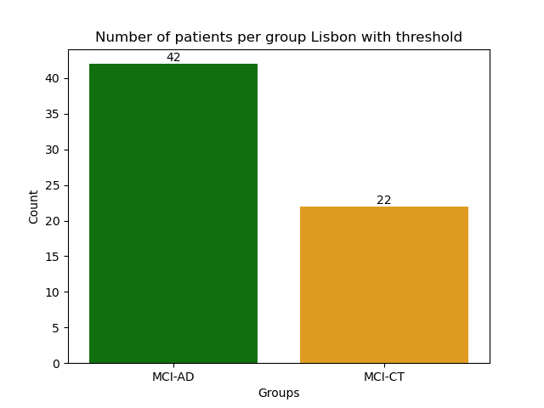
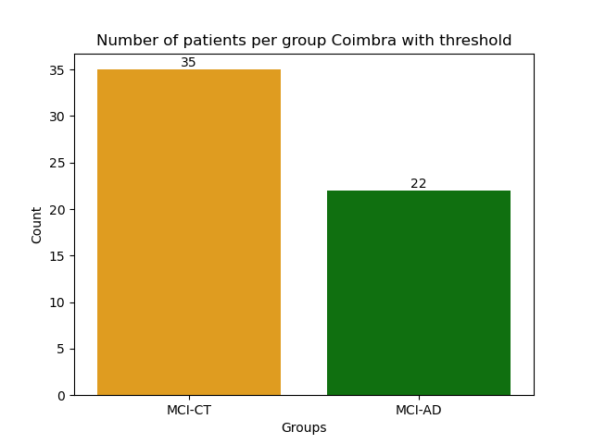
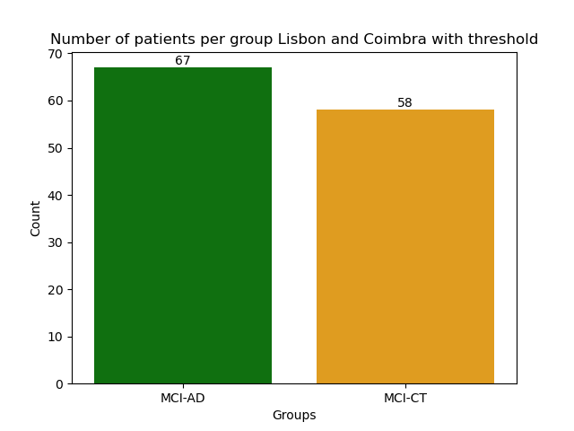
From Full Cohort to AD Population

Slide 3
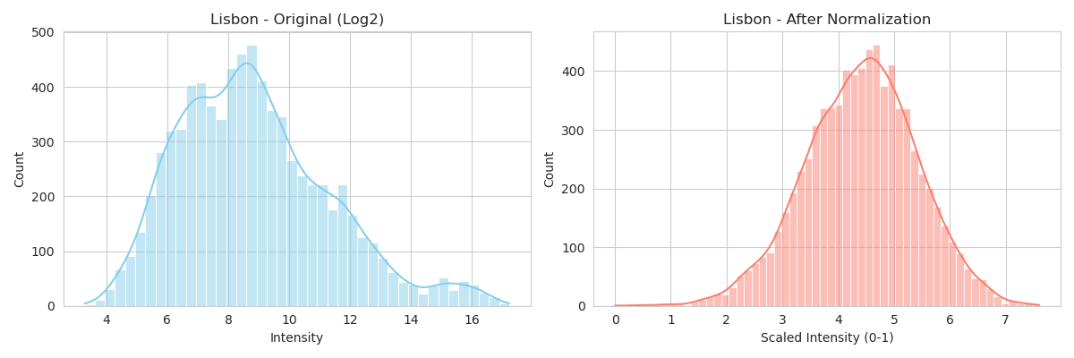
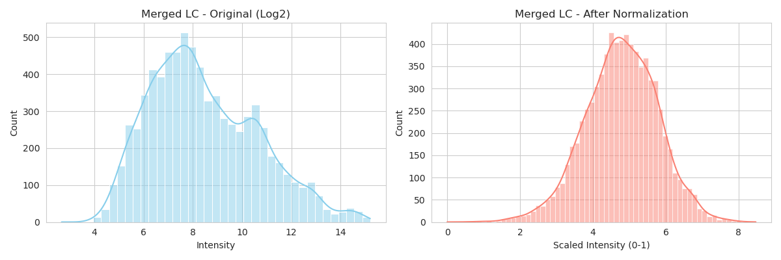
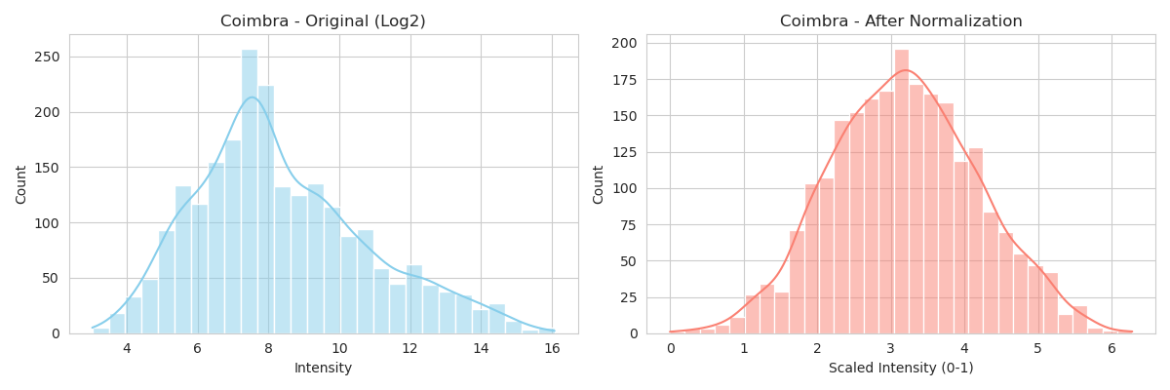
Data Normalization Across Cohorts
Z-score normalization was applied to standardize features while preserving relative differences, followed by a shift to ensure non-negativity required for NMF

Slide 4
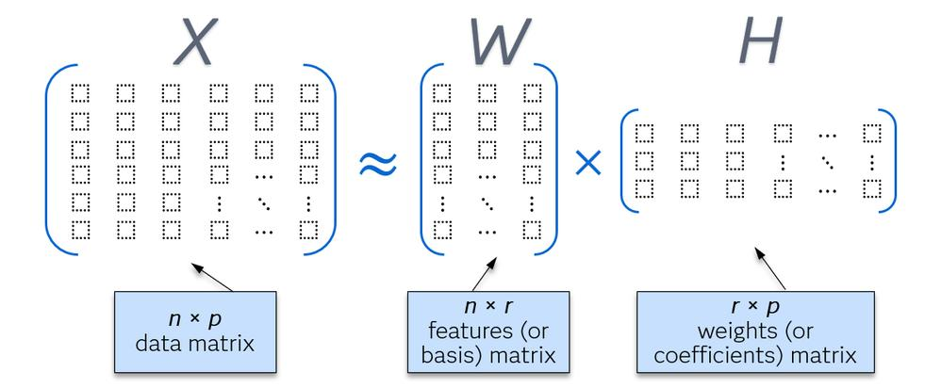
NMF-Based Subtype Identification
Pipeline (for each k = 2–9)
Perform multiple NMF runs (n = 60) with random initialization
Select the best model based on minimum reconstruction error
Extract top features for each component

Slide 5
Evaluation Metrics
Reconstruction Error → measures how well NMF approximates the original data
Δ Error (Marginal Gain) → improvement in reconstruction when increasing k
% Variance Explained → additional information captured by each component
Cophenetic Coefficient → stability of clustering across multiple NMF runs
Silhouette Score → separation between clusters
Random Baseline → performance on permuted data used as noise reference
Fold Improvement → ratio between real and random improvement → values > 1 indicate non-random structure

Slide 6
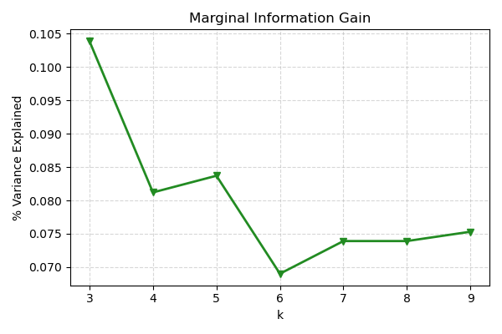
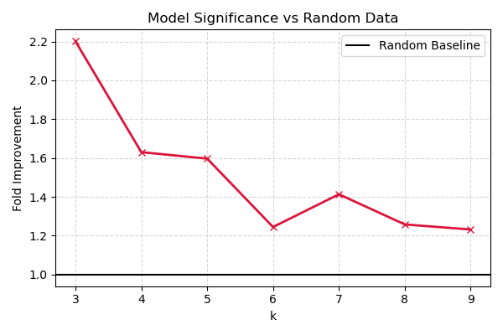
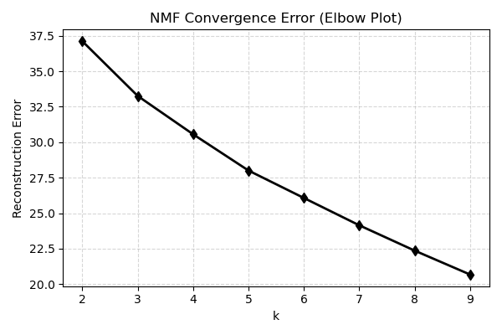
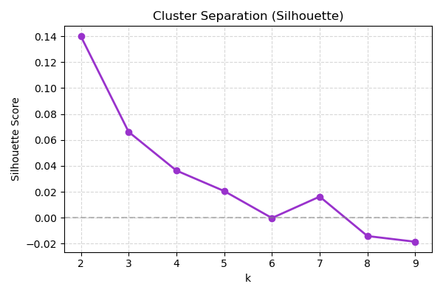
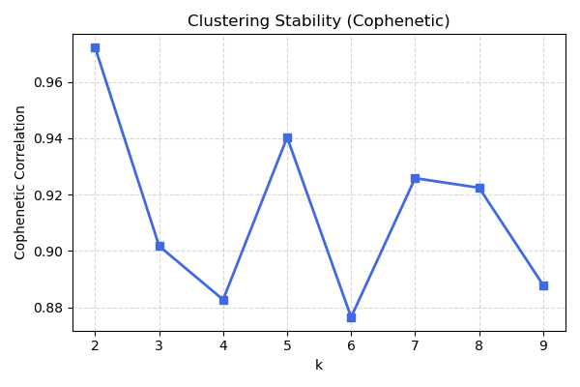
Selection of optimal number of subtypes in Coimbra dataset

Slide 7
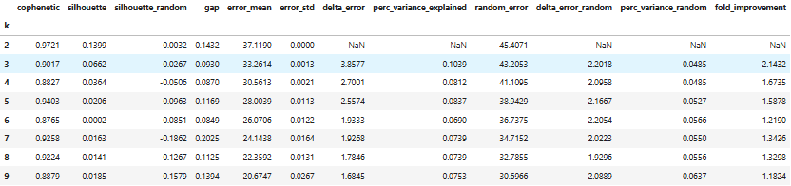
Selection of optimal number of subtypes in Coimbra dataset

Slide 8
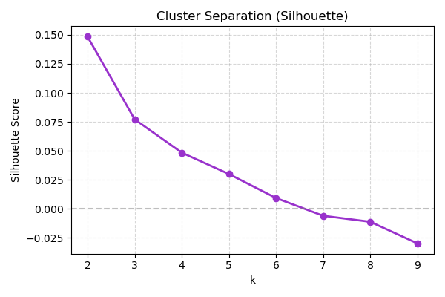
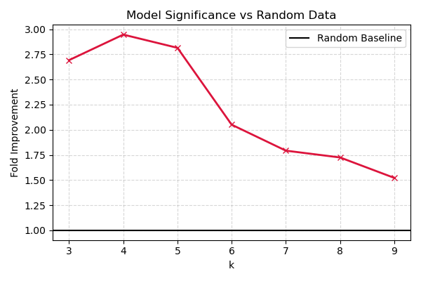
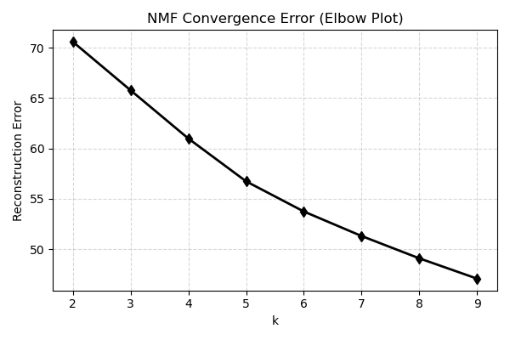
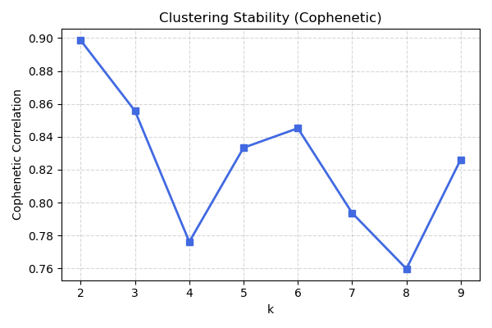
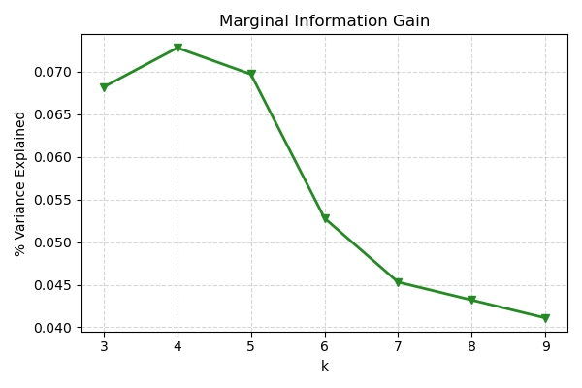
Selection of optimal number of subtypes in Lisbon dataset

Slide 9
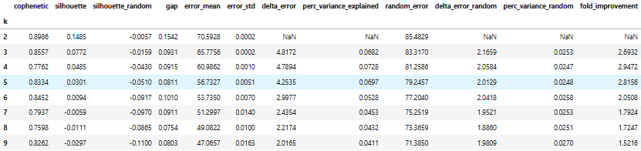
Selection of optimal number of subtypes in Lisbon dataset

Slide 10
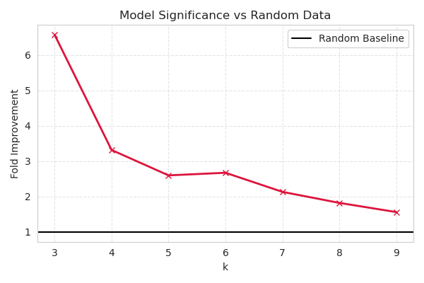
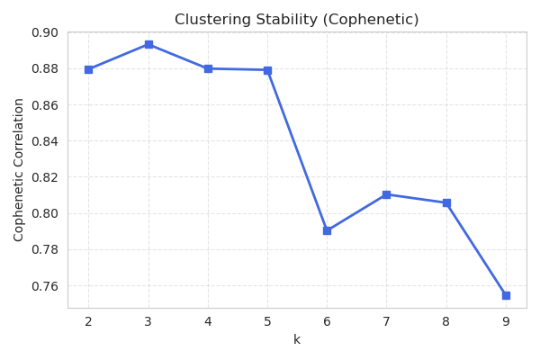
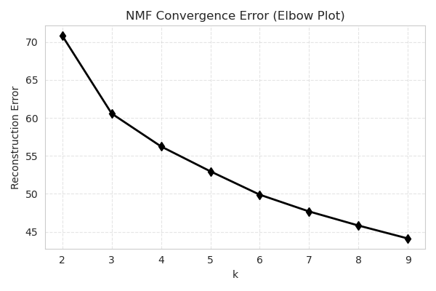
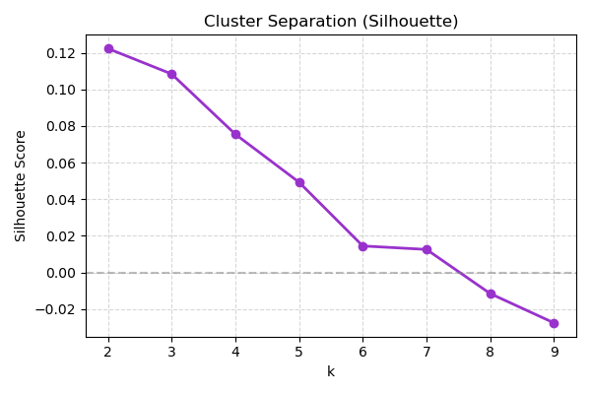
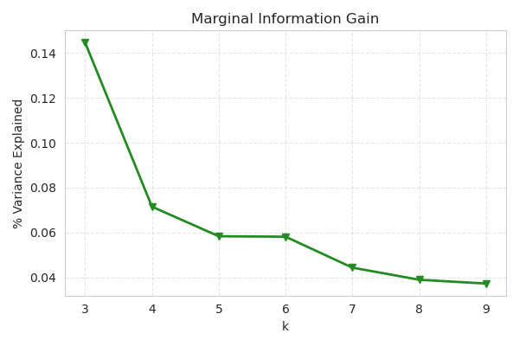
Selection of optimal number of subtypes in Lisbon + Coimbra dataset

Slide 11
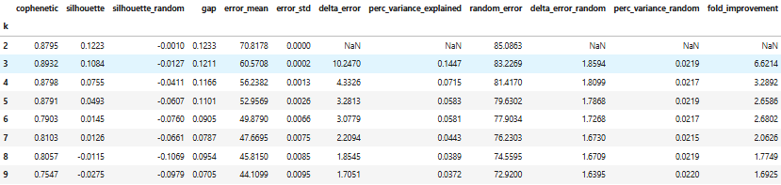
Selection of optimal number of subtypes in Lisbon + Coimbra dataset

Slide 12
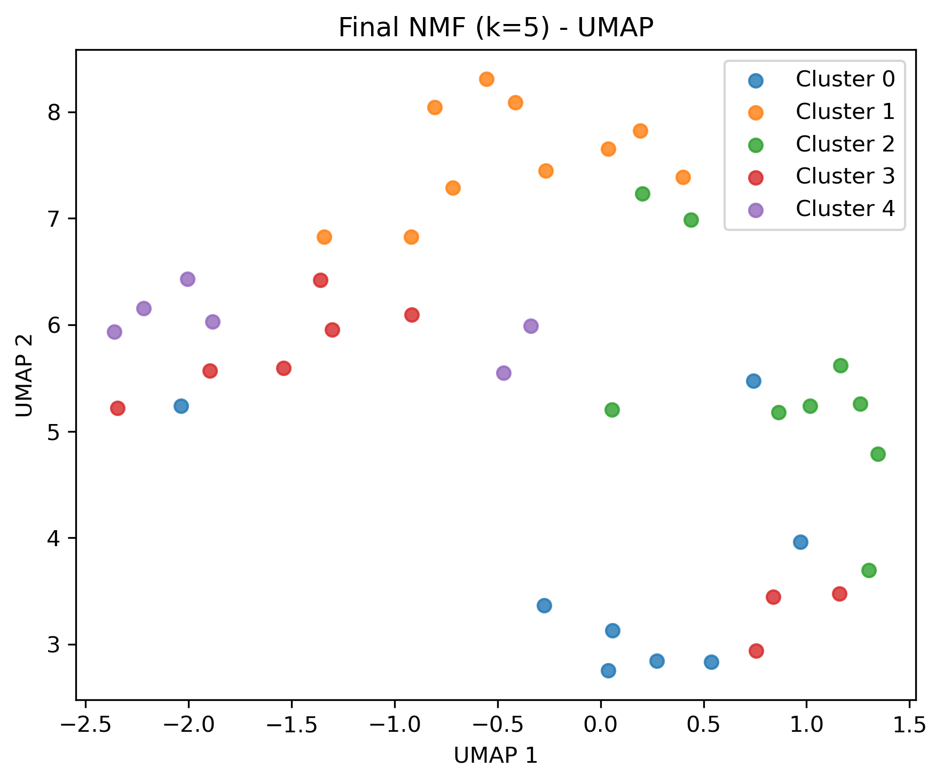
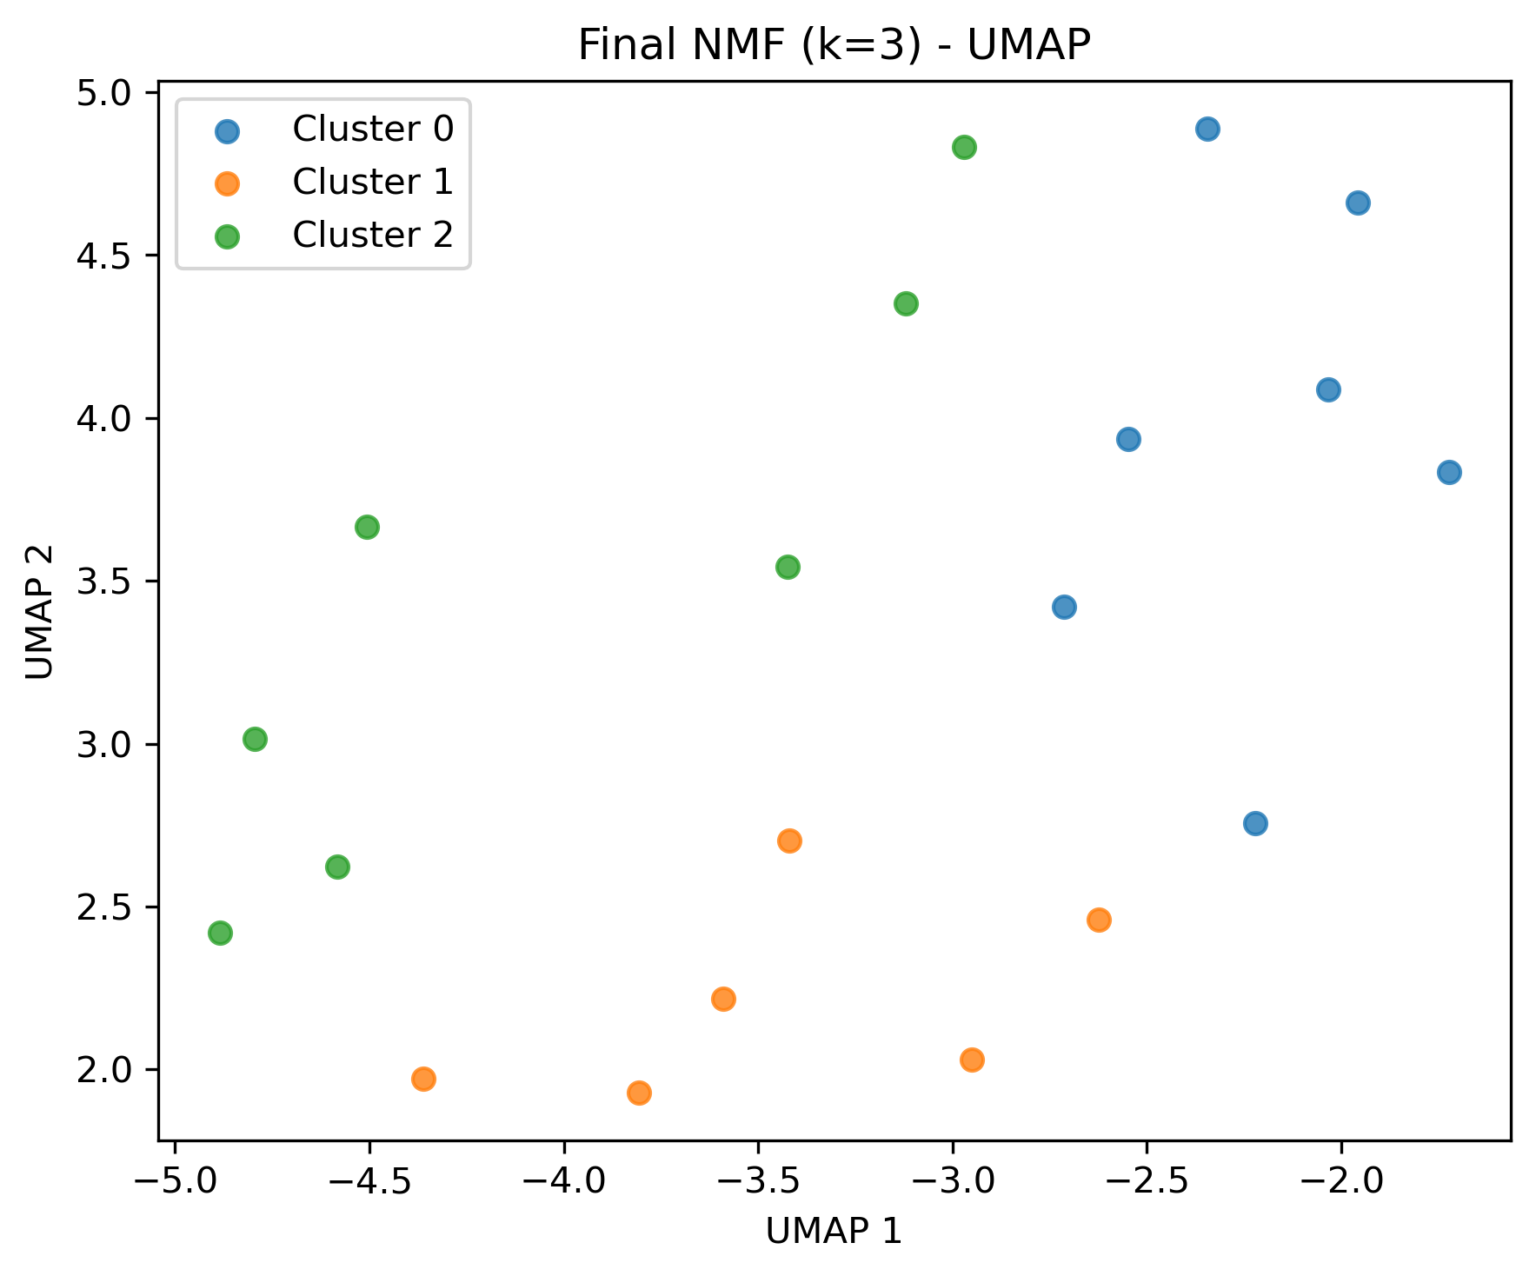
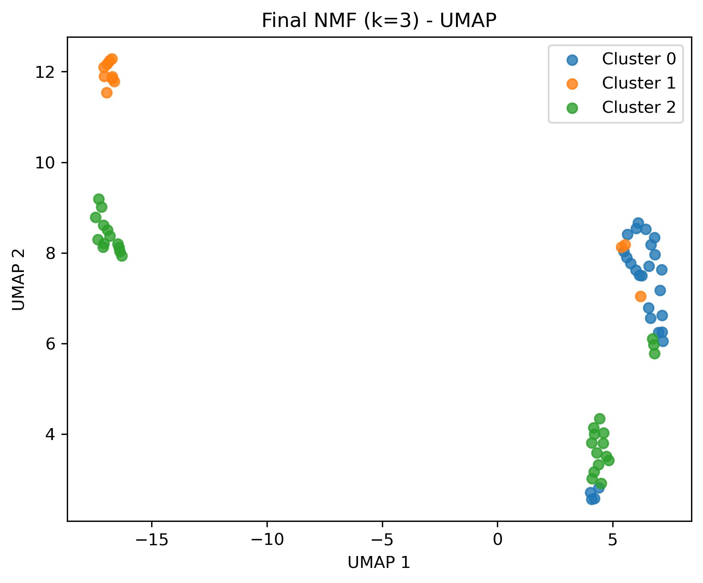
Final NMF Model and Subtype Visualization
NMF trained using the selected number of components (k)
Deterministic initialization (NNDSVD) for improved stability and reproducibility
Top 30 proteins extracted per component (from H matrix)
Patients assigned to subtypes based on W

Slide 13
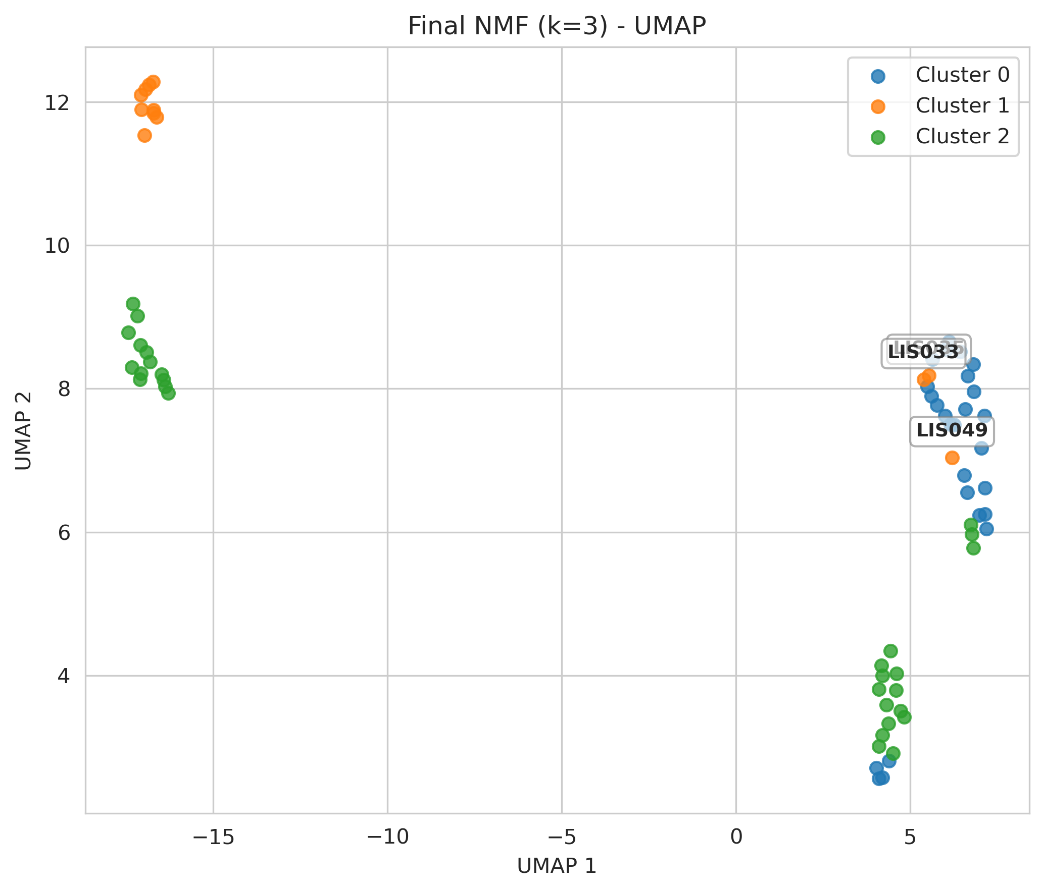
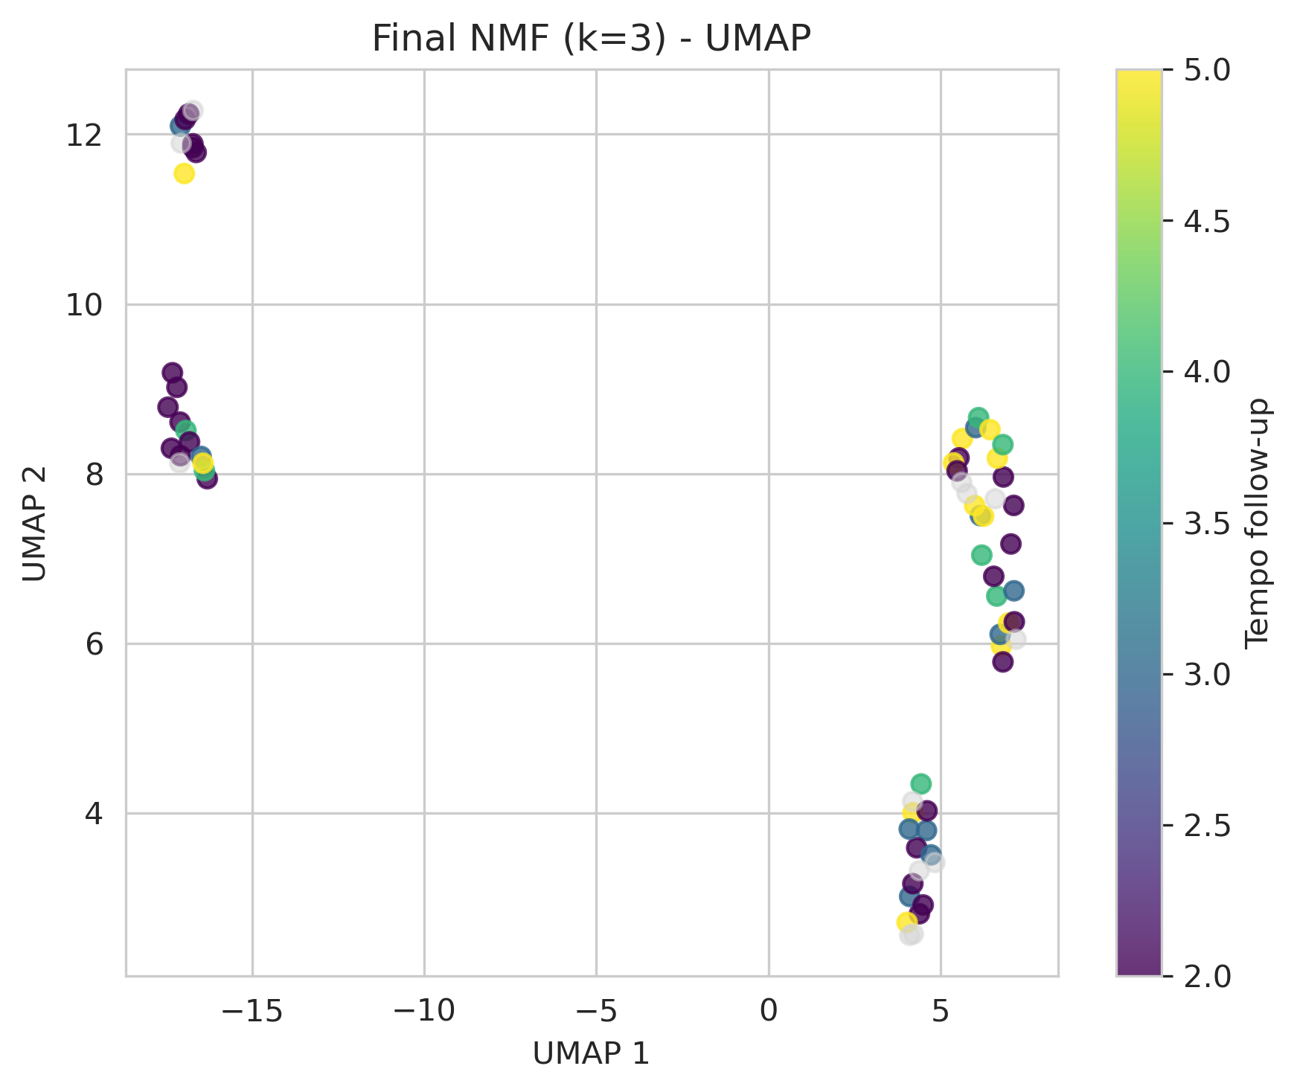
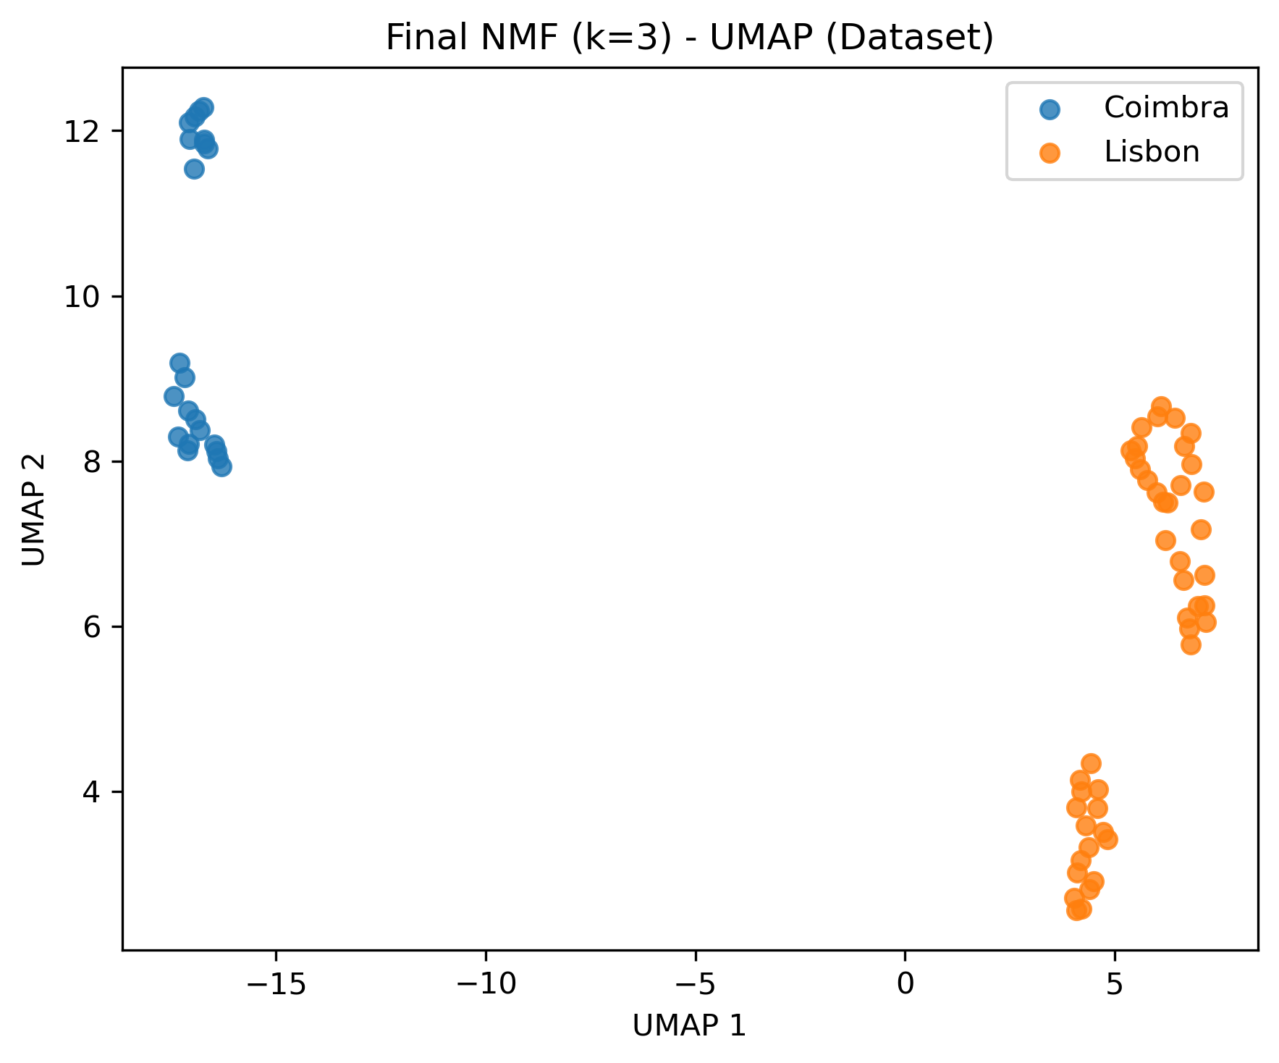
Latent Space Colored by Dataset and follow-up

Slide 14
Further analysis on follow-up conditions in Lisbon+Coimbra
Cluster | N-patients | %Coimbra | %Lisbon | % FU=2 | % FU=3 | % FU=4 | % FU=5
0 | 26 | 0 | 100 | 35 | 15 | 15 | 35
1 | 12 | 75 | 25 | 60 | 10 | 10 | 20
2 | 29 | 44.8 | 55.2 | 52 | 24 | 12 | 12

Slide 15
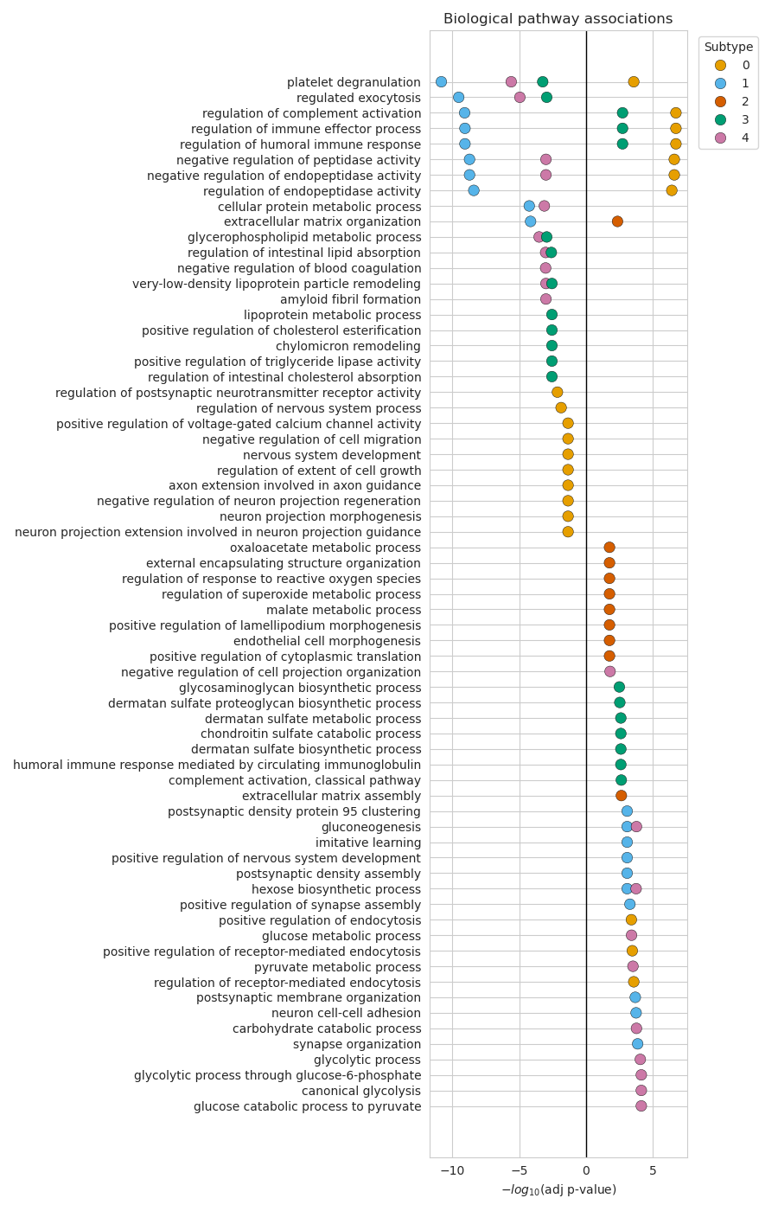
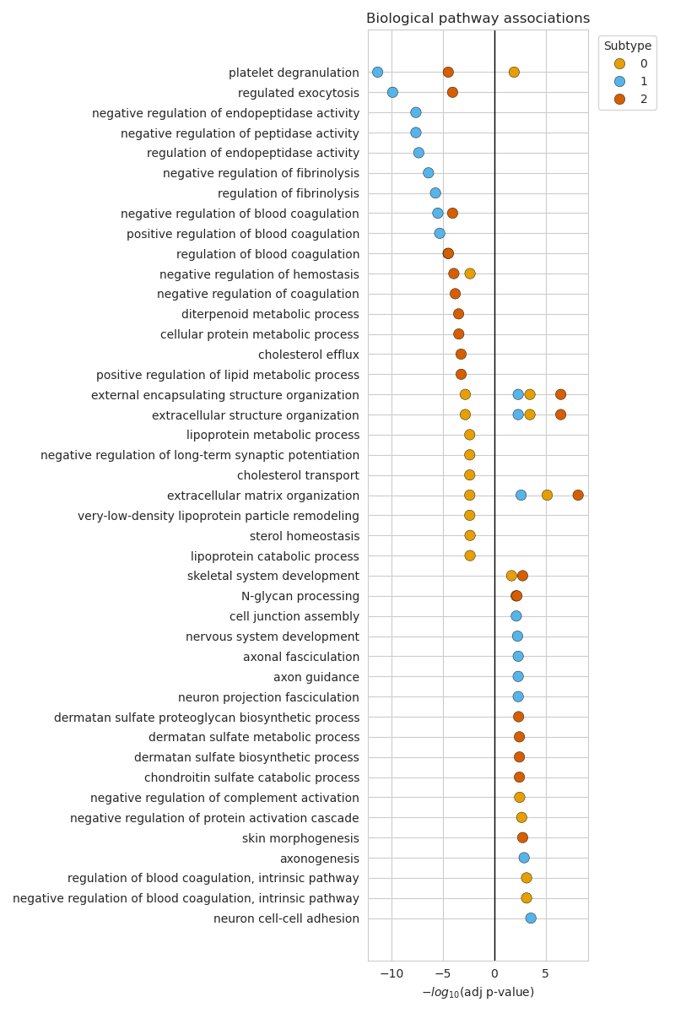
Pathway Enrichment Across NMF Subtypes

Slide 16
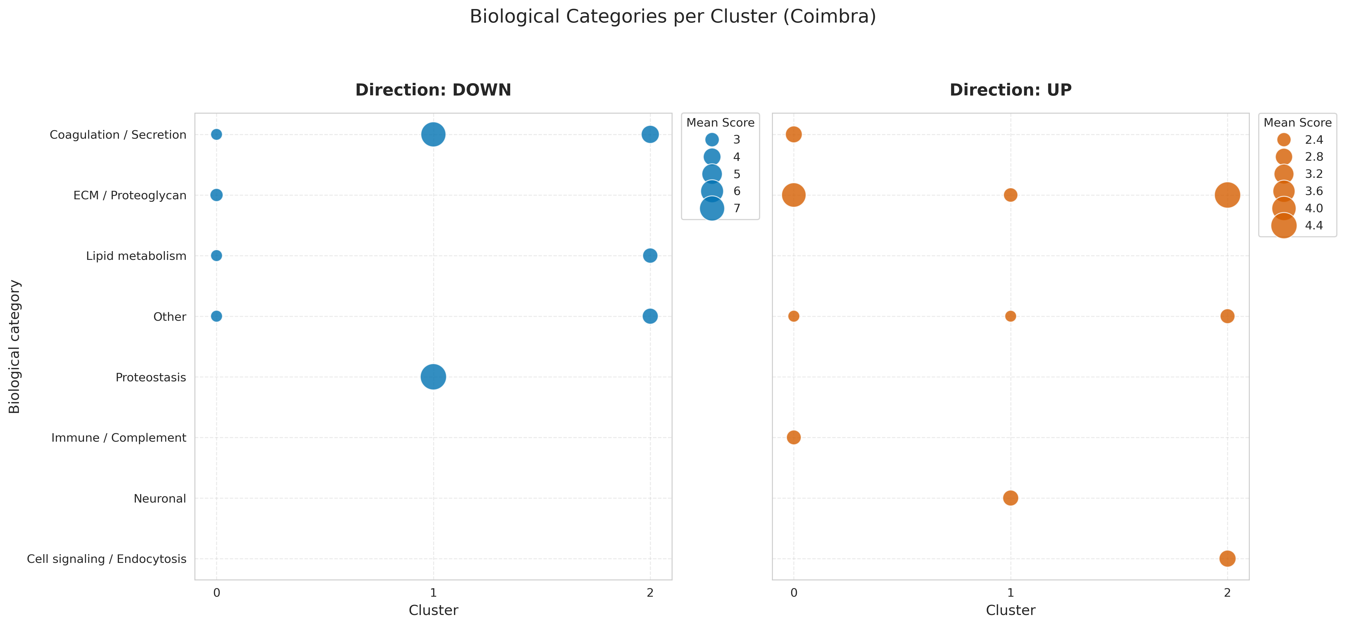
Biological Signatures of Identified Subtypes Coimbra

Slide 17
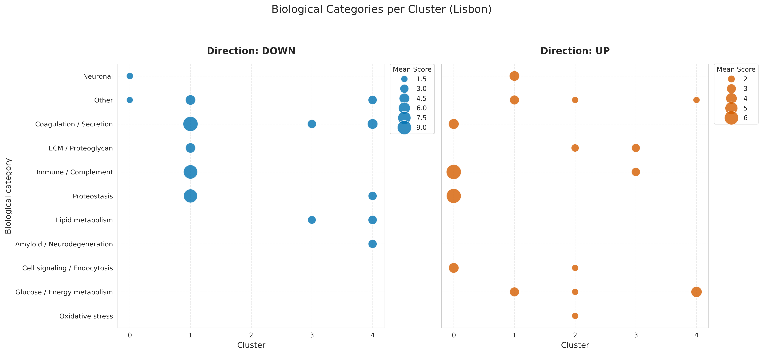
Biological Signatures of Identified Subtypes Lisbon

Slide 18
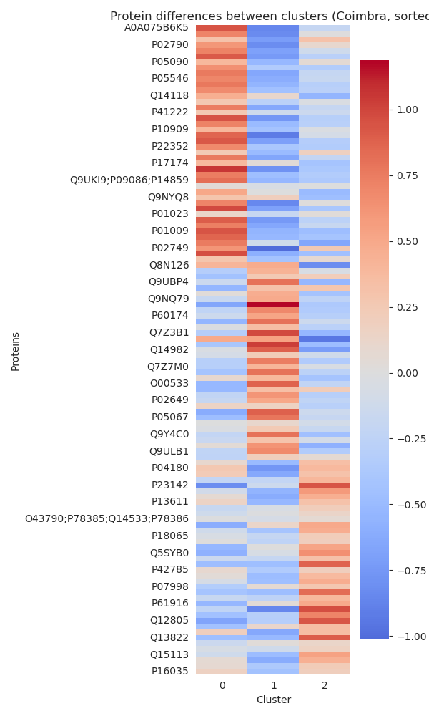
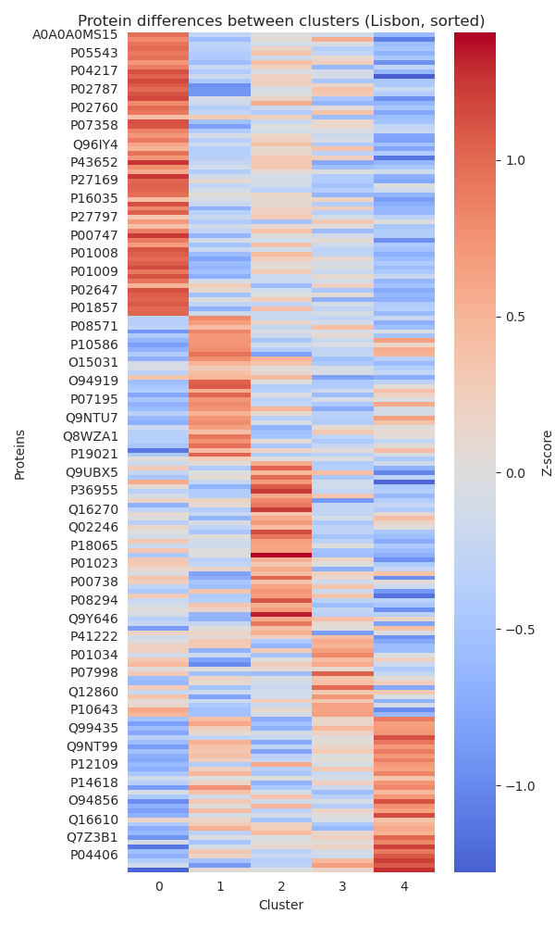
Differential Protein Expression Across Subtypes
Top discriminative proteins per subtype are shown
Values represent standardized expression (z-score)
Distinct protein patterns characterize each subtype

Slide 19
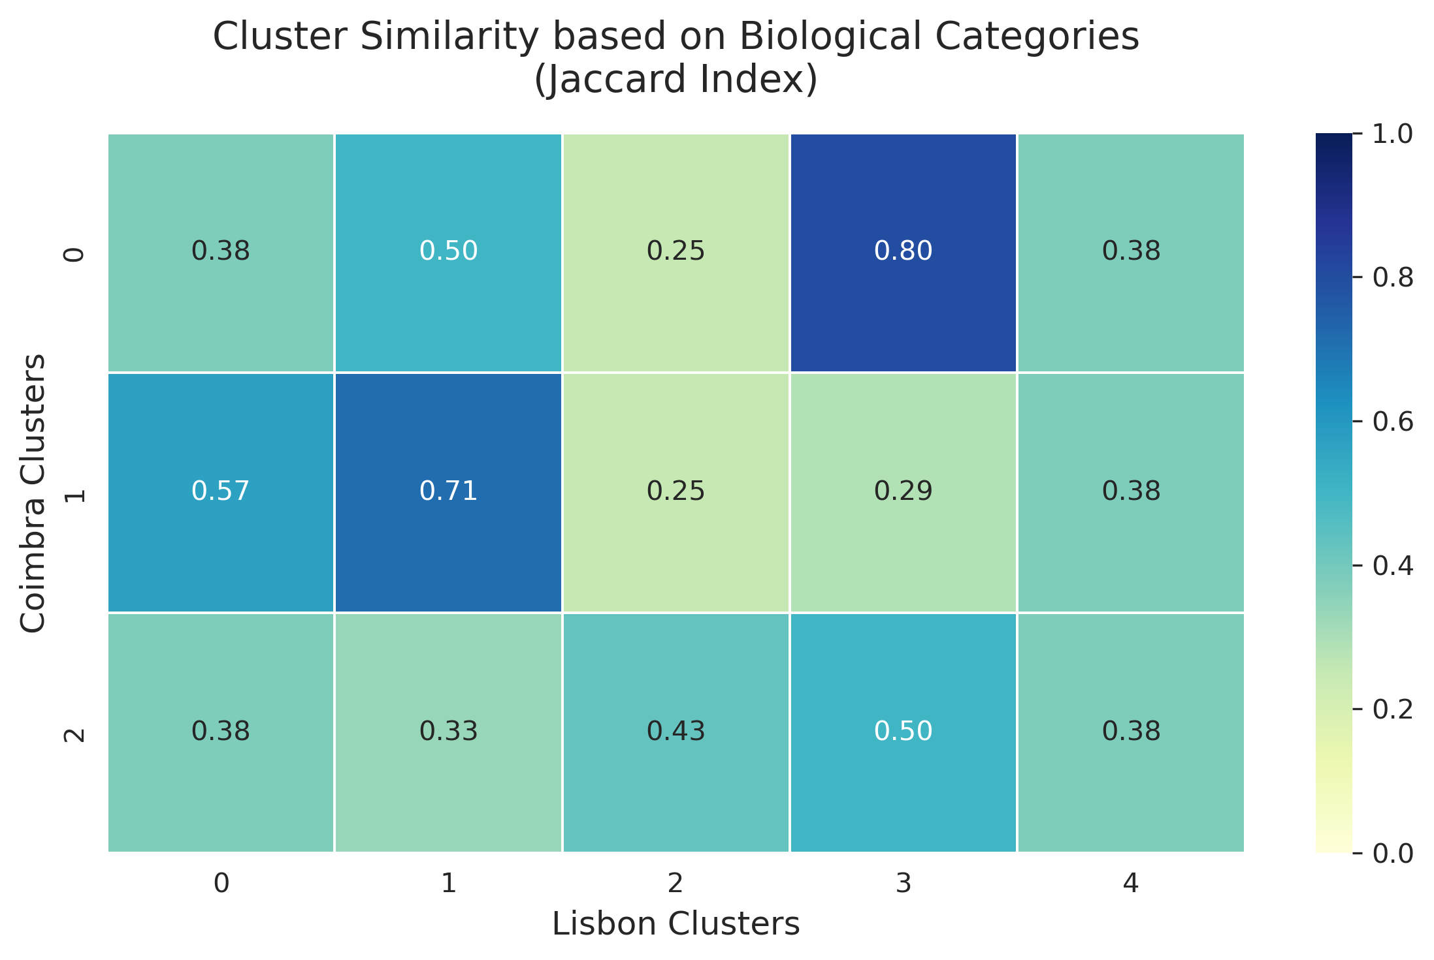
Cross-Dataset Subtype Similarity (Jaccard Index)
Similarity between Coimbra and Lisbon subtypes was quantified
Jaccard index measures overlap in biological categories
High similarity supports reproducibility of subtypes

Slide 20
Cross-Validation of Cluster Biomarkers: NMF vs. Random Forest
Objective: To validate the robustness of the biomarkers identified through NMF (Non-negative Matrix Factorization).
Orthogonal Methodology: We implemented a Random Forest supervised learning approach to independently test the discriminative power of the proteins for each cluster.
Consistency Metrics: Using the Jaccard Similarity Index to quantify the agreement between the mathematical decomposition (NMF) and the predictive model (RF).
Key Outcome: Identification of High-Confidence Biomarkers—proteins consistently selected by both algorithms as primary drivers of cluster identity.

Slide 21
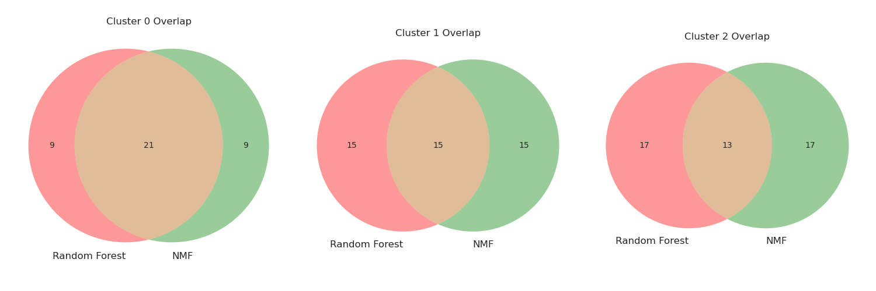
Consensus-Driven Biomarker Discovery: Overlap Analysis on Coimbra

Slide 22
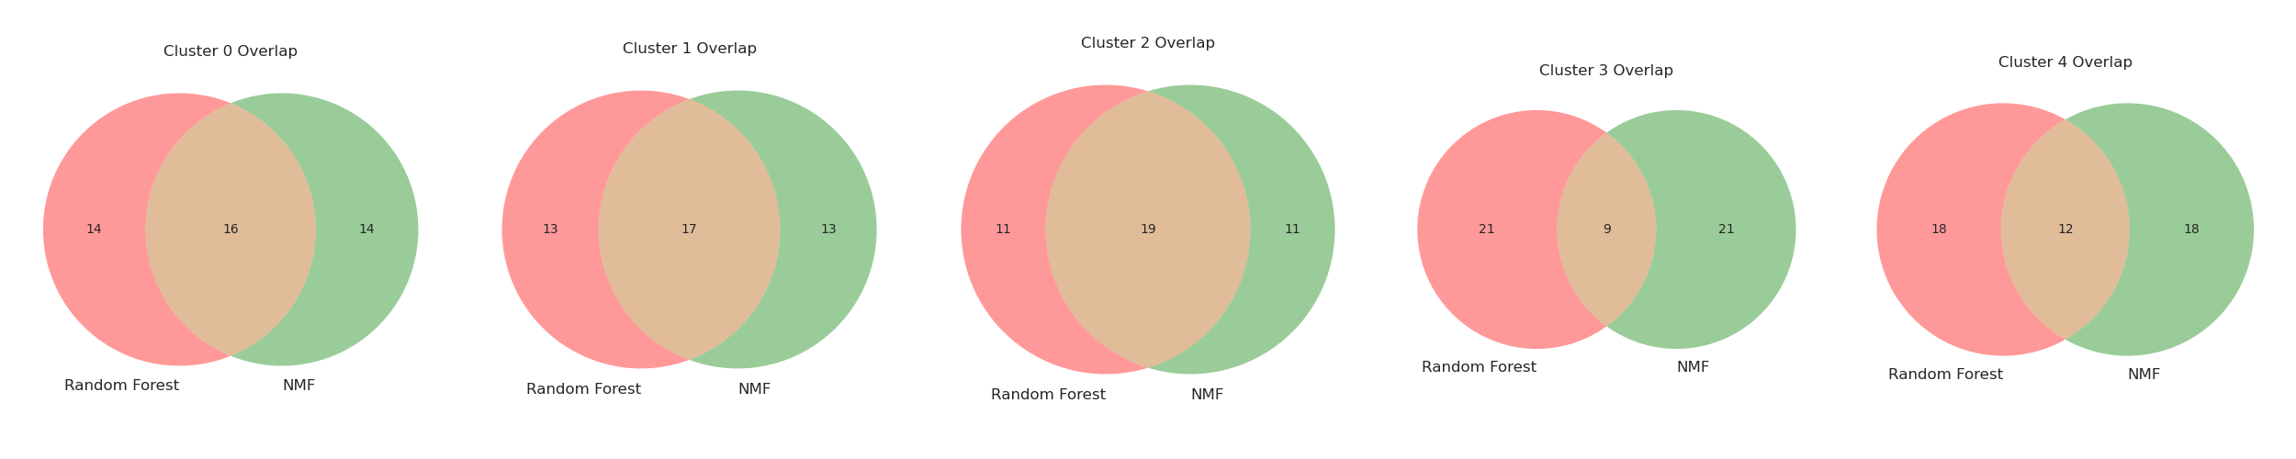
Consensus-Driven Biomarker Discovery: Overlap Analysis on Lisbon

Slide 23
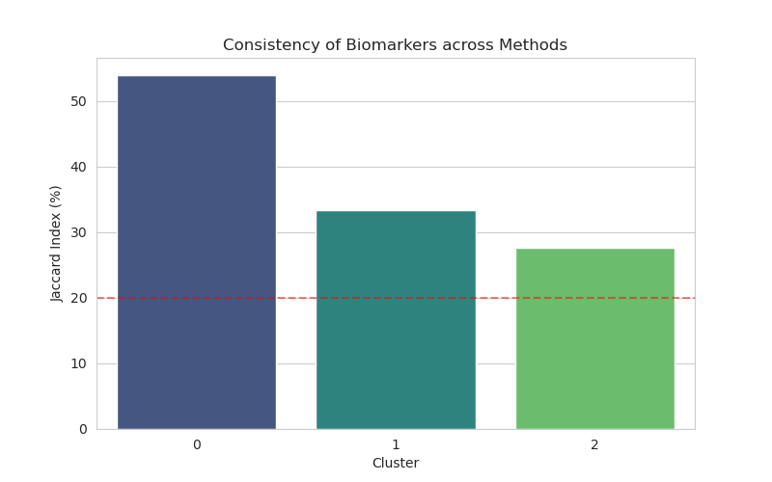
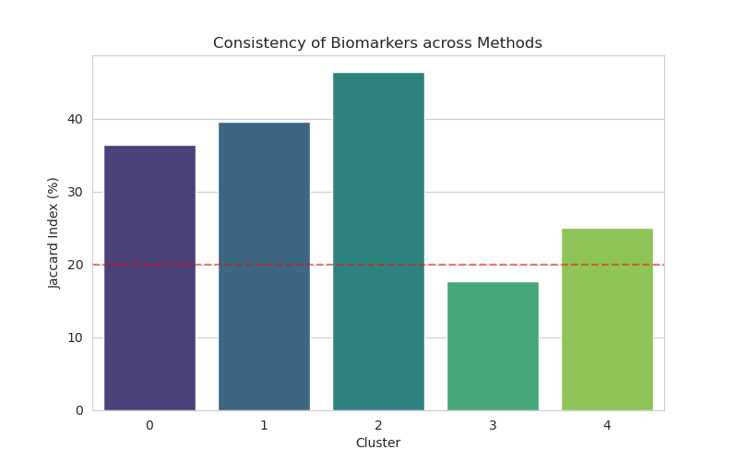
Quantitative Validation: Jaccard Similarity Analysis
Measuring Consistency: The Jaccard Index evaluates the intersection over the union of features selected by NMF and Random Forest.
Statistical Significance: * The red dashed line represents a 20% threshold, often considered a strong consensus in high-dimensional proteomic data.

Slide 24
OBRIGADO!

