Slide 1

Proteomic Analysis of CSF in MCI-AD and MCI-CT Patients

Slide 2
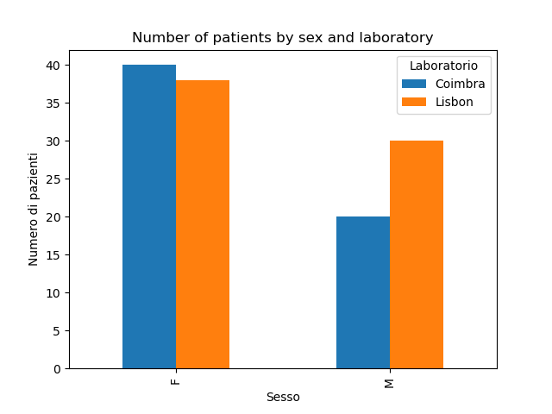
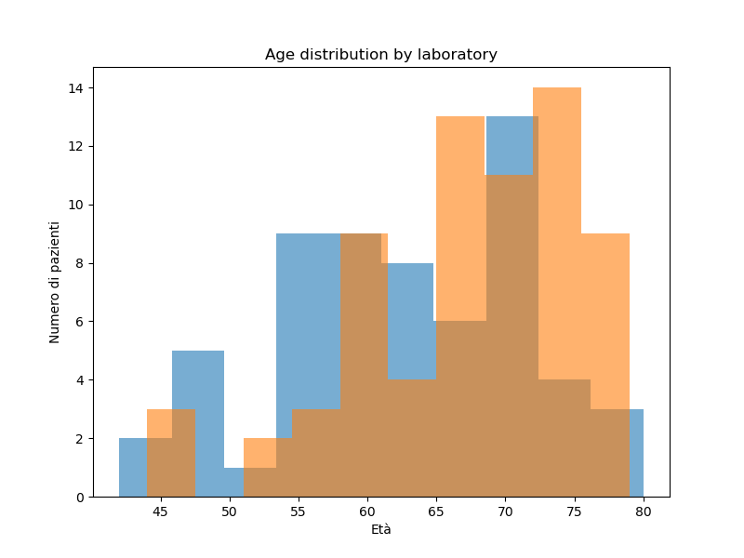
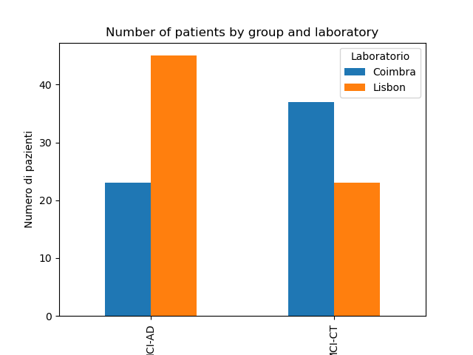
Cohort Characteristics
LISBON:
Tot : 74 Unknown : 6
MCI-AD : 45
MCI-CT : 23
COIMBRA:
Tot:60 MCI-AD : 23
MCI-CT : 37

Slide 3
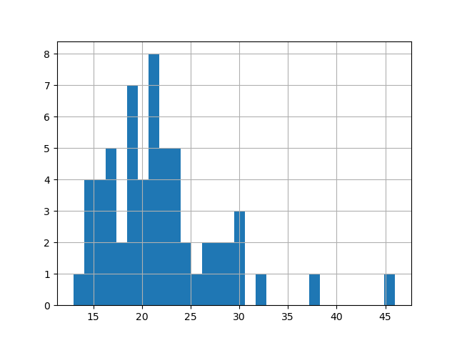
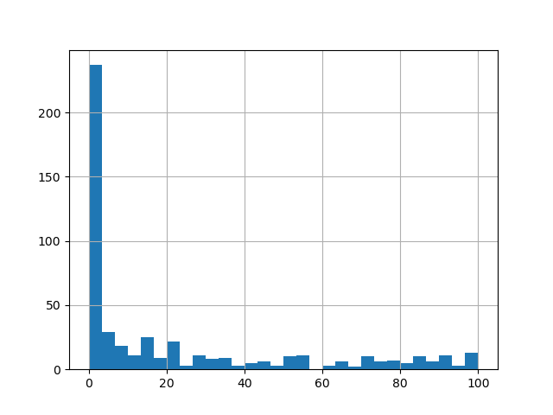
Filtering in Coimbra dataset
The plots show the original, unfiltered data and represent the dataset state prior to missing value filtering. No additional preprocessing steps were required at this stage, as there was no need to remove samples labeled as unknown, samples without data, or duplicate samples. Additionally, the number of proteotypic peptides is consistently greater than two.
Below, a table reports the different thresholds tested on the dataset to remove patients with a high proportion of missing values. This step was performed to increase the number of proteins retained in the dataset after applying missing value filtering at the protein level rather than at the sample level.
 | NO THRESHOLD | Threshold of 30% | Threshold of 31%
Number of patients | 60 | 55 | 57
Number of proteins | 215 | 240 | 238

Slide 4
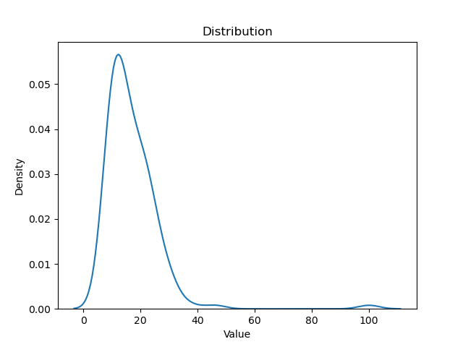
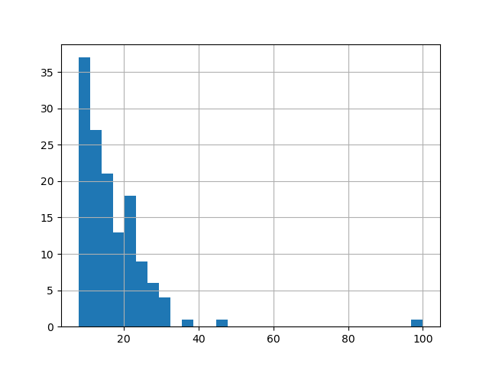
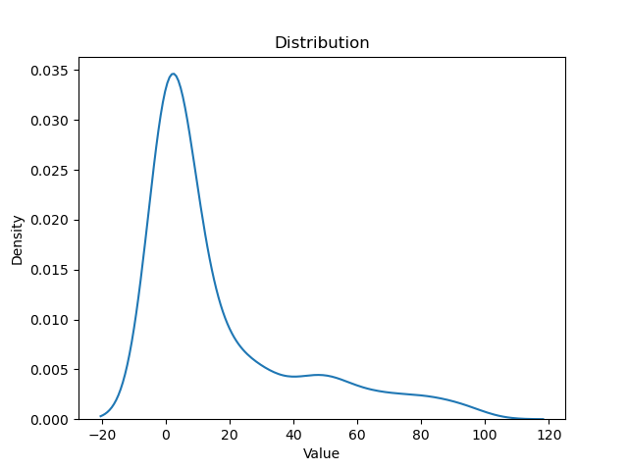
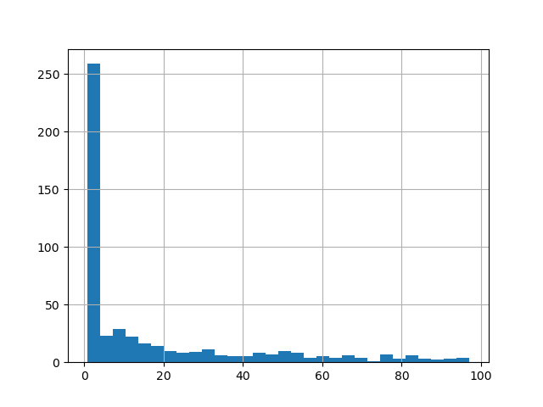
Filtering in Coimbra+Lisbon dataset
Initial dataset: 138 patients and 502 proteins.
The two plots show the distributions of the original data by patients(the 2 above) and proteins (the 2 below). The following filtering steps were subsequently applied:
N. Proteotypic Sequences ≥ 2: resulting in 138 patients and 353 proteins (−30% proteins).
Removal of duplicate samples: resulting in 135 patients and 353 proteins (−3 patients).
Removal of samples without data: resulting in 134 patients and 353 proteins (−1 patient).
Removal of samples labeled as unknown: resulting in 128 patients and 353 proteins (−6 patients).
Final dataset: 128 patients and 353 proteins.

Slide 5
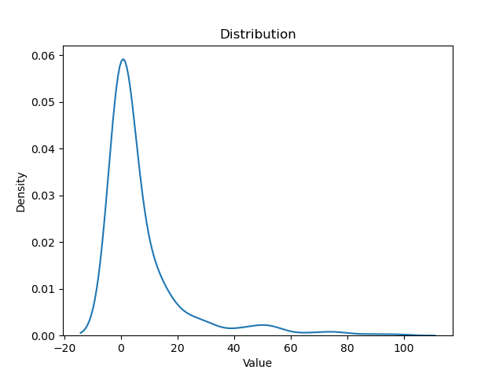
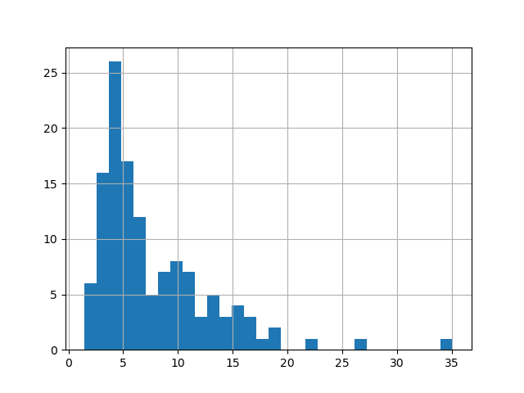
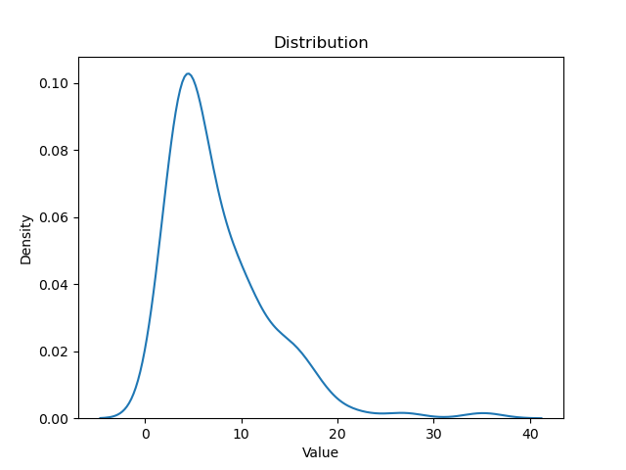

Apply thresholds on Coimbra+Lisbon dataset
The plots show the dataset after applying the initial filtering steps. The upper plot represents the distribution of missing values across patients, while the lower plot shows the distribution across proteins.
The table below reports the number of patients and proteins obtained when applying different thresholds to remove patients with a high proportion of missing values before removing proteins containing missing values. This approach was used to evaluate whether removing patients with many missing values could increase the number of proteins retained in the final dataset.
 | NO THRESHOLD | Threshold of 10% | Threshold of 17% | Threshold of 20%
Number of patients | 128 | 96 | 122 | 125
Number of proteins | 184 | 231 | 206 | 204

Slide 6
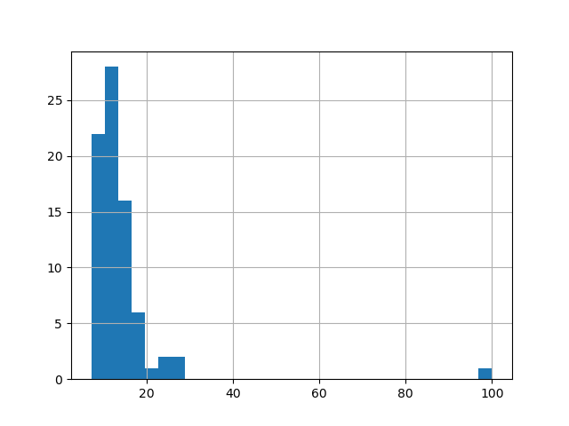
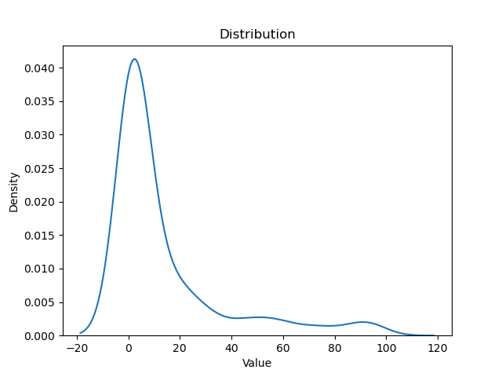

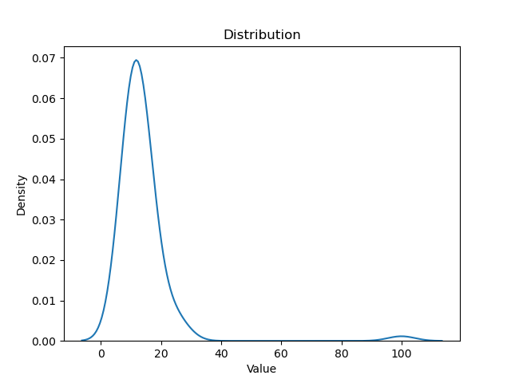
Filtering in Lisbon dataset
Initial dataset: 78 patients and 492 proteins.
The two plots show the distributions of the original data by patients(the 2 above) and proteins (the 2 below). The following filtering steps were subsequently applied:
N. Proteotypic Sequences ≥ 2: resulting in 78 patients and 351 proteins (−29% proteins).
Removal of duplicate samples: resulting in 75 patients and 351 proteins (−3 patients).
Removal of samples without data: resulting in 74 patients and 351 proteins (−1 patient).
Removal of samples labeled as unknown: resulting in 68 patients and 351 proteins (−6 patients).
Final dataset: 68 patients and 351proteins

Slide 7
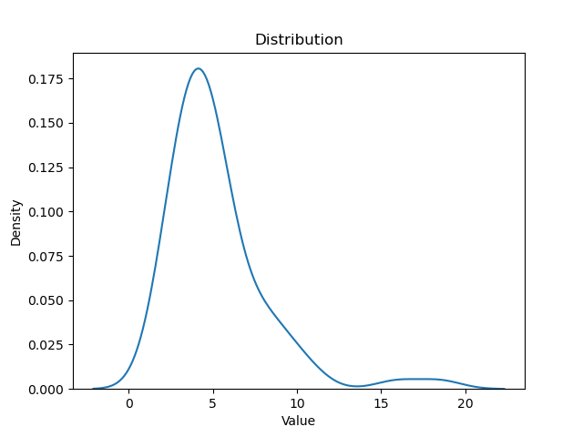
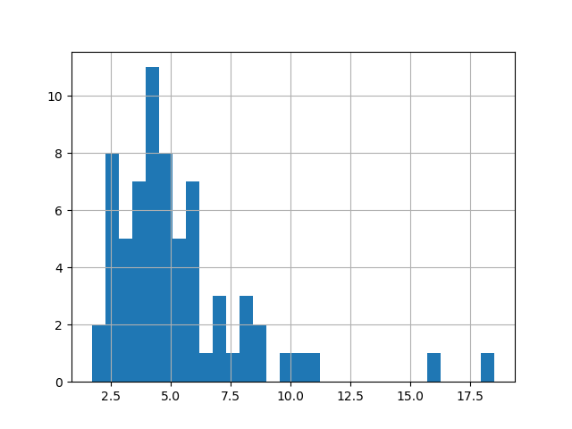
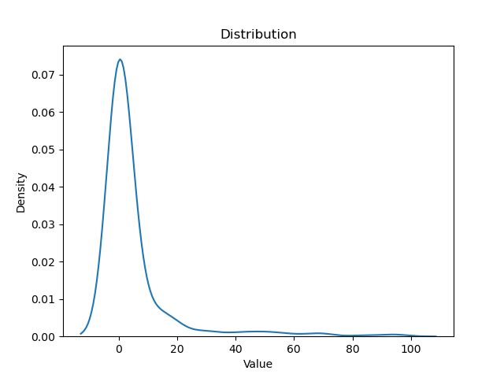
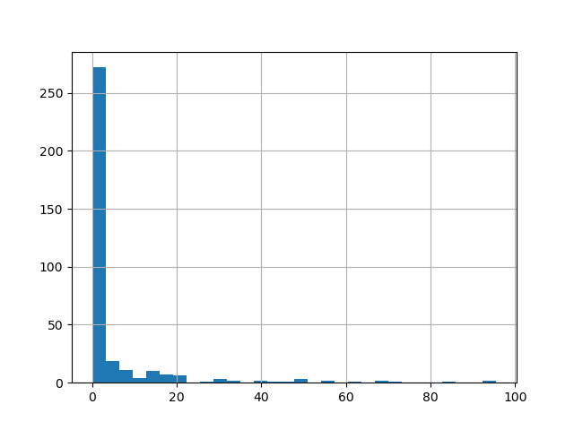
Apply thresholds on Lisbon dataset
The plots show the dataset after applying the initial filtering steps. The upper plot represents the distribution of missing values across patients, while the lower plot shows the distribution across proteins.
The table below reports the number of patients and proteins obtained when applying different thresholds to remove patients with a high proportion of missing values before removing proteins containing missing values. This approach was used to evaluate whether removing patients with many missing values could increase the number of proteins retained in the final dataset.
 | NO THRESHOLD | Threshold of 9% | Threshold of 10%
Number of patients | 68 | 63 | 64
Number of proteins | 237 | 262 | 259

Slide 8
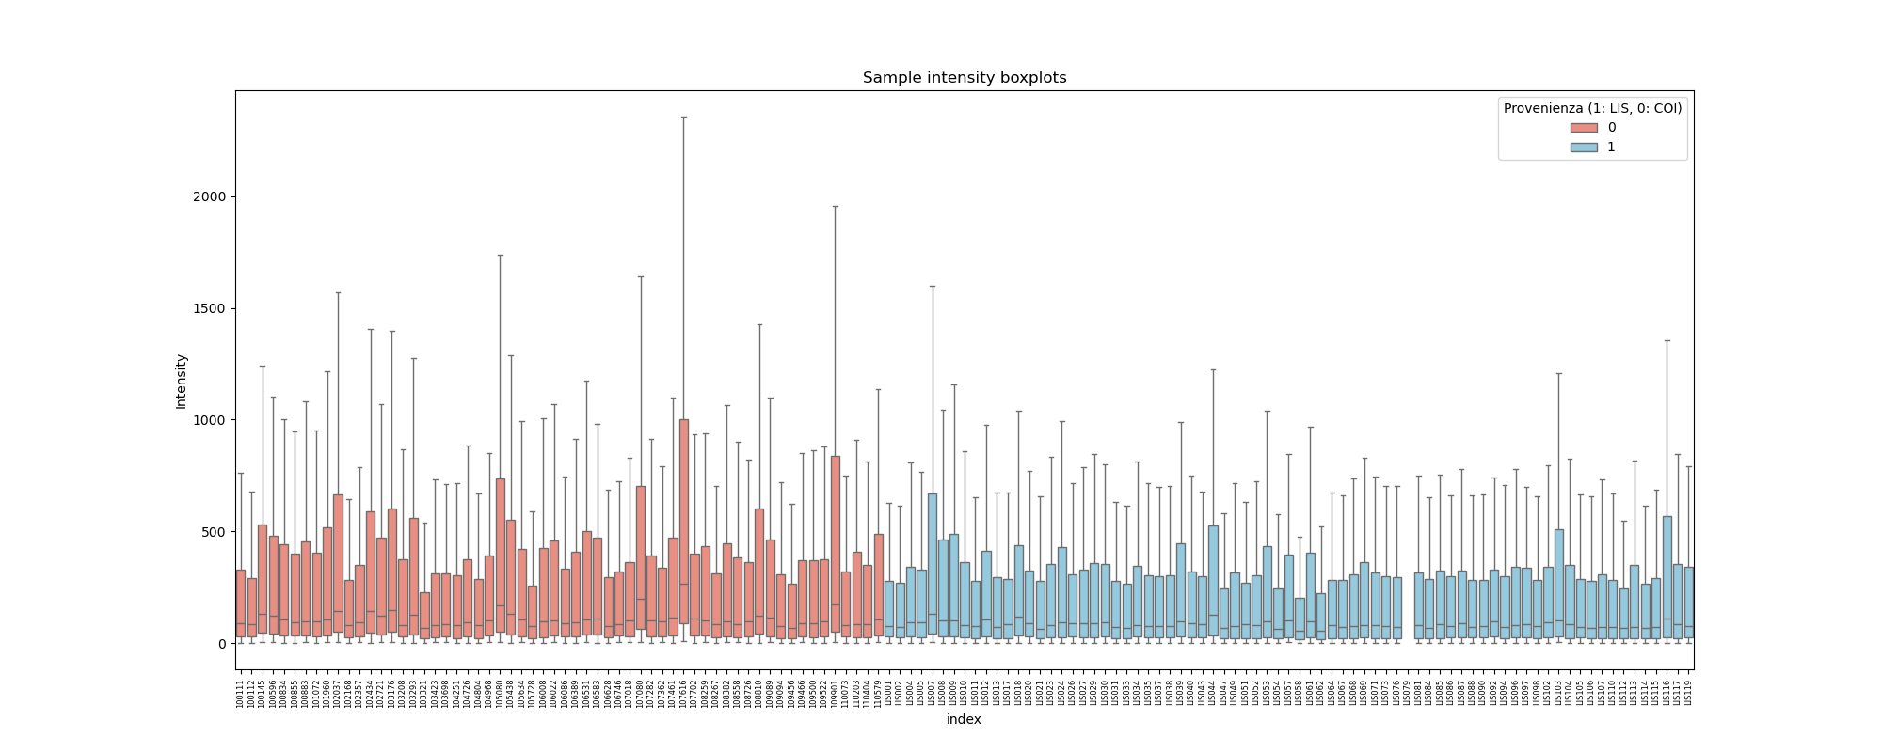
Distribution of Protein Intensities Across Samples

Slide 9
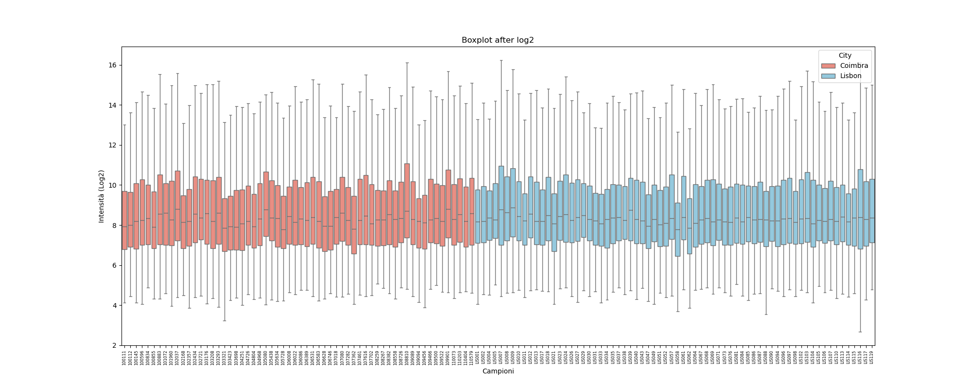
Sample Intensity Distribution After Log₂ Transformation
Log₂ transformation applied to protein intensities
Reduction of extreme values
More comparable distributions across samples and stabilized variance

Slide 10
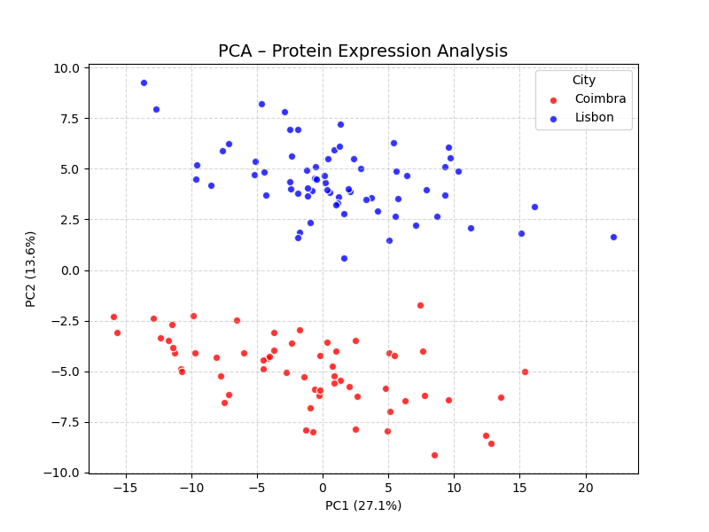
PCA of Protein Expression by Laboratory
PCA was applied to explore the structure of the dataset, revealing that samples cluster according to their laboratory of origin, suggesting a potential batch effect.

Slide 11
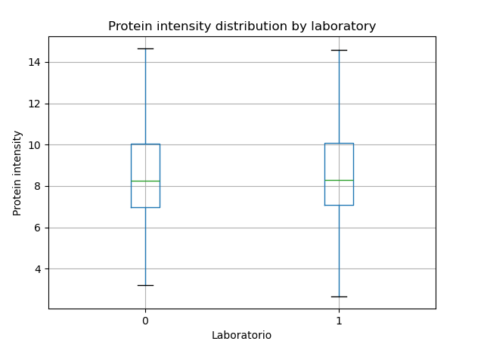
Protein Intensity Distribution by Laboratory
Protein intensity distributions are similar between Lisbon and Coimbra
Median and variability are comparable across laboratories

Slide 12

Batch Effect or Biological Variability?
Observations:
PCA shows a separation of samples according to the laboratory of origin
However, the protein intensity distributions across laboratories are very similar

Slide 13
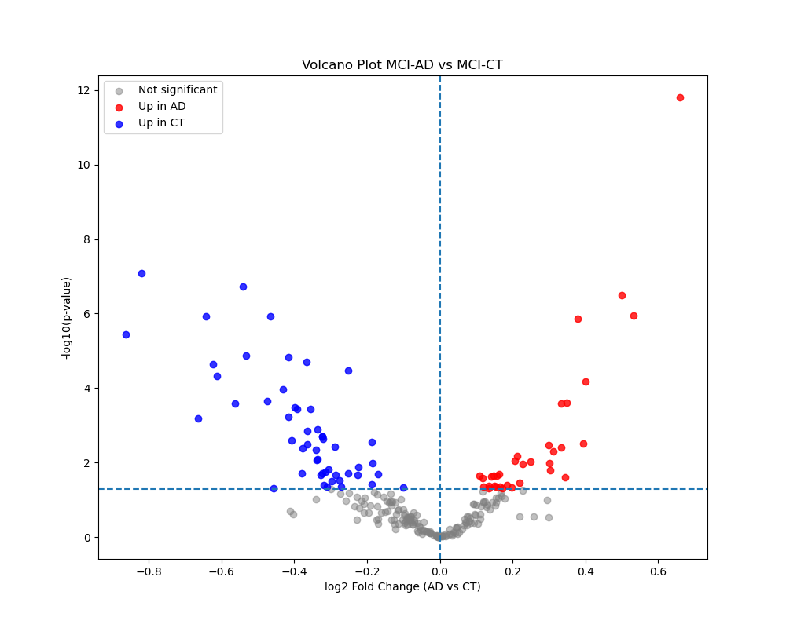
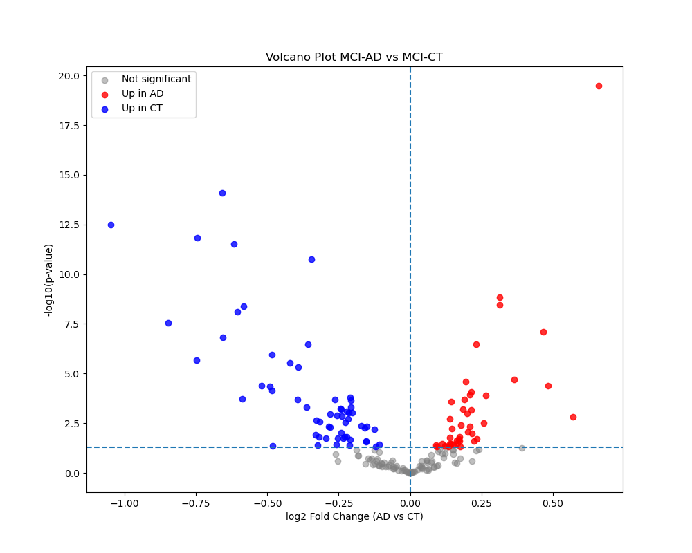
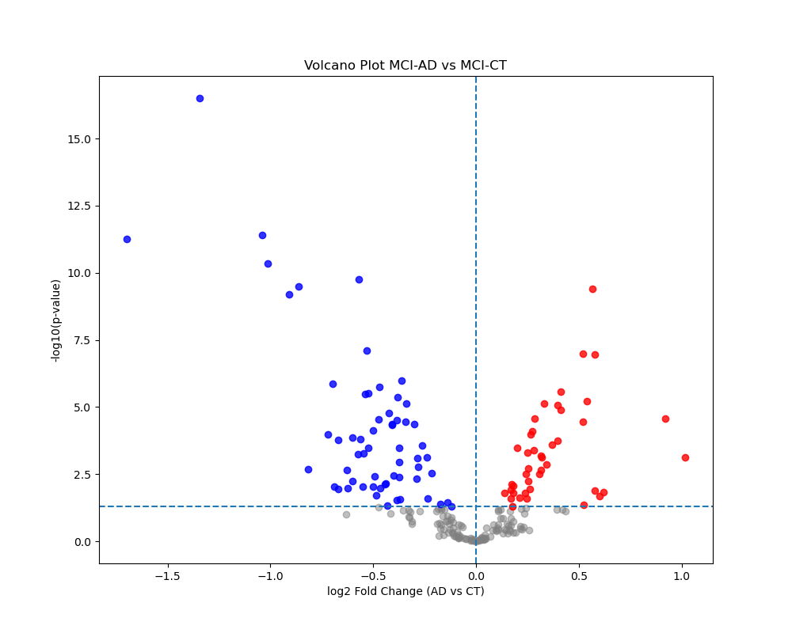
Differential Protein Expression: MCI-AD vs MCI-CT
LISBON
LISBON-COIMBRA
COIMBRA

Slide 14
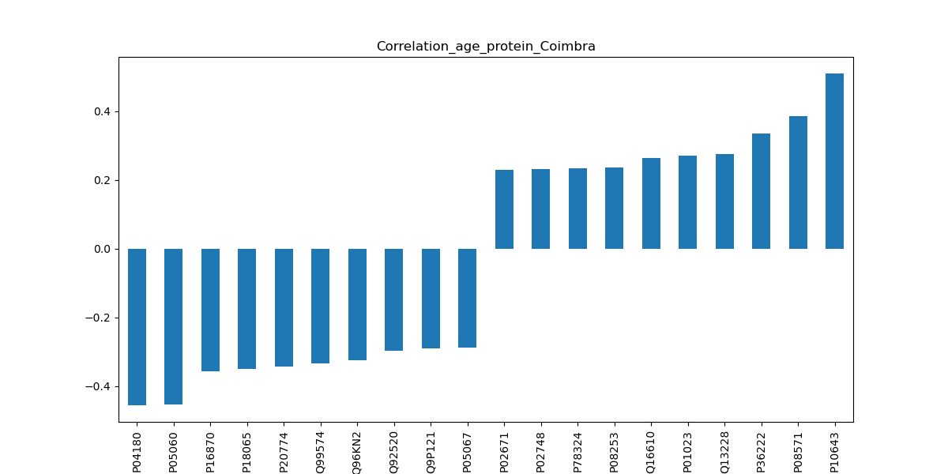
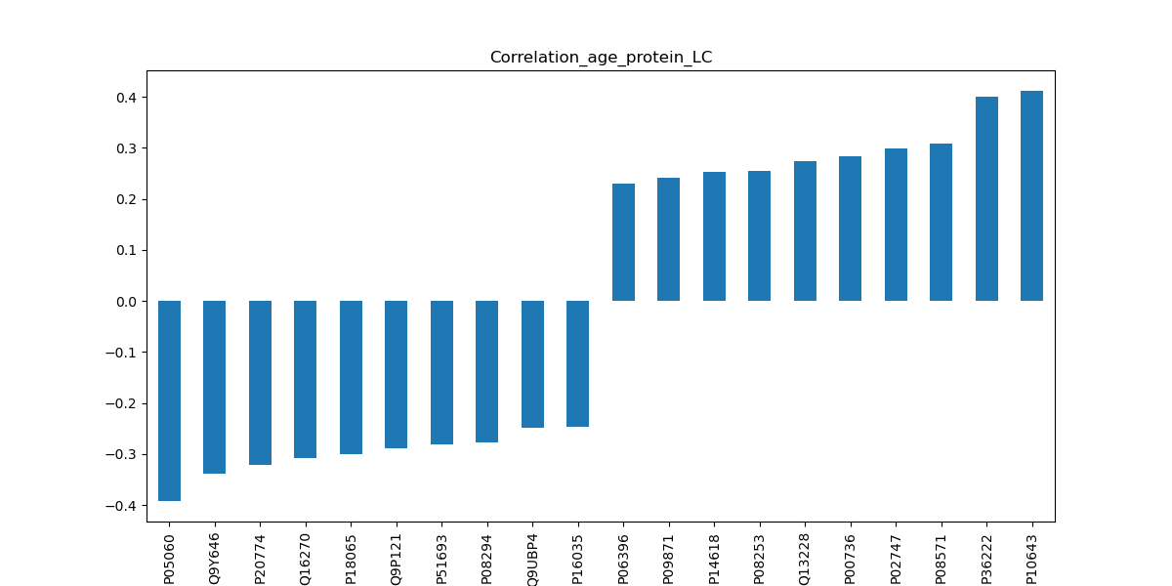
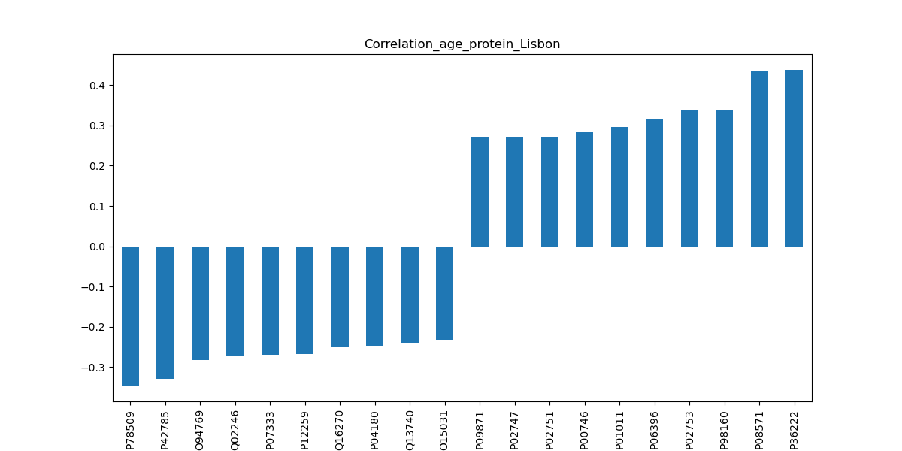
Age-Associated Protein Expression
These proteins appear in two or more datasets, suggesting consistent differential expression across the analyses:
P05060
P20774
Q16270
P18065
Q9P121
P06396
P09871
P08253
Q13228
P02747
P08571
P36222
P10643
P04180

Slide 15
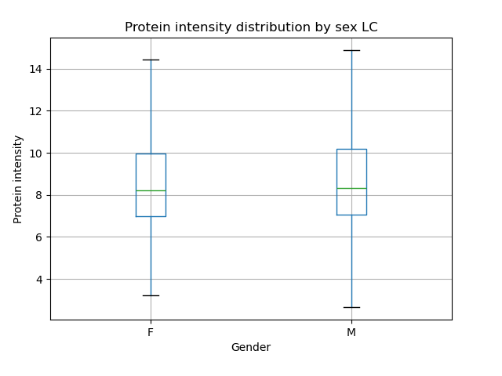
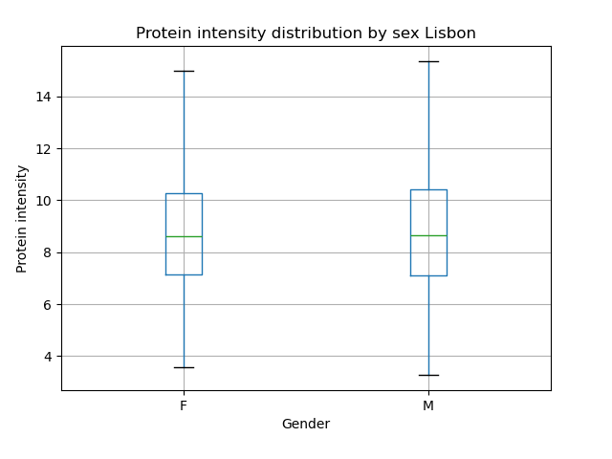
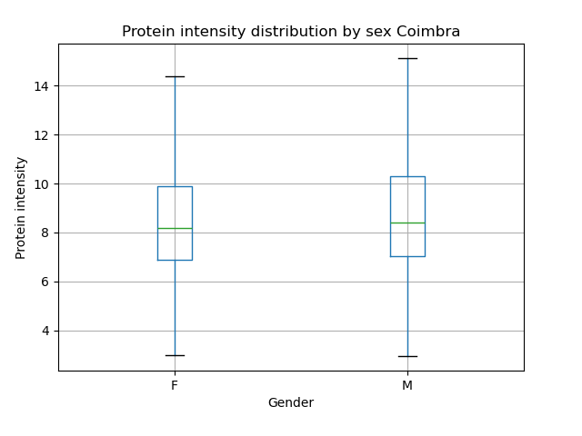
Protein Intensity Distribution by Sex

Slide 16
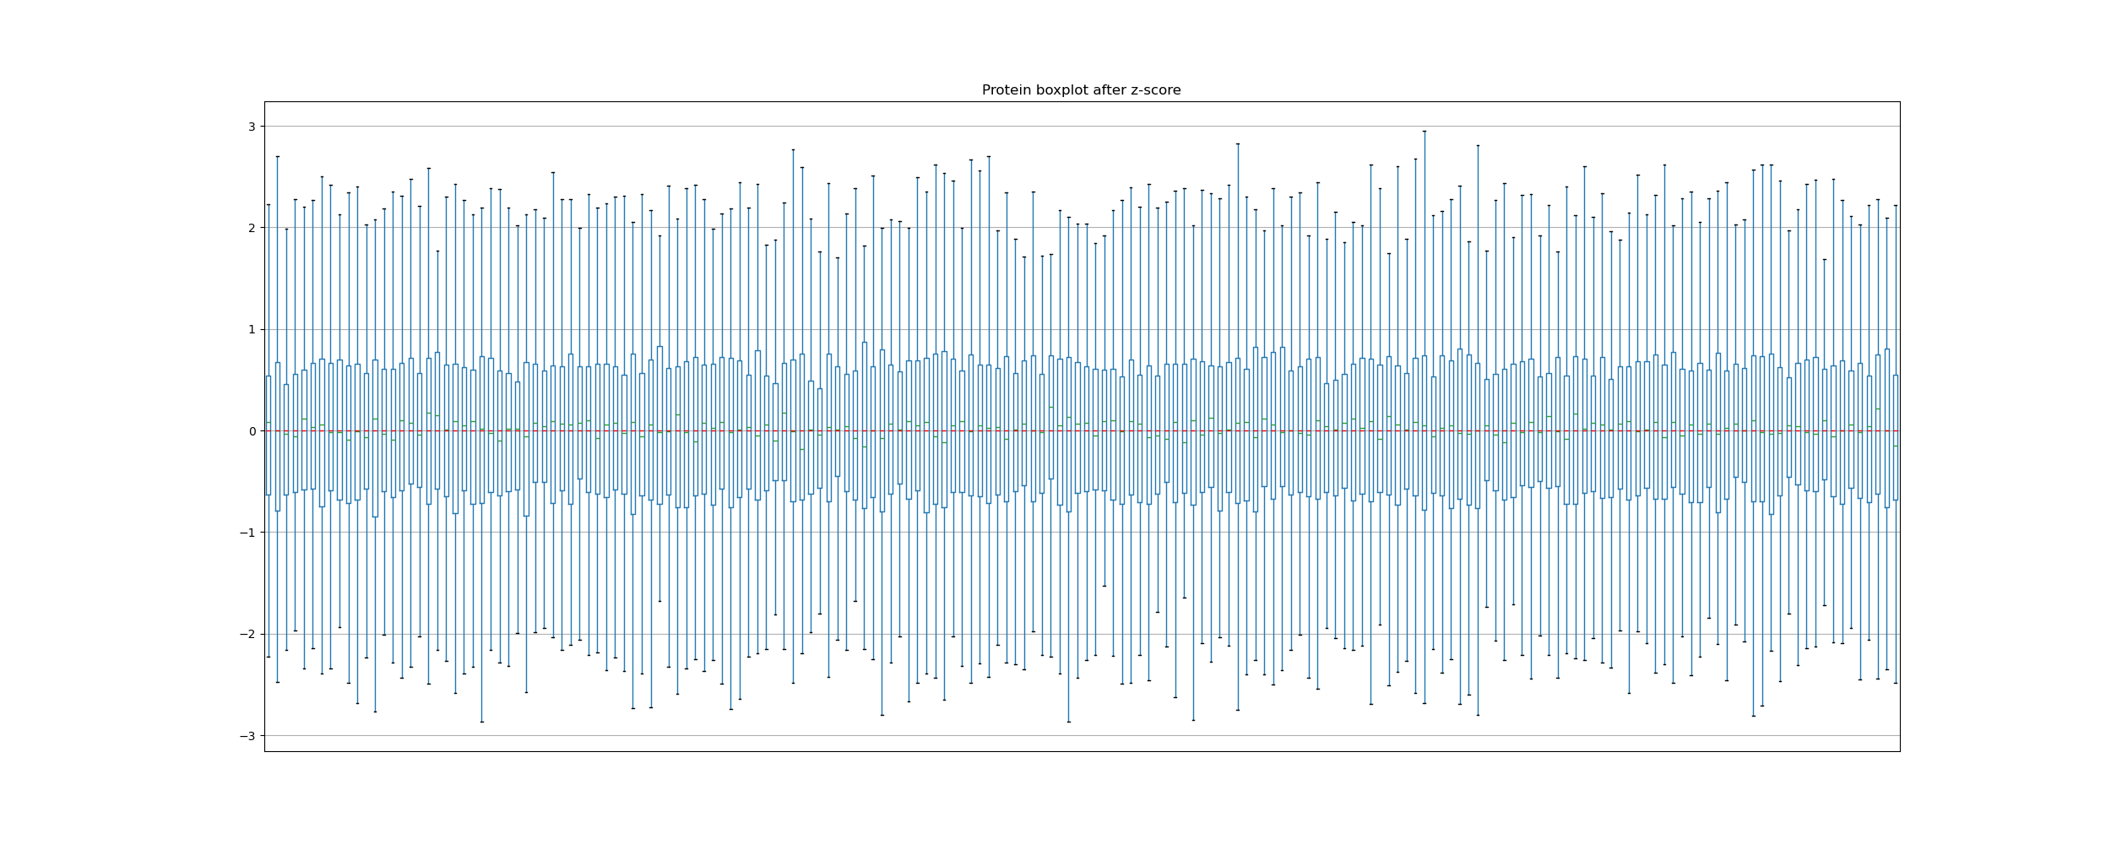
Z-score Normalization of Protein Intensities
Protein intensities were standardized using Z-score normalization
Distributions are centered around zero
This allows comparability across proteins and samples

Slide 17
Open Questions About the Dataset
Why are some samples labeled as unknown? Should we discard them?
Why are the cohorts not balanced between AD and CT groups?
Why are there duplicate samples in the dataset?
Was any batch effect correction applied before data release?

Slide 18

Obrigado pela atenção!

