Slide 1

Comparison Between PLS-DA and Random Forest in Selecting the Most Significant Proteins for MCI-AD vs MCI-CT Classification

Slide 2
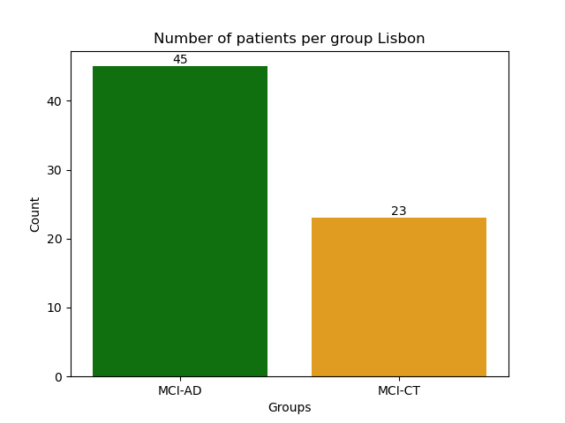
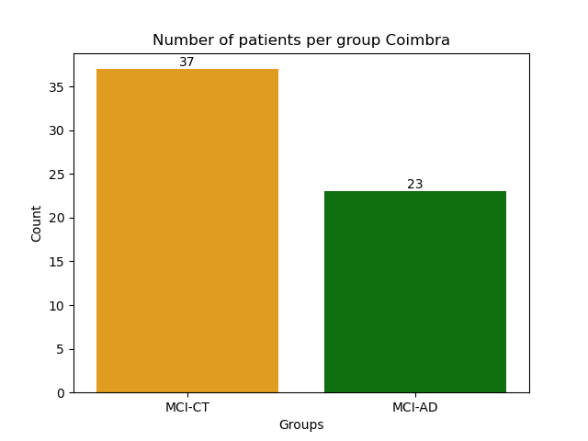
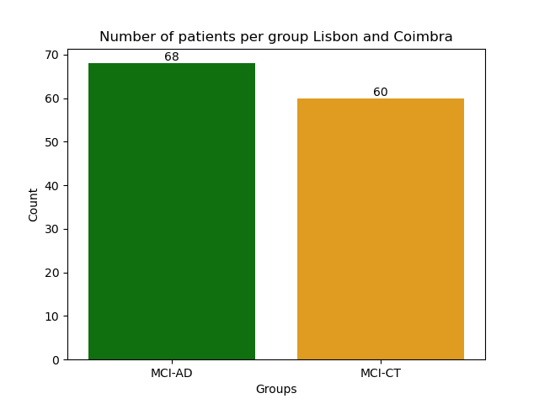
Patient Cohort Overview without threshold
Total patients:
Lisbon : 68 (MCI-AD:66% MCI-CT:34%)
Coimbra : 60 (MCI-AD:38% MCI-CT:62%)
Lisbon + Coimbra : 128 (MCI-AD:53% MCI-CT:47%)

Slide 3


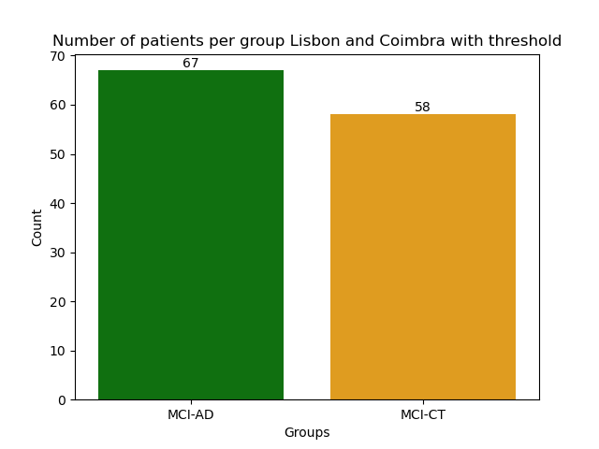
Patient Cohort Overview with threshold
Total patients:
Lisbon : 64 (MCI-AD:65% MCI-CT:35%)
Coimbra : 57 (MCI-AD:39% MCI-CT:61%)
Lisbon + Coimbra : 125 (MCI-AD:54% MCI-CT:46%)

Slide 4
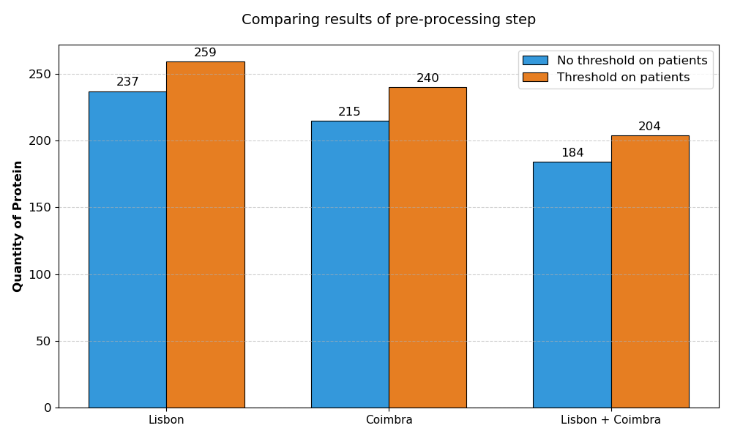
Impact of Thresholding on Number of Selected Proteins

Slide 5
Presentation Overview
Comparison between PLS-DA and Random Forest
Performance differences between threshold and non-threshold datasets

Slide 6
Random Forest pipeline
TRAINING SET
TEST SET
The pipeline includes cross-validation with bootstrap-based feature selection. Different cumulative importance thresholds (0.7, 0.8, 0.9) are evaluated, and the entire process is repeated over 15 random seeds to ensure robustness.
SUBTRAINING SET
VALIDATION SET
X 5
MCC / AUC
BOOTSTRAP X50
CUMULATIVE IMPORTANCE
200 trees each bootstrap

Slide 7
PLS-DA pipeline
TRAINING SET
TEST SET
Feature selection is based on VIP scores (VIP > 1) combined with selection frequency across bootstrap iterations. Multiple frequency thresholds (0.1–1.0) are tested, and the pipeline is repeated over 15 seeds to ensure robustness.
SUBTRAINING SET
VALIDATION SET
X 5
MCC / AUC
BOOTSTRAP X50
VIP FREQUENCY (>1)

Slide 8

Evaluation Metrics: MCC and AUC
Model performance was evaluated using Matthews Correlation Coefficient (MCC) and Area Under the Curve (AUC). MCC provides a balanced measure of classification quality, taking into account all elements of the confusion matrix and being robust to class imbalance. AUC evaluates the model’s ability to distinguish between classes across different thresholds.
Together, these metrics provide a comprehensive assessment of both classification accuracy and discriminative performance.

Slide 9
Impact of Thresholding in Data Preprocessing
PLS-DA
RANDOM FOREST
 | WITH THRESHOLD | NO THRESHOLD
LISBON | MCC = 0.8834 AUC = 0.9773 | MCC = 0.8250 AUC = 0.9667
COIBRA | MCC = 0.9773 AUC = 1 | MCC = 0.9415 AUC = 0.9965
LISBON+ COIMBRA | MCC = 0.9520 AUC = 0.9970 | MCC = 0.9292 AUC = 0.9937
COIMBRA(TRAIN)/ LISBOA(TEST) | MCC= 0.5158 AUC = 0.8439 | MCC = 0.5026 AUC = 0.8435
LISBON(TRAIN)/ COIMBRA(TEST) | MCC = 0.906 AUC = 0.9911 | MCC = 0.9092 AUC = 0.9936
 | WITH THRESHOLD | NO THRESHOLD
LISBON | MCC = 0.8747 AUC =0.9703 | MCC = 0.7683 AUC = 0.9600
COIBRA | MCC = 0.9473 AUC = 0.9982 | MCC = 0.8956 AUC = 0.9939
LISBON+ COIMBRA | MCC = 0.9380 AUC = 0.9953 | MCC = 0.9007 AUC = 0.9920
COIMBRA(TRAIN)/ LISBOA(TEST) | MCC = 0.3770 AUC =0.7560 | MCC = 0.3790 AUC = 0.7400
LISBON(TRAIN)/ COIMBRA(TEST) | MCC = 0.7140 AUC = 0.9870 | MCC = 0.7140 AUC = 0.9730

Slide 10
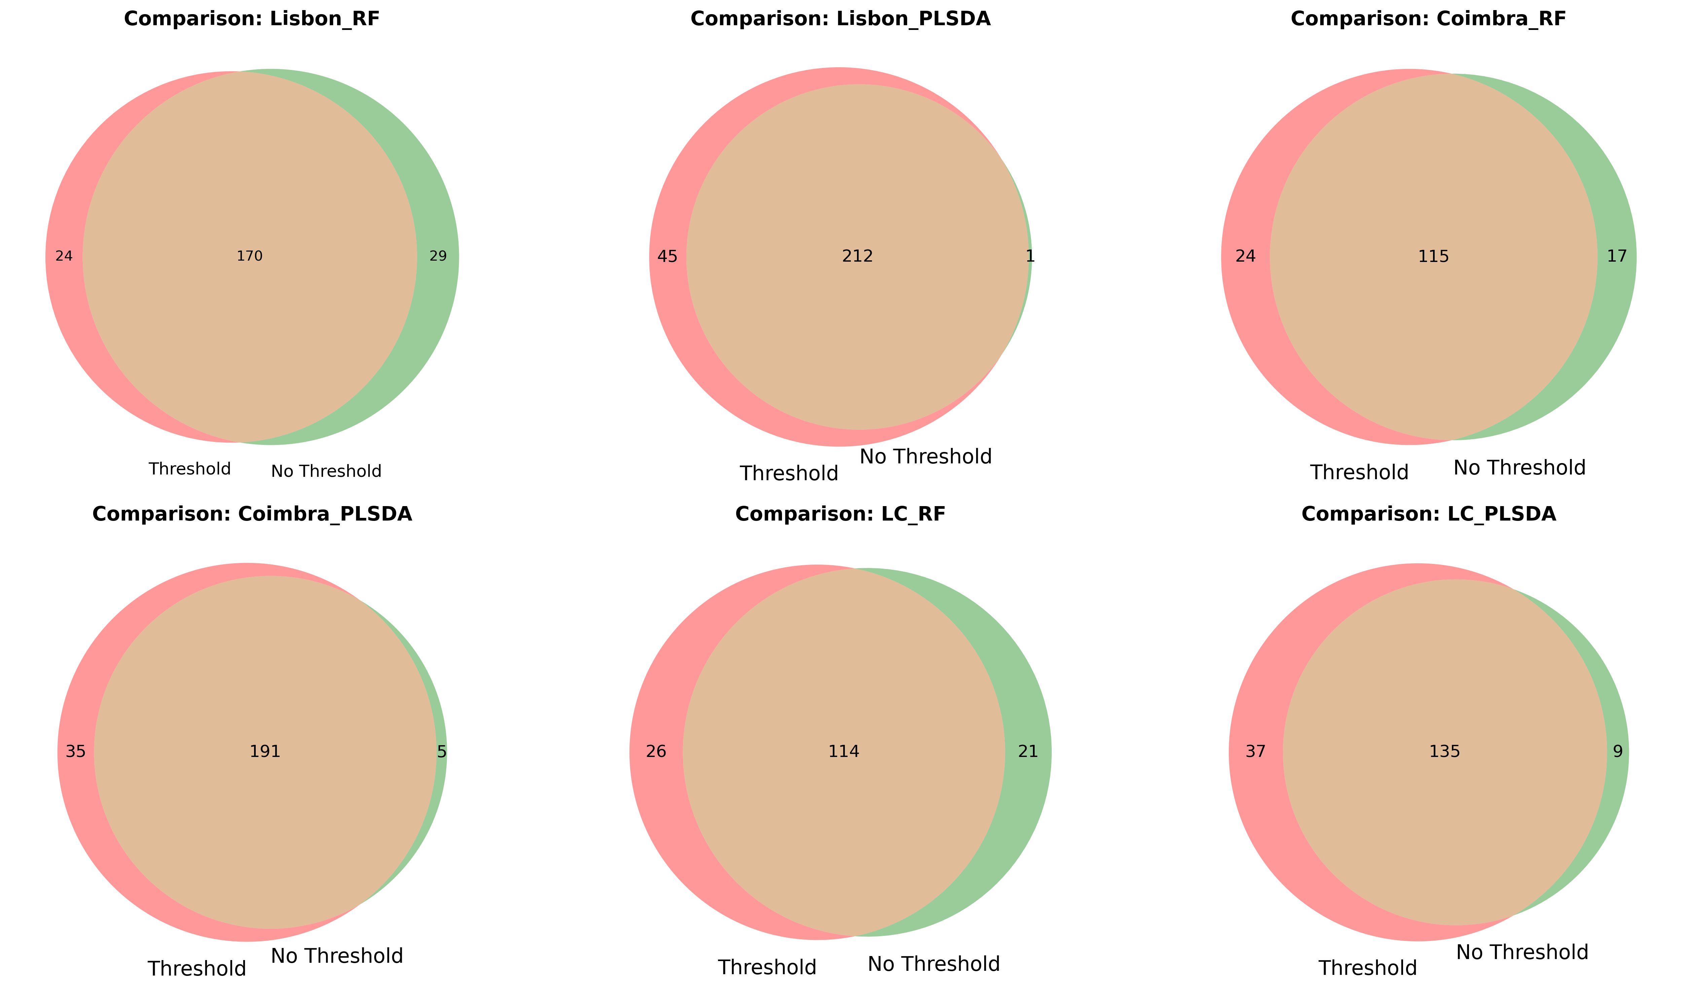
Impact of Thresholding in Data Preprocessing
The proteins identified are largely consistent across both approaches. However, applying a threshold at the patient level generally results in a higher number of selected proteins.

Slide 11
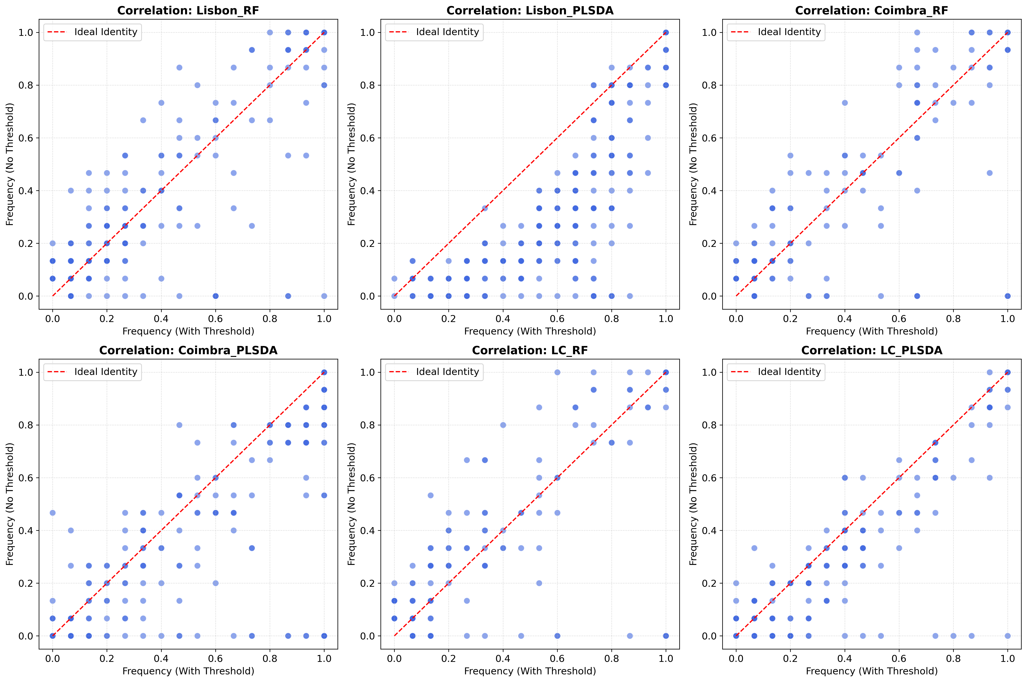
Impact of Thresholding in Data Preprocessing
Protein selection is generally consistent across both approaches, as shown by the positive correlation. Nevertheless, some proteins exhibit different selection frequencies, suggesting that preprocessing choices can influence feature stability.

Slide 12
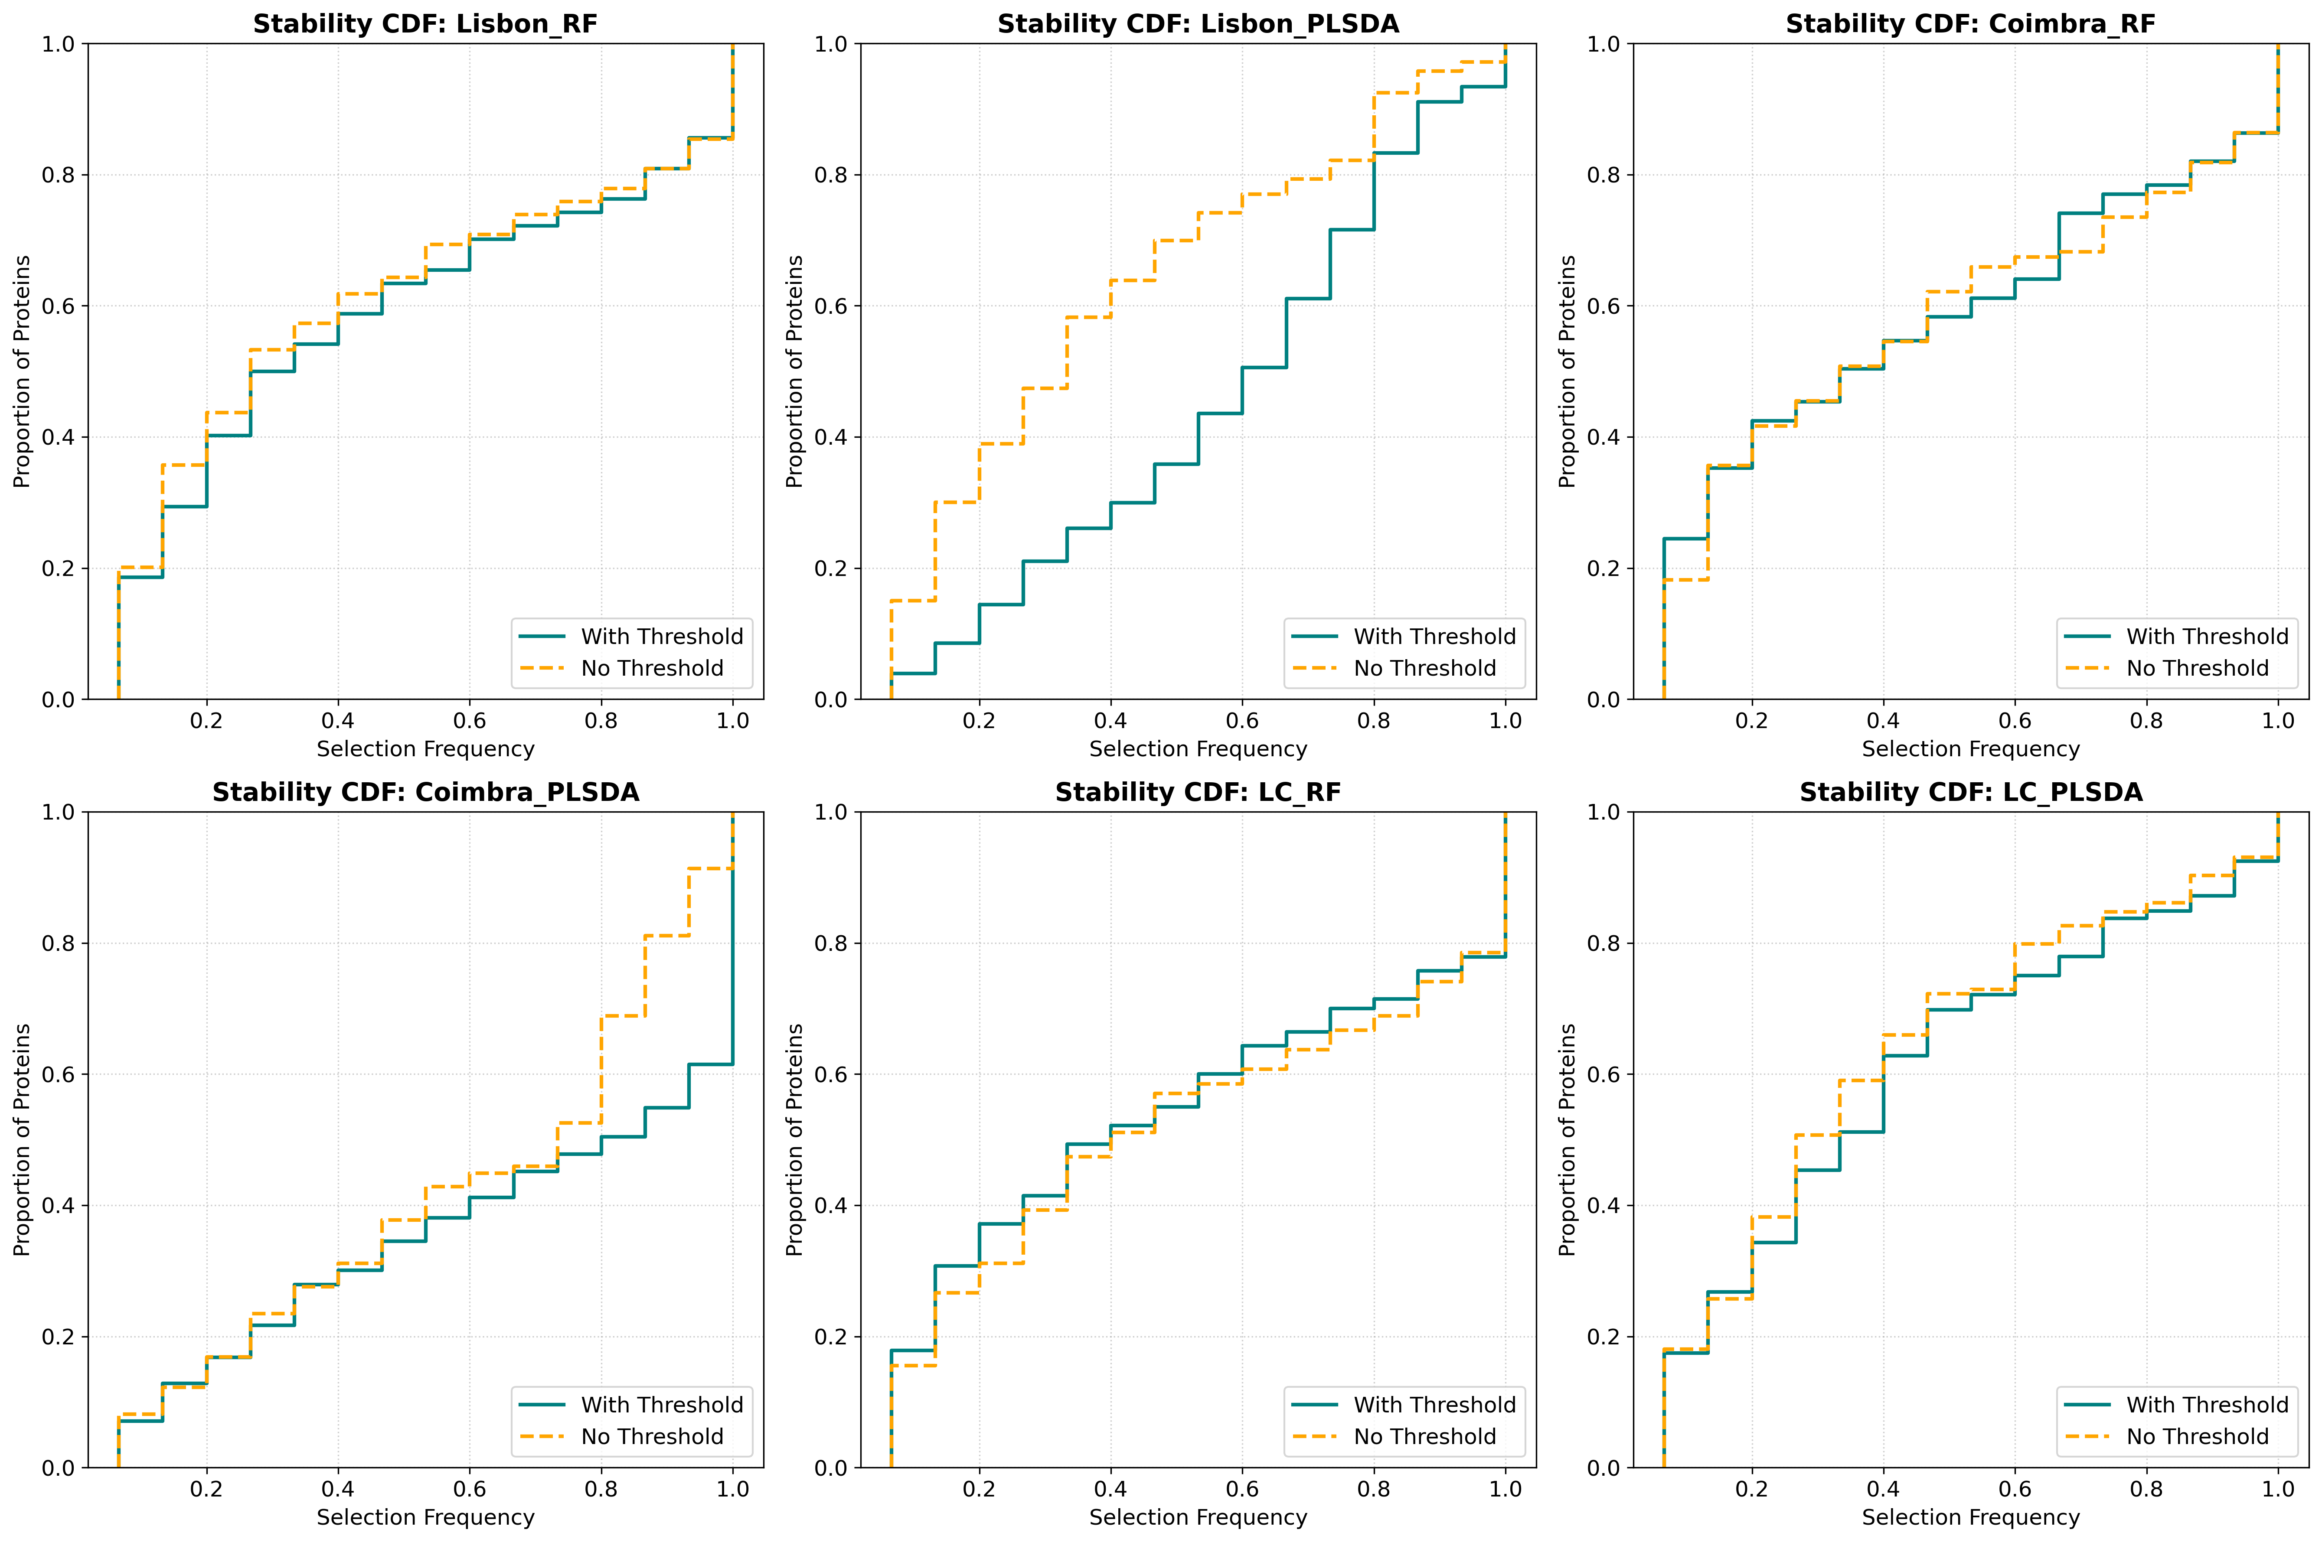
Impact of Thresholding in Data Preprocessing
Feature selection is generally consistent across approaches, but thresholding tends to increase stability by reducing the number of low-frequency proteins. Differences between models suggest that PLS-DA is more sensitive to preprocessing, while Random Forest appears more robust.

Slide 13

Choice of Patient-Level Thresholding
Based on previous analyses, the differences between threshold and no-threshold approaches are not substantial. However, applying a threshold at the patient level allows the selection of a larger number of proteins.
For this reason, the threshold-based dataset was chosen for subsequent analyses.

Slide 14
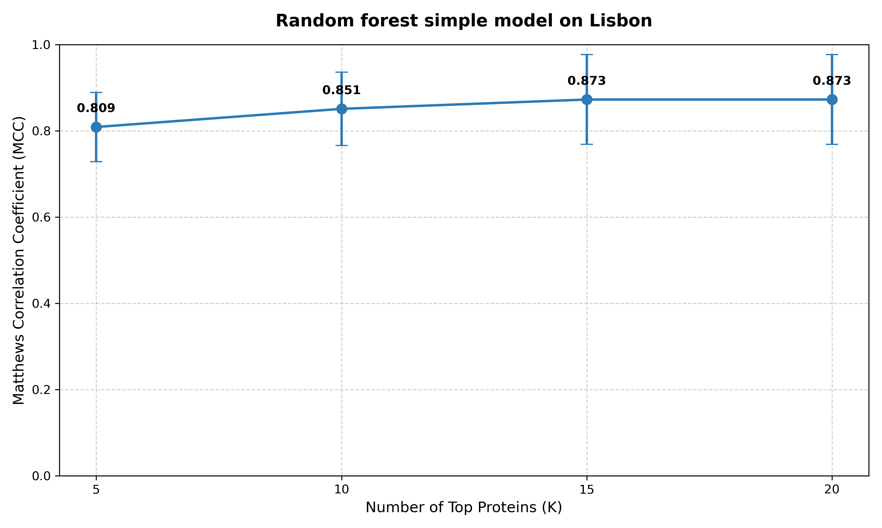
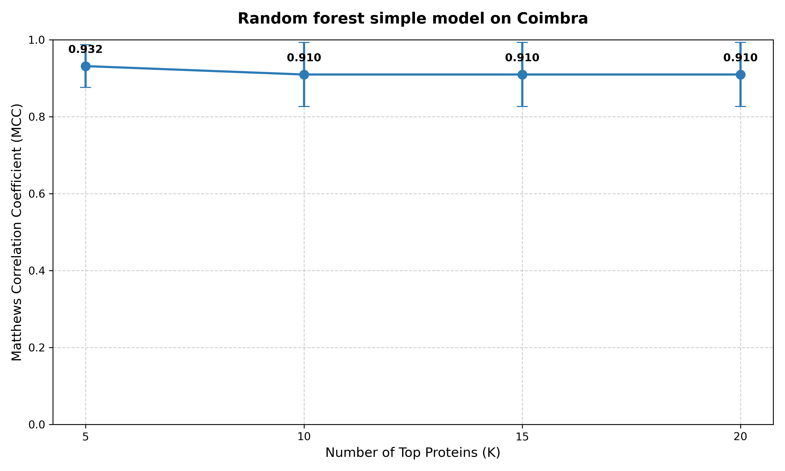
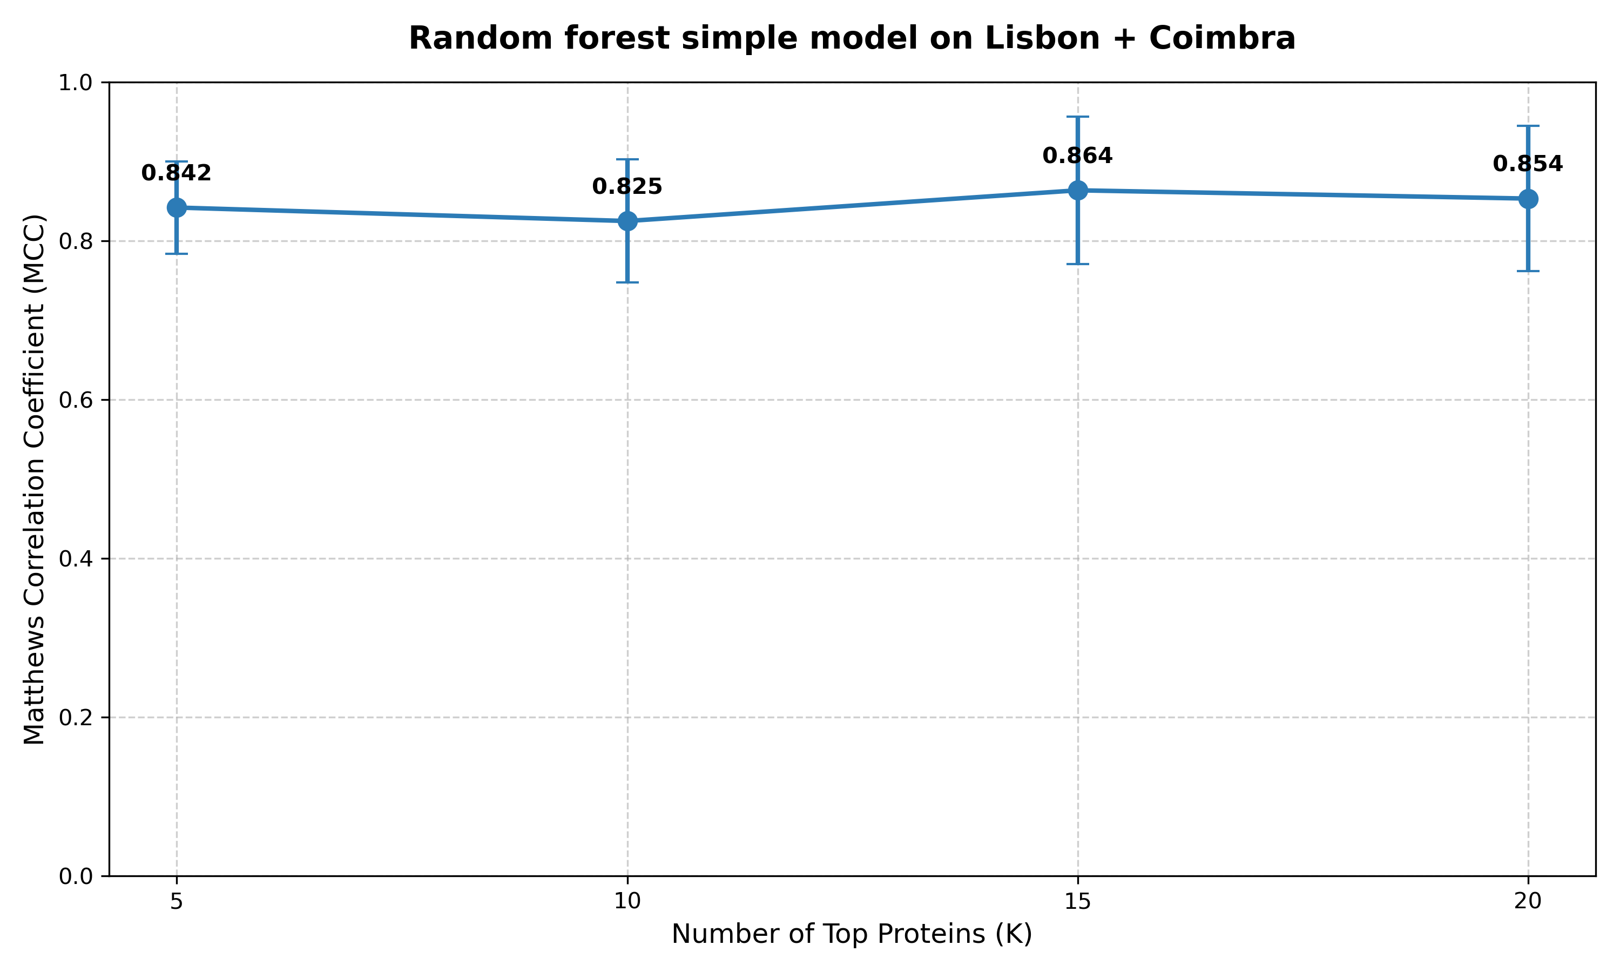
Performance of a Simple Random Forest Model

Slide 15
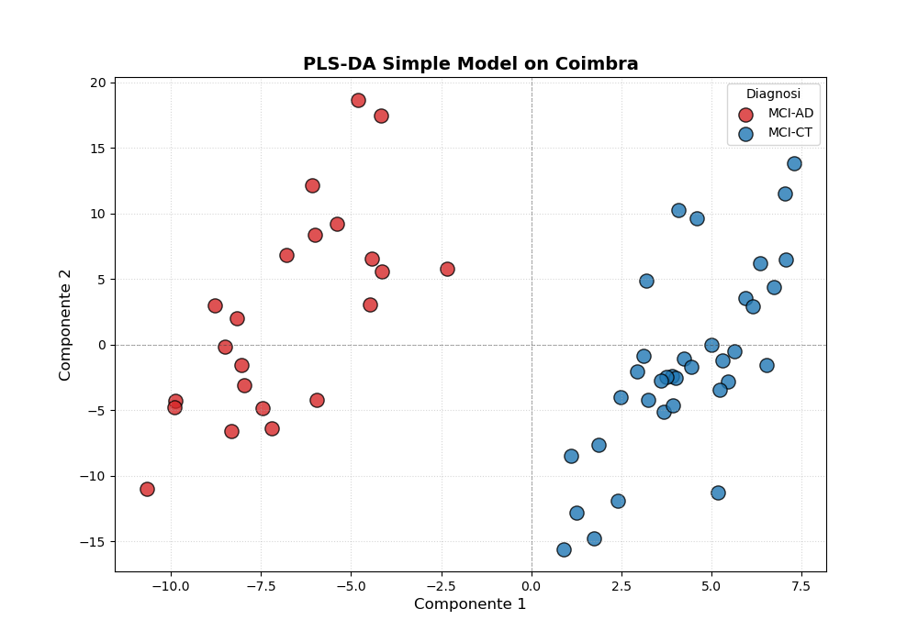
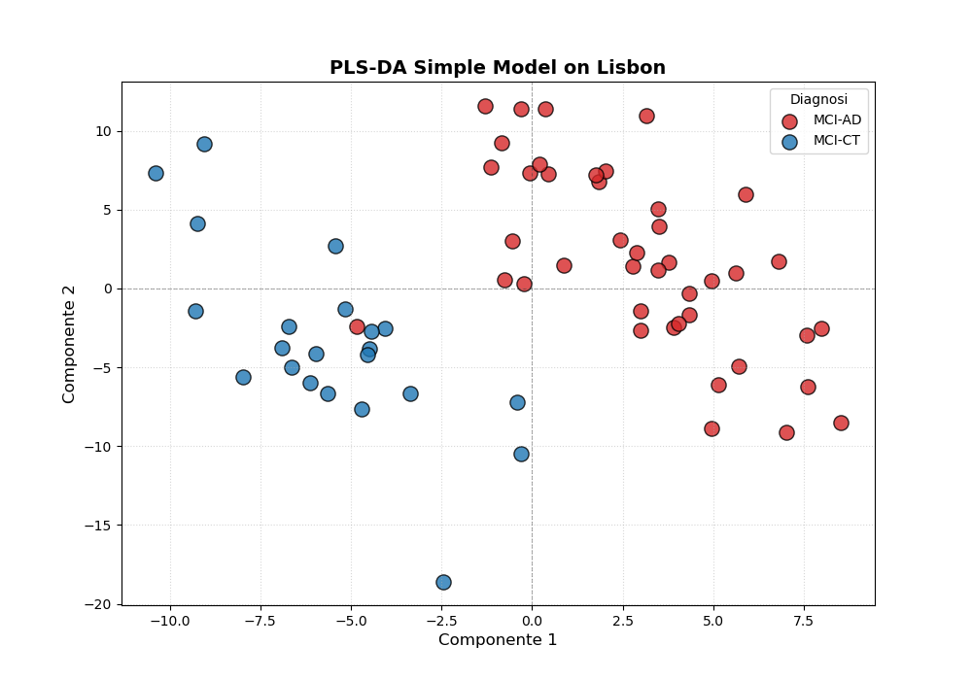
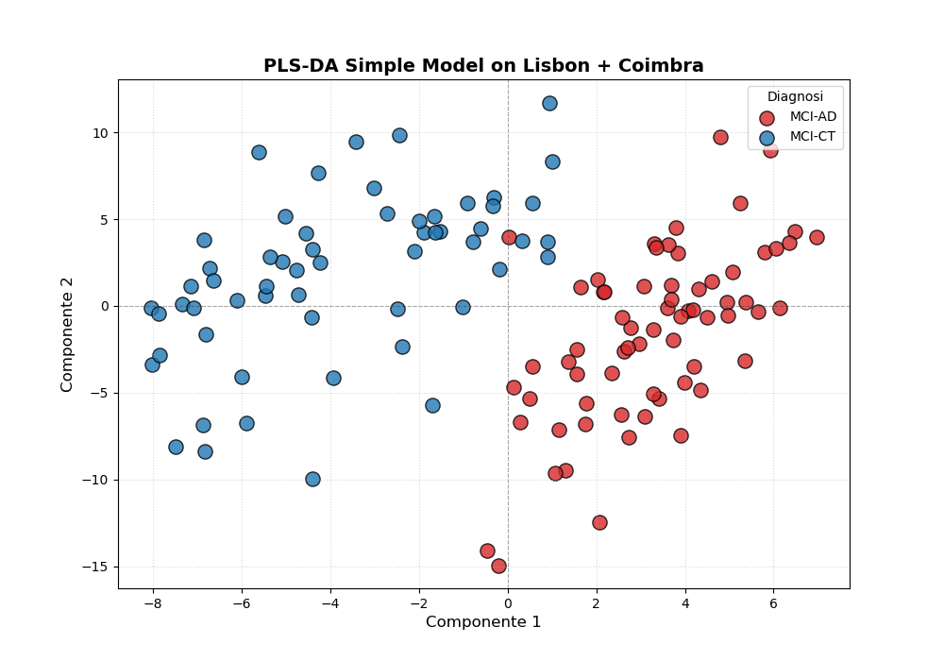
Performance of a Simple PLS-DA Model

Slide 16
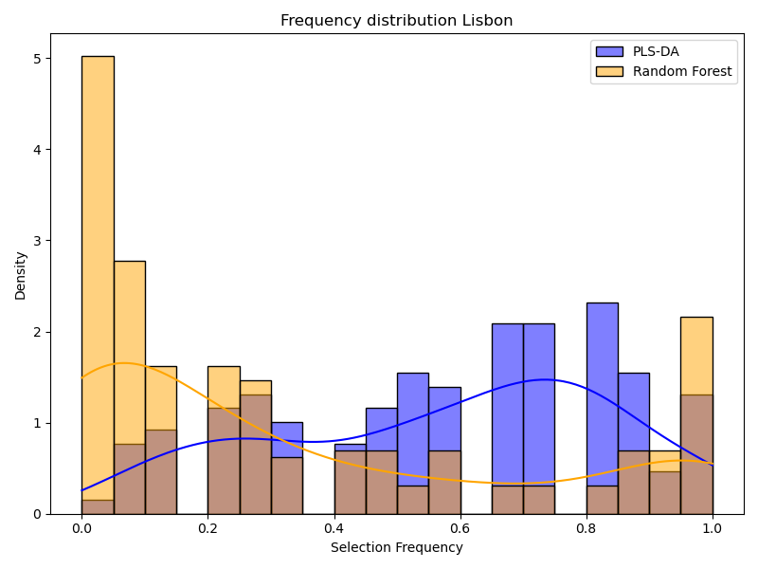
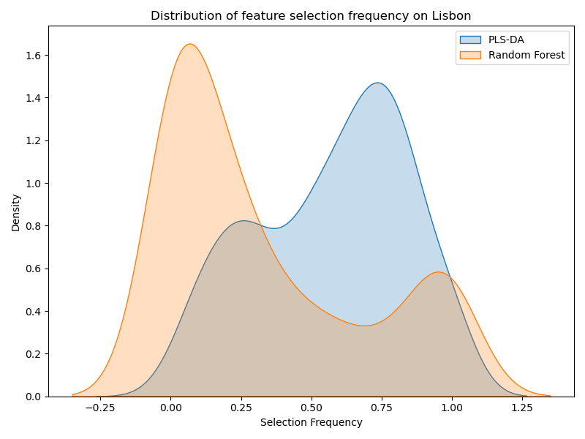
Comparison between PLS-DA and Random forest on Lisbon
The plots display the distribution of feature selection frequencies for PLS-DA and Random Forest. PLS-DA shows more consistent selection of a subset of proteins, while Random Forest distributes importance across a larger number of features.

Slide 17
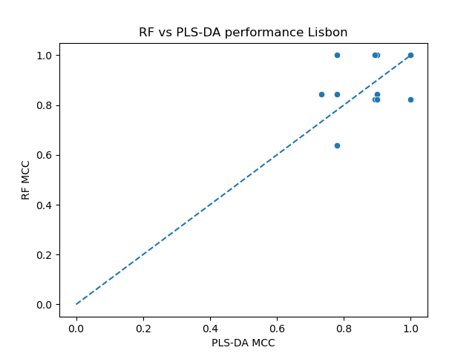
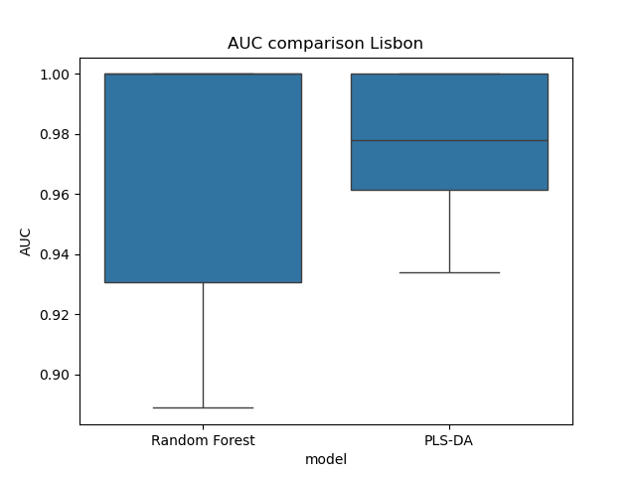
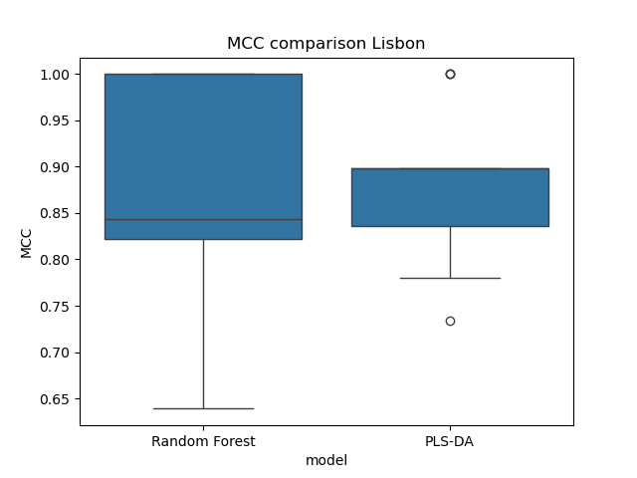
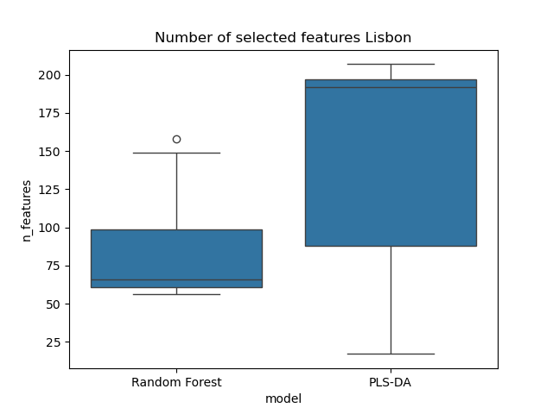
Comparison between PLS-DA and Random forest on Lisbon

Slide 18
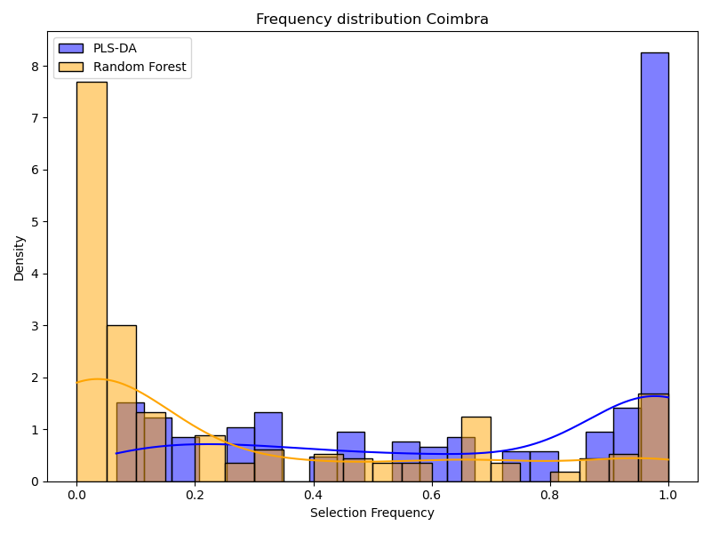
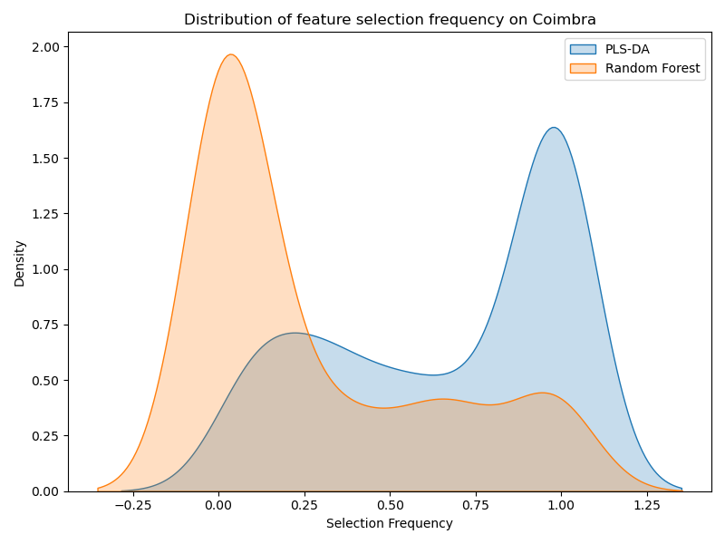
Comparison between PLS-DA and Random forest on Coimbra
PLS-DA identifies a large number of proteins with high selection frequency, suggesting that many features contribute to the classification. In contrast, Random Forest concentrates on a smaller subset of highly relevant proteins, while treating many others as less informative or noise.

Slide 19
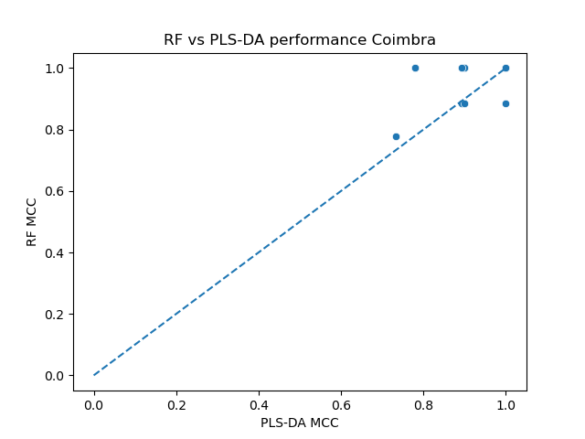
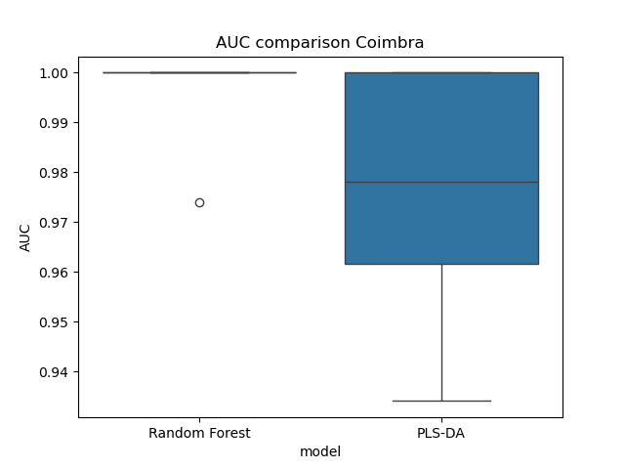
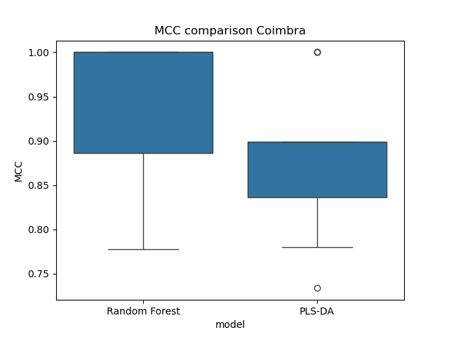
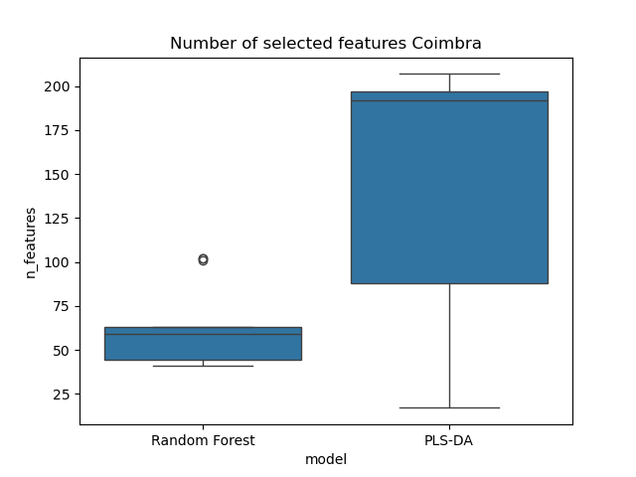
Comparison between PLS-DA and Random forest on Coimbra

Slide 20
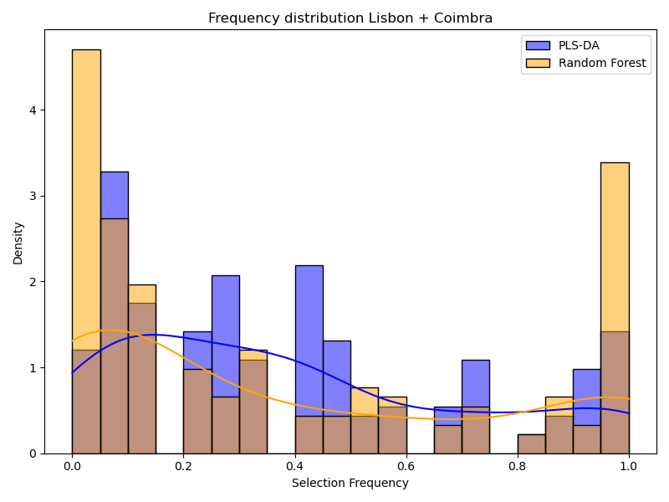
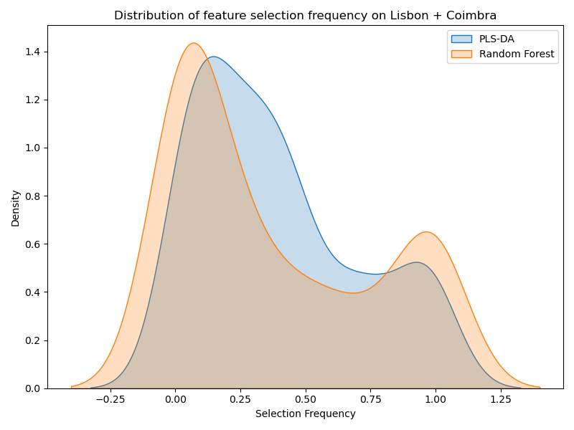
Comparison between PLS-DA and Random forest on Lisbon + Coimbra
PLS-DA shows a broader distribution with many proteins selected at moderate to high frequencies, suggesting that multiple features contribute to the classification. In contrast, Random Forest exhibits a more polarized behavior, focusing on a smaller subset of highly selected proteins while assigning low importance to many others.

Slide 21
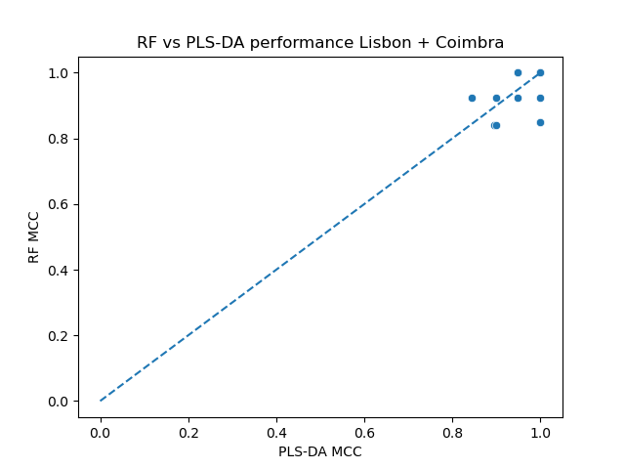
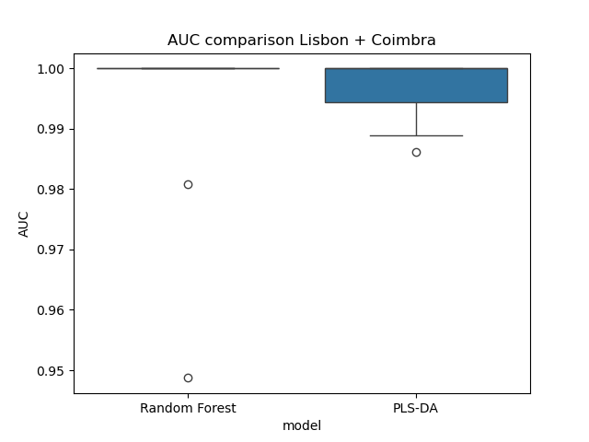
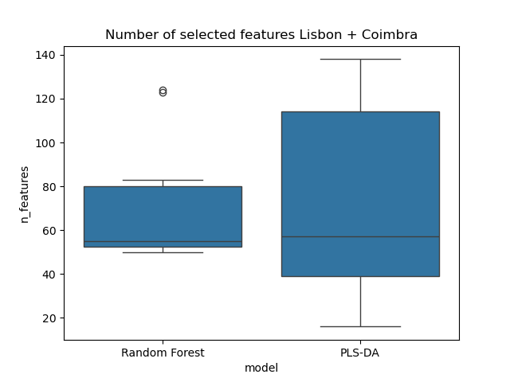
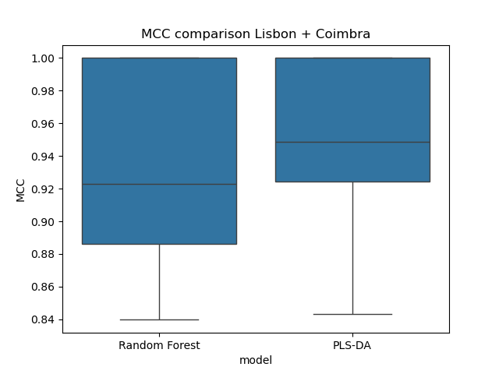
Comparison between PLS-DA and Random forest on Lisbon + Coimbra

Slide 22
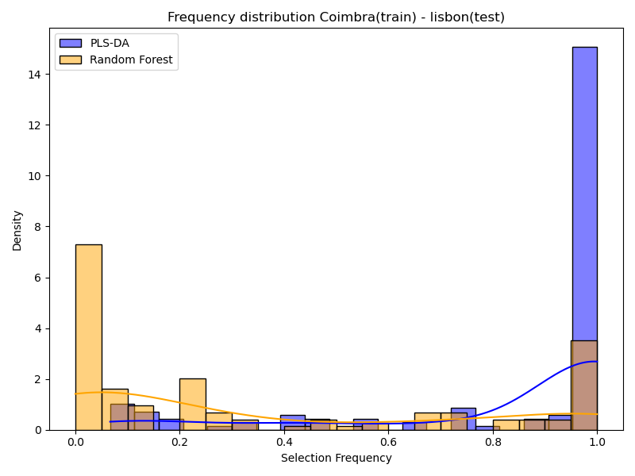
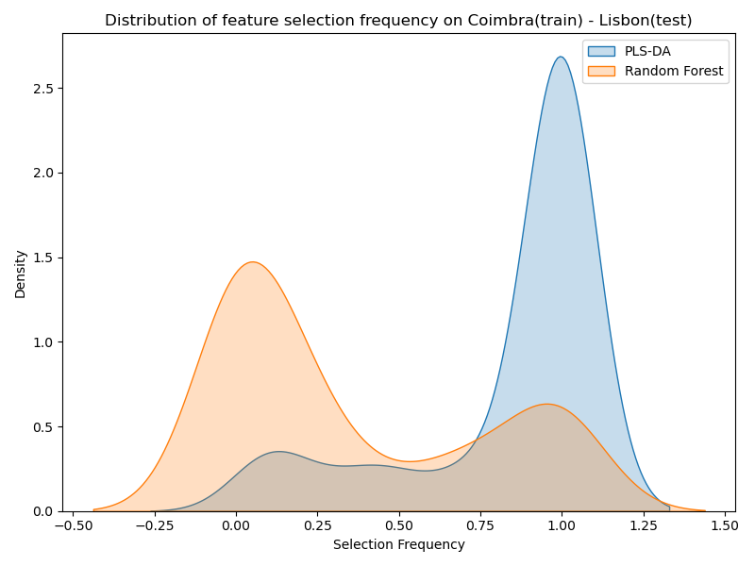
Comparison between PLS-DA and Random forest on Coimbra (train) / Lisbon (test)
PLS-DA selects a large number of proteins with high selection frequency, indicating that many features contribute consistently to the model. In contrast, Random Forest focuses on a smaller subset of highly selected proteins, while treating many other proteins as noise.

Slide 23
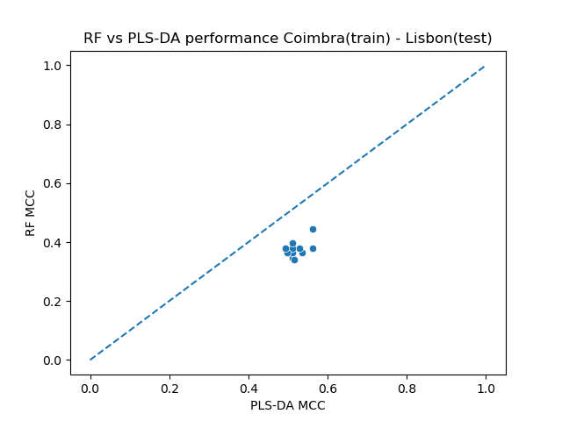
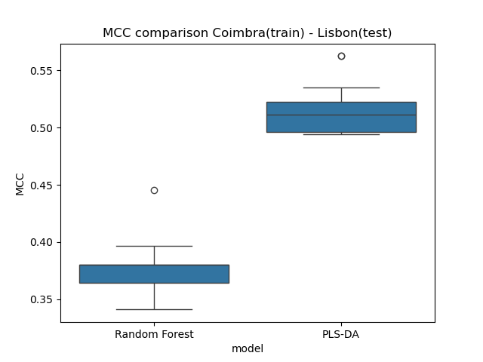
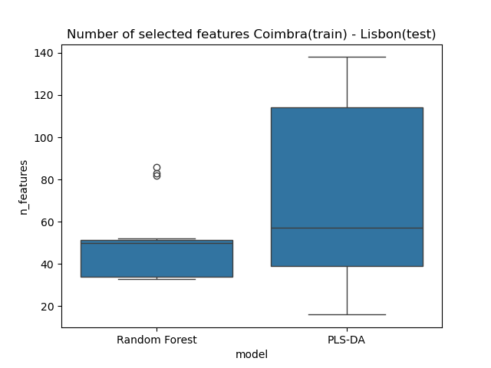
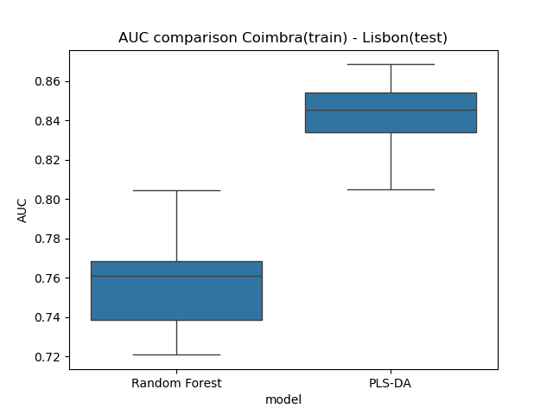
Comparison between PLS-DA and Random forest on Coimbra (train) / Lisbon (test)

Slide 24
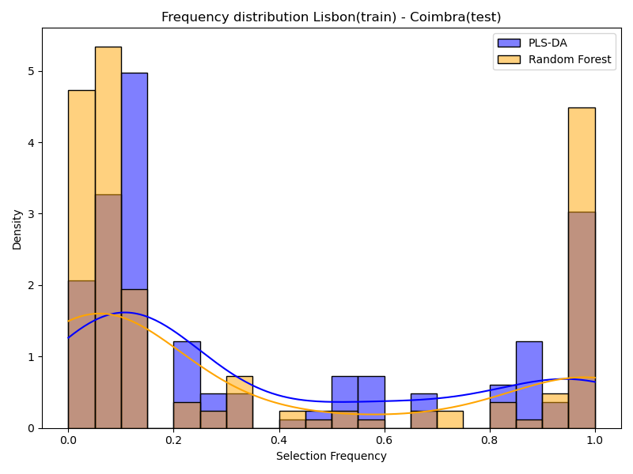
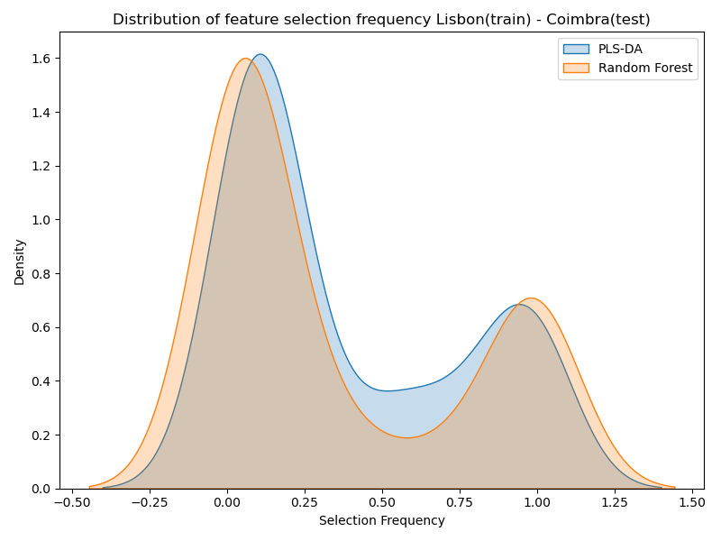
Comparison between PLS-DA and Random forest on Lisbon (train) / Coimbra (test)
In this case, both models assign high importance to a large number of proteins, indicating that multiple features contribute to the classification. However, Random Forest selects a higher number of proteins with very high selection frequency, while PLS-DA shows a greater proportion of proteins with intermediate selection frequency.

Slide 25
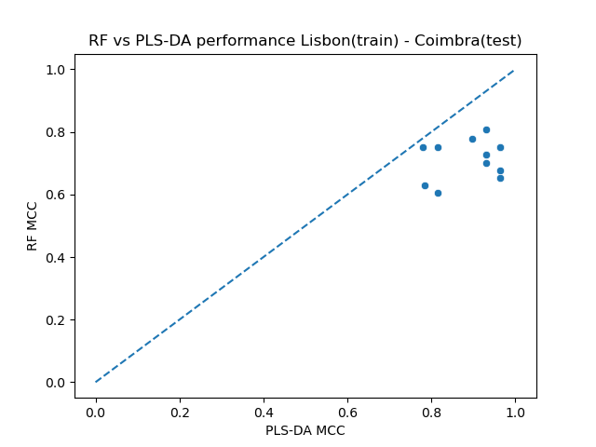
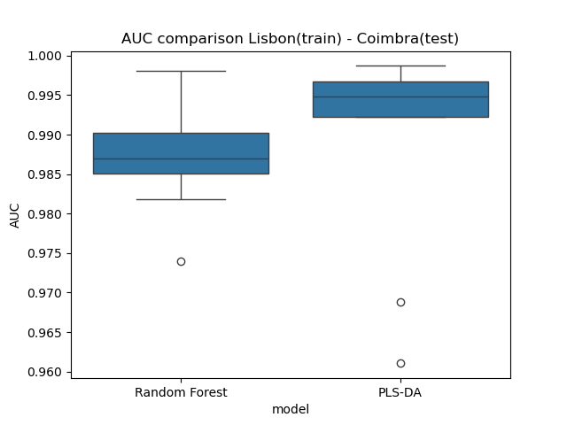
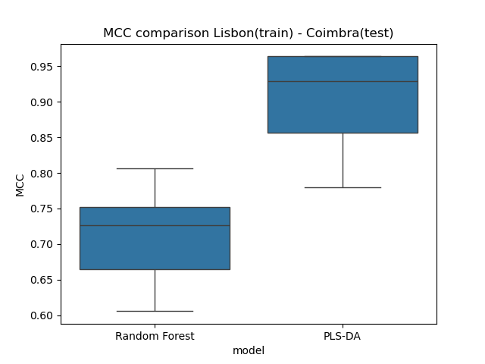
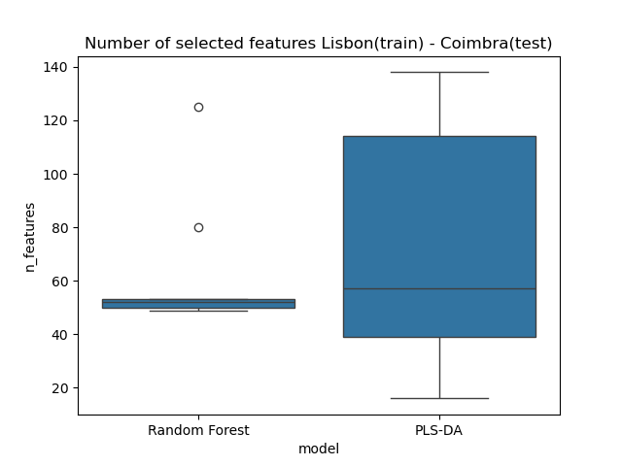
Comparison between PLS-DA and Random forest on Lisbon (train) / Coimbra (test)

Slide 26
Comparison Between PLS-DA and Random Forest
Both PLS-DA and Random Forest achieve strong performance, indicating that the classification task is well-defined. However, PLS-DA generally shows better generalization, performing more consistently when applied to different datasets.
Rather than prioritizing one model over the other, a combined approach may be more informative, identifying proteins that are consistently relevant across both methods.

Slide 27
Protein Selection Across Models
Proteins were categorized based on their selection frequency across PLS-DA and Random Forest models. For each protein, selection frequencies from both models were combined and used to define four categories:
Core : frequently selected by both models (≥ 0.5)
Model-specific : highly selected by one model (≥ 0.7) but not the other (< 0.3)
Noise : rarely selected by both models (< 0.3)
Intermediate : all remaining cases
 | LISBON | COIMBRA | LISBON+COIMBRA
CORE | 71 | 58 | 46
MODEL SPECIFIC | 23 | 48 | 3
INTERMEDIATE | 109 | 71 | 55
NOISE | 56 | 49 | 79
TOTAL | 259 | 226 | 183

Slide 28
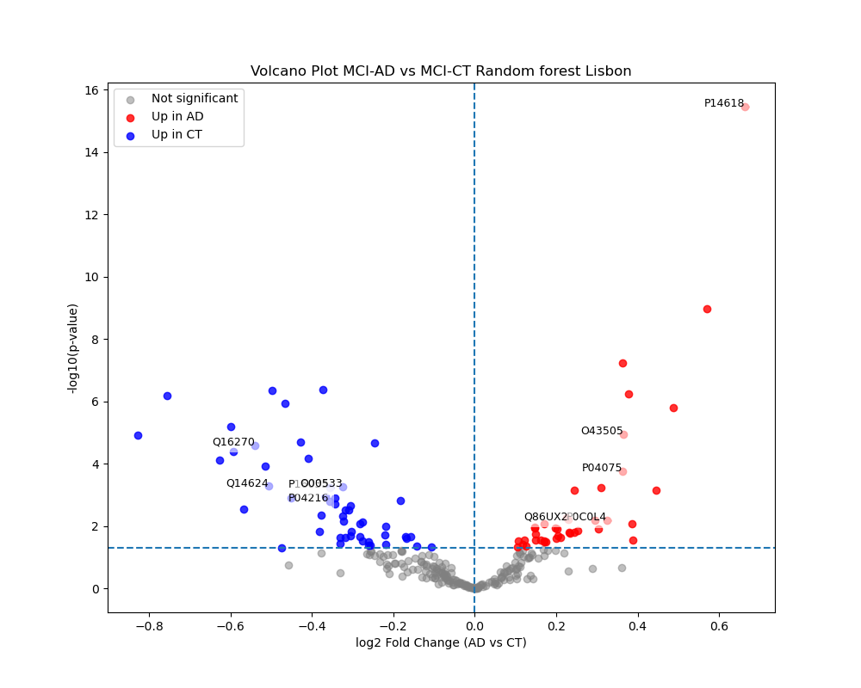
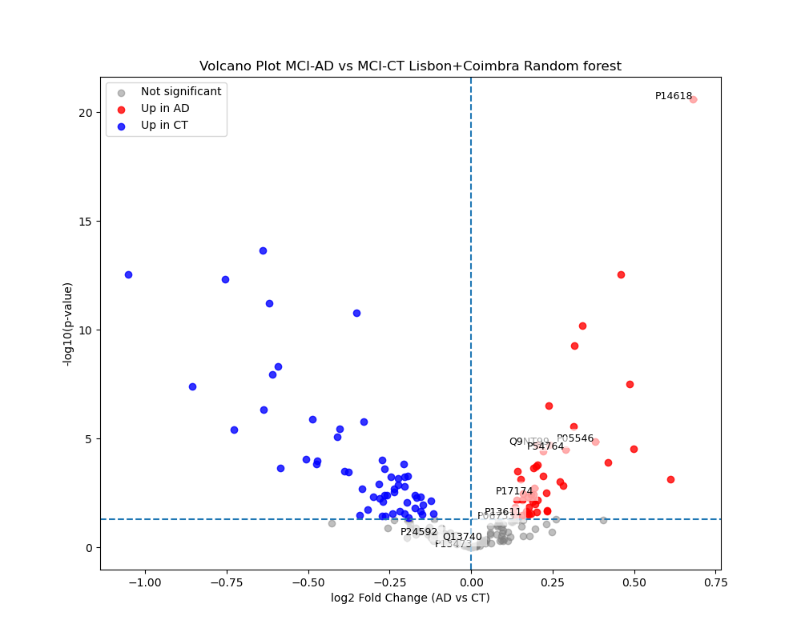
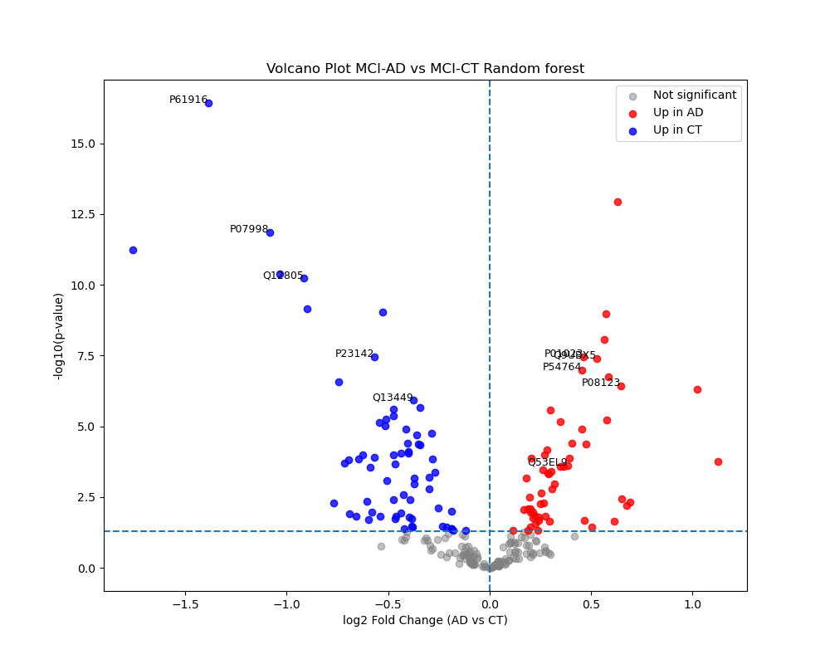
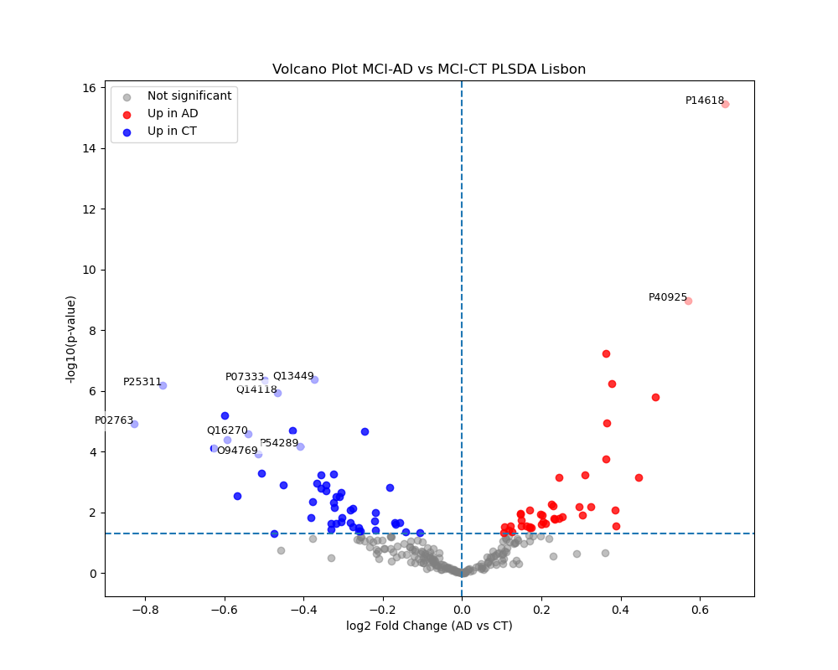
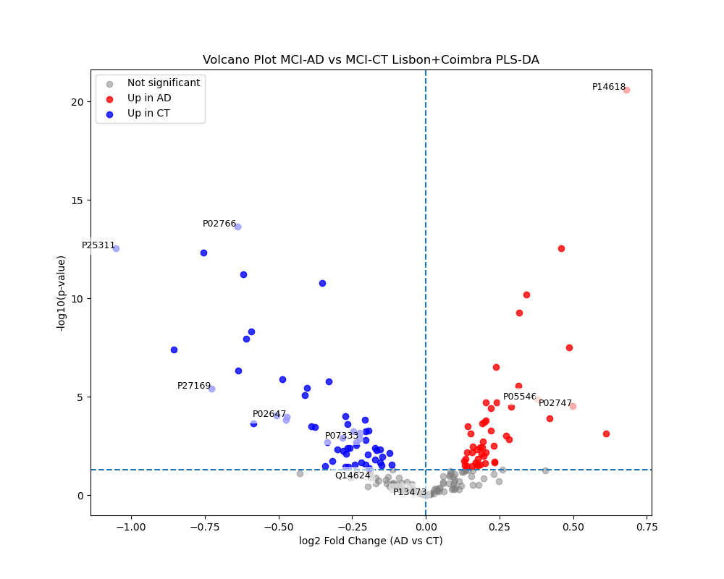
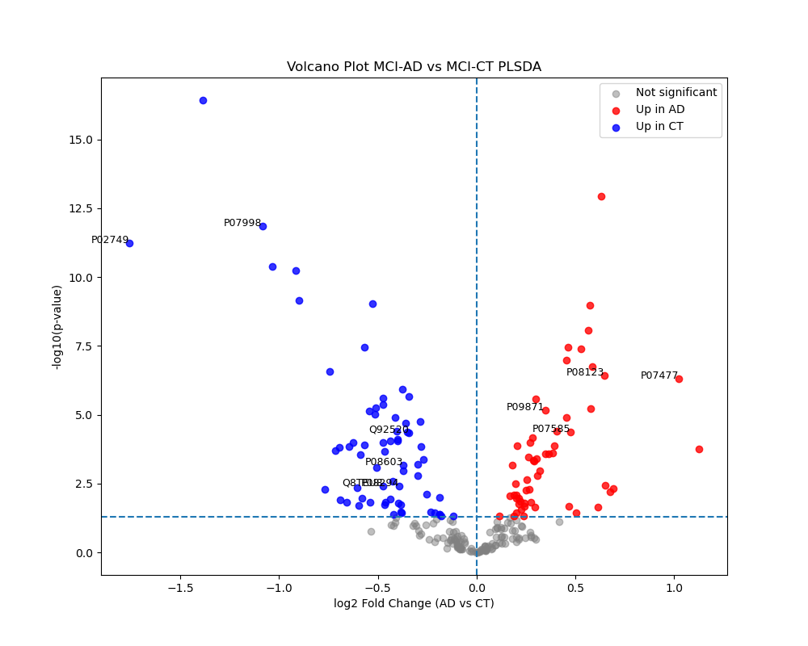
Do Machine Learning Selected Proteins Match Statistical Significance?

Slide 29

Some of the top-ranked proteins are labeled as cRAP proteins. Should these be considered reliable biological signals, or should they be removed as potential contaminants?”

Slide 30
OBRIGADO!

