Slide 1

Mini Threat Intelligence
Data Warehouse
Valerio Montagliani | Student ID 1759418
Notes:
1

Slide 2
The project
An end-to-end data warehousing workflow
Integrate threat intelligence feeds
for local SQL analysis
2 sources
3 types
1 data mart
URLhaus + ThreatFox
URL · domain · IP
Observation data
ACQUIRE → RECONCILE → MODEL → ANALYZE
Preserve source records · Apply common rules
Load a dimensional model · Run OLAP queries
Mini TI Data Warehouse
Valerio Montagliani
2 / 7
Notes:
2

Slide 3
Motivation and sources
Different formats and coverage; one analytical model
URLhaus
ThreatFox
CSV feed
Malicious URLs
Status, tags and context
JSON API + authentication
Multiple indicator types
Recent records: 1–7 days
Project scope: URLs, domains and IP addresses
Hash indicators are excluded during reconciliation
Reconcile once; analyze locally on the collected data
Mini TI Data Warehouse
Valerio Montagliani
3 / 7
Notes:
3

Slide 4
Architecture
Python ETL + PostgreSQL relational OLAP
Raw staging
01
Source-specific tables · Original records + ingest metadata
Append-only storage for traceability
Canonical layer
02
Common fields · Supported types · Conservative normalization
Deduplication: source + type + value + event day
Dimensional warehouse
03
Dimension tables + observation fact + tag bridge
Upserts and unique keys prevent duplicate fact rows
URLhaus / ThreatFox → raw → canonical → DW → SQL
Mini TI Data Warehouse
Valerio Montagliani
4 / 7
Notes:
4

Slide 5
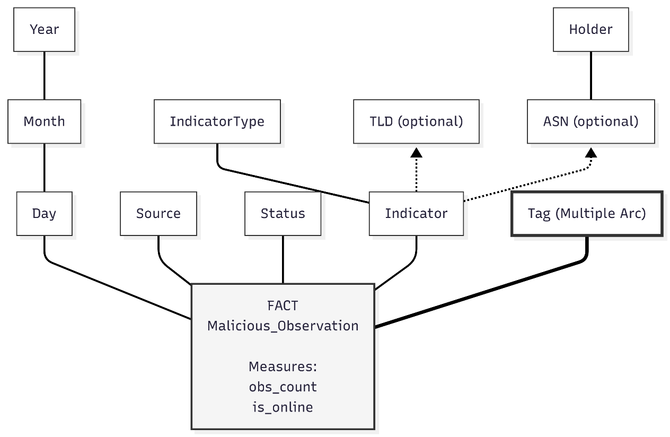
Conceptual model
DFM: grain, measures and dimensional relationships
Grain: indicator (type + value) × source × event day
Mini TI Data Warehouse
Valerio Montagliani
5 / 7
Notes:
5

Slide 6
Star schema
Implemented PostgreSQL tables and relationships
dim_time
dim_indicator_type
day · month · year
url · domain · ip
fact_observation
dim_source
Dimension keys
canonical_id (unique)
obs_count = 1
is_online (nullable)
URLhaus · ThreatFox
dim_indicator
value · type
domain · TLD
dim_status
online · offline
unknown
dim_tag
bridge_observation_tag
tag_name
observation_id + tag_id
Tags are many-to-many: avoid counting a fact again for each joined tag
Mini TI Data Warehouse
Valerio Montagliani
6 / 7
Notes:
6

Slide 7
OLAP queries
From analytical questions to SQL aggregations
MONTHLY TRENDS
How do volumes change over time?
Roll up day → month; SUM(obs_count) by source
SOURCE COMPOSITION
Which types does each source report?
Source + type; counts and within-source percentages
CROSS-SOURCE OVERLAP
Which indicators occur in both sources?
Exact (type, value) matches; top common indicators
TOP TLDs
Which TLDs are most frequent?
Rank the top 10 per source; exclude missing TLDs
Measure: collected feed observations
Mini TI Data Warehouse
Valerio Montagliani
7 / 7

