Slide 1
Industry Self-Classification in the Economic Census
Joint Statistical Meetings
Washington, DC
August 10, 2022
Brian Dumbacher and Daniel Whitehead
U.S. Census Bureau
Disclaimer: Any opinions and conclusions expressed herein are those of the authors and do not reflect the views of the U.S. Census Bureau. The Census Bureau has reviewed this data product for unauthorized disclosure of confidential information and has approved the disclosure avoidance practices applied (Approval ID: CBDRB-FY22-ESMD002-023).

Slide 2
North American Industry Classification System (NAICS)
Establishments are physical locations where business is conducted
U.S. Census Bureau classifies establishments by NAICS industry based on primary business or activity
NAICS is utilized throughout the survey life cycle
Sample selection
Data collection
Publication
Hierarchical 6-digit coding structure
First two digits represent the economic sector (52 – Finance and Insurance)
Additional non-zero digits add industry detail (522291 – Consumer Lending)

Slide 3
Economic Census (EC)
Conducted every five years for years ending in “2” or “7”
Represents approximately eight million establishments, covering most industries and all geographic areas of the U.S.
Key statistics
Total number of establishments
Total number of employees
Value of sales, shipments, receipts, and revenue
Total annual payroll
Data products are presented by NAICS and geography

Slide 4
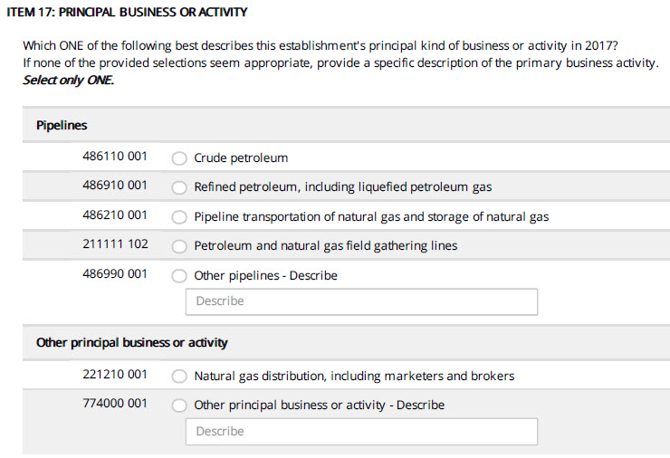
Principal Business or Activity Question from the 2017 EC
Question asks respondents to describe their business
There are prelisted descriptions corresponding to an estimated NAICS code, but the respondent can also provide a description
Clerical analysis of write-in text is resource-intensive
Source: 2017 Economic Census

Slide 5
BEACON Overview
Business Establishment Automated Classification of NAICS
General idea
The respondent inputs a business description
BEACON returns a ranked list of 6-digit NAICS codes with industry descriptions
Goals
Help respondents self-designate their NAICS code
Send respondents down correct EC questionnaire path
Reduce clerical work associated with write-ins
Methodology is based on machine learning, natural language processing, and information retrieval (e.g., internet search)

Slide 6
Training Data
Historical write-in responses to the EC
Frequent write-in text that was autocoded during 2017 EC
Business descriptions from Internal Revenue Service (IRS) SS-4 forms
Classification Analytical Processing System (CAPS) items
Harmonized System (HS) commodity descriptions
Variables
Business description text
Corresponding NAICS code

Slide 7
Source: 2002, 2007, 2012, 2017 Economic Census; Internal Revenue Service; and Classification Analytical Processing System

Slide 8
Text Cleaning
Convert to lowercase and account for numbers and punctuation
Remove common “stop” words
Stem words to reduce the number of word variations
Correct common misspellings
Input Text | Clean Text
This is a convenence store. | conveni store
automobile mfg | car manufactur
We rapair watches & jewelry. | repair watch jewelri

Slide 9
Dictionary
Underlying BEACON is a dictionary of text that occurs frequently in the cleaned training data
Words
Word combinations
Full-length/exact descriptions
Dictionary size is currently 455,380
These pieces of text are the model features
Dictionary stores features’ NAICS distributions and associated purity weights that measure how concentrated, or pure, the distribution is

Slide 10
purity weight = 0.2565
purity weight
= 0.3374
Source: 2002, 2007, 2012, 2017 Economic Census; Internal Revenue Service; and Classification Analytical Processing System

Slide 11
purity weight = 0.5603
purity weight
= 0.4969
Source: 2002, 2007, 2012, 2017 Economic Census; Internal Revenue Service; and Classification Analytical Processing System

Slide 12
Model Ensemble
Three information retrieval sub-models use different features
Example: description “Sporting goods” with clean text “sport good”
Sub-Model | Description | Features in Example
All | All words and word combinations | Word “sport” Word “good” Two-word combination {“sport”, “good”}
Umbrella | Words and word combinations that are not subsets of others | Two-word combination {“sport”, “good”}
Exact | Full-length/exact description | Full-length description exact{“sport”, “good”}

Slide 13
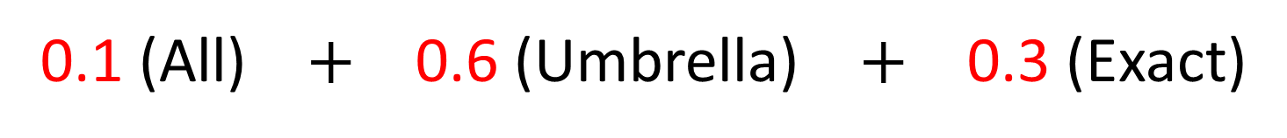
Model Ensemble (cont.)
BEACON assigns relevance scores to NAICS codes for ranking
For each sub-model, the NAICS distributions of the relevant features are averaged using purity weights to calculate relevance scores
The model ensemble calculates a weighted average of scores from the three sub-models, where the weights are optimized using machine learning
0.1 (All) $+$ 0.6 (Umbrella) $+$ 0.3 (Exact)

Slide 14
Hierarchical Model Structure
Assigning relevance scores directly at the 6-digit level is challenging
Model ensemble is applied 21 times
1x to assign scores at the 2-digit level
20x to assign sector-conditional scores at the 6-digit level
Scores are calculated using the conditional probability formula
score(52) $×$ score(522291|52) $=$ score(522291)

Slide 15
Economic Census Field Test
October 2021 – February 2022
Test usability of new EC questionnaire features with respondents
Sample consisted of 37,000 single-unit establishments
By design, a third of the sample had a reliable NAICS code on record
“Truth deck”
Used to evaluate accuracy of BEACON
Received approximately 20,000 descriptions

Slide 16
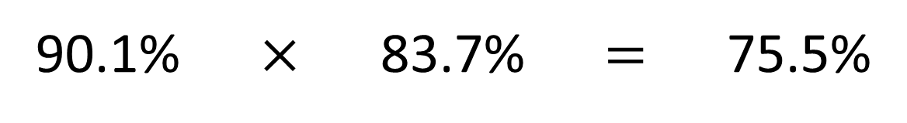
Economic Census Field Test (cont.)
For a successful NAICS self-classification, two actions need to occur
BEACON needs to return the correct NAICS code as one of its search results
The respondent then needs to select the correct NAICS code
Probability estimates based on truth deck
90.1% $×$ 83.7% $=$ 75.5%
BEACON returns
correct NAICS code
Respondent selects
correct NAICS code given
that it is a search result
Successful NAICS
self-classification

Slide 17
Future Work
Refine text cleaning algorithm
Incorporate new data sources such as write-ins from the 2022 EC
Research more advanced models
Word embeddings
Model stacking – applying a second-stage, or meta, model that uses the sub-models’ scores as input

Slide 18
Contact Information
Brian.Dumbacher@census.gov
Daniel.Whitehead@census.gov

