Slide 1
Ensemble Modeling Techniques for NAICS Classification in the Economic Census
Federal Committee on Statistical Methodology
Machine Learning Applications
October 24, 2023
Daniel Whitehead
Brian Dumbacher
Economic Statistical Methods Division
U.S. Census Bureau

Slide 2
Disclaimer
Any opinions and conclusions expressed herein are those of the authors and do not reflect the views of the U.S. Census Bureau. The Census Bureau has reviewed this data product to ensure appropriate access, use, and disclosure avoidance protection of the confidential source data used to produce this product [Data Management System (DMS) number: P-7504847, subproject P-7514952; Disclosure Review Board (DRB) approval number: CBDRB-FY23-ESMD002-034].

Slide 3
Outline
Background: Slides 4 - 10
BEACON Methodology: Slides 11 - 13
Model Stacking: Slides 14 - 18
Results: Slides 19 - 25
Conclusions/Contacts: Slides 26 - 27

Slide 4
Background: North American Industry Classification System (NAICS)
U.S. Census Bureau classifies business establishments by NAICS code based on primary business activity
NAICS is utilized throughout the survey life cycle
Sample selection
Data collection
Analytical review
Publication
Hierarchical 6-digit coding structure
First two digits of NAICS code represent economic sector (22 – Utilities)
Additional non-zero digits add industry detail (221210 – Natural Gas Distribution)

Slide 5
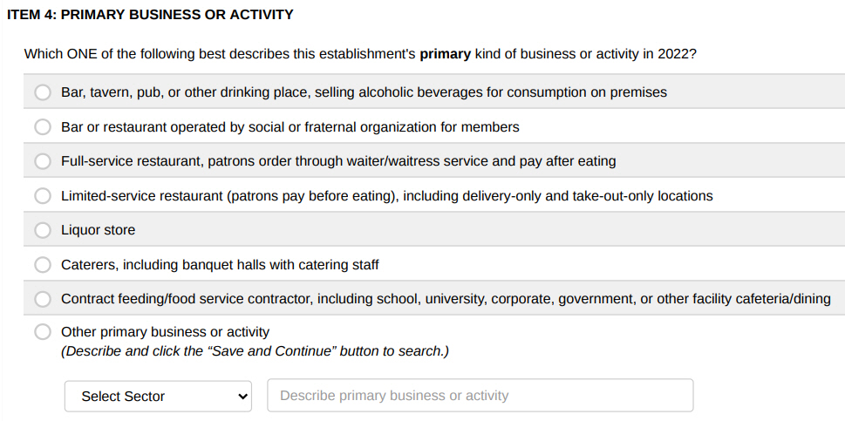
Background: Primary Business or Activity Question from the Economic Census
Question asks respondents to describe their business
There are prelisted descriptions, but the respondent also has the option of writing in a business description
Manual coding of write-in text is resource-intensive
Source: 2022 Economic Census

Slide 6
Background: What is BEACON?
Business Establishment Automated Classification of NAICS
A machine learning tool developed by the Economic Statistical Methods Division (U.S. Census Bureau) to classify NAICS for establishments based on a write-in business description
Respondent provides write-in description
Text is outputted to BEACON API
API returns most relevant NAICS codes to respondent
Notes:
Methodology is influenced by machine learning, text analysis, and information retrieval (e.g., internet search)

Slide 7
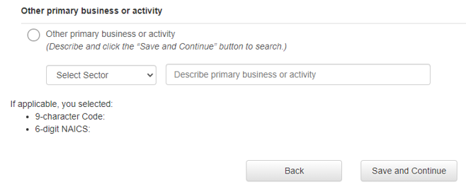
Background: Goals of BEACON
Assist respondents in self-designating their NAICS codes
Improve accuracy of self-designated NAICS codes
Reduce manual coding of write-ins

Slide 8
Background: Training Data
Historic write-in responses to the Economic Census (EC)
Frequent write-in text that was autocoded during 2017 EC
Business descriptions from IRS SS-4 forms*
Classification Analytical Processing System (CAPS) items
Harmonized System commodity descriptions
Variables
Business description text
Corresponding NAICS code
Business Description Text | NAICS
This is a car dealership. | 441110
R&D lab – medical/health | 541715
we mainly repair furniture, some sales | 811420
*IRS data used for internal statistical purposes only, in accordance with Title 26.

Slide 9
Background: Training Data
Data Source | Number of Observations | Advantages | Disadvantages
EC | ~ 1,611,000 (single-unit) | Represents target population Reflects natural language | Descriptions not perfectly classified Descriptions contain misspellings
EC Autocoded | ~ 98,000 * | Improves consistency with autocoding during 2017 EC | Relatively small data source
IRS SS-4 | ~ 865,000 (single-unit) | Provides timely data Reflects natural language | Descriptions not perfectly classified Descriptions contain misspellings
CAPS | ~ 1,508,000 * | Provides a rich vocabulary Descriptions are classified correctly | Does not always reflect natural language
Harmonized System | ~21,000 | Provides examples of industry-specific abbreviations/terminology | Relatively small data source Does not always reflect natural language
*Includes duplicates and variations of original observations.

Slide 10
Data Sources: Economic Census (2002–2022), 2021 Industry Classification Report, Internal Revenue Service SS-4 (2002–2016), Classification Analytical Processing System, Harmonized System
Notes:
Add latest graph

Slide 11
Methodology: Text Cleaning
Removal of extraneous words/symbols
Remove extra white space and common “stop” words (“the”, “and”, “or”, etc.)
Account for numbers and punctuation
Correct common misspellings
Map stems of misspelled words to stems of correctly spelled words
For example, “manifactur” → “manufactur”
Stem
Apply prefix/suffix stripping rules to reduce number of word variations
For example, “manufacturing” → “manufactur”, “cars” → “car”
Lemmatize
Map synonyms and abbreviations to a common concept
For example, “mfg” → “manufactur”, “auto” → “car”

Slide 12
Methodology: Dictionary
Words and word combinations that BEACON recognizes
All model features are based on the data dictionary
Associations between words and NAICS codes in the training data influence predictions
“tutor” is highly associated with NAICS 611691 – Exam Preparation and Tutoring
“store” occurs in many NAICS codes and is therefore less predictive

Slide 13
Methodology: Model Ensemble
Model ensemble
Information retrieval models look at how words, combinations, and entire descriptions are distributed across NAICS codes
Individual predictions are averaged, yielding relevance scores
Relevance scores
Range in value between 0 and 100
Reflect how confident BEACON is that the NAICS code is correct

Slide 14
Model Stacking: Overview
Separate prediction problem into two parts
Create multiple models to generate initial predictions
Use these predictions as inputs to meta-model
Proposal:
Generate predictions from component models within BEACON
Refine initial predictions with predictions from meta-models
Sources:
Todorovski, L. and Džeroski, S. (2003). Combining Classifiers with Meta Decision Trees. Machine Learning, 50, 223–249. Netherlands: Kluwer Academic Publishers.
Merz, C. (1999). Using Correspondence Analysis to Combine Classifiers. Machine Learning, 36, 33–58.
Notes:
Predictions used as inputs to potential meta-models

Slide 15
Model Stacking: Within BEACON
Standard
Considers all words and combinations of words (up to 2)
Ex. “car repair”
Umbrella
Excludes words/combs that are subsets of other combs
Exact
Only considers complete write-in description
Ex. “car repair”
Includes: “car repair” (all qualifying write-ins)
Includes: “car”, “repair”, “car repair” (all qualifying write-ins)
Excludes: “car”, “repair”
Includes: “car repair” (includes only write-ins consisting only of terms “car” and “repair”)
Excludes: “car”, “repair”
Ex. “car repair”
Notes:
Examples of descriptions excluded by the Exact method but included by the All and Umbrella method are “car repair and paint” or “car exhaust repair”.

Slide 16
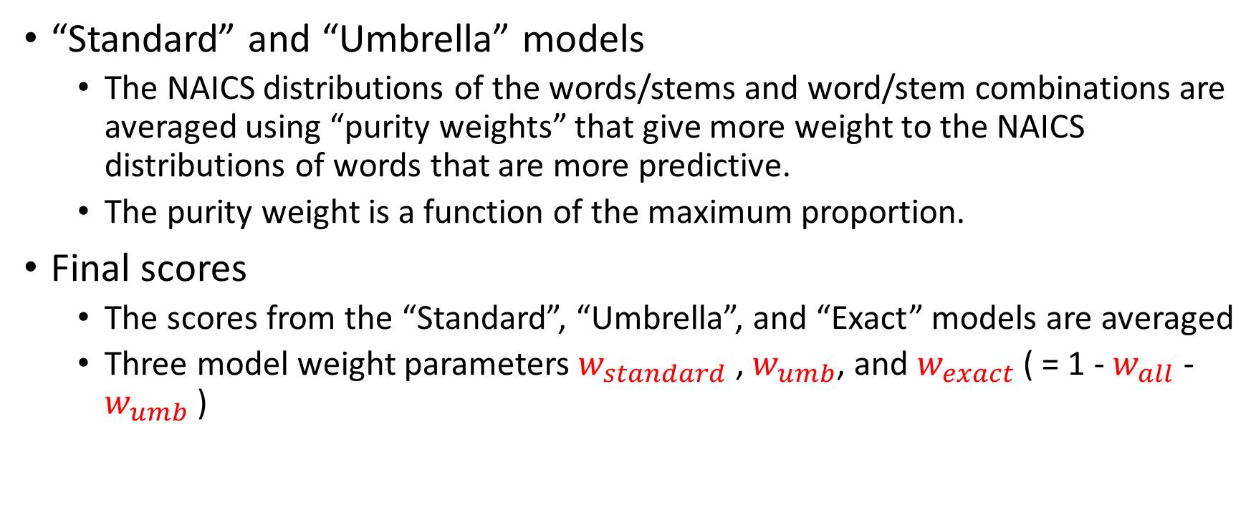
Model Stacking: Within BEACON
“Standard” and “Umbrella” models
The NAICS distributions of the words/stems and word/stem combinations are averaged using “purity weights” that give more weight to the NAICS distributions of words that are more predictive.
The purity weight is a function of the maximum proportion.
Final scores
The scores from the “Standard”, “Umbrella”, and “Exact” models are averaged
Three model weight parameters $w_{standard}$ , $w_{umb}$, and $w_{exact}$ ( = 1 - $w_{all}$ - $w_{umb}$ )
Notes:
Purity weight for “exact” model is 1 as only single such term for each write-in.

Slide 17
Model Stacking: Proposal
Generate predictions from component models within BEACON
“Standard”
“Umbrella”
“Exact”
Refine initial predictions with predictions from meta-models
Logistic Regression
Decision Tree
Random Forest

Slide 18
Model Stacking: Evaluation Metrics
Top-k
Measures success rate where success is % of times that true NAICS code is found in top-k predictions within sector
Evaluated for k = 1, 2, 3, 4, 5
F₁ score
Harmonic mean of precision and recall

Slide 19
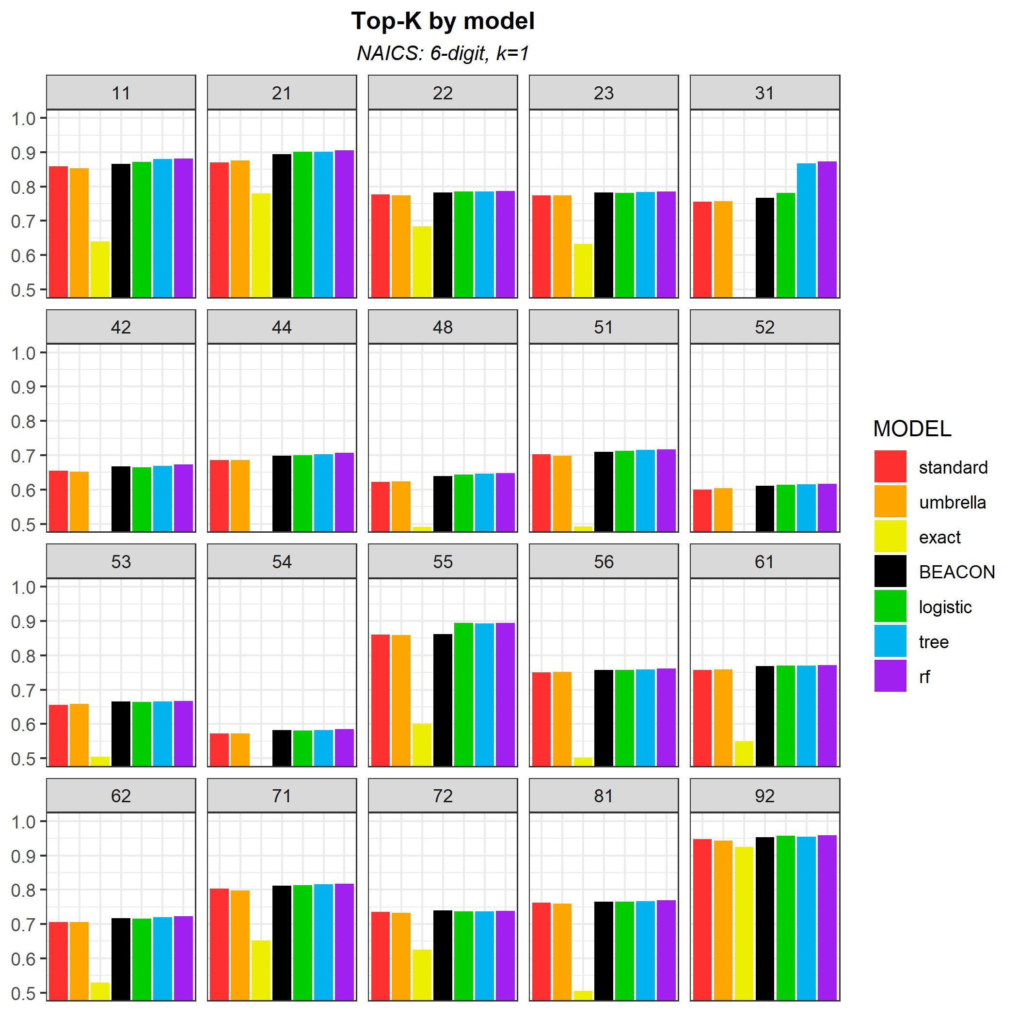
Results
Exact model is least accurate of individual component models.
BEACON model tends to produce more accurate predictions than any of its component models.
Data Sources: Economic Census (2002–2022), 2021 Industry Classification Report, Internal Revenue Service SS-4 (2002–2016), Classification Analytical Processing System, Harmonized System

Slide 20
Results
Meta-models offer similar potential for incremental improvement.
Random forest and decision trees methods appear most promising.
Potential improvement in manufacturing sector (31) is encouraging.
Data Sources: Economic Census (2002–2022), 2021 Industry Classification Report, Internal Revenue Service SS-4 (2002–2016), Classification Analytical Processing System, Harmonized System

Slide 21
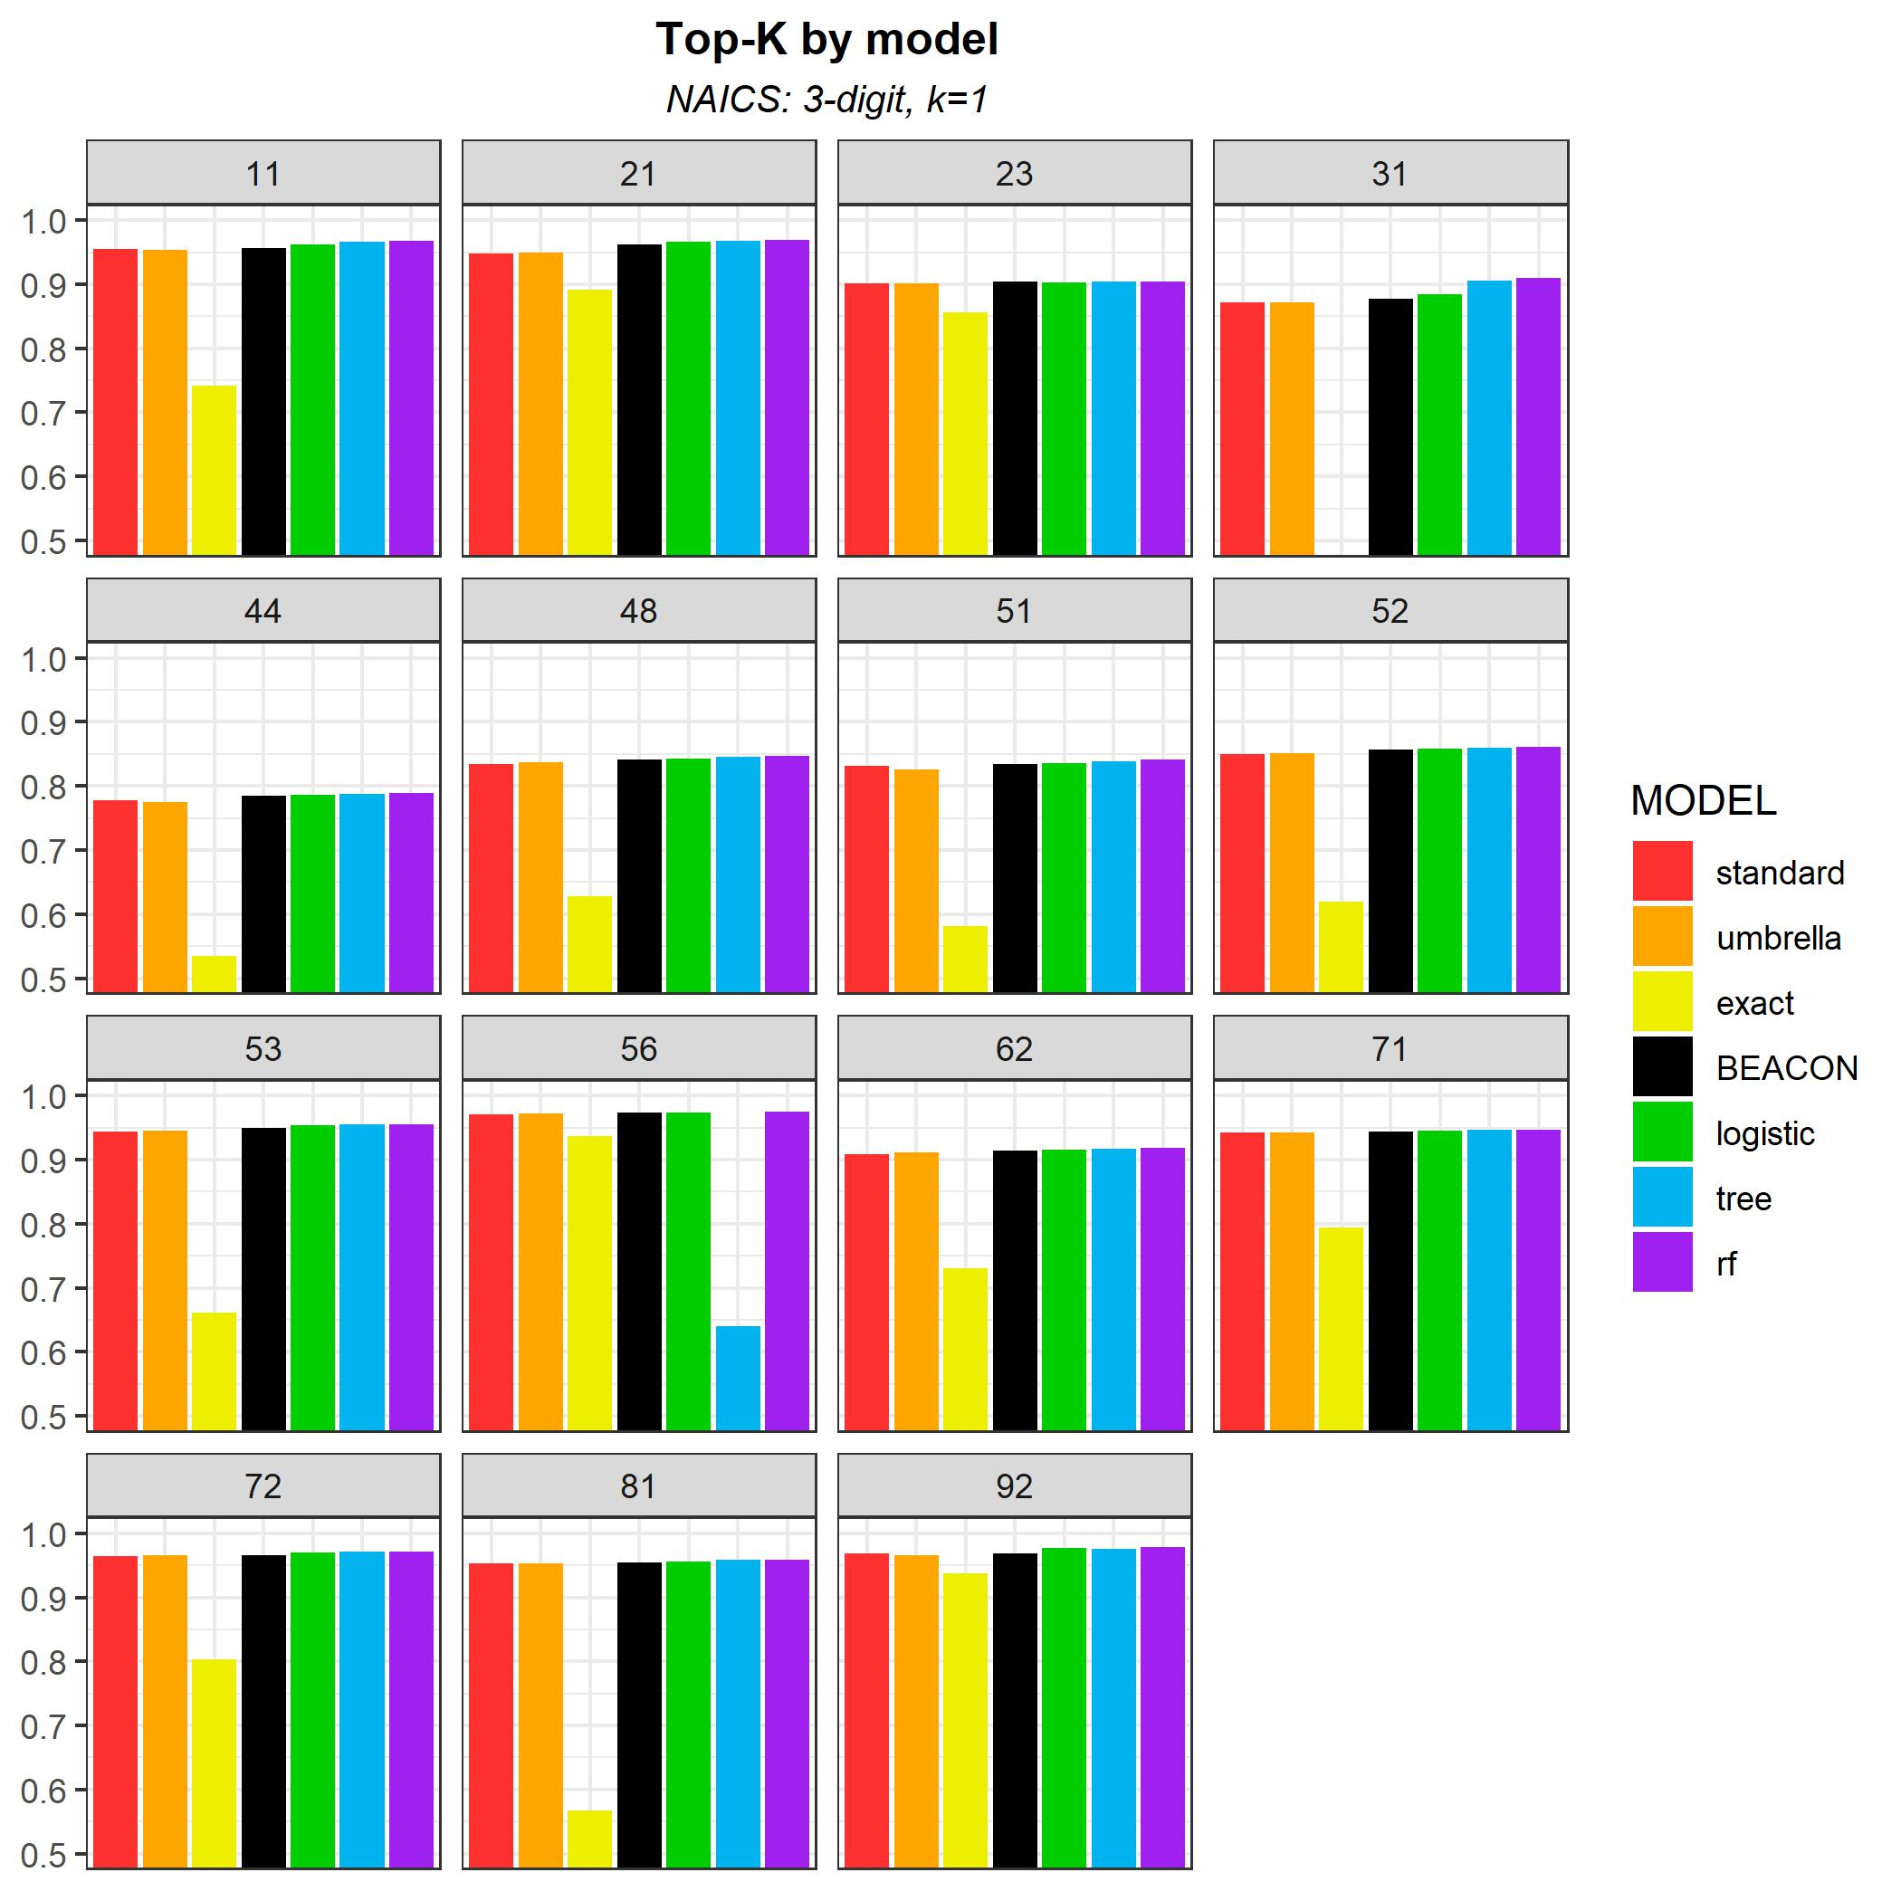
Results
Similar results were found at other NAICS levels.
Data Sources: Economic Census (2002–2022), 2021 Industry Classification Report, Internal Revenue Service SS-4 (2002–2016), Classification Analytical Processing System, Harmonized System

Slide 22
Results
Median BEACON F₁ score:
3-digit NAICS codes
Meta-models improved performance in sectors where BEACON was already doing well.
F₁ score of BEACON in NAICS codes where meta-model outperformed BEACON is higher than that of NAICS codes where BEACON outperformed meta-model.
 | RF | Tree | LR
NAICS codes where F₁ score of meta-model > F₁ score of BEACON | 0.93 | 0.93 | 0.95
NAICS codes where F₁ score of BEACON > F₁ score of meta-model | 0.85 | 0.85 | 0.89
Data Sources: Economic Census (2002–2022), 2021 Industry Classification Report, Internal Revenue Service SS-4 (2002–2016), Classification Analytical Processing System, Harmonized System

Slide 23
Results
Median BEACON F₁ score:
6-digit NAICS codes
Meta-models improved performance in sectors where BEACON was already doing well.
F₁ score of BEACON in NAICS codes where meta-model outperformed BEACON is higher than that of NAICS codes where BEACON outperformed meta-model.
 | RF | Tree | LR
NAICS codes where F₁ score of meta-model > F₁ score of BEACON | 0.89 | 0.89 | 0.89
NAICS codes where F₁ score of BEACON > F₁ score of meta-model | 0.85 | 0.86 | 0.85
Data Sources: Economic Census (2002–2022), 2021 Industry Classification Report, Internal Revenue Service SS-4 (2002–2016), Classification Analytical Processing System, Harmonized System

Slide 24
Results
Meta-models may offer more potential for providing a single predicted NAICS than for providing multiple NAICS codes to a respondent.
Data Sources: Economic Census (2002–2022), 2021 Industry Classification Report, Internal Revenue Service SS-4 (2002–2016), Classification Analytical Processing System, Harmonized System

Slide 25
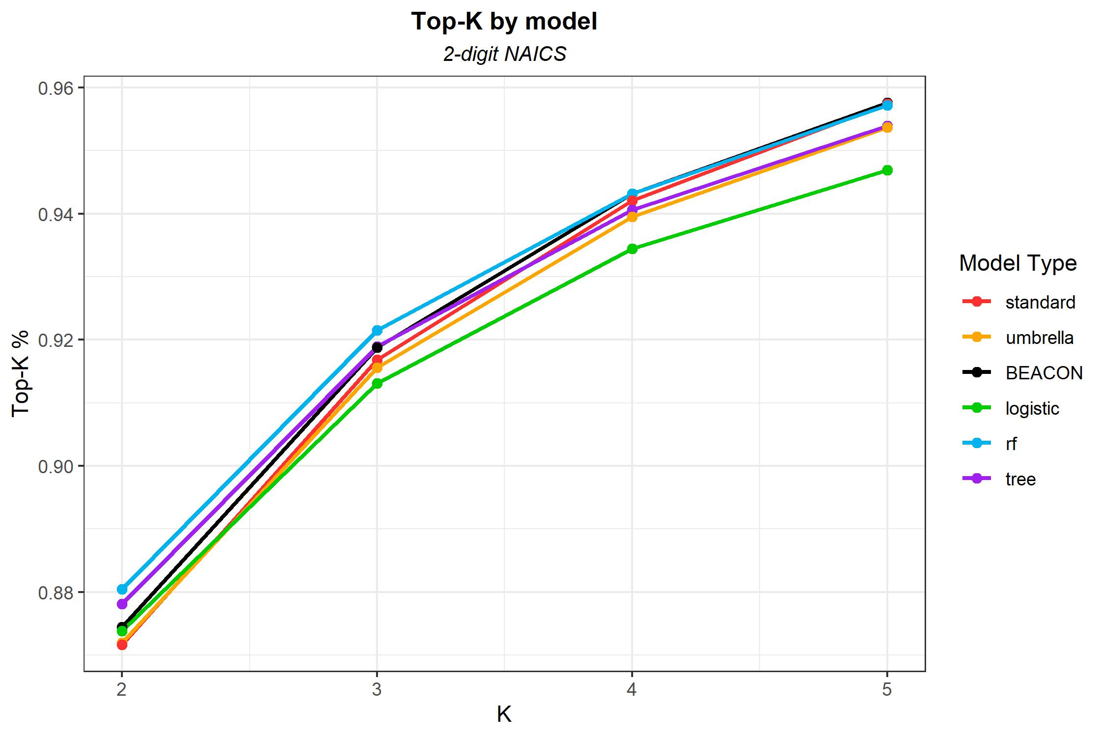
Results
BEACON performed as well or better than meta-models as top-k goal was relaxed.
BEACON is well-equipped at providing multiple NAICS codes to respondent.
Data Sources: Economic Census (2002–2022), 2021 Industry Classification Report, Internal Revenue Service SS-4 (2002–2016), Classification Analytical Processing System, Harmonized System

Slide 26
Conclusions
Meta-models performed best, compared to BEACON, at predicting single best NAICS code.
BEACON performed as well or better than meta-models when goal was to include best NAICS code as one of several potential NAICS codes.
Meta-models may be helpful in manufacturing sector, which has more NAICS codes than any other sector.

Slide 27
Contacts
Email: Daniel.Whitehead@Census.gov
Email: Brian.Dumbacher@Census.gov

