Slide 1
Implementing Interactive Classification Tools in the 2022 Economic Census
Emily Wiley
Daniel Whitehead
U.S. Census Bureau
October 27, 2022
Any opinions and conclusions expressed herein are those of the author(s) and do not reflect the views of the U.S. Census Bureau. The Census Bureau has reviewed this data product to ensure appropriate access, use, and disclosure avoidance protection of the confidential source data used to produce this product (Data Management System (DMS) number: P-7504847, subproject P-7514952; Disclosure Review Board (DRB) approval number: CBDRB-FY22-ESMD009-007).

Slide 2
Outline
Background and motivation
BEACON overview
SINCT overview
Field Test results
Lessons learned and conclusions

Slide 3
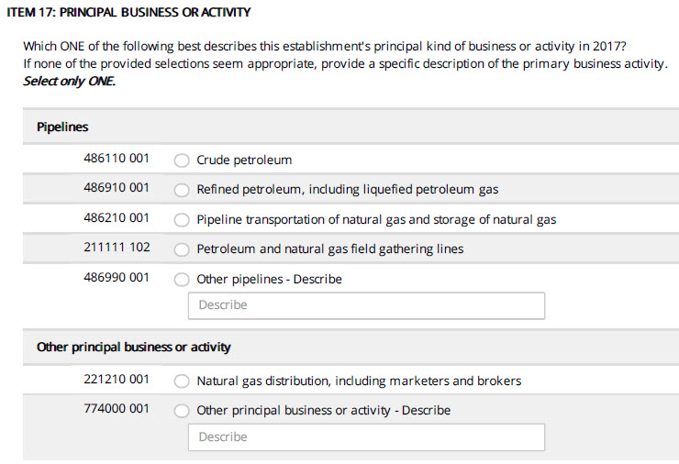
North American Industry Classification System (NAICS)
Business establishments are classified by NAICS code based on primary business activity
There are prelisted descriptions, but the respondent also has the option of writing in a business description
Source: 2017 Economic Census

Slide 4
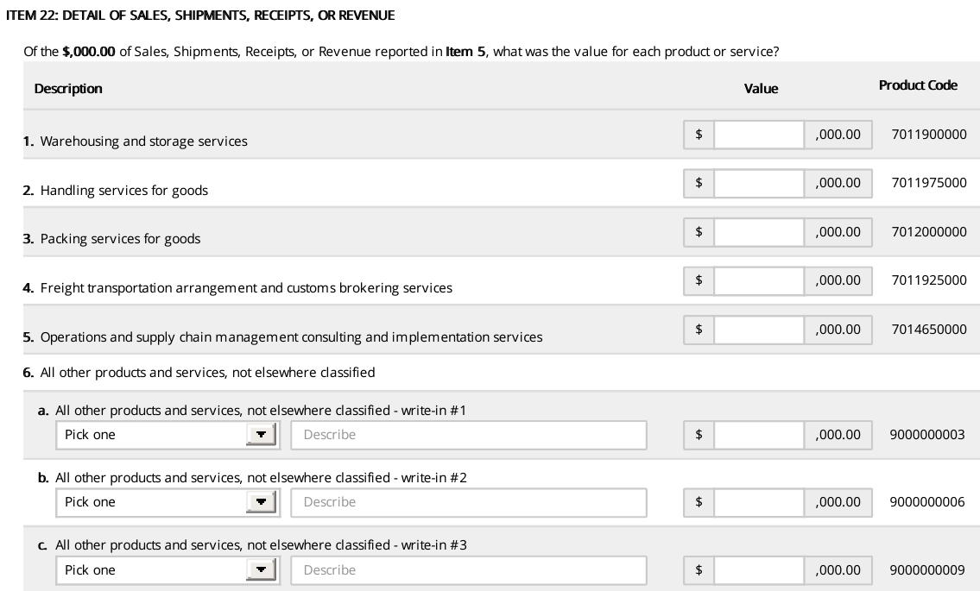
North American Product Classification System (NAPCS)
Businesses classify their revenue into NAPCS codes based on specific products and services
Similar to NAICS, respondents choose from a prelist or provide a write-in
Source: 2017 Economic Census

Slide 5
Motivation for Machine Learning Applications
Goal: develop ML applications and integrate them into the electronic reporting instrument for the 2022 Economic Census

Slide 6
What is BEACON?
Business Establishment Automated Classification of NAICS
A machine learning tool developed by the Economic Statistical Methods Division (U.S. Census Bureau) to classify NAICS for establishments based on a write-in business description
Respondent provides write-in description
Text is outputted to BEACON API
API returns most relevant NAICS codes to respondent

Slide 7
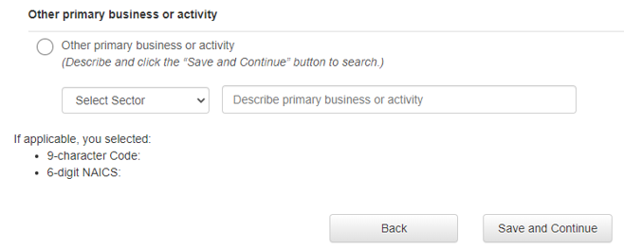
BEACON: Goals
Assist respondents in self-designating their NAICS codes
Improve accuracy of self-designated NAICS codes
Reduce manual coding of write-ins

Slide 8
BEACON: Training Data
Historic write-in responses to the Economic Census (EC)
Frequent write-in text that was autocoded during 2017 EC
Business descriptions from IRS SS-4 forms
Classification Analytical Processing System (CAPS) items
Harmonized System commodity description
Business Description Text | NAICS
This is a car dealership. | 441110
R&D lab – medical/health | 541715
we mainly repair furniture, some sales | 811420

Slide 9
BEACON: Methodology
Text cleaning
Remove common words and phrases (e.g., “the”, “has”, “for instance”)
Correct common misspellings
Dictionary
Words and word combinations that BEACON recognizes
Words are cleaned, stemmed, and meet minimum frequency requirements
Associations between words and NAICS codes in the training data
“tutor” is highly associated with NAICS 611691 – Exam Preparation and Tutoring
“retail” occurs in many NAICS codes and is therefore less predictive

Slide 10
BEACON: Methodology
Three separate information retrieval models
Models are applied hierarchically
First: 2-digit (sector level)
Then: 6-digit (industry level)
Information retrieval models applied to individual words/phrases
Distributions of individual words/phrases averaged using purity weights
Predictions across models are averaged, yielding relevance scores

Slide 11
BEACON: Methodology
Purity Weights
The NAICS distributions of the various words/combs are averaged using “purity weights” that give more weight to the NAICS distributions of words/combs that are more pure/predictive
The purity weight is a function of the maximum proportion
Relevance scores
Range in value between 0 and 100
Reflect how confident BEACON is that the NAICS code is correct

Slide 12
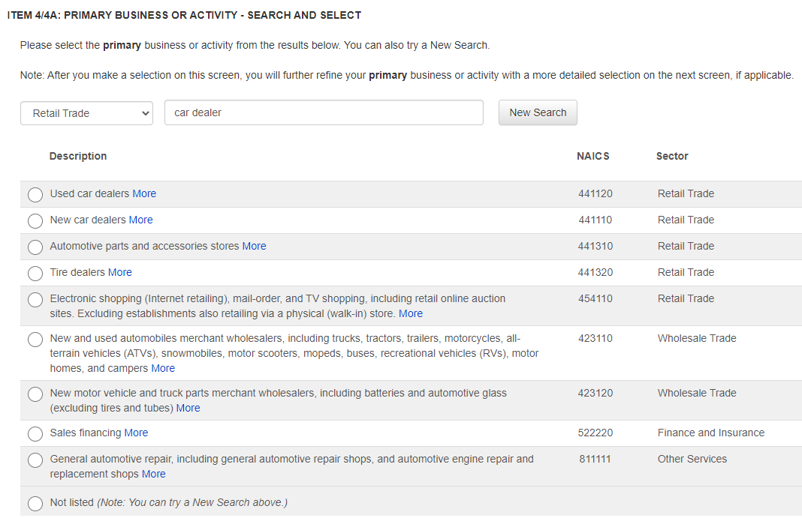
BEACON: Results
From these scores, BEACON returns a ranked list of NAICS codes at the 6-digit level

Slide 13

What is SINCT?
Smart Instrument NAPCS Classification Tool
Developed by Economy-Wide Statistics Division
Two distinct versions
SINCT 1.0: TF-IDF
SINCT 2.0: Doc2Vec
Source: istockphoto.com

Slide 14
SINCT: Training Data
Reclassified write-ins from the 2012 and 2017 Economic Census
Classification Analytical Processing System (CAPS) items
Subject matter expert examples
NAPCS title file
NAICS | Search Term | NAPCS
423860 | Airplane | 4002000003
481111 | Airplane | 7003075000

Slide 15
SINCT 1.0: Methodology
Term frequency-inverse document frequency (TF-IDF)
Compute the frequency of a word or phrase within a document, and then adjust that calculation to account for common words
Compute TF-IDF scores for every word in training data
Compare the search term with every matching word in the training data
Add the TF-IDF scores for each word, and return the ten highest-scored NAPCS codes

Slide 16
SINCT 2.0: Methodology
Doc2Vec machine learning model
Neural network model
Represent words, phrases, sentences, or paragraphs as a vector
Text cleaning and spell check
Convert the search string into a numerical representation
Use cosine similarity scores to identify the ten closest training examples, and return those NAPCS codes

Slide 17
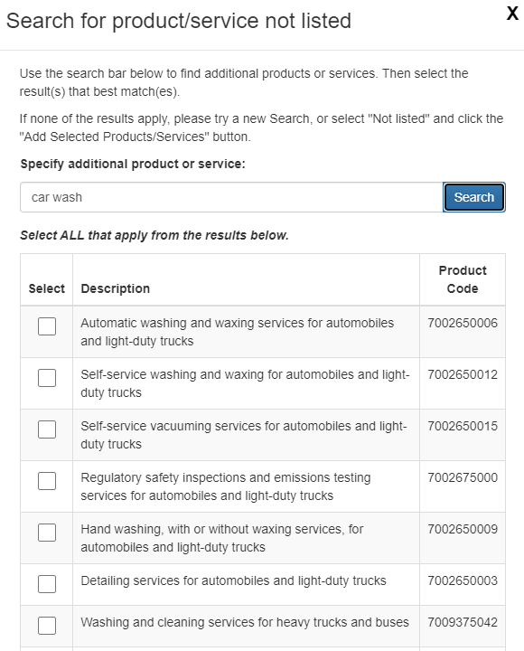
SINCT: Results
SINCT returns the ten highest-scored NAPCS codes to respondents
Respondents can select from those results, perform a new search, or leave their search term as a write-in

Slide 18
2021 Industry Classification Report Field Test
The 2021 Economic Census Industry Classification Report (Refile) was repurposed as a field test for BEACON and SINCT
Approximately 37,000 establishments
12,000 truth deck
25,000 non-truth deck

Slide 19
Field Test: Results
BEACON
Returned correct NAICS code 90% of the time
Respondents selected it 83% of the time
SINCT
Returned correct NAPCS code 74% of the time
Respondents only selected it 50% of the time

Slide 20
Lessons Learned
BEACON performed as expected
Speed and concurrent request requirements were met
90% accuracy rate
SINCT performance was lower than expected
6% timeout rate
74% accuracy rate
Solution: overhaul the model, improving speed and accuracy

Slide 21
Lessons Learned
Respondents often select “none of these”, even if the correct result is presented
Solution: update wording and instructions for main mailing
Additional training data
Added 7,000 examples each to BEACON and SINCT’s training data

Slide 22
Conclusions
BEACON and SINCT should significantly reduce the number of unclassified write-ins in the 2022 Economic Census
Analysts will spend less time and will code a higher percentage of write-ins
Data quality will be improved

Slide 23
Thank You!
Emily Wiley
Emily.L.Wiley@census.gov
Daniel Whitehead
Daniel.Whitehead@census.gov

