Slide 1
BEACON: An Industry Classification Tool
Eurostat Webinar
April 30, 2024
Daniel Whitehead
Sarah Pfeiff
Economic Statistical Methods Division
U.S. Census Bureau

Slide 2
Disclaimer
Any opinions and conclusions expressed herein are those of the authors and do not reflect the views of the U.S. Census Bureau. The Census Bureau has reviewed this data product to ensure appropriate access, use, and disclosure avoidance protection of the confidential source data [Project No. P-7504847, Disclosure Review Board (DRB) approval number: CBDRB-FY23-EMSD001-011.]

Slide 3
Outline
Background
Motivating Problem
BEACON Methodology
Future Work
Demo

Slide 4
North American Industry Classification System (NAICS)
Establishments are physical locations where business is conducted
U.S. Census Bureau classifies establishments by NAICS industry based on primary business activity
Used throughout survey life cycle
Sample selection
Data collection
Publication
Hierarchical 6-digit structure
First two digits represent sector
Additional non-zero digits add detail
Example NAICS Structure
NAICS | Description
51 | Information
515 | Broadcasting (except Internet)
5151 | Radio and Television Broadcasting
51511 | Radio Broadcasting
515112 | Radio Stations

Slide 5
Economic Census (EC)
Conducted by the Census Bureau for years ending in “2” or “7”
Covers approximately eight million establishments, most industries, and all geographic areas of the U.S.
Key statistics
Total number of establishments
Total number of employees
Value of sales, shipments, receipts, and revenue
Total annual payroll
Data products are presented by NAICS and geography

Slide 6
Primary Business or Activity Question
Question asks respondents to describe their business
Respondent is presented with prelisted descriptions based on an estimated NAICS code at the time of mailout
Respondent can also provide a short, open-ended response
There are hundreds of thousands of these so-called “write-in” responses every EC
Clerical analysis of write-in text is mostly manual
Using more automated methods can improve efficiency

Slide 7
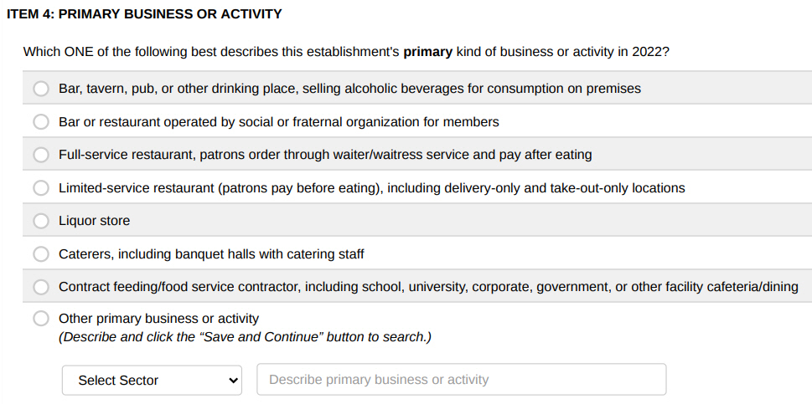
Primary Business or Activity Question (cont.)
Prelisted descriptions
based on estimated NAICS code
Write-in
Source: https://bhs.econ.census.gov/ombpdfs2022/export/2022_AF-72240_su.pdf

Slide 8
BEACON Overview
Business Establishment Automated Classification of NAICS
Text classification tool used in the 2022 EC that aims to
Help respondents self-classify their NAICS code in real time
Ensure respondents receive appropriate industry questions
Reduce clerical work associated with write-ins
Uses an Application Programming Interface (API)
Respondent provides write-in
Questionnaire sends write-in to BEACON via API
BEACON API returns ranked list of NAICS codes
Respondent selects NAICS code

Slide 9
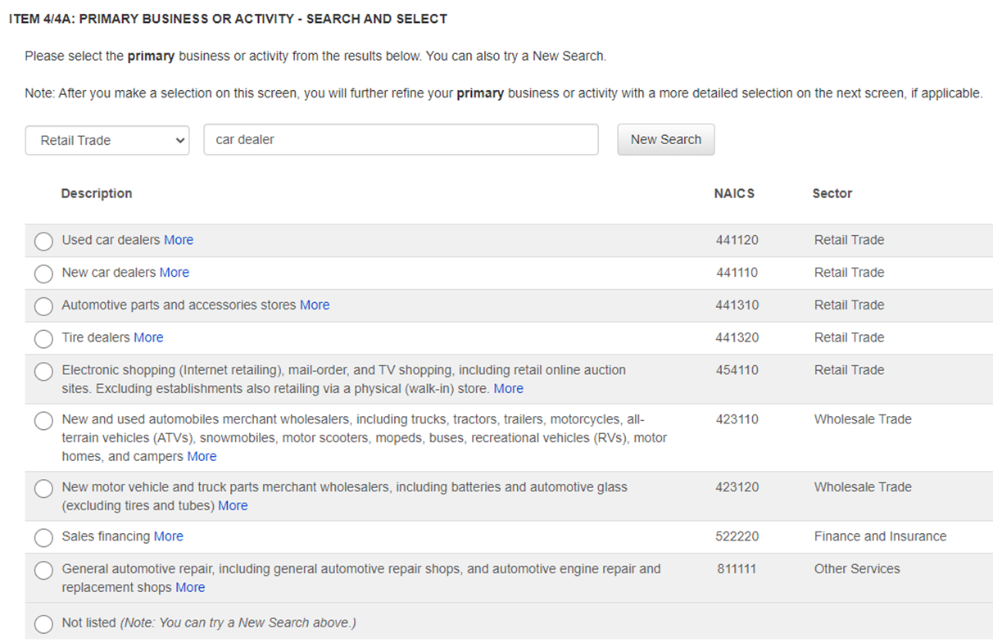
BEACON Results Screen
Respondent entered the description “car dealer”
Possible actions
Select a NAICS code
Click on “More” to view NAICS-specific page on www.census.gov/naics
Try a new search
Go back to the prelist screen
Select “Not listed”

Slide 10




Methodology Overview
3.9+ million observations
Rich training data
Thorough text cleaning algorithm
Large dictionary of features
Words
2- and 3-word combinations
Full-length descriptions
Optimized model ensemble using machine learning
28,000+ text cleaning rules
475,000+ model features in dictionary
3 information retrieval sub-models in ensemble

Slide 11
Training Data
Data sources
Historical write-in responses to the EC
Frequent write-in text that was autocoded during 2017 EC
Business descriptions from Internal Revenue Service (IRS) SS-4 forms
Classification Assistance Tool (CAT) items
Harmonized System (HS) commodity descriptions
Variables
Business description text
Corresponding NAICS code
Text | NAICS
This is a convenence store. | 445120
automobile MFG | 336111
We rapair watches & jewelry. | 811490

Slide 12
Data Source | Number of Observations | Advantages | Disadvantages
EC | 1,439,000 | Represents target population Reflects natural language | Descriptions not perfectly classified Descriptions contain misspellings
EC Autocoded | *98,000 | Improves consistency with autocoding during 2017 EC | Relatively small data source
IRS SS-4 | 865,000 | Reflects natural language | Descriptions not perfectly classified Descriptions contain misspellings
CAT | *1,507,000 | Provides a rich vocabulary Descriptions classified correctly | Does not always reflect natural language
HS | 21,000 | Increases sample sizes for sectors not represented well in other data sources Descriptions classified correctly | Relatively small data source Covers only three sectors (11, 21, and 31-33)
* Includes duplicates and variations of original observations

Slide 13
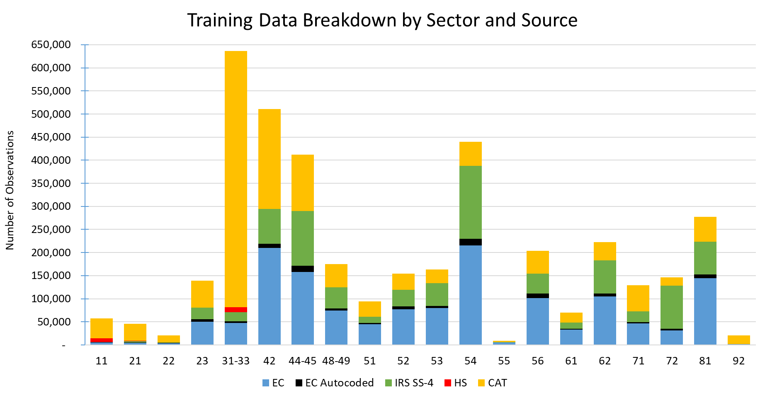
Sources: 2002, 2007, 2012, 2017, 2022 Economic Census; Internal Revenue Service; Classification Assistance Tool; and Harmonized System
Date: 29 March 2023

Slide 14
Text Cleaning
Removal of extraneous words/symbols
Remove extra white space and common “stop” words (“the”, “and”, “or”, etc.)
Account for numbers and punctuation
Correct common misspellings
Map misspelled words to stem of true word
For example, “manifactur” → “manufactur”
Stem
Apply prefix/suffix stripping rules to reduce number of word variations
For example, “manufacturing” → “manufactur”, “cars” → “car”
Lemmatize
Map synonyms and abbreviations to a common concept
For example, “mfg” → “manufactur”, “auto” → “car”

Slide 15
Text Cleaning (cont.)
Text | Clean Text
new & ussed car dealer - ship | new used car dealership
automobile MFG | car manufactur
3PL | thirdparti logist
long dist trckng | long distanc trucking
Mini Golf with Juicebar! | minigolf juic bar
We rapair watches & jewelry. | repair watch jewelri
This is a convenence store. | conveni store
we do liq dist | liquor distribut
NAICS code #722511 | 722511

Slide 16
Dictionary
Words and word combinations that BEACON recognizes
Individual words
2- and 3-word combinations
Full-length/exact descriptions
Data dictionary contains model features for component models
Associations between words and NAICS codes influence predictions
“tutor” is highly associated with NAICS 611691 – Exam Preparation and Tutoring
“store” occurs in many NAICS codes and is therefore less predictive

Slide 17
Model Ensemble
Information retrieval models look at how words, combinations, and entire descriptions are distributed across NAICS codes
Three information retrieval sub-models use different features
Individual predictions are averaged, yielding relevance scores

Slide 18
Component Models
Standard
Considers all words and combinations of words (up to 2)
Ex. “car repair”
Umbrella
Excludes words/combs that are subsets of other combs
Exact
Only considers complete write-in description
Ex. “car repair”
Includes: “car repair” (all qualifying write-ins)
Includes: “car”, “repair”, “car repair” (all qualifying write-ins)
Excludes: “car”, “repair”
Includes: “car repair” (includes only write-ins consisting only of terms “car” and “repair”)
Excludes: “car”, “repair”
Ex. “car repair”
Notes:
Examples of descriptions excluded by the Exact method but included by the All and Umbrella method are “car repair and paint” or “car exhaust repair”.

Slide 19
Purity Weights
The NAICS distributions of the stems and stem combinations are averaged using “purity weights” that give more weight to the NAICS distributions of words that are more predictive.
Only applied to the “standard” and “umbrella” models.
Designed so that all terms have a weight between 0 and 1, inclusive.
Notes:
Purity weight for “exact” model is 1 as only single such term for each write-in.

Slide 20
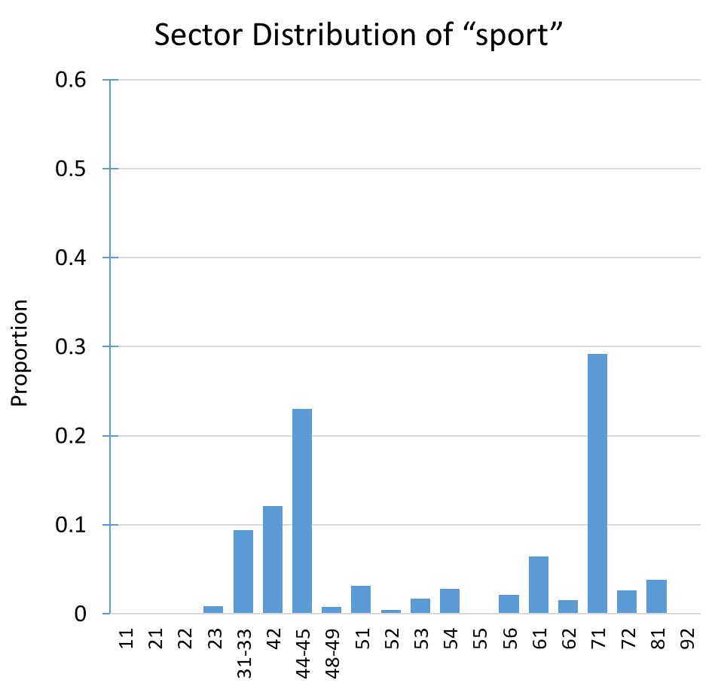
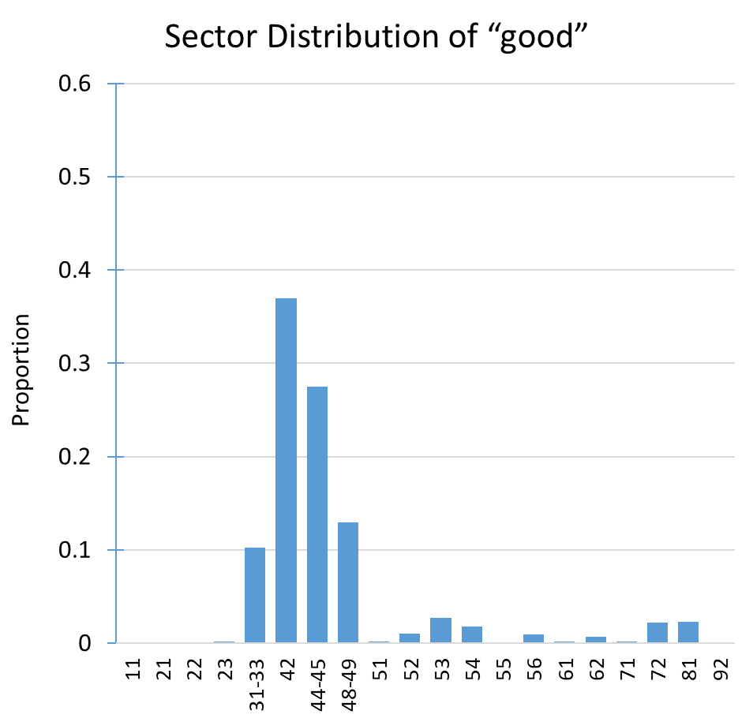
purity weight = 0.26
purity weight
= 0.34
Sources: 2002, 2007, 2012, 2017, 2022 Economic Census; Internal Revenue Service; Classification Assistance Tool; and Harmonized System

Slide 21
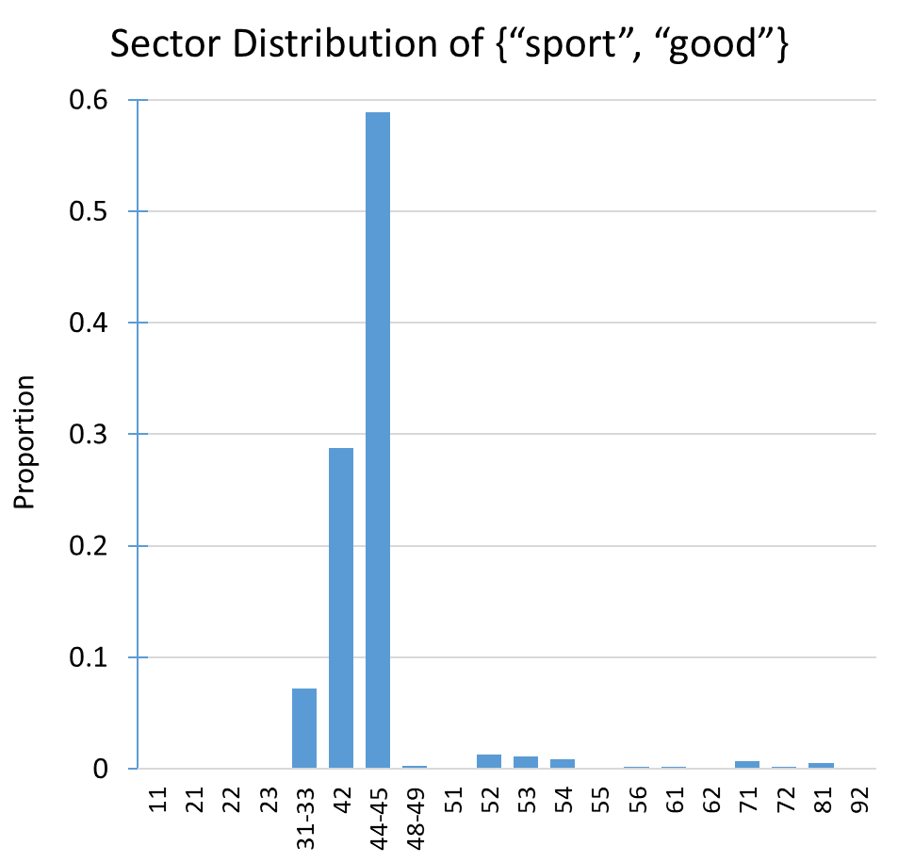
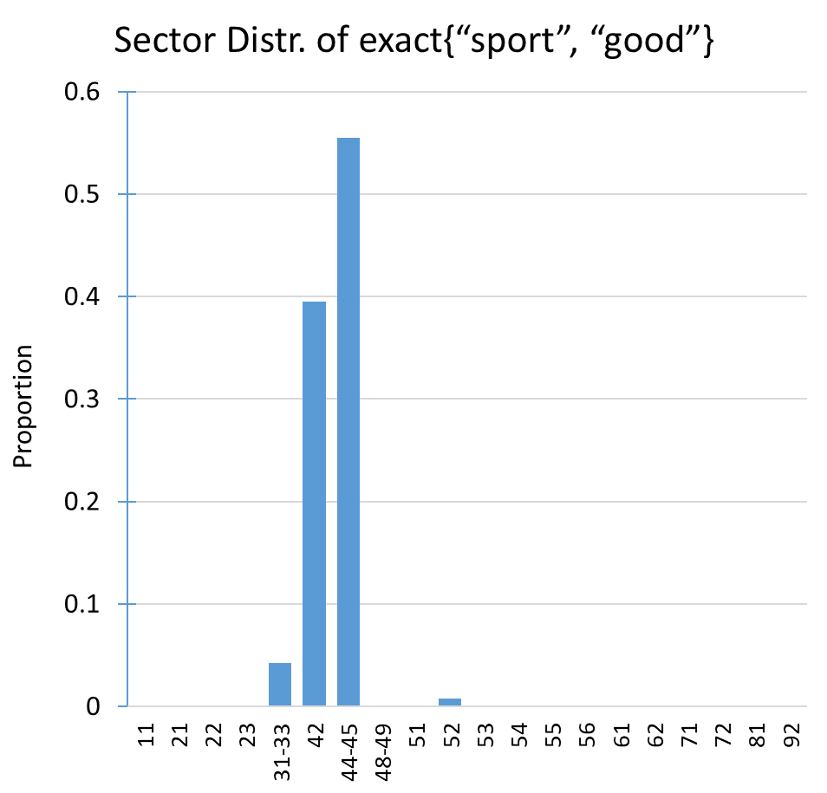
purity weight = 0.57
purity weight
= 0.53
Sources: 2002, 2007, 2012, 2017, 2022 Economic Census; Internal Revenue Service; Classification Assistance Tool; and Harmonized System

Slide 22
Relevance Scores
BEACON assigns relevance scores to NAICS codes for ranking
For each sub-model, the NAICS distributions of the relevant features are averaged using purity weights to calculate relevance scores
The model ensemble calculates a weighted average of scores from the three sub-models, where the weights are optimized using machine learning
0.1 (Standard) $+$ 0.6 (Umbrella) $+$ 0.3 (Exact)

Slide 23
Hierarchical Model Structure
Assigning relevance scores directly at the 6-digit level is challenging
Model ensemble is applied 21 times
1x to assign scores at the 2-digit level
20x to assign sector-conditional scores at the 6-digit level
Scores are calculated using the conditional probability formula
score(515112) $=$ score(51) $×$ score(515112|51)

Slide 24
Future Work
Continue to refine text cleaning algorithm
Research more advanced models
Model stacking
Word embeddings
Incorporate more Spanish language words
Develop external interface for BEACON

Slide 25
Demo of Internal Interface

Slide 26
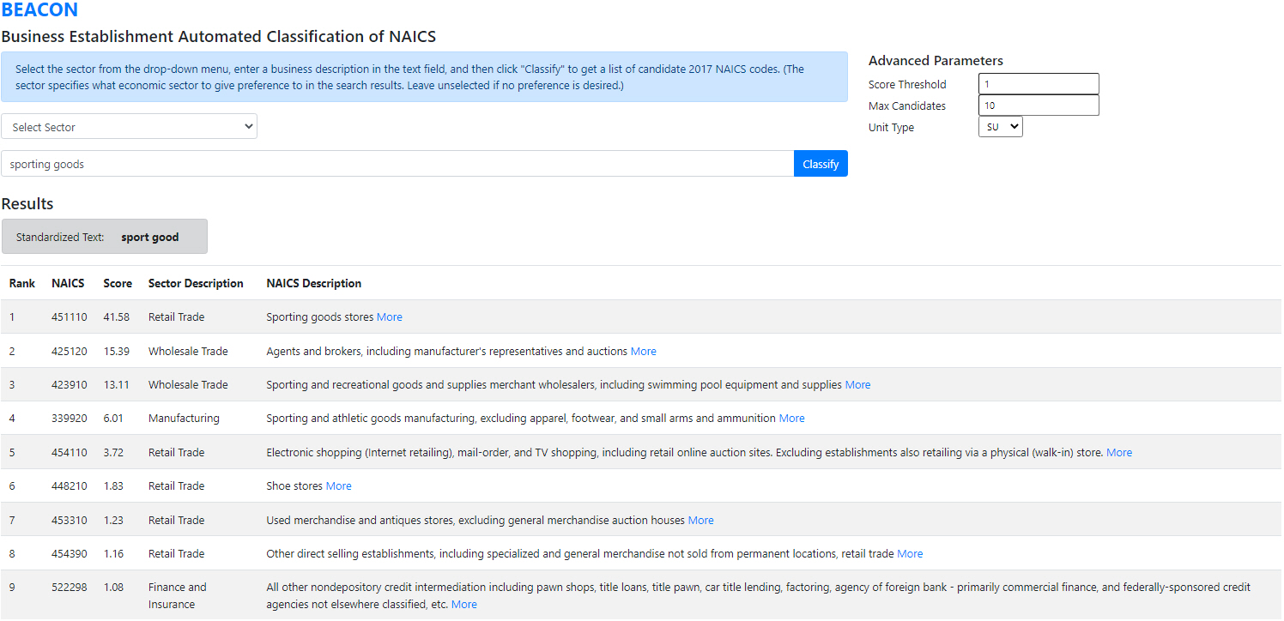
Sources: 2002, 2007, 2012, 2017, 2022 Economic Census; Internal Revenue Service; Classification Assistance Tool; and Harmonized System

Slide 27
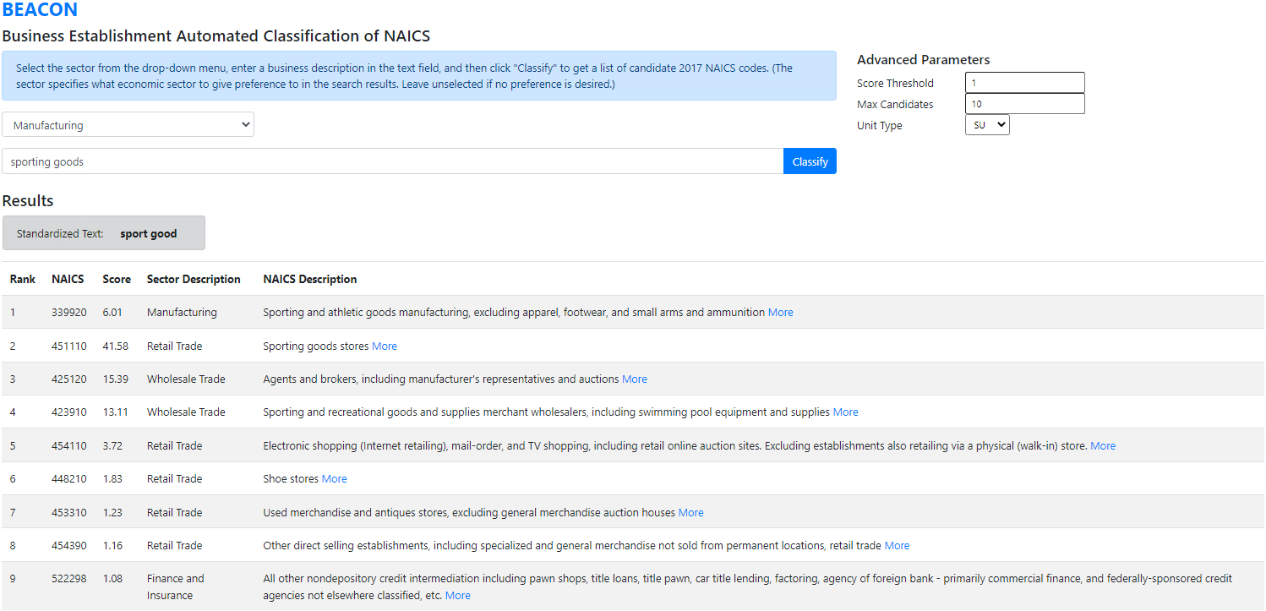
Sources: 2002, 2007, 2012, 2017, 2022 Economic Census; Internal Revenue Service; Classification Assistance Tool; and Harmonized System

Slide 28
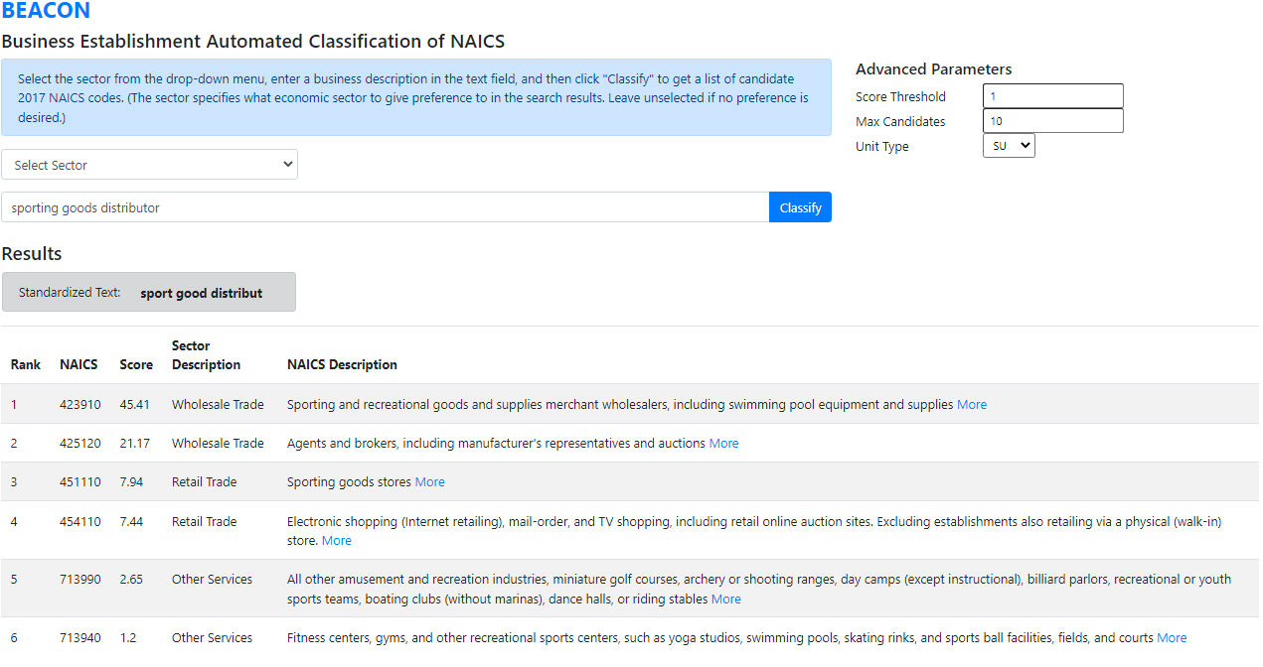
Sources: 2002, 2007, 2012, 2017, 2022 Economic Census; Internal Revenue Service; Classification Assistance Tool; and Harmonized System

Slide 29
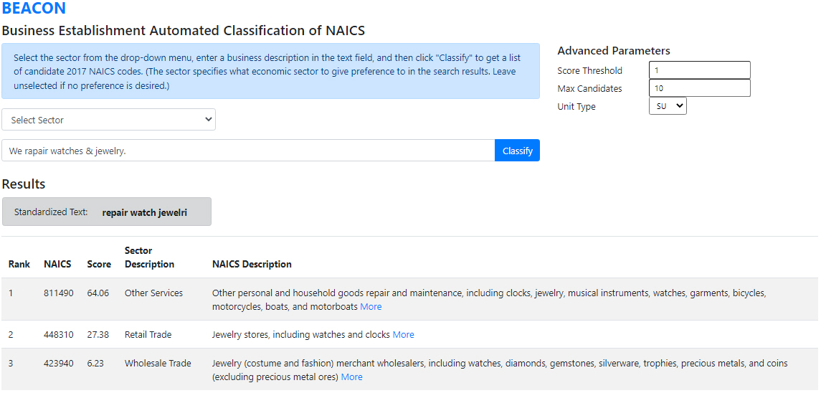
Sources: 2002, 2007, 2012, 2017, 2022 Economic Census; Internal Revenue Service; Classification Assistance Tool; and Harmonized System

Slide 30
References
Aggarwal, C.C. (2018). Machine learning for text. Cham: Springer International Publishing.
Dumbacher, B. and Whitehead, D. (2022). Industry self-classification in the Economic Census. 2022 Proceedings of the American Statistical Association, Section on Statistical Learning and Data Science, 1049–1064.
Figueiredo, F., Rocha, L., Couto, T., Salles, T., Gonçalves, M.A., Meira Jr., W. (2011). Word co-occurrence features for text classification. Information Systems, 36(5), 843–858.
U.S. Census Bureau. (2017). 2017 North American Industry Classification System Manual. https://www.census.gov/naics/reference_files_tools/2017_NAICS_Manual.pdf
Whitehead D., Dumbacher B. (2023). Ensemble modeling techniques for NAICS classification in the Economic Census. Proceedings of the 2023 Federal Committee on Statistical Methodology Research and Policy Conference.
Wiley, E. and Whitehead, D. (2022). Implementing interactive classification tools in the 2022 Economic Census. Proceedings of the 2022 Federal Committee on Statistical Methodology Research and Policy Conference.

Slide 31
Contact Information
Sarah.Pfeiff@census.gov
Daniel.Whitehead@census.gov

