Slide 1
Image Denoising
Usage of Auto Encoders for Denoising

Slide 2
Motivation
The idea behind the course work is to test how Auto Encoders handle heavy noise and compare to:
Gaussian Blur
Unsharp Masking (USP) (Lecture 3)

Slide 3
Introduction
There is a nice overview of technology described on Keras https://keras.io/examples/vision/autoencoder/
Industry leaders such as Intel and NVIDIA have sponsored research in machine learning based denoisers, Intel Open Image Denoise and the NVIDIA Optix Autoencoder both use a denoising autoencoder to denoise images to great success.
There's been research in the area of algorithmic techniques to denoise images in real time using spherical harmonics to encode low frequency data, guided filters to blur while avoiding sharp changes in normals or albedo information, and spatio-temporal reprojection to reuse data that isn't view dependent such as global illumination or shadows.

Slide 4
Introduction
There are ways of combining these two methods, using spatio-temporal methods to feed a sample map estimator network to help dictate how many rays a renderer should dispatch. This helps solve the issue of denoising salt/peppering highlights/shadows in real time.

Slide 5
Description: Using Autoencoders and Convolution matrixes in this test
An encoder: This part of the model takes in parameter the input data and compresses it. E(x) = c where x is the input data, c the latent representation and E our encoding function.
A decoder: This part takes in parameter the latent representation and try to reconstruct the original input. D(c) = x’ where x’ is the output of the decoder and D our decoding function

Slide 6
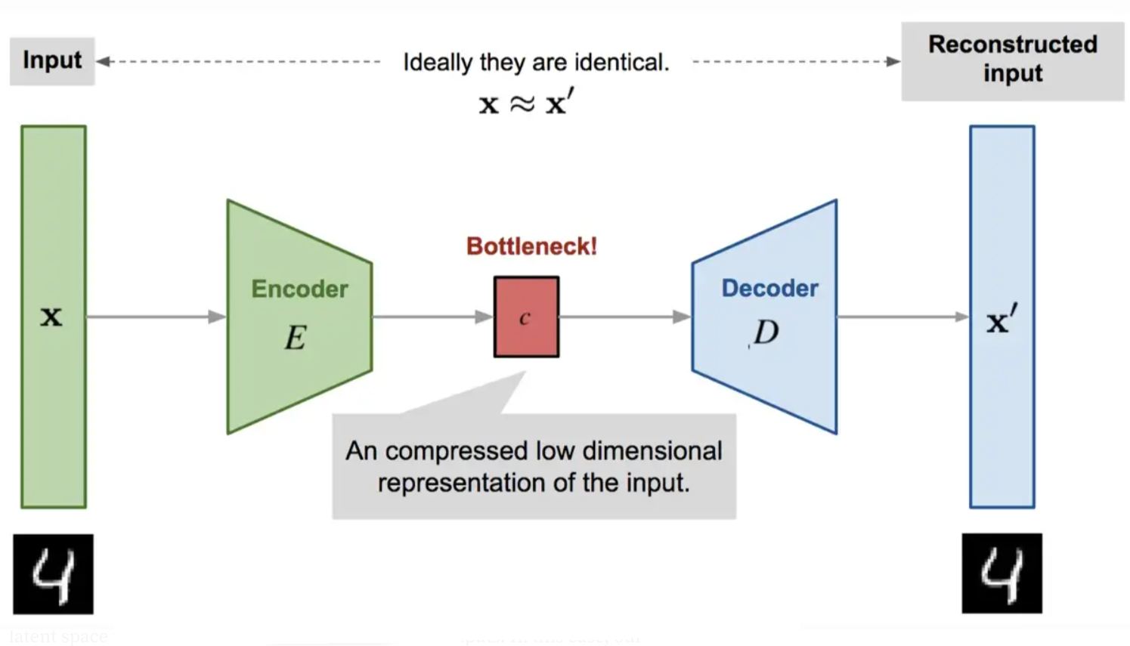
Description: Using Autoencoders and Convolution matrixes in this test

Slide 7

Description: Using Autoencoders and Convolution matrixes in this test
The learning process is quite regular, it aims at minimizing a loss function.
There are different metrics to quantify this loss function such as the Mean Square Error or the cross-entropy (when the activation function is a sigmoid for instance). This loss must penalize the reconstruction for being dissimilar from x.

Slide 8
Description: Using Autoencoders and Convolution matrixes in this test
The original (218, 178) images in the dataset were converted to (216, 176) in order to use 2 Conv layers
autoencoder = tf.keras.models.Sequential()
#Encoder
autoencoder.add(tf.keras.layers.Conv2D(filters=16, kernel_size=3, strides=2, padding="same", input_shape=(216, 176, 3)))
autoencoder.add(tf.keras.layers.Conv2D(filters=8, kernel_size=3, strides=2, padding="same"))
#Encoded image
autoencoder.add(tf.keras.layers.Conv2D(filters=8, kernel_size=3, strides=1, padding="same"))
#Decoder
autoencoder.add(tf.keras.layers.Conv2DTranspose(filters=16, kernel_size=3, strides=2, padding="same"))
autoencoder.add(tf.keras.layers.Conv2DTranspose(filters=3, kernel_size=3, strides=2, activation='sigmoid', padding="same"))

Slide 9
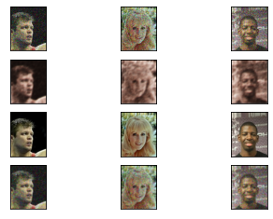
Demo
Added noise
Our Denoising
Original
Compared to blured

Slide 10
Results and Conclusion
As the result, it makes sense to use convolutional neural networks as encoders and decoders. However, the convolutional autoencoders generate a very blurred version of the original image.
The behavior of encoder and decoder will be lossy. Because the autoencoder learns to convert high-dimensional data (e.g., an image) into lower-dimensional format (i.e., the encoded/latent state), data must be dropped in order to maximize the relationships between image and encoded state. Additionally, going from latent state to output also incurs information loss. By consequence, it's important to understand that encoder and decoder will behave in a lossy way. Lossless use of autoencoders is impossible.
Compared to the Gaussian blurring, the results with convolutional networks are in my opinion better in case of heavy noise.
In case of not much noice on the images, it is most likely that using Gaussian bluring or Unsharp Masking (USP) will give better us results.

Slide 11
Results and Conclusion
Because of Google Colab memory limitation, I was unable to use full set of faces database, only 2000 images were used.
We did not get the perfect results, our images are too blurred, I will be
Working with different algorythms and techniques mentioned below:
https://alain.xyz/blog/ray-tracing-filtering
https://alain.xyz/blog/machine-learning-denoising

Slide 12
Information used:
https://github.com/junjun-jiang/Face-Hallucination-Benchmark
https://github.com/csxmli2016/DMDNet
https://github.com/TencentARC/GFPGAN
https://github.com/FelixMohr/Deep-learning-with-Python/blob/master/DCGAN-face-creation.ipynb
https://colab.research.google.com/drive/1sVsoBd9AjckIXThgtZhGrHRfFI6UUYOo
https://github.com/csjliang/LDL
https://github.com/FelixMohr/Deep-learning-with-Python/blob/master/DCGAN-face-creation.ipynb
https://www.youtube.com/watch?v=_bH2oh75Kdo
https://github.com/machinelearnear/towards_robust_blind_face_restoration/blob/main/step_by_step.ipynb
https://github.com/iamshuvra/A-Deep-Learning-Framework-to-Reconstruct-Face-under-Mask/blob/main/GenderClassificationsKerasTunner.ipynb
https://github.com/microsoft/Bringing-Old-Photos-Back-to-Life
https://www.kaggle.com/code/iljoong/celebrity-face-classification-using-keras
https://stackoverflow.com/questions/63700836/dataset-generated-from-image-dataset-from-directory-function-does-not-include-ba
https://yapdianang.github.io/celeba/
https://colab.research.google.com/github/keras-team/keras-io/blob/master/examples/generative/ipynb/stylegan.ipynb#scrollTo=5ytRqls1R01P
https://github.com/juli-amezquita/Fashion-MNIST-image-classification/blob/main/Amezquita_Abello_Juliana_Actividad_1_Redes_Neuronales_Artificiales_ANN.ipynb
https://github.com/khanhnamle1994/fashion-mnist/blob/master/CNN-3Conv.ipynb
https://keras.io/examples/generative/dcgan_overriding_train_step/
https://keras.io/examples/vision/super_resolution_sub_pixel/
https://analyticsindiamag.com/10-face-datasets-to-start-facial-recognition-projects/
https://www.v7labs.com/blog/autoencoders-guide#:~:text=An%20autoencoder%20is%20an%20unsupervised,even%20generation%20of%20image%20data.
https://github.com/Valeriy77/Image-Denoising-Using-Autoencoder/blob/master/Image%20Denoising%20using%20AutoEncoders.ipynb
https://cseweb.ucsd.edu/~weijian/static/datasets/celeba/

