Slide 1
Image Denoising
Usage of Auto Encoders for Denoising

Slide 2
Motivation
The idea behind the course work is to test how Auto Encoders handle heavy noise and compare to:
Gaussian Blur
Unsharp Masking (USP) (Lecture 3)

Slide 3
Motivation
With the advancement of Deep Learning techniques, it is now possible to remove real noise from images such that the denoised image will be very similar to the ground truth image with minimal loss of detail.
Over the recent years, many deep learning architectures have been developed for image denoising tasks. Among them, I’ll be implementing Autoencoders deep learning architecture to solve this problem.
Autoencoders
CBDNet (will work on this later, stay tuned )
PRIDNet (will work on this later, stay tuned )
RIDNet (will work on this later, stay tuned ) - as per my research this architecture will provide the best result

Slide 4
Introduction
There is a nice overview of technology described on Keras https://keras.io/examples/vision/autoencoder/
Industry leaders such as Intel and NVIDIA have sponsored research in machine learning based denoisers, Intel Open Image Denoise and the NVIDIA Optix Autoencoder both use a denoising autoencoder to denoise images to great success.
We will be working on the CELEBA dataset (~220K images). As my resources for calculation are limited at the moment, I will start with a portion of this dataset and increase it to get the satisfactory result.

Slide 5
Description: Using Autoencoders and Convolution matrixes in this test
An encoder: This part of the model takes in parameter the input data and compresses it. E(x) = c where x is the input data, c the latent representation and E our encoding function.
A decoder: This part takes in parameter the latent representation and try to reconstruct the original input. D(c) = x’ where x’ is the output of the decoder and D our decoding function

Slide 6
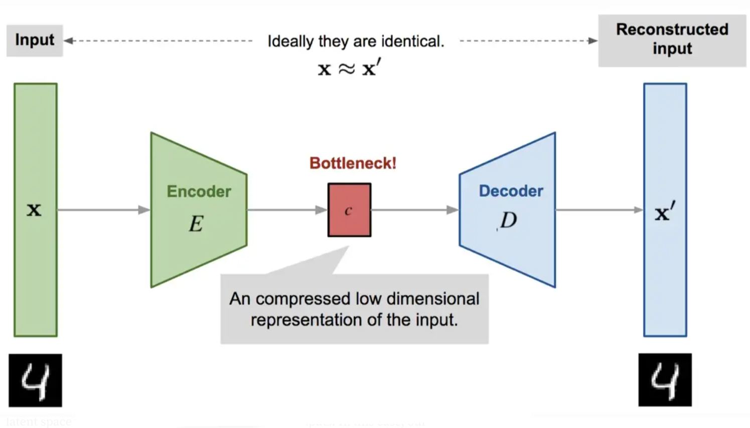
Description: Using Autoencoders and Convolution matrixes in this test

Slide 7

Description: Using Autoencoders and Convolution matrixes in this test
The learning process is quite regular, it aims at minimizing a loss function.
There are different metrics to quantify this loss function such as the Mean Square Error or the cross-entropy (when the activation function is a sigmoid for instance). This loss must penalize the reconstruction for being dissimilar from x.

Slide 8
Description: Using Autoencoders and Convolution matrixes in this test
The original (218, 178) images in the dataset were converted to (216, 176) in order to use 2 Conv layers
autoencoder = tf.keras.models.Sequential()
#Encoder
autoencoder.add(tf.keras.layers.Conv2D(filters=16, kernel_size=3, strides=2, padding="same", input_shape=(216, 176, 3)))
autoencoder.add(tf.keras.layers.Conv2D(filters=8, kernel_size=3, strides=2, padding="same"))
#Encoded image
autoencoder.add(tf.keras.layers.Conv2D(filters=8, kernel_size=3, strides=1, padding="same"))
#Decoder
autoencoder.add(tf.keras.layers.Conv2DTranspose(filters=16, kernel_size=3, strides=2, padding="same"))
autoencoder.add(tf.keras.layers.Conv2DTranspose(filters=3, kernel_size=3, strides=2, activation='sigmoid', padding="same"))

Slide 9
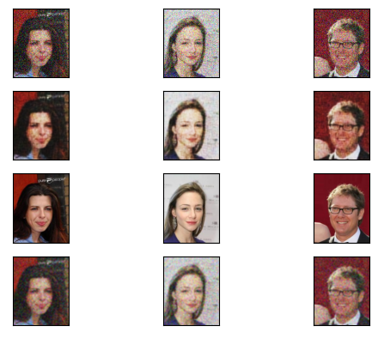
Demo
Added noise
PSNR: 12.66
Our Denoising
PSNR: 24.31
GT
Blured(Gaussian)
PSNR 21.43

Slide 10
Results and Conclusion
As the result, it makes sense to use convolutional neural networks as encoders and decoders. However, the convolutional autoencoders generate a very blurred version of the original image.
The behavior of encoder and decoder is lossy. Because the autoencoder learns to convert high-dimensional data (e.g., an image) into lower-dimensional format (i.e., the encoded/latent state), data must be dropped in order to maximize the relationships between image and encoded state. Additionally, going from latent state to output also incurs information loss. By consequence, it's important to understand that encoder and decoder will behave in a lossy way. Lossless use of autoencoders is impossible.
Compared to the Gaussian blurring, the results with convolutional networks are in my opinion better in case of heavy noise.
In case of not much noise on the images, it is most likely that using Gaussian blurring or Unsharp Masking (USP) will give better visual results.

Slide 11
Results and Conclusion
Working under Colab limitations and local laptop limitations, I used 12000 images from the CELEBA dataset.
We did not get perfect results, our images are kinda blurred, I believe I need to find ways to use more GPU resources for better results.
Best article on this subject: https://medium.com/analytics-vidhya/image-denoising-using-deep-learning-dc2b19a3fd54
https://alain.xyz/blog/ray-tracing-filtering
https://alain.xyz/blog/machine-learning-denoising

Slide 12
Information used:
https://github.com/junjun-jiang/Face-Hallucination-Benchmark
https://github.com/csxmli2016/DMDNet
https://github.com/TencentARC/GFPGAN
https://github.com/FelixMohr/Deep-learning-with-Python/blob/master/DCGAN-face-creation.ipynb
https://colab.research.google.com/drive/1sVsoBd9AjckIXThgtZhGrHRfFI6UUYOo
https://github.com/csjliang/LDL
https://github.com/FelixMohr/Deep-learning-with-Python/blob/master/DCGAN-face-creation.ipynb
https://www.youtube.com/watch?v=_bH2oh75Kdo
https://github.com/machinelearnear/towards_robust_blind_face_restoration/blob/main/step_by_step.ipynb
https://github.com/iamshuvra/A-Deep-Learning-Framework-to-Reconstruct-Face-under-Mask/blob/main/GenderClassificationsKerasTunner.ipynb
https://github.com/microsoft/Bringing-Old-Photos-Back-to-Life
https://www.kaggle.com/code/iljoong/celebrity-face-classification-using-keras
https://stackoverflow.com/questions/63700836/dataset-generated-from-image-dataset-from-directory-function-does-not-include-ba
https://yapdianang.github.io/celeba/
https://colab.research.google.com/github/keras-team/keras-io/blob/master/examples/generative/ipynb/stylegan.ipynb#scrollTo=5ytRqls1R01P
https://github.com/juli-amezquita/Fashion-MNIST-image-classification/blob/main/Amezquita_Abello_Juliana_Actividad_1_Redes_Neuronales_Artificiales_ANN.ipynb
https://github.com/khanhnamle1994/fashion-mnist/blob/master/CNN-3Conv.ipynb
https://keras.io/examples/generative/dcgan_overriding_train_step/
https://keras.io/examples/vision/super_resolution_sub_pixel/
https://analyticsindiamag.com/10-face-datasets-to-start-facial-recognition-projects/
https://www.v7labs.com/blog/autoencoders-guide#:~:text=An%20autoencoder%20is%20an%20unsupervised,even%20generation%20of%20image%20data.
https://github.com/Valeriy77/Image-Denoising-Using-Autoencoder/blob/master/Image%20Denoising%20using%20AutoEncoders.ipynb
https://cseweb.ucsd.edu/~weijian/static/datasets/celeba/

