Slide 1
Architecture Requirements (Final)
Emojitor network

Slide 2
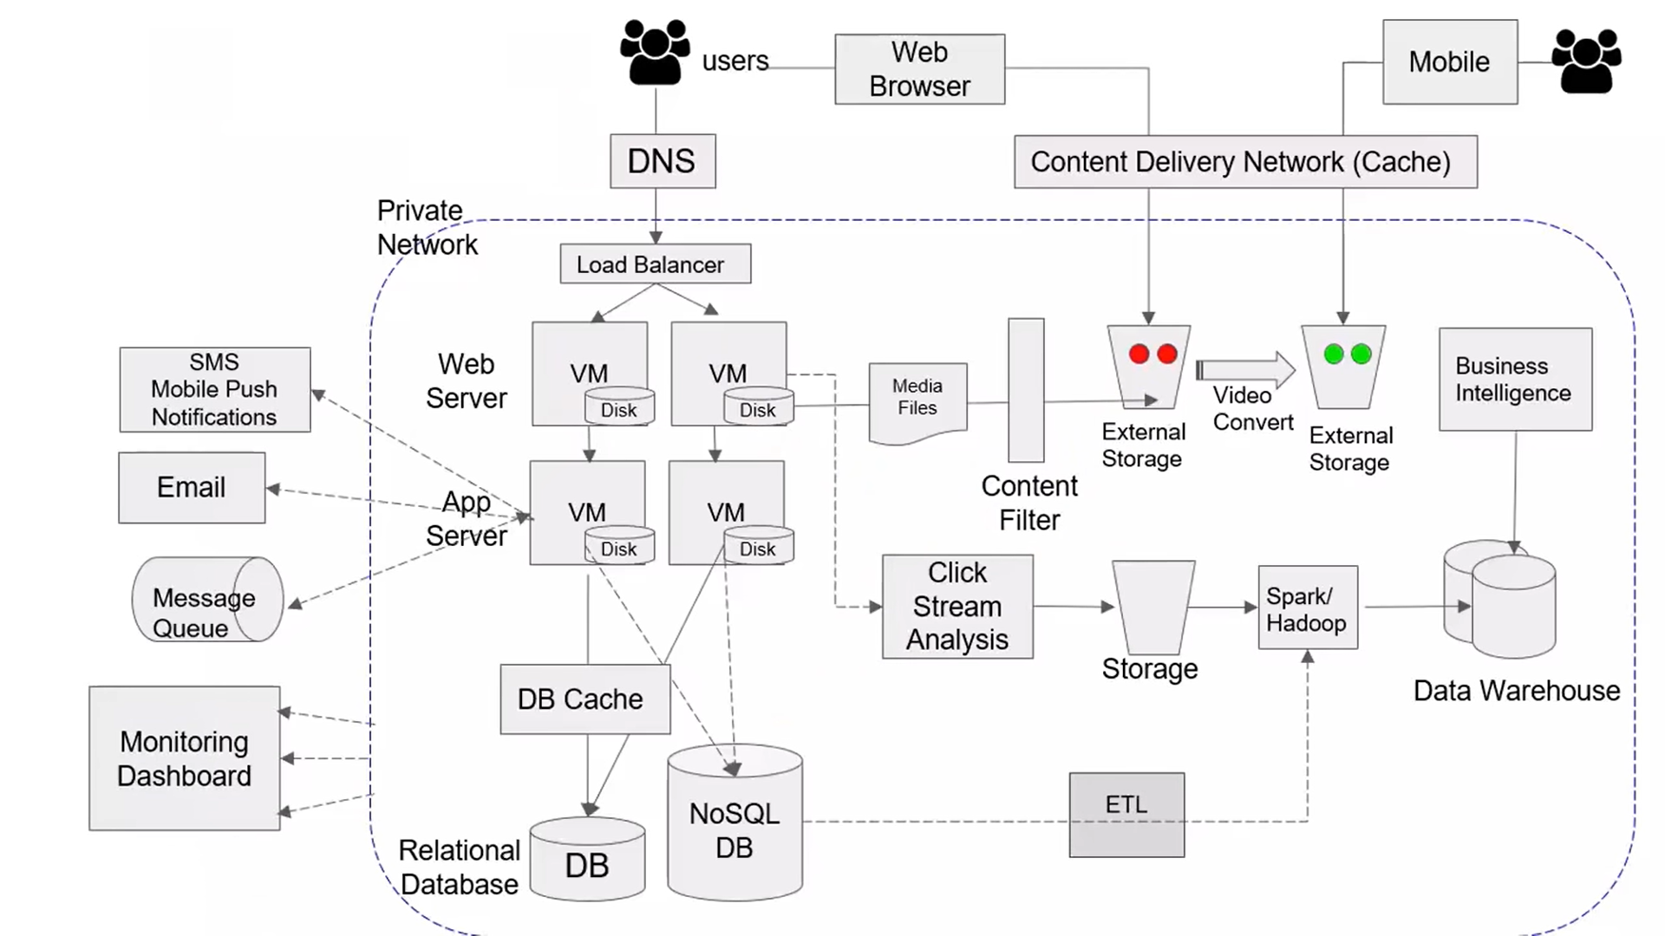
Final architecture structure

Slide 3
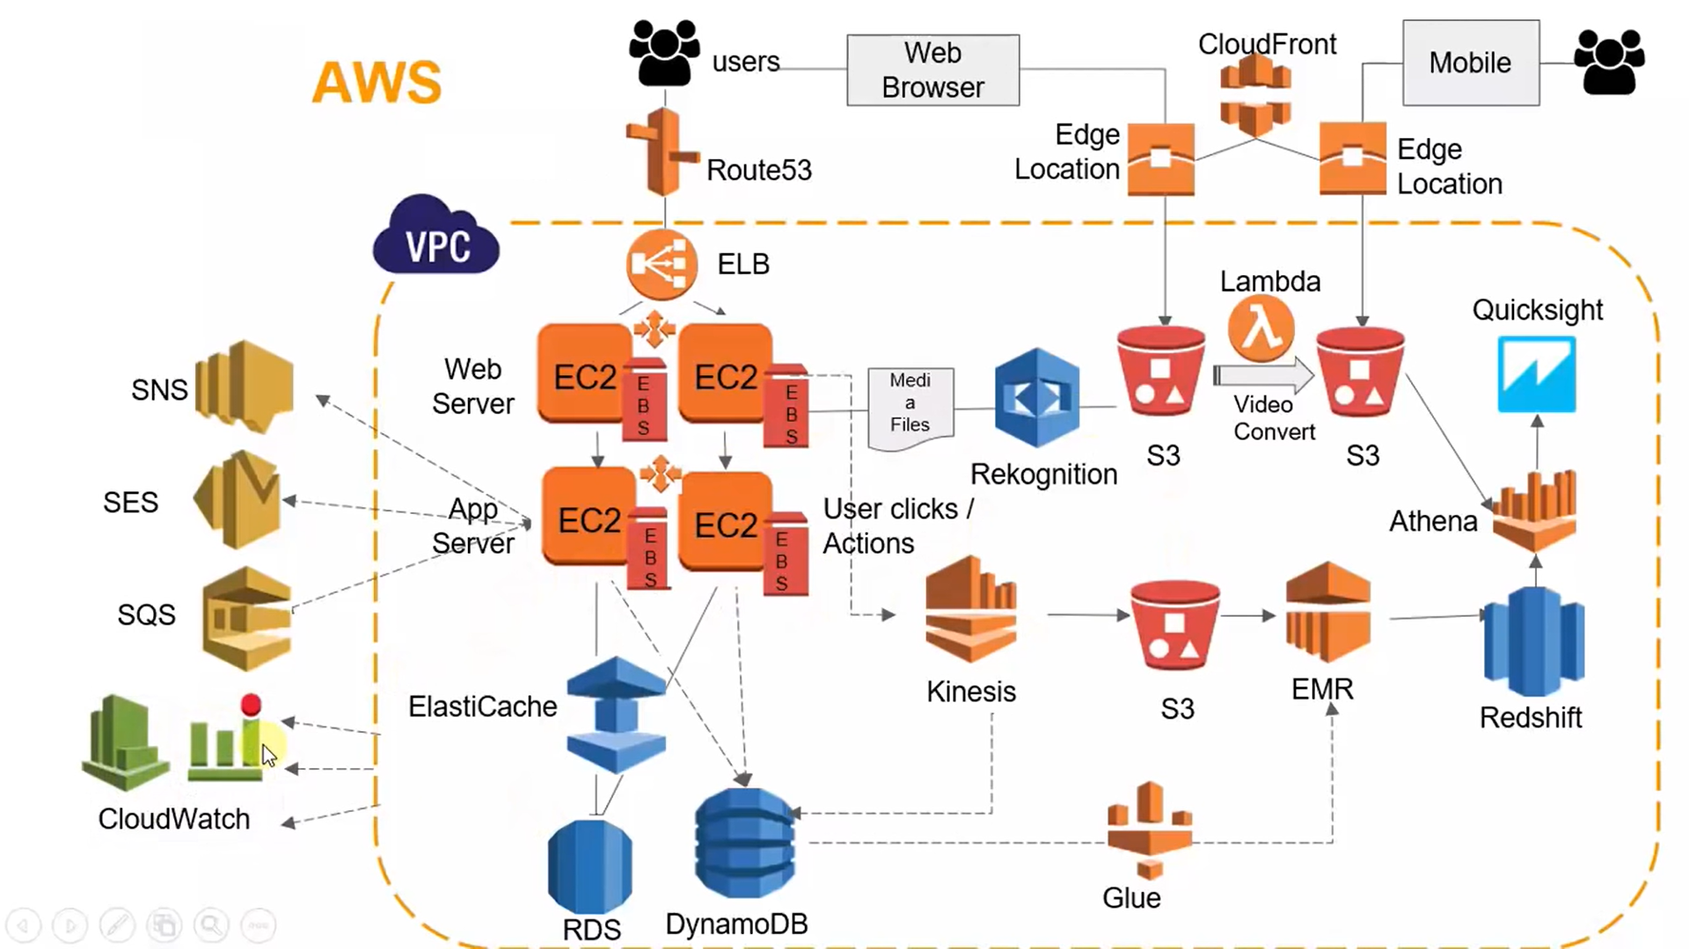
AWS implemented- Final architecture structure

Slide 4
Features
Reading of new Records (messages) more often than old records (messages)
Hit rate on Cache: 10%
Timeline: 300k request per second
System load: 1M of users, 10M writes, 100M reads, 1:10 ratio
4 pastes/s write, 40 pastes/s read

Slide 5
Limitations
Celebrities with the number of followers up to 100K
Regular users: up to 5K followers
Limitation for the number of users to follow per on person: 5K

Slide 6
Reliability
Hardware/Software faults - AWS Architecture (Cloud)
Human error tolerance (adversity)
Fault tolerance, Algorithm in case of Global System failure
Chaos Monkey by Netflix
RAID Configuration
Software faults: Testing; Cascade denial; Process Isolation; Monitoring and Analysis (alerts etc). Release process schedule.
Sandbox environment
Security Update checks

Slide 7
Scalability
Possibility to work under increasing load and increasing system demands
Vertical scaling - making an instance bigger or smaller
Allocate resources for growth: pastes/s write, pastes/s read, 50% per year
Online users: Allocate resources for 50% growth
Percentile: p95

Slide 8
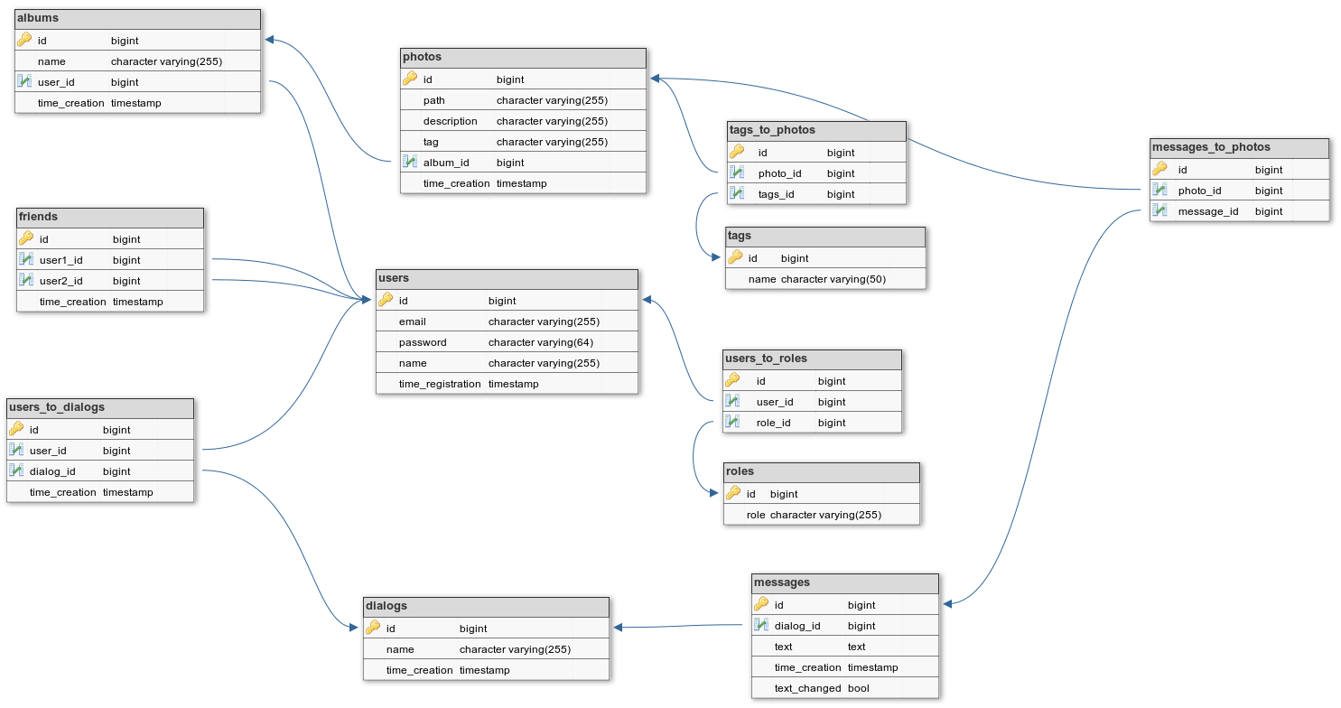
Реляционная структура

Slide 9
Maintainability
Operability /users can be assigned a different status
Simplicity
Evolvability
Costs 70% development / 30% support: licenses, software, hardware, salaries
Perfective updates
Business logic change
Perfective updates
Refactoring

Slide 10
Virtual Machine Instances in use
General Purpose
Web servers, code repositories, etc.
Compute optimized
Gaming servers, high performance computing, etc.
Memory optimized
Memory intensive processes
Accelerated computing
Graphics processing, floating point number calculations, etc.
Storage optimized
High performance locally stored data

Slide 11
Elastic Load Balancing (ELB)
Routes incoming requests to multiple instances
Regional construct = runs at the regional level (across all data centers in a region) instead of at the instance level
Automatically highly available
As demand goes up, new instances spin up and signal load balancer to send traffic
As demand goes down, balancer stop NEW traffic to instance then decommissions them once all processes are complete
Preventing disruptions to current users
ELBs can sit between front end and back end tiers of instances
New instances only have to signal 1 ELB instead of every instance on the front end tier
This would be considered “decoupled architecture”

Slide 12
Regions
Geographically isolated large groups of data centers
Connected through high speed fiber network controlled by AWS
Completely isolated, data does not move outside a region without explicit request to export
Choosing a region involves
Compliance
Does data need to stay within that country?
Proximity
Closer to customer base = lower latency
Feature availability
Not every region has every AWS feature
New features require new hardware that roll out over time, etc.
Pricing
Some regions are more expensive to use than others

Slide 13
Route 53
Translates website names into IP addresses using
Can also buy and manage domain names
Routing policies that include:
Latency-based routing
Geolocation DNS
Traffic is routed to the region closest to their geographical location
Geoproximity routing
Weighted round robin
Works with CloudFront (CDN) to deliver edge content to the nearest edge location to the user

Slide 14
Components
DNS: AWS Database Migration Service (DMS) helps in migrating databases to AWS quickly and securely. It can migrate the data to and from most widely used commercial and open-source databases. It supports homogeneous migrations same database platforms as well as heterogeneous migrations between different database platforms. We can continuously replicate our data with high availability and consolidate databases into a petabyte-scale data warehouse by streaming data to Amazon Redshift and Amazon S3.
Amazon Redshift is a data warehouse. It’s one of the world’s fastest cloud data warehouse. Simple and cost effective to run high performance queries on petabytes of structured data so that we can build powerful reports and dashboards using our existing business intelligence tools. It works with structured and semi-structured data. We can query petabytes of structured and semi-structured data across our data warehouse, operational database, and our data lake using standard SQL.

Slide 15
Components
Logstash
Logstash is a free and open server-side data processing pipeline that ingests data from a multitude of sources, transforms it, and then sends it to your favorite "stash". It dynamically ingests, transforms, and ships our data regardless of format or complexity. Derive structure from unstructured data with grok, decipher geo coordinates from IP addresses, anonymize or exclude sensitive fields, and ease overall processing.
Three components of Logstash are Inputs, filters & outputs. It supports a variety of inputs that pull in events from a multitude of common sources, all at the same time. Easily ingest from your logs, metrics, web applications, data stores, and various AWS services, all in continuous, streaming fashion. It filters parse each event, identify named fields to build structure, and transform them to converge on a common format for more powerful analysis and business value.

Slide 16
Метрики/алертинг

Slide 17
Потенциальное развитие проекта

Slide 18
Оценка эффективности системы, сильные/слабые стороны, возникшие трудности

