Slide 1





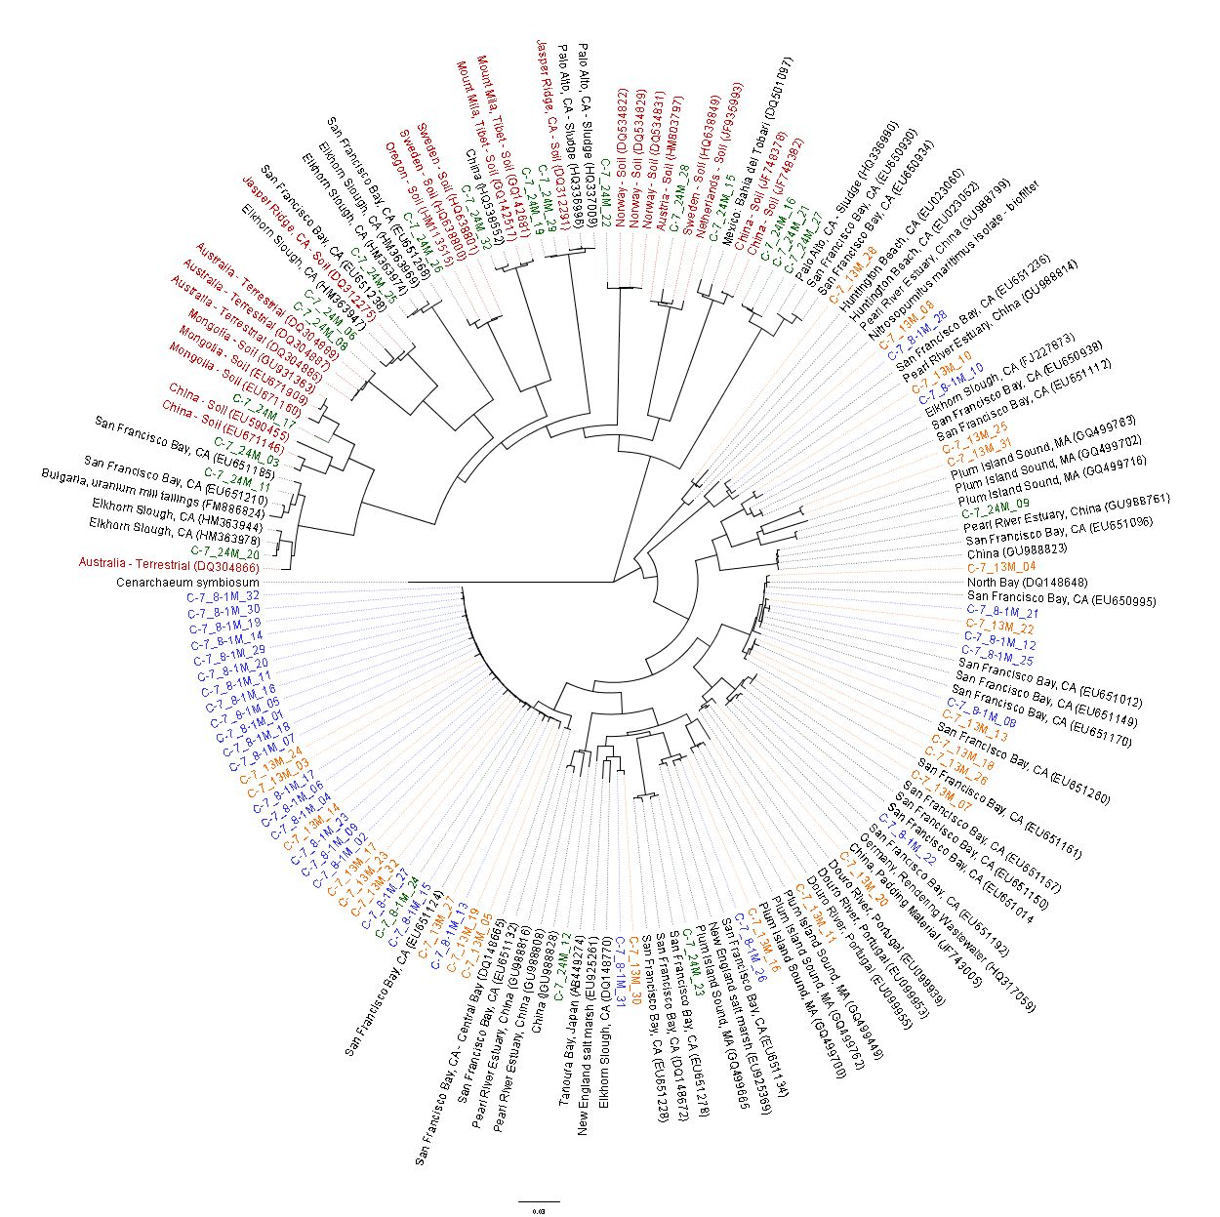
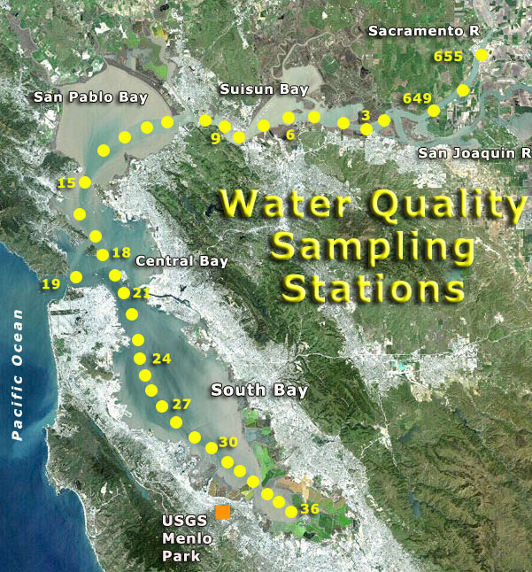
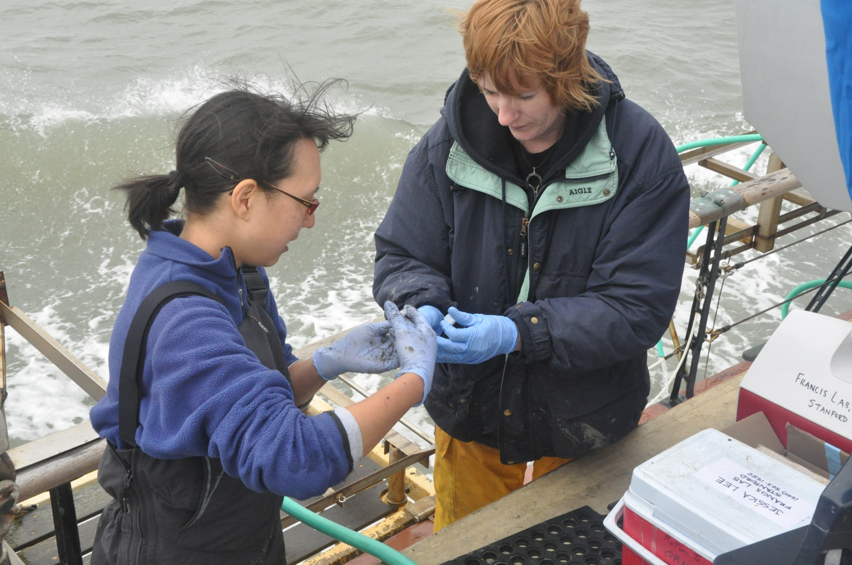
Distribution and Diversity of Ammonia Oxidizing Archaea in the San Francisco Bay.
Valery Lynn
Francis Lab, Dept. of Environmental Earth System Science,
Stanford University
Introduction
The impact of human activities on the global nitrogen cycle has resulted in eutrophication of terrestrial and aquatic systems (Vitousek et al., 1997; Gruber and Galloway, 2008). Currently, over half of US estuaries are affected by eutrophication (Bricker et al., 1999). Most of the processes in the nitrogen cycle are mediated by the microbial community. Levels of nitrogen can be diminished in estuaries through these processes. In particular, as much as 50% of dissolved inorganic nitrogen can be removed from inputs to estuaries by nitrification-denitrification reactions (Seitzinger et al., 2006).
The abundance and ubiquity of ammonia oxidizing archaea has only recently become known through the use of molecular technology (Francis, et al., 2005; Mosier and Francis, 2008). PCR primers that target ammonia monooxygenase subunit A (amoA), an enzyme engaged in one of the critical steps of ammonia oxidation in the nitrogen cycle, allow for the retrieval of unique archaeal sequences extracted from soil, water columns, and ocean and estuary sediment DNA.
Methods
Sediment samples were collected from 3 sites in the San Francisco Bay in conjunction with the USGS water quality sampling cruise in July 2011. DNA was extracted from the upper 5 mm of the sediment cores using Fast DNA SPIN kit for soil (QBiogene, Inc.). PCR was conducted for amoA using the primers Arch-amoAF and Arch-amoAR (Francis, 2005). Clone libraries of archaeal amoA gene fragments were constructed (pGEM-T Easy Vector System, Promega, Inc.) and individual clones were sequenced. Sequences were manually aligned using the software Geneious. Operational taxonomic units (OTUs) were defined using a 5% cutoff at the DNA level. 75 individual representatives were BLASTed against the NCBI nucleotide database for highly similar sequences. The top 3 published sequences for each OTU was used to construct a phylogenetic tree.
Results
Conclusions
Site 8.1 and 24 show distinct phylogenetic clusters. Site 8.1 has lower salinity than site 24 which may be the main driver for the distinct phylotypes present at the two sites.
Site 24 has several OTUs related to those found globally in soil.
Literature Cited
Bricker, S.B., et al. (1999) National Estuarine Eutrophication Assessment: Effects of Nutrient Enrichment in the Nation’s Estuaries. Silver Spring, MD, USA: NOAA, National Ocean Service. Special Projects Office and the National. Centers for Coastal Ocean Science.
Francis, C.A., et al. (2005) Ubiquity and diversity of ammoniaoxidizing archaea in water columns and sediments of the ocean. Proc Natl Acad Sci USA 102: 14683–14688.
Gruber, N., and Galloway, J.N. (2008) An Earth-system perspective of the global nitrogen cycle. Nature 451: 293–296.
Mosier, A.C., and Francis, C.A. (2008) Relative abundance and diversity of ammonia-oxidizing archaea and bacteria in the San Francisco Bay estuary. Env. Microbiology 10(11), 3002–3016.
Seitzinger, S., et al. (2006) Denitrification across landscapes and waterscapes: a synthesis. Ecol Appl 16: 2064–2090. Stephen, J.R., McCaig,
Vitousek, P.M., et al. (1997) Technical report: human alteration of the global nitrogen cycle: sources and consequences. Ecol Appl 7: 737–750.
Site 8.1
Site 13
Site 24
Soil
*All sites are estuaries unless otherwise noted.
Phylogenetic relationships of archeael amoA OTUs found globally.
13
8.1
Acknowledgements
Francis Lab, Stanford University: Jessica A. Lee; Marie Lund, PhD; Julian Damashek, and Chris Francis, PhD (PI).
USGS: Jessica Dyke, Eddie Moreno, Ship Master - Joel Fritsch, and Chief Engineer Scott Conard.
And all the folks at IISME for making this possible!
Purpose
This study examines archaeal sequences extracted from sediments along 3 sites in the San Francisco Bay, the largest estuary in the western United States, and compares them using phylogenetic methods with highly similar sequences distributed globally to date.
24
Jessica A. Lee, IISME mentor from the Francis Group (left),
with the author (right). USGS R/V Polaris cruise, July 2011.
Water Quality Sampling Stations – USGS R/V Polaris

