Slide 1
Schema Refinement and Normal Forms
Chapter 19
Notes:
1

Slide 2
The Evils of Redundancy
Redundancy is at the root of several problems associated with relational schemas:
redundant storage, insert/delete/update anomalies
Integrity constraints, in particular functional dependencies, can be used to identify schemas with such problems and to suggest refinements.
Main refinement technique: decomposition (replacing ABCD with, say, AB and BCD, or ACD and ABD).
Decomposition should be used judiciously:
Is there reason to decompose a relation?
What problems (if any) does the decomposition cause?
Notes:
14

Slide 3
Functional Dependencies (FDs)
A functional dependency X → Y holds over relation R if, for every allowable instance r of R:
t1 ∈ r, t2 ∈ r, ∏_{X}(t1) = ∏_{X}(t2) implies ∏_{Y}(t1) = ∏_{Y}(t2)
Example: SSN → StudentNum
Given two tuples in r
if the X values agree
then the Y values must also agree
Y and Y are sets of attributes
Notes:
15

Slide 4
Functional Dependencies (FDs)
An FD is a statement about all allowable instances of a relation.
Must be identified based on semantics of application.
Given some allowable instance of R, we can check if it violates some FD f, but we cannot tell if f holds over R!
K is a candidate key for R means that K → R
However, K → R does not require K to be minimal!
Notes:
15

Slide 5
Example: Constraints on Entity Set
Consider relation obtained from Hourly_Emps:
Hourly_Emps (ssn, name, lot, rating, hrly_wages, hrs_worked)
Notation: We will denote this relation schema by listing the attributes: SNLRWH
This is really the set of attributes {S,N,L,R,W,H}.
Sometimes, we will refer to all attributes of a relation by using the relation name. (e.g., Hourly_Emps for SNLRWH)
Some FDs on Hourly_Emps:
ssn is the key: S → SNLRWH
rating determines hrly_wages: R → W
S N L R W H
Notes:
16

Slide 6
Example (Contd.)
Problems due to R → W :
Update anomaly: Can we change W in just the 1st tuple of SNLRWH?
Insertion anomaly: What if we want to insert an employee and don’t know the hourly wage for his rating?
Deletion anomaly: If we delete all employees with rating 5, we lose the information about the wage for rating 5!
Hourly_Emps2
Using two smaller tables is better
Wages
Notes:
17

Slide 7
Reasoning About FDs
Given some FDs, we can usually infer additional FDs:
{ ssn → did, did → lot } implies ssn → lot
An FD f is implied by a set of FDs F if f holds whenever all FDs in F hold.
F⁺ = closure of F is the set of all FDs that are implied by F.
F
F⁺
f₁
Implies
f
f₂
f₃
Notes:
19

Slide 8
Armstrong’s Axiom
Armstrong’s Axioms (X, Y, Z are sets of attributes):
Reflexivity: If X ⊆ Y, then Y → X
Augmentation: If X → Y, then XZ → YZ for any Z
Transitivity: If X → Y and Y → Z, then X → Z
These are sound and complete inference rules for FDs!
Couple of additional rules (that follow from AA):
Union: If X → Y and X → Z, then X → YZ
Decomposition: If X → YZ, then X → Y and X → Z
Notes:
19

Slide 9
Reasoning About FDs - Example
Project ID
Department ID
Supplier ID
Part ID
Contract ID
Quantity
Example: Contracts(cid,sid,jid,did,pid,qty,value), and:
C is the key: C → CSJDPQV (C is a candidate key)
Project purchases each part using single contract: JP → C
Dept purchases at most one part from a supplier: SD → P
JP → C, C → CSJDPQV imply JP → CSJDPQV
SD → P implies SDJ → JP
SDJ → JP, JP → CSJDPQV imply SDJ → CSJDPQV
These are also candidate keys
Notes:
20

Slide 10
Closure of a FD set
F
F⁺ = closure of F is the set of all FDs that are implied by F
X→AB
…
Explicit set
Implicit set
F⁺
F
Notes:
21

Slide 11
Attribute Closure (≠ closure of FD set)
B
F
X→AB
…
X⁺ = attribute closure of an attribute set X wrt to a set of FD F is the set of all attributes A such that X → A is in F⁺
X⁺
X
A
X
Any attribute whose value can be determined from the value of X (according to F⁺)
F
F⁺
f₁
Implies
f
f₂
f₃
Notes:
21

Slide 12
Attribute Closure (≠ closure of FD set)
B
F
X→AB
…
X⁺ = attribute closure of an attribute set X wrt to a set of FD F is the set of all attributes A such that X → A is in F⁺
X⁺
X
A
X
Any attribute whose value can be determined from the value of X (according to F⁺)
If left-hand side is in the closure, add the right hand side to the closure
Closure = X;
Repeat until there is no change {
if there is an FD U→V in F⁺ such that U ⊆ closure,
then set closure = closure ∪ V }
Notes:
21

Slide 13
Attribute Closure - Example
Relation ABCDEF with FD’s {AB→C, BC→AD, D→E, CF→B}
What is {A, B}⁺ ?
C
Initially, {A, B}⁺ = {A, B}
AB→C ⇒ {A, B}⁺ = {A, B, C}
BC→AD ⇒ {A, B}⁺ = {A, B, C, D}
D→E ⇒ {A, B}⁺ = {A, B, C, D, E}
CF→B ⇒ F is on the left-hand side, we cannot include F
{A,B}⁺
A
B
Make sure to consider the closure of the FD set
F
F⁺

Slide 14
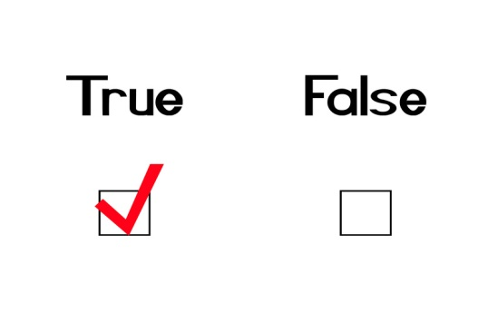
Reasoning About FDs (Contd.)
Computing the closure of a set of FDs can be expensive.
Size of closure is exponential in # attrs!
Typically, we just want to check if a given FD X → Y is in the closure of a set of FDs F. An efficient check:
Compute X⁺ wrt F
Check if Y is in X⁺ (i.e., Do we have X → Y ?)
X → Y ?
F
X
Y
If Yes
?
F⁺
X⁺
Notes:
21

Slide 15
Normal Forms
Returning to the issue of schema refinement, the first question to ask is whether any refinement is needed!
Role of FDs in detecting redundancy:
Consider a relation R with 3 attributes, ABC.
Given A → B: Several tuples could have the same A value, and if so, they’ll all have the same B value - redundancy !
No FDs hold: There is no redundancy here
Note: A → B potentially causes problems. However, if we know that no two tuples share the same value for A, then such problems cannot occur (a normal form)
If a relation is in a certain normal form (BCNF, 3NF etc.), it is known that certain kinds of problems are avoided/minimized. This can be used to help us decide whether decomposing the relation will help.
Notes:
22

Slide 16
Boyce-Codd Normal Form (BCNF)
R | A relation
F | The set of FD hold over R
X | A subset of the attributes of R
A | An attribute of R
Notes:
23

Slide 17
Boyce-Codd Normal Form (BCNF)
Relation R is in BCNF if, for all X → A in F,
A ∈ X (called a trivial FD), or
X is a superkey (i.e., contains a key of R)
R | A relation
F | The set of FD hold over R
X | A subset of the attributes of R
A | An attribute of R
R
X1 | . . . | X6 | A | X7 | C
X
Trivial FD
In other words, R is in BCNF if the only non-trivial FDs that hold over R are key constraints (i.e., X must be a superkey!)
R
X1 | . . . | X7 | A | B | C
X
[X1 ··· X7] is a superkey
Notes:
23

Slide 18
BCNF is Desirable
X | Y | A
x | y1 | y2
x | y2 | ?
Consider the relation: X→A
“X →A” ⇒ The 2nd tuple also has y2 in the third column
⇒ an example of redundancy
Such a situation cannot arise in a BCNF relation:
BCNF ⇒ X must be a key
⇒ we must have X→Y
⇒ we must have “y1 = y2” (1)
X→A ⇒ The two tuples have the same value for A (2)
(1) & (2) ⇒ The two tuples are identical
⇒ This situation cannot happen in a relation
Should be y2
Not in BCNF
Notes:
23

Slide 19


BCNF: Desirable Property
A relation is in BCNF
every entry records a piece of information that cannot be inferred (using only FDs) from the other entries in the relation instance
No redundant information !
Key constraint is the only form of FDs allowed in BCNF
A relation R(ABC)
B→C: The value of B determines C, and the value of C can be inferred from another tuple with the same B value ⇒ redundancy ! (not BCNF)
A→BC: Although the value of A determines the values of B and C, we cannot infer their values from other tuples because no two tuples in R have the same value for A ⇒ no redundancy ! (BCNF)

Slide 20
Third Normal Form (3NF)
Let R be a relation with the set of FDs F, X be a subset of the attributes, and A be an attribute of R
Relation R is in 3NF if, for all X → A in F
A ∈ X (called a trivial FD), or
X is a superkey (containing some key), or
A is part of some key for R.
Minimality of a key is crucial in third condition above!
If A is part of some superkey, then this condition would be true for any relation (because we can add any additional attribute to the superkey to make a bigger superkey).
Same as in BCNF
Notes:
24

Slide 21
3NF is a Compromise
Let R be a relation with the set of FDs F, X be a subset of the attributes, and A be an attribute of R
Relation R is in 3NF if, for all X → A in F
A ∈ X (called a trivial FD), or
X is a superkey (containing some key), or
A is part of some key for R.
Same as in BCNF
Observation:
If R is in BCNF, obviously in 3NF.
If R is in 3NF, some redundancy is possible. It is a compromise, used when BCNF not achievable (e.g., no ``good’’ decomp, or performance considerations).
Discussed later
Notes:
24

Slide 22
Compromise (1)
Suppose X→A causes a violation of 3NF ⇒ There are two cases
CASE 1: X is a proper subset of some key K (partial dependency)
CASE 2: X is not a proper subset of any key (transitive dependency because we have a chain of dependencies KEY → X → A)
KEY
X
A
KEY
X
A
3NF
A ∈ X (called a trivial FD), or
X is a superkey (containing some key), or
A is part of some key for R.

Slide 23
Compromise (2)
Suppose X→A causes a violation of 3NF ⇒ There are two cases
CASE 1: X is a proper subset of some key K (partial dependency)
In this case we store (X,A) pairs redundantly
EXAMPLE: Relation Reserves(SBDC) with FD S → C
We store the credit card number for a sailor as many times as there are reservations for that sailor.
KEY
X
A
Boat
Date
Sailor
Credit Card

Slide 24
Compromise (3)
Suppose X → A causes a violation of 3NF ⇒ There are two cases
CASE 2: X is not a proper subset of any key (transitive dependency)
EXAMPLE: Hourly_Emps(SNLRWH) with FD R →W (i.e., rating determines wage)
We have S → R → W (transitive dependency)
We cannot record a rating without knowing the hourly wage for that rating
This condition leads to insertion, deletion, and update anomalies (see page 5)
KEY (i.e., S)
W
R

Slide 25
Redundancy in 3NF
EXAMPLE: Relation Reserves(SBDC) with the FD’s
S → C and C → S
S is part of the key ⇒ “C → S” does not violate 3NF
C → S (i.e., Credit card uniquely identifies the sailor)
CBD → SBD (Augmentation axiom)
CBD → SBD → SBDC (SBD is a key)
CBD is also a key of Reserves (Transitivity axiom)
“S → C” does not violate 3NF because C is part of the key
Reserves relation is in 3NF. Nonetheless, the same (S,C) pair is redundantly recorded for all tuples with the same S value.
1
2
1
&
2
⇒
3NF is indeed a compromise relative to BCNF

Slide 26
Motivation for 3NF
3NF weakens the BCNF requirements just enough to ensure that every relation can be decomposed into a collection of 3NF relations
Lossless-join & dependency-preserving decomposition of R into a collection of 3NF relations always possible.
The above guarantee does not exist for BCNF relations
Notes:
24

Slide 27
Decomposition of a Relation Schema
Suppose that relation R contains attributes A1 ... An. A decomposition of R consists of replacing R by two or more relations such that:
Each new relation schema contains a subset of the attributes of R (and no attributes that do not appear in R), and
Every attribute of R appears as an attribute in at least one of the new relations.
Decomposition
A | B | C
C | D | E
Notes:
26

Slide 28
Decomposition of a Relation Schema
Intuitively, decomposing R means we will store instances of the relation schemas produced by the decomposition, instead of instances of R.
E.g., Can decompose SNLRWH into SNLRH and RW.
Notes:
26

Slide 29
Example Decomposition
Decompositions should be used only when needed.
SNLRWH has FDs S → SNLRWH and R → W
R → W causes violation of 3NF; W values repeatedly associated with R values.
Solution: Decompose SNLRWH into SNLRH and RW
The information to be stored consists of SNLRWH tuples. If we just store the projections of these tuples onto SNLRH and RW, are there any potential problems that we should be aware of ?
We might have duplicates in RW
Notes:
27

Slide 30
Problems with Decompositions
decompose SNLRWH into SNLRH and RW
There are three potential problems to consider:
Some queries become more expensive.
e.g., How much did sailor Joe earn? (salary = W*H)
Given instances of the decomposed relations, we may not be able to reconstruct the corresponding instance of the original relation!
Fortunately, not in the SNLRWH example.
Checking some dependencies may require joining the instances of the decomposed relations.
Fortunately, not in the SNLRWH example.
Tradeoff: Must consider these issues vs. redundancy.
Lossless Join
Dependency Preserving
Notes:
28

Slide 31
Lossless Join Decompositions
Decomposition of R into X and Y is lossless-join w.r.t. a set of FDs F if, for every instance r that satisfies F, we have π_{X}(r) π_{Y}(r) = r
It is always true that
r ⊆ π_{X}(r) π_{Y}(r)
In general, the other direction does not hold! If it does, the decomposition is lossless-join.
NOT
LOSSLESS JOIN
Join two
tables on
B
Notes:
29

Slide 32
Lossless Join Decompositions
Definition extended to decomposition into 3 or more relations in a straightforward way.
It is essential that all decompositions used to deal with redundancy be lossless! (Avoids Problem (2) in page 30)
Notes:
29

Slide 33
More on Lossless Join
The decomposition of R into X and Y is lossless-join wrt F if and only if the closure of F contains:
X ∩ Y → X, or
X ∩ Y → Y
Example:
Decompose SNLRWH into SNLRH and RW
Foreign key
The intersection “R” is the primary key
The intersection must be the primary key of X or Y
In particular, the decomposition of R into UV and R-V is lossless-join if U→V holds over R. (Next page)
Notes:
30

Slide 34
Loss-Less Join Decomposition
the decomposition of R into UV and R-V is lossless-join if U→V holds over R.
Given U→V, we create the first table as UV
Remove V from the original table (i.e., R-V) to create the second table
U
V
Primary key
Foreign key
T
U
V
T
U

Slide 35
Dependency Preserving Decomposition
Consider CSJDPQV, C is key, JP → C and SD →P.
BCNF decomposition: CSJDQV and SDP
Problem: Checking JP → C requires a join!
C | S | J | D | P | Q | V
BCNF decomposition
C | S | J | D | Q | V
S | D | P
Checking JP→C requires a join
Notes:
3

Slide 36
Dependency Preserving Decomposition
If R is decomposed into X, Y and Z, and we enforce the FDs that hold on X, on Y and on Z, then all FDs that were given to hold on R must also hold. (Avoids Problem (3) in page 30.)
Notes:
3

Slide 37
Projection of a Set of FDs
If R is decomposed into X, ... projection of F onto X (denoted F_{X} ) is the set of FDs U → V in F⁺ such that U, V are in X
F⁺
R (A, B, C, D, E)
F: Set of FD’s
A→B
B→D
B→CD
F
B→C
F_{BCD}
i.e., F_{X} is the set of FDs in F⁺, that involve only attributes in X
Important to consider F ⁺, not F, in this definition (see page 40)
Projection of F onto BCD
Notes:
3

Slide 38
Dependency Preserving Decomposition vs. Lossless Join Decomposition
Dependency preserving does not imply lossless join:
ABC, with F = {A→B}, decomposed into AB and BC.
F_{AB} = {A→B} and F_{BC} = φ
(F_{AB} ∪ F_{BC} )⁺ = {A→B} = F⁺
The decomposition is dependency preserving. Nonetheless, it is not a lossless-join decomposition !
And vice-versa!
The intersection “B” is not a key of either relation
Consider CSJDPQV, C is key, JP → C and SD →P.
BCNF decomposition: CSJDQV and SDP
Problem: Checking JP → C requires a join!
Lossless Join decomposition
Not dependency preserving !
Notes:
4

Slide 39
Dependency Preserving Decompositions (Contd.)
Decomposition of R into X and Y is dependency preserving if (F_{X} ∪ F_{Y} )⁺ = F⁺
We need to enforce only the dependencies in F_{X} and F_{Y} ; and all FDs in F⁺ are then sure to be satisfied
To enforce F_{X} , we need to examine only relation X on inserts to that relation.
To enforce F_{Y} , we need to examine only relation Y.
X
R
Y
Notes:
4

Slide 40
Dependency Preserving Decompositions: Example
Decomposition of R into X and Y is dependency preserving if (F_{X} ∪ F_{Y} ) ⁺ = F ⁺
ABC, A→B, B →C, C→A, decomposed into AB and BC.
F⁺ = F ∪ { A→C, B→A, C→B }
If we consider only F (instead of F⁺) ⇒ F_{AB} = {A→B} and F_{BC} = {B→C}
(F_{AB} ∪ F_{BC} )⁺ = {A→B, B→C, A→C} ≠ F⁺
not dependency preserving ??
We need to examine F⁺ (not F) when computing F_{AB} & F_{BC}
F_{AB} = {A→B, B→A} and F_{BC} = {B→C, C→B}
F_{AB} ∪ F_{BC} = {A→B, B→A, B→C, C→B}
(F_{AB} ∪ F_{BC} )⁺ = {A→B, B→A, B→C, C→B, A→C, C→A} = F⁺
The decomposition preserves the dependencies !!
Notes:
4

Slide 41
Decomposition into BCNF
Consider relation R with FDs F. If X →Y violates BCNF, decompose R into R-Y and XY.
Repeated application of this idea will give us a collection of relations that are in BCNF; lossless join decomposition, and guaranteed to terminate.
Example: CSJDPQV, key C, JP →C, SD →P, J →S
Keep SD as a foreign key to facilitate JOIN
CJDQV
CSJDQV
J →S
CSJDPQV
SD →P
JS
SDP
Notes:
5

Slide 42
Decomposition into BCNF
In general, several dependencies may cause violation of BCNF. The order in which we ``deal with’’ them could lead to very different sets of relations!
CJDQV
CSJDQV
J →S
CSJDPQV
SD →P
JS
SDP
Notes:
5

Slide 43
BCNF & Dependency Preservation
In general, there may not be a dependency preserving decomposition into BCNF
Example 2: Decomposition of CSJDQV into SDP, JS, and CJDQV is not dependency preserving (w.r.t. the FDs JP → C, SD → P, and J → S).
This is a lossless join decomposition. However JP → C is not preserved
Adding JPC to the collection of relations gives us a dependency preserving decomposition.
JPC tuples stored only for checking FD! (Redundancy!)
CJDQV
JP→C ?
CSJDQV
J →S
CSJDPQV
SD →P
JS
SDP
Notes:
6

Slide 44
Decomposition into 3NF
To ensure dependency preservation, one idea:
If X → Y is not preserved, add relation XY.
Problem is that XY may violate 3NF!
Example: In the following decomposition, adding JPC to preserve JP→C does not work if we also have J→ C.
Refinement: Instead of the given set of FDs F, use a minimal cover for F (another form of F).
CJDQV
CSJDQV
J →S
Does not work if we also have J→C
CSJDPQV
SD →P
JS
SDP
JP→C
JPC
Notes:
7

Slide 45
Minimal Cover for a Set of FDs
Minimal cover G for a set of FDs F is a set of FDs such that
Closure of F = closure of G.
Right hand side of each FD in G is a single attribute.
If we modify G by deleting an FD or by deleting attributes from an FD in G, the closure changes (i.e., it is minimal).
Intuitively, every FD in G is needed, and ``as small as possible’’ in order to get the same closure as F.
Notes:
8

Slide 46
Minimal Cover: Example
A→ B, EF→GH, ABCD → E, ACDF→EG Compute minimal cover
Initial Set = {A→ B, EF→G, EF→H, ABCD → E, ACDF→E, ACDF→G}
We keep A→ B, EF→G, and EF→H because they are minimal and cannot be inferred from the other FDs in the initial set
We can remove B from ABCD → E because
A→ B ⇒ AACD → BACD → E ⇒ ACD → E
We also have ACD → E ⇒ ABCD → E
We do not keep ACDF→E because we already keep ACD → E (i.e., F can be removed)
We do not keep ACDF→G because we already keep ACD → E
ACD → E ⇒ ACDF → EF → G ⇒ ACDF → G
A minimal Cover for F is {A→ B, EF→G, EF→H, ACD→E}
ABCD → E and
ACD → E are
equivalent
⇒
Notes:
8

Slide 47
Minimal Cover: Algorithm
Put FDs in the standard form: Obtain a collection G of equivalent FDs with a single attribute on the right side (i.e., the initial set)
Minimize the left side of each FD: For each FD in G, check each attribute in the left side to determine if it can be deleted while preserving equivalence to F⁺
Delete redundant FDs: Check each remaining FD in G to determine if it can be deleted while preserving equivalence to F⁺

Slide 48
Lossless-Join Dependency-Preserving Decomposition into 3NF
Compute a minimal cover F of the original set of FDs
Obtain a lossless-join decomposition: R₁, R₂, … R_{n} such that each one is in 3NF
Determine the projection of F onto each R_{i} , i.e., F_{i}
Identify the set N of FDs in F that is not preserved, i.e., not included in (F₁∪F₂ ∪ … ∪ F_{n})⁺
For each FD X→A in N, create a relation schema XA and add it to the result set
Optimization: If N contains {X→A₁, X → A₂, … X → A_{k}}, replace them with X → A₁A₂…A_{k} to produce only one relation

Slide 49
Lossless-Join & Dependency-Preserving 3NF Example
CJDQV
CSJDQV
J →S
CSJDPQV
SD →P
JS
SDP
JP→C
JPC
A minimal cover: F = {SD →P, J →S, JP→C}
F_{SDP} = {SD →P}, F_{JS} = {J →S} ⇒ (F_{SDP} ∪ F_{JS})⁺ = {SD →P, J →S}
JP→C is not in (F_{SDP} ∪ F_{JS})⁺ ⇒ add relation JPC
(SDP, CJDQV, JS, and JPC) is a lossless-join dependency preserving 3NF decomposition

Slide 50
Good News !
A decomposition into 3NF relations that is lossless-join and dependency-preserving is always possible
Notes:
7

Slide 51
Refining an ER Diagram
Before:
1st diagram translated: Workers(S,N,L,D,Si) Departments(D,M,B)
Lots associated with workers.
Suppose all workers in a dept are assigned the same lot: D→L
Redundancy; fixed by: Workers2(S,N,D,Si) Dept_Lots(D,L)
Can fine-tune this: Workers2(S,N,D,Si) Departments(D,M,B,L)
since
name
dname
ssn
lot
did
budget
Employees
Works_In
Departments
Refining
After:
since
budget
name
dname
ssn
did
lot
Employees
Works_In
Departments
Notes:
18

Slide 52
Schema Refinement
Should a good ER design not lead to a collection of relations free of redundancy problems ?
ER design is a complex and subjective process
Some FDs as constraints are not expressible in terms of ER diagrams
Decomposition of relations produced through ER design might be necessary

Slide 53
Summary of Schema Refinement
If a relation is in BCNF, it is free of redundancies that can be detected using FDs. Thus, trying to ensure that all relations are in BCNF is a good heuristic.
If a relation is not in BCNF, we can try to decompose it into a collection of BCNF relations.
Must consider whether all FDs are preserved.
If a lossless-join, dependency preserving decomposition into BCNF is not possible (or unsuitable, given typical queries), should consider decomposition into 3NF.
Decompositions should be carried out and/or re-examined while keeping performance requirements in mind.
Notes:
9

Slide 54
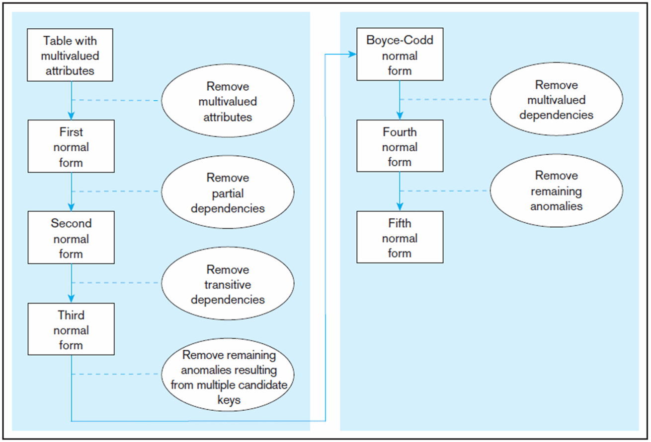
Modern Database Management11th Edition Jeffrey A. Hoffer, V. Ramesh, Heikki Topi

