Slide 1
Nifty100 Financial Analytics Dashboard
Prepared By:
Vali Shaik

Slide 2
Problem Statement
Financial data is spread across multiple datasets.
A centralized solution is required to:
• Store data
• Validate quality
• Analyze performance
• Generate insights

Slide 3
Project Objectives
• Build SQLite database
• Load and validate datasets
• Perform SQL analytics
• Develop Power BI dashboard
• Generate business insights

Slide 4
Datasets Used
Companies
Profit & Loss
Balance Sheet
Cash Flow
Documents
Stock Prices
Market Cap
Sectors
Peer Groups

Slide 5
ETL Pipeline
Excel Files
↓
Data Validation
↓
Normalization
↓
SQLite Database
↓
SQL Analytics
↓
Power BI Dashboard

Slide 6
Database Statistics
Table | Rows
Companies | 92
Profit & Loss | 1276
Balance Sheet | 1312
Cash Flow | 1187
Documents | 1585
Stock Prices | 5520
Market Cap | 552
Sectors | 92
Peer Groups | 56

Slide 7
Data Quality Checks
• Primary Key Validation
• Company-Year Validation
• Foreign Key Validation
• Balance Sheet Validation
• OPM Validation
• Sales Validation
• Cash Flow Validation
• URL Validation

Slide 8
Key Findings
Top ROE Company:
Nestle India Ltd
Top ROCE Company:
Nestle India Ltd
Best Performing Sector:
Consumer Staples
Largest Sector:
Financials

Slide 9
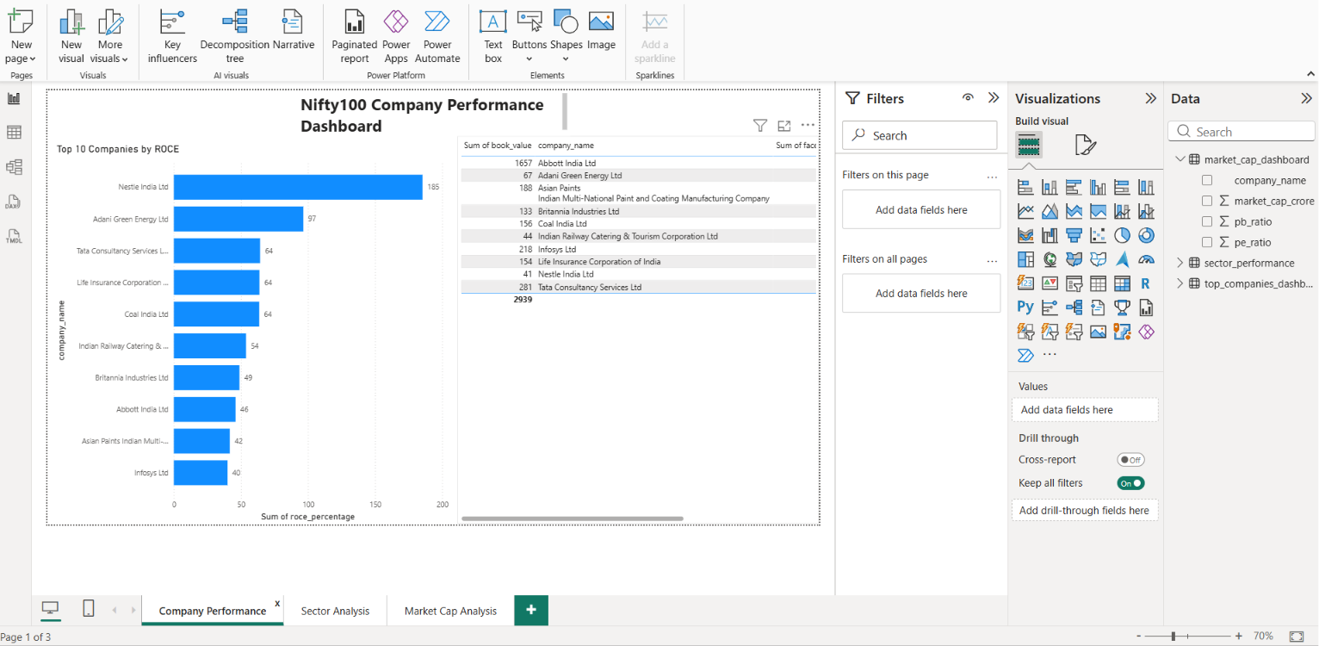
Company Performance Dashboard

Slide 10
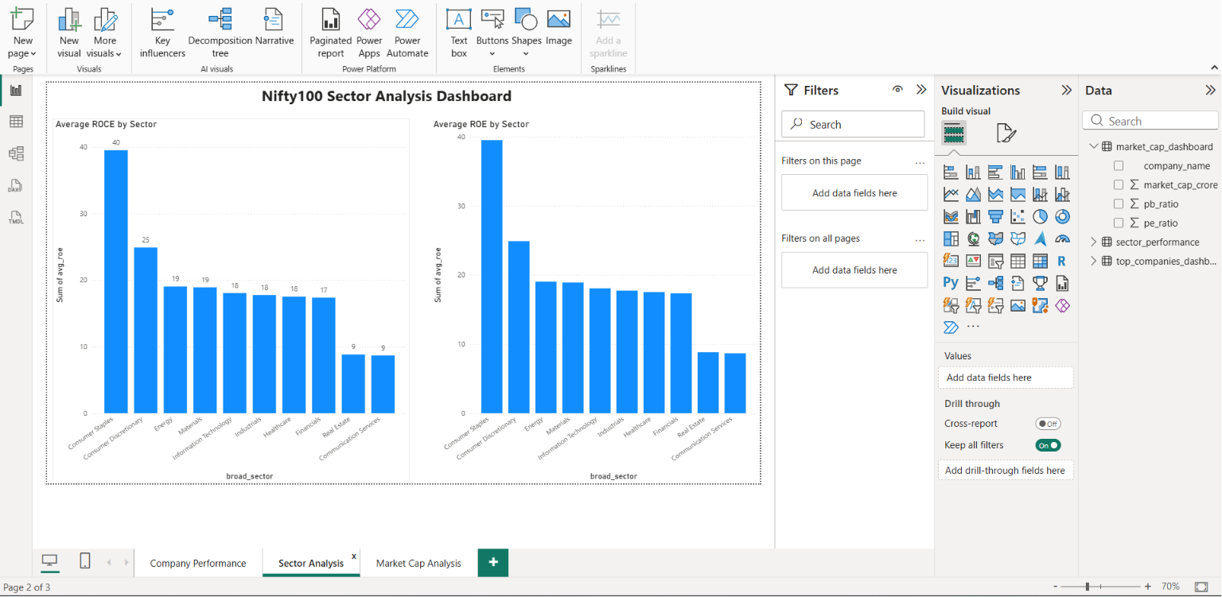
Sector Analysis Dashboard

Slide 11
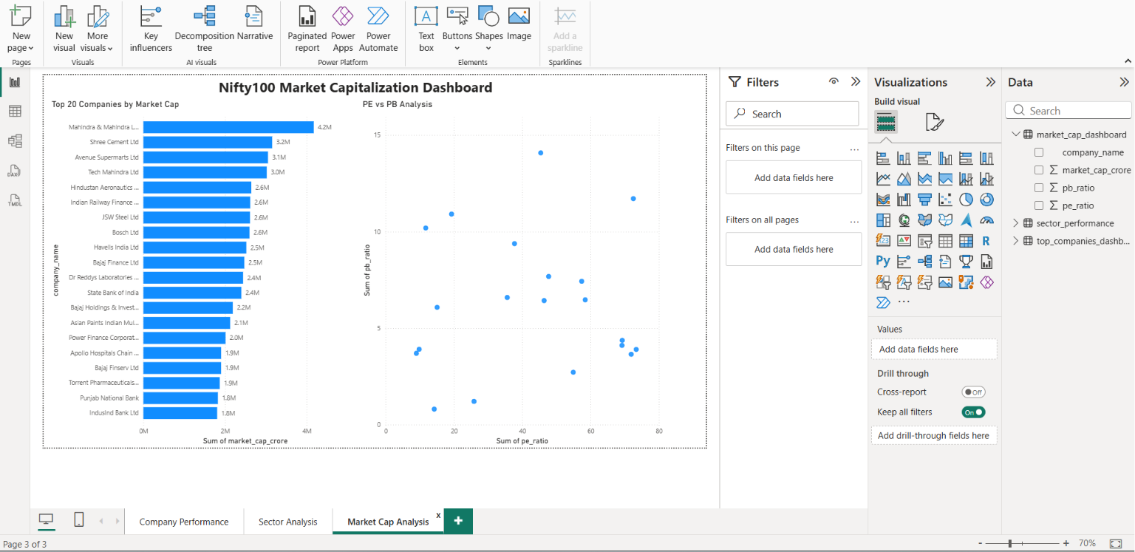
Market Capitalization Dashboard

Slide 12
Conclusion
Successfully built an end-to-end financial analytics platform using Python, SQLite, SQL and Power BI.
Thank You

