Slide 1

INDEX

Slide 2
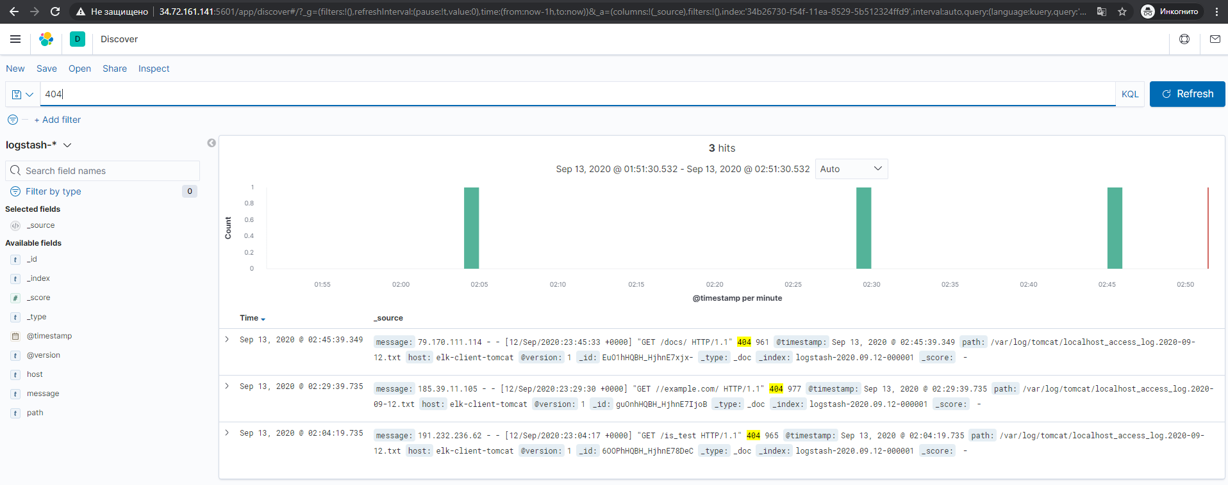
FILTER

Slide 3
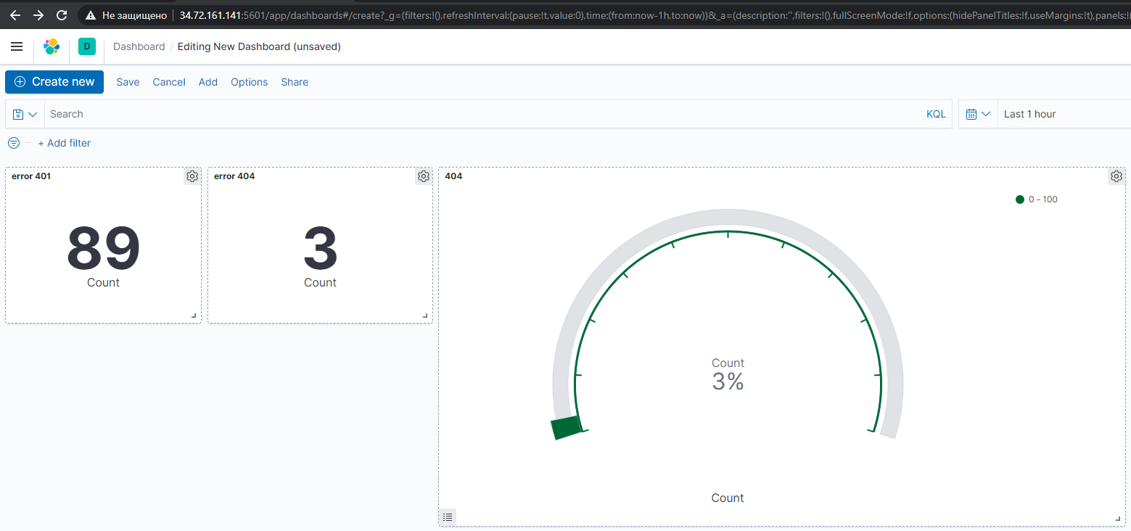
DASHBOARD

